Slide 1
Catastrophism and Uniformitarianism
Ronny Nalin, PhD
…and saying: “Where is the promise of His coming? For since the fathers fell asleep, all things continue as they were from the beginning of creation.” 2 Peter 3:4

Slide 2
Goals of the presentation
Philosophical assumptions in historical sciences
How these assumptions influence geology (catastrophism and uniformitarianism)
Biblical perspective on the validity of these assumptions
Why should we care?
What we ask and how we search affect the kind of answers we get

Slide 3
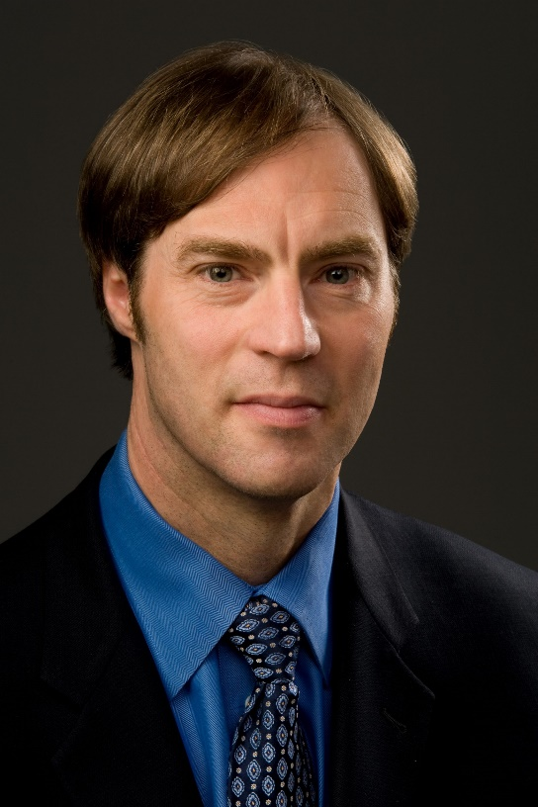
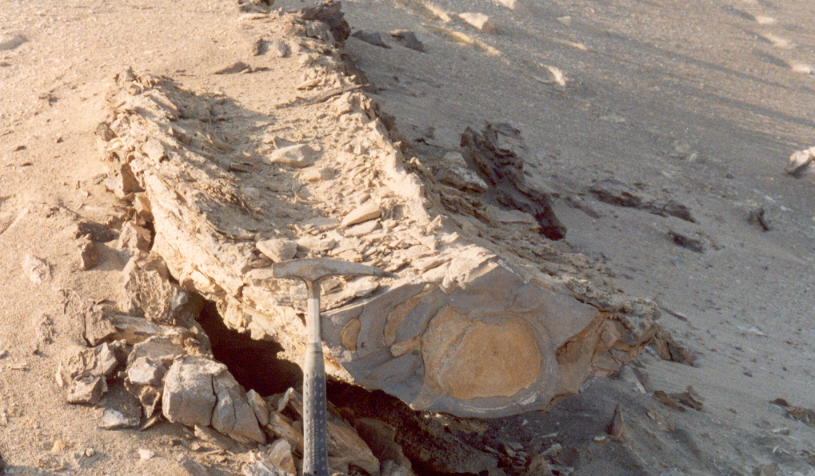
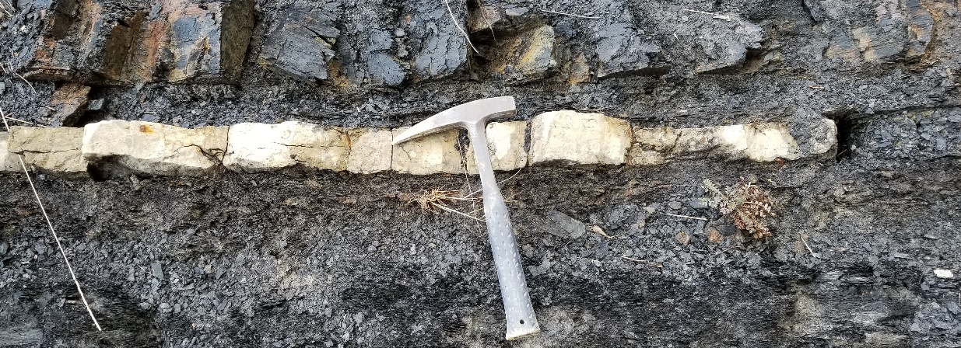
Historical sciences
Stephen C. Meyer
https://stephencmeyer.org/2008/10/07/a-scientific-history-and-philosophical-defense-of-the-theory-of-intelligent-design/#

Slide 4
Historical sciences
Paleontology Geology Archeology Evolutionary Biology
Cosmology
Distinctive goal:
Infer past causes from present results
(“Infer history form its results” S.J. Gould, 1986)

Slide 5
Historical sciences and abductive reasoning
Inductive reasoning: universal principle from repeated individual observations
Deductive reasoning: individual determination based on universal principle
Abductive reasoning (C.S. Peirce, 1932): time component;
Infer unseen facts, events or causes in the past from clues or facts in the present
Notes:
1) I observe that I feel sick after a long flight… for many times… conclusion: long flights make me sick; 2) I know that I am sleepy after I eat; therefore, I should not eat before an important talk; both inductive and deductive reasoning used in the collection and evaluation of data, but abductive has a specific component proper to historical sciences…the time dimension, from present to past.

Slide 6
Limitations of abductive reasoning
If it rains, the streets will get wet.
The streets are wet.
Therefore, it rained.
Logical Fallacy: affirming the consequent (taking a true statement and assuming the converse form would be true as well)
There are many possible causes of a given effect. Difficult to make inferences about the past

Slide 7
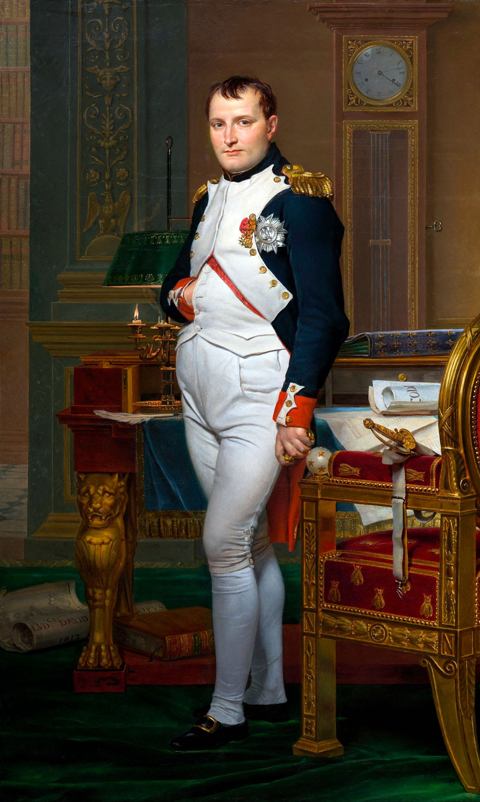
When does abductive reasoning work?
No one doubts the existence of Napoleon.
We use abductive reasoning to infer Napoleon’s existence. We infer his past existence from present effects.
"Though we have not seen the man [Napoleon], yet we cannot explain what we have seen without" the hypothesis of his existence (Peirce, 1932)
An abductive inference can be enhanced if it can be shown that it represents the best or the only adequate explanation of the manifest effects

Slide 8
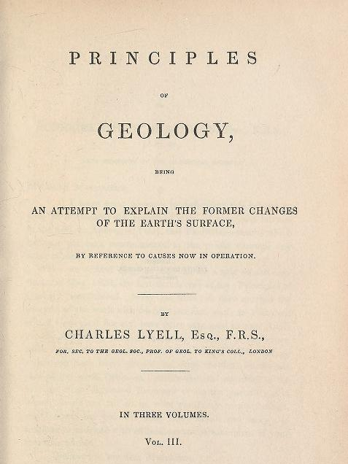
Inference to the best explanation
Historical scientists generally consider best the inference that is most causally adequate.
- Evaluate hypotheses against present knowledge of cause and effect
- Causes that are known to produce the effect in question are judged to be better causes than those that are not
“Principles of Geology being an attempt to explain the former changes of the earth’s surface by reference to causes now in operation” C. Lyell, 1830

Slide 9
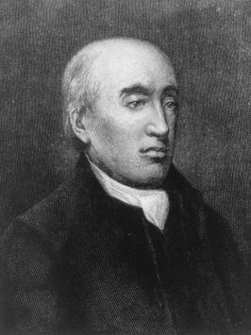
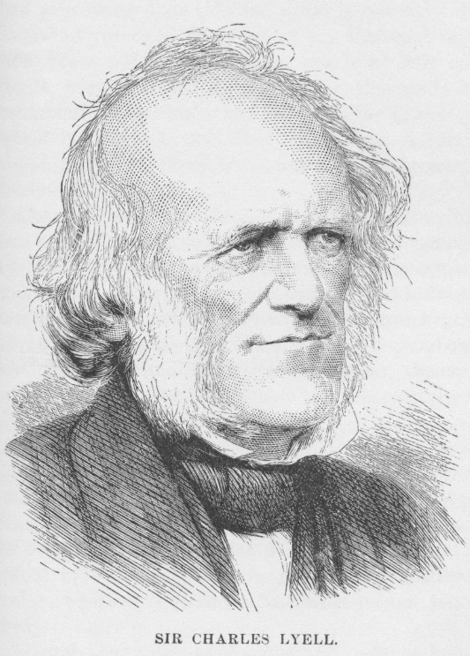
Present causes and Uniformitarianism
“No powers are to be employed that are not natural to the globe, no action to be admitted except those of which we know the principle.”
J. Hutton, Theory of the Earth, vol. 2, p. 547
James Hutton
(1726-1797)
“Never was there a dogma more calculated to foster indolence, and to blunt the keen edge of curiosity, than this assumption of the discordance between the ancient and existing causes of change.”
C. Lyell, Principles of Geology, vol. 1, p. 324
“Causes never acted with different degree of energy from that which they now exert.”
C. Lyell, letter to R. Murchinson
Charles Lyell
(1797-1875)

Slide 10
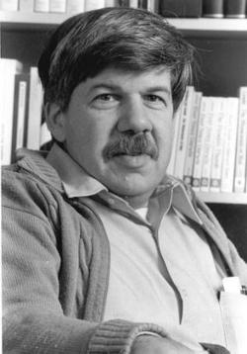
Four types of uniformitarianism
A) Methodological Uniformitarianism: how we do science
1) Uniformity of laws (naturalism)
S. J. Gould, (1965; 1984)
2) Uniformity of process (actualism, principle of simplicity)
B) Substantive Uniformitarianism: how nature is
3) Uniformity of rates (gradualism)
4) Uniformity of conditions (non-directionalism)
Notes:
“The rules” of the game of abduction; “Weak form: present-day processes are most appropriate for explaining the geological past (also known as ‘‘actualism’’). Strong form – the geological past must be explained by invoking processes that can be presently observed today.
If a past phenomenon can be understood as the result of a process now acting in time and space, one should not invent an extinct or unknown cause as its explanation.” Baker 2014

Slide 11
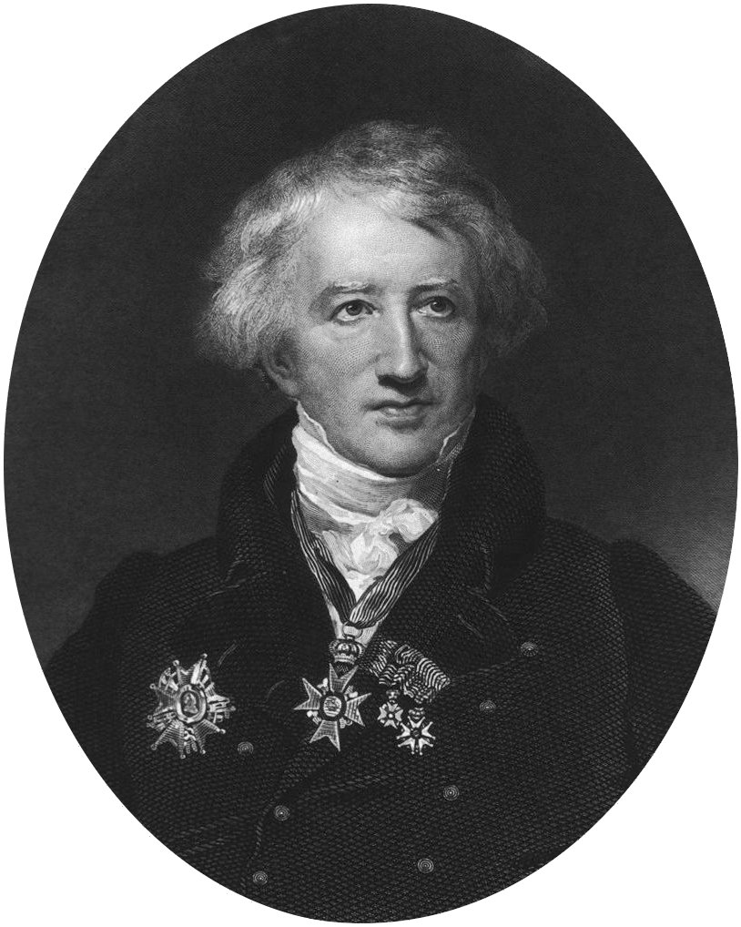
Catastrophism vs uniformitarianism
Georges Cuvier (1769-1832):
“It has been long considered possible to explain the more ancient revolutions on... [the Earth's] surface by means of these still existing causes; in the same manner as it is found easy to explain past events in political history, by an acquaintance with the passions and intrigues of the present day. But we shall presently see that unfortunately this is not the case in physical history:—the thread of operation is here broken, the march of nature is changed, and none of the agents that she now employs were sufficient for the production of her ancient works.”
Essay on the Theory of the Earth, p. 24
Book available online at http://lhldigital.lindahall.org/cdm/ref/collection/earththeory/id/4519
Notes:
Sensu latu: scale and processes, not just rate

Slide 12
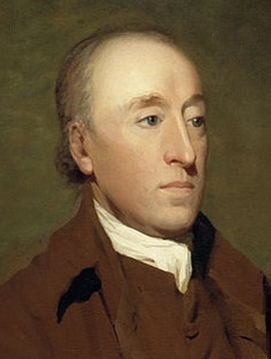
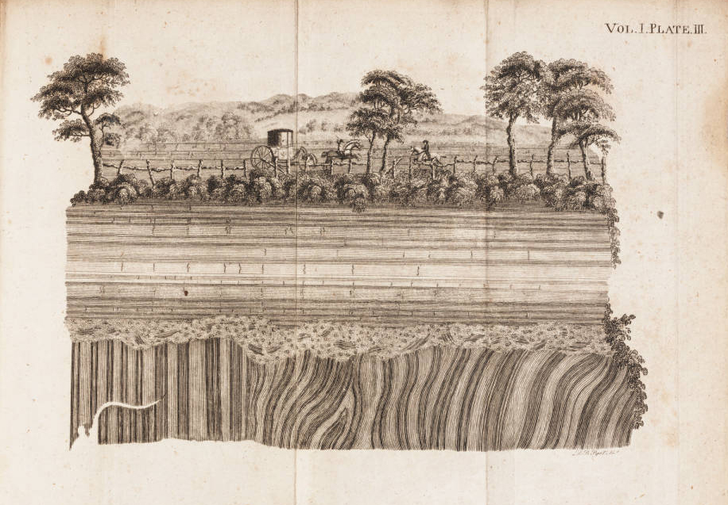
Unconformities and long, cyclical view of history
James Hutton (1726-1797)
Theory of the Earth (early version published in 1788)
Notes:
Another key figure in geology that understands the value of surfaces for inferring history is the Scottish James Hutton. His worldview of earth history is very different, and entails a very long chronology with repeated cycles. Part of his argument is founded on the identification of angular unconformities.

Slide 13
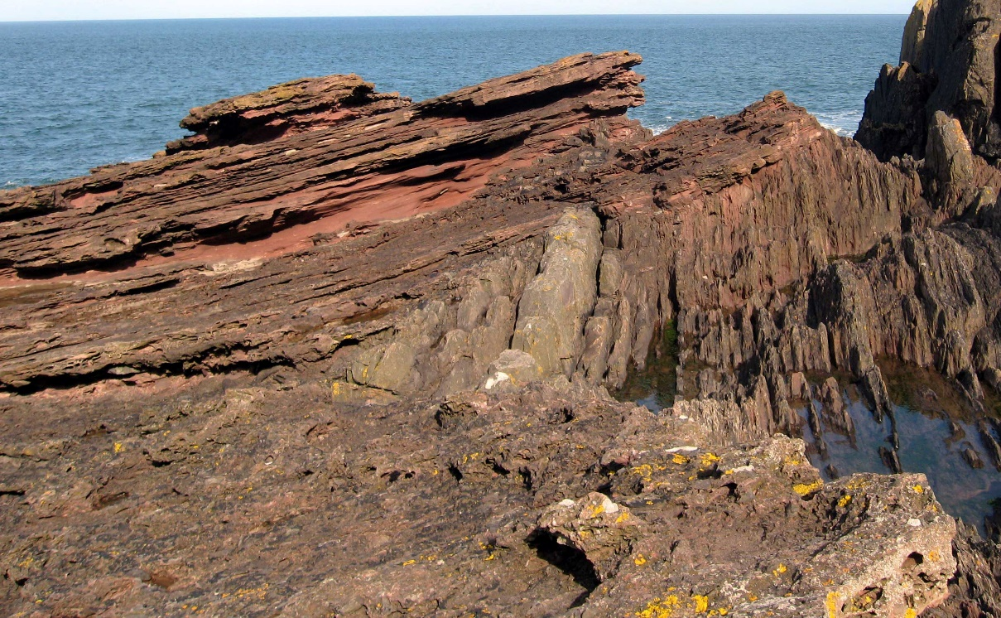
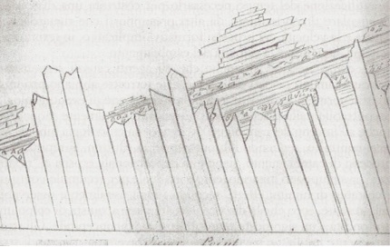
Angular unconformity at Siccar Point
1788, fieldtrip with James Hall (chemist) and John Playfair (mathematician)
“We felt necessarily carried back to a time when the schistus on which we stood was yet at the bottom of the sea, and when the sandstone before us was only beginning to be deposited, in the shape of sand or mud, from the waters of the supercontinent ocean... The mind seemed to grow giddy by looking so far back into the abyss of time.”
John Playfair, 1805
Image courtesy of Dave Souza, https://en.wikipedia.org/wiki/File:Siccar_Point_red_capstone_closeup.jpg
Sketch of the unconformity by James Hall

Slide 14
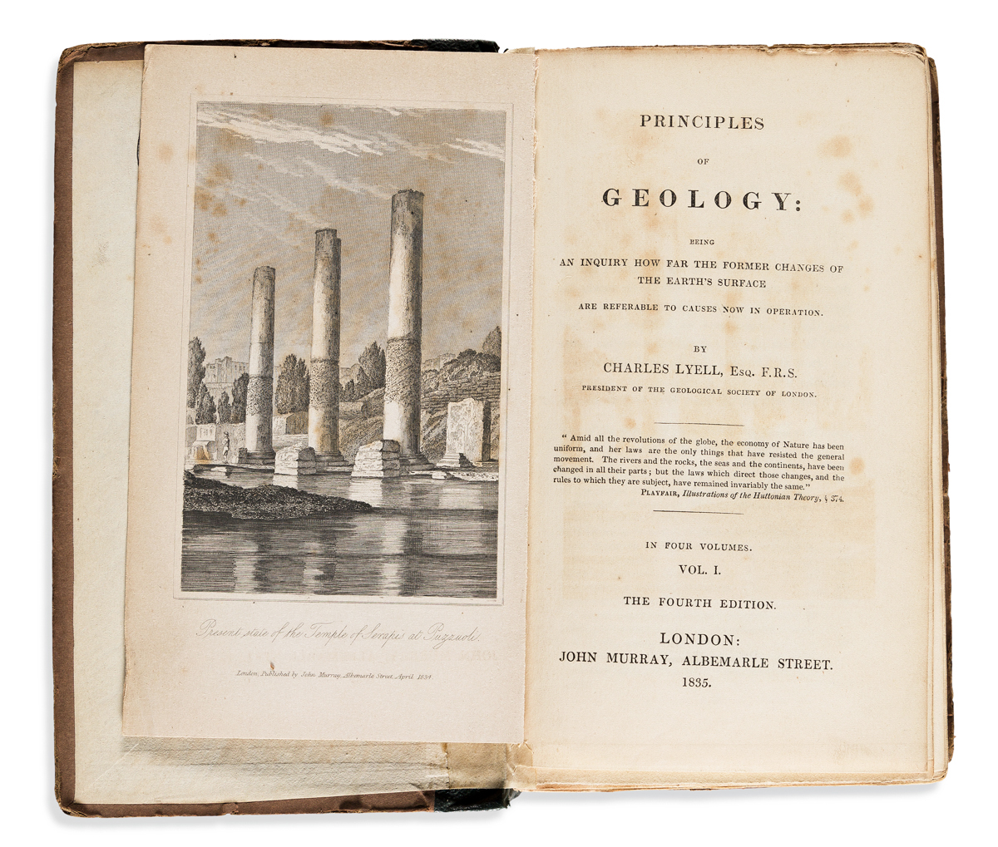
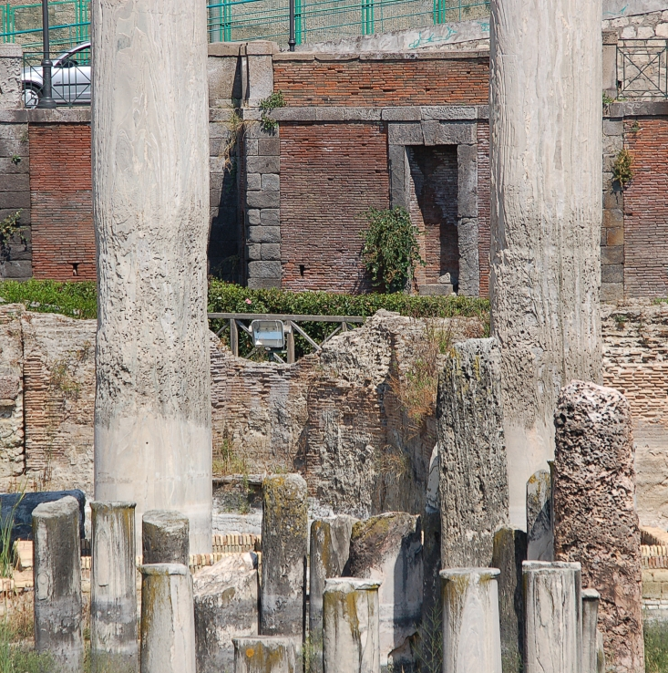
Catastrophism vs uniformitarianism

Slide 15
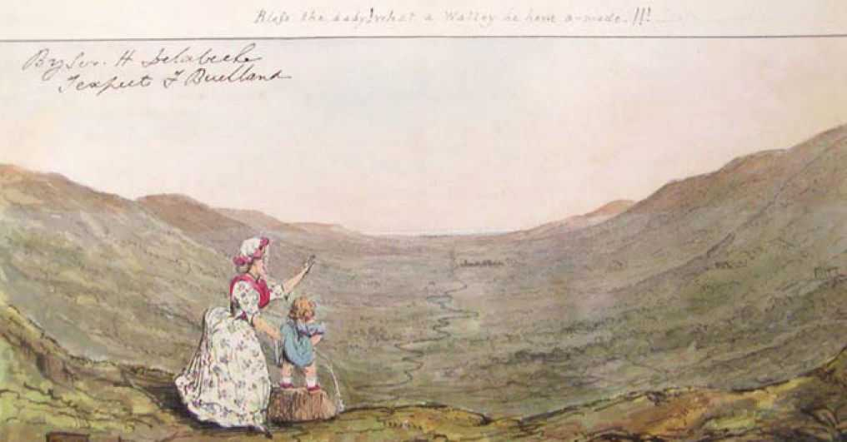
“Cause and Effect" 1830-1833. The caption on top notes: "Bless the baby! What a valley he have a-made!!!",
Roderick Murchison, a stringent critic of Lyell, wrote to the De la Beche about his book, The Geological Observer: “I could only have wished that it did not seem to me that you favoured the ‘piddling’ school more than of old, when you drew Frank Buckland as a baby denuding a valley. We shall hear a good deal more made of the book [The Geological Observer] tomorrow night; so I reserve my say except to hope that you have not actually become an inch by inch geologist” from Haile, 1997

Slide 16
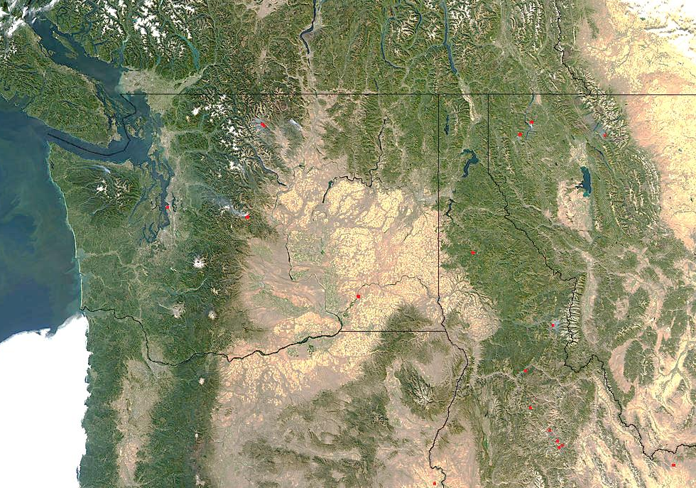
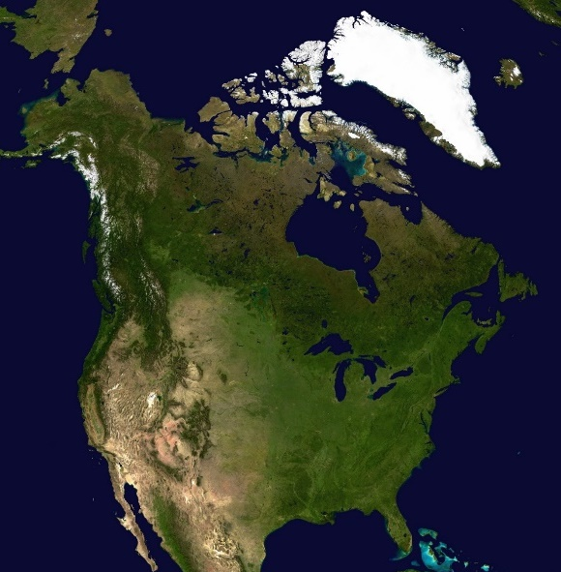
Neocatastrophism: Bretz, the Channeled Scablands and Megafloods
North-western United States: Distinctive landscape (Channeled Scablands)
Courtesy of NASA
http://visibleearth.nasa.gov

Slide 17
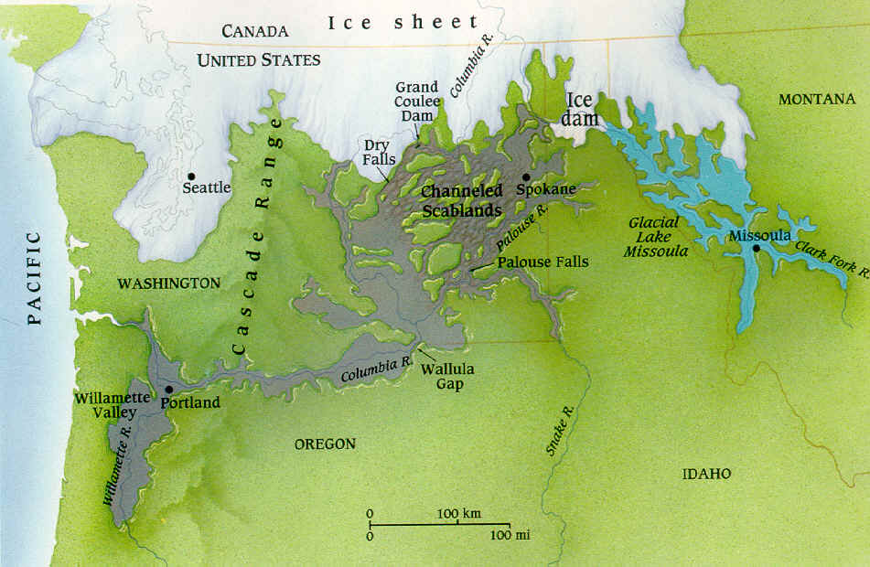
Catastrophic processes and no uniformity of rates (Neocatastrophism)
Neocatastrophism: Bretz, the Channeled Scablands and Megafloods
In 1923 Harlen Bretz proposes a catastrophic flood as genetic mechanism
Initially rejected, his hypothesis is finally accepted in 1965
Catastrophic floods (more than one?) related to glacial discharge
Largest: Missoula flood, breaking of ice dam and draining of glacial lake; flow speed up to 120 km/h, lake drained in estimated 48 h
From http://www.guboards.spokesmanreview.com/showthread.php?t=3086

Slide 18
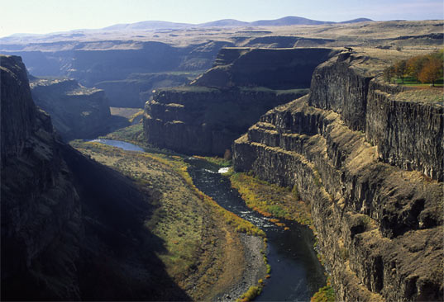
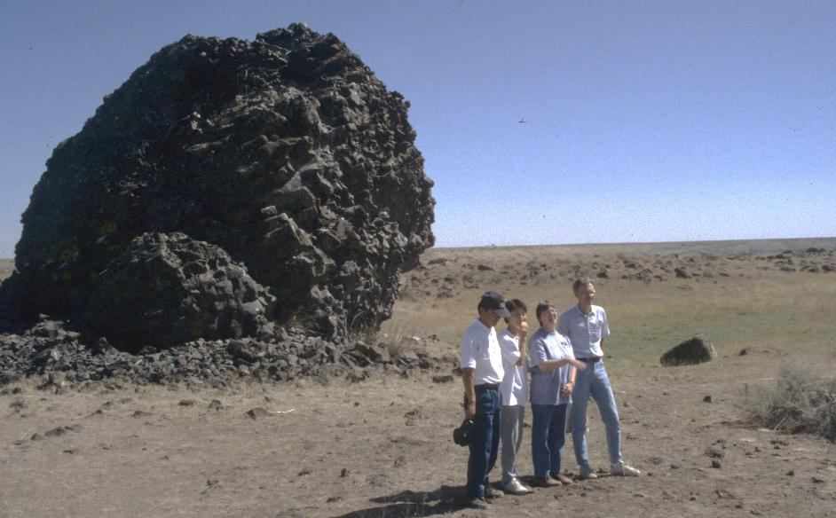
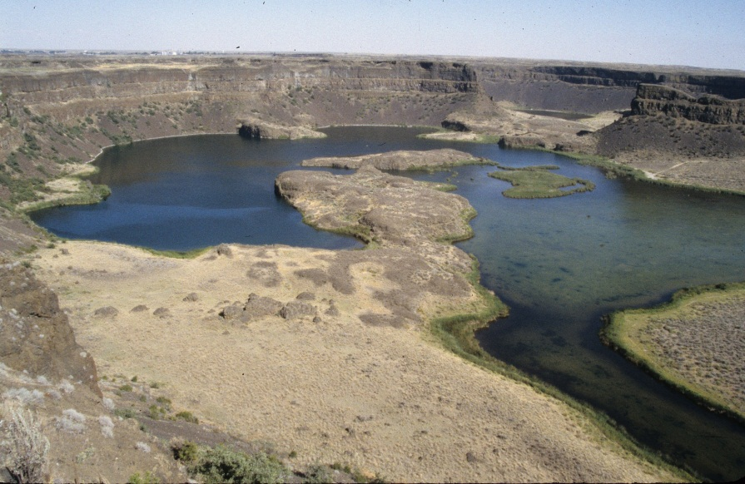
Channeled Scablands Megafloods
Megafloods
Dramatic impact on the landscape:
Substantial erosion (canyons, dry falls) and deposition (megaripples, gravel bars)
From: http://www.pbs.org/wgbh/nova/megaflood/scab-07.html

Slide 19
Neocatastrophism: Alvarez and the Impact Hypothesis
Meteoritic impacts
“Ever since the acceptance of the Huttonian principle of uniformitarianism, it has been difficult for Earth scientists to accept any explanation of a geological event that relies on a catastrophic mechanism. This problem is epitomised by the time that was taken to recognise the importance of meteoritic impacts in planetary evolution.”
Jones, A.P., et al. (2002). Earth and Planetary Science Letters 202:551-561

Slide 20
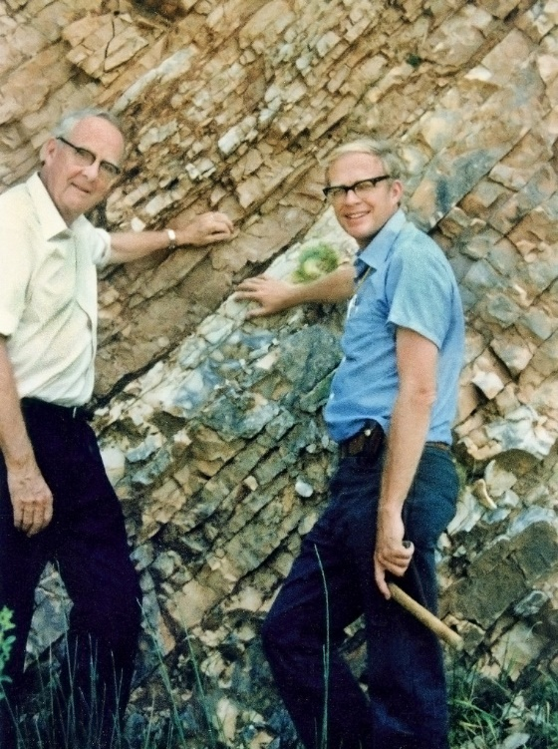
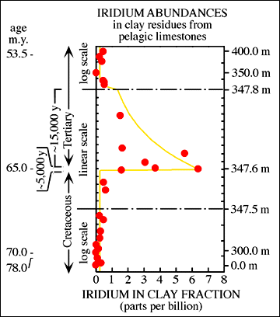
Neocatastrophism: Alvarez and the Impact Hypothesis
Iridium anomaly in thin clay at K-Pg boundary
Image courtesy of Berkeley Lab available at https://c2.staticflickr.com/4/3641/3523006823_3b7cd2aed7_b.jpg (CC BY-NC-ND 2.0)
http://eesc.columbia.edu/courses/ees/life/lectures/lect08.html, adapted from Alvarez et al., 1980

Slide 21
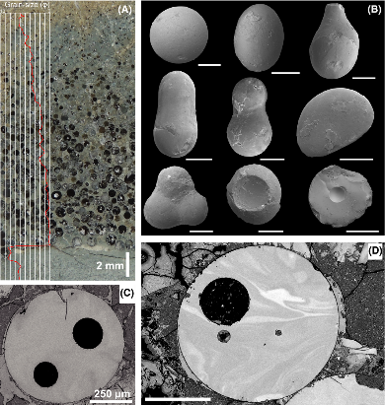
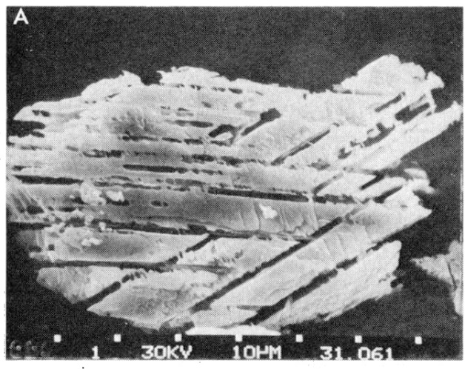
Neocatastrophism: Alvarez and the Impact Hypothesis
Impact spherules
Vaporized and melted rock, ejected through the atmosphere after an impact, and rapidly solidified with cooling; forms layers settling during fallout
Shocked quartz and mineral grains
Deformation structures induced by high P and T generated by shock wave
From Bohor et al. (1984) Science
From Bermúdez et al. (2016) Terra Nova

Slide 22
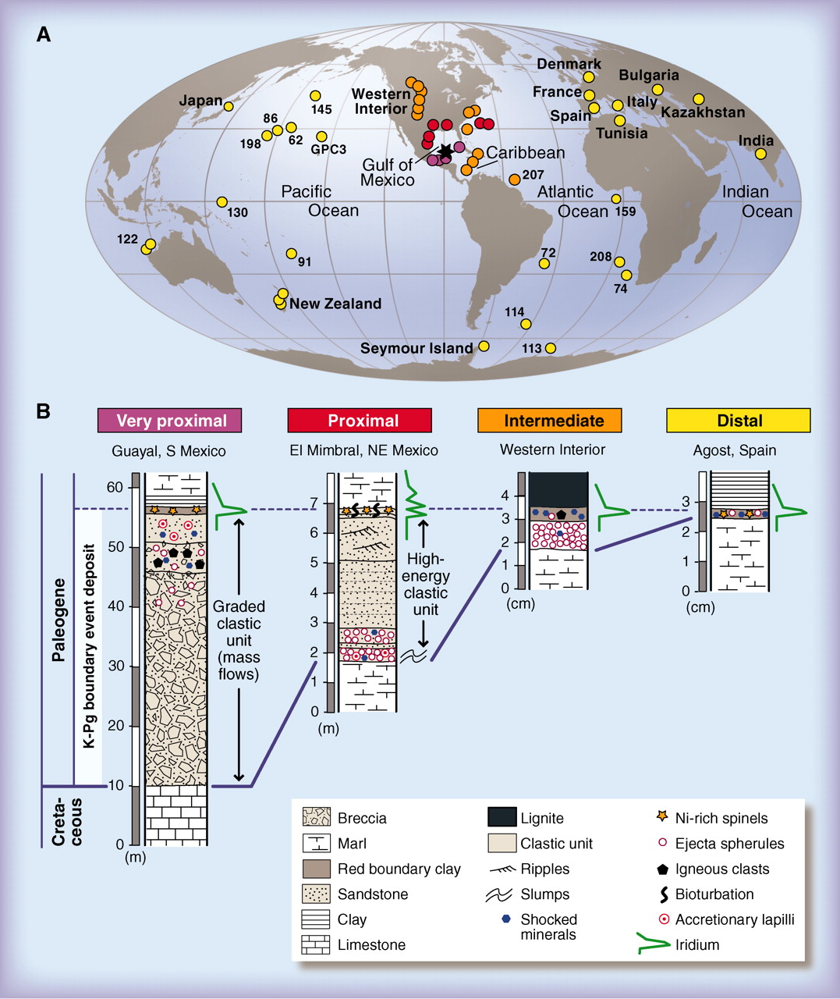
Global distribution of deposits at the K-Pg boundary with some of these characteristics
Differences in thickness and type of deposits
Impact site somewhere between North and South America
Estimates of crater diameter: ~ 200 km
From Schulte et al. (2010) Science

Slide 23
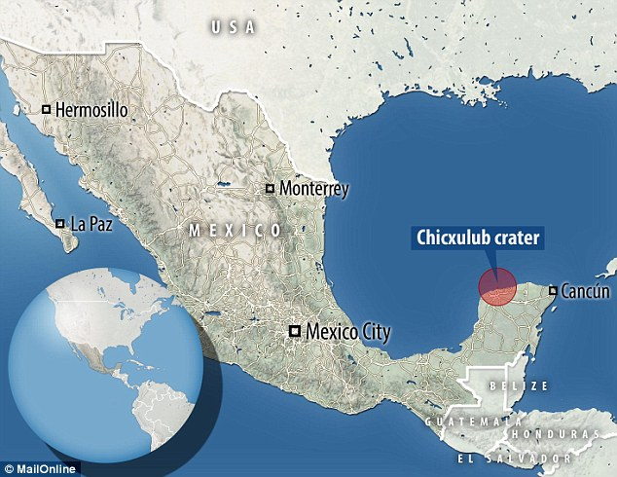
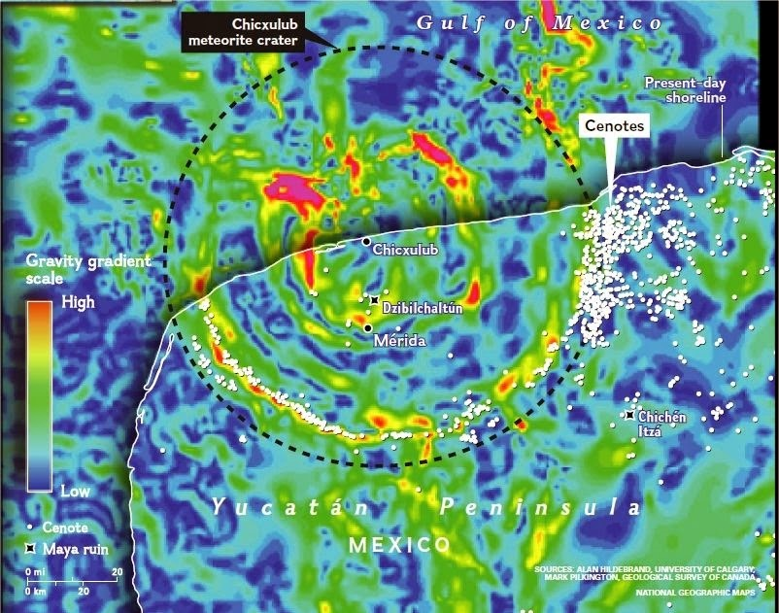
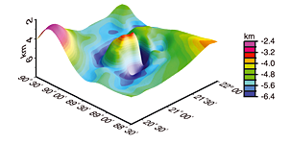
1991: Circular structure in the subsurface of Yucatán Peninsula (Mexico) suggested as the impact site Chicxulub Crater
From http://i.dailymail.co.uk/i/pix/2016/03/07/10/31F361BC00000578-0-The_researcher_will_sail_18_miles_off_the_coast_of_Mexico_s_Yuca-a-4_1457347981349.jpg
From http://2.bp.blogspot.com/-8qxyDMtRZb4/VNjoPqBXypI/AAAAAAAAiJM/U70z8LhYhUk/s1600/ring%2Bof%2BCenotes.jpg
From Gulick et al. (2013) Review of Geophysics

Slide 24
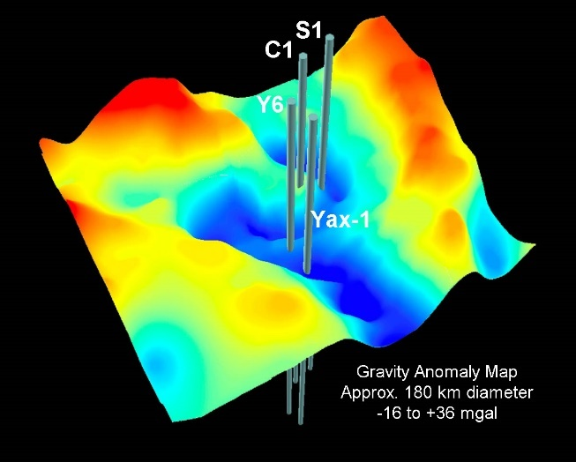
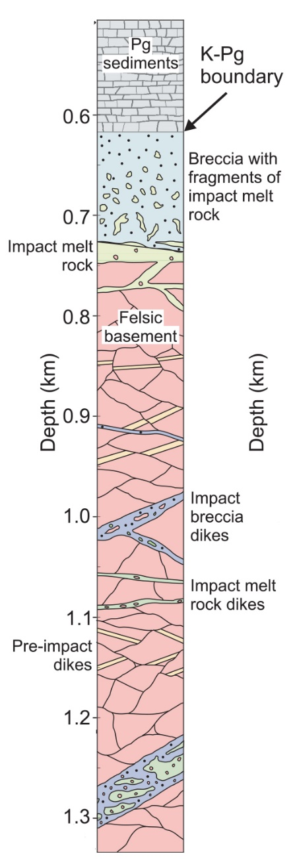
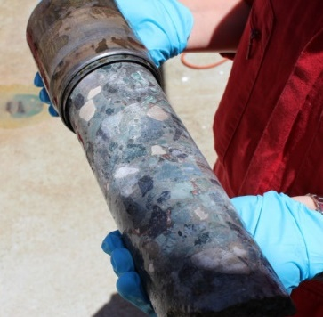
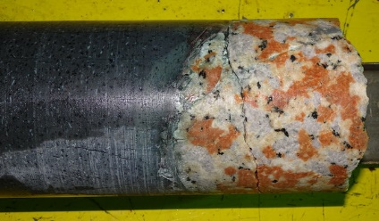
Neocatastrophism: Alvarez and the Impact Hypothesis
Drilling of the structure:
Impact Breccias
From http://www.b14643.de/Chicxulub_event/Chicx-03A.htm
From http://www.lpi.usra.edu/science/kring/Chicxulub/images/hi-res/ChicxulubGravityandBoreholes.jpg
Impact melt and granite basement
From https://www.nytimes.com/2016/11/18/science/chicxulub-crater-dinosaur-extinction.html?_r=0
From https://arstechnica.com/science/2016/11/how-the-dino-killing-asteroid-put-a-ring-on-its-crater/
From Morgan et al (2016) Science

Slide 25
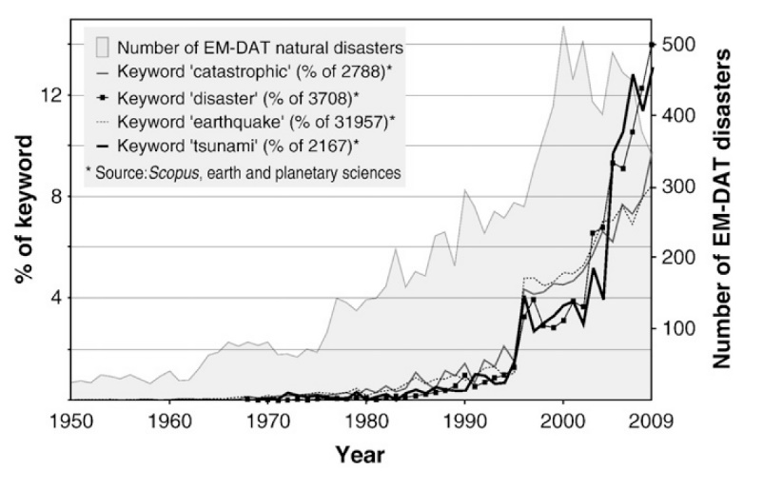
New trends in modern geology
Recognition of catastrophic processes and no uniformity of rates (Neocatastrophism)
“For the period 1950–2009, the bibliographic data show an exponential rise in catastrophic literature after 1990. […] The neocatastrophist mode came to prominence in North America during the 1960s and 1970s before being more widely espoused in Europe, essentially after 1980.”
Marriner et al., (2010) Global and Planetary Change 74:43-48.
Jones, A.P., et al. (2002). Earth and Planetary Science Letters 202:551-561

Slide 26
Uniformitarianism in Geology and Biblical Worldview: Potential for tension at the methodological/philosophical level
Uniformity of rates | high | Short duration, cataclysmic
Uniformity of conditions | high | Global flooding
Uniformity of process | High to moderate | Processes involved
Uniformity of laws | High, if strict naturalism | Divine agency
moderate?

Slide 27
What does “supernatural” mean?
Are miracles violations of the laws of nature or a reflection of our limited understanding of God's action in the cosmos?
"God does not annul His laws or work contrary to them, but He is continually using them as His instruments." [Patriarchs and Prophets, p. 114]
“How vast the field in which the Creator can work in harmony with His own laws and yet wholly beyond the comprehension of finite beings!" [PP, p. 114]

Slide 28
What does “supernatural” mean?
However, careful in placing nature above God:
"The Lawgiver is greater than the laws of nature, […] Omnipotence is at no loss for means to accomplish His purposes" (PP 103.3);
In speaking of the unwarranted assumptions of antediluvians, "They reasoned, as many reason now, that nature is above the God of nature, and that her laws are so firmly established that God Himself could not change them" (PP 97.1).

Slide 29
A commitment to consistency, stability, reliability
Continuity and discontinuity: Is God’s action arbitrary?
Scoffers will come in the last days, walking according to their own lusts, and saying, “Where is the promise of His coming? For since the fathers fell asleep, all things continue as they were from the beginning of creation.” For this they willfully forget: that by the word of God the heavens were of old, and the earth standing out of water and in the water, by which the world that then existed perished, being flooded with water. But the heavens and the earth which are now preserved by the same word, are reserved for fire until the day of judgment and perdition of ungodly men. 2 Pet 3:3-7
Notes:
If the laws of nature are God’s way of sustaining the world, our experience shows that He carries this task with a commitment…
But then why these discontinuities. Why these punctuations in history, these interventions, to the point of complete reorganization? I found an answer to these questions in an important passage in 2 Peter 3. Very modern in addressing uniformitarianism, naturalism, and the theological questions probing the divine balance between continuity and discontinuity and the reasons for this alternation.

Slide 30
Peter’s argument
1) “Willfully” [θέλοντας thelontas]
For this they willfully forget: that by the word of God the heavens were of old, and the earth standing out of water and in the water, by which the world that then existed perished, being flooded with water. But the heavens and the earth which are now preserved by the same word, are reserved for fire until the day of judgment and perdition of ungodly men. 2 Pet 3:4-7
Notes:
“It is hidden (lanthanei) to them (autous) this (touto), thelontas,” Depending on how we link touto to the rest of the sentence, 2 possible translations: they deliberately forget or in maintaining this, they forget. The latter option does not imply that the scoffers are consciously suppressing data, but, rather, that their commitment to their ideas does not allow them to see the data. In any case, we are dealing with an a priori commitment to disregard a set of possibilities: a choice, the same we are all facing.

Slide 31
2) “By the word of God:” rejection of naturalism
For this they willfully forget: that by the word of God the heavens were of old, and the earth standing out of water and in the water, by which the world that then existed perished, being flooded with water. But the heavens and the earth which are now preserved by the same word, are reserved for fire until the day of judgment and perdition of ungodly men. 2 Pet 3:4-7
Notes:
In v. 6 the plural relative pronoun ὧν ōn refers to the Word of God and water, mentioned at the end of verse 5. Peter proclaims the reality of God and His agency in the cosmos. He is therefore openly rejecting the naturalistic assumption shared by many modern scientists. He is also challenging the uniformitarianistic view by mentioning a special mode of agency, “by the Word.” Which takes us to the third point…

Slide 32
Peter’s argument
3) There have been discontinuities: rejection of strict uniformitarianism
For this they willfully forget: that by the word of God the heavens were of old, and the earth standing out of water and in the water, by which the world that then existed perished, being flooded with water. But the heavens and the earth which are now preserved by the same word, are reserved for fire until the day of judgment and perdition of ungodly men. 2 Pet 3:4-7
Notes:
True uniformitarianism warrants that the same kind of divine action that happened in the past will happen in the future. Not only there was a creation, not only there was a flood, but there will also be a day of judgment. What is truly invariable throughout this history is the Word of God, not the physical realities it brought into existence. The Word which preserves the present world is “the same [αὐτῷ auto]” (2 Peter 3:7) one by which the heavens were of old (2 Peter 3:5) and by which they were destroyed (2 Peter 3:6).

Slide 33
Punctuated equilibria
Discontinuity 1: The creation
“by the word of God the heavens were of old, and the earth standing out of water and in the water”
Continuity/Certainty:
“of the tree of the knowledge of good and evil you shall not eat, for in the day that you eat of it you shall surely die” (Gen 2:17, NKJV).
Notes:
each one of the interventions described represents, after its origination, a system where God upholds underlying regularities.

Slide 34
Punctuated equilibria
Punctuated equilibria
Discontinuity 2: The Flood
“by which the world that then existed perished, being flooded with water. ”
Continuity/Certainty:
“While the earth remains, seedtime and harvest, cold and heat, winter and summer, and day and night shall not cease” (Genesis 8:22). “He makes His sun rise on the evil and on the good, and sends rain on the just and on the unjust” (Mt. 5:45, NKJV).
“the heavens and the earth which are now preserved by the same word […]”
Notes:
“preserved…stored”: thesaurizo + Tereo: to watch, guard, observe… This is not a distant form of preservation, but involved, active…

Slide 35
Punctuated equilibria
Punctuated equilibria
Discontinuity 3: The Day of Judgment
“the heavens and the earth which are now preserved by the same word, are reserved for fire until the day of judgment and perdition of ungodly men. ”
Continuity/Certainty:
“Death will be no more; mourning and crying and pain will be no more,” (Rev 21:4).

Slide 36
Conclusions
Historical sciences use abductive reasoning: limitations related to the possibility that multiple processed lead to the same effects
The best cause is typically considered one that can be observed in the present (uniformitarianistic approach)
Uniformitarianistic approach has led to the exclusion of a catastrophist perspective. However, the geologic record preserves trace of processes, rates and conditions very different from those observed today. Reappraisal in modern geological literature, creating opportunities for creationist thinking.
How natural processes and divine action are related remains a complex issue in the study of the geologic record. Science might not be the best tool to explore divine intervention.
Scripture clearly indicates the existence of discontinuities and divine intervention in the past, also affirming the value of regularities.

Slide 37
Resources
Various articles on catastrophism (including Bretz’s Missoula megaflood and the K-Pg impact) in GRI blog: http://grisda.wordpress.com/

