Slide 1
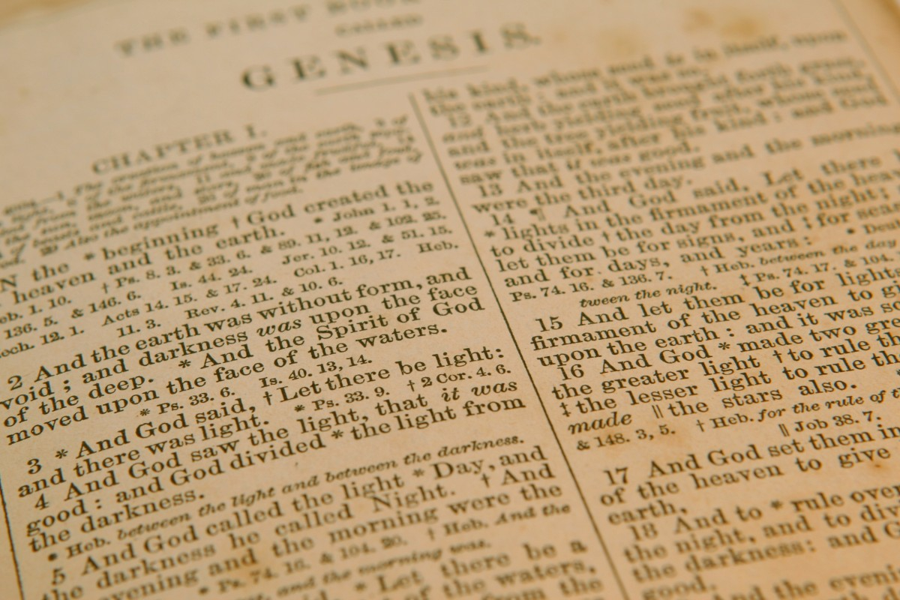
“In Six Days…” Sharing the beautiful message of creation week
Ronny Nalin, Geoscience Research Institute

Slide 2
God, the Creator
“On their release, Peter and John went back to their own people and reported all that the chief priests and the elders had said to them. When they heard this, they raised their voices together in prayer to God. “Sovereign Lord,” they said, “you made the heavens and the earth and the sea, and everything in them.”
Acts 4:23-24
Notes:
At times we have forgotten how foundational and integral this doctrine is that we remain surprised by some Biblical passages… Today we would have started this prayer of thanksgiving something like “Thank you Jesus because you are always near us and protect us…” but they begun with this affirmation. Do you sense what is implicit in this statement of trust? It’s the purest form of worship, because it shifts the focus away from the creature to the Creator. From I to You. Willful submission to the God of Love. Full circle. Infinite power and free will meet.

Slide 3
God, the Creator
“They lay their crowns before the throne and say:
“You are worthy, our Lord and God,
to receive glory and honor and power,
for you created all things,
and by your will they were created
and have their being.”
Revelation 4:10-11
Notes:
At the core of heavenly worship, at the center of the relationships between God and other beings in the cosmos lies this fundamental truth: everything exists and is sustained, including you and I, today, and our environment, because of the will of God.

Slide 4
God, the Creator
“He said in a loud voice, “Fear God and give him glory, because the hour of his judgment has come. Worship him who made the heavens, the earth, the sea and the springs of water.” Revelation 14:7
Notes:
Seventh-day Adventists have embraced this truth. In fact, they have made it part of their mandate to proclaim it with a loud voice. To become a minster in the SDA church entails to embrace and deeply understand the beauty of this truth, with an unwavering commitment to reach out to those who do not share this understanding.

Slide 5
God, the Creator
“In six days”
“God has revealed in Scripture the authentic and historical account of His creative activity. He created the universe, and in a recent six-day creation the Lord made “the heavens and the earth, the sea, and all that is in them” and rested on the seventh day. Thus He established the Sabbath as a perpetual memorial of the work He performed and completed during six literal days that together with the Sabbath constituted the same unit of time that we call a week today…” FB6
Why bother?
Notes:
So, it should not surprise us that SDAs have included this aspect in their constitutive doctrines. Considered so fundamental to who we are that it is stated in the fundamental beliefs. Most explicitly in FB6
In essence, it is trying to convey that we believe God created the world recently, in six real days, literal not metaphorical. It does not take a stand about the age of the universe as a whole, but certainly about our system. You are certainly aware that nowadays in Christianity there are many advocates of different views of what it means that “God created,” particularly when it comes to time (over long time) and process (through biological evolution), the mainstream alterantive approach known as theistic evolution. It will be likely you will encounter it in your churches or in your readings.
It is important then to ask the question of why. Why did the church feel the need to articulate this particular understanding. If I am a church member, why should I care? What difference does it make for my walk with God if He created this world in six days or over thousand or millions of years.
Humbly sharing a point of view. My personal testimony of the value this understanding brings to my spiritual journey. The way that for me this notion is tied to the character of God and His way of acting in history.

Slide 6
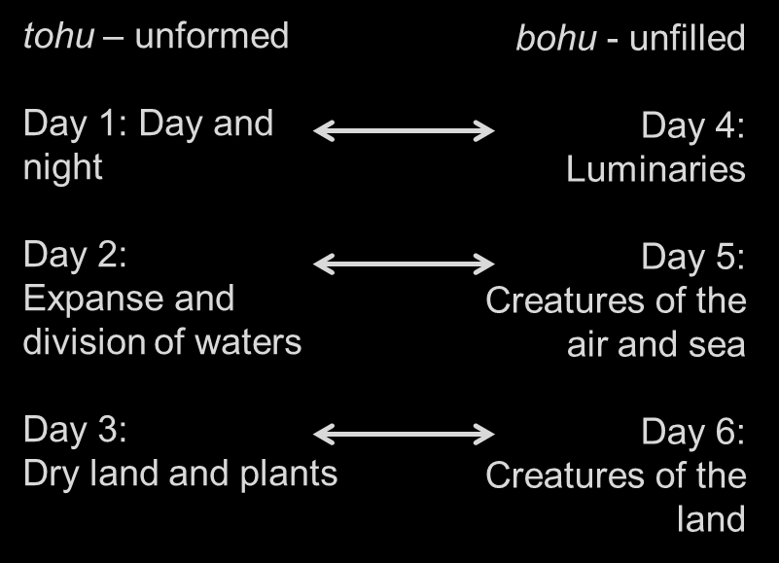
1) Creation as planned
Parallel structure: “forming” and “filling”
Notes:
First aspect intrinsic to the structure of the six-day creation

Slide 7
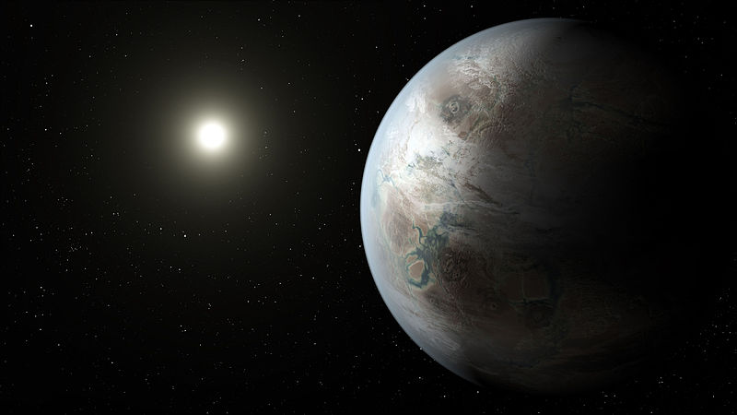
1) Creation as planned
Parallel structure: “forming” and “filling”
In the six days creation, the “forming” is presented as essential and integral to the “filling”
Astrobiology and exoplanets: what makes a planet habitable
“We define a ‘potentially habitable’ planet to be one that is mostly rock, with a small (≤100 bar), high molecular weight atmosphere, and with energy sources and an internal structure such that the surface temperature and pressure permit liquid water for geological timescales.” Barnes et al. (2015), The Astrophysical Journal
Notes:
Just to show that this parallelism is not simply a literary construction, there is in fact scientific value in the link between forming and filling, and in the list of elements presented antecedently to the days dedicated to the creation of living beings.

Slide 8
1) Creation as planned
b) “Saw that it was good:” parts and whole system
Inspection, quality control
Reference standard, model and implementation
c) “Thus the heavens and the earth, and all the host of them, were finished.” Gen 2:1
Notes:
Examination, quality control. To know that something is good you need a standard, a model to compare what observed with what was planned. Not a casual looking but a real inspection. To know that something is completed requires a target, a “contract”

Slide 9
1) Creation as planned
A cohesive, not haphazard, project
A specific target, a master plan
http://www.sxc.hu/photo/913660
Notes:
Planning, implementation, and examination

Slide 10
2) God’s direct involvement and power
a) Verbs of action: created, said, divided, called, made, blessed
b) He spoke and it was done.
A God infinitely greater than me.
Notes:
Does not step back, is not distant, fully invested in every detail, every part of Adam and Eve has been planned in the mind of God and executed according to his will. And through them, after generations and generations, in spite of centuries of evil, I can still feel the touch of God when I look at my frame and design.
Aspects in the six day creation that include processes (ex nihilo, by fiat) that escape our current understanding of physics.
The two combined: what a powerful message. The Omnipotent God who makes me with His hands. Central theme of the gospel, really.

Slide 11
3) Discontinuities and structure
“According to its kind” (grass, herb with seed, tree with fruit , creatures of the sea, creatures of the air, creatures of the land)
“Have dominion over the fish of the sea, over the birds of the air, and over every living thing that moves on the earth”
“to you it shall be for food”
http://www.sxc.hu/browse.phtml?f=view&id=958410
Value of humans
Stewardship of interdependent, ordered system
Notes:
Role of humans. A planned cohesive whole with well interacting components, interdependent, complex, ordered, structured. Affects the way we see ourselves with regard to the rest of the creation. Had you ever thought the six days have a connection with environmental stewardship? Entrusted with a brand new machine with us in mind as drivers.
Some versions of this hard to accept…hierarchy, boundaries. What if I were a rock or an ant. However, this resistance is in part due to how we frame this discussion. In nature, narrative of cooperation not necessarily competition. Seen at the church level too, variety of talents and functions. Also, might be dynamic within group, not static, growth and expansion.
The narrative of Satan in Eden. Be like God, God has forbidden you to take from…

Slide 12
4) “Very good” and “Not yet”
Affirmation of the goodness and completeness of creation (7 “it was good”) organic and inorganic, in its individual components and as a whole
Account of creation contrasted in Gn 2:5 with what is to come with sin (“not” and “not yet”)
“Now no shrub had yet appeared on the earth and no plant of the field had yet sprung up, for the LORD God had not sent rain on the earth and there was no one to work the ground” (Gn. 2:5)
http://www.openclipart.org/detail/10940
Notes:
What is this goodness?
Particularly relevant when compared with alternatives suggesting slow emergence over time.

Slide 13
4) “Very good” and “Not yet”
A major discontinuity
A present worst state of things
Implications for discussion on evil in nature
http://www.openclipart.org/detail/10940

Slide 14
Theistic Evolution: An Alternative Model
“Attempt to maintain Christian teaching about God’s involvement in 'salvation history' without resorting to account of supernatural intervention in the natural order.” N. Murphy, 2007
God “created” through the natural process of evolution over long time
Notes:
Let’s pause here for a moment and consider the most popular alternative model in Christianity, theistic evolution. What is the rationale behind this approach? It is basically an attempt to do away with the “miraculous” in the Scriptures. It rejects an unscientific and interventionist the 6-days model of origins and basically concedes that when it comes to the how/when/what of the origins of the world we should not look at the Bible as a source of knowledge.
So, what does theistic evolution look like? The narrative is essentially not different from the standard naturalistic view: evolution over billions of years.
Various suggestions on the role of God’s action in this process. In general God interacts in a “soft way” trying to “persuade” the system towards the best possible outcome. Or “fully gifted” or “fully endowed” creation. Initial setup only.

Slide 15
Theistic evolution and evil in nature
Why would God “create” through evolution?
Model 1: It was the only possible way (constitutive)
“Transience, dissolution, death, and the pain, suffering, and loss they induce have their roots in the underlying characteristics of nature.” W.R. Stoeger, 2007
“Suffering is a side effect of the freedom that God wills for his creation.” D. Falk, 2009
Notes:
If God created through the evolutionary process, we are faced with the dilemma of explaining why He used a methodology that includes natural evil.

Slide 16
Theistic evolution and evil in nature
Model 2: Divinely appointed purpose for evil (developmental or instrumental)
“The creation of humankind through the evolutionary process as an immature creature living in a challenging and therefore person-making world.” J. Hick, 1981
“The eternal plan of God has always and unchangingly been to permit and use suffering for a time to accomplish His eternal goals. Suffering is an undeniable, though temporary, part of His “very good” creation through which He is bringing His plan to fruition.” M. Whorton, 2005

Slide 17
Theistic evolution and evil in nature
Evil as part of how God created.
Opposite to the thrust of the gospel, where God distances Himself from evil and provides a solution for it.
“You were perfect in your ways from the day you were created, till iniquity was found in you.” Ez. 28:15
“The last enemy that will be destroyed is death.” 1 Cor. 15:26
Notes:
The six days creation disentangles God from evil. This world of evil that you see is not me, it’s not what I created.

Slide 18
In six days: worshiping the Creator
“Remember the Sabbath day, to keep it holy. […] For in six days the Lord made the heavens and the earth, the sea, and all that is in them, and rested the seventh day. Therefore the Lord blessed the Sabbath day and hallowed it.” (Ex. 20:8,11)
“Remember that you were a slave in the land of Egypt, and the Lord your God brought you out from there by a mighty hand and by an outstretched arm; therefore the Lord your God commanded you to keep the Sabbath day.”
Notes:
Another aspect of the seven days creation: it affects my worship experience.
A central element in the celebration of our communion with God is the Sabbath institution. So crucial that figures among the ten commandments. And for Adventists it is part of our name.
But what is it really that we worship in this day? What is it that we remember? What kind of God? It is the God of the six days , the Powerful Creator and Maker. It is the God of the mighty hand and outstretched arm. I rest as a way to acknowledge that the power is in Him, not in me. The power is in the Creator not in the creature. True Sabbath worship (and true worship) moves the emphasis away from the self, a self-determined and almost independent system, and brings it back to the One who makes and commands. Submission in free will.
Belief in a six days creation impacts the way I experience the Sabbath also in another way. This day is not just as a symbol, but an actual historical institution directly established by God. Sabbath worship, then, has a historical component that goes back all the way to the original creation. A linkage that remained a strong bridge to the divine through the centuries, reminding us even today of a never lost connection.

Slide 19
In six days: worshiping the Creator
Who came first? “The Sabbath was made for man” (Mark 2:27).
Our role and value in the world

Slide 20
In six days: “Has God really said?”
“For in six days the Lord made the heavens and the earth, the sea, and all that is in them, and rested the seventh day. Therefore the Lord blessed the Sabbath day and hallowed it.” (Ex. 20:11)
Later elaboration of “the origin myth of a particular set of Bronze Age desert tribesmen”
Writing engraved by God Himself on the tablets of the Testimony
Notes:
A final aspect that is exemplified very well by the Church’s stand on the literal six days. The issue of hermeneutics. We come to the Bible with many different approaches, even among Christians.
Take a text like this, found in Exodus. At the two opposite ends of a range of approaches we could find some that see it as an expression of a cultural tradition, and some who see it as actual words written by God Himself on real stone tablets and physically given to Moses on Mount Sinai.

Slide 21
In six days: how do we read the Bible
Emphasis on the human: a) text generated through human initiative b) human scientific understanding constrains what is acceptable
Emphasis on the divine: a) text generated through divine initiative b) God’s action not constrained by what scientific understanding considers acceptable
Notes:
In my opinion, the main difference between the extremes of the two approaches is their central focus. One emphasizes the human component, the other the divine component.
This is reflected, in particular, on two critical levels. How the content formed. And who sets the criteria to evaluate the content.
Expression of a collective or individual religious experience (bottom up) or God’s initiated revelation/inspiration (top down)
Human understanding is the filter that determines what is or not possible/reliable in Scripture. Critiquing before receiving.

Slide 22
In six days: why sharing?
1) God cares, He is active, He is powerful, and He is good
2) My relationship and responsibility towards the rest of the creation
3) I worship the God of creation week
4) Listening to the word of God
Notes:
We started this discussion with “what difference does it make.” It does make a difference, practically and conceptually, in these respects. It impacts…
God is Who He says He is and did what He has revealed He did. I accept that possibility and I am willing to listen.
This is a testimony to the organic interconnectedness of the Biblical message. Every facet is well integrated within a bigger picture.

Slide 23
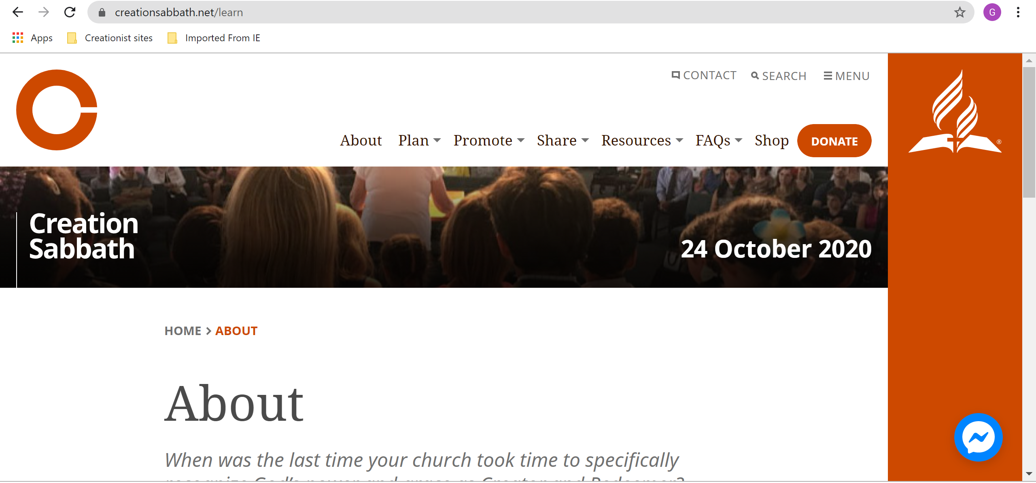
creationsabbath.net

Slide 24
www.grisda.org

Slide 25
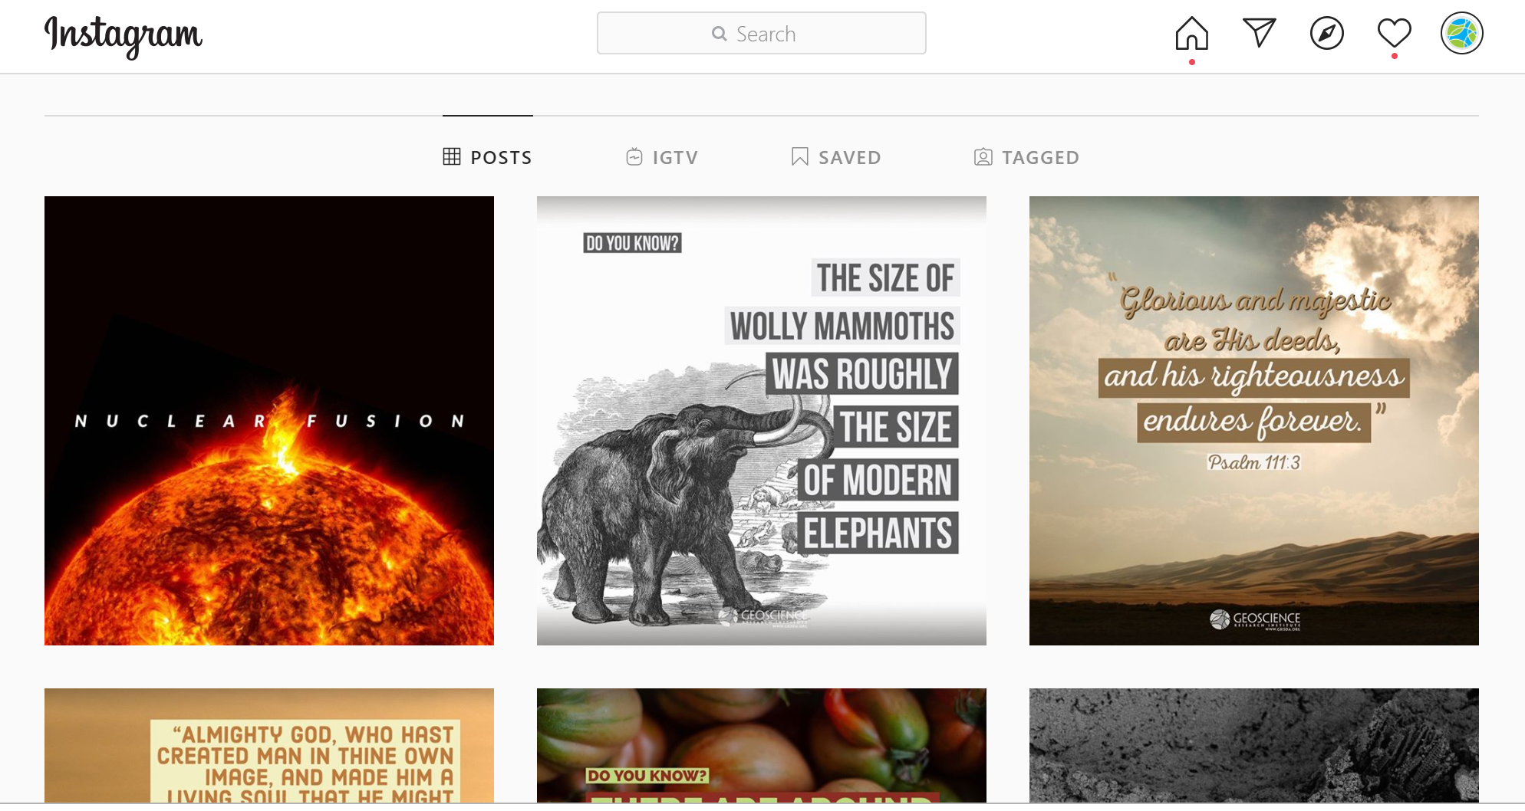
Instagram: @geoscienceresearchinstitute

Slide 26
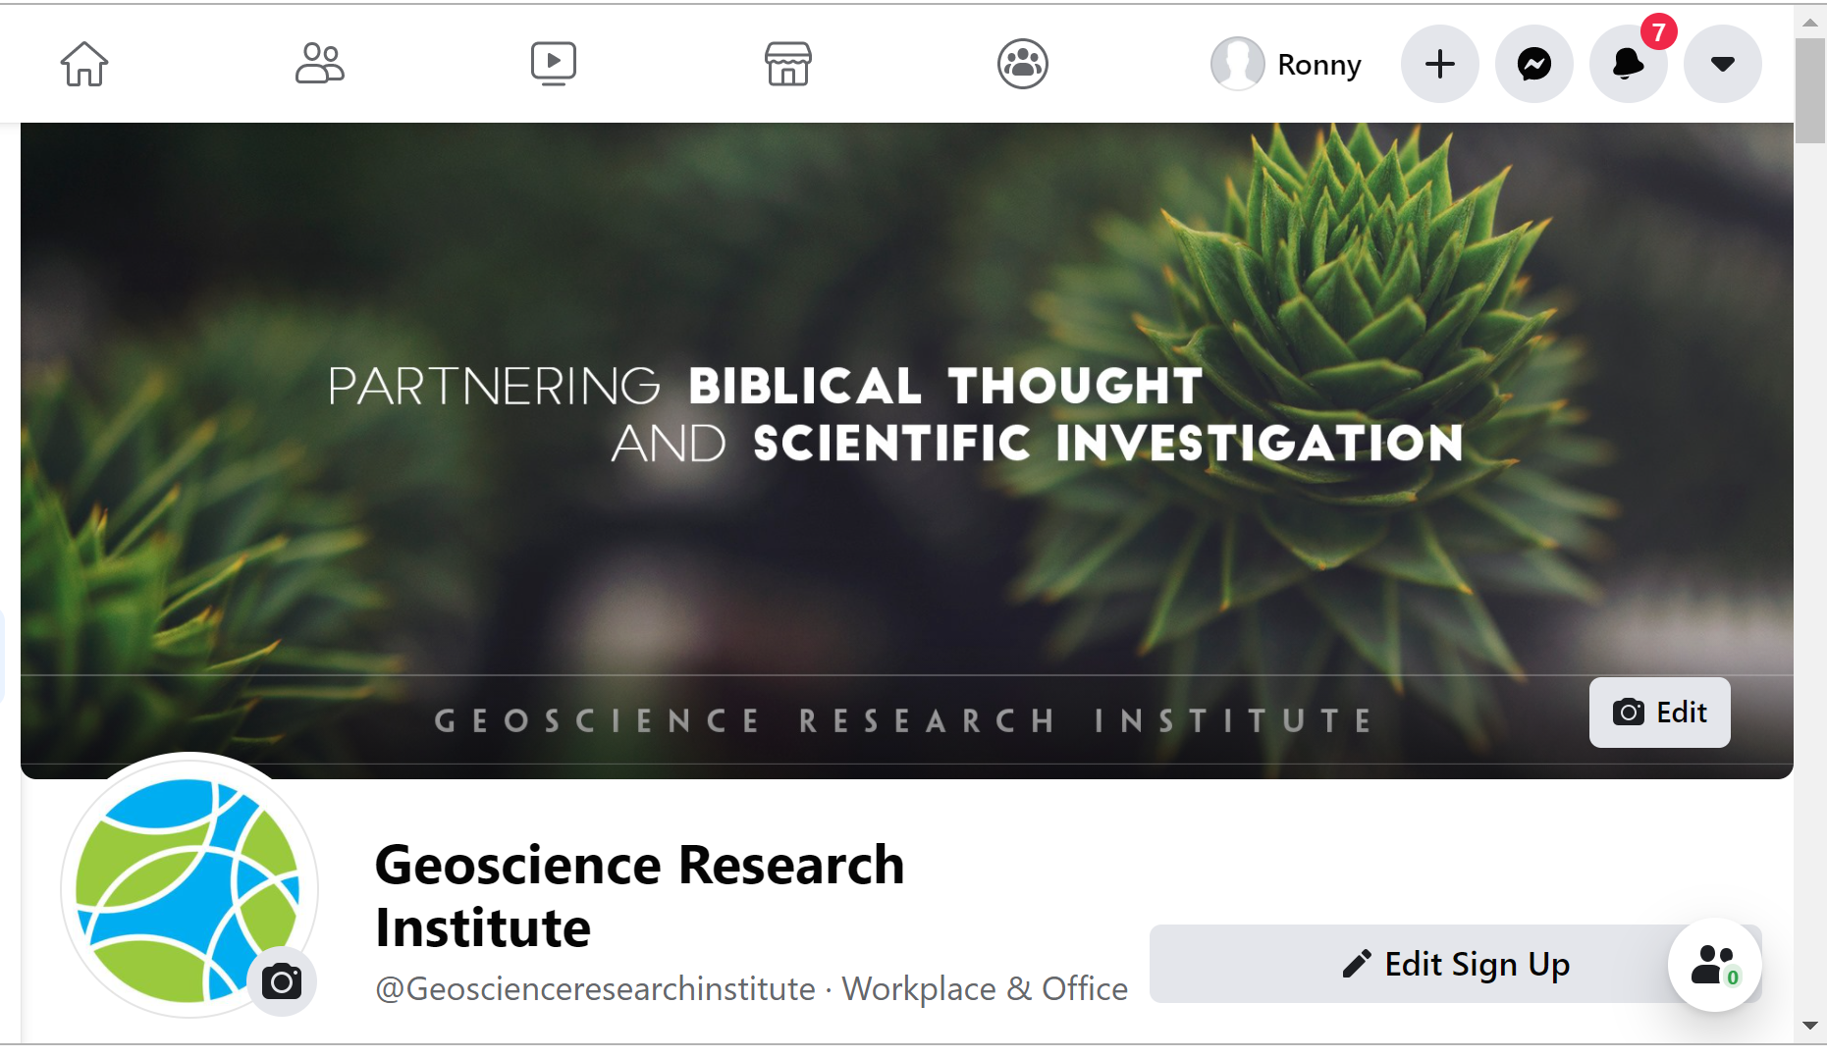
Facebook: @geoscienceresearchinstitute

