Slide 1
You are free to use this presentation for your own personal study, or for lectures in a classroom setting. Feel free to modify and improve it for classroom use in any way that you see fit. I ask that it not be redistributed in whole or in part for any purpose without my written permission. If you would like to use it for some other purpose, or wish to share it using any media please contact me at:
tstandish@llu.edu
Thank you for respecting my wishes with this.

Slide 2
grisda.org
Follow us on Facebook:
Geoscience Research Institute

Slide 3
22 OCT
creationsabbath.net

Slide 4

Biological Evidence of a recent creation
Timothy G. Standish, PhD.

Slide 5
Observations
Commonly the logic used to infer long time periods requires multiple assumptions and logical steps
Direct observation of 6 biological phenomena indicate that life is not ancient (millions or billions of years old):
Observed ¹⁴C in the remains of organisms
Observed fossil-associated biological molecules
Observed mutation rates
Observed hybridization between many organisms
Interchangeability of parts
mtDNA

Slide 6
“5 million” years
Notes:
This is the Bulli coal seam visible at Coal Cliff, NSW, Australia
Have you ever wondered what 5 million years looks like?

Slide 7
Two clocks
At Coal Cliff there are at least 2 clocks:
The radiometric clock says 5 million years
The flat interface between the layers indicates a short period of time
“Flat gaps” like this in the fossil record are called “Paraconformities” and they are fairly common
The paraconformity visible at Coal Cliff covers about 97,000 square miles (251,000 km²)

Slide 8
Notes:
Another view of the Bulli coal seam at Coal Cliff, NSW, Australia.

Slide 9
Radiometric Dating
Assumptions:
  Initial isotope concentrations can be known
  Constant isotope decay rates over time
  Isotope decay is the only factor that alters relative concentrations of isotopes and their breakdown products
Observation: Radiometric dating commonly appears to work, but also commonly gives dates that no one believes

Slide 10
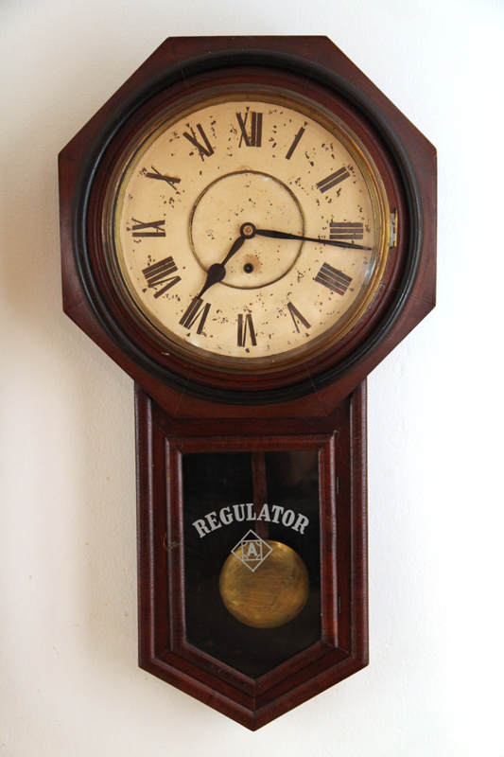

Slide 11
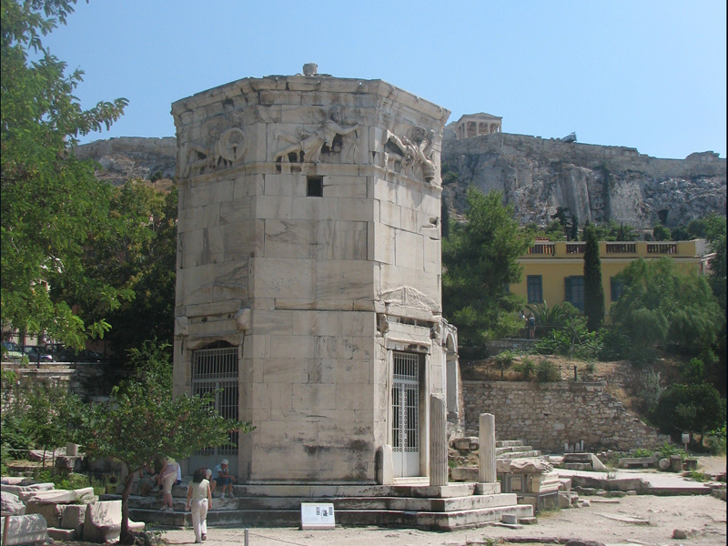
Notes:
Tower of the Winds, an ancient water clock in Athens just below the Acropolis.

Slide 12
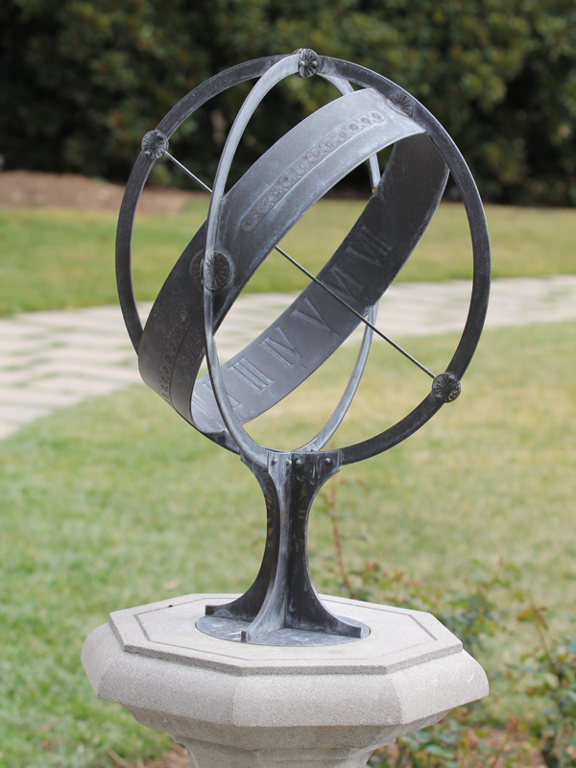
Notes:
Sundial at Huntington Gardens

Slide 13
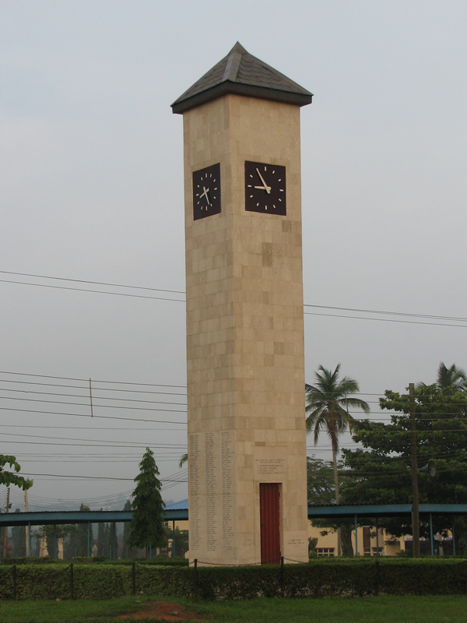
Notes:
Clock tower at Babcock University, Nigeria

Slide 14

Notes:
Clock tower at Babcock University, Nigeria
Note different times.

Slide 15
¹⁴C in Coal
¹⁴C is generally recognized to be incapable of measuring ages beyond about 100,000 years
This is because ¹⁴C breaks down to ¹⁴N so fast that none should be present to measure after 100,000 years
So, if ¹⁴C is measured in a coal sample, it has either had ¹⁴C put into it, or it is less than 100,000 years old
¹⁴C found in coal, other organic remains and even diamonds is commonly dismissed as contamination
Notes:
Half-life of 14C is about 5,730 years.

Slide 16
Conclusion:
Different “clocks” give different ages for life
The radiometric clock sometimes indicates that life is thousands of years old, sometimes millions of years old
People generally choose to believe the “clocks” that agree with their presuppositions

Slide 17
2-Fossil-associated Biological Molecules
Observation (Data):
The following molecules have been found associated with fossils:
  Proteins
  Polysaccharides
  Nucleic acids
  Unsaturated fats
Notes:
About 900 peer reviewed papers talking about this.

Slide 18
Protein Synthesis
Glycine
Glycine
H
O
H
O
H
N
C
OH
H
N
C
OH
C
C
H
O
AMINE
ACID
H
H
H
H
H
N
C
OH
C
ANYTHING
R
H
H₂O
H
H
O
O
Amino Acid
H
N
C
N
C
OH
C
C
H
H
H
H
diglycine

Slide 19
Making Proteins
H₂O
H₂O
H₂O
L
I
F
E

Slide 20
Unmaking Proteins
H₂O
H₂O
H₂O
L
I
F
E

Slide 21
Other Biological Polymers
Major biological molecules other than proteins are also made by condensation reactions:
  Polysaccharides (Starch and cellulose)
  Nucleic acids (DNA and RNA)
  Triglycerides (fats and oils)
All spontaneously break down in the presence of water

Slide 22
Proteins and other biological polymers are not stable
Water breaks them
They oxidize
Other chemical reactions degrade them
They can be physically broken
radiation can break them

Slide 23
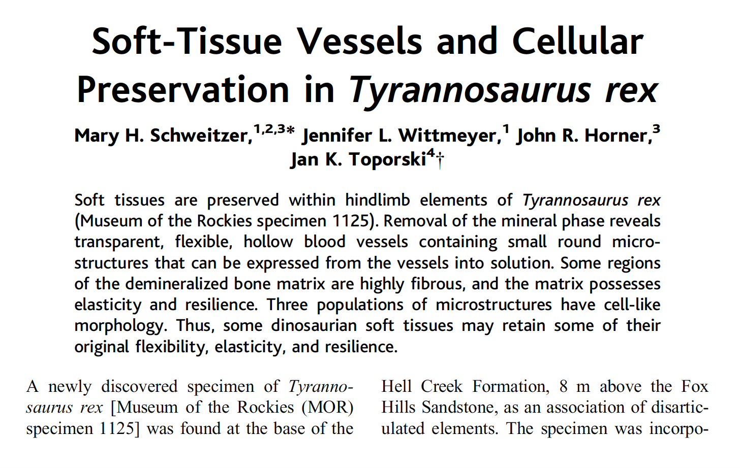
Schweitzer MH, Wittmeyer JL, Horner JR, Toporski JK. 2012. Soft-Tissue Vessels and Cellular Preservation in Tyrannosaurus rex. Science 307:1952-1955.
Notes:
Remind about Suzie talking about collagen “rebar” in bones.

Slide 25
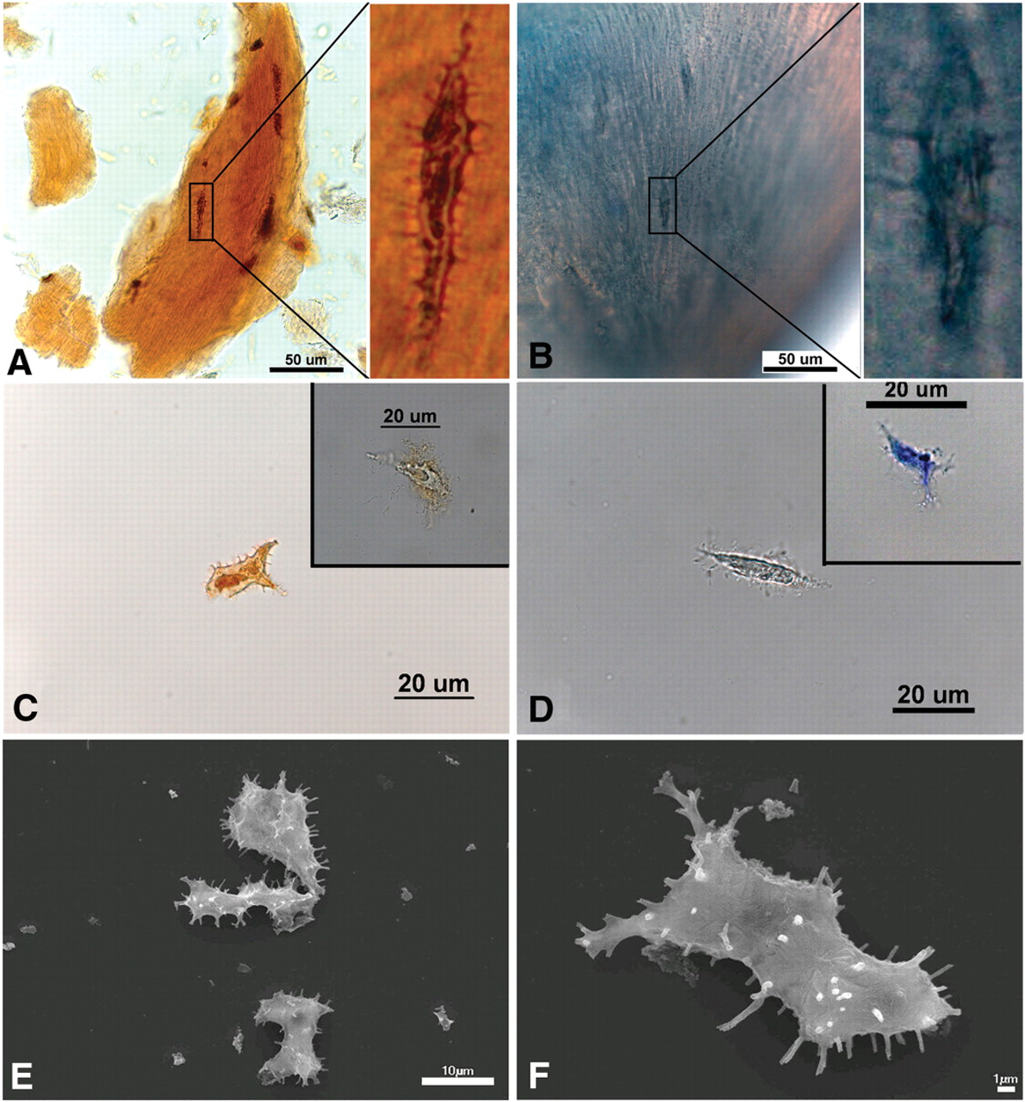
Notes:
Image from: Schweitzer MH, Suo Z, Avci R, Asara JM, Allen MA, Teran Arce F, Horner JR. 2007. Analyses of soft tissue from Tyrannosaurus rex suggest the presence of protein. Science 316: 277-280.

Slide 26
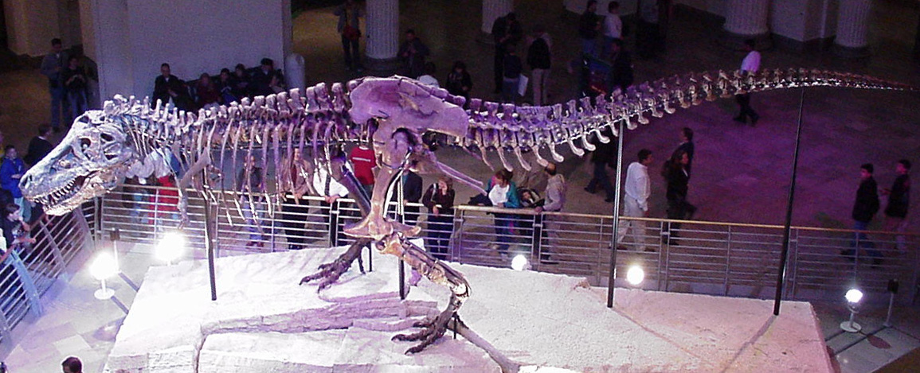
The T. Rex Skeleton

Slide 27
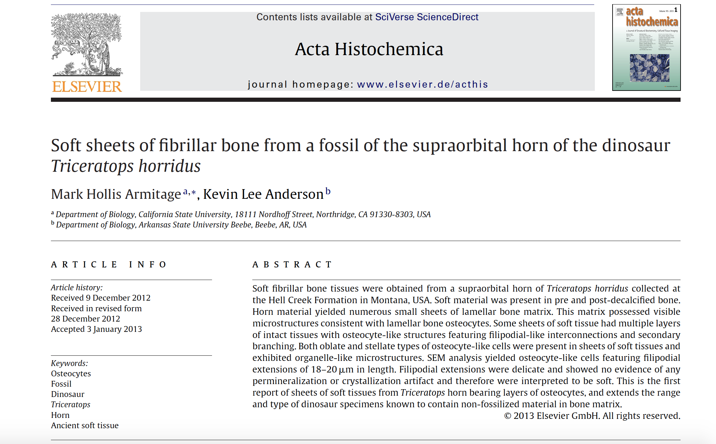

Slide 28
Conclusion:
All biological polymers are subject to degradation over time under any reasonably conceivable conditions
Rates of degradation have been measured
Explanations other than thousands rather than millions of years, are appeals to miracles, not to science as it is currently understood

Slide 29
3-Mutations
Mutations are changes in an organism’s DNA sequence:
  Mutations are considered to be random and undirected (except when they are not - Fitzgerald and Rosenberg 2019)
  Most undirected mutations have a negative impact on fitness
  The most common are “near neutral” mutations, which have a very small negative impact on fitness
  Undirected mutations that have a positive impact on fitness are rare
Notes:
Fitzgerald DM, Rosenberg SM (2019) What is mutation? A chapter in the series: How microbes “jeopardize” the modern synthesis. PLoS Genet 15(4): e1007995. https://doi.org/10.1371/ journal.pgen.1007995

Slide 31
0.1 mutations per individual per generation

Slide 32
0.5 mutations per individual per generation

Slide 33
1.0 mutations per individual per generation
Note that in reality there will be some that survive, while others get 2 or 3 mutations.
Notes:
Note that in reality there will be some that survive and some that get 2 or 3 mutations.

Slide 34
Human Mutation Rate
Estimates vary, but the consensus is that humans experience more than 100 mutations per individual per generation
This means that few if any children would survive if all negative mutations were selected out in each generation
But most mutations are near neutral, with just a small negative impact on fitness
Because they are not subject to selection, near neutral mutations accumulate

Slide 35
Error Catastrophe
Because the measured human mutation rate is so high that all negative mutations cannot be eliminated by natural selection, humans are in “error catastrophe”
The human genome is degenerating, but because much degeneration is Near neutral mutations and the genome was so robust in the first place, we survive to the present
However, there is a limit to how long near neutral mutations can accumulate before fitness declines beyond the point that we can survive

Slide 36
Conclusion:
The high measured mutation rate in humans indicates that our genome is most likely degrading, and thus makes the contention that humans have existed for more than a few thousand years improbable
The same could be said for other organisms

Slide 37
4-Observed hybridization
There are a number of well-documented examples of speciation via hybridization
A good example is the London Plain Tree Platanus acerifolia
Notes:
Another great example is the recently discovered hybridization between American paddlefish and Russian sturgeon, supposedly separated by 180 million years: https://crev.info/2020/07/impossible-hybrid-fish/

Slide 38
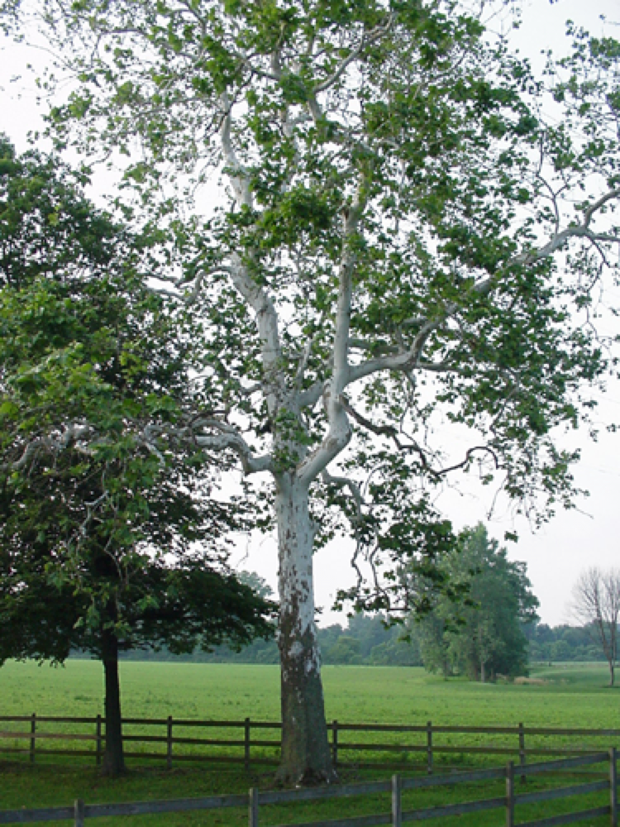
American Planetree or Sycamore
Platanus occidentalis

Slide 39
Oriental Planetree
Platanus orientalis

Slide 40




Oxford Botanical Gardens
c1670
Platanus acerifolia
North America
Europe
>5,000 km
Platanus occidentalis
50,000,000 Years
Platanus orientalis
Atlantic
Africa

Slide 43
Conclusion:
If these two species really have been separated by 50 million years of time, it seems remarkable that they can still interbreed, let alone produce offspring more tolerant of environmental challenges than either parent species
It seems more reasonable to conclude that they were not separated for eons of time

Slide 44
5-Interchangeable Parts
Sometimes, parts from the molecular machines in one organism can be interchanged with parts from other organisms
This seems reasonable within similar species, but remarkable when it occurs between very different species that are supposed to be separated by extraordinarily long time periods

Slide 45
Signal Recognition Particle
Proteins
SRP54
RNA

Slide 46
Interchangeable Parts
Human SRP proteins form functional SRPs when combined with the RNA component of Xenopus laevis (frogs) or Drosophila (flies)
Replacing one major component of Canis familiaris (dog) SRPs with the single large protein from Escherichia coli SRP, makes a SRP functional in all respects except for binding to the endoplasmic reticulum receptor
The corresponding dog SRP protein can bind to the RNA portion of E. coli SRP
  These proteins share only 38 % amino acid identity, yet their three-dimensional structures contain similar structural elements
  dramatic differences exist between dog and E. coli SRP RNA
Notes:
Walter P, Blobel G. 1983. Disassembly and reconstitution of signal recognition particle. Cell 34:525-533.
Bernstein HD, Zopf D, Freymann DM, Walter P. 1993. Functional substitution of the signal recognition particle 54-kDa subunit by its Escherichia coli homolog. Proceedings of the National Academy of Sciences USA. 90:5229-5233.
Romisch K, Webb J, Lingelbach K, Gausepohl H, Dobberstein B. The 54-kD protein of signal recognition particle contains a methionine-rich RNA binding domain. Journal of Cell Biology 111:1793-1802. And Zopf D, Bernstein HD, Johnson AE, Walter P. 1990. The methionine-rich domain of the 54 kd protein subunit of the signal recognition particle contains an RNA binding site and can be crosslinked to a signal sequence. EMBO Journal 9(13):4511-4517.
Bernstein HD, Poritz MA, Strub K, Hoben PJ, Brenner S, Walter P. Model for signal sequence recognition from amino-acid sequence of 54K subunit of signal recognition particle. Nature 340:482-486.
Larson N, Zwieb C. 1991. SRP-RNA sequence alignment and secondary structure. Nucleic Acids Research 19(2):209-215. And Zwieb C. 2002. Personal communication.

Slide 47
Conclusion:
Humans’, frogs’ and flies’ interchangeable parts are better explained by common design over a short time than common ancestry and hundreds of millions of years of evolution
This is even more true of dogs and bacteria which are supposed to be separated by over a billion years

Slide 48
mtDNA – All life converges on a relatively recent date
Mitochondria are usually inherited from mothers to their children and they contain a small circular segment of dna
This mtDNA indicates that about 90 % of organisms cluster into groups that each descended from a single female, estimated to live within the past 200,000 years
Not only is this clustering consistent with a polyphyletic origin of different taxa, The timespan is relatively recent
Notes:
https://evolutionnews.org/2018/12/does-barcoding-dna-reveal-a-single-human-pair/

Slide 49
An alternative explanation
Due to coalescence, over time, any population will probably end up with mtDNA derived from the same female
X
X
X

Slide 51
… For example, researchers have calculated that 'mitochondrial Eve'--the woman whose mtDNA was ancestral to that in all living people--lived 100,000 to 200,000 years ago in Africa. Using the new clock, she would be a mere 6,000 years old.
No one thinks that's the case, but at what point should models switch from one mtDNA time zone to the other? …
Ann Gibbons, 1998
Notes:
Gibbons, A. 1998. Calibrating the mitochondrial clock. Science 279:28-29
DOI: 10.1126/science.279.5347.28
See also: Parsons, T, et al. 1997. A high observed substitution rate in the human mitochondrial DNA control region. Nature Genetics. 15 (4): 363-368.

Slide 52
Summary:
Multiple lines of evidence in living things and their preserved remains point toward thousands rather than millions of years of life on Earth
These include:
  Observed ¹⁴C in the remains of organisms
  Observed fossil-associated biological molecules
  Observed mutation rates
  Observed hybridization
  Interchangeability of parts
  mtDNA

Slide 53
Summary:
Evidence of short time for life requires interpretation, just like evidence of long ages
Evidence of a recent creation requires an equal number, or fewer, assumptions and logical steps to interpret within a short biblical chronology than long Darwinian time periods
Thus the biblical record of thousands of years of life is just as scientific, and possibly more reasonable, than theories postulating millions of years of life

Slide 54
22 OCT
creationsabbath.net

Slide 55
grisda.org
Follow us on Facebook:
Geoscience Research Institute

Slide 56
Then I heard a loud voice in heaven, saying,
“Now the salvation, and the power, and the kingdom of our God and the authority of His Christ have come, for the accuser of our brethren has been thrown down, he who accuses them before our God day and night. And they overcame him because of the blood of the Lamb and because of the word of their testimony, and they did not love their life even when faced with death. For this reason, rejoice, O heavens and you who dwell in them. Woe to the earth and the sea, because the devil has come down to you, having great wrath, knowing that he has only a short time.”
Revelation 12:10-12 NASB

Slide 57
The END

Slide 58
You are free to use this presentation for your own personal study, or for lectures in a classroom setting. Feel free to modify and improve it for classroom use in any way that you see fit. I ask that it not be redistributed in whole or in part for any purpose without my written permission. If you would like to use it for some other purpose, or wish to share it using any media please contact me at:
tstandish@llu.edu
Thank you for respecting my wishes with this.

Slide 59
Abstract:
How old is life? Hundreds of millions or billions of years old? Immense ages are most commonly claimed based on inferences from geological data, but how old do living things themselves appear to be when we examine them? We will look at multiple lines of evidence that point to surprising conclusions for those who believe life is immensely old, but unsurprising to those who believe the biblical record of history.

Slide 60
When is
Creation Sabbath?
22 October 2022
creationsabbath.net

Slide 61
Is 6 Days Too Long?
In the context of some aspects of molecular biology and ecology, 6 days seems long
If God didn’t interact with matter, time doesn’t solve the real problems; In fact, it may well be a problem
Humility - There is plenty that we don’t know, the Bible presents a scenario more reasonable than the alternatives, so I’m going with the record of history it documents

Slide 62
For this corruptible must put on incorruption, and this mortal must put on immortality.
1 Corinthians 15:53 NKJV

