Slide 1
Origins & End Time Prophecy
2 PET. 3: 3-4
Notes:
Ellen G. White and Earth Science by Gerhard Pfandl
in Journal of the Adventist Theological Society, 14/1 (Spring 2003): 176–194.
Article copyright © 2003 by Gerhard Pfandl. Retrieved April 6, 2014 from http://www.atsjats.org/publication_file.php?pub_id=44

Slide 2
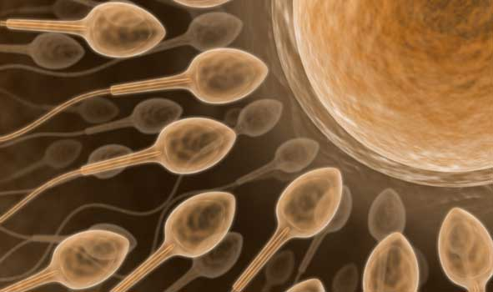
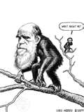
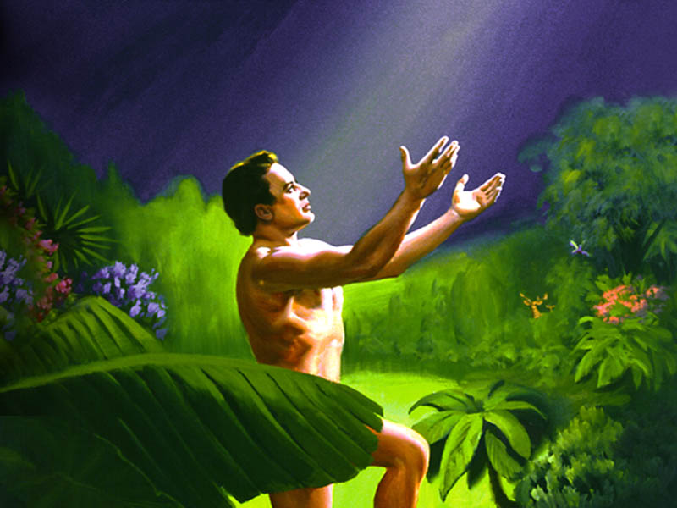
Evolved From Chimpanzee?
Created By God?
Or

Slide 3
Notes:
A POISONOUS EDUCATIONAL WORLDVIEW

Slide 4
“Dear friends, this is now my second letter to you. I have written both of them as reminders to stimulate you to wholesome thinking. I want you to recall the words spoken in the past by the holy prophets and the command given by our Lord and Savior through your apostles. Above all, you must understand that in the last days scoffers will come, scoffing and following their own evil desires.

Slide 5
They will say, “Where is this ‘coming’ he promised? Ever since our ancestors died, everything goes on as it has since the beginning of creation.” 5 But they deliberately forget that long ago by God’s word the heavens came into being and the earth was formed out of water and by water. By these waters also the world of that time was deluged and destroyed. By the same word the present heavens and earth are reserved for fire, being kept for the day of judgment and destruction of the ungodly.”

Slide 6
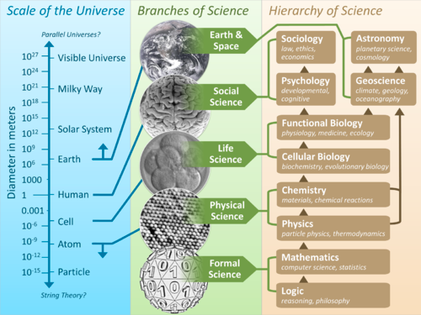
Knowledge has increased in both the Written Word & Book of Nature

Slide 8
12th C Renaissance (Revitalization of Western Europe)
Thomas Aquinas (1227-1274): Eternal, Divine, Natural, & Human Laws
Erasmus Darwin (1794-1796--Zoonmia)
Jean Baptiste de Lamarck (1809—Philosophie Zoologique)
Charles Lyell (Uniformitarianism)
Notes:
Aquinas Laws: http://home.wlu.edu/~mahonj/PhilLawLecture1NatLaw.htm

Slide 9
Theological & Scientific Reformation
Waldenses (from 12th C in France)
Anabaptists(1525) Ulrich Zwingli in Swiss (1519)
Luther in Germany (1521)
John Calvin in France (1541)
Blaise Pascal (1623-1662) - Mathematician
Robert Boyle (1627-1691) - Chemist
Sir Isaac Newton (1642-1727)-Physicist
Carolus Linnaeus (1707-1778) - Biologist
Michael Faraday (1791-1867) - physicist
Adam Sedgwick (1785-1873) - geologist
First Great Awakening (1730-1743)
Solomon Stoddad
George Whitefield
James Davenport
Jonathan Edward
Gilbert Tennent
Second Great Awakening (1790-1840)
Millerites
Advent Movement
Explosion of Evolution Postulate
s
Intelligent Design Postulates
s

Slide 10
Theological & Scientific Reformation
Apostolic Church
Catholic Church
Waldenses
Geocentric Cosmology
Dark Ages
Reformation
Renaissance/Naturalism
Inquisition
Heliocentric Cosmology
Great Awakening
Emerging Church
Great Scientific Advancement/ Catastrophism
Darwinism/
Uniformitarianism
Neo-Darwinism

Slide 11
Key Notions of Disregard of
the Supernatural in the Bible:
Noah’s time:
Genesis 6-7;
Hebrews 11: 7;
2 Peter 2: 5-7
Jesus’ reference to Noah’s time:
Luke 17: 26-27
Scoffers of the last days:
2 Peter 3: 3, 4

Slide 12
Events Surrounding “1844”
Charles Lyell:
Uniformitarianism
Frederick Engels & Karl Marx meet in Paris:
Marxism:
Way to real happiness was socialism & communism
1844
Charles Darwin:
Darwinism
1836: The HMS Beagle
1842: Abstract of the Theory (35pp)
1844: Expansion of draft to 230pp
1859: Origins of Species published
John Nelson Darby:
Dispensationalism
1843-1845: Secret Rapture
Tim LaHaye & Jenkins:
Left Behind==Second Chance
Notes:
1844: Coincidence or providence? By Ron du Preez==http://dialogue.adventist.org/articles/18_3_dupreez_e.htm

Slide 13
Biblical Theology Attempting to affirm the authority and authenticity of the Word of God and to Herald the Everlasting Gospel centered on God’s creative, redemptive, and restoring acts in the universe
Bible-Believing Science Attempting to Affirm Bible truth through scientific discovery:
Adventist Education is at the crossroad to affirm the truth, redeem & restore the willing,
Evolutionary Theology Attempting to harmonize the Bible with macro-evolutionary science
Naturalistic science Attempting to eradicate supernatural origin of and intervention in nature by Re-enforcing the war against the existence of God

Slide 14
Implications for Seventh-day Adventist today
Church’s identity:
Christianity; Christ is Creator, Redeemer, and Restorer (John 1: 1-2; John 3: 16; John 1: 12; cf. GC., chap 15 “The Bible and the French Revolution”
Church’s prophetic mission:
The Three Angels’ Message is centered on Origins
Church’s Day-of-Atonement Attitude:
Repentance
Self-denial
Prayer
Watching and Waiting
Revival
Celebration & Witnessing

Slide 15
CHURCH’S READINESS OF WITNESSING :
Sheep Among Wolves—see the Waldenses’ experiences (GC, chap. 4), Matthew 10: 16
End-time Christian Apologetics (see Acts 17; Modern Revivals in GC, chap. 27; Engaging Unbelief by Curtis Chung)

Slide 16
CHURCH’S EVANGELISTIC APPROACH:
Many of our witnessing strategies proceed by either condemnation or imposition or threats. Christianity goes by validation, persuasion, and conviction. This means, among other things:
Recognize God’s image in people of other opinions
Interest in other people’s salvation
Getting to know what others stand for
Identify the positive in other people’s way of life
Use others’ virtues/values as entry points in their story
Identify the weakness of their story
Bring out the upper hand of the Bible story
Invite the opponents to stem from their positives and launch into the wider and better story of God.

Slide 17
A BIBLICAL EXAMPLE
Acts 17:
16: troubled by idol worship in Athens
17-20: willingness to share his beliefs with mockers
21: taking advantage of the scholars’ “open forum” of the time
22: Validating the virtues of the opponent: High religiosity
23: Identifying the connecting point: temple of the Unknown God
24-31: Connecting God’s story with opponent’s story
32: Allow the opponent their freedom of choice
33-34: Identify with those who believe

Slide 18
Church’s Philosophy Of Holistic Education:
✔Intellectualism vs. Sensationalism
✔Propositional Knowledge vs. Experiential Knowledge
✔Acculturation vs. Syncretism
➔Our Theology: informing and cautioning our scientific interpretive orientations: the biblical mission for the end-time Christianity must determine what to offer to the believers in formal and informal educational settings such as home, school, and Church.
➔Scientific Principles: informing, cautioning, and affirming our theological and doctrinal emphasis and relevance

Slide 19
The Remnant and Origins:
The Proclamation of the 3-Angels’ Message Hinges on a careful and prayerful study of both the written words and Nature, as both come together to teach us how to “fear of God and give Him glory; because the hour of His judging is come; and give worship to Him who made heaven and earth and the sea and the fountains of water” Rev. 14: 6-7
While the Bible is not a textbook for scientific principles and methodologies, it does point us to the indispensability of studying nature for the sake of knowing the greatness and love of God. Similarly, while science is not the most adequate tool for the exploration of the supernatural, it does open our minds to tasting God’s might and surpassing intelligence, thereby increasing our reverence and dependence on Him.
Therefore, separating the study of nature from the study of Scripture may in no wise be less than idolatry.

Slide 20
The believer’s decision to witness for Jesus results in what we may call the Devil-Isolation or Heaven-Promotion Process!

Slide 21
The Devil looses both the witness & the prospect
God is invited to equip both the witness & the prospect
When the believer decides to witness, he/she is automatically revived!
The world’s spiritual balance tilts toward heaven
The Church is revived through the witness & expanded through the prospect

Slide 22
The believer’s failure to involve in witnessing results in what we may call God- Isolation Process or Hell- Promotion Process.

Slide 23
The Devil is invited to equip both the apostate “believer” & the prospect
God looses both the “believer” & the prospect
When the believer denies Christ by refusing to witness, thereby becoming unbeliever
The world’s spiritual balance tilts toward hell!
The Church is weakened & diminished through the apostate “believer”

Slide 24
Spiritual Growth Ladder
The Holiness-celebration stage
Love
The selfless, others-centeredness stage
Brotherly kindness
The Transformation/Divine-invasion stage
Godliness
The Persecution & endurance stage
Perseverance
Self-control
The Awareness/Self- stage
Knowledge
Goodness
The Acquaintance/Discovery stage
The Followship/Imitation stage
Faith
2 Peter 1: 5-7
The Calling/Initiation stage

Slide 25
“For I am not ashamed of this Good News about Christ. It is the power of God at work, saving everyone who believes”

