Slide 1
ACTION FOR MISSION
WAD WOMEN’S MINISTRIES

Slide 2
OBJECTIVE 3
To make developing resources for mission to non-Christian religions and belief systems a high priority
KPI 3.3.
Global Mission Centers report yearly to Annual Council on approaches to, and progress in, reaching world religions and belief systems

Slide 3
WM ACTION PLAN FOR KPI 3.3
Conduct Muslim Evangelism Seminar to equip women/young ladies for this type of ministry

Slide 4
WM BUILDING BRIDGES SEMINAR IN 2021
WM BUILDING BRIDGES SEMINAR IN 2021 directed by GC Women’s Ministreis and Adventist Muslim Relation

Slide 5
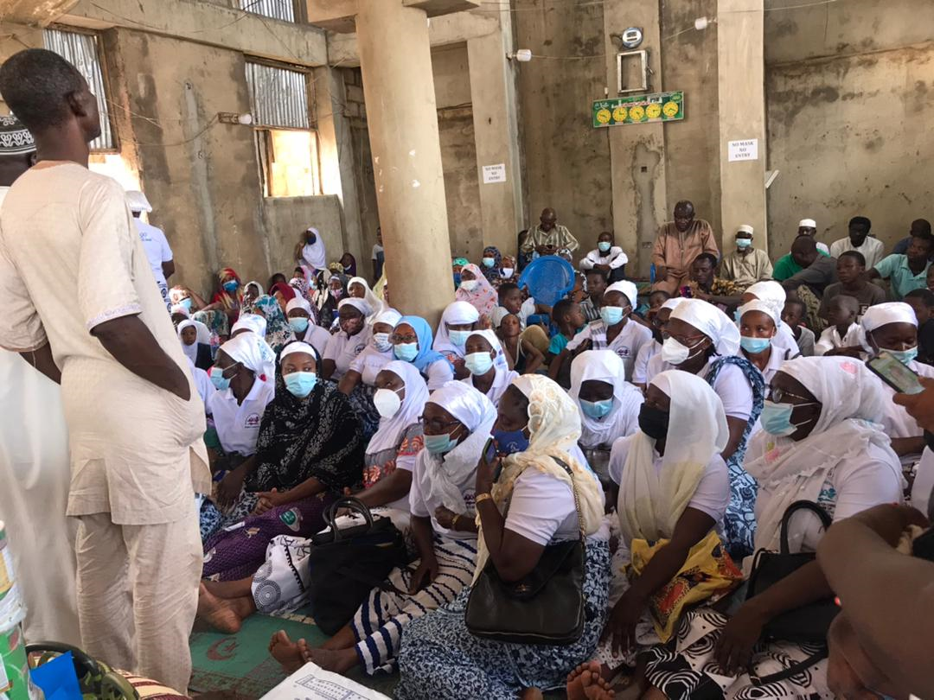
ACTIONS 2021

Slide 6
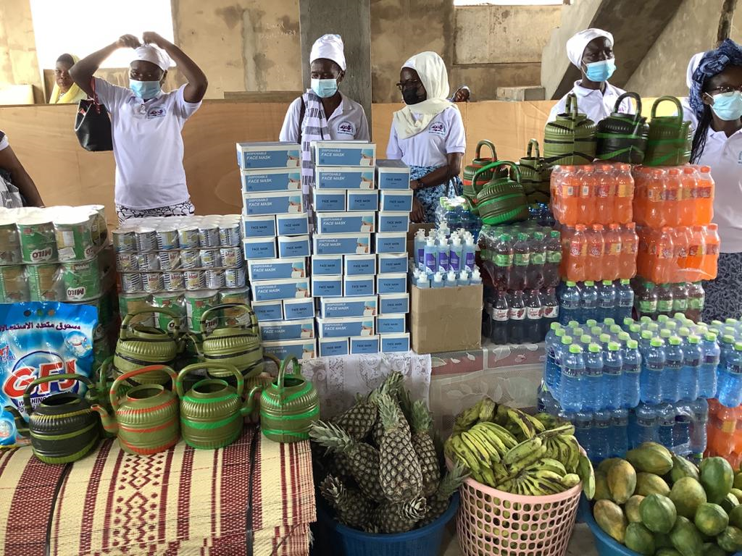

Slide 7
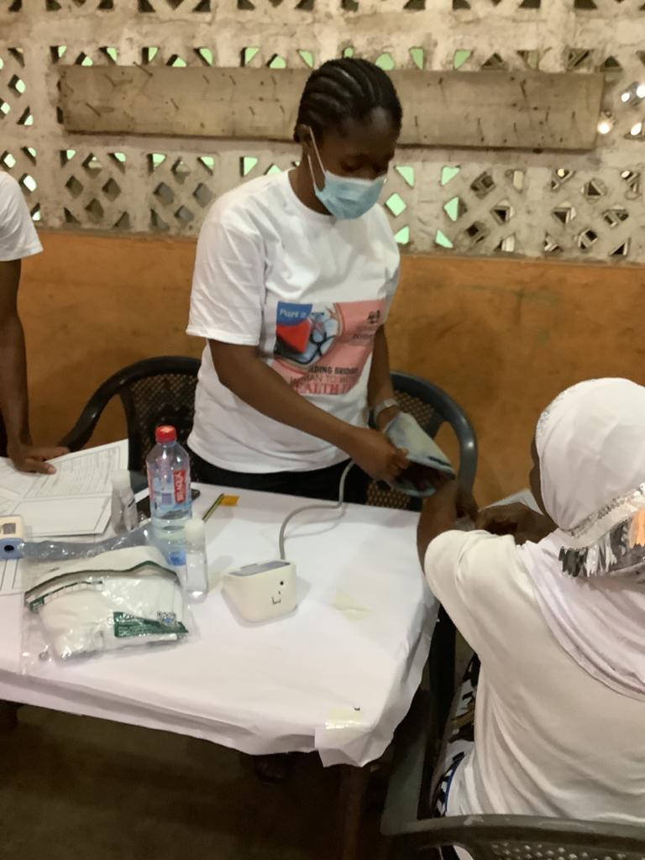

Slide 8
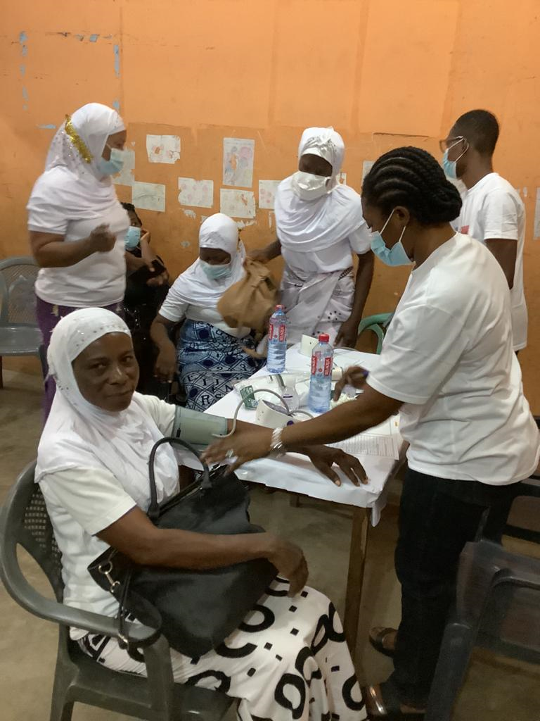

Slide 9
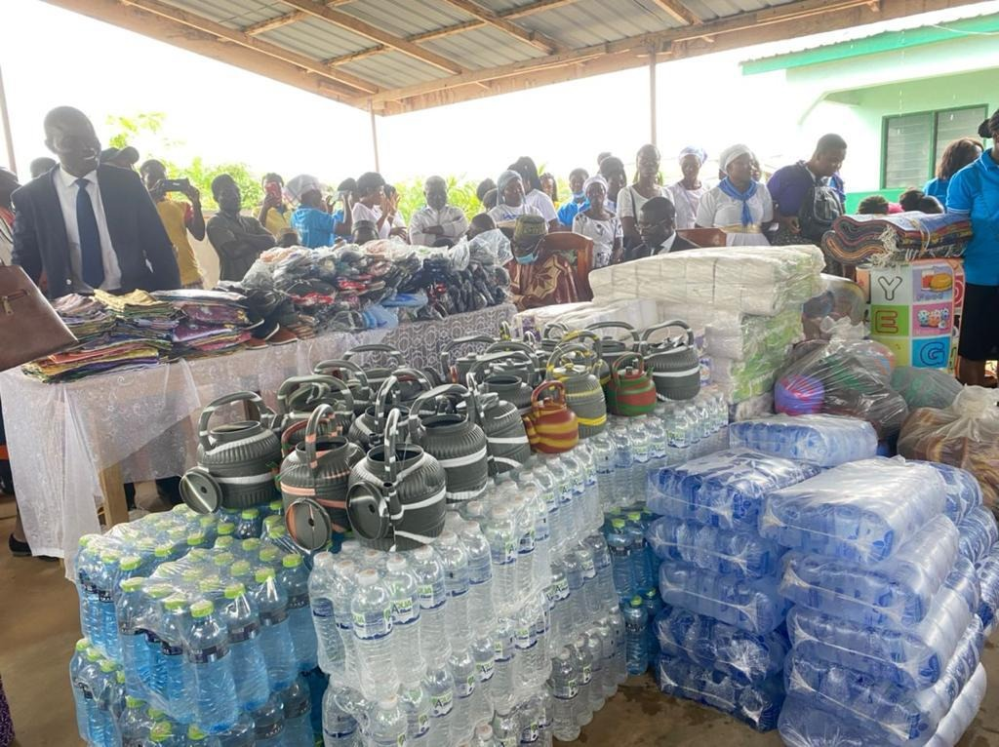
Actions 2022

Slide 10
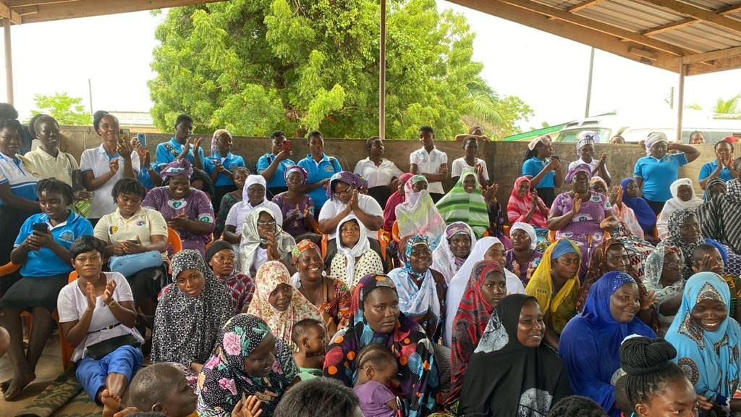

Slide 11
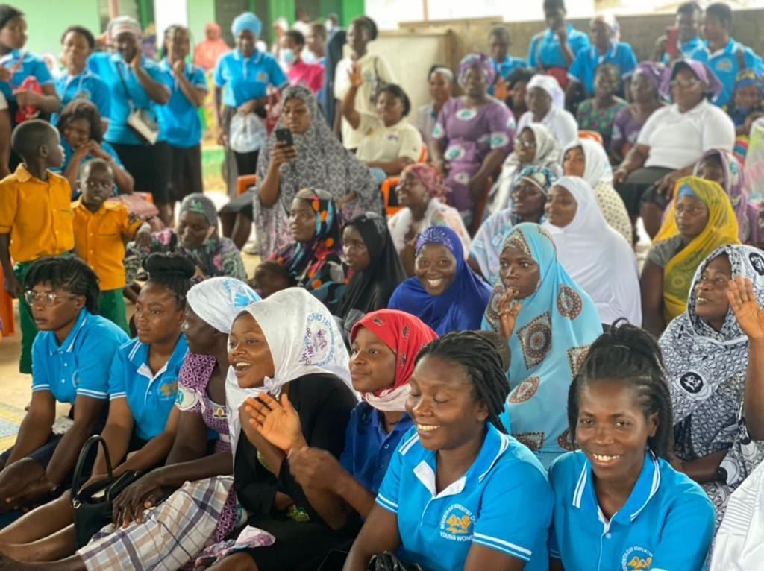

Slide 12
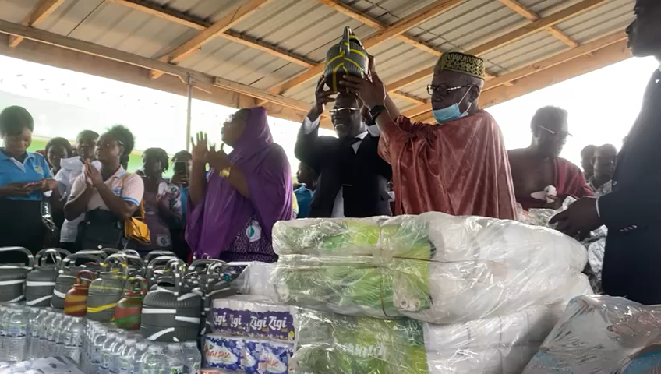

Slide 13
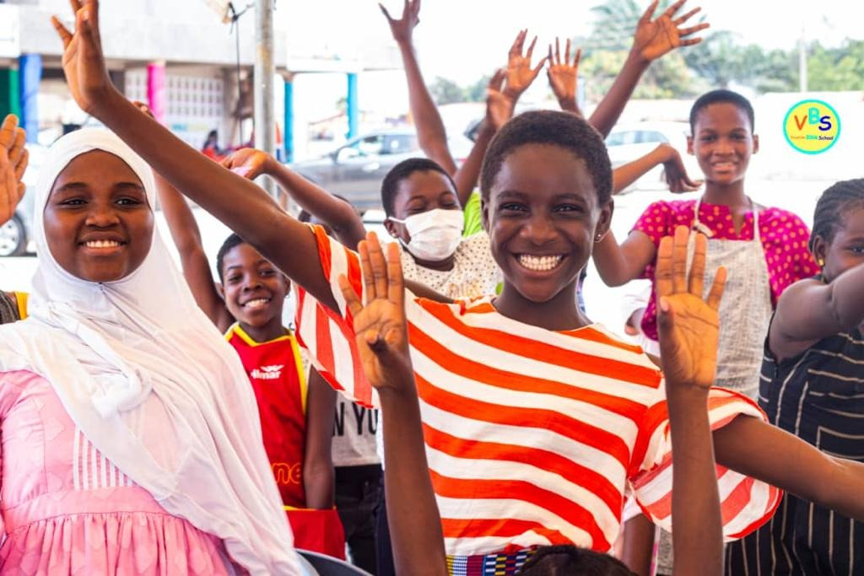

Slide 14
