Slide 1
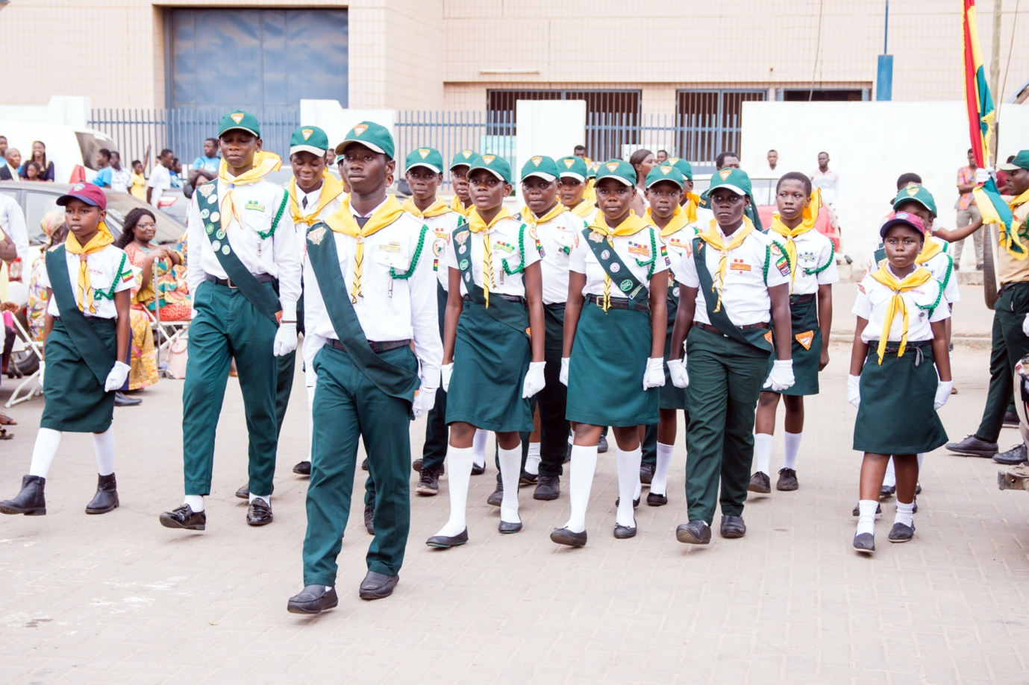
YEAR-END REPORT 2022
Pr. Alfred Kwasi Asiem
Youth Director, WAD

Slide 2
INTRODUCTION
The youth department of West-Central Africa Division is committed to its mission of spreading the everlasting gospel in all the corners of West-Central Africa Division in our generation and this begins with our local churches. The following objectives were achieved to the glory of God based on the KPIs in the WAD Strategic plan.

Slide 3
KPI 1.1
Increased number of church members participating in both personal and public evangelistic outreach initiatives with a goal of Total Member Involvement (TMI).
GLOBAL YOUTH DAY 2022
The youth across the Division participated in this year’s Global Youth Day dubbed “Loving the forgotten. The youth from all the unions participated in sharing foods, clothes, medical aid items, Blood donations, Visits to Orphanage Homes, Community Services Pot-Luck and many other items were given to people in deprived areas.

Slide 4
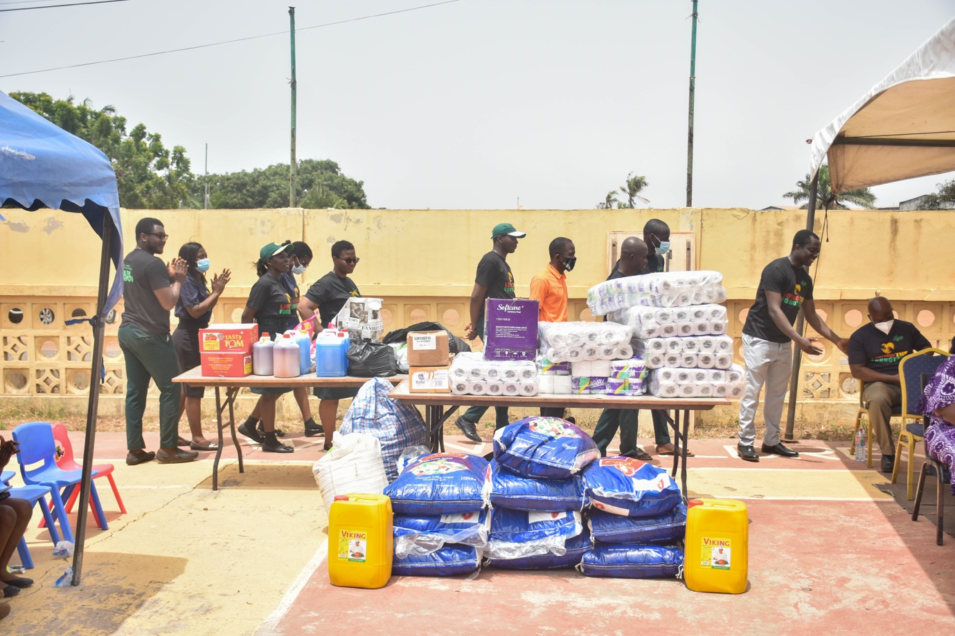

Slide 5
KPI 1.1
Increased number of church members participating in both personal and public evangelistic outreach initiatives with a goal of Total Member Involvement (TMI).
GLOBAL YOUTH DAY 2022
With a special interest, in Southern Ghana Union Conference there was blind man Mr. Kwabena Latter and his six (6) children who lived in a dilapidated house received a new residence which was built by the youth from Mid-South Ghana Conference.

Slide 6
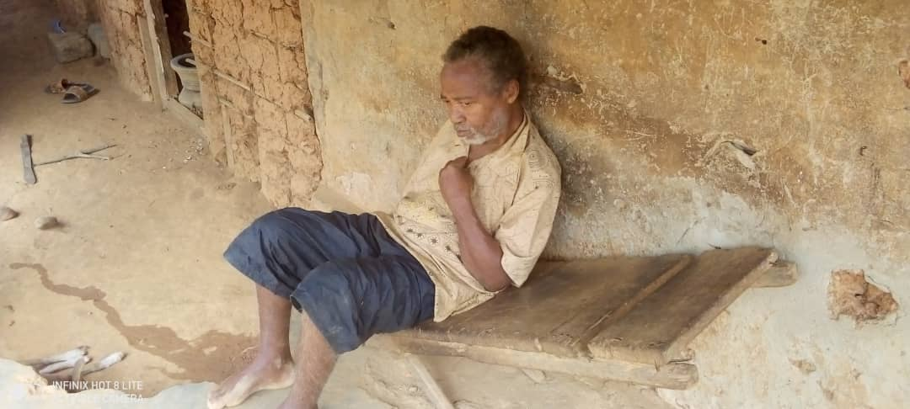

Slide 7
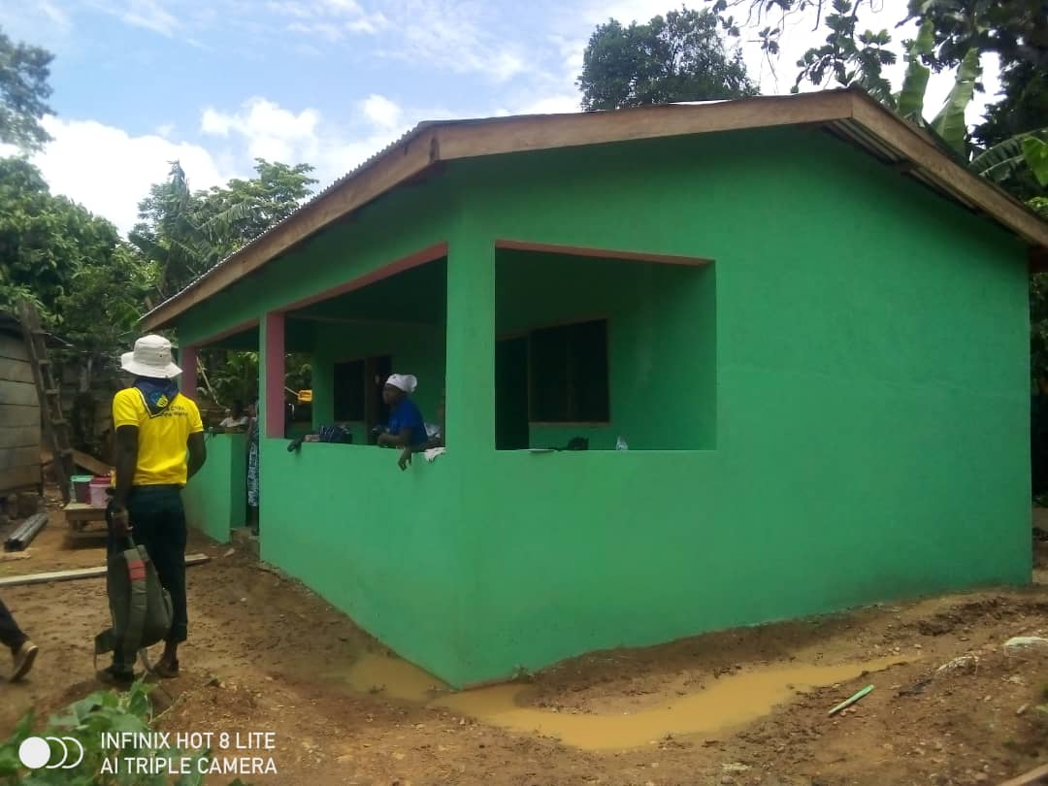

Slide 8
KPI 1.1
Increased number of church members participating in both personal and public evangelistic outreach initiatives with a goal of Total Member Involvement (TMI).
Voice of Youth
Voice of Youth is a General Conference initiative designed to help young people grow closer to Jesus, bond as a team, discover their gifts and effectively share the Three Angels Messages with the world.
In a layman’s language, Voice of Youth (VOY) can be referred to as Christian evangelistic small groups which involves young people that evangelize their communities using their own innovative strategies or methods. WAD Youth mobilized 70 of such teams or small groups. To the glory of God, the activities of these teams yielded, a total baptism of 1,305.

Slide 9
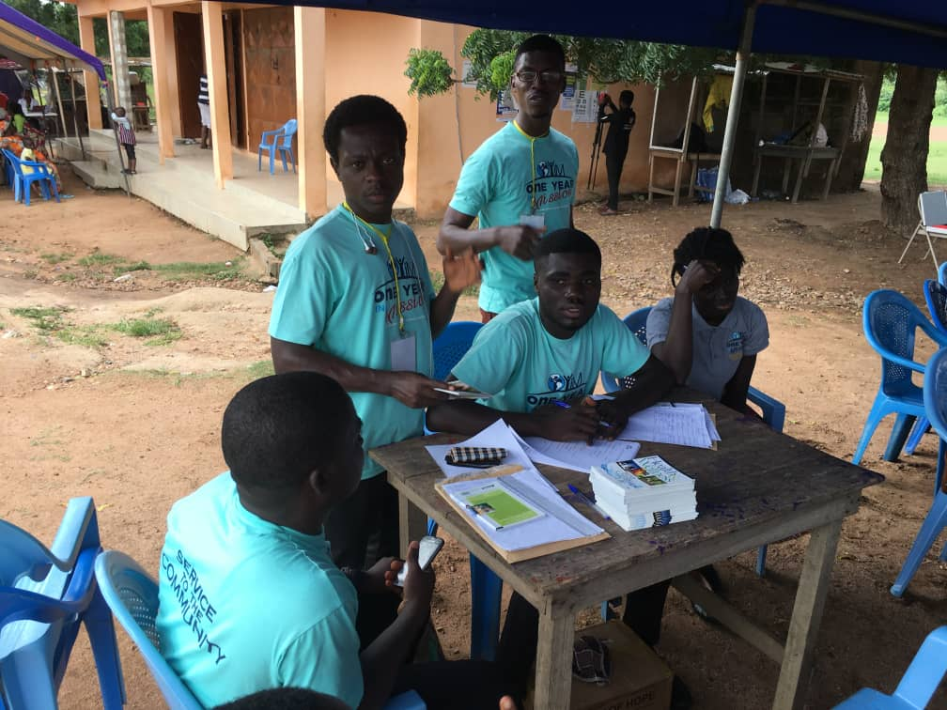
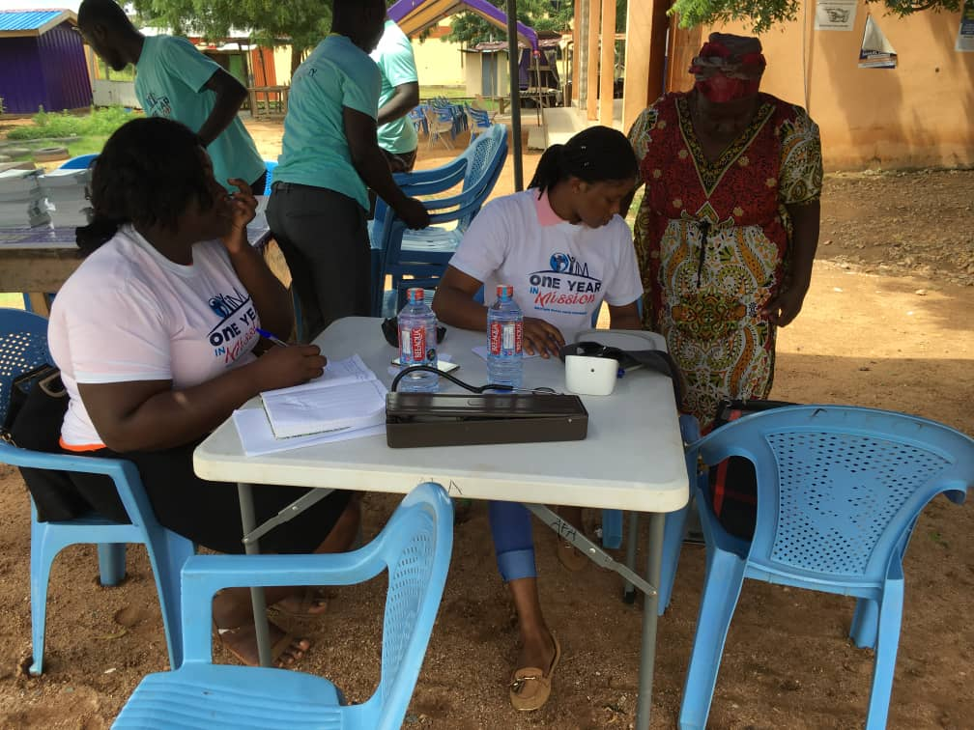

Slide 10
KPI 1.1: Increased number of church members participating in both personal and public evangelistic outreach initiatives with a goal of Total Member Involvement (TMI).
KPI 6:1: Increased church member involvement in fellowship and service, both in the church and in the local community
CLEAN UP EXERCISE
WAD youth and WAD ADRA collaborated with the Abidjan Mission to organized a clean-up exercise as part of the World 72nd Pathfinder Day celebration.
The exercise took place at Adjeme national bus station on September 19, 2022. A total of 251 youth from all the churches in Abidjan participated and 21 dustbins were donated to the bus station.

Slide 11
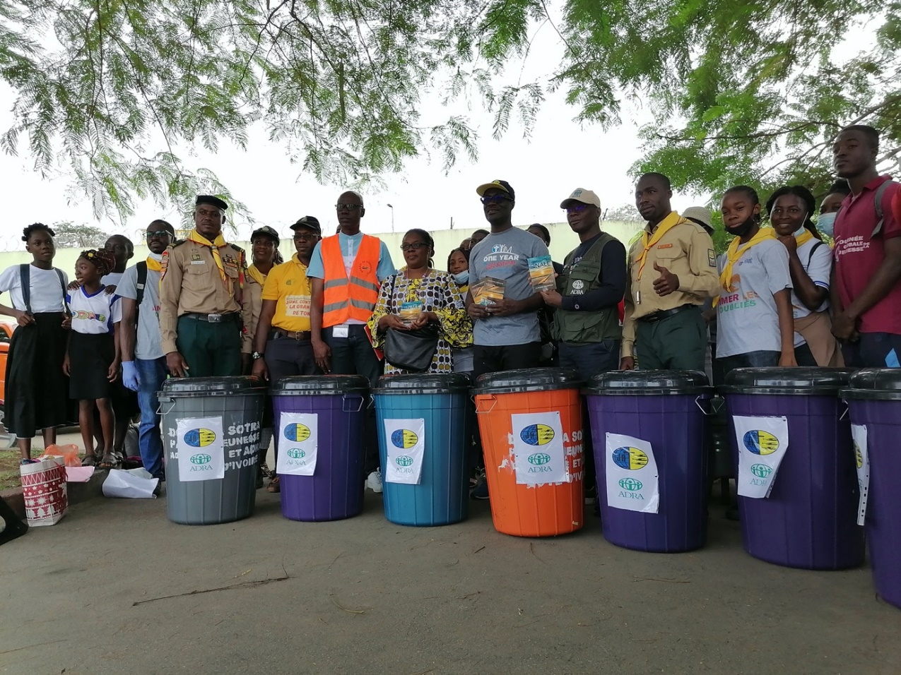
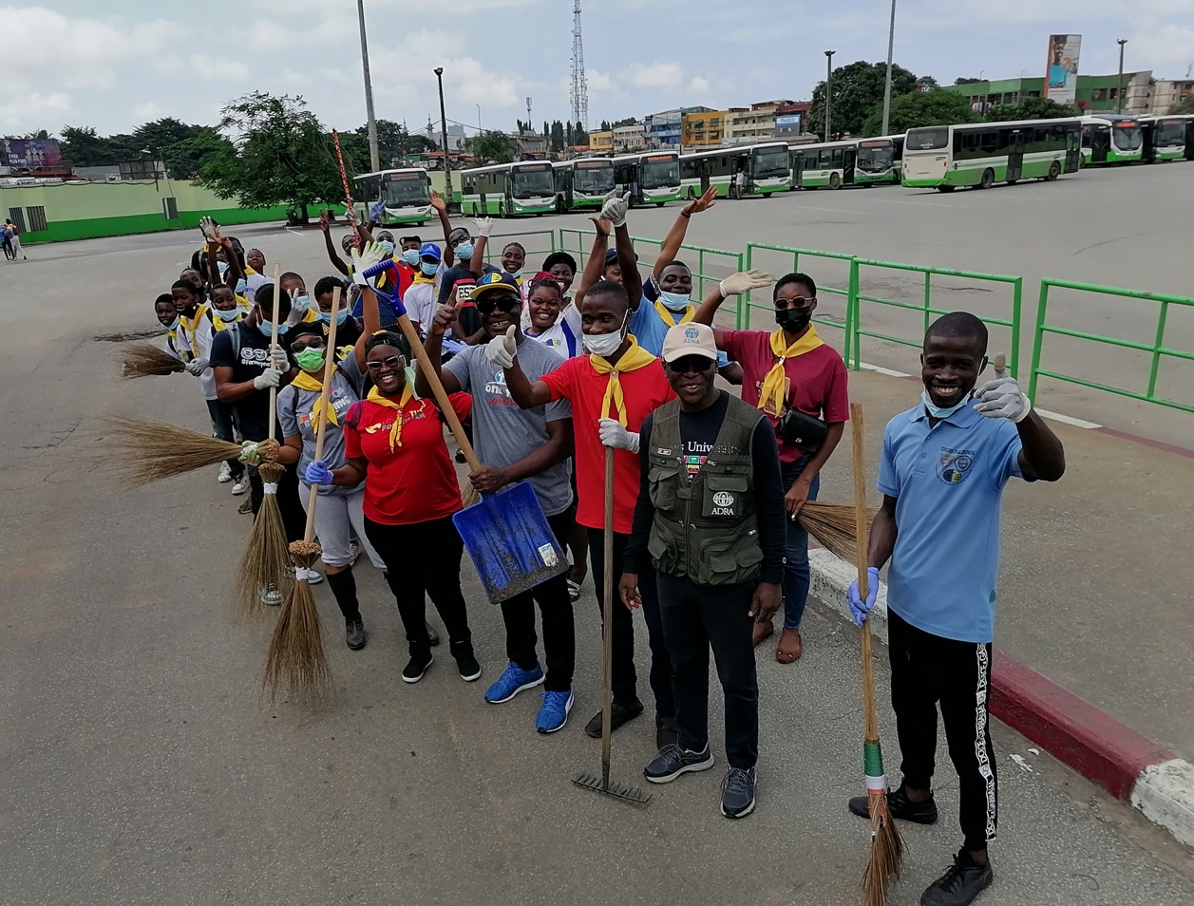
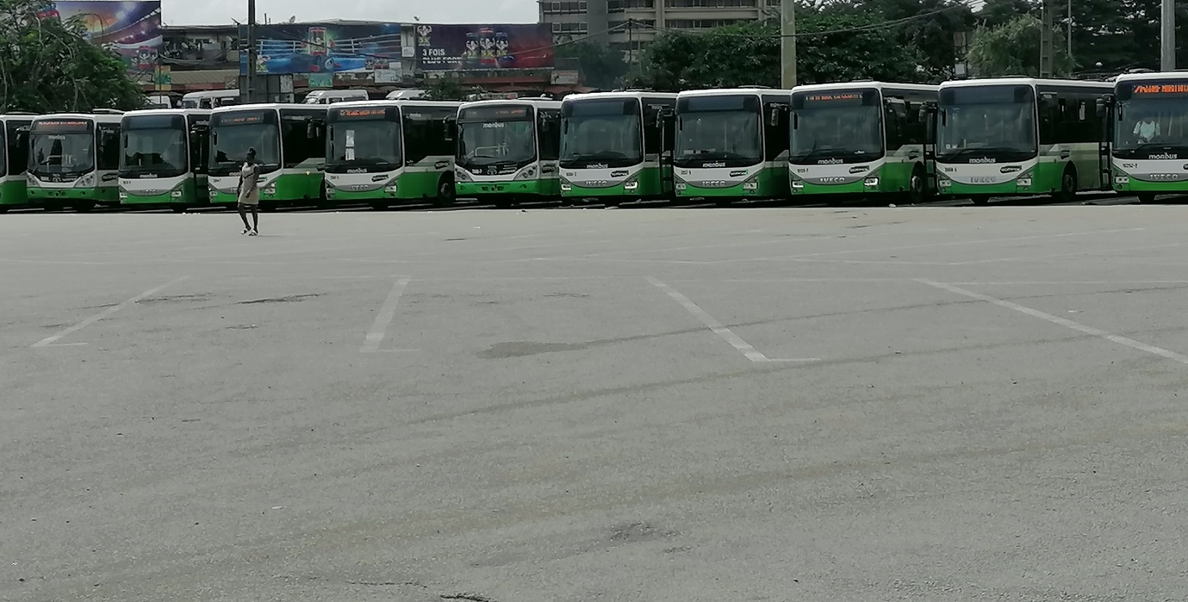

Slide 12
THANK YOU!

Slide 13
KPI 6.1
Increased church member involvement in fellowship and service, both in the church and in the local community
Youth Week of Prayer
Youth Week of Prayer is one of the spiritual activities that involves our young people in fellowship and in service, both in their local churches and in their local communities.
The 2022 Youth Week of Prayer was very well organized in all the Unions within WAD. With the theme: “The Present Truth: God’s Message for Today,” the youth and the entire church were encouraged to get to know the Heavenly Father on an even deeper level and living out a life that is pleasing to God.

Slide 14
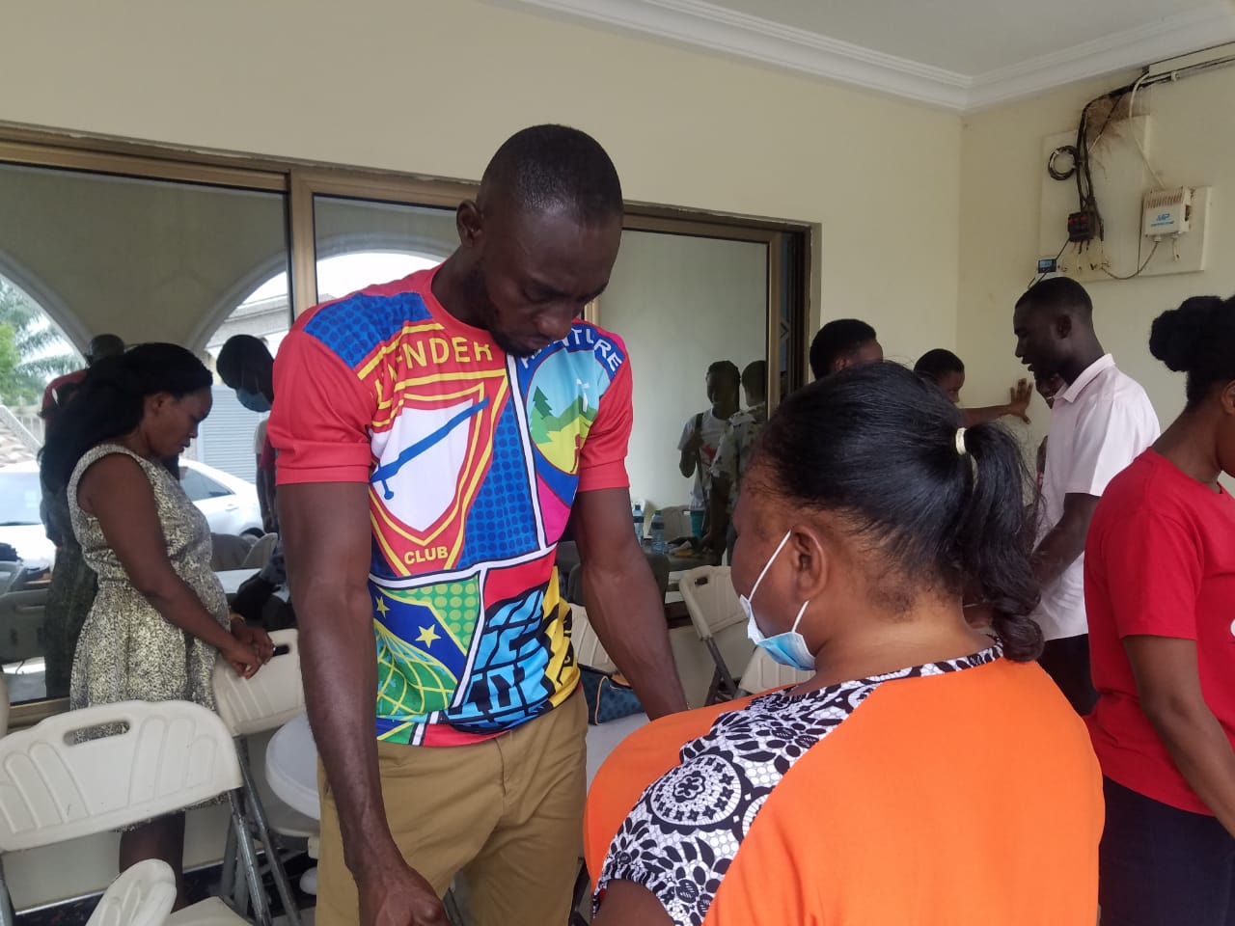

Slide 15
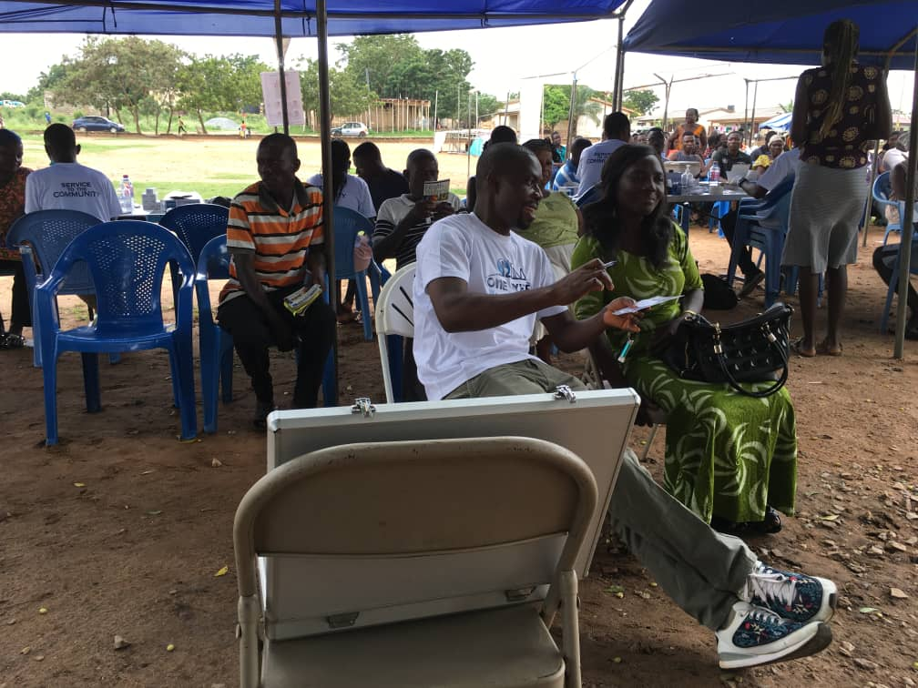
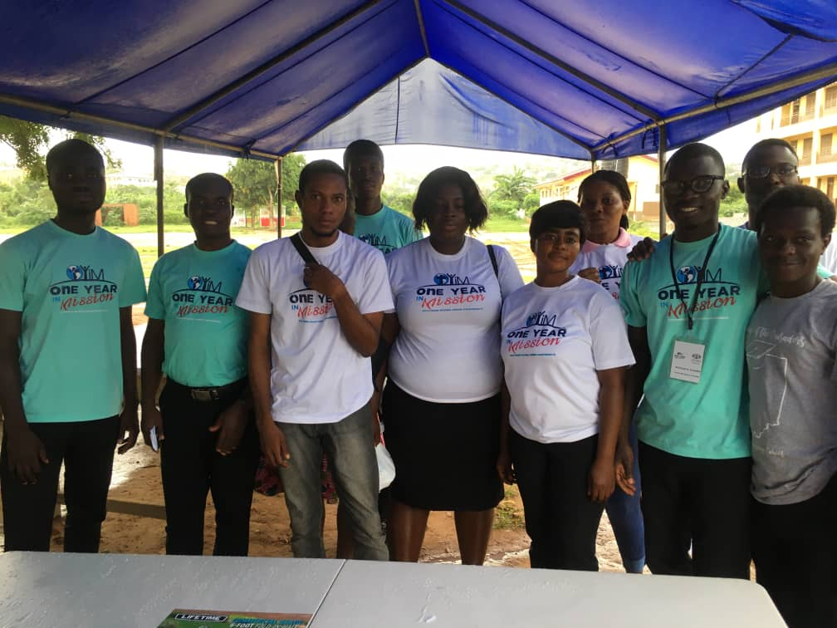

Slide 16
KPI 1.7
Improved retention rates of audited membership
KPI 5.1
Significant increase in numbers of church members regularly praying, studying the Bible, using the Sabbath School Bible Study Guides, reading the writings of Ellen White and engaging in other personal devotions.
Progressive Classes
Progressive Classes is the heart of the Pathfinder and Adventurer Ministries. It is the nurturing program that seeks to work on the spiritual development of our young people.
It is a weekly routine program which should be organize by every church. The period under review saw 25,258 investiture services from all the fields within WAD.

Slide 17
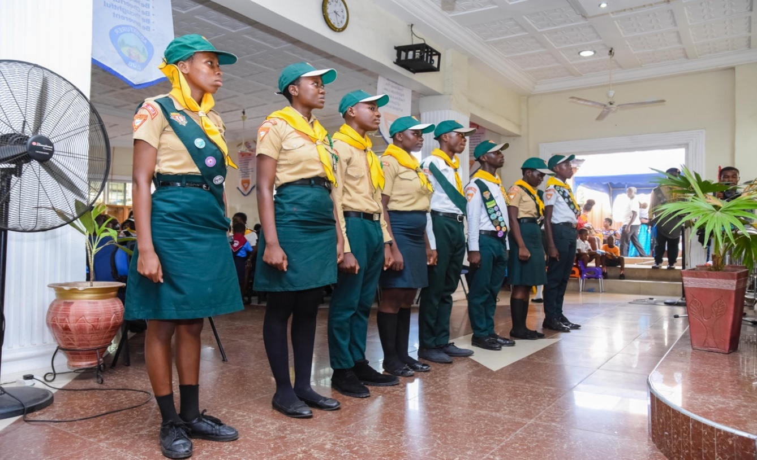
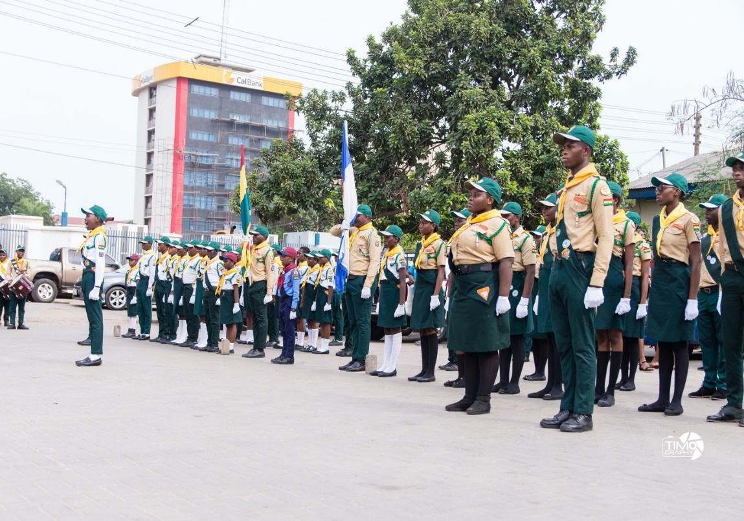


Slide 18
KPI 1.7
Improved retention rates of audited membership
KPI 5.1
Significant increase in numbers of church members regularly praying, studying the Bible, using the Sabbath School Bible Study Guides, reading the writings of Ellen White and engaging in other personal devotions.
Senior Youth Leadership
Senior Youth Leadership training program is designed to prepare youth and young adult leaders to address the alarming depletion of our young people from our church. Several Senior Youth Leadership programs were launch in the Unions during the period under review.
However, some of the Unions which had their Senior Youth Launch before this period had trainings and graduation ceremonies: A total of 326 were graduated during the period.

Slide 19
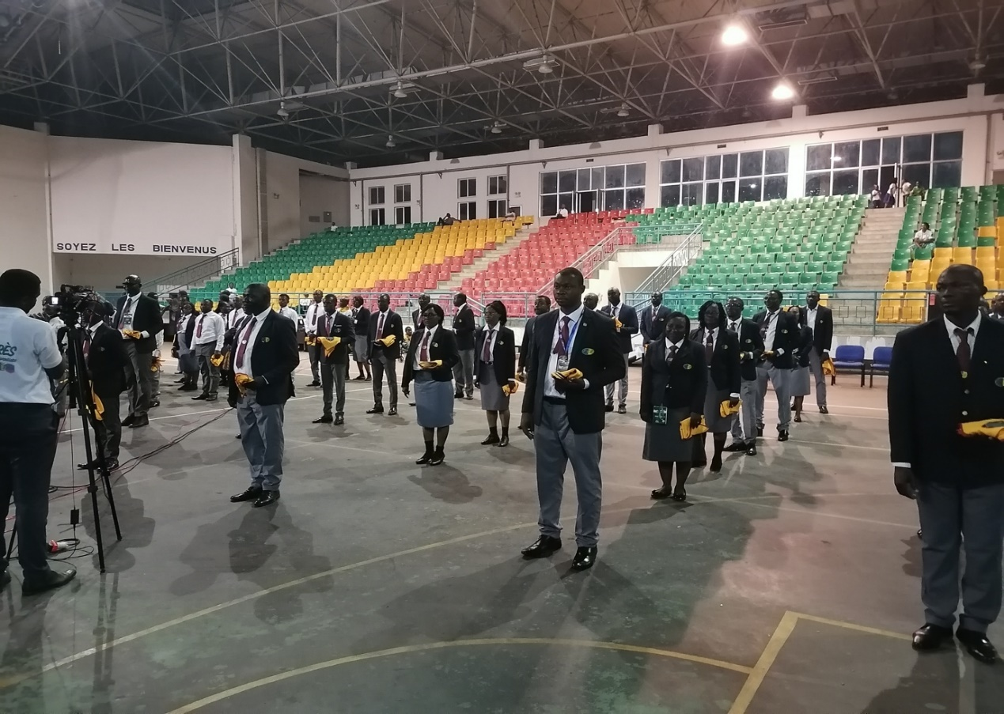
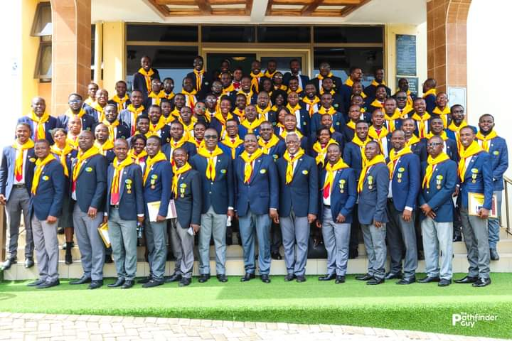
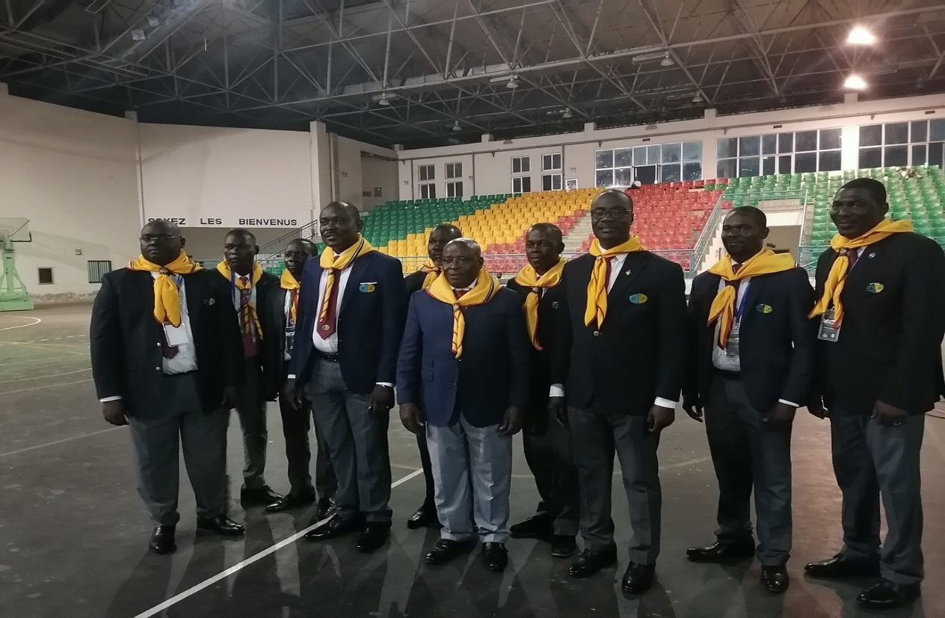

Slide 20
KPI 5.1:
Significant increase in numbers of church members regularly praying, studying the Bible, using the Sabbath School Bible Study Guides, reading the writings of Ellen White and engaging in other personal devotions.
MASTER GUIDE TRAINING FOR SHEPHERDESS
As part of the department strategy to involve church leaders in the activities of the youth, a special Master Guide training and investiture were organized for the Shepherdesses of the West Africa Union on the 27th of August 2022 in Monrovia. A total of 12 Shepherdess were invested

Slide 21
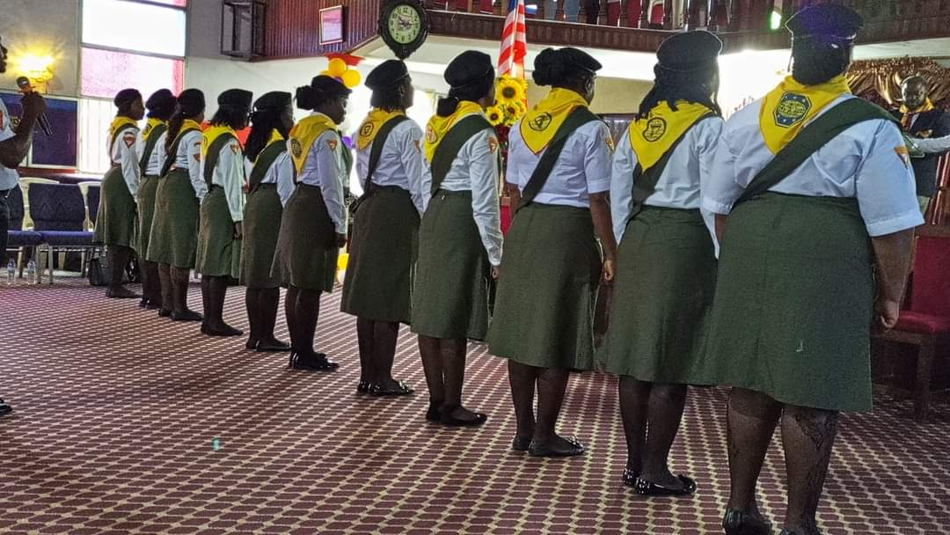
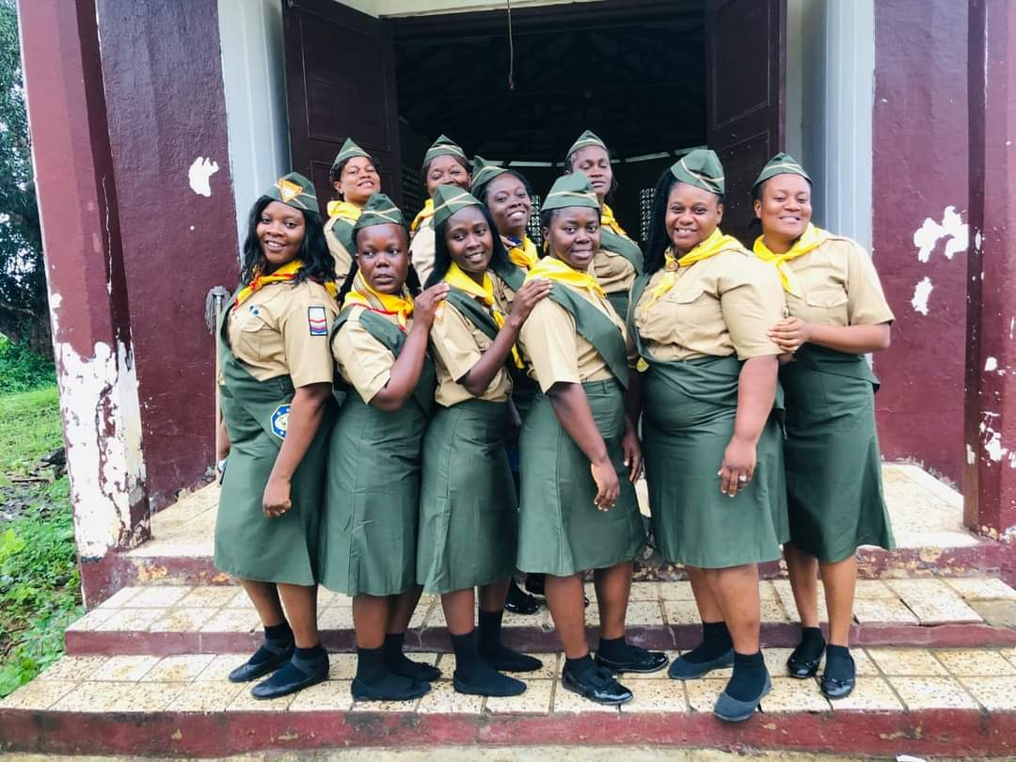

Slide 22
KPI 6:1:
Increased church member involvement in fellowship and service, both in the church and in the local community
WORLD PATHFINDER DAY/WAD YOUTH NECKERCHIEF CHALLENGE
2022 world 72nd Pathfinder Day with the theme: “Change the World” was celebrated throughout the Division. For the purposes of awareness creation and saturation of the environments, WAD youth encouraged the Pathfinders to wear their neckerchiefs to everyday activities to promote the Pathfinder Ministry.

Slide 23
KPI 6:1:
Increased church member involvement in fellowship and service, both in the church and in the local community
WORLD PATHFINDER DAY/WAD YOUTH NECKERCHIEF CHALLENGE
They were also encouraged to share missionary books as their invitation cards to the World Pathfinder Day. The WAD President and the Executive Secretary fully participated in this challenge by recording special video messages encouraging the Pathfinders to “Get involved in the challenge.”

Slide 24
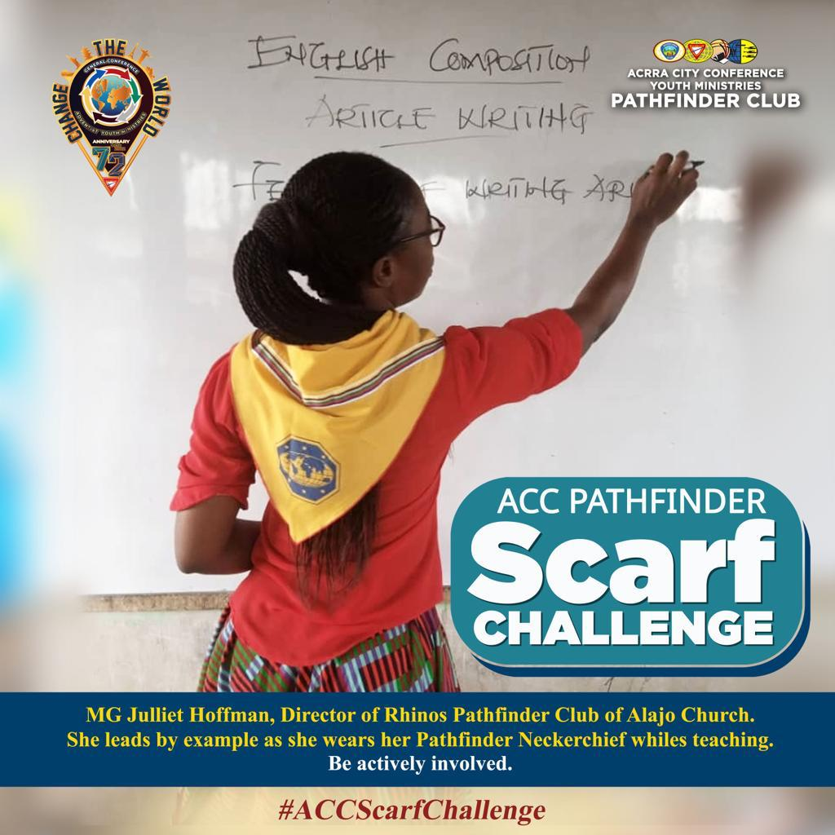
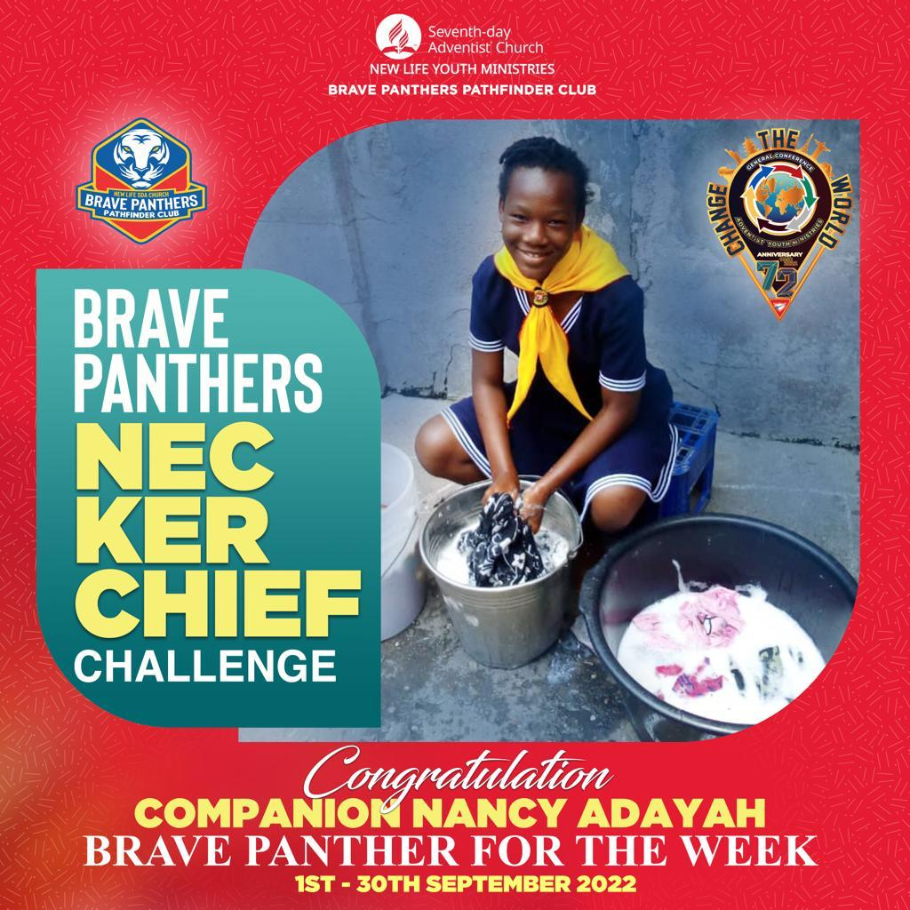
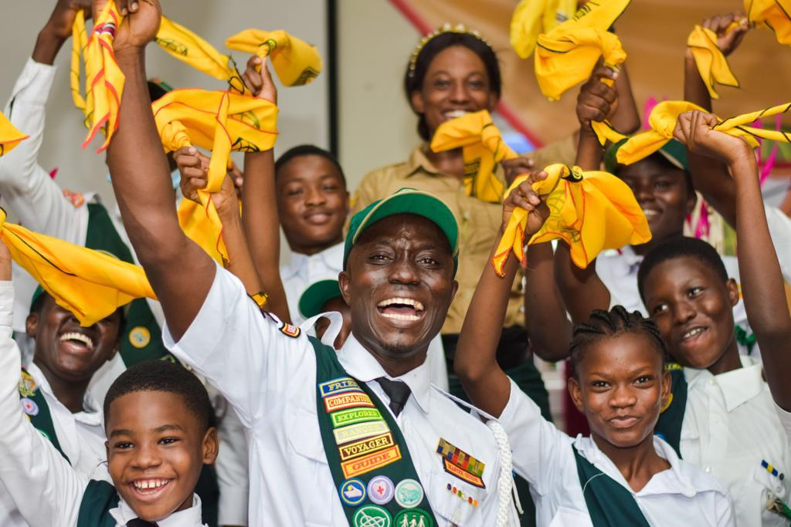

Slide 25
KPI 1.7: Improved retention rates of audited membership
YOUTH CONGRESS
The period under review saw two Youth Congresses. The Central Africa Union Mission organized its first Youth Congress from August 14-21, 2022 at OYO in Congo Brazzaville. 630 youth from the five countries that form the Union Mission, and all the Union and its various officers and pastors participated in the congress. 8 souls were baptized as a result of the outreach activities of the congress.

Slide 26
KPI 1.7: Improved retention rates of audited membership
YOUTH CONGRESS
The Northern Nigeria Union Conference also organized a Senior Youth Congress from the 28th August to 4th September, 2022 at Billiri, in Gombe State. A total of 674 youth participated and 15 souls got baptized during the program.

Slide 27
