Slide 1
AUA Report to
WAD EXCOM
By Vincent R Injety
1 November, 2022

Slide 2
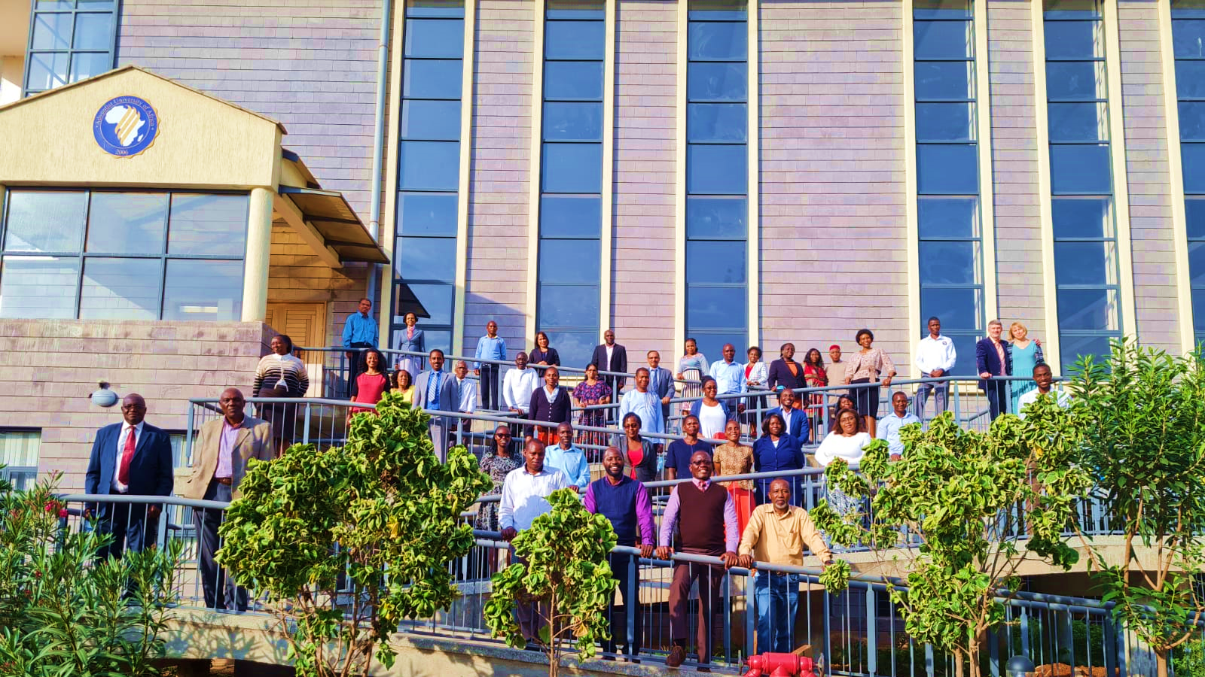
“Our Mission is to Support Your Mission”
AUA - PREPARING GRADUATES FOR MISSION

Slide 3
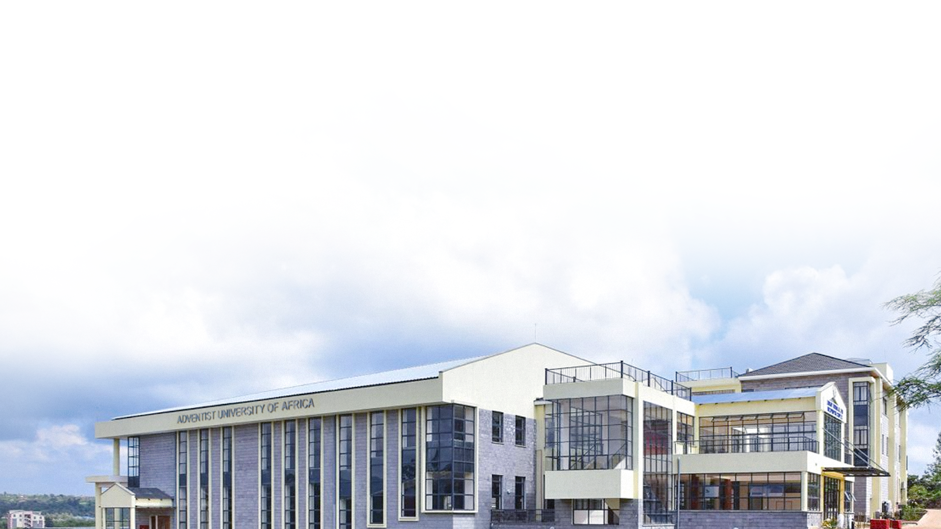
Motto
Mission
Vision
Values
Revision
of Philosophy
Statements

Slide 4
Motto
Developing Leaders
Developing Leaders for Service
Adventist University of Africa

Slide 5
CORE VALUES
Accountability
Fairness
Respect
Integrity
Collaboration
Adventist Heritage
Adventist University of Africa

Slide 6
MISSION
“To deliver outstanding postgraduate education from a biblical foundation to prepare competent leaders to serve the church and society in a Christ-like manner.”
Adventist University of Africa
Notes:
Christs Method alone will give us true success in reaching the people

Slide 7
VISION
To be a premier university in postgraduate and professional education and research.
Adventist University of Africa

Slide 8
Enrolment
School
In Class
(A)
Writing
Stage
(B)
Total
Enrollment
FTE of Students
in Writing Stage
(C)
Total FTE
Students
(A+C)
Student
Faculty
Ratio
Faculty
School of
Postgraduate
Studies
103
75
178
15
118
15
8:1
Theological Seminary
207
275
464
51
258
12
21:1
310
332
642
66
376
27
15:1
Total

Slide 9
Programs Enrolled
PhD in Biblical & Theological Studies
D Min, PhD in Leadership
MA in BTS
MA Leadership, MBA
MA Missiology, MA Chaplaincy
M Divinity
M Public Health
MSc Computer Science

Slide 10
ENROLMENT DIVISION-WISE
Program Title | ECD | SID | WAD
Doctor of Ministry | 0 | 0 | 0
Doctor of Philosophy (PhD) in Biblical and Theological | 9 | 12 | 15
Doctor of Philosophy (PhD) in Leadership | 12 | 8 | 3
Master of Arts in Biblical and Theological Studies | 21 | 47 | 2
Master of Arts in Leadership | 11 | 2 | 0
Master of Arts in Missiology | 7 | 6 | 2
Master of Business Administration | 3 | 14 | 6
Master of Chaplaincy | 9 | 6 | 6
Master of Divinity | 28 | 15 | 25
Master of Arts in Pastoral Theology | 0 | 3 | 0
Master of Public Health | 16 | 12 | 2
Master of Science in Applied Computer Science | 4 | 3 | 2
Total by Division | 120 | 128 | 63

Slide 11
Master’s program
258
students
Doctoral program
52
students
Enrolment

Slide 12
Enrolment School-wise
SPS = 31%
Seminary = 69%
Student-Faculty Ratio
Seminary = 21:1
SPS = 8:1
Overall = 15:1

Slide 13
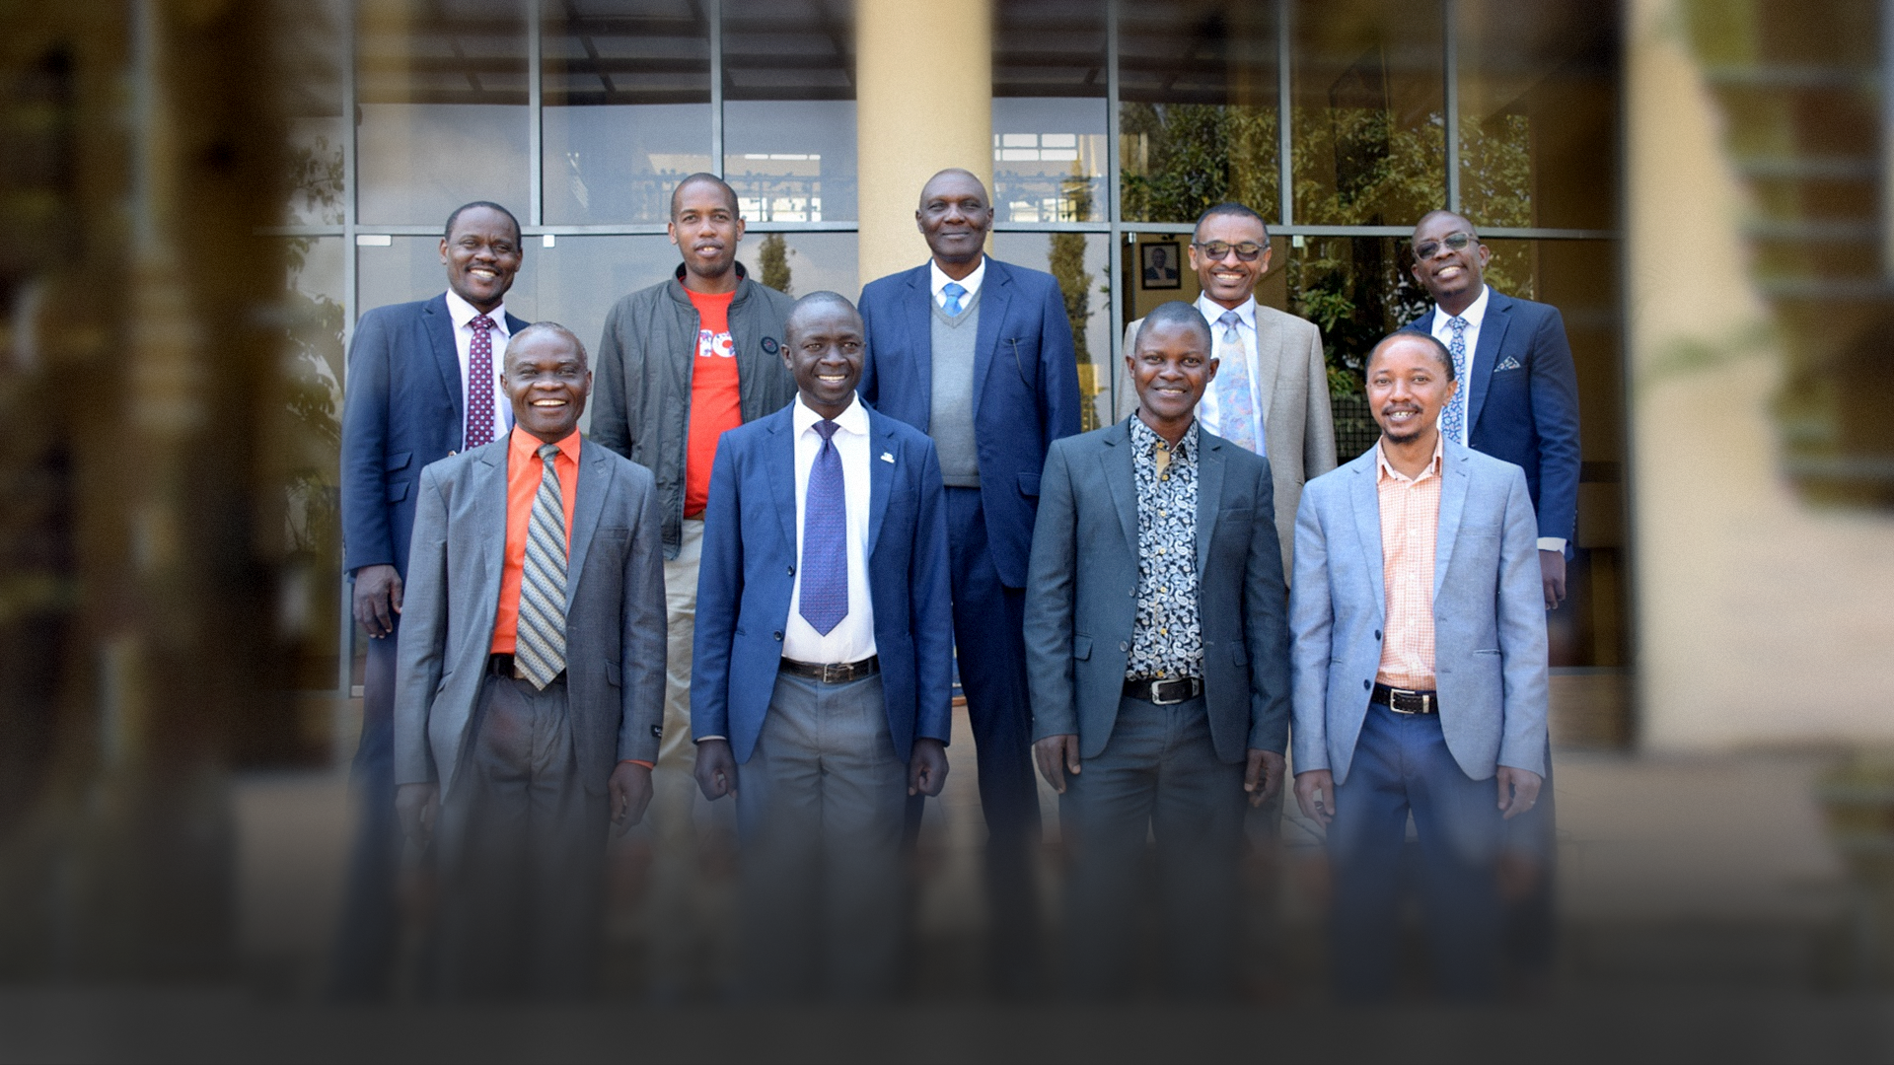
MA Leadership students on Campus

Slide 14
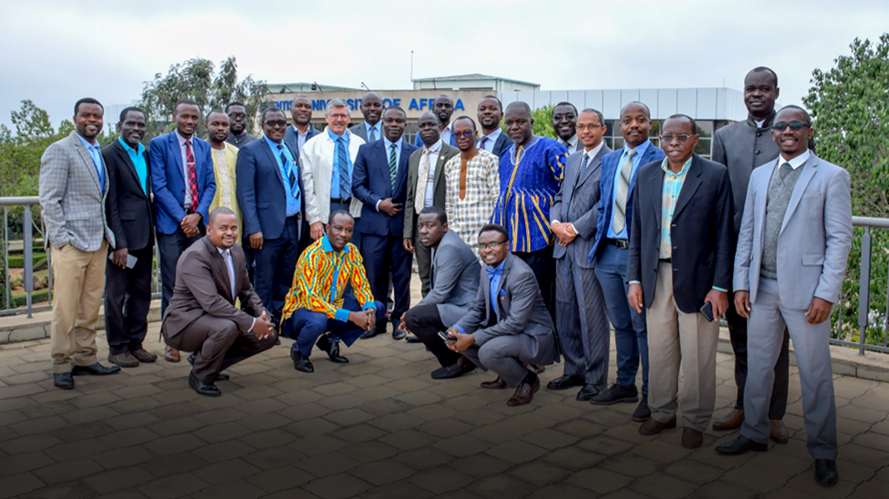
PhD BTS students on Campus

Slide 15
Demography of students
96% are Adventists
4% are non-Adventists

Slide 16
Demography of students
81% are male
19% are female

Slide 17
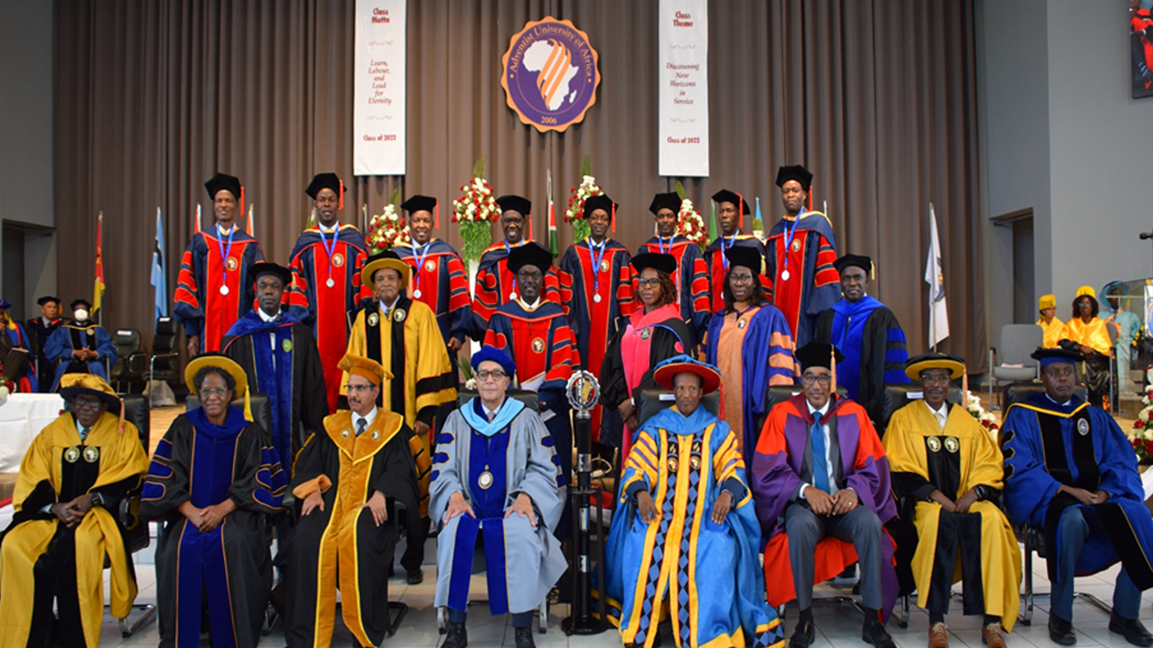

Slide 18
Graduation Ceremony 2022
55 students graduates
8 graduated with D Min
4 graduated with PhD Leadership
43 with Master’s programs

Slide 19
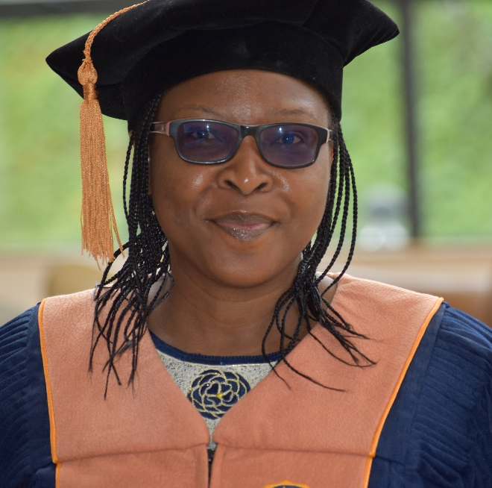
Notes:
We are pleased to inform Sister Adeola Sessou is the first woman (WAD) to graduate with a PhD in Leadership program at AUA.

Slide 20
ECD Graduates |  | SID Graduates |  | WAD Graduates
Country | No | Country | No | Country | No
South Sudan | 6 | Mauritius | 1 | Benin | 1
Burundi | 11 | Sao Tome | 1 | Cape Verde | 1
Ethiopia | 15 | Seychelles | 1 | Chad | 1
Uganda | 25 | Mozambique | 2 | Senegal | 1
Rwanda | 31 | Botswana | 8 | Gabon | 2
Tanzania | 39 | Angola | 9 | Guinea Bissau | 2
D R Congo | 45 | South Africa | 9 | Ivory Coast | 3
Kenya | 122 | Madagascar | 14 | Sierra Leone | 5
Djibouti | 0 | Malawi | 30 | Togo | 10
Eritrea | 0 | Zambia | 49 | Liberia | 11
Somalia | 0 | Zimbabwe | 79 | Cameroon | 41
 |  | Comoros | 0 | Ghana | 86
 |  | Eswatini | 0 | Nigeria | 98
 |  | Lesotho | 0 | Burkino Faso | 0
 |  | Mayotte | 0 | C. Africa Republic | 0
 |  | Namibia | 0 | Congo | 0
 |  | St. Helena | 0 | Equatorial Guinea | 0
 |  |  |  | Gambia | 0
Total | 294 |  | 203 |  | 262
Grand Total: 759

Slide 21
STUDENTS WRITING THESIS 2016 -2022
Program | ECD | SID | WAD
Doctor of Ministry | 13 | 18 | 14
Doctor of Philosophy (PhD) in Biblical and Theological Stu. | 11 | 3 | 10
Doctor of Philosophy (PhD) in Leadership | 13 | 9 | 14
Master of Arts in Biblical and Theological Studies | 23 | 21 | 3
Master of Arts in Leadership | 2 | 10 | 8
Master of Arts in Missiology | 13 | 7 | 1
Master of Business Administration | 15 | 12 | 5
Master of Chaplaincy | 10 | 0 | 7
Master of Divinity | 19 | 16 | 21
Master of Arts in Pastoral Theology | 1 | 35 | 13
Master of Public Health | 11 | 21 | 4
Master of Science in Applied Computer Science | 6 | 0 | 2
Total by Division | 137 | 152 | 102

Slide 22
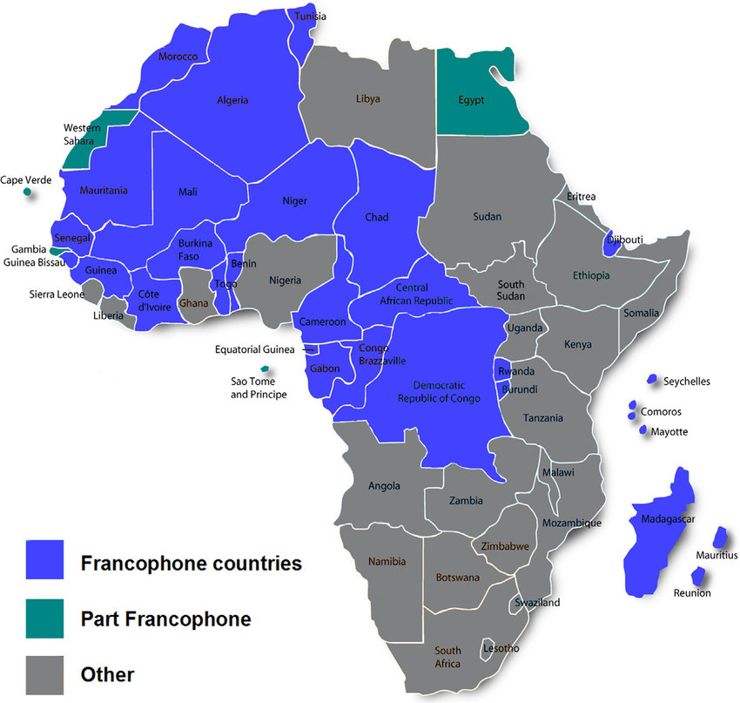

Slide 23
Accreditation
& Charter
AAA visit April 2022
Commission of University Education
Revisions in the charter, gazetted soon

Slide 24
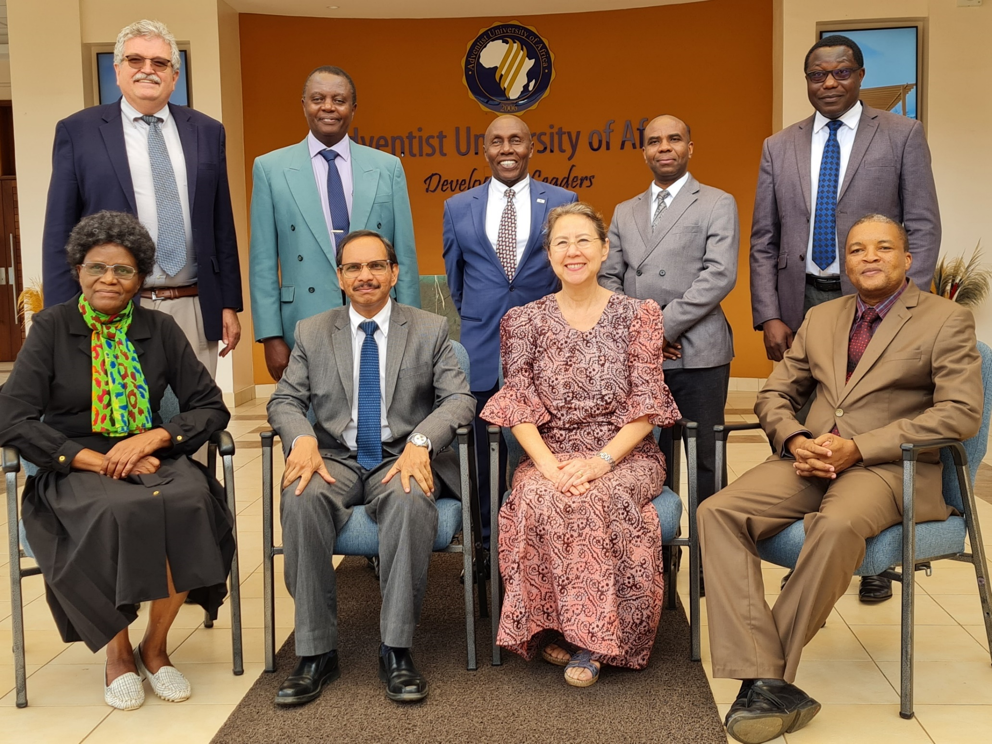
AAA Team
April 2022

Slide 25
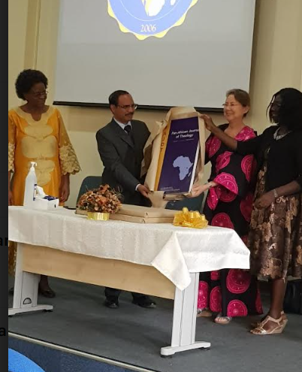
Launch
of research
Journals

Slide 26
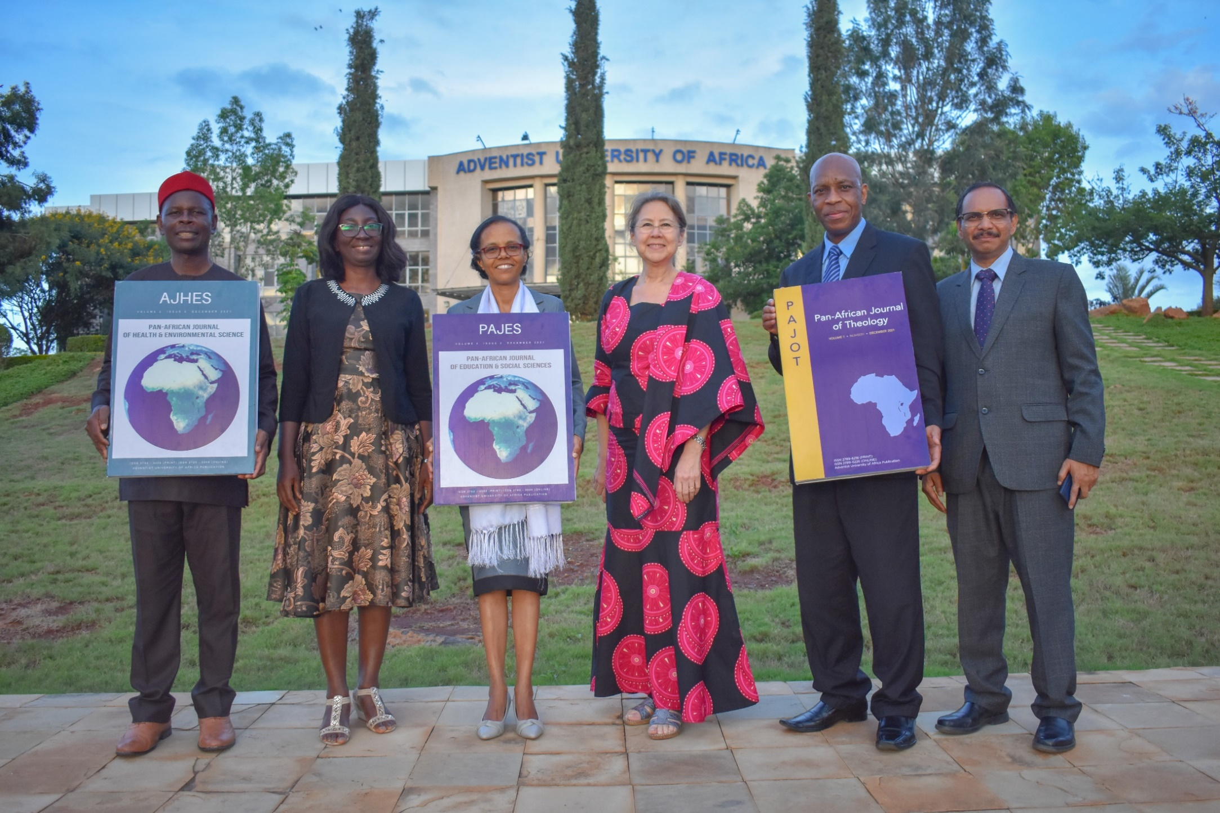
Launch
of research
Journals

Slide 27
Research and Grants
LAUNCHING OF THREE JOURNALS
Pan-African Journal of Education and Social Sciences (PAJES)
Link: https://journals.aua.ke/

Slide 28
Research and Grants
LAUNCHING OF THREE JOURNALS
Pan-African Journal of Health and Environmental Studies (PAHES)
Link: https://journals.aua.ke/

Slide 29
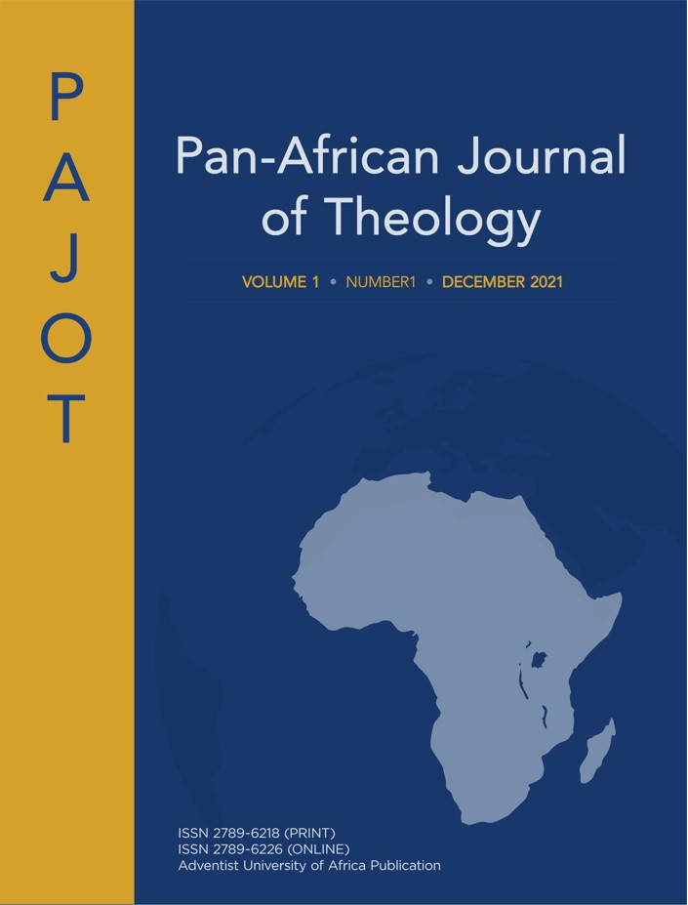
Research and grants
LAUNCHING OF THREE JOURNALS
Pan-African Journal of Theology (PAJOT)
Link: https://journals.aua.ke/

Slide 30
Research papers & funding
Six staff members presented research papers
Research grant of $ 72 710 from GRSPI
Research Project funded by ECD, SID and WAD on:
“ Evangelism Strategies, Conversion Patterns and Membership Retention Strategies in the SDA Church in Sub-Saharan Africa

Slide 31
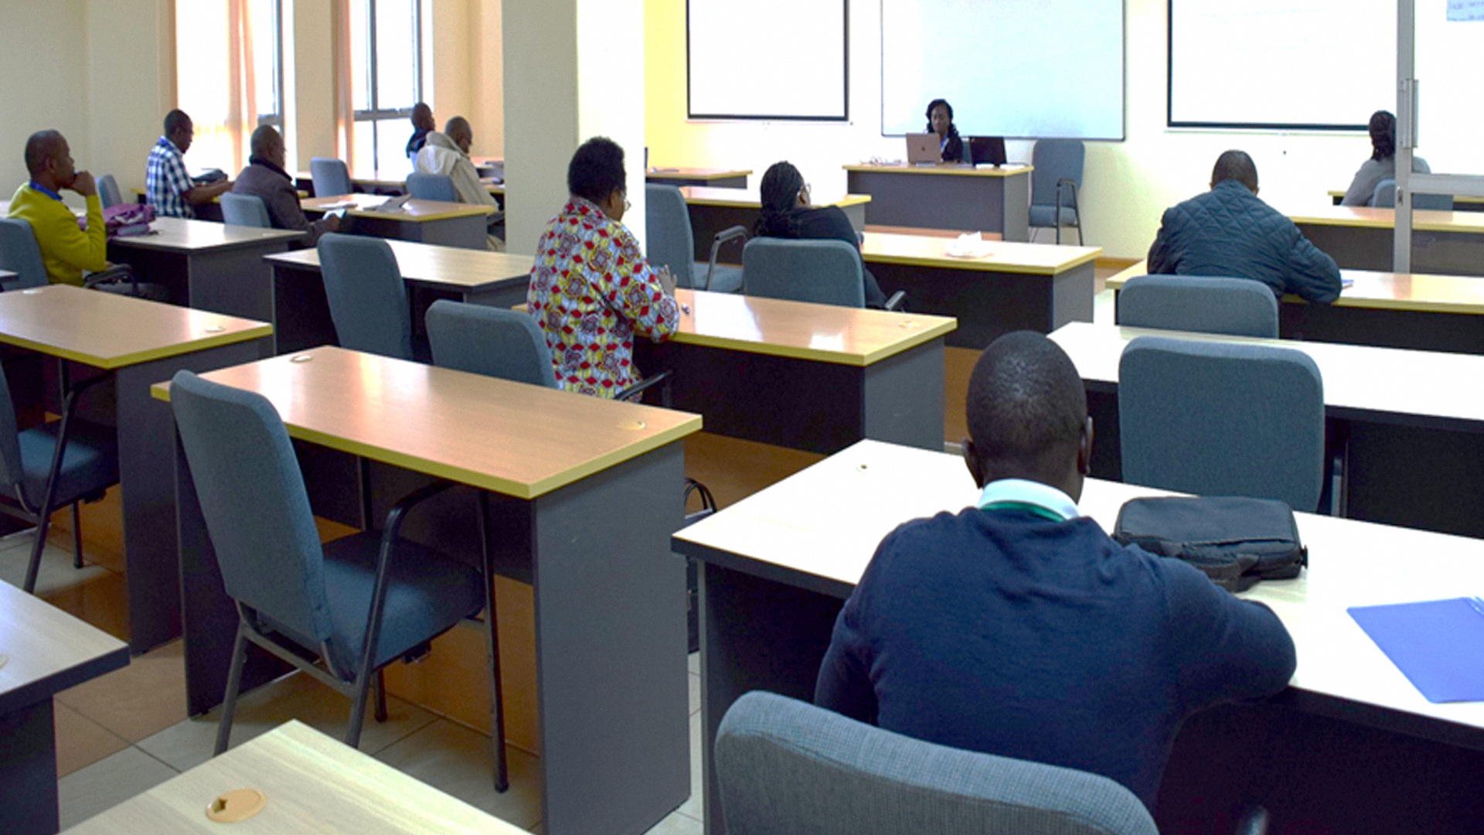
6th International Research Conference
on Social and Applied Sciences
Topic: “The Designing the future of the workforce beyond Covid-19”
August 18-20, 2022

Slide 32
Spiritual Program
Daily morning devotions
Mid-week prayer meetings
Sabbath services
Week of Spiritual Emphasis (WOSE)
Life Issues as part of WOSE
Camp meetings

Slide 33
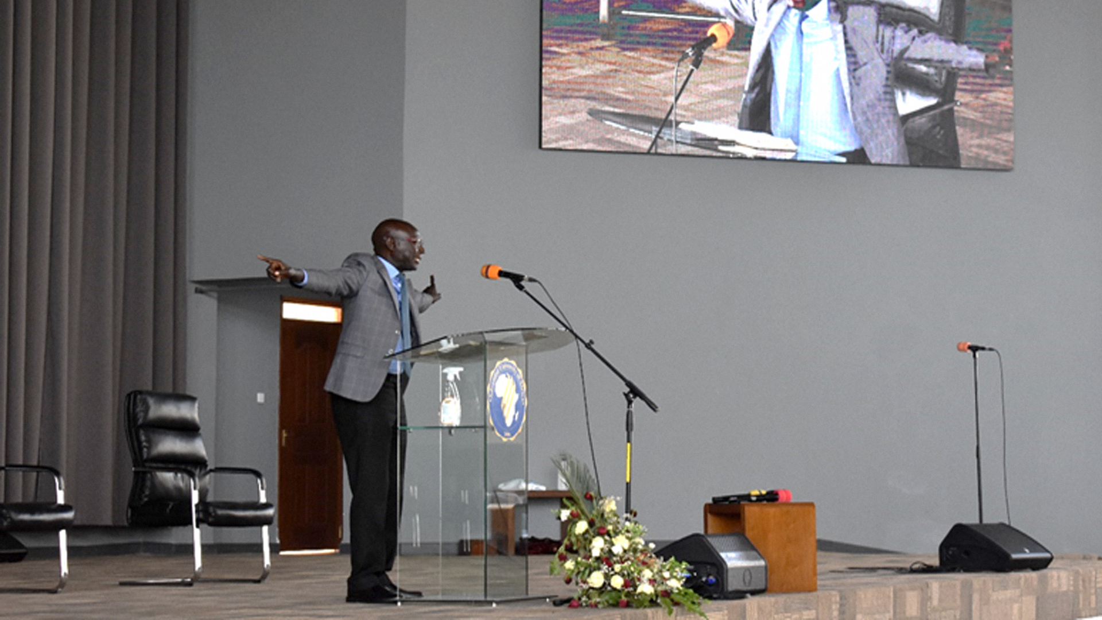
Week of Spiritual Emphasis
March 26 – April 2, 2022

Slide 34
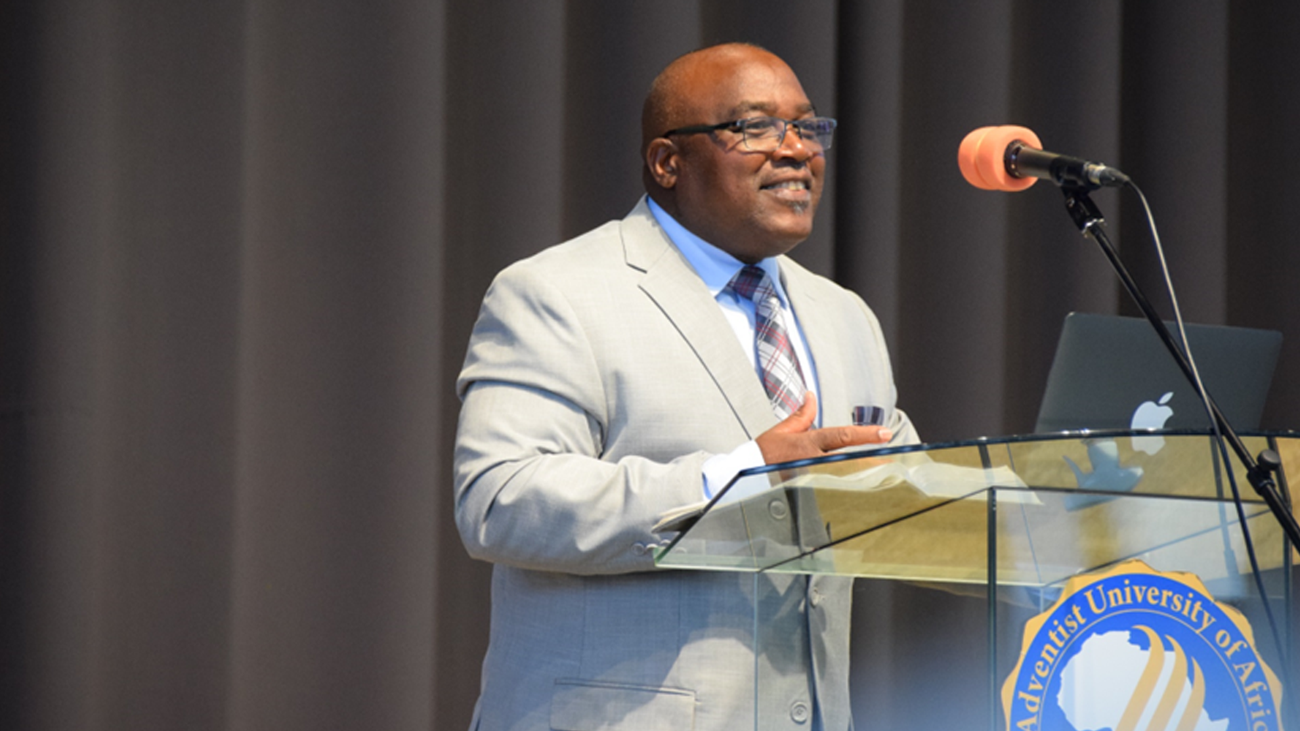
Week of Spiritual Emphasis
August 1-6, 2022

Slide 35
Financial Administration
Income
Kes 60 493 566
Appropriations
77 523 312
Total Income
148 016 878
Expenditure
(125 123 170)
Net Income
Kes 12 893 708

Slide 36
SPONSROSHIPS
AUA Merit Scholarships for new applicants
Sponsorships for new female applicants
Scholarships for 10/40 window countries in Africa.

Slide 37
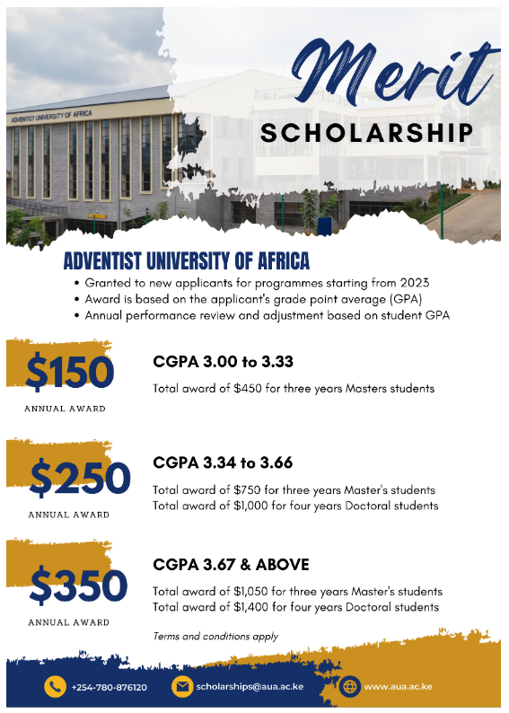

Slide 38
10/40 window countries

Slide 39
SPONSROSHIPS
New female applicants 50% tuition in the first session.
10/40 window countries
(100% tuition Scholarships for MA Missiology). Three per Union.

Slide 40
Appreciation
WAD
Unions and Entities in WAD
General Conference
Sponsor and Students

Slide 41
“Our Mission is to Support Your Mission”
AUA - PREPARING GRADUATES FOR MISSION

