Slide 1
GCAMR RAMADAN PRAYER INITIATIVE
Edited version
GCAMR©2023

Slide 2
1 Timothy 2
I urge, then, first of all, that petitions, prayers, intercession and thanksgiving be made for all people— ² for kings and all those in authority, that we may live peaceful and quiet lives in all godliness and holiness. ³ This is good, and pleases God our Savior, ⁴ who wants all people to be saved and to come to a knowledge of the truth. ⁵ For there is one God and one mediator between God and mankind, the man Christ Jesus

Slide 3
GCAMR-WAD RPI MEETING
SAMUEL LUMWE, PHD
ASSOCIATE DIRECTOR, GCAMR

Slide 4
M populations in each Division: source Joshua Project, August 2022 Source: joshuaproject.net and worldpopulationreview.com
 | Population | People groups | Muslim People groups | Muslim Population | %
CHUM | 1,430,863,000 | 581 | 31 | 28,665,802 | 2
ECD | 442,162,000 | 848 | 166 | 91,400,921 | 20.7
ESD | 294,022,000 | 603 | 307 | 99,450,429 | 33.8
EUD | 321,055,000 | 778 | 154 | 18,197,109 | 5.7
IAD | 299,492,900 | 876 | 25 | 406,094 | 0.13
IF | 8,828,000 | 49 | 8 | 1,700,300 | 19.8
NAD | 372,805,000 | 818 | 110 | 5,764,900 | 1.5
NSD | 229,777,000 | 129 | 19 | 792,400 | 0.3
SUD | 1,431,617,000 | 2,724 | 437 | 191,570,500 | 13
SAD | 434,388,800 | 887 | 15 | 3,018,456 | 0.7
SID | 223,564,800 | 537 | 57 | 13,327,632 | 6
SSD | 1,133,083,000 | 3,298 | 1,195 | 653,801,152 | 58
SPD | 42,941,000 | 1,497 | 42 | 1,199,400 | 3
TED | 206,693,611 | 944 | 178 | 13,857,531 | 7
Ukraine | 43,132,000 | 78 | 23 | 452,500 | 1
WAD | 480,895,000 | 1,974 | 613 | 278,079,409 | 58
 | 7,395,320,111 | 16621 | 3380 | 1,401,684,535
https://worldpopulationreview.com/country-rankings/muslim-population-by-country

Slide 5
GCAMR Vision
To establish new groups of disciples among Muslim people groups

Slide 6
3. GCAMR 3-STEP STRATEGY
1
2
3
PREPARATION
ACTION
ASSIMILATION
TRAINING
WITNESSING
TRADITIONAL CHURCH

Slide 7
GCAMR 3-STEP STRATEGY
1
2
3
PREPARATION
ACTION
ASSIMILATION

Slide 8
GCAMR 3-STEP STRATEGY
1
2
3
PREPARATION
ACTION
ASSIMILATION
PRAYER
ACTS OF KINDNESS
HOUSE CHURCH

Slide 9
GCAMR 3-STEP STRATEGY
1
2
3
ACTION
ASSIMILATION
PREPARATION
PRAYER
(2-3 months)
Module One: Theology of Mission and Islam
ACTS OF KINDNESS
(6 months)
Module Two: Dialogue / Conversation
HOUSE
CHURCH
Module Three: Discipleship

Slide 10
GCAMR Three Dimension Initiative
Phase 1: Preparation-
Prayer
Training-Mission,Islam Theology
2-3 months
Phase 3: Asimilation-
Disicpleship House church
Pahse 2:
Action-
Acts of kindness
Prayer
Dialogue/Conversation
6 months
Prayer
Acts of kindness

Slide 11
GCAMR Ministry values
1. As Seventh-day Adventists, we take our rightful position as the people of the book that upholds the truth as stated in the Holy Bible.

Slide 12
GCAMR Ministry Core values
2. To establish common grounds with our Muslim friends that will enhance redemptive relationships.
3. That, we are called to prepare people in the world, including our Muslim brothers and sisters, for the soon return of Jesus the Messiah.

Slide 13
4. We endeavour to share the truth as it is in the Bible with great humility and respect of other people’s cultural and religious beliefs and practices
5. We are sensitive to the cultural dynamics in mission, hence, carrying out the mission work among Muslims in line with cross-cultural mission principles by being considerate to both, the traditional and religious realities of the receptor.

Slide 14
WHAT IS AMR Ministry?
It is a service-oriented ministry
It is about building bridges of understanding with Muslim communities
It’s aim is to equip believers so that they can interrelate well with their Muslim friends, neighbours, relatives and work associates
It is to be integrated to outreach approaches
It is for the fulfilment of God’s mission as per Revelation 14:6

Slide 15
Objectives of Intercessory Prayer Ministry
To make prayer ministry as one of the approaches to ministry among Muslims
To demonstrate a more spiritual approach to mission among Muslims
To ensure that any believer involved in reaching out to Muslims leads a prayerful life

Slide 16
1 Corintians 9:19-23
¹⁹ Though I am free and belong to no one, I have made myself a slave to everyone, to win as many as possible. ²⁰ To the Jews I became like a Jew, to win the Jews. To those under the law I became like one under the law (though I myself am not under the law), so as to win those under the law. ²¹ To those not having the law I became like one not having the law (though I am not free from God’s law but am under Christ’s law), so as to win those not having the law. ²² To the weak I became weak, to win the weak. I have become all things to all people so that by all possible means I might save some. ²³ I do all this for the sake of the gospel, that I may share in its blessings.

Slide 17
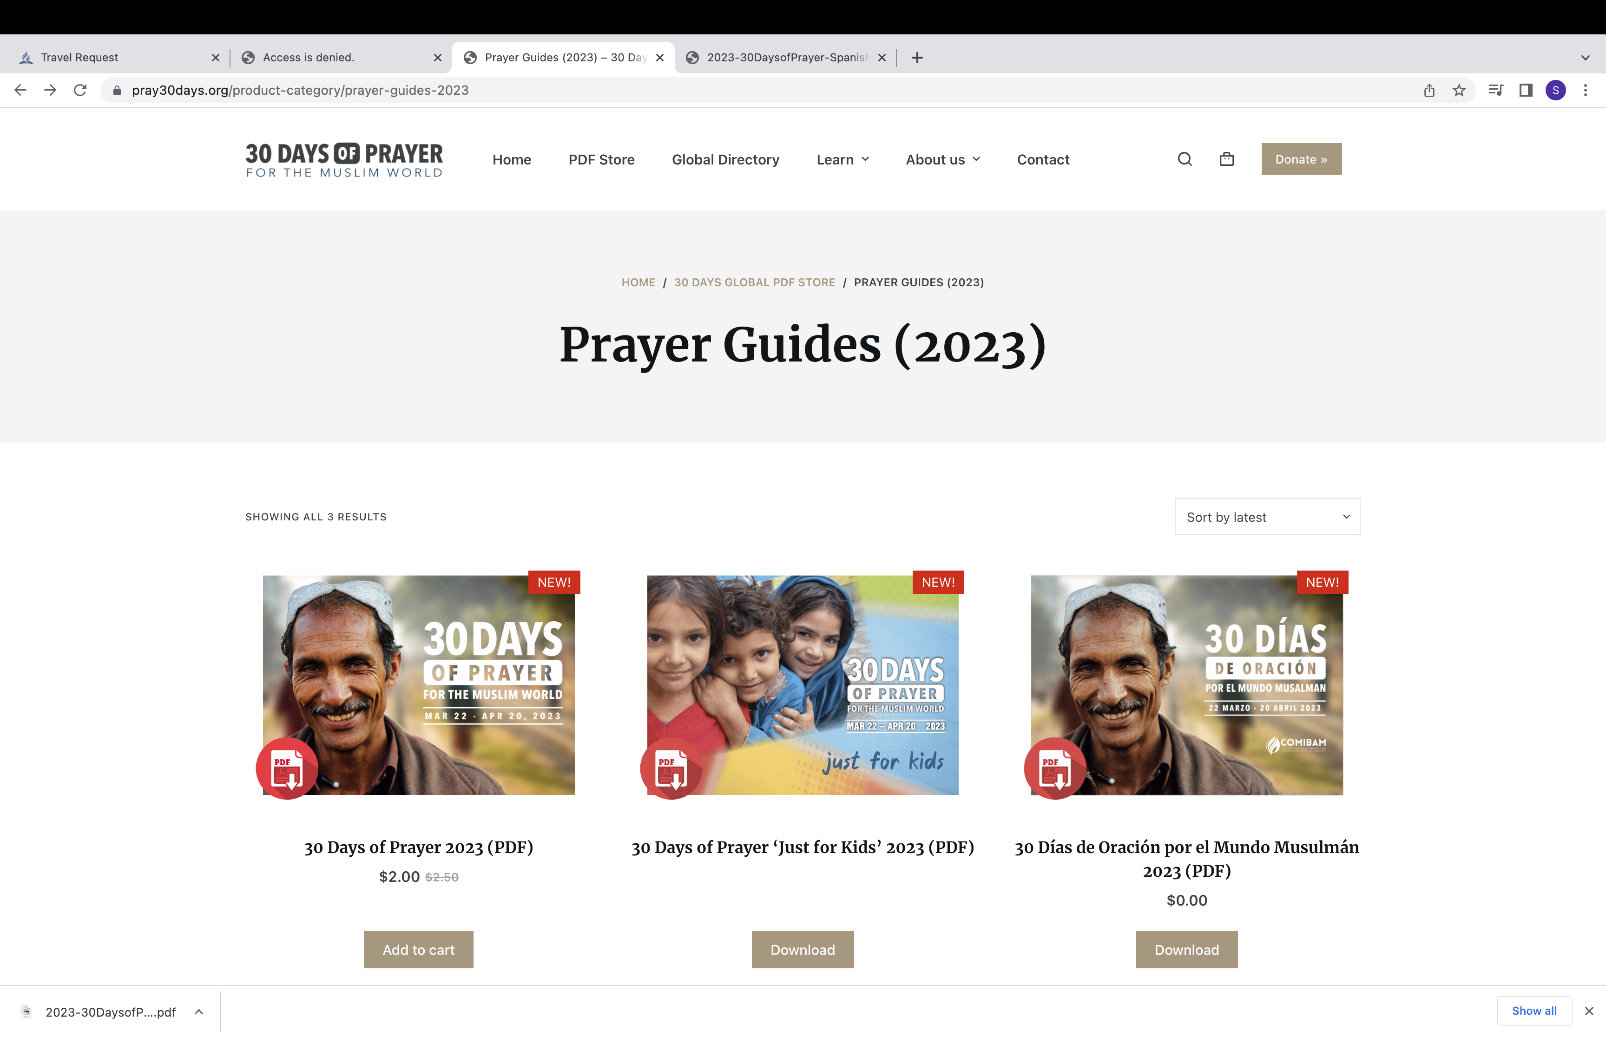
Evangelical Ministry
https://www.pray30days.org/store/30-days-of-prayer-2023-pdf

Slide 18
Objectives of Ramadan Prayer Intiative
Establish and or enhance our relationships with Muslims
Pray for and with Muslim acquaintances
Meet the needs of Muslim acquaintances
Study scripture with Muslim acquaintances
Share the Three Angels’ Messages where opportunity avails
Establish an Adventist prayer Movemnt for our cousins

Slide 19
The Focus
Pray for people groups in the cities listed in the Ramadan Prayer Diary
Pray for AMR leaders and work in different territories
Share a meal with Muslim neighbors
Prepare Iftar for Muslim communities
Study scripture with Muslim friends
Join the Ramadan Global Prayer sessions (March 22 to April 21, 2023)

Slide 20
Objectives of Intercessory Prayer Ministry
To make prayer ministry as one of the approaches to ministry among Muslims
To demonstrate a more spiritual approach to mission among Muslims
To ensure that any believer involved in reaching out to Muslims leads a prayerful life

Slide 21
What is Ramadan
It is the ninth month of the year according to the Islamic calendar which is regarded as the holiest month.
It is believed that the Qur’an was first revealed in this month.
It is one of the five pillars of Islam.

Slide 22
Muslims are instructed to fast according to the following verses
Oh you who believe! Fasting is prescribed to you as it was prescribed to those before you, that you may learn piety and righteousness". 2:183
The most honoured by Allah amongst you are those best in taqwa (the most righteous of you). 49:13
. . . And it is better for you that ye fast, if ye only knew." (Q 2:184)

Slide 23
Islamic religion viewpoint on Ramadan Fasting
For the forgiveness of sins (Imam Bukhari 1:37).
A special gate into paradise called ar-Rayyan. On the Day of Resurrection it will say: 'Where are those who fasted?' When the last [one] has passed through the gate, it will be locked." [Imam Bukhari and Imam Muslim].
A sure way to paradise
Abu Umaamah r.a.a. said: I said: 'O Messenger of Allah (saw), tell me of an action by which I may enter Paradise'. He said: 'Take to Fasting, there is nothing like it.' [Imam Nasai’, Ibn Hibbaan, Al-Haakim, Sahih]
It is the month of blessing [Imam Tabarani]
When in Hell those who fasted will be protected
"Fasting is a shield with which a servant protects himself from the Fire." [Imam Ahmad, Sahih]

Slide 24
The Supplication of the Fasting Person is Answered
"There are in the month of Ramadan in every day and night those to whom Allah grants freedom from the Fire, and there is for every Muslim an supplication which he can make and will be granted."Al-Bazzar and Ahmad. Sahih
Fasting is a shield against one’s desires al-Bukhaari, 1894; Muslim, 1151
The devils are chained.
Sahih al-Bukhari 31: 123; Sahih Muslim Book 6, Number 2361:
Abu Huraira reported Allah's Messenger (may peace be upon him) as saying: When there comes the month of Ramadan, the gates of mercy are opened, and the gates of Hell are locked and the devils are chained,

Slide 25
What each Muslim is requred to do
To fast for 12 hours during the day
To perform prayer 5 times a day, plus other sunnah (traditional) prayers
To read Qur’an all the 30 parts of the Qur’an are called Juzu, each Juzu per day
To help those in need
To be devoted to reading the Qur’an

Slide 26
Missional implications
Majority of them are devoted to spiritual matters by;
Spending more time in prayer and study of scriptures
Exercising humility
They are also very friendly and open to visitors

Slide 27
GCAMR Office
The office established Ramadan Prayer Initiaitve for the following objectives:
To pray for the outpouring of the Holy Spirit in our lives and the lives of our M friends so that God may send to them dreams and visions during this month of Ramadan
To pray for our M friends and relatives that God will reveal himself in miraculous ways, through healing and deliverance.
Our members may join their friends, Ms, in their fasting and look for opportunities to share the love of Christ.
To reach out to Muslim families that cannot afford iftar and help them.
To equip our members to look for ways where they can engage with their M friends in a spiritual discussion.

Slide 28
The focus is to;
1. Pray for people groups in the cities list on the Ramadan Prayer Diary.
2. Prayer for Muslim acquintances
3. Prayer for AMR leaders and work in different territories
4. Sharing a meal with Muslim neigbours
5. Prepare and share Iftar for Muslim in your communities
6. Study scriptures with M friends
7. Join the Ramadan Global Prayer sessions to be conducted from March 26th and April 21st 2023-Link shall be provided

Slide 29
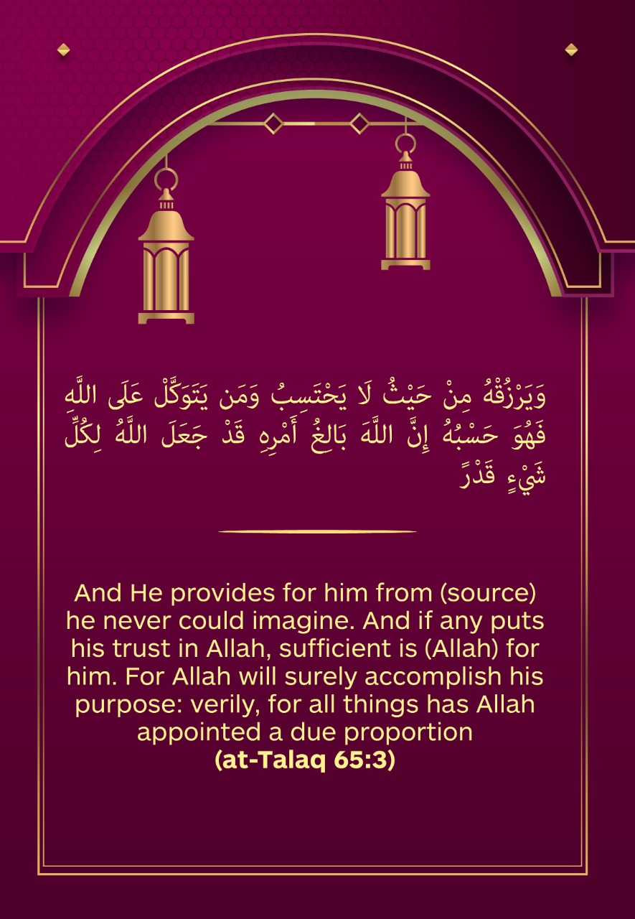
Ensure that you receive a daily Ramadan Qur’an verse e-card for sharing with M friends

Slide 30
Purpose of the ecards
Most people have found the ecard act as an ice breaker for spiritual conversation.
Therefore, you are expected to share with a Muslim friend or family member (s) as a recipe to ignite a spiritual conversation.
It helps to connect with your Muslim friend (s) daily in a natural way.
The ecards have an inscription of verses from the Q which are carefully selected and might have a common message with the Bible, acting as a bridge. This can help you to share and discuss the verse with your Muslim friend.
Sometimes If your friend has no prior knowledge about your faith may be tempted to ask you a question such as “are you a Muslim?’ Such questions act as a key to starting a spiritual conversation.

Slide 31
2023 Ramadan Prayers Plan
Date: March 21st to April 20th 2023
Focus : Major cities with a high Muslim population
Daily prayer session for and with Muslim acquintances
Daily Qur’an verse quotation for sharing with Muslim friends
New component: The last 14 days (April 8th April to 21st, 2023) we have scheduled for online Global Ramadan prayers to be facilitated by GCAMR Office and selected Divisions

Slide 34
Local churches, Field/Conferences, Unions Involvement

Slide 37
Each member to be encouraged to
Identify and make a list of at least two M friends to pray for daily and communicate regularly including sending the ecard
To identify the needs of M's friends, family members, or neighbours and try to address them.
To support the needy family with food stuff. Churches can organize a community Iftar
Pray that God may visit your friends through dreams and visions
Pray for opportunities to share the love and truth of God

Slide 38
You may incorperate different prayer initiatives
Weekly prayer and fasting day.
GC and Division prayer initiaitves e.g 10 days of prayer, 777, Prayer and fasting every first Sabbath of the Qurater, Spiritual weeks of emphasis.
Prayer camps or Conferences.
Ramadan Prayer Initiatives (RPI).
Family and individual prayer and fasting initiatives.

Slide 39
Prayer methods
Congregational prayers, e.g. Sabbath prayer day.
Chain prayers.
Prayer walk-Jericho model.
Meditational prayer.
Social media prayer initiatives`(Zoom or mobile-phone call prayers)
House church cell prayers.

Slide 40
Prayer points-Pray that . . .
God may revive each member.
God may help leaders and believers to love our cousins genuinely.
God may nurture your friendship into a redemptive relationship.
God may manifest Himself through miracles of deliverance from their problem (e.g. sickness).
God may send his Spirit to our cousins and soften their hearts.
God may give you wisdom on how to advance your relationship.
God may create an opportunity for sharing His truth.
God may visit them through a dream or a vision.
Support them (our friends, neighbors, relatives and work associates etc.) in their needs.

Slide 41
“And he said unto them, This kind can come forth by nothing, but by prayer and fasting.”
Mark 9: 29

Slide 42
Expected out come as a result of intercessory prayer ministry
The manifestation of God’s power through miracles experienced among our Muslim friends: deliverance and healing is experienced among our Muslim friends
Genuine love for the lost people is demonstrated among our believers
Revival of the mission spirit among our church members
True revival and reformation among church members
Manifestation of God to our Muslim friends through dreams and visions
There will be a Total Member Involvement (TMI)
Another miraculous movement among Adventists
Muslims being saved into the Kingdom

Slide 43
A healthy, Spirit-driven congregation
A healthy, Spirit-driven congregation does not wait passively for people to come to the church and its activities, but proactively reaches out to the surrounding community and the wider world. It works intentionally, as Christ did, to mingle with people…show sympathy to them, and minister to their needs. (Ellen White in Ministry of Healing, page 143.) CS 7

Slide 44
“I was hungry and you gave me something to eat, I was thirsty and you gave me something to drink, I was a stranger and you invited me in. I needed clothes and you clothed me. I was sick and you looked after me. I was in prison and you came to visit me”
(vv. Mathew 35-36).

Slide 45
Women Ministry members in Burundi praying for our cousins during the month of Ramadan, 2021

Slide 46
Ramadan Prayer Initiative report form to be used at Local church, Conference, Union and Division Levels (2023)
Name of the Division/Union/Conference ______________________________
Date submitted _____________________
Name of the AMR Leader/Director _______________________
 | Activity | Total
1 | Number of members involved in the Ramadan Prayer Intiative
2 | Number of prayer groups formed
3 | Number of Muslim friends/Family members/Work associates being prayed for
4 | Number of Muslims helped
5 | Number of answered prayer
6 | Number of Interests (Muslims who have expressed interest on spiritual conversations)
7 | Number of e-cards sent to M friends/Family members/Work associates
8 | Number of literature distributed to Ms
8 | Number of scripture studies (Bible studies) conducted
9 | Number of Ms Baptismed
Noted: Send this report to the AMR Director at the next higher organization weekly during the month of Ramadan

Slide 47
Luke 9:1-2
Then He called His twelve disciples together and gave them power and authority over all demons, and to cure diseases. ² He sent them to preach the kingdom of God and to heal the sick

