Slide 1
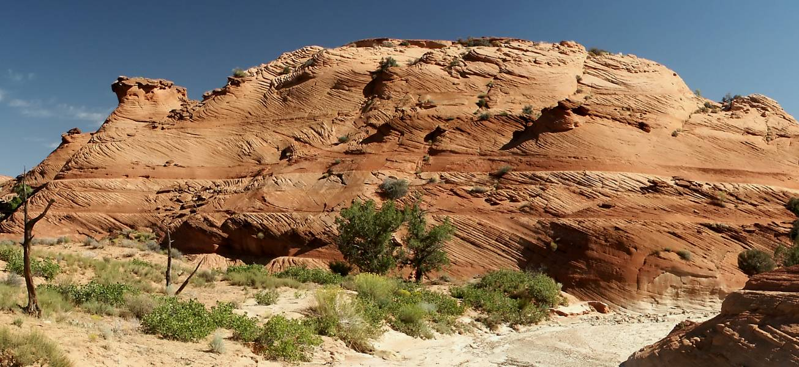
Paleocurrents: A Window into Geologic History
What can we learn about the past history of the earth from studying the sediments?

Slide 2
Paleocurrents
What are Paleocurrents and why might they be useful to us?
Where do we get them and how can we visualize them?
What are the results for North America through geologic time?
What are the results on a global scale through geologic time?
How can we use this information to better understand the history of the earth?

Slide 3
Why Paleocurrents?

Slide 4
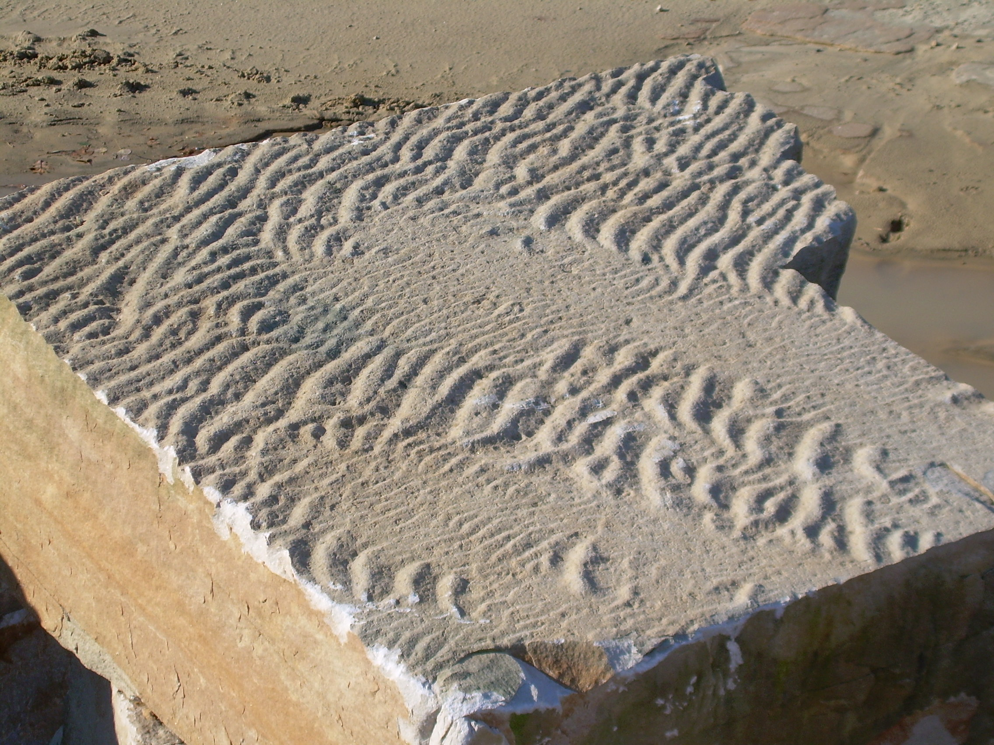
What are Paleocurrents?
Paleocurrents are flow directions derived from features of sedimentary rocks that reveal the sense of the current of wind or water that deposited the sediment.
All sedimentary rocks contain paleocurrent indicators, some of which can be read and interpreted.

Slide 5
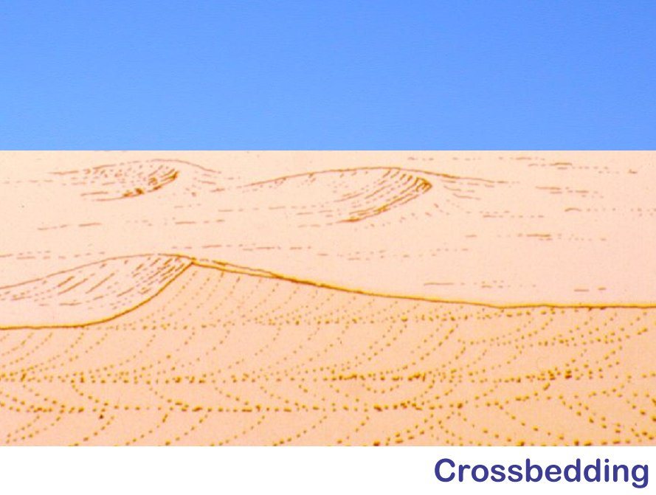

Slide 6
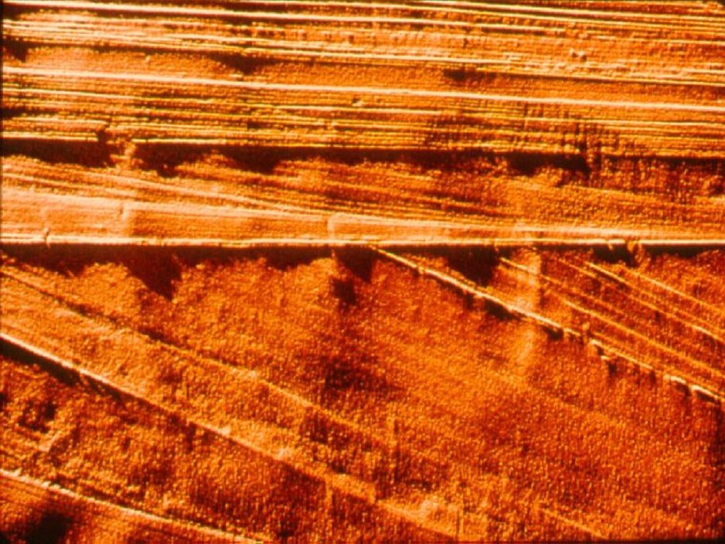

Slide 7
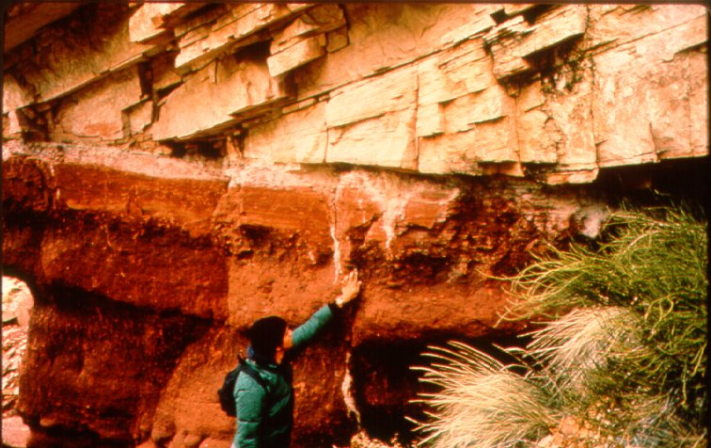

Slide 8
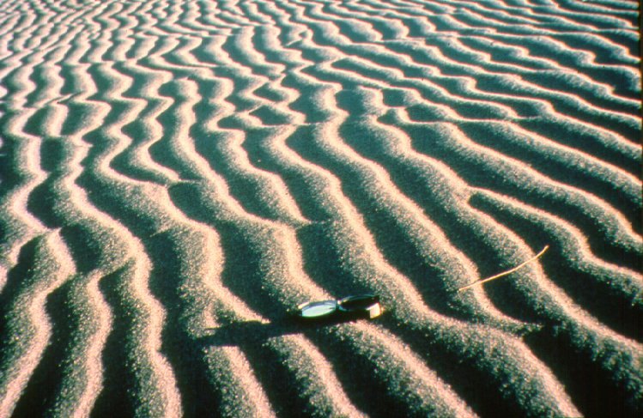
Ripple marks

Slide 9
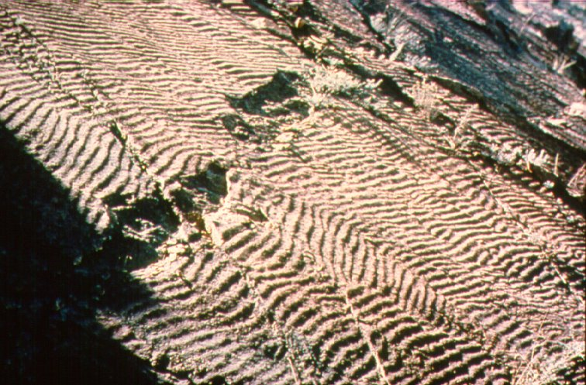

Slide 10
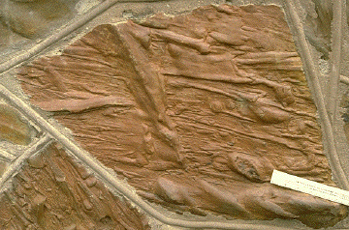
Scour Marks

Slide 11
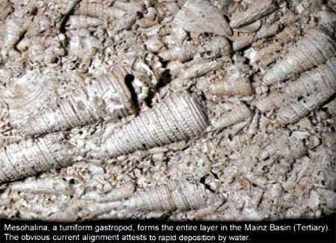

Slide 12
Paleocurrents
What are Paleocurrents and why might they be useful to us?
Where do we get them and how can we interpret them?
What are the results for North America through geologic time?
What are the results on a global scale through geologic time?
How can we use this information to better understand the history of the earth?

Slide 13
Where do we get them?
Theses and dissertations in libraries of major universities with geology departments.
Online.
Results of over 1,000,000 measurements of paleocurrents throughout the geologic record are in the database.
North America, South America, Australia, Great Britain, parts of Western Europe, China, Africa fairly well represented.
Antarctica, Eastern Europe, Asia modestly represented.
Russia poorly represented.

Slide 14
How can we interpret them?
What do we expect to see:
  from standard geological models?
  from a catastrophic, global flood?
What do we see?
Which model best fits the data?
What can we learn in the process?

Slide 15

What is a Sedimentary Basin?

Slide 16
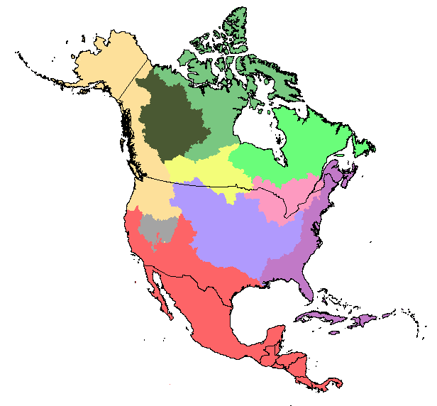

Slide 17
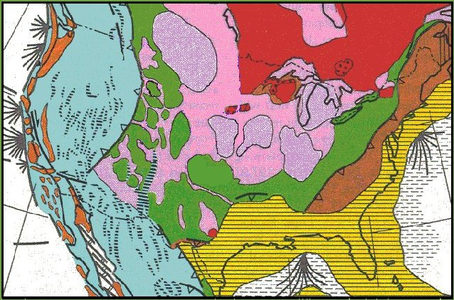
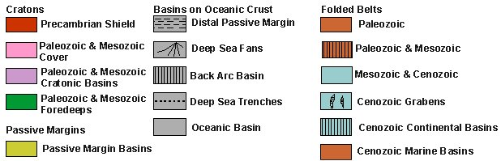

Slide 18
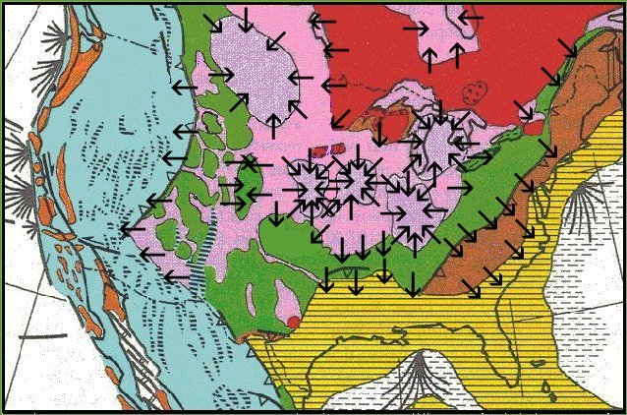

Slide 19
Paleocurrents
What are Paleocurrents and why might they be useful to us?
Where do we get them and how can we interpret them?
What are the results for North America through geologic time?
What are the results on a global scale through geologic time?
How can we use this information to better understand the history of the earth?

Slide 20
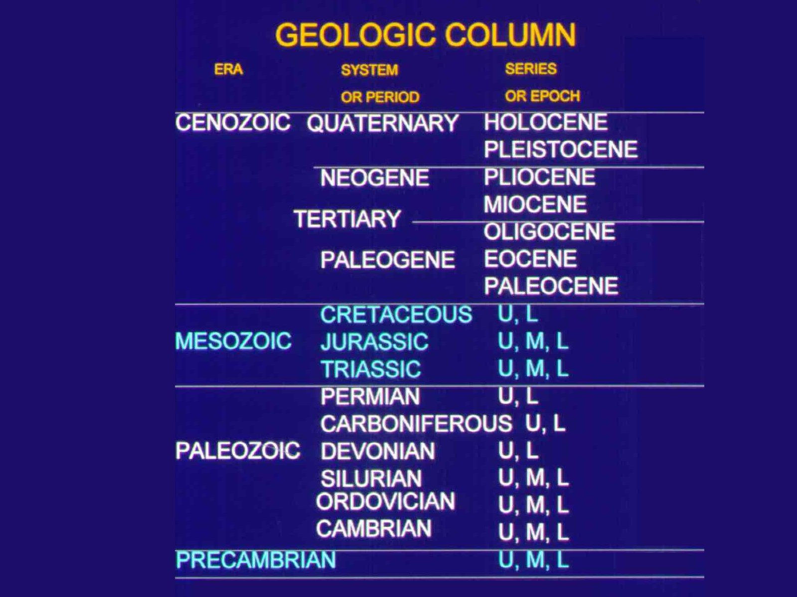
The Geologic Column

Slide 21
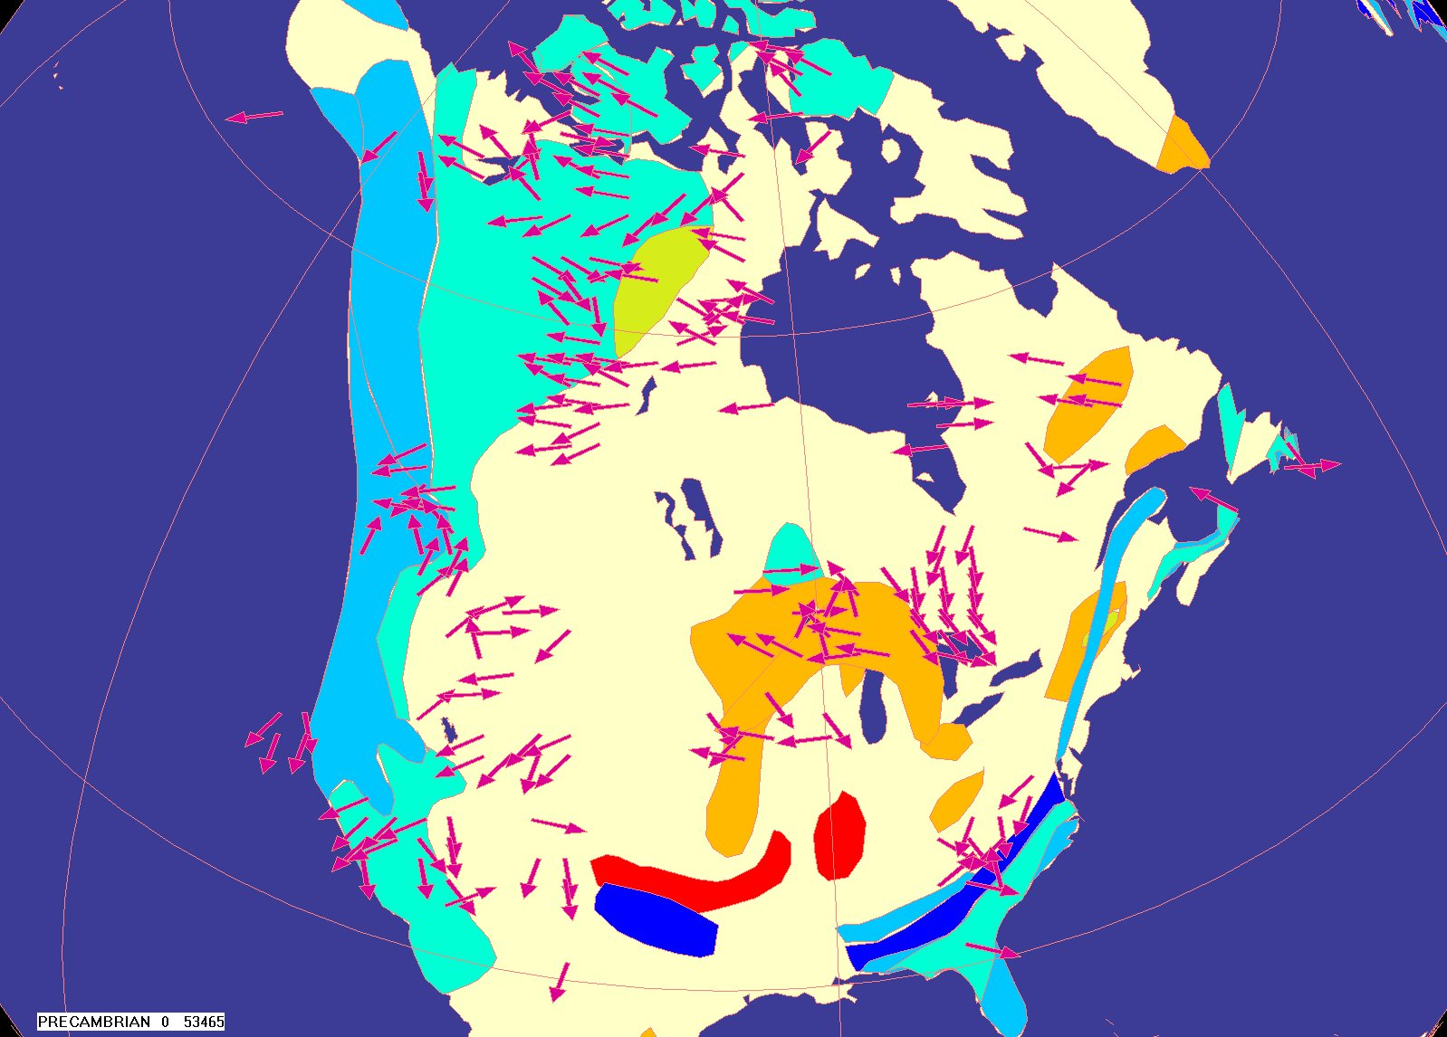
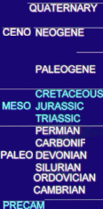
f

Slide 22
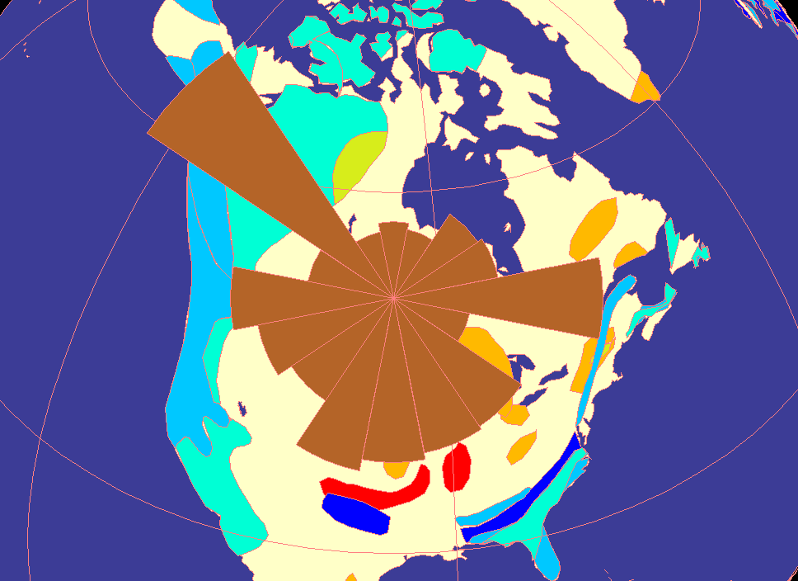
f

Slide 23
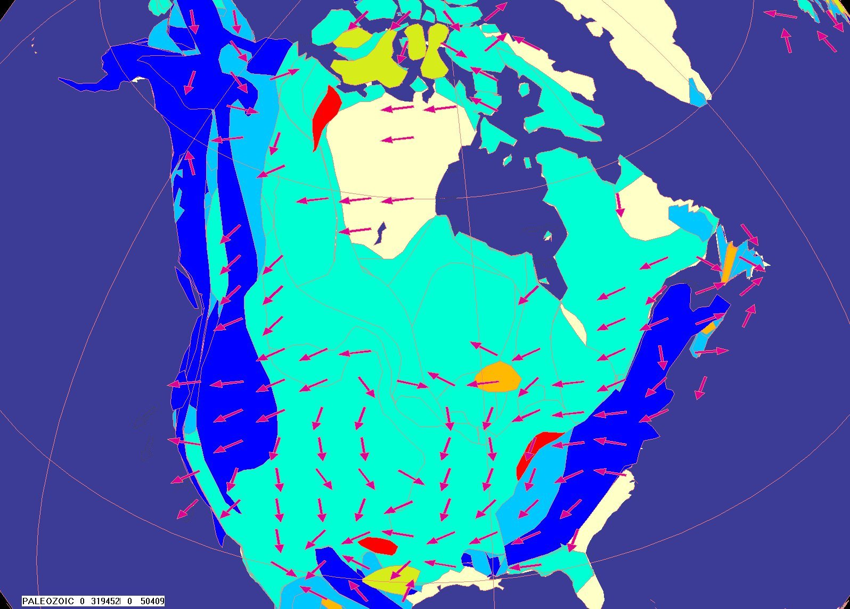
f

Slide 24
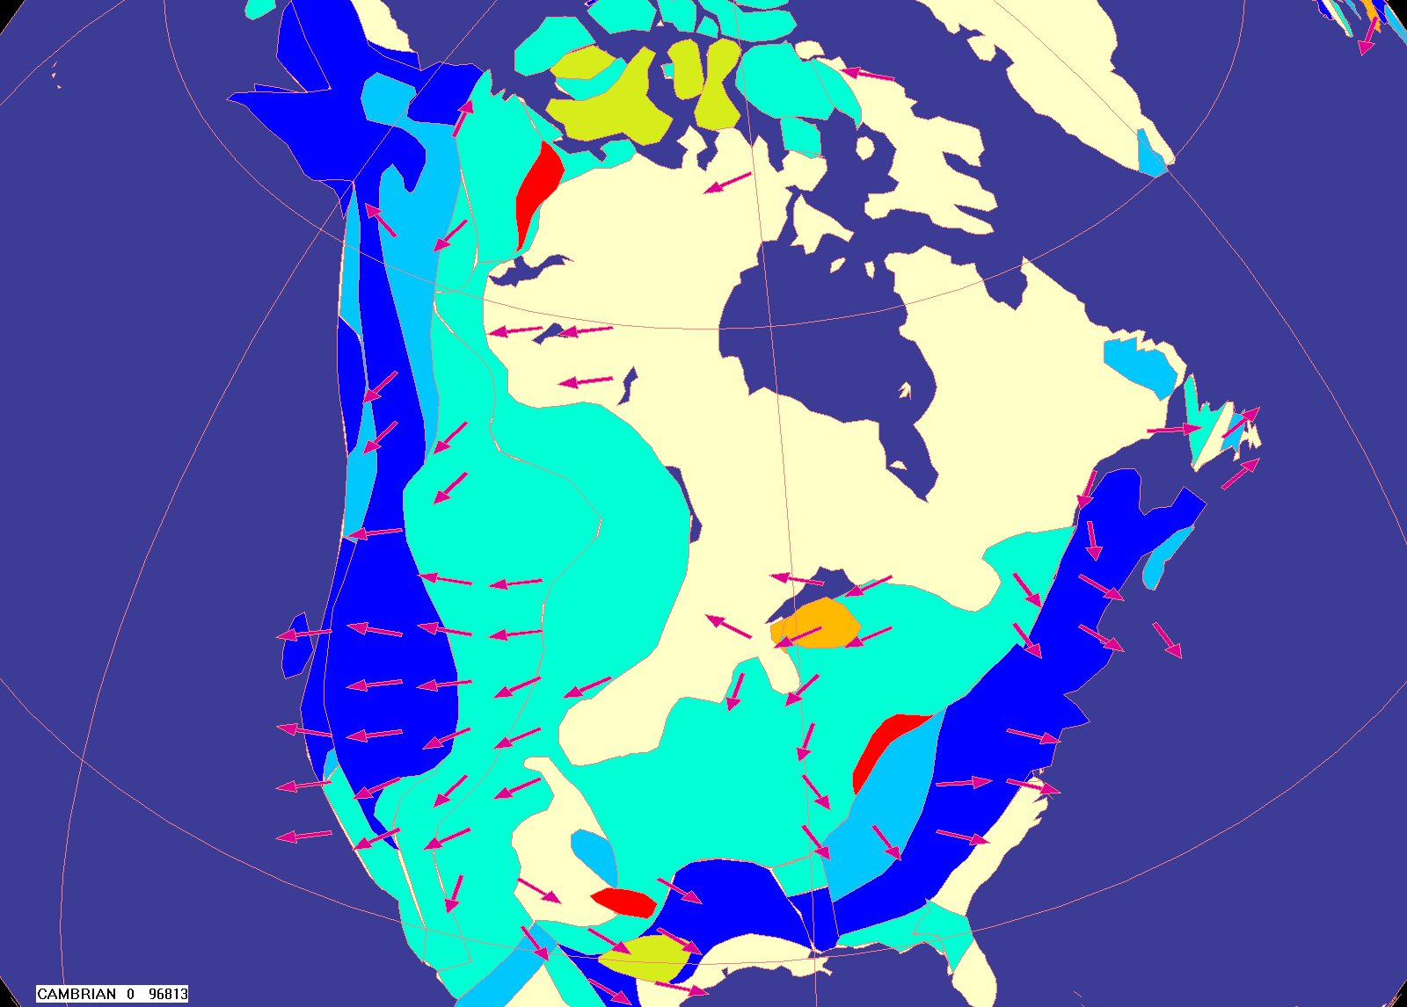
f

Slide 25
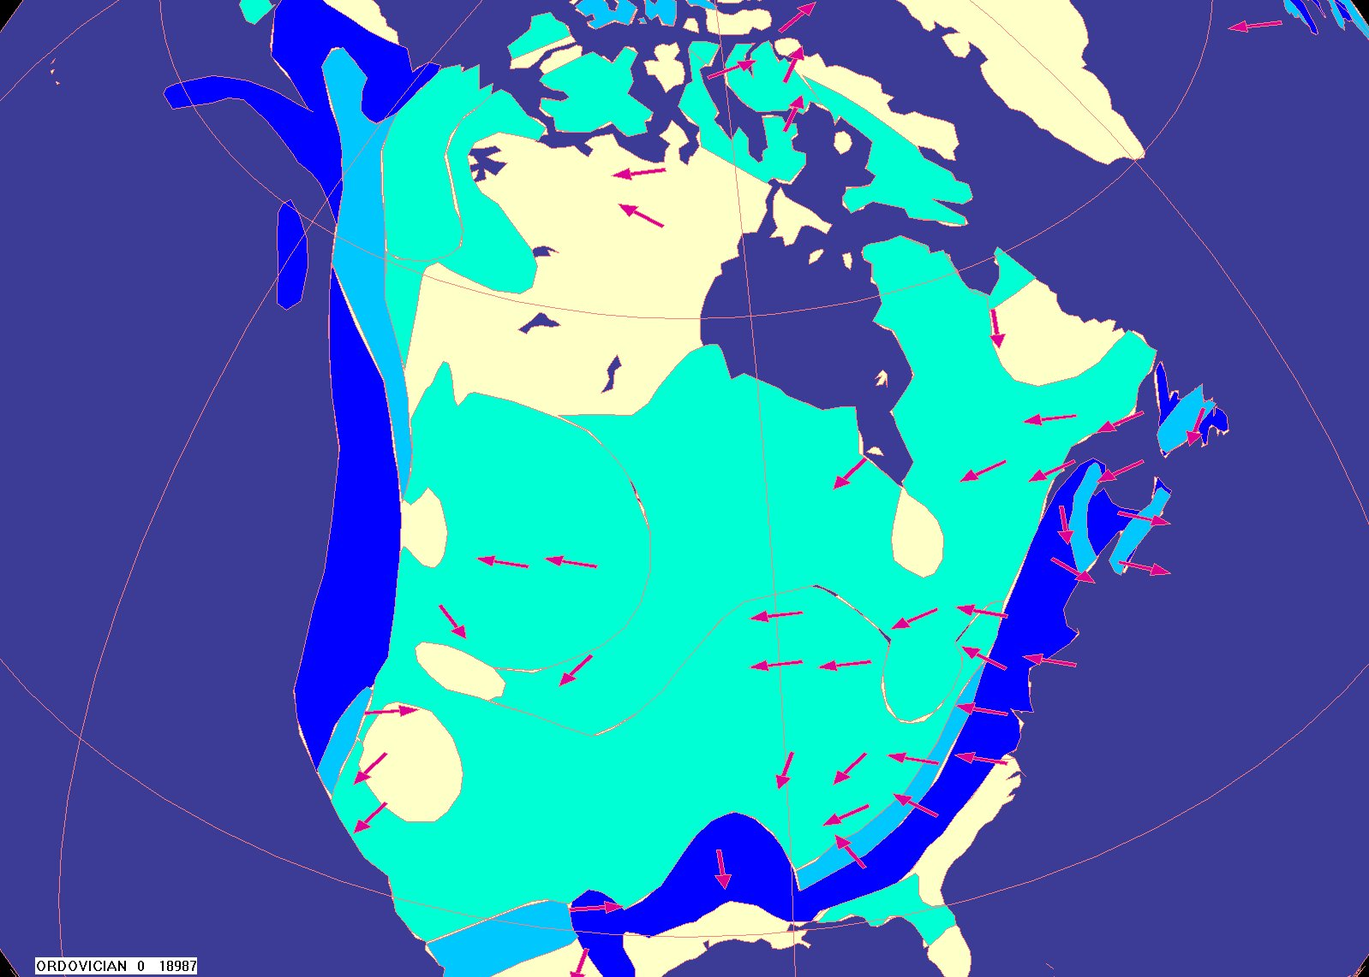
f

Slide 26
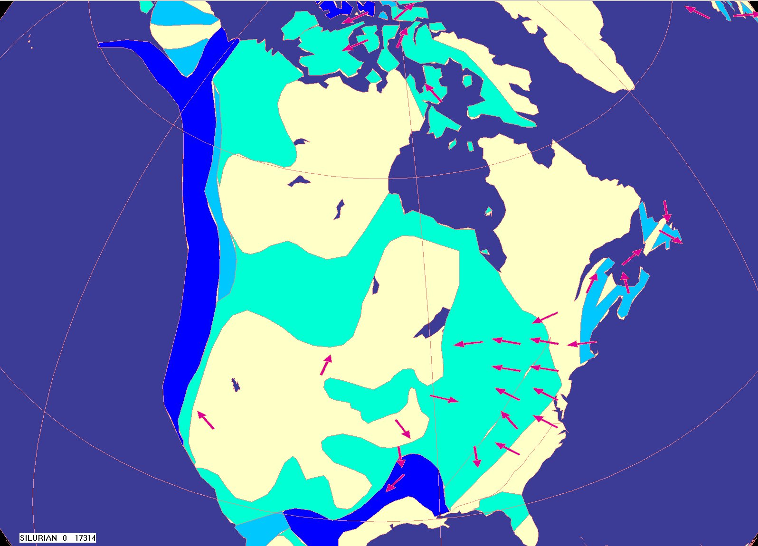
f

Slide 27
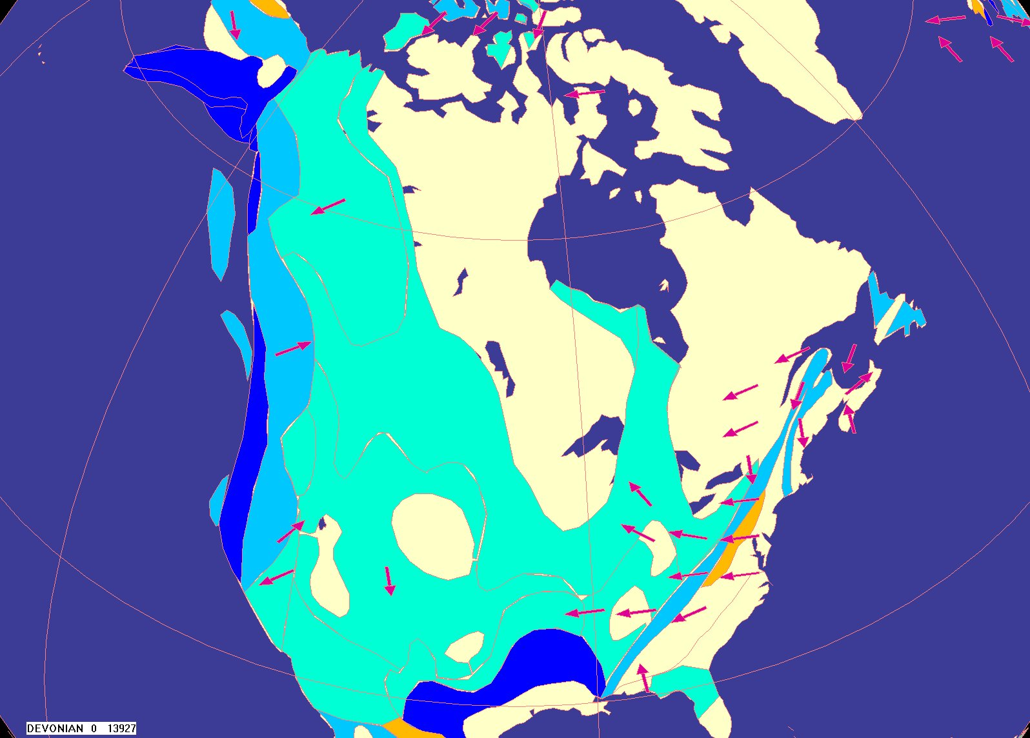
f

Slide 28
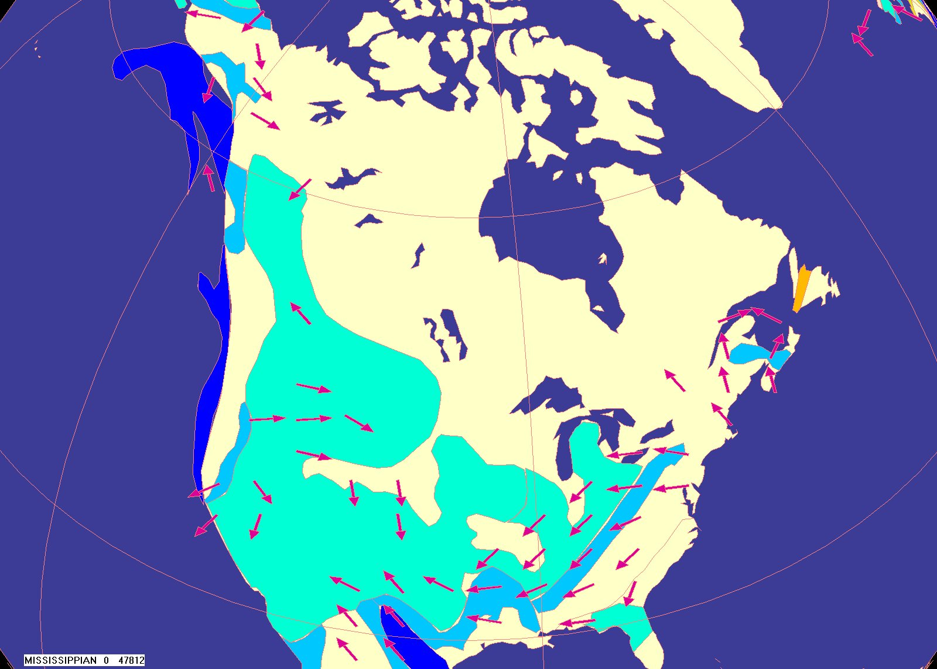
f

Slide 29
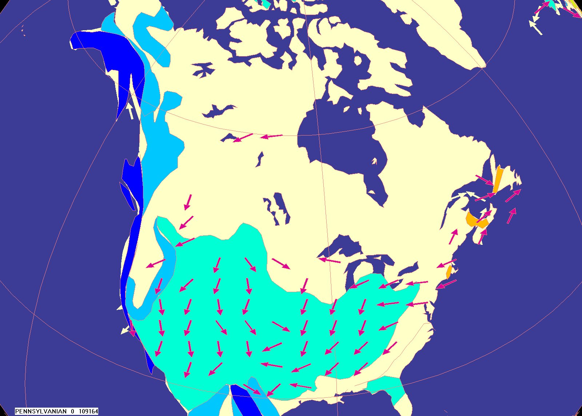
f

Slide 30
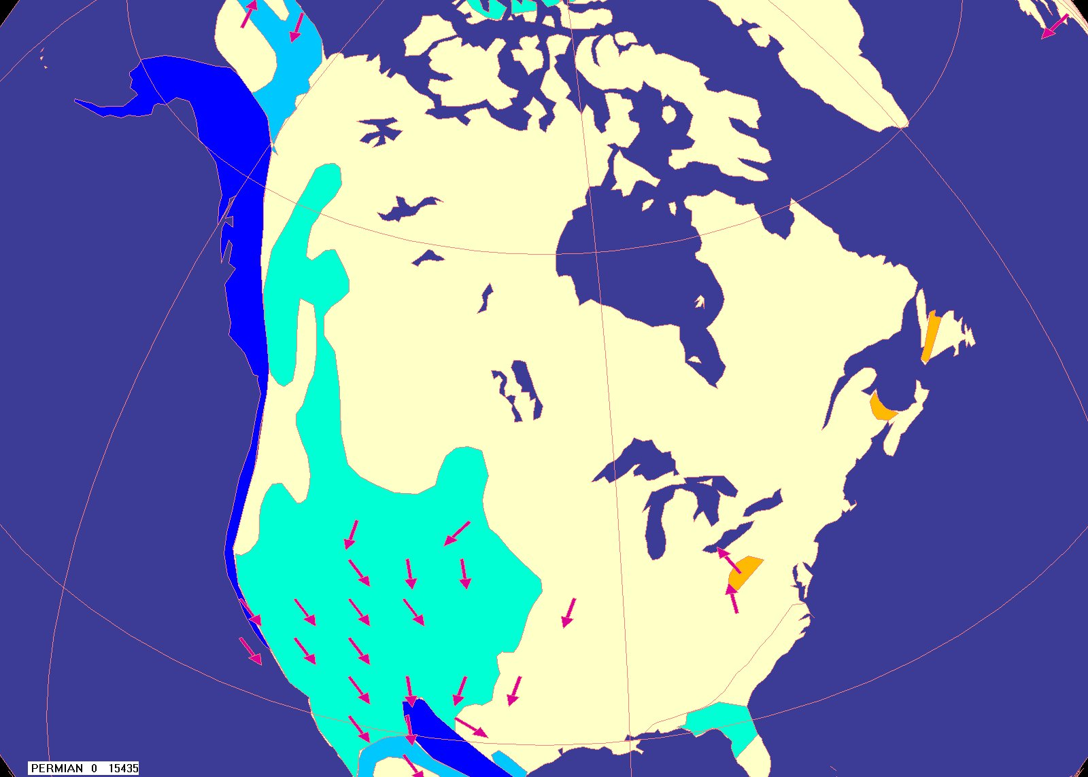
f

Slide 31
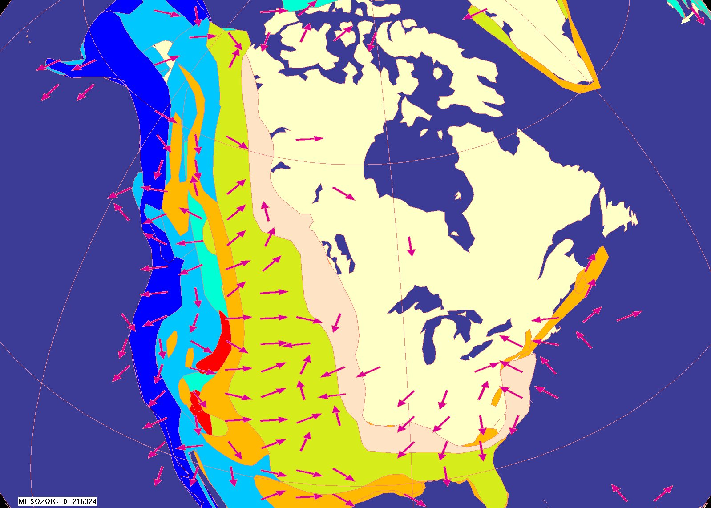
f

Slide 32
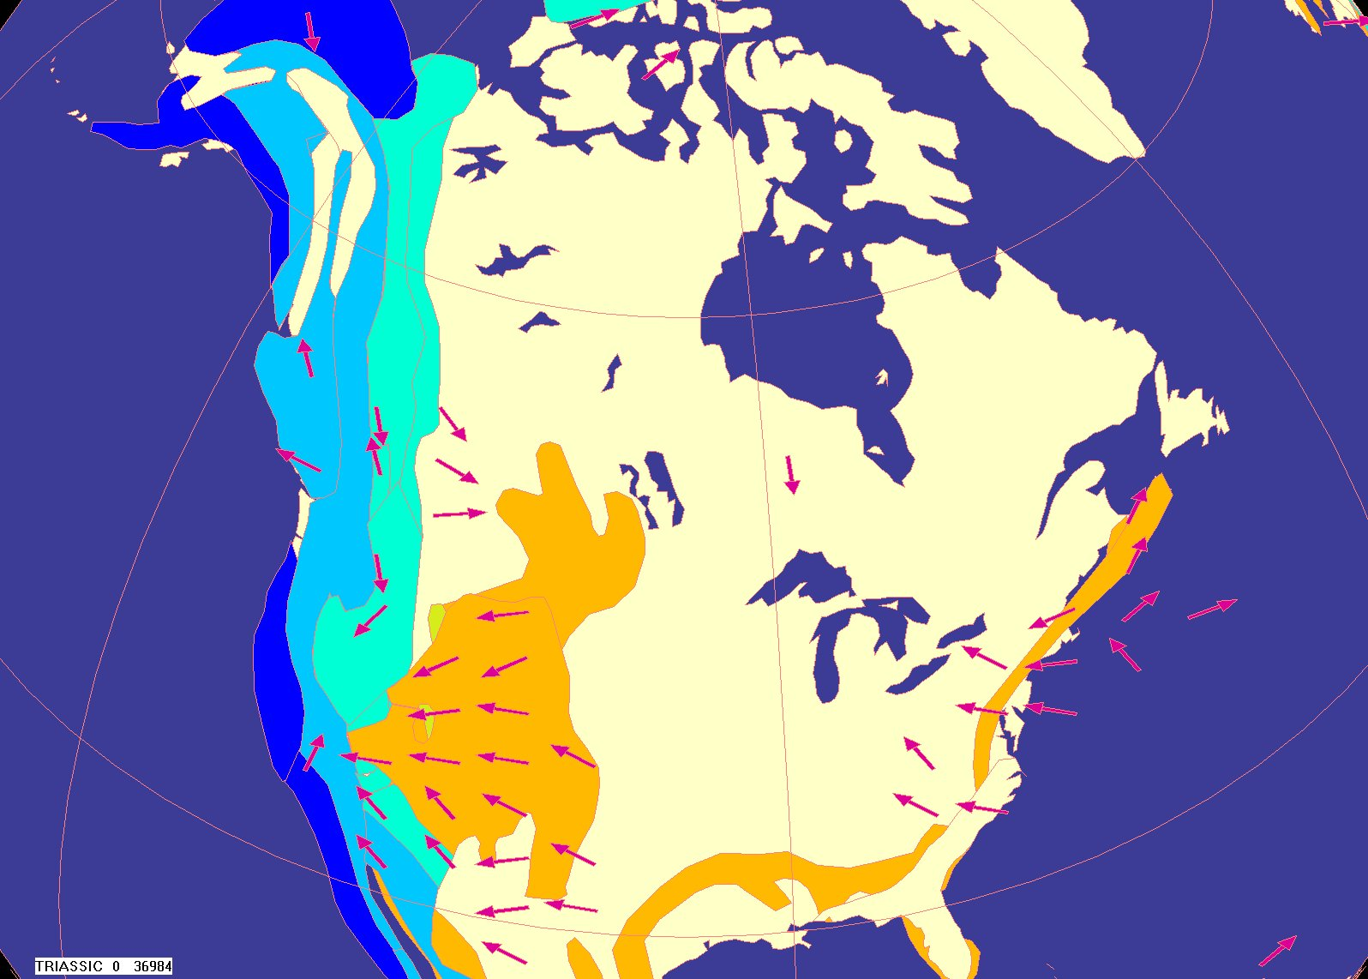
f

Slide 33
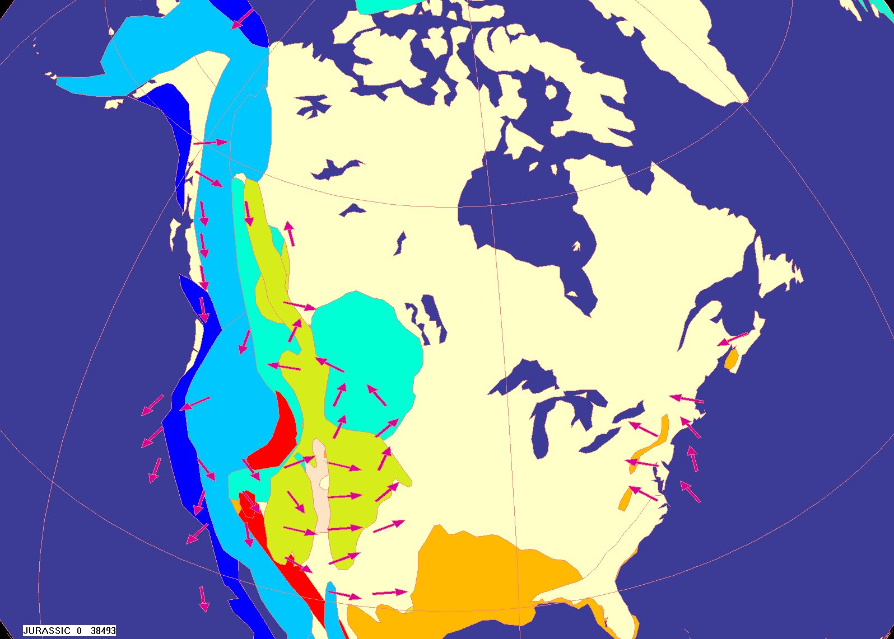
f

Slide 34
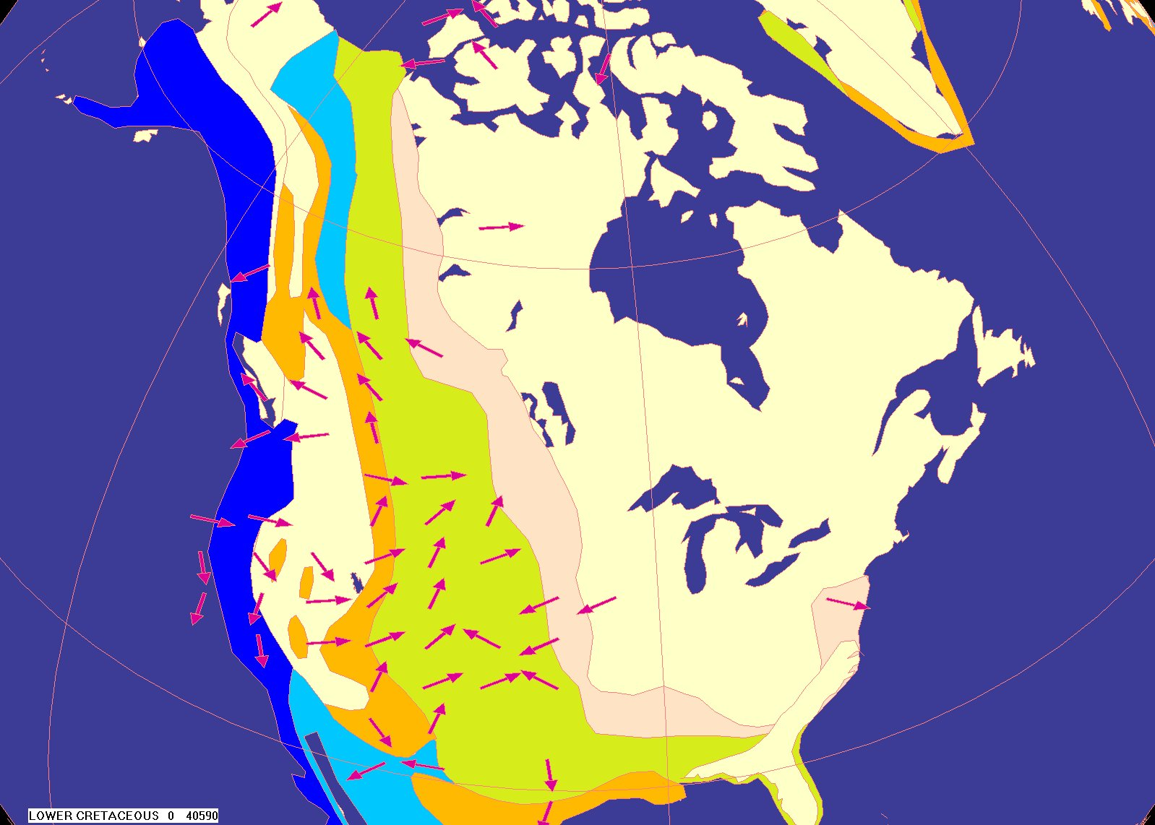
f

Slide 35
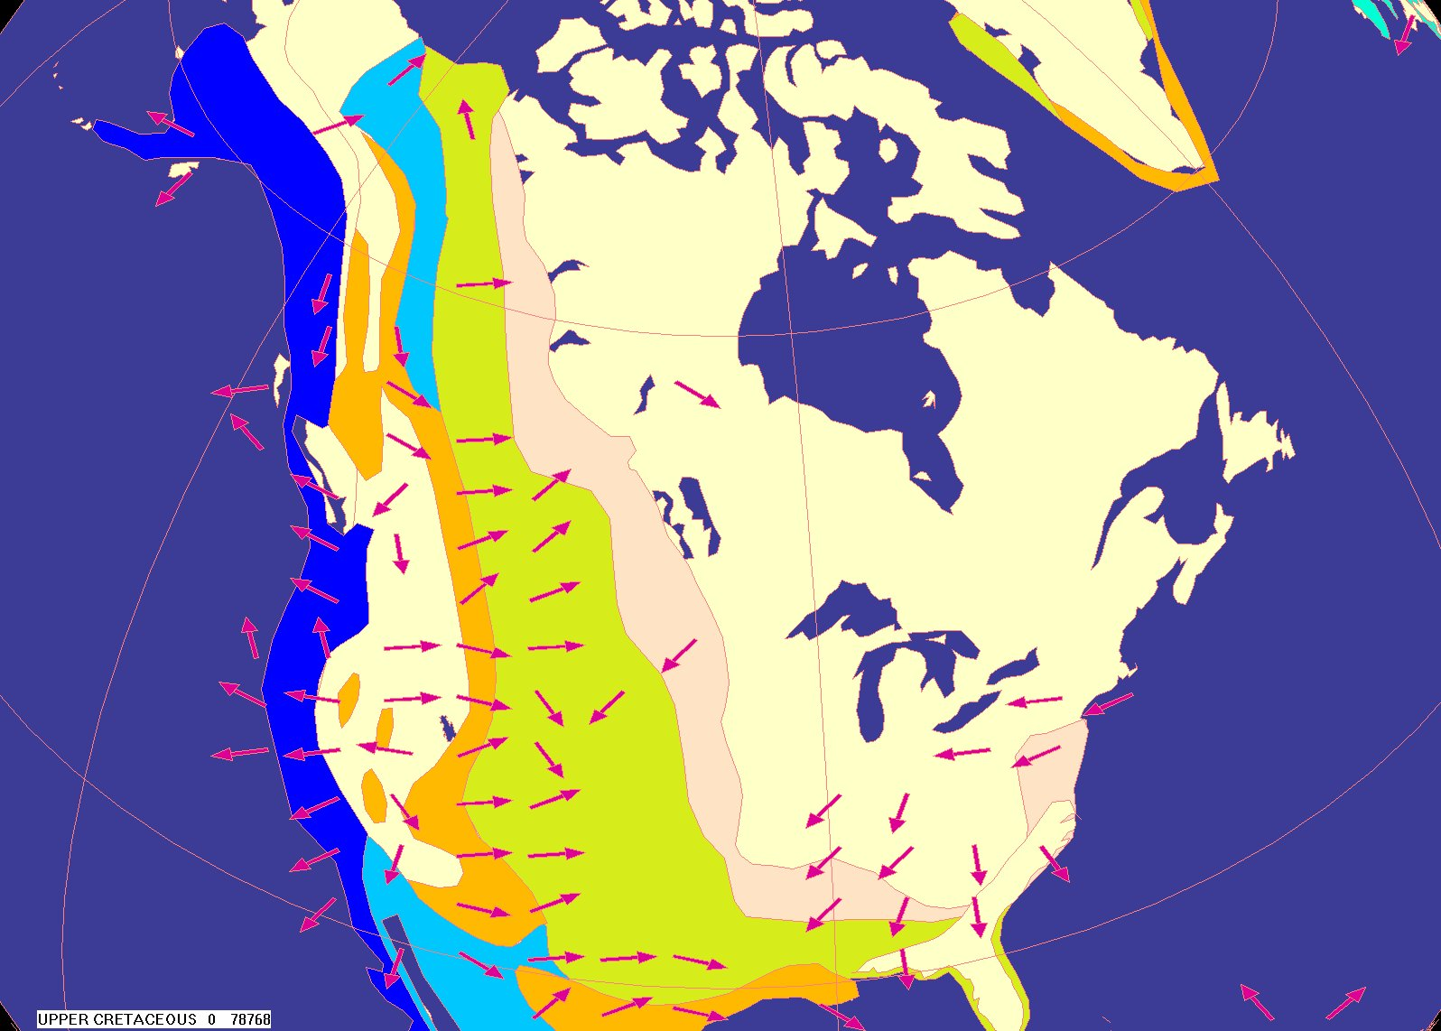
f

Slide 36

f

Slide 37
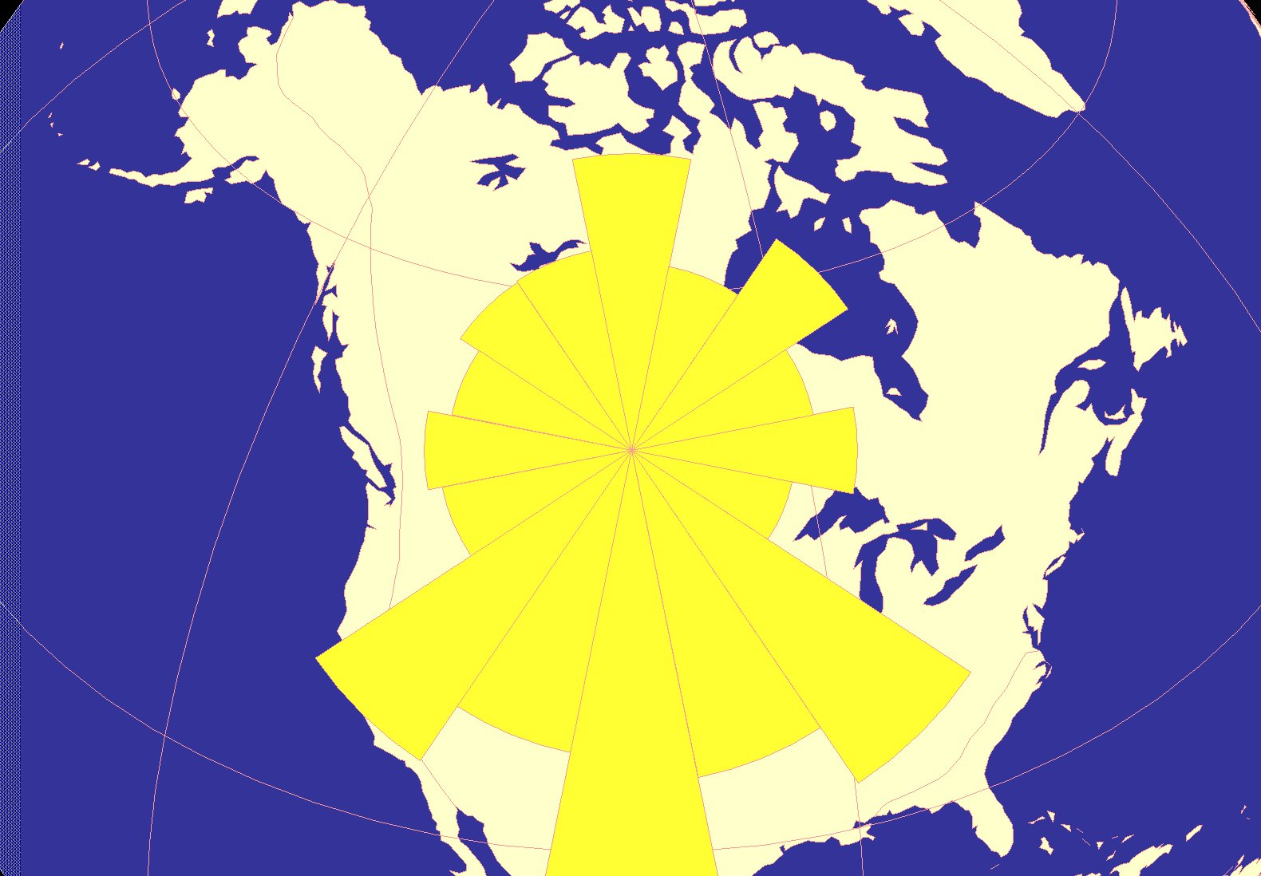
f
Paleogene

Slide 38
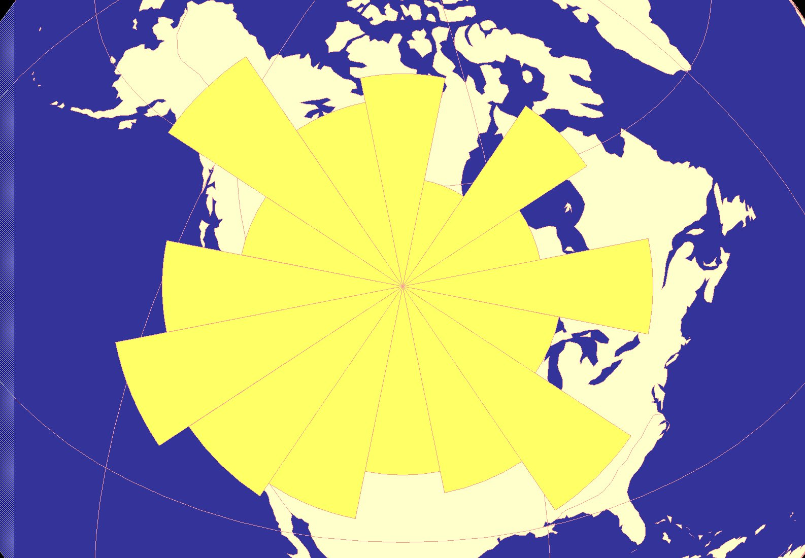
f
Neogene

Slide 39
Summary:
Precambrian: North American paleocurrents are variable and show no distinctive continent-wide patterns.
Paleozoic: Paleocurrents show patterns that are continent-wide and typically flow towards the southwest across the continent.
Mesozoic: Patterns are continent-wide and typically flow toward the east across the continent.
Cenozoic: North American paleocurrents are again variable and do not show continent-wide patterns.

Slide 40
Summary (cont):
These trends are not expected in the model of conventional basinal geology.
Trends show processes were active that were larger than those predicted for conventional geologic models, suggesting such models may be inadequate.
Such trends seem to be consistent with a process such as the Genesis flood, but other explanations may be forthcoming.

Slide 41
Paleocurrents
What are Paleocurrents and why might they be useful to us?
Where do we get them and how can we interpret them?
What are the results for North America through geologic time?
What are the results on a global scale through geologic time?
How can we use this information to better understand the history of the earth?

Slide 42
Supracontinental Megatrends
Patterns on Pangaea
Problem:
  Conventional geology has not typically been thought of on this scale.
  Evidence of continent-wide trends is anomalous, but recognized.
  Basin-limited supracontinental paleocurrents were one of the lines of evidence supporting plate tectonics. What was happening outside the basin?
Can we see any supracontinental trends in paleocurrent patterns, and if so, what do they tell us?

Slide 43
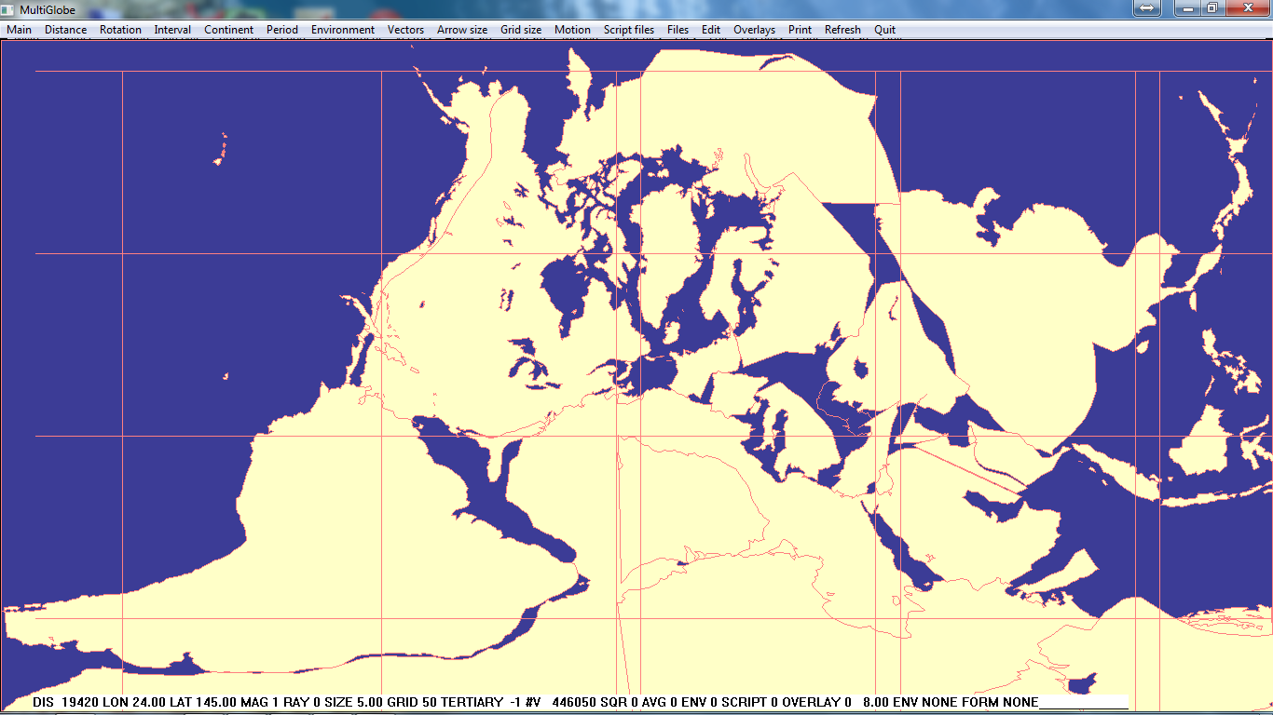

Slide 44
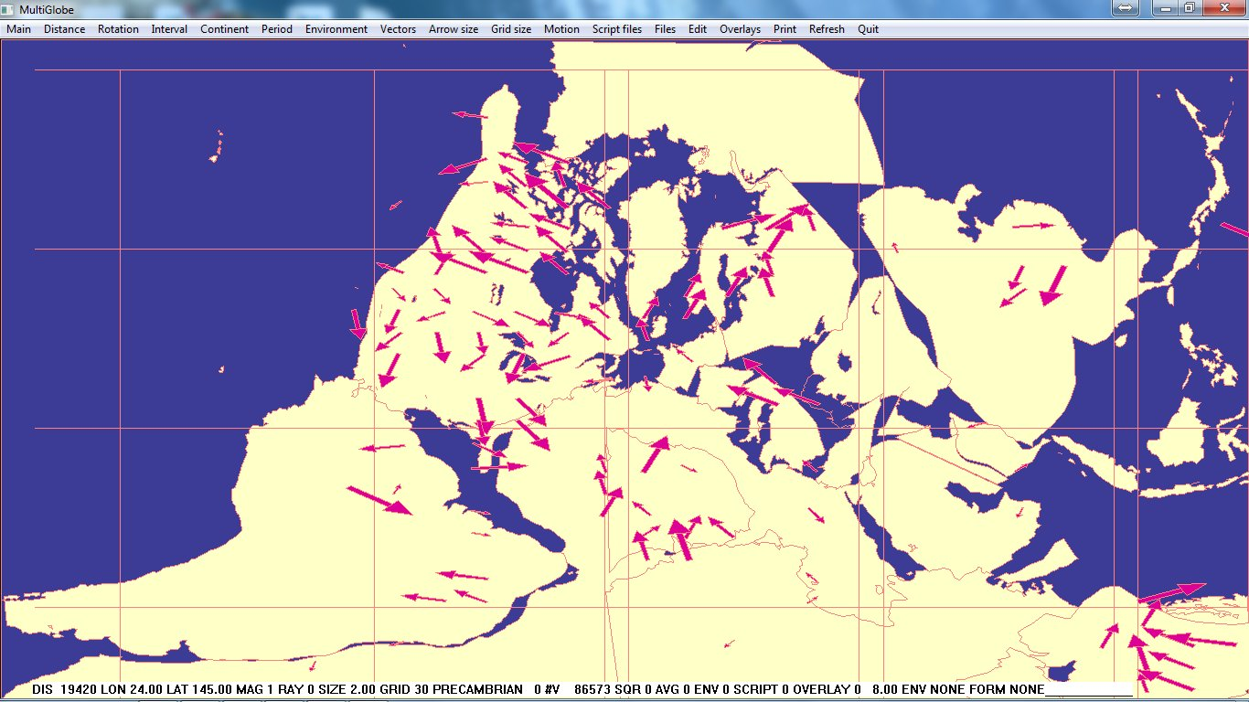
!

Slide 45
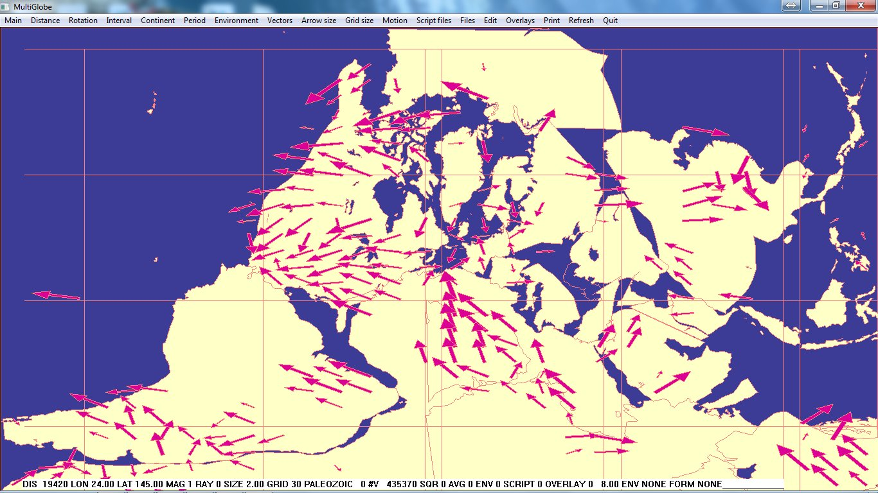
!

Slide 46
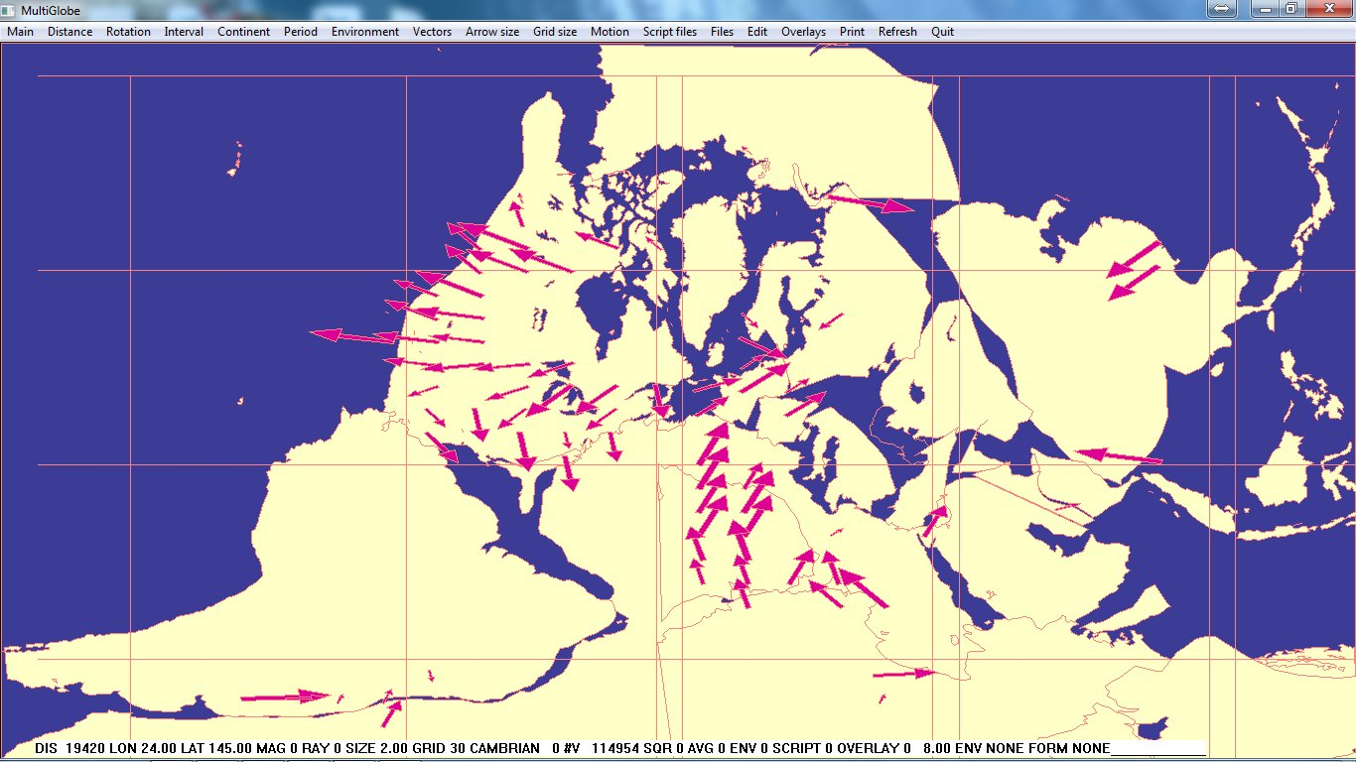
!

Slide 47
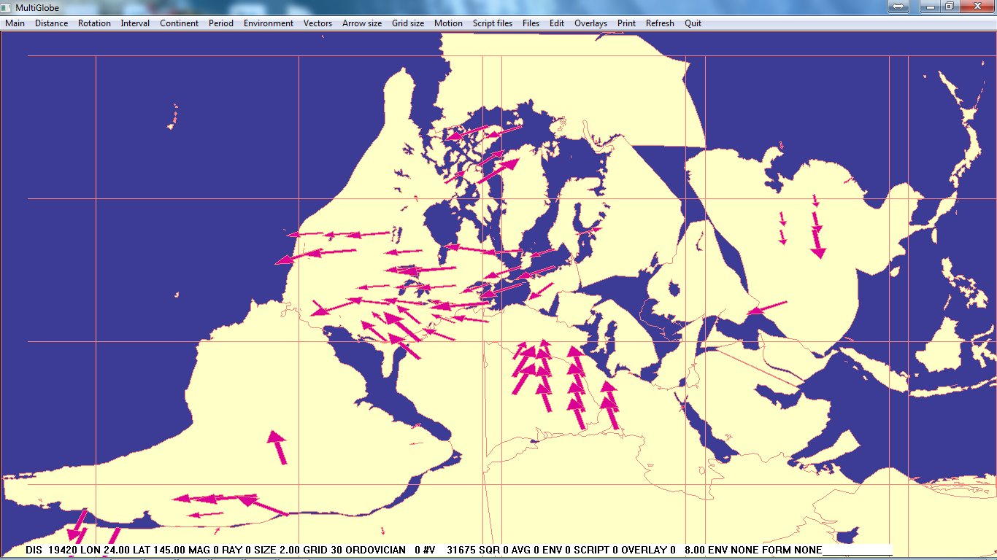
!

Slide 48
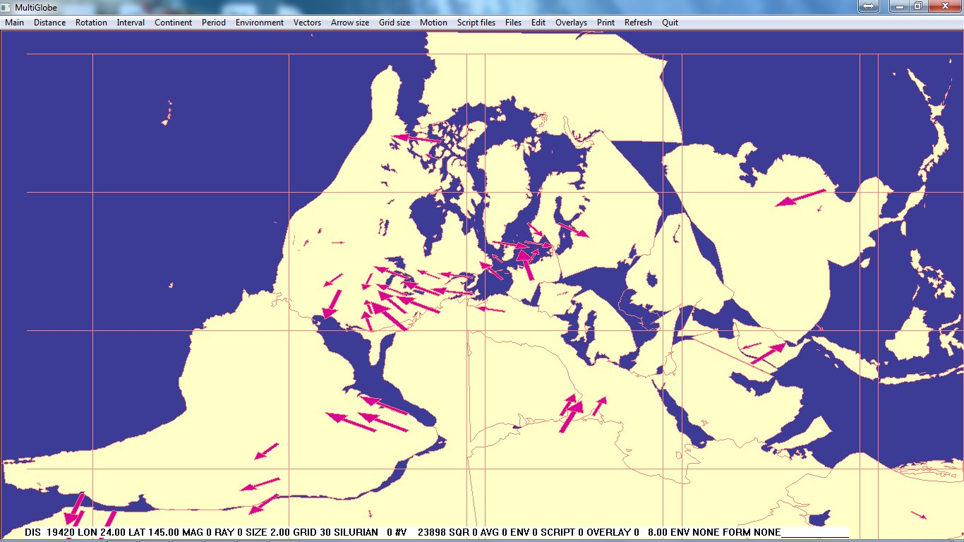
!

Slide 49
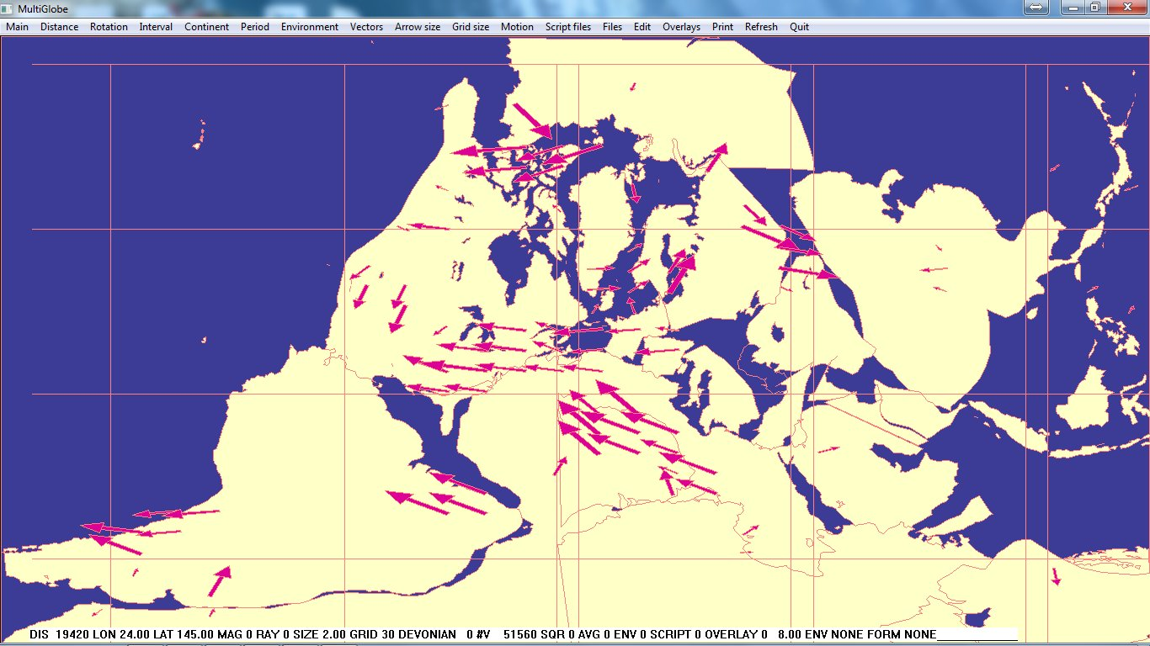
!

Slide 50
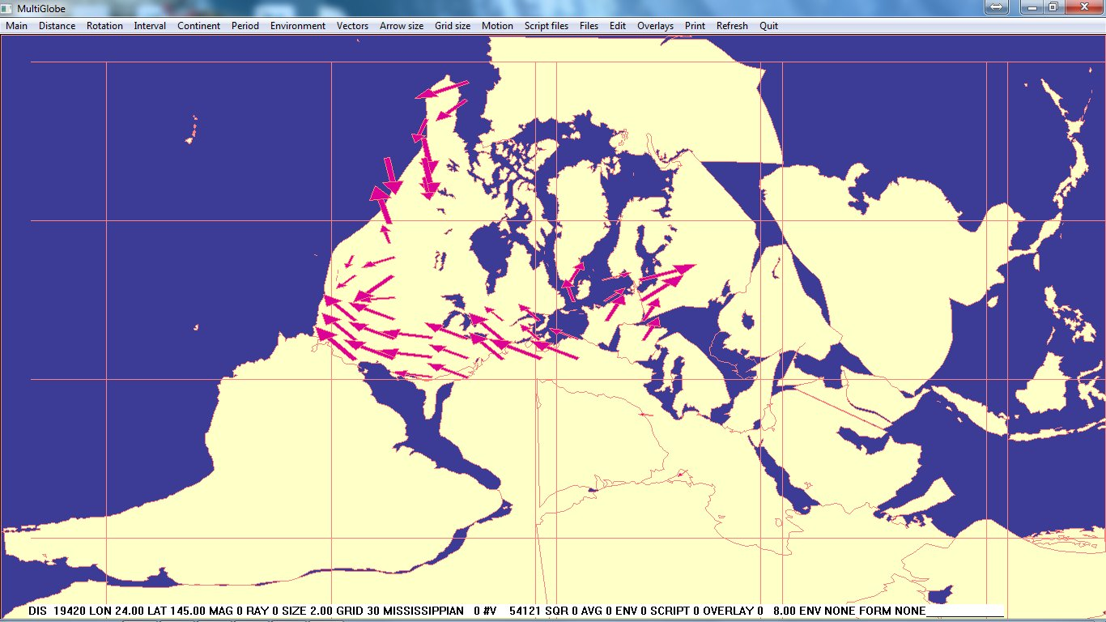
!

Slide 51
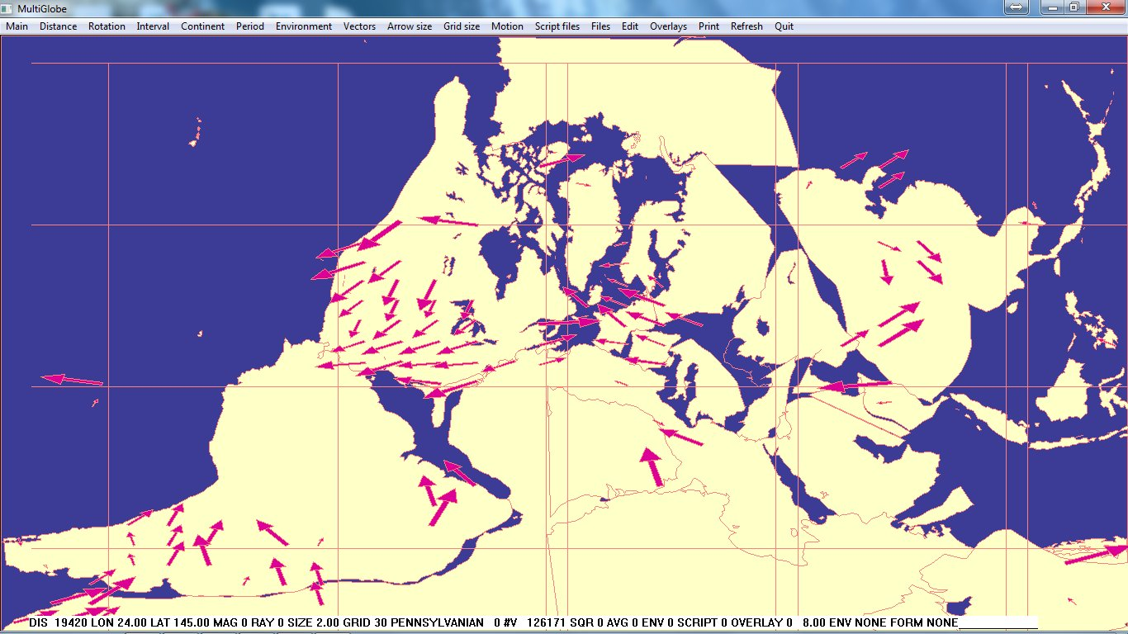
!

Slide 52

!

Slide 53
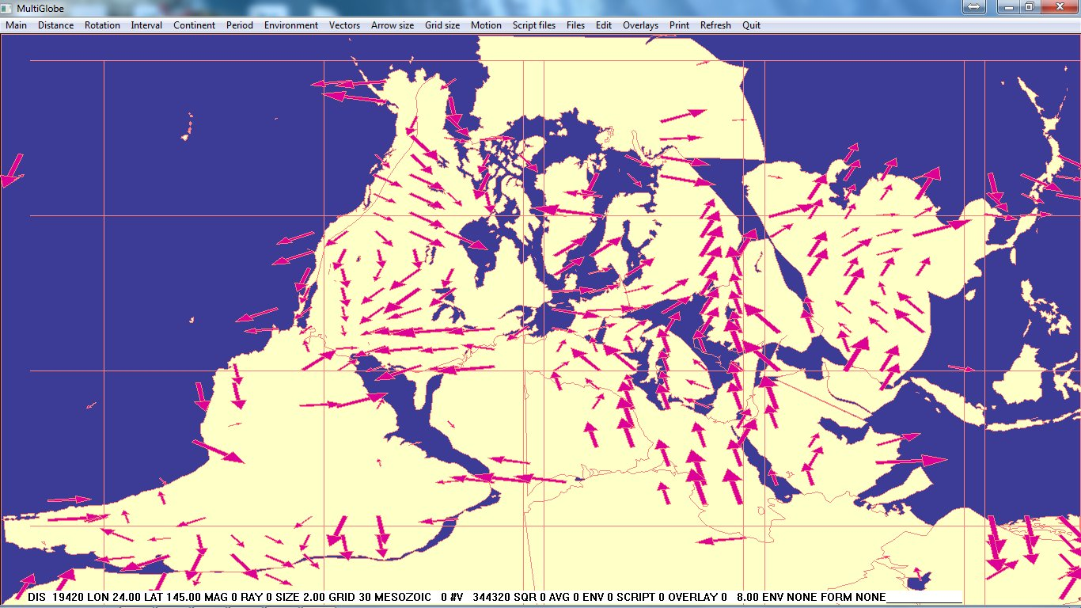
!

Slide 54
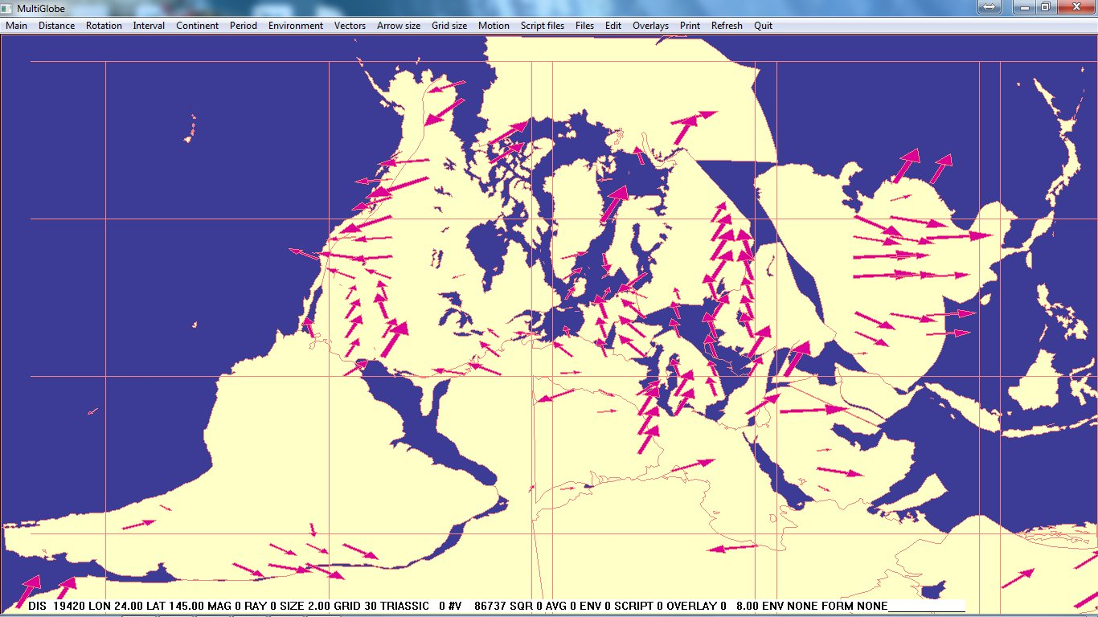
!

Slide 55
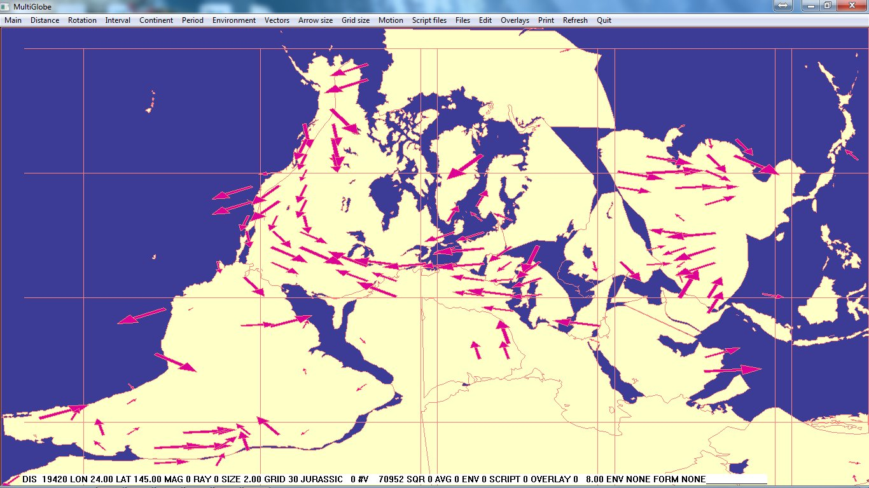
!

Slide 56
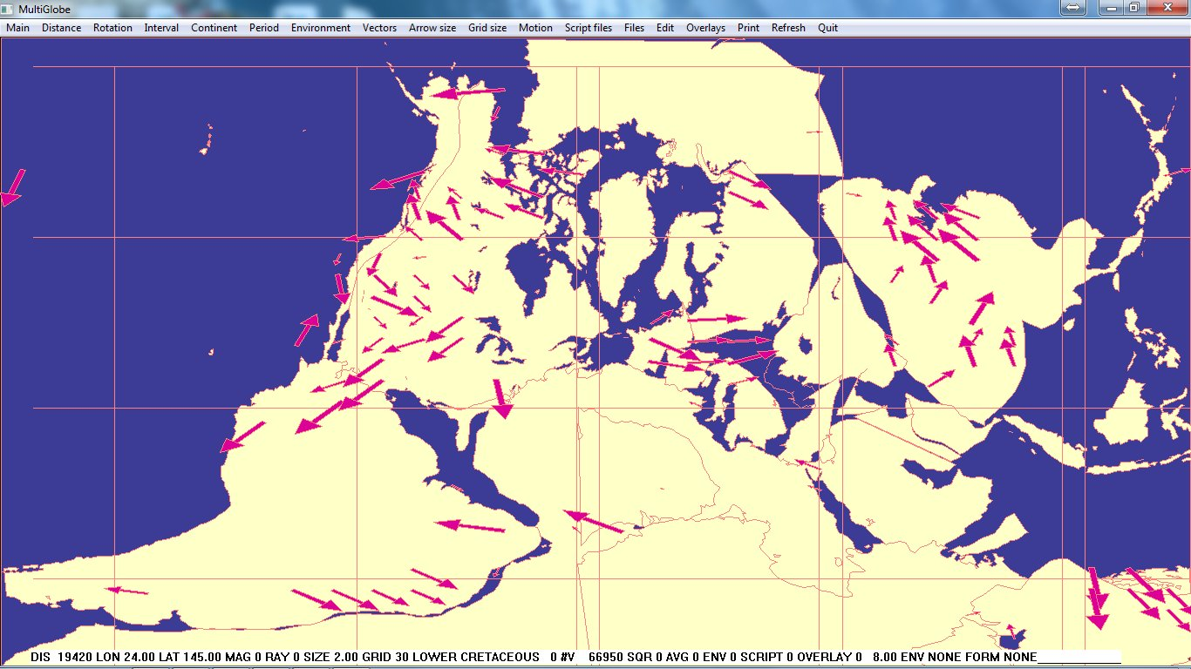
!

Slide 57
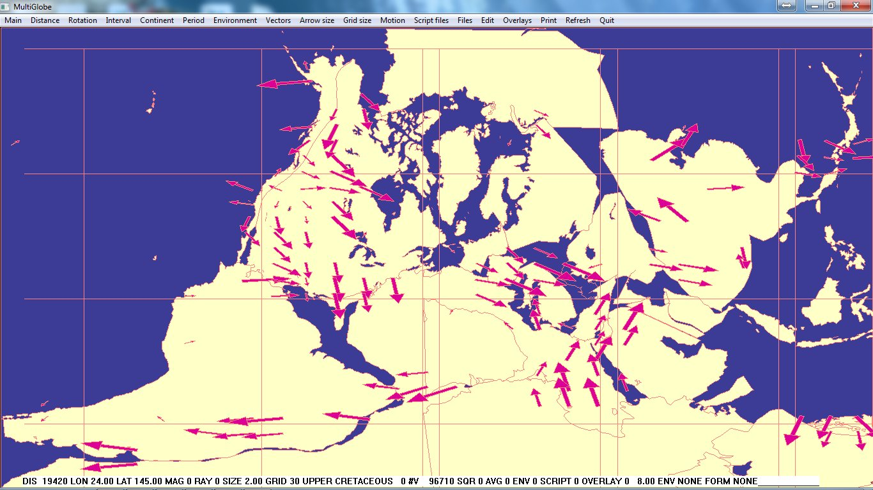
!

Slide 58
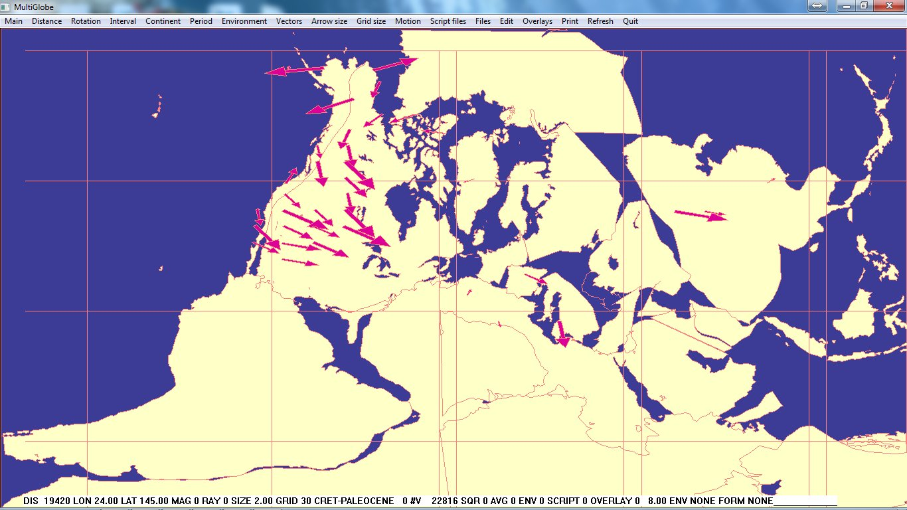
!

Slide 59
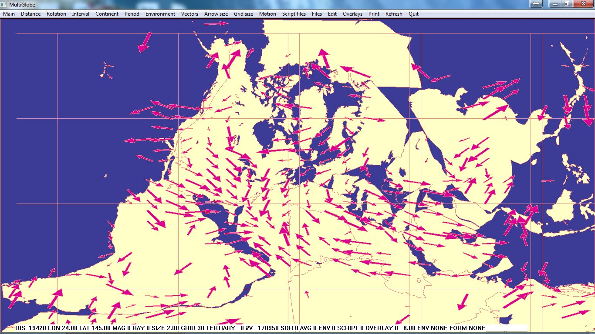
!

Slide 60
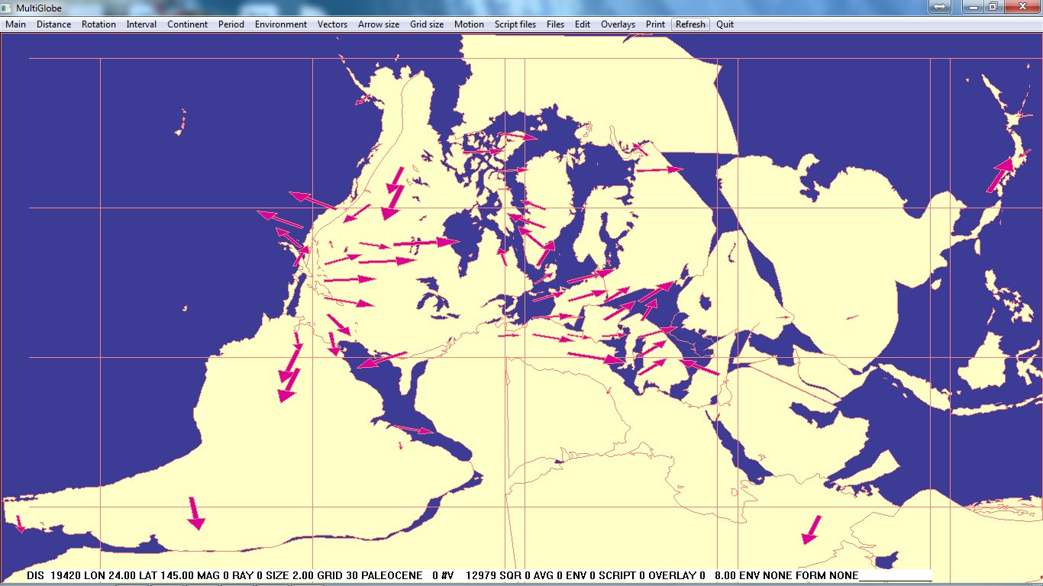
!

Slide 61
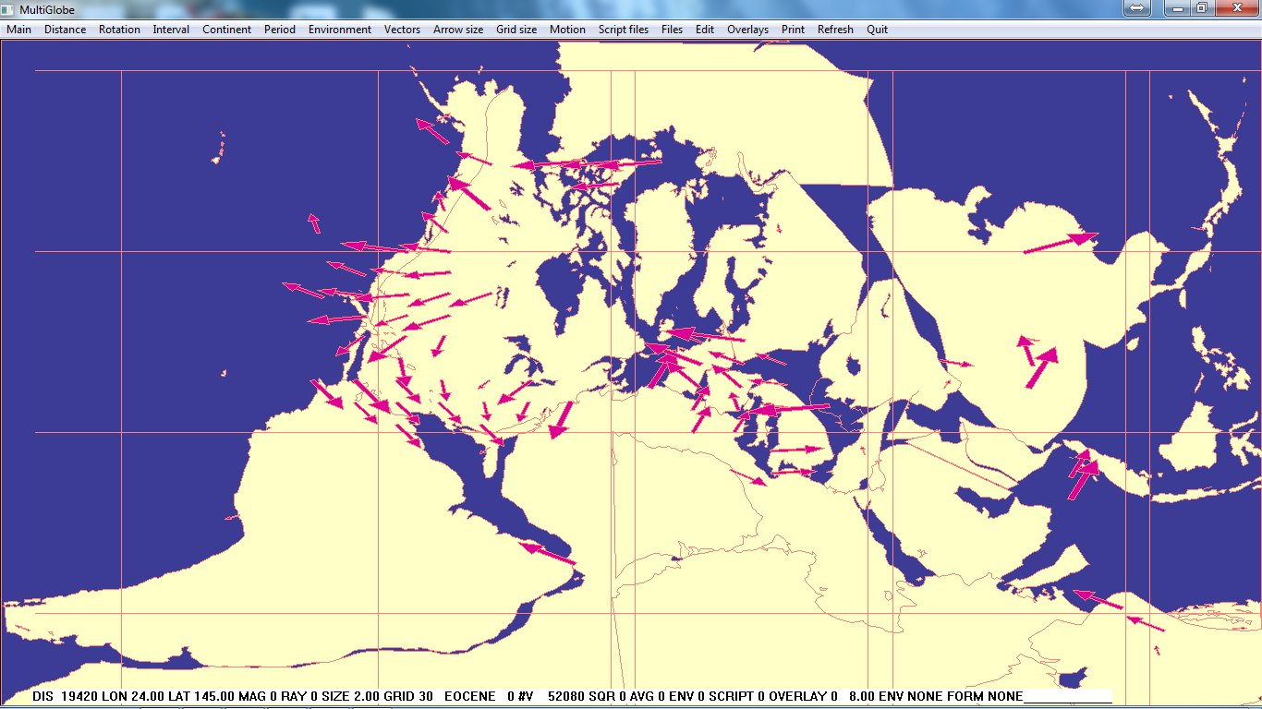
!

Slide 62

!

Slide 63

!

Slide 64

!

Slide 65

!

Slide 66

!

Slide 67

!

Slide 68
Conclusions
Continent-wide paleocurrents are unexpected (anomalous) but recognized and probably could be accommodated in conventional models.
Supracontinental (megatrends) are unexpected and unrecognized and probably cannot be accommodated in conventional models.
A global catastrophic flood is consistent with the observations and worthy of further consideration.

Slide 69
Paleocurrents
What are Paleocurrents and why might they be useful to us?
Where do we get them and how can we interpret them?
What are the results for North America through geologic time?
What are the results on a global scale through geologic time?
How can we use this information to better understand the history of the earth?

Slide 70
The End

Slide 71
The End

Slide 72
The End

Slide 73
The End

Slide 74
South America, Details

Slide 75


Slide 76


Slide 77


Slide 78


Slide 79


Slide 80


Slide 81


Slide 82


Slide 83


Slide 84


Slide 85


Slide 86


Slide 87


Slide 88


