Slide 1
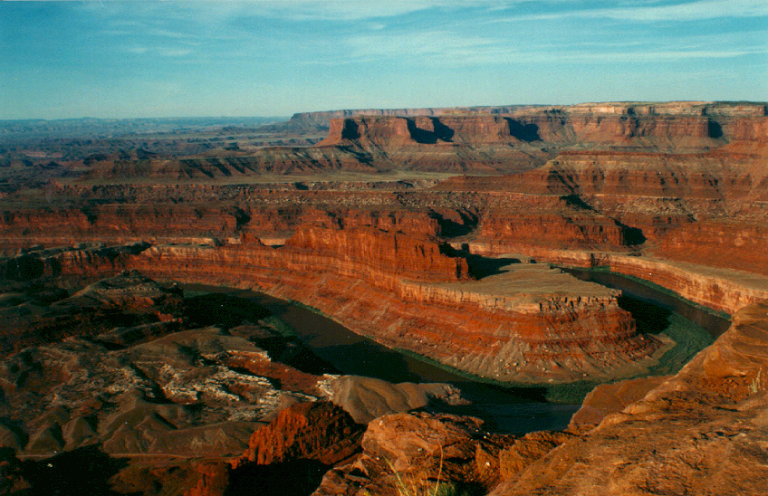
Radiocarbon dating

Slide 2
What is an atom?
An atom is the smallest part of a substance that still has all the properties of that substance.

Slide 3

What is an atom?
All materials are composed of atoms
Atoms are very small. In fact even for something really heavy like iron, if you had 600,000,000,000,000,000,000,000 atoms, they would only weigh 56 grams, about the weight of a single hen’s egg.

Slide 4
What are atoms made from?
Atoms are composed of a nucleus and an electron cloud.
The nucleus of atoms is composed of two kinds of particles, protons and neutrons in approximately equal numbers.
Protons have a positive charge and weigh one AMU.
Neutrons have no charge and weigh one AMU. They are
essentially a proton combined
with an electron.

Slide 5
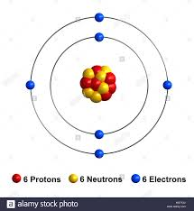
The electron cloud
The electron cloud of the atom consists of a number of electrons outside the nucleus,
The number of electrons is equal to the number of protons in the nucleus. Electrons have a negative charge but they weigh very little.

Slide 6
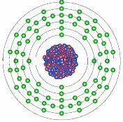
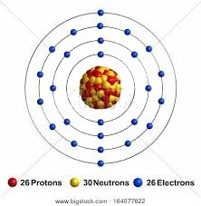
What determines the physical properties of an atom
The number of protons in the nucleus determines what substance the atom is.
Carbon Iron Gold 79
6 26 92

Slide 7
Periodic table of the Elements

Slide 8
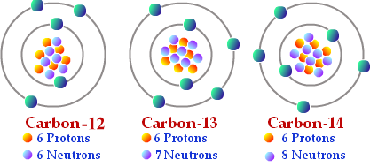
What do the neutrons do?
Neutrons allow the positively charged protons to live happily together in the nucleus.
Their number can vary without affecting the physical properties of the atom, except for the weight. Such variants are called isotopes.

Slide 9
Radioactive isotopes
Some isotopes are stable, such as Carbon-12, and Carbon-13. That means that over any time period that we can measure, they remain Carbon-12 or Carbon-13.
Some isotopes, for reasons we do not understand very well, are unstable. They break down at a rate that can be measured, to become atoms of something else.
Carbon-14 is an unstable isotope of carbon. Such isotopes are called “Radioactive” because they were originally detected using an electronic radio-like apparatus that gave off a audible click when a decay was detected.

Slide 10
Radioactive decay
Since we are concerned with Carbon-14 in this talk, I will focus on just this isotope for the rest of the presentation, but know that there are radioactive isotopes of other elements that are also used for dating rocks.
Radioactive Carbon-14 breaks down at a rate such that half of the atoms will be gone in 5700 years. So if we have 10 atoms today, in 5700 years we will have 5 atoms. This time to lose half of the atoms is called the half life.

Slide 11
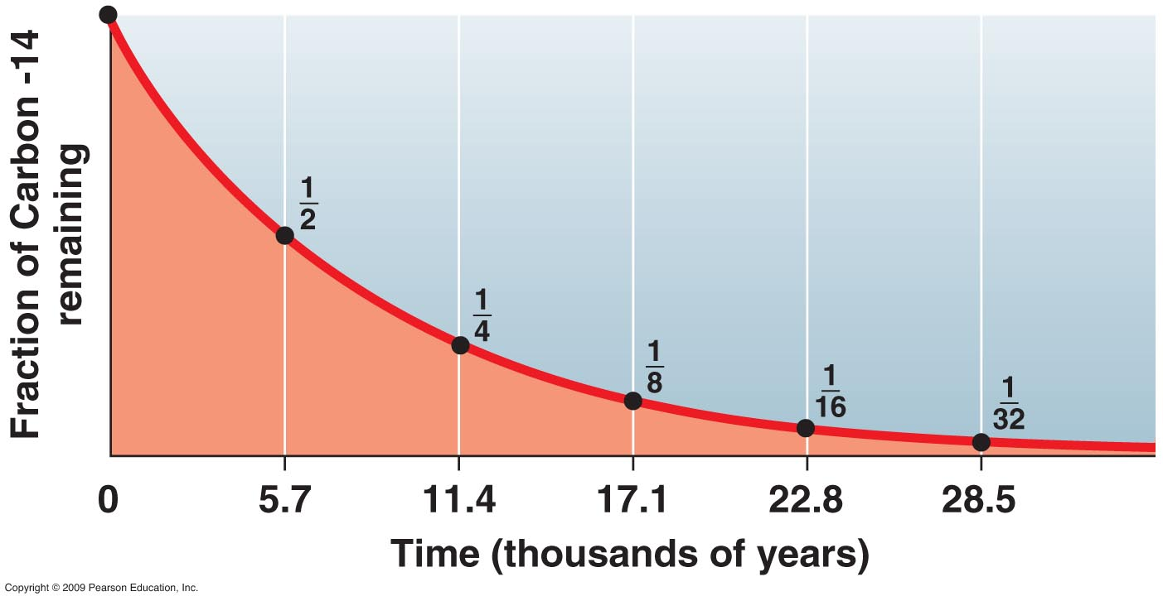
Half-life curve

Slide 12
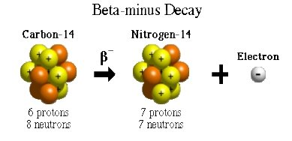
Radioactive decay of ¹⁴C
When Carbon-14 decays, one of the neutrons loses an electron (-) and becomes a proton (+).
Since there are now a different number of protons, it must be a different substance. The Carbon-14 atom is now an atom of Nitrogen-14.

Slide 13
Periodic table of the Elements

Slide 14
Periodic table of the Elements

Slide 15
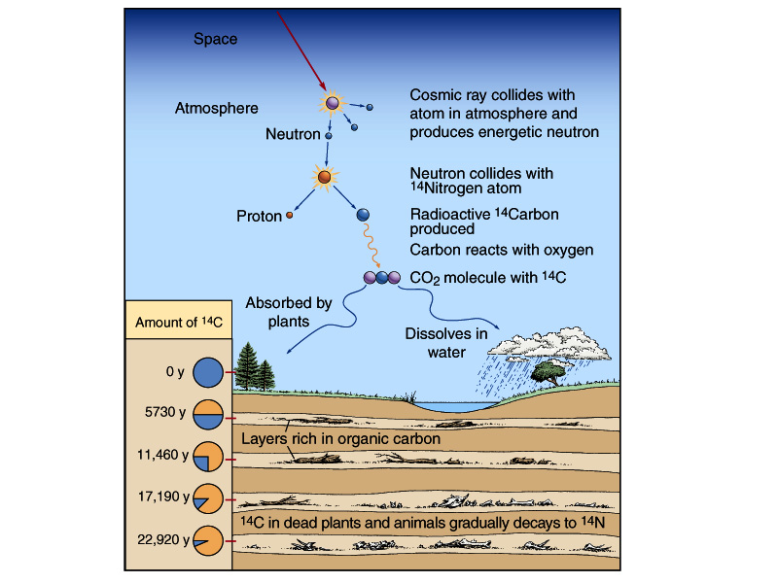
Carbon-14 radiometric clock

Slide 16
What Assumptions Have We Made?
Decay rate constant over time
Decay is unaffected by pressure and temperature
No C-14 atoms have escaped or been added
Starting amount of C-14 is known
Other assumptions, some of which may not be known to us yet …

Slide 17
Things to understand about 14C dating
Dates fossils (organic remains), not generally rocks.
Limited to about 50,000 radiometric years.
Dependent on atmospheric level of radiocarbon at time organism was alive.
Generally calibrated by tree rings, which are in turn calibrated by C-14 (!)
Radiocarbon can be exchanged with normal carbon from the environment after death.
Finding a control blank is a formidable problem for the method. Even diamonds thought to be a billion years old appear to contain some radiocarbon.

Slide 18
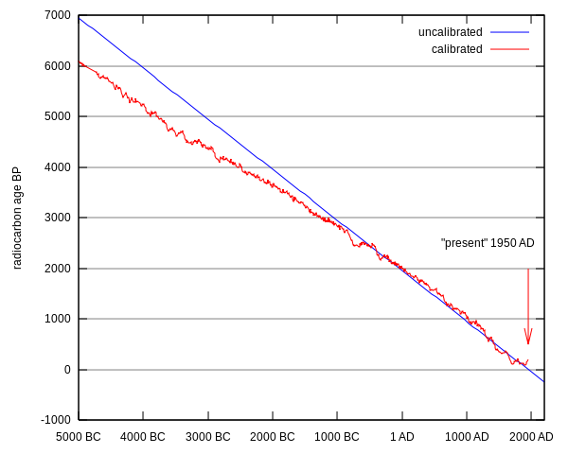
Deviations from expected decay curve

Slide 19
When C-14 dating doesn’t work – or does it?
Dinosaur | Lab/method/fraction | ¹⁴C Years B.P. | δ13C/ pMC | Report date | Discovery Location
1.Acrocanthosaurus | GX-15155-A/Beta/bio | >32,400 | -8.3/<1.78 | 1/10/1989 | Texas
2.Acrocanthosaurus | GX-15155-A-AMS/bio | 25,750 ± 280 | -8.3/4.08 | 6/14/1990 | Texas
3.Acrocanthosaurs | AA-5786-AMS/bio/scrape | 23,760 ± 270 | /5.22 | 10/23/1990 | Texas
4.Acrocanthosaurus | UGAMS-7509a/AMS/bio | 29,690 ± 90 | -4.7/2.48 | 10/27/2010 | Texas
5.Acrocanthosaurs | UGAMS-7509b/AMS/bow | 30,640 ± 90 | -23.8/2.21 | 10/27/2010 | Texas
6.Allosaurus | UGAMS-02947/AMS/bio | 31,360 ± 100 | -6.6/1.98 | 5/1/2008 | Colorado
7.Hadrosaur #1 | KIA-5523/AMS/bow | 31,050 + 230/-220 | -28.4/2.10 | 10/1/1998 | Arkansas
8.Hadrosaur #1 | KIA-5523/AMS/hum | 36,480 + 560/-530 | -25.5/1.07 | 10/1/1998 | Arkansas
9.Triceratops #1 | GX-32372-AMS/col | 30,890 ± 200 | -20.1/2.16 | 8/25/2006 | Montana
10.Triceratops #1 | GX-32647-Beta/bow | 33,830 +2910/-1960 | -16.6/1.38 | 9/12/2006 | Montana
11.Triceratops #1 | UGAMS-04973a-AMS/bio | 24,340 ± 70 | -3.1/4.83 | 10/29/2009 | Montana
12.Triceratops #2 | UGAMS-03228a-AMS/bio | 39,230 ± 140 | -4.7/0.76 | 8/27/2008 | Montana
13.Triceratops #2 | UGAMS-03228b-AMS/col | 30,110 ± 80 | -23.8/2.36 | 8/27/2008 | Montana

Slide 20
When C-14 dating doesn’t work – or does it?
14.Triceratops #3 | UGAMS-11752-AMS/bow | 33,570±120 | -17.1/1.53 | 08/14/2012 | Montana
15.Triceratops #3 | UGAMS-11752a-AMS/bio | 41,010±220 | -4.3/0.61 | 08/14/2012 | Montana
16.Hadrosaur #2 | GX-32739-Beta/ext | 22,380 ± 800 | -16.0/6.19 | 1/6/2007 | Montana
17.Hadrosaur #2 | GX-32678/AMS/w | 22,990 ±130 | -18.4/5.74 | 4/4/2007 | Montana
18.Hadrosaur #2 | UGAMS-01935/AMS/bio | 25,670 ± 220 | -6.4/4.09 | 4/10/2007 | Montana
19.Hadrosaur #2 | UGAMS-01936/AMS/w | 25,170 ± 230 | -15.7/4.36 | 4/10/2007 | Montana
20.Hadrosaur #2 | UGMAS-01937/AMS/col | 23,170 ± 170 | -22.7/5.59 | 4/10/2007 | Montana
21.Hadrosaur #3 | UGAMS-9893/AMS/bio | 37,660 ± 160 | -4.9/0.93 | 11/29/2011 | North Dakota
22.Stegosaurus | UGAMS-9891/AMS/bio | 38,250 ± 160 | -9.1/0.86 | 11/29/2011 | Colorado
23.Psittacosaur | UGAMS-8824/AMS/bio | 22,020 ± 50 | -5.4/6.45 | 5/31/2011 | China
24.Mosasaur | Lund, Sweden AMS Lab | 24,600 | /4.8 | 2011 | Belgium

Slide 21
Biomolecules, tissues and carbon 14
Relict C-14 is not the only remnant that is found in fossil materials that should not be there. We also can find abundant evidence for fossil biomolecules and tissues.
What are fossil biomolecules? Remnants of original Proteins, Nucleic acids (DNA, RNA), Carbohydrates, Lipids found in fossils.
What are tissues? Any materials constructed by a living system that were at one time alive, that remain in fossils with sufficient integrity so that we can identify them.

Slide 22
Survival of biomolecules argues for recent origin of dinosaurs and other forms
Current status based on work of Mary Schweitzer and others
Documented existence of tissues, proteins, blood cells in bones supposed to be 65 million years old as determined by radiometric dating.
Many other examples are now known of biomolecules lasting far beyond their physical chemical determined limits.

Slide 23
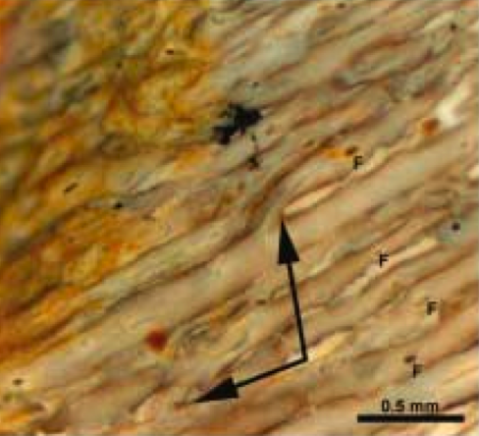
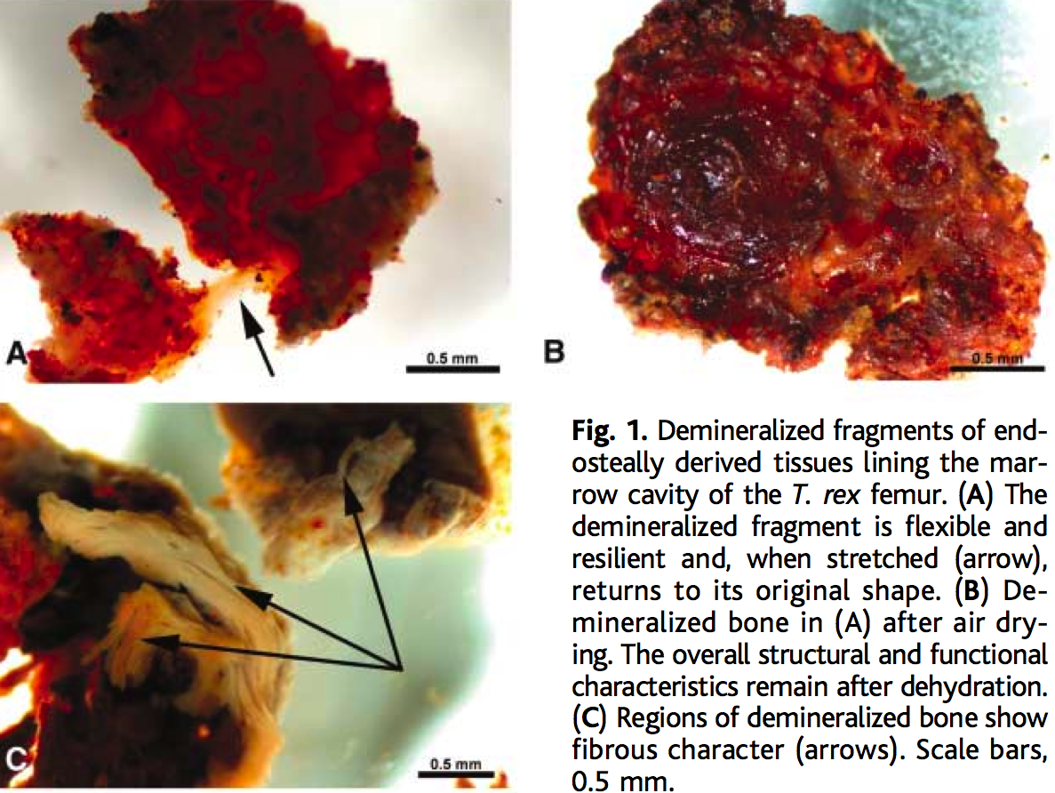
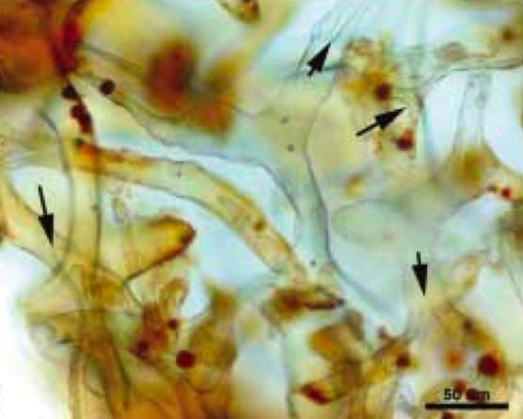
T. rex Tissue Examples
Notes:
Top right picture shows bifurcated vascular canals in partially demineralized cortical bone.
Bottom right picture shows branched transparent vessels with “cells” inside.

Slide 24
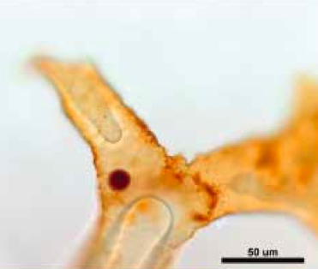
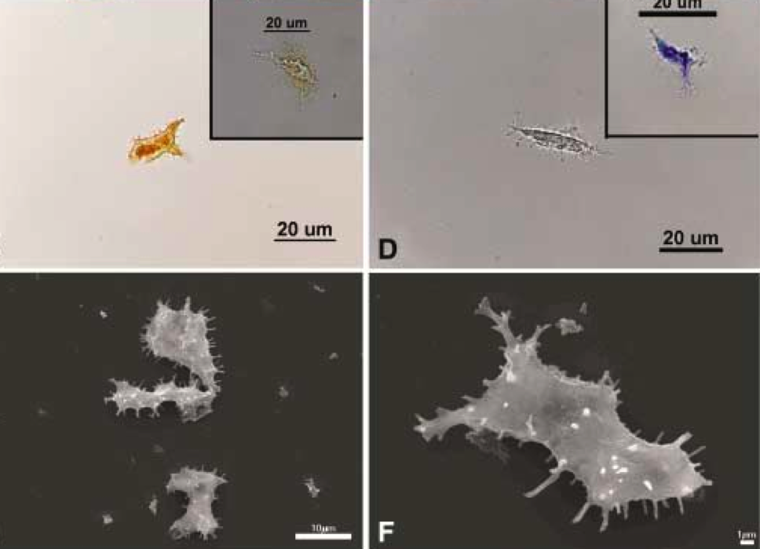
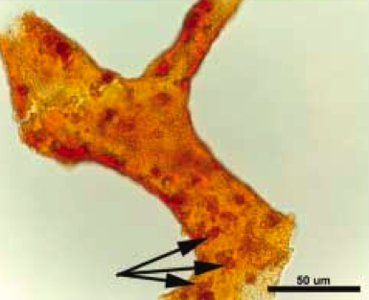
T. rex Tissue Examples
Notes:
Left image: Comparison of isolated T. rex “osteocyte” (left sides) with modern ostrich osteocyte images (top = light microscope, bottom = scanning electrom microscope).
Top right image: Hollow blood vessel with possible red blood cell inside.
Bottom right image: Vessels showing endothelial cell nuclei.

Slide 25
Conclusions
Radiocarbon is neither our friend nor our enemy. It is one way of assessing time that has liabilities, like every other method.
Radiocarbon dates are fairly accurate for historical dates, but deviate outside the range of history, and may deviate much more than calibration curves reveal.
Radiocarbon dates of supposedly very old materials show that there is a lot we do not yet understand.
Survival of biomolecules is indicative of a serious problem with the conventional interpretation of radiometric dates.

