Slide 1


Science and the Bible

Slide 2
Science AND PROOF

Slide 3
The tentative nature of science

Slide 4
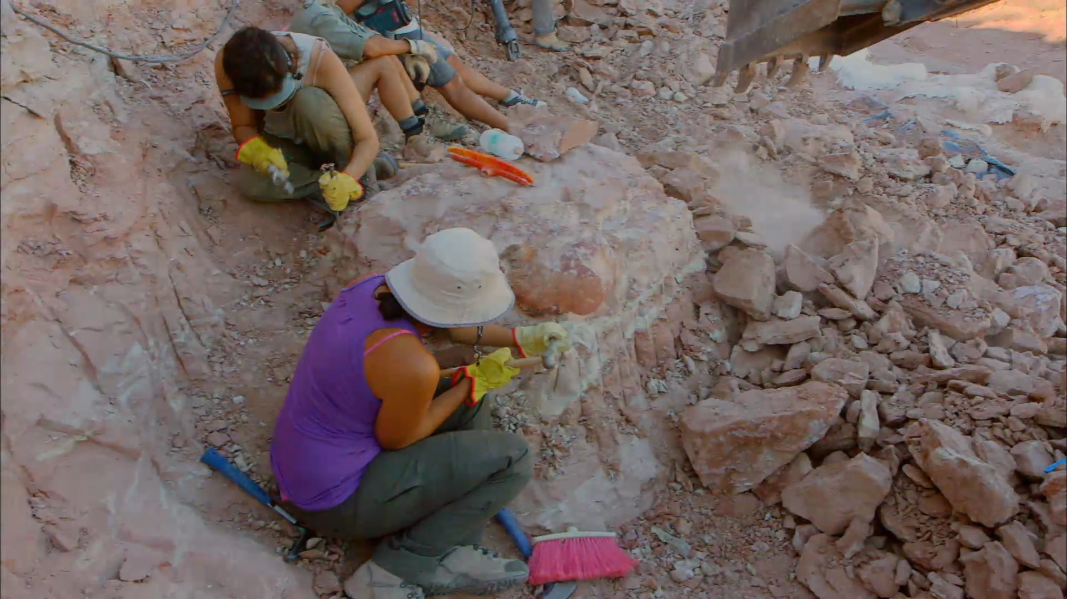
Geology and Paleontology are different

Slide 5
Making sense of Paleontology

Slide 6
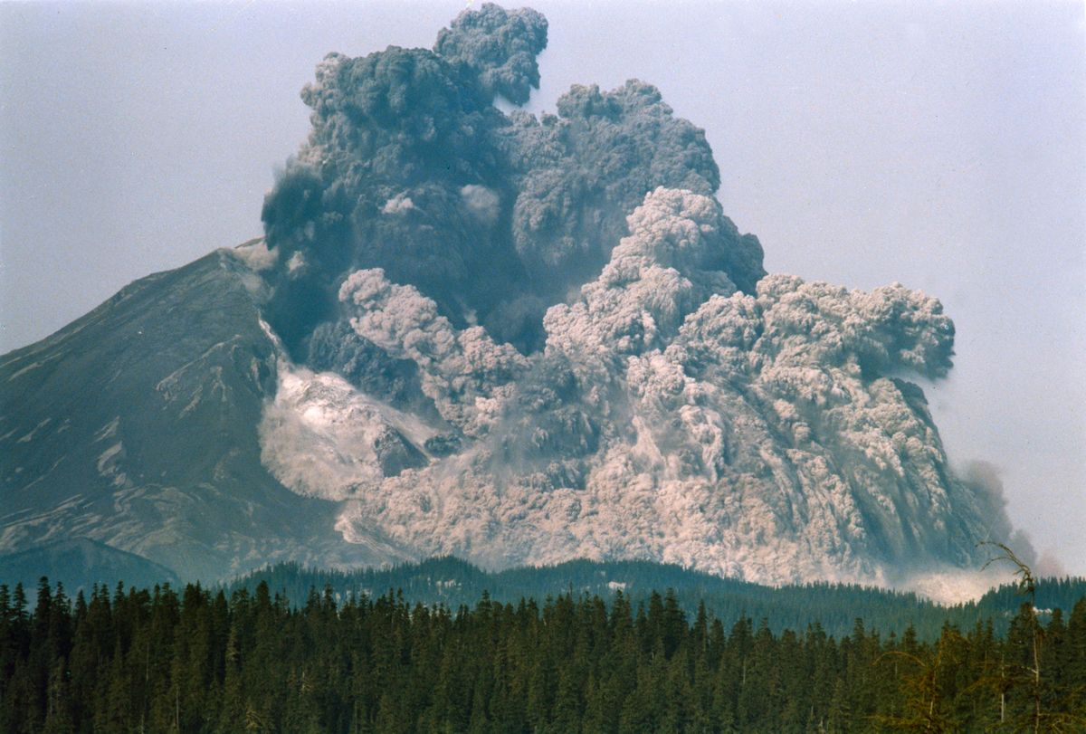
When geology does experiments

Slide 7


Naturalism vs methodological naturalism

Slide 8
The Creation advantage
Creationists have more space to work in (more choices for model building)
Creationists don’t have to ignore data that don’t fit their preconceptions.

Slide 9
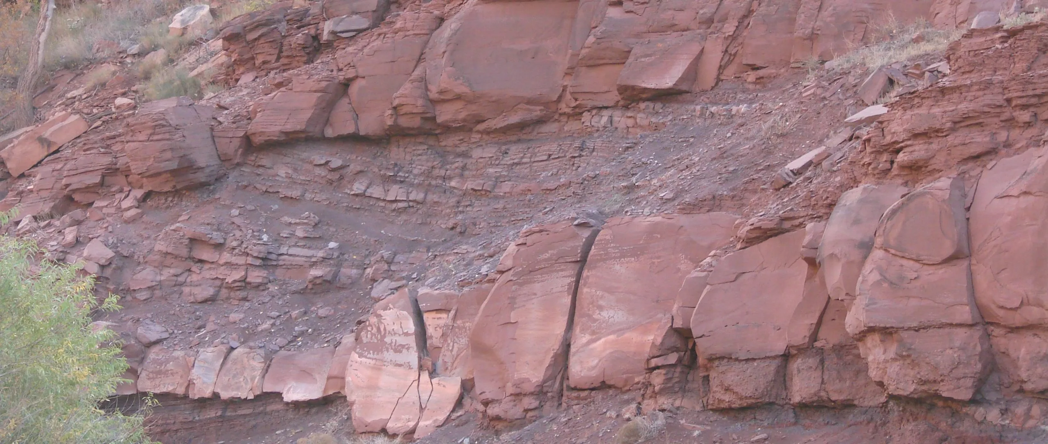
sedimentology
Creationists have ready explanations for why sedimentary rates are far too slow.
Creationists have ready explanations for why sediments appear to have been deposited rapidly.
Creationists have ready explanations for why erosion rates today are far too fast.
Creationists have ready explanations for why biomolecules are still present in fossils.

Slide 10

Origin of life
Creationists have ready explanations for how life came to be.
Creationists have ready explanations for the complexity of the living cell.
Creationists have ready explanations for why the first fossilized life forms were fully as complex as the modern forms.

Slide 11
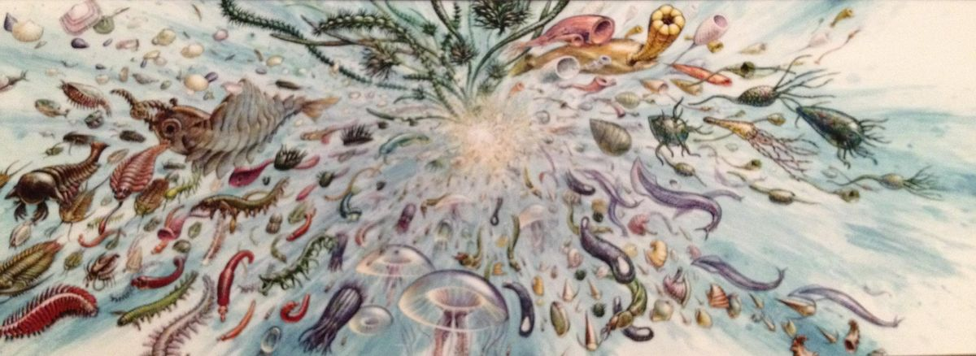
Cambrian explosion
Creationists have ready explanations for why the origin of complex life forms is called “The Cambrian Explosion”
Creationists have ready explanations for why the first complex life forms were already diverse at their first appearance.

Slide 12
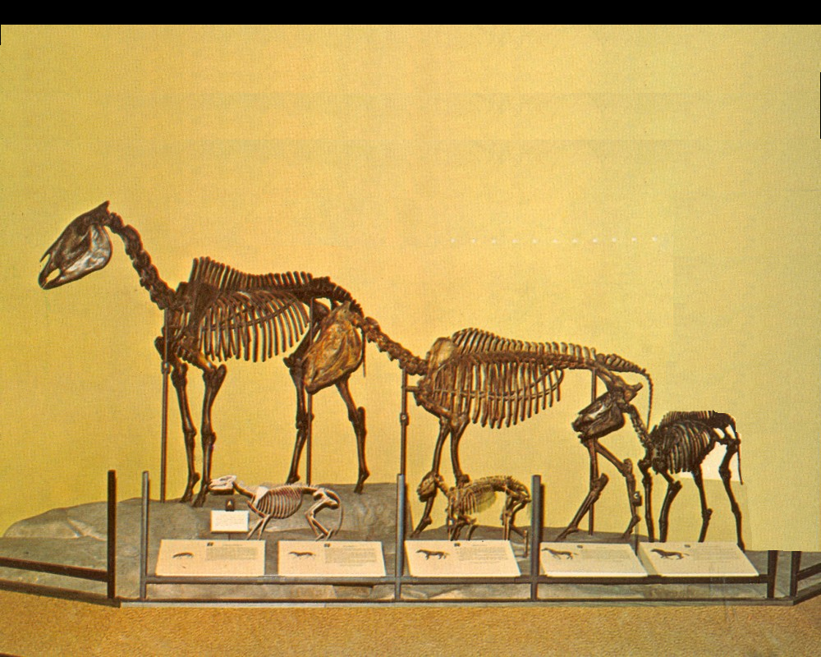
Evolutionary sequences
Creationists have a ready explanation for why we do not find sequences of fossils preserved a as the evolutionary record requires.

Slide 13
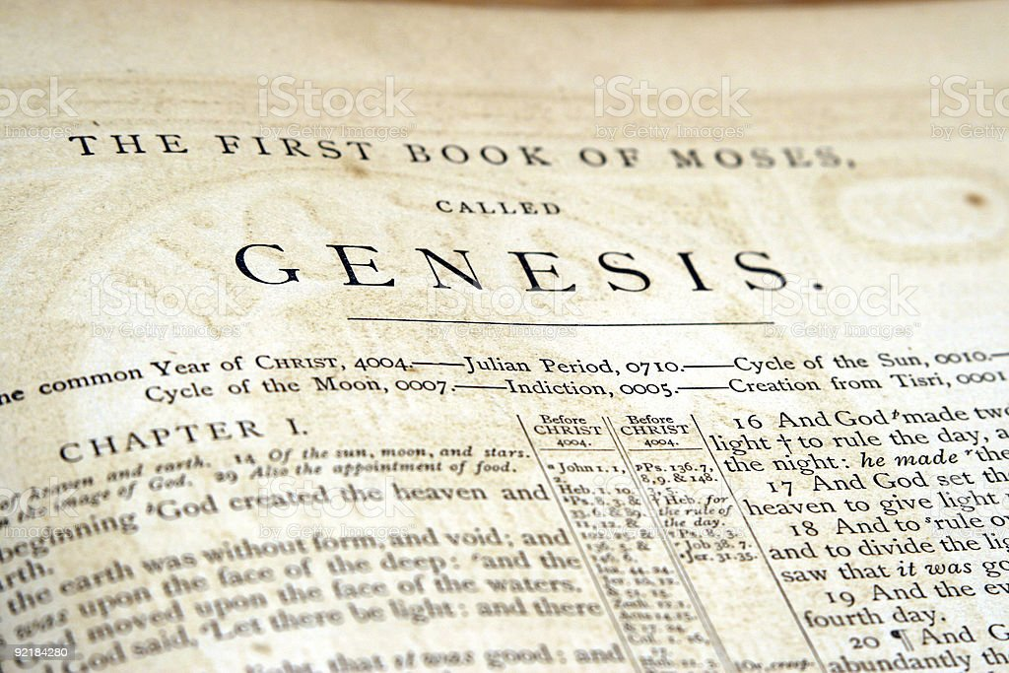
Other advantages of the Christian Scientist
Scripture as a source of inspiration

Slide 14

An openness to new ideas

Slide 15

A fundamental belief in the creatorship of God

Slide 16

Honesty and integrity

Slide 17

Stewardship of the earth

Slide 18

Naturalism is an enemy
Naturalism is a religion. It is not founded on a search for Truth.

Slide 19
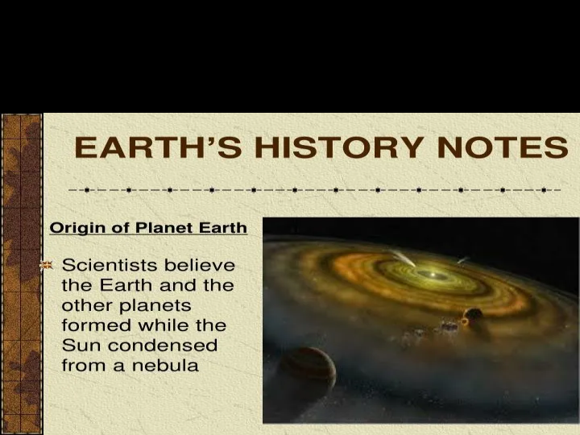
A proscribed view of earth history

Slide 20

The yahoo problem

Slide 21
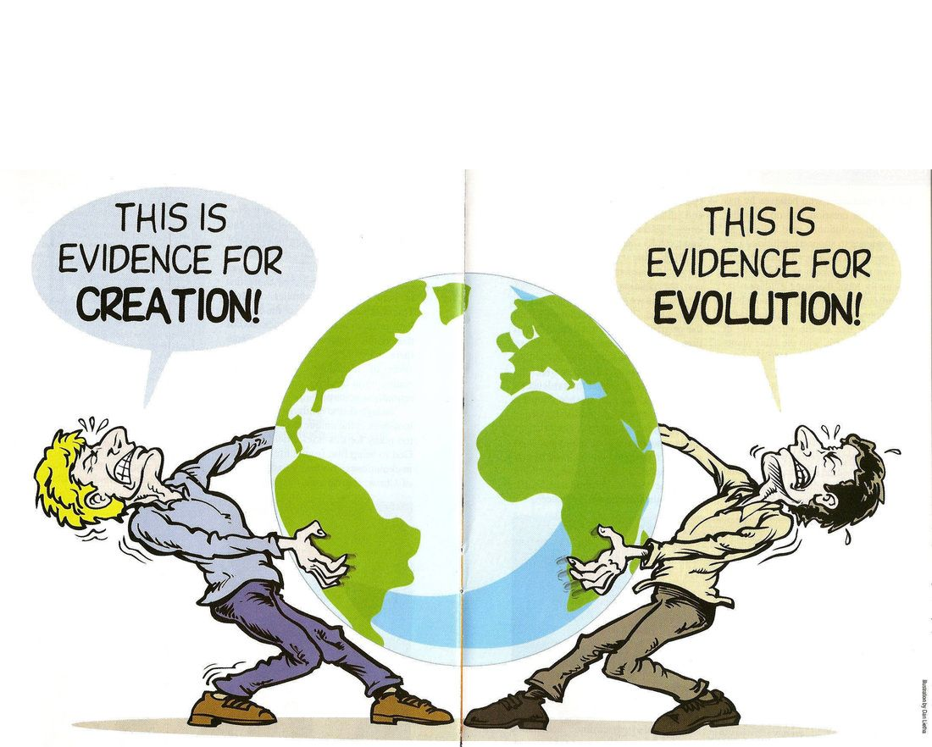
THE YAHOO PROBLEM

