Slide 1

The Biblical Foundation for Adventist Education
Adventist
Education
By E. Edward Zinke
Illustrations by David Zinke
and Carol Raney
Motivation by Doug Zinke
and by Seven Grandchildren
Notes:
*

Slide 2
Principles for Biblical Thought
Key elements for Building a Biblical World View

Slide 3
Key Issues in Biblical Foundations to Faith and Reason

Slide 4
Key Issues in Biblical Foundations to Faith and Reason
Knowledge of God is dependent upon His self-revelation in Jesus Christ and his Word
Notes:
See presentations by Dr. Joann Davidson
https://www.southern.edu/sites/academics/Documents/May2010/Certainty2ndComing.pdf, chapter 2

Slide 5
Key Issues in Biblical Foundations to Faith and Reason
Knowledge of God is dependent upon His self-revelation
in Jesus Christ and His Word
The nature of the Bible – It is divinely revealed and therefore the foundation of human thought
Notes:
See presentations by Dr. Joann Davidson
https://www.southern.edu/sites/academics/Documents/May2010/Certainty2ndComing.pdf, chapter 2

Slide 6
The Nature of the Bible
“All Scripture is given by inspiration of God” 2 Tim 3:16
Scripture came by the will of God, not by the will of man
2 Peter 1:21

Slide 7
Key Issues in Biblical Foundations to Faith and Reason
Knowledge of God is dependent upon His self-revelation
in Jesus Christ and His Word
The nature of the Bible – It is divinely revealed and therefore the foundation of human thought
The nature of theodicy – We do not bring God into judgment
Notes:
Is God on Trial in the Universe. Or is God the one who will preside in the judgment? If the former, we can understand the universe apart from God, We can determine what true love is, what true justice is, what truth is totally independent of God as a means of measuring God to bring Him into judgment. Both the Bible and EGW speak of the danger of attempting to bring God into Judgment. They also speak of the danger of doubt, its destructive power. That was the original sin of Lucifer.
See Certainty of the Second Coming by E Edward Zinke in additional materials, chapter 7
https://www.southern.edu/sites/academics/Documents/May2010/Certainty2ndComing.pdf

Slide 8
Key Issues in Biblical Foundations to Faith and Reason
Knowledge of God is dependent upon His self-revelation
in Jesus Christ and His Word
The nature of the Bible – It is divinely revealed and therefore the foundation of human thought
The nature of theodicy – We do not bring God into judgement
Hermeneutics – the Bible provides the basis for its appropriate hermeneutic and its own world view within which to interpret it
Notes:
https://www.southern.edu/sites/academics/Documents/May2010/Certainty2ndComing.pdf, chapter 2
See work by Richard Davidson on hermeneutics

Slide 9
Hermeneutics
In harmony with its nature as the inspired Word of God, Scripture provides its own world view and methods of interpretation.
Notes:
See the Presentations given by Dr. Richard Davidson

Slide 10
Key Issues in Biblical Foundations to Faith and Reason
Knowledge of God is dependent upon His self-revelation
in Jesus Christ and His Word
The nature of the Bible – It is divinely revealed and therefore the foundation of human thought
The nature of theodicy – We do not bring God into judgment
Hermeneutics – the Bible provides the basis for its appropriate hermeneutic and its own world view within which to interpret it
The Biblical concept of truth

Slide 11
Key Issues in Biblical Foundations to Faith and Reason
The nature and source of human knowledge of God
The nature of the Bible – Is it divinely revealed and therefore the foundation of human thought?
The nature of theodicy – we do not bring God into judgment
Hermeneutics – the Bible provide the basis for its appropriate hermeneutic and its own world view within which to interpret it?
The Biblical concept of truth
The nature of faith
Notes:
https://www.southern.edu/sites/academics/Documents/May2010/Certainty2ndComing.pdf, see chapter 9

Slide 12
The Logos
In the beginning was the Word, and the Word was with God, and the Word was God. He was in the beginning with God. All things were made through Him, and without Him nothing was made that was made. In Him was life, and the life was the light of men. And the light shines in the darkness, and the darkness did not comprehend it. John 1:1-5 NKJV
Notes:
The Logos in Greek philosophy was the structure of the universe, the really real, the source of truth. John says that Jesus Christ is truth.

Slide 13
Christ is the Light of the World
In the context of His role in the creation of the universe and the declaration that He is the Logos, Christ is recognized to be the light of the world. John 1:4-11
Your word is a lamp to my feet And a light to my path. Psa. 119:105
The entrance of Your words gives light; It gives understanding to the simple. Psa.119:130
Notes:
Christ is the light of the world. Because of His revelation, It is possible for us to see. That does not take away the need for us to use our eyes. But the revelation of Jesus Christ makes it possible for us to see when we open our eyes.

Slide 14
“Human knowledge of both material and spiritual things is partial and imperfect; therefore many are unable to harmonize their views of science with Scripture statements. Many accept mere theories and speculations as scientific facts, and they think that God’s Word is to be tested by the teachings of ‘science falsely so called.’ 1 Timothy 6:20.” --Great Controversy, p. 522.

Slide 15
Biblical Epistemology
Pilot asked, “What is truth?” (John 18:38)
The One who was the way, the truth, the life was standing right before him. (John 14:6)
God wants us to know Him, the only true God. (John 17:3)

Slide 16
Biblical Examples of Epistemology
Adam & Eve
Antediluvians
Kadesh-barnea
Christ
Notes:
Eve – Satan brought doubt – has God truly said?
Eve – Scientific method – serpent has eaten – is speaking
If I eat – image – I might become as God
Philosophical – a God of love would not destroy the creature He has created.
She departed from the Word of God and yielded to the temptation.

Slide 17
Noah – by faith Noah heeded the command of God (Hebrew 11:7). “The wise men of this world talked of science and the fixed laws of nature, and declared that there could be no variation in these laws, and that this message of Noah could not possibly be true. The talented men of Noah’s time set themselves in league against God’s will and purpose, and scorned the message and the messenger that he had sent. When they could not move Noah from his firm and implicit trust in the word of God, they pointed to him as a fanatic, as a ranting old man, full of superstition and madness.
Notes:
Naturalism - uniformitarianism

Slide 18
Thus they condemned him because he would not be turned from his purpose by reasonings and theories of men. It was true that Noah could not controvert their philosophies, or refute the claims of science so called; but he could proclaim the word of God; for he knew it contained the infinite wisdom of the creator, and, as he sounded it everywhere, it lost none of its force and reality because men of the world treated him with ridicule and contempt.” Signs of the Times, April 18, 1895, pp. 243-44
Notes:
Naturalism

Slide 19
Abraham – “’By faith Abraham obeyed when he was called to go out into a place which he should after receive for an inheritance, obeyed; and he went out, not knowing whither he went.’ Hebrews 11:3. Abraham’s unquestioning obedience is one of the most striking evidences of faith to be found in all the Bible. To him, faith was ‘the substance of things hoped for, the evidence of things not seen.’ Verse 1.
Notes:
Imagine the local church board – Abraham – why are you leaving Ur – This is the logical place for you to do evangelism.

Slide 20
Relying upon the divine promise, without the least outward assurance of its fulfillment, he abandoned home and kindred and native land, and went forth, he knew not whither, to follow where God should lead…. He could not even explain his course of action so as to be understood by his friends. Spiritual things are spiritually discerned, and his motives and actions were not comprehended by his idolatrous kindred.” Patriarchs and Prophets, p. 126
Notes:
Faith operates on a different set of principles than the natural world.

Slide 21
Kadesh-barnea:
  Giants in the land
  Weapons we have never seen
  Soldiers well trained for battle
  Passes fortified
  10 spies – therefore we should not go
    illustration of a humanistic faith
  2 spies – no disagreement with data
    decision made with eyes of faith
Notes:
Faith gave an entirely different world view, a different way of looking at the data, and a different course of action was prescribed based upon faith in the promises of God.

Slide 22
Christ
“It is written.” (Matt 4:4, 7, 10)
The temptation took place right after the baptism of Christ and the declaration that He was the Son of God
The temptation was to doubt the Word of God – the same temptation that Adam and Eve had in Eden

Slide 23
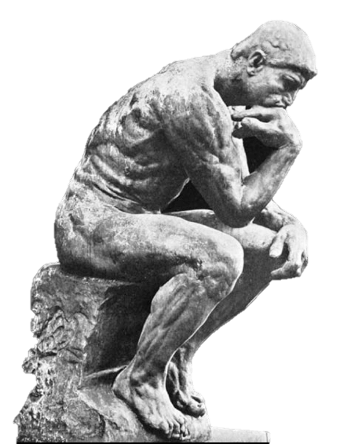

Humanistic Faith
Begins with doubt
Attempts to prove the Bible worthy of our faith
?
Notes:
The process generally starts with doubt---attempting to prove the validity of an assertion in order to offer it as truth---as worthy of one’s faith.
It relies upon genius, creativity, initiative, freedom of exploration, and capabilities of mankind.
It relies upon the five senses as a basis for collecting the relevant data.
*

Slide 24
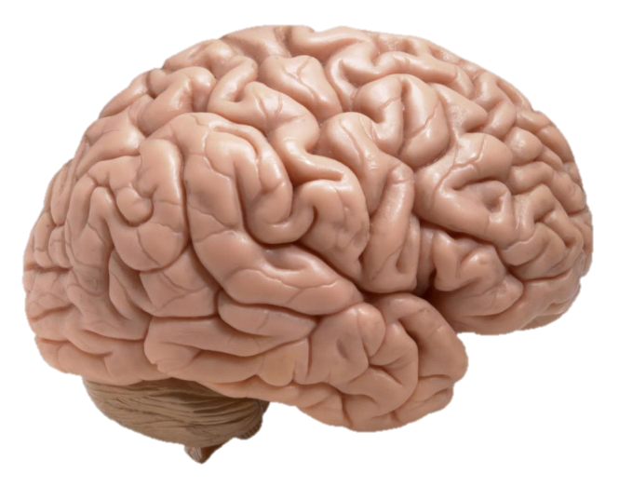
Humanistic Faith
Begins with doubt
Attempts to prove it worthy of our faith
?
Notes:
The process generally starts with doubt---attempting to prove the validity of an assertion in order to offer it as truth---as worthy of one’s faith.
It relies upon genius, creativity, initiative, freedom of exploration, and capabilities of mankind.
It relies upon the five senses as a basis for collecting the relevant data.
*

Slide 25
Humanistic Faith
Relies on capabilities of man
Relies on the five senses
Looks for patterns
Forms a hypothesis and testable predictions
Results in more observations
Notes:
It relies upon genius, creativity, initiative, freedom of exploration, and capabilities of mankind. It relies upon the five senses as a basis of collecting the relevant data. It looks for patterns, and integrates the data and interprets it on the basis of a paradigm which interprets our common experience and understanding of the world. A hypothesis is formed which leads to testable predictions which result in new round of observations
*

Slide 26
Humanistic Faith
The result is a probability statement as to what things are like or as to how new pieces of data entering the system will relate to the old.
Notes:
*

Slide 27
Humanistic Faith
In summary, the data is brought together in such a way as to yield a conclusion, a faith statement as to how things probably are. The conclusion is in the hand of mankind. It is under human control, it is a human achievement, and it is created upon human basis such as reason, sense experience or some other faculty of mankind

Slide 28
Biblical Faith
Faith is not a human creation; it is the gift of God (Eph 2:8) in order that faith might not rest on the wisdom of man but in the power of God (I Cor 2:4, 5).
Gift from God
Notes:
https://www.southern.edu/sites/academics/Documents/May2010/Certainty2ndComing.pdf, chapter 8
*

Slide 29
Biblical Faith
Faith is itself the substance of things hoped for, the evidence of thing not seen Heb 11:1
We walk by faith, not by sight 2 Cor 5:7
Faith comes by hearing the Word of God Rom 10:17

Slide 30



Biblical Faith
The spirit and Word work together. “No man can create faith. The Spirit operating upon and enlightening the human mind creates faith in God.” 7BC p.
Notes:
The spirit who gave us the Bible also guides in our study of it, and brings faith and conviction.
A totally different way of living from that of humanism.
*

Slide 31
To attempt to use the data of reason as criteria for determining whether Scripture is the Word of God is to doubt that which has already been declared by God. It is similar to Christ’s temptation in the wilderness, namely, to doubt that He was the Son of God after “it had already been affirmed by the Word of God. Genuine faith has its foundation in the promises and provisions of the Scriptures.” DA p. 72; cf. GW p. 260; EW p. 72

Slide 32
Biblical Faith
Faith in the Word of God is not based upon humanistically derived knowledge; rather faith itself is the foundation of knowledge.
“By faith we understand that the worlds were framed by the word of God.” (Heb 11:3).

Slide 33
EGW on Faith
“Only in the light of revelation can it (nature) be read aright.” Ed p. 134 “Faith is the key of knowledge.” Ed p. 24, DA p. 139 It is the basis for discerning between truth and error 1 SM p. 346, TM p. 229
Faith comes by hearing the Word of God (Rm 11:17). The assurance and evidence for faith is God’s Word 2 SM p. 243

Slide 34
Biblical Epistemology
“For since, in the wisdom of God, the world through wisdom did not know God, it pleased God through the foolishness of the message preached to save those who believe.
For Jews request a sign, and Greeks seek after wisdom; but we preach Christ crucified, to the Jews a stumbling block and to the Greeks foolishness, but to those who are called, both Jews and Greeks, Christ the power of God and the wisdom of God.” 1 Cor 1:21--24
Notes:
The Jews empirical verification, the Greeks seek philosophical verification.

Slide 35
“And my speech and my preaching were not with persuasive words of human wisdom, but in demonstration of the Spirit and of power, that your faith should not rest in the wisdom of men but in the power of God.” 1 Cor 2:4, 5

Slide 36
Salvation by Faith Parallel Understanding by the Word of God
Sola Gratia
There is nothing I can do on my own to obtain righteousness.
Righteousness is not to be manipulated by humans.
Righteousness rests upon the gift of God alone.
Works follow naturally from the receipt of the gift of God’s salvation.
Works never form the basis of our salvation.
Sola Scriptura
There is nothing I can do on my own to obtain special revelation.
Revelation is not to be manipulated by humans.
Revelation rests upon the gift of God alone.
Epistemological works follow naturally from the receipt of God’s Word.
Humanistic epistemologies are not the true foundation of our knowledge.
Notes:
The two doctrines are analogous and they are really one—God’s gift of Himself to us in order that we might know Him, the only true God (John 17:3)

Slide 37
God has given us our minds, feelings, interpersonal relationships, etc. All of these are important to who we are. God desires that we use our talents to the fullest, including our reason and ability to observe. These talents are given to be used in harmony with God’s Word rather than over against it.

Slide 38
Knowledge of God
God presents Himself as one who is unsearchable. “For my thoughts are not your thoughts, nor your ways My ways, says the Lord. For as the heavens are higher than the earth, so are My ways higher than your ways, and my thoughts than your thoughts.”—Isaiah 55:8, 9.

Slide 39
It is not the place of philosophy to determine the ways and works of God. The human mind cannot measure infinity.
True religion is not grounded in philosophy (Col 2:8)
For the world through its wisdom did not come to know God.” (1 Cor 1:21)
The Jews asked for signs and the Greeks rest their case on wisdom (1 Cor 1:21)
But God has destroyed the wisdom of the wise (1 Cor 1:19, 20)
For salvation comes by the foolishness of preaching (1 Cor 1:21)
And the message of preaching comes not in persuasive words of wisdom but in a demonstration of His Spirit and the power of faith which rests upon God rather than on the wisdom of man (1 Cor 2: 4, 5)

Slide 40
When mankind attempts to gain knowledge of God through the natural world, the results are the worship of the creature rather than the Creator.

Slide 41
There is in conscience and in nature a revelation of the wrath, power, and divine nature of God (Romans 1:19, 20).
      This revelation does not lead to the possibility of a natural theology. The problem lies not in the revelation but within man, for man is incapable by means of application of his naturalistic capabilities to acquire adequate knowledge to arrive at the proper concept of the God who reveals Himself (1 Corinthians 1:21).
Notes:
*

Slide 42
Professing to be wise, man becomes a fool (Romans 1:22).
Man misrepresents the data because of sin in his life (Romans 1:18).
He suppresses the truth about God (Romans 1:18, 2).

Slide 43
He exchanges “the glory of the incorruptible God for an image in the form of corruptible man and of birds and four-footed animals and crawling creatures” (Romans 1:23, NASB).
Man exchanges the truth of God for a lie (Romans 1:25).

Slide 44
The natural tendency of man by the exercise of his natural faculties is to demonstrate his foolishness by suppressing the knowledge of God available by natural revelation and exchanging it for an idol of man’s own making (Romans 1:21-26).
The futile speculations of man (Ephesians 4:17) lead to a darkened heart (Romans 1:21).

Slide 45
God gives men up to their own evil ways which in the first place led to this suppression and exchange (Romans 1:24, 26, 28).
As opposed to philosophical systems which attempt to gain knowledge of God, the gospel reveals the righteousness of God and the way by which God intends to save man (Romans 1:16, 17).

Slide 46
“In its human wisdom the world knows not God. Its wise men gather an imperfect knowledge of Him from His created works; but this knowledge, so far from giving them exalted conceptions of God, so far from elevating the mind and the soul, and bringing the whole being into conformity with His will, tends to make men idolaters. In their blindness they exalt nature and the laws of nature above nature’s God …

Slide 47
The greatest minds, if not guided by the word of God, become bewildered in their attempts to investigate the relations of science and revelation…When they find themselves incapable of measuring the Creator and His works by their own imperfect knowledge of science, they question the existence of God and attribute infinite power to nature.”--Testimonies, Vol. 8, pp. 257-57.

Slide 48
From a human standpoint the task of obtaining knowledge of God is hopeless, for man does not have available within himself the necessary tools by which to ascertain the nature of God.

Slide 49
“Can you discover the depths of God? Can you discover the limits of the Almighty? It is high as the heavens, what can you do? Deeper than Sheol, what can you know? Its measure is longer than the earth, and broader than the sea.” –Job 11:7-9 NASB.

Slide 50
Neither by searching the recesses of the earth nor in vain endeavors to penetrate the mysteries of God’s being is wisdom found. It is found, rather, humbly receiving the revelation that He has been pleased to give, and in conforming the life to His will. 8T p. 280

Slide 51
By the grace of God we have not been left in a state of hopelessness without possible knowledge of God. Knowledge of a transcendent and hidden God requires self-revelation and God has done just that. He has given us Himself in revelation.
“For behold, He who forms mountains and creates the wind and declares to man what are His thoughts, He who makes dawn into darkness and treads on the high places of the earth, the Lord God of hosts is His name.” Amos 4:13 NASB

Slide 52
If mankind is to have reliable information about God, he must be willing to depend upon the revelation which God has made concerning Himself. This revelation through Jesus Christ comes to us through the Bible. We are therefore dependent upon the Bible for a true understanding of God.

Slide 53
“The secret things belong to the Lord our God, but the things revealed belong to us and to our sons forever that we may observe all the words of this law.”—Deuteronomy 29:29, NASB

Slide 54
“Human talent and human conjecture have tried by searching to find out God. But guesswork has proved itself to be guesswork. Man cannot by searching find out God. This problem has not been given to human beings. All that man needs to know and can know of God has been revealed in His word and in the life of His Son, the great Teacher.” –SDA Bible Commentary, Vol. 6, p. 1079.

Slide 55
“Searching the Scriptures alone will bring the knowledge of the true God and Jesus Christ whom He has sent.” --Fundamentals of Christian Education, p. 415.

Slide 56
God is the Source of Knowledge
God is Himself wisdom and therefore the source of all wisdom.
All things are what they are by virtue of God’s plan and will.
Wisdom and knowledge do not have existence apart from God Himself. They are not principles autonomous from God.
Since knowledge and wisdom are to be identified with God and since all things have their character by virtue of God’s creative activity and His plan and will, God is also Himself the source of knowledge.

Slide 57
God is the Source of Knowledge
If we desire to inquire into the nature of reality, we must go to God who is the source of reality.
Just as humanity is dependent upon God for righteousness, so are we also dependent upon God for knowledge.
Chris is not only our righteousness, sanctification and redemption, He is also our wisdom (1 Cor 1:30). Not only did grace come through Christ but also truth (John 1;17)
In Christ are hid all the treasure of wisdom and knowledge (Col 2:3)

Slide 58
“Human knowledge of both material and spiritual things is partial and imperfect; therefore many are unable to harmonize their views of science with Scripture statements. Many accept mere theories and speculations as scientific facts, and they think that God’s Word is to be tested by the teachings of ‘science falsely so called.’ 1 Timothy 6:20.” --Great Controversy, p. 522.

Slide 59
Key Issues in Biblical Foundations to Faith and Reason
The nature and source of human knowledge of God
The nature of the Bible – Is it divinely revealed and therefore the foundation of human thought?
The nature of theodicy – we do not bring God into judgment
Hermeneutics – the Bible provide the basis for its appropriate hermeneutic and its own world view within which to interpret it?
The Biblical concept of truth
The nature of faith
The nature of freedom

Slide 60
Humanistic Concept of Freedom
Autonomy – absolute independent
Free from every human institution
Free from authority of the Bible
Acquisition of truth is independent of God and His Word
The possibility of truth in the Bible must be determined on a humanistic basis
Free to determine the nature of truth
Notes:
The humanistic concept of epistemological freedom is that of autonomy. Not only are we free from every human institution, we are also free from the authority of the Bible, the Word of God. The possibility of truth in the Bible must be determined on a humanistic basis rather than by its divine inspiration
*

Slide 61
Biblical Concept of Freedom
Absolute independence from God is sin – the original sin of Lucifer, to ascend into heaven and become like God Is 14:13, 14
We are either slaves of sin or God Rm 6:18-22

Slide 62
Humanistic Concept
Biblical Concept
We are free to determine our own truth to decide how to relate to Christ
We are free when we come to Christ Jn 8:36; Gal 5:1
We shall know the truth and the truth shall set you free Jn 8:32
Notes:
The Biblical concept is that the desire to live in absolute independence from God is itself sin. Further, we are not autonomous, for we are either a slave of sin or of God (Rom 6:15-22, Josh 24:15). The humanistic concept is that we are free to come to Christ, the Biblical concept is that we become free when we come to Christ; the humanistic concept is that we are free to discover truth in order to come to Christ, the Biblical concept is that we shall know the truth and the truth shall set us free (John 8:31-34).
*

Slide 63
Key Issues in Biblical Foundations to
Faith and Reason
The nature and source of human knowledge of God
The nature of the Bible – Is it divinely revealed and therefore the foundation of human thought?
The nature of theodicy – we do not bring God into judgment
Hermeneutics – the Bible provide the basis for its appropriate hermeneutic and its own world view within which to interpret it?
The Biblical concept of truth
The nature of faith
The nature of freedom
The power of the Word of God under the Holy Sprit

Slide 64
The Power of the Word of God
The power of:
Science
Philosophy
History
Psychology
Sociology Etc.
The power of the Word of God
Under the Holy Spirit

Slide 65
Conversion
Notes:
Conversion not only of the heart (click) but of the mind as well – not only to live in harmony with God, but to think in harmony with Him.
John 3: Nicodemus – wanted to determine faith by humanistic means – how is that possible?
Christ – by the rebirth through the power of the Spirit.
*

Slide 66
Ellen White and the Role of the Bible in Obtaining Knowledge
Notes:
Please see fuller collection of EGW on the role of the Bible in academic study.

Slide 67
Authority of the Bible
“The Bible is God’s voice speaking to us just as surely as though we could hear Him with our ears.” HP p. 134
Notes:
The reformers and EGW – when we read the Bible – it is as if God were in the room speaking with us.

Slide 68
Authority of the Bible
"He [Christ] pointed to the Scriptures as of unquestionable authority, and we should do the same. The Bible is to be presented as the word of the infinite God, as the end of all controversy and the foundation of all faith." COL pp. 39, 40

Slide 69
Authority of the Bible
"Leave the impression upon the mind that the Bible, and the Bible alone, is our rule of faith, and that the sayings and doings of men are not to be a criterion for our doctrines or actions," CSW p. 84
"The Bible, and the Bible alone, is to be our creed, and sole bond of union; all who bow to this Holy Word will be in harmony. Man is fallible, but God's Word is infallible." 1 SM p. 416
"The Bible is an unerring guide." 4T p. 312

Slide 70
Basis of religion
Basis of faith
Test of inspiration
Test for the operation of the Holy Spirit
Guide to life
Rule of conscience
Standard of character
Only basis of happiness

Slide 71
Authority Over the Senses
Are the people of God now so firmly established upon His word that they would not yield to the evidence of their senses? Would they, in such a crisis, cling to the Bible and the Bible only?" GC p. 625

Slide 72
Basis of Knowledge,
Truth, and Education
The Bible is to be made the basis of all education.” FE p. 490
"The Bible must be made the foundation for all study." FE p. 451

Slide 73
Basis of Knowledge of God and Christ
"Searching the Scriptures alone will bring the knowledge of the true God and Jesus Christ whom He hath sent." FE p. 415

Slide 74
Foundation for the
Study of Science
"Apart from Christ, science is misleading and philosophy is foolishness." MM p. 91

Slide 75
Foundation for the
Study of Science
“The greatest minds, if not guided by the word of God, become bewildered in their attempts to investigate the relations of science and revelation. The Creator and His works are beyond their comprehension; and because these cannot be explained by natural laws, Bible history is pronounced unreliable.

Slide 76
Foundation for the
Study of Science
"In true science there can be nothing contrary to the teaching of the word of God, for both have the same Author." 8T pp. 251, 258

Slide 77
Foundation for the
Study of Science
"He who has a knowledge of God and His word through personal experience has a settled faith in the divinity of the Holy Scriptures. He has proved that God's word is truth, and he knows that truth can never contradict itself. He does not test the Bible by men's ideas of science; he brings these ideas to the test of the unerring standard.

Slide 78
Foundation for the
Study of Science
He knows that in true science there can be nothing contrary to the teaching of the word; since both have the same Author, a correct understanding of both will prove them to be in harmony. Whatever in so-called scientific teaching contradicts the testimony of God's word is mere human guesswork." MH p. 462

Slide 79
Foundation for the
Study of Science
“But apart from Bible history, geology can prove nothing." PP p. 112

Slide 80
Basis of an Understanding of History
"In the annals of human history the growth of nations, the rise and fall of empires, appear as dependent on the will and prowess of man. But in the word of God the curtain is drawn aside, and we behold, behind, above, and through all the play and counter play of human interests and power and passions, the agencies of the all-merciful One, silently, patiently working out the counsel of His own will." Ed p. 173

Slide 81
Basis of an Understanding of History
Here only do we find an authentic account of the origin of nations. . . . The Bible reveals the true philosophy of history. Ed 173

Slide 82
Key to Philosophy
Basis of Principles of True Psychology
Basis of National Prosperity

Slide 83
General Warnings About Placing Other Authorities Above the Bible
“The Word of the Lord is not to be judged by a human standard.” 5T p. 301

Slide 84
General Warnings About Placing Other Authorities Above the Bible
“Men consider themselves wiser than the Word of God, wiser even than God; and instead of planting their feet on the immovable foundation, and bringing everything to the test of God’s word, they test that word by their own ideas of science and nature, and if it seems not to agree with their scientific ideas, it is discarded as unworthy of credence.” Signs of the Times, March 27, 1844, p. 139.

Slide 85
General Warnings About Placing Other Authorities Above the Bible
“Man’s inventions are not only unreliable, they are dangerous; for they place man where God should be. They place the sayings of men where a ‘Thus saith the Lord’ should be.” COL p. 110

Slide 86
General Warnings About Placing Other Authorities Above the Bible
Men “set up their judgment as superior to the word; and the Scripture which they do teach rests upon their own authority. Its divine authenticity is destroyed.” Ibid. p. 39.

Slide 87
Possible Relations Between Science & Scripture
Human Studies ALONE | Integration of Nature AND the Bible | Separation of Nature & the Bible | Nature AND the Bible with the Bible as Foundation
Human studies ALONE are the absolute foundation for all knowledge whether it comes from nature or from the Bible.
Notes:
Human studies—science, philosophy, history, psychology, etc. -- are alone the absolute foundation for all knowledge whether it comes from nature or from the Bible
*

Slide 88
Possible Relations Between Science & Scripture
Human Studies ALONE | Synthesis of Nature AND the Bible | Separation of Nature & the Bible | Nature AND the Bible with the Bible as Foundation
No valid truth in the Bible apart from human verification
Notes:
There is no valid truth in the Bible apart from human verification. Human study alone provides the way, the truth and the life.
*

Slide 89
Possible Relations Between Science & Scripture
Human Studies ALONE | Synthesis of Nature AND the Bible | Separation of Nature & the Bible | Nature AND the Bible with the Bible as Foundation
Truth is truth, wherever it may be found.
All truth is God’s truth integration of nature AND The Bible
Notes:
Truth is truth wherever it may be found. Nature and the Bible -- both bring a valid approach to knowledge. Human and religious studies provide the way, the truth and the life. (click) The task of the theologian is to integrate the knowledge from both worlds into a theological system.
*

Slide 90
Possible Relations Between Science & Scripture
Human Studies ALONE | Synthesis of Nature AND the Bible | Separation of Nature & the Bible | Nature AND the Bible with the Bible as Foundation
Science deals with nature ALONE, and the Bible deals with religion ALONE. They should be kept separate.
Both may be understood completely on their own.
Notes:
The realm of nature and of the Bible is radically separate. Science deals with nature alone, and the Bible deals with religion alone. The two do not intersect. (click) Both may be understood completely on their own. Since there is no connection between them, it is useless to try to synthesize them.
*

Slide 91
Power of the Word of God
“For the word of God is living and powerful, and sharper than a two-edged sward, piercing even to the division of soul and spirit, and of joints and marrow, and is a discerner of the thoughts and intents of the heart.” Heb. 4:12

Slide 92
Possible Relations Between Science & Scripture
Human Studies ALONE | Integration of Nature AND the Bible | Separation of Nature & the Bible | Nature AND the Bible with the Bible as Foundation
God has revealed Himself both in nature and in the Bible. Both should be studied from the foundation of the Bible ALONE.
Notes:
God has revealed Himself both in nature and in the Bible. Nature by itself is sometimes misleading. Both may be legitimately studied from the standpoint of the Bible and the Bible alone. Christ alone as He is represented in His Word is the way, the truth and the life.
*

Slide 93
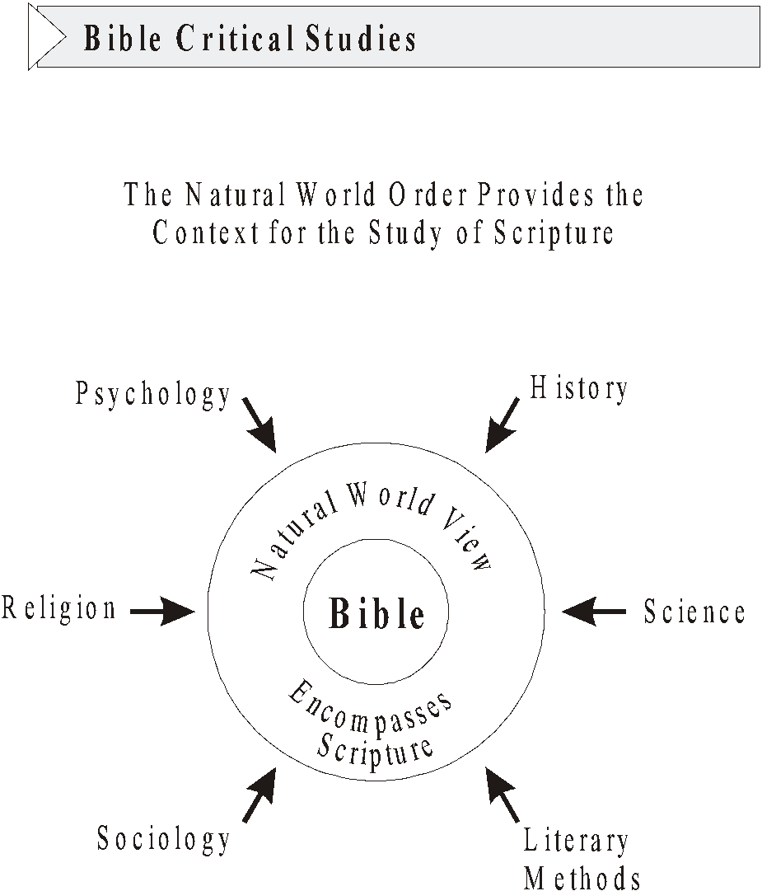
Notes:
*

Slide 94
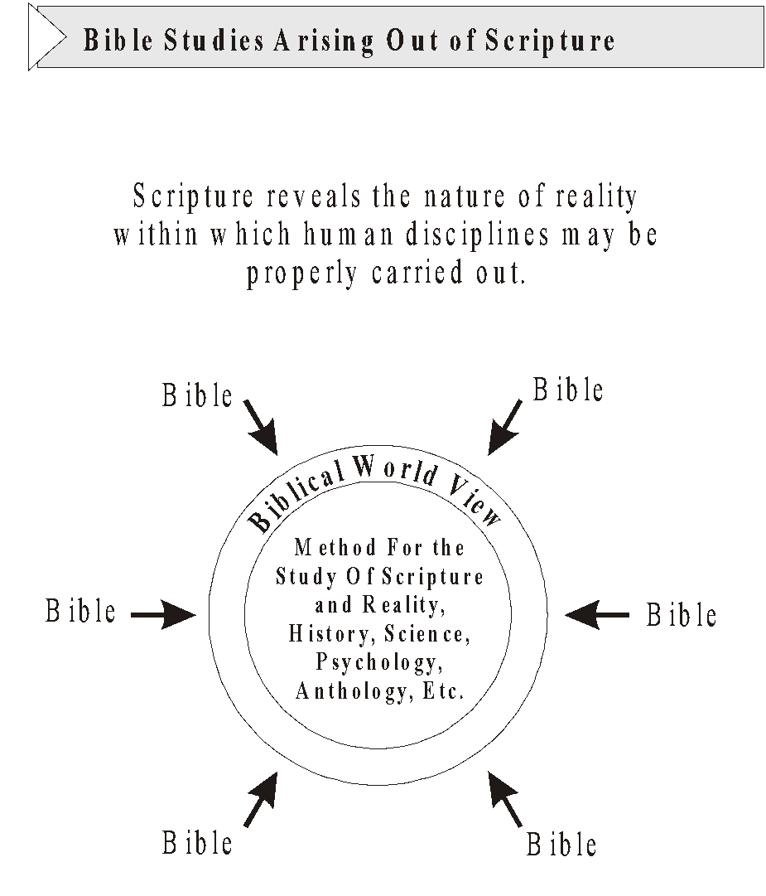
Notes:
*

Slide 95
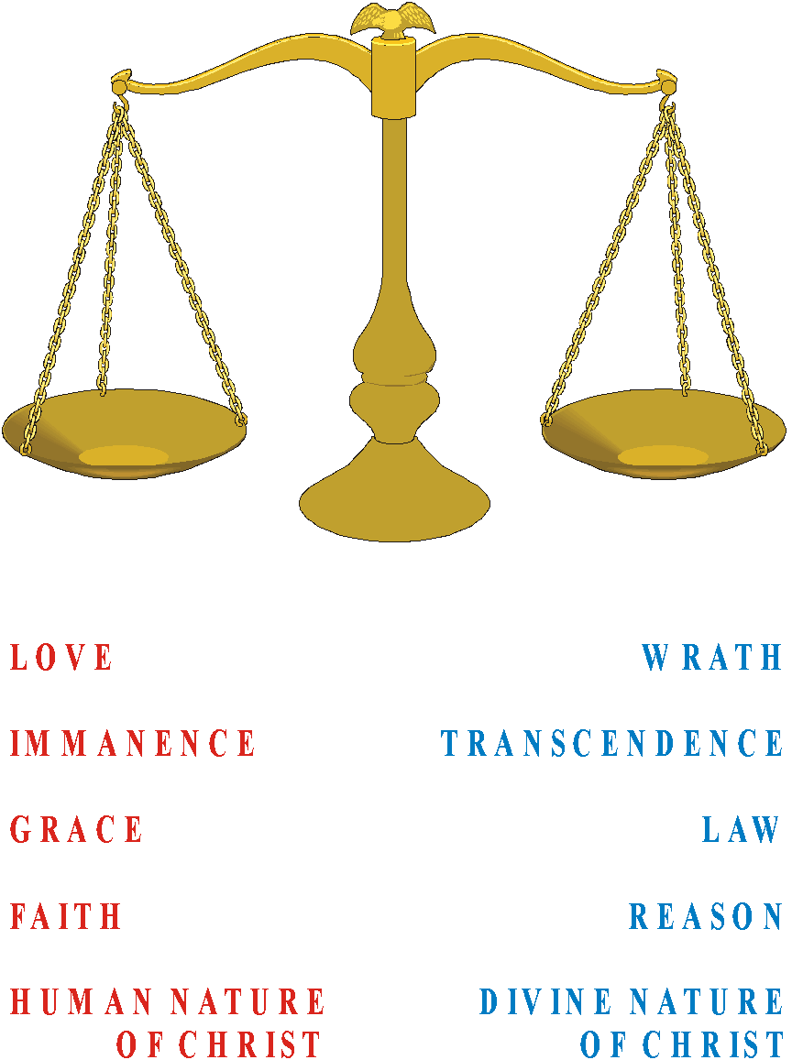
Notes:
We want a theology. Use our own judgment as to what is balanced.
*

Slide 96
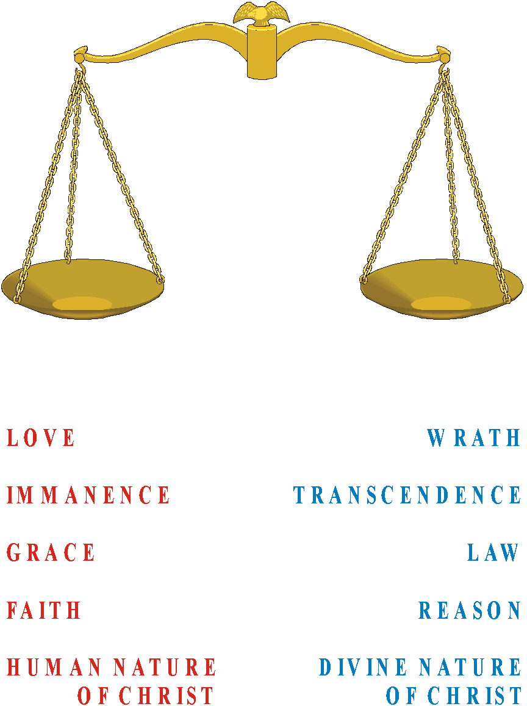
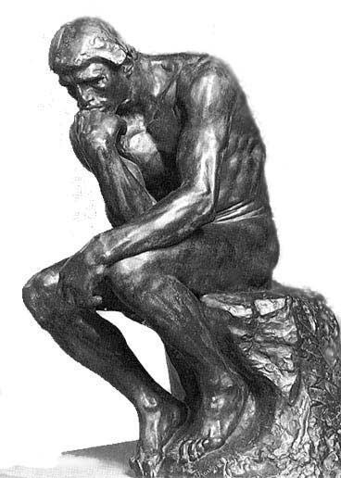
Notes:
*

Slide 97
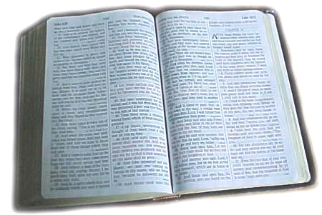
Notes:
We want the biblical balance – not what looks right in our own eyes.
*

Slide 98
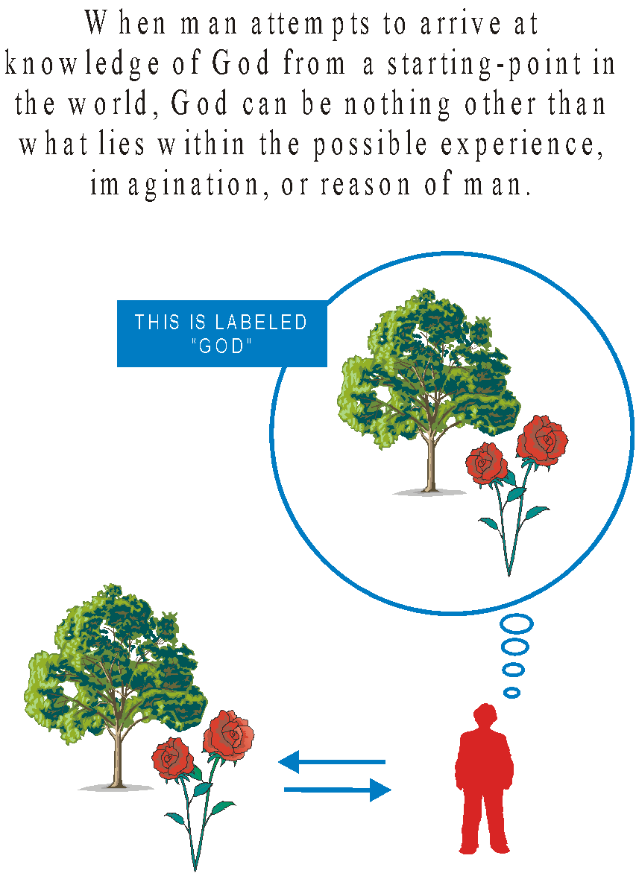
When man attempts to arrive at knowledge of God from a starting point in the world, God can be nothing other than what lies within the possible experience, imagination, or reason of man.
Notes:
When man attempts to arrive at knowledge of God from a starting point in the world, God can be nothing other than what lies within the possible experience, imagination, or reason of man.
*

Slide 99
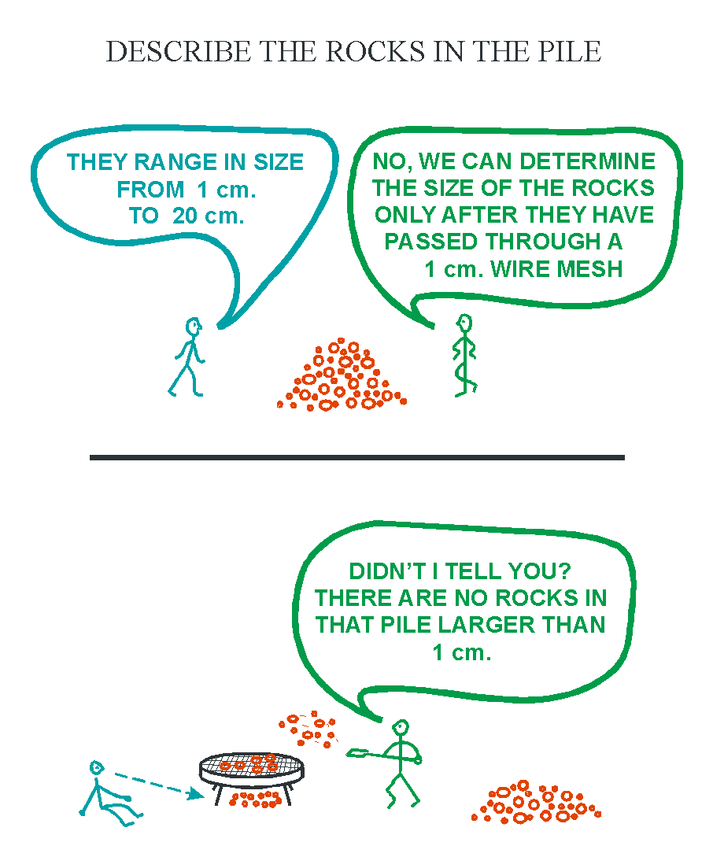
Notes:
*

Slide 100
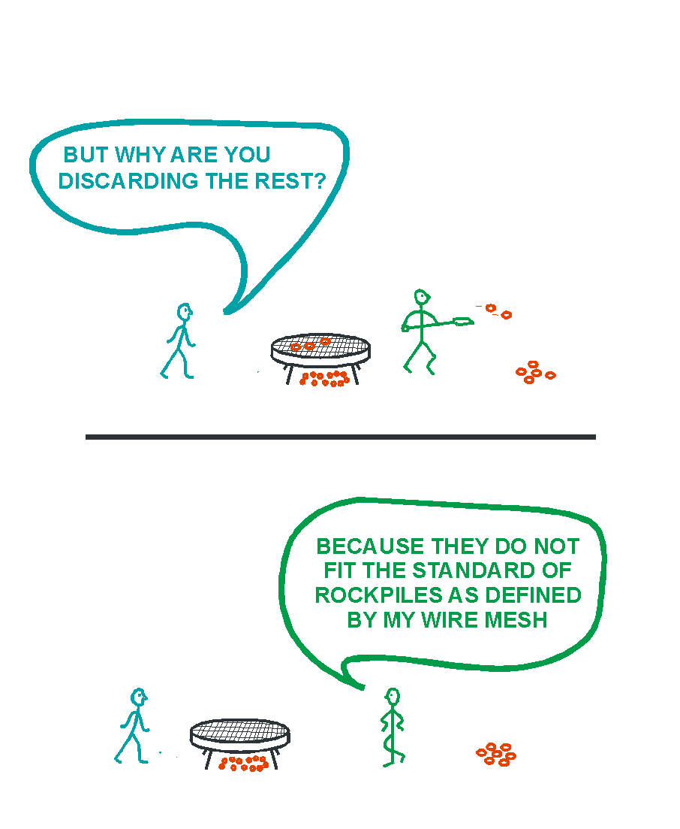
Notes:
We put God through our sieve in order to find him. The result is an idol of our own making.
*

Slide 101
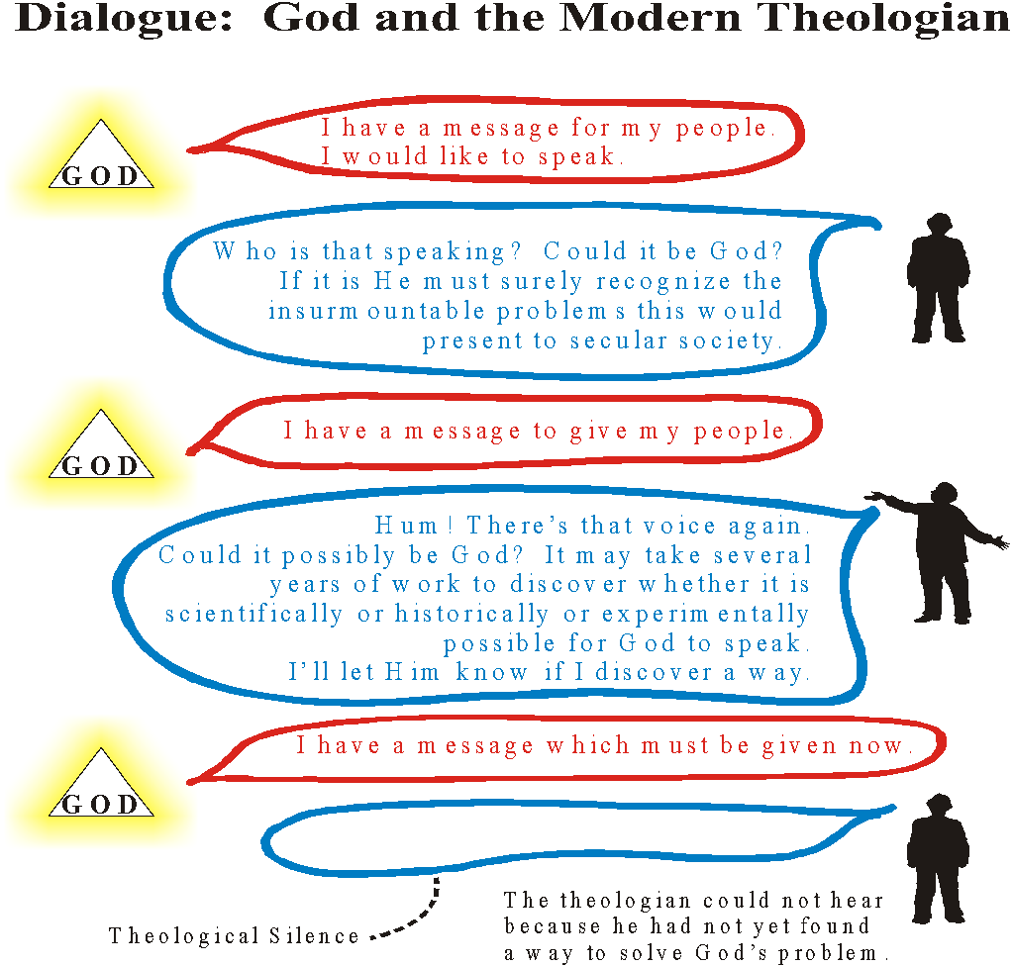
Notes:
*

Slide 102

Notes:
*
Let’s compromise. There is no compromise, no synthesis!

