Slide 1
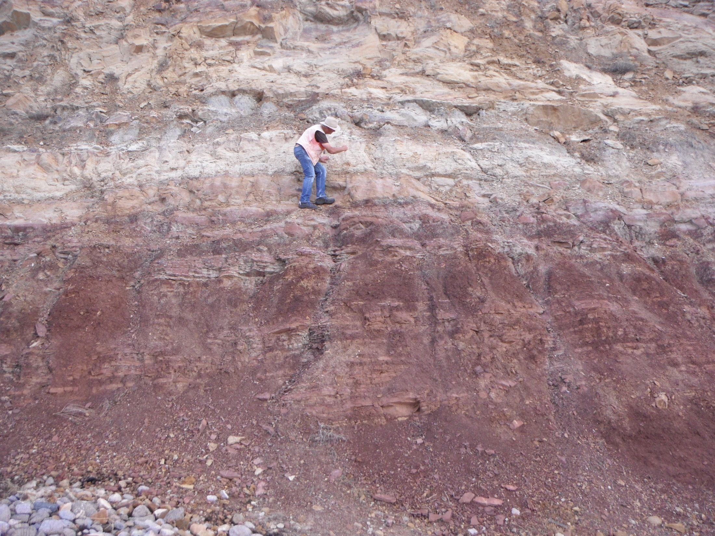
Does the Shinarump/Moenkopi contact represent a 10 MY time gap on the Colorado Plateau?
Radiometric dating
Other dating methods
Fossil record
Orderly fossil record
Hominid record
Etc.
Art chadwick and Leonard Brand

Slide 2
Goals of this talk:
Describe the seeming challenge of these rock formations
Explain how the Bible can help us:
Do better science
Find more correct explanations

Slide 3
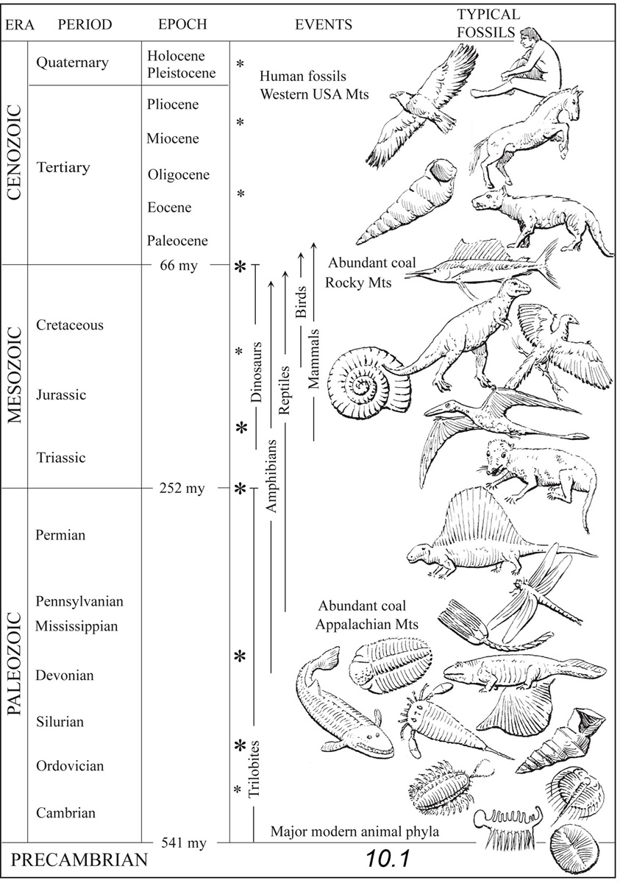
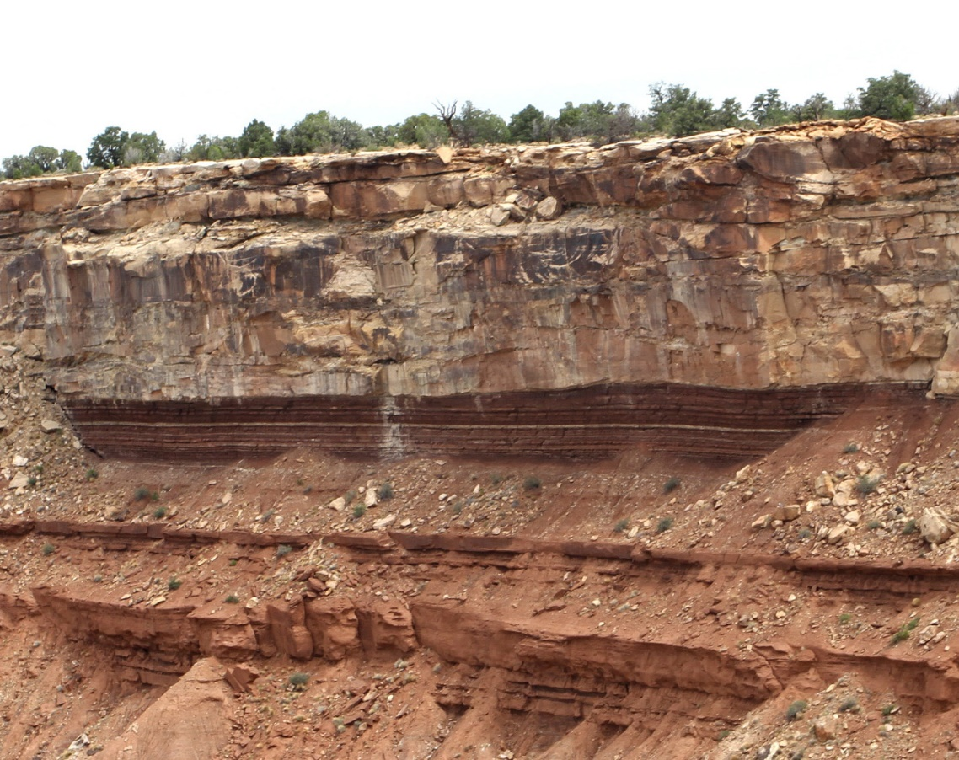
Definitions:
Naturalistic model: used here to refer to an explanation of history of life in a millions of years time frame (deep time).
Deposition: The laying down of layers of sediment
that make up the geologic column.

Slide 4
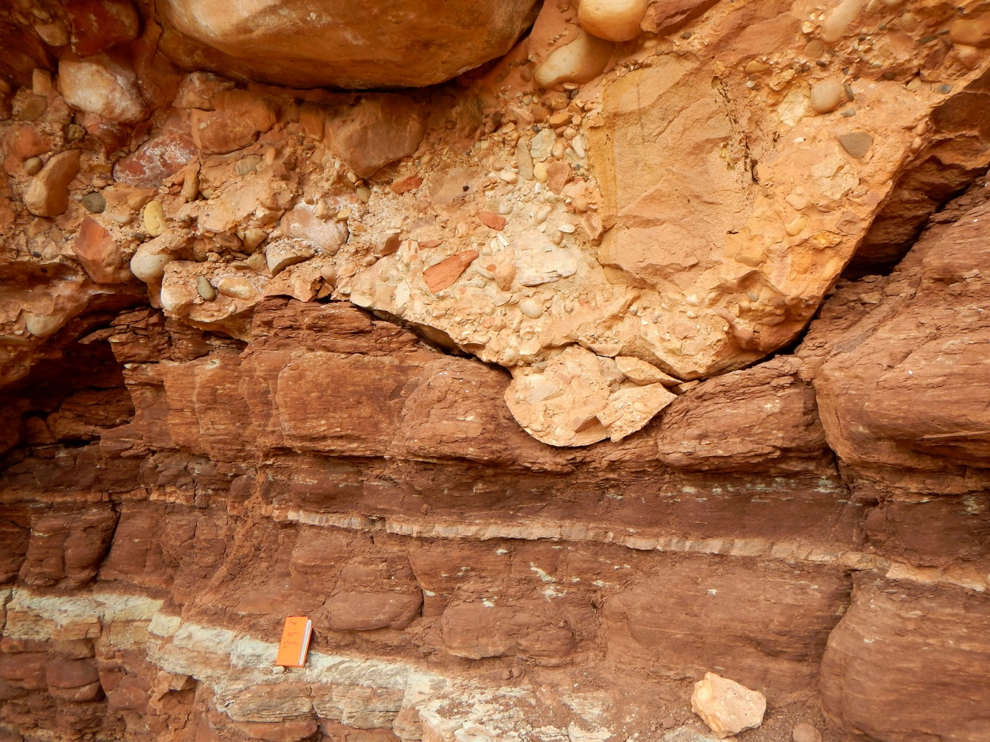
Definitions:
Unconformity: Two successive layers do not
meet in a flat surface, indicating that some
event has occurred between them,
involving time.
Paraconformity: Two successive layers meet
in a flat surface.
But, it is assumed that time has passed
after the lower layer was deposited.

Slide 5
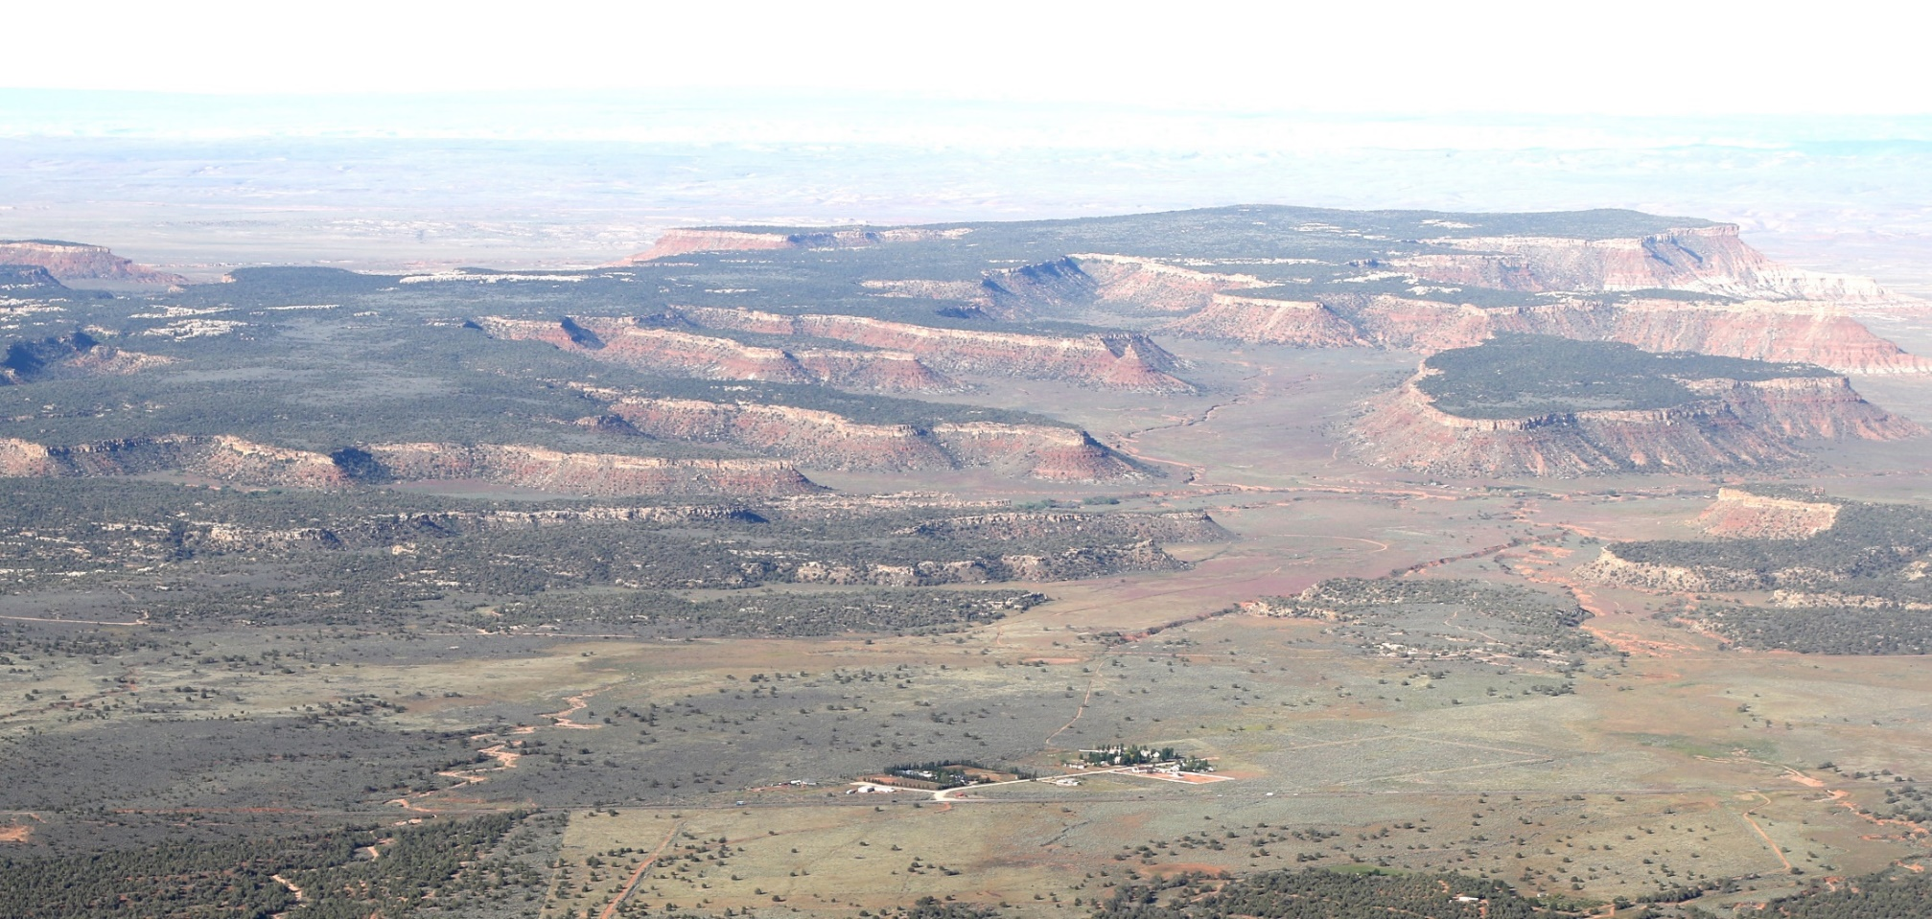
The research project – the Moenkopi Formation and the Shinarump Conglomerate
Shinarump Conglomerate
Missing time –
10 + million years ??
Moenkopi Formation

Slide 6
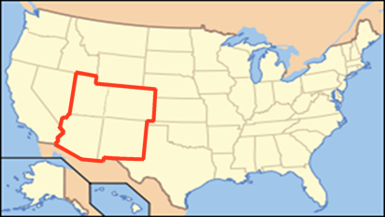
The moenkopi formation
The Moenkopi Formation and the overlying Shinarump Member of the Chinle cover over 100,000 square miles
Colorado Plateau

Slide 7
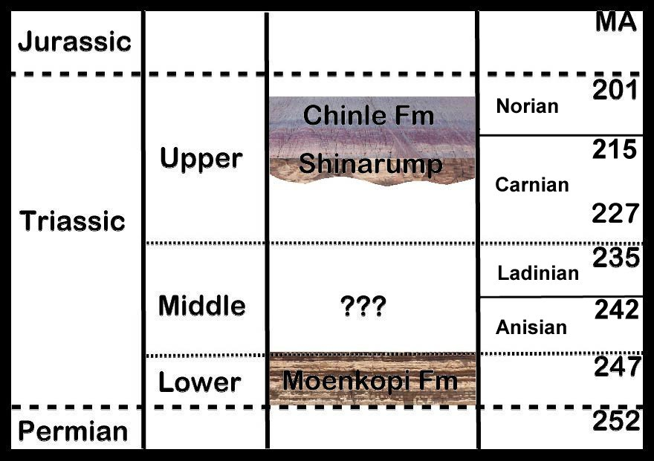
Time gap above the moenkopi?
Geologists have concluded that there is a time gap of 10-35 million radiometric years.

Slide 8
THERE ARE OCCASIONAL EROSIONAL CHANNELS

Slide 9
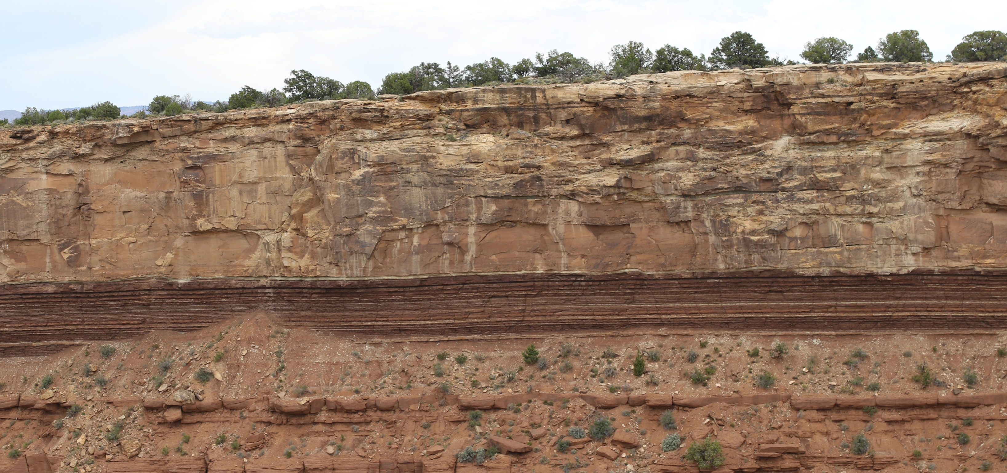
Usually the contact is flat and smooth
But usually the contact is flat, with little or no evidence of the passage of time.
It is considered a paraconformity.

Slide 10
Time and amount of erosion
How much erosion could occur in 10-35 million years?
At modern erosion rates, all of North America will be eroded to sea level in 10 million years.*
*Gilluly, James, 1955, Geologic contrasts between continents and ocean basins : Geol. Soc. America Special Paper 62, p. 7-18.

Slide 11
Time and amount of erosion
How much erosion could occur in 10-35 million years?
At modern erosion rates, all of North America will be eroded to sea level in 10 million years.*
At this rate, in 10 my there should be no Moenkopi left, at all.
But, if there was little or no time in that “gap” there would be no erosion.
*Gilluly, James, 1955, Geologic contrasts between continents and ocean basins : Geol. Soc. America Special Paper 62, p. 7-18.

Slide 12
If no erosion, then no time
A flat contact for over 100,000 square miles – no erosion

Slide 13
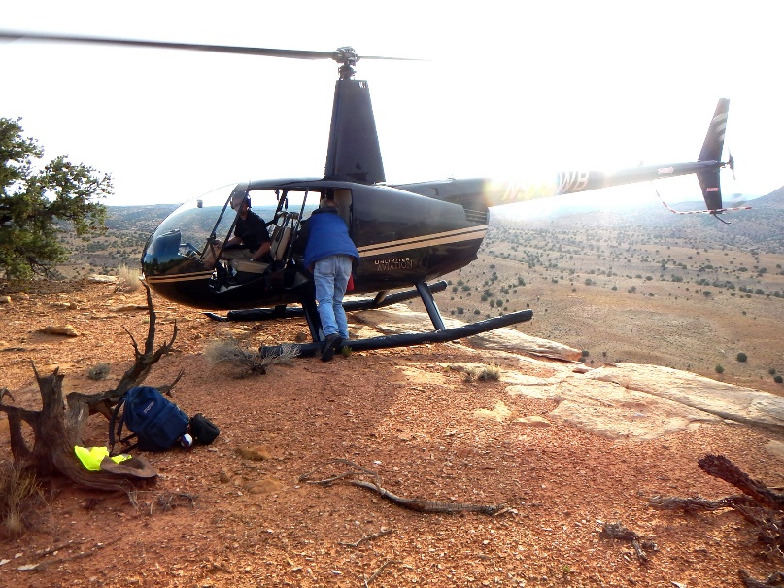
Our research Sites visited and photographed for analysis: Utah and Arizona

Slide 14
EVIDENCE
NO BIOTURBATION (BURROWS) – NO TIME BETWEEN THE TWO FORMATIONS
CONTACT
NO BIOTURBATION

Slide 15
LOAD CASTS – THE MOENKOPI WAS SOFT WHEN THE SHINARUMP WAS DEPOSITED
Load cast
Moenkopi – Shinarump Contact

Slide 16
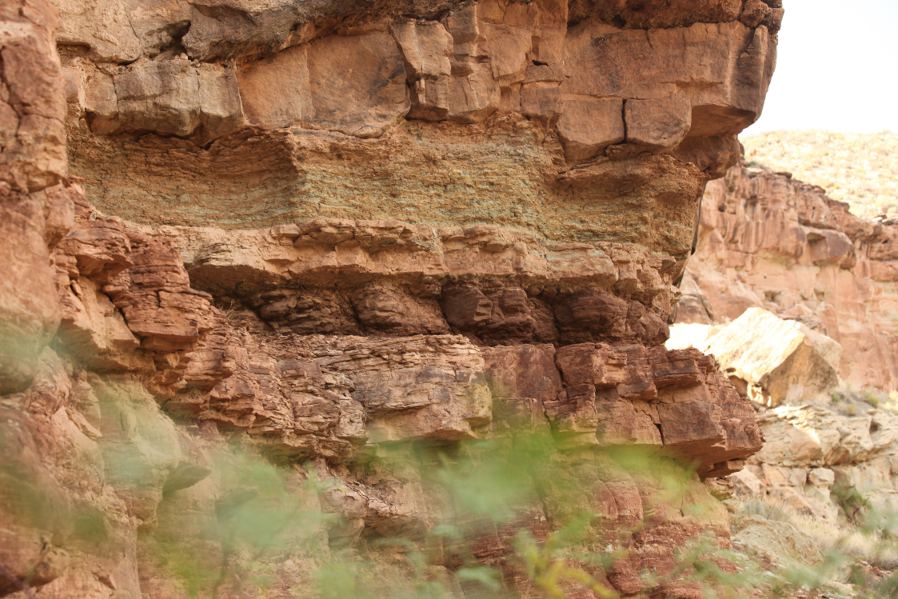
Load casts
Shinarump
Contact
Moenkopi

Slide 17
Moenkopi – Shinarump Contact
Porcellanous layer

Slide 18
Porcellanous layer

Slide 19
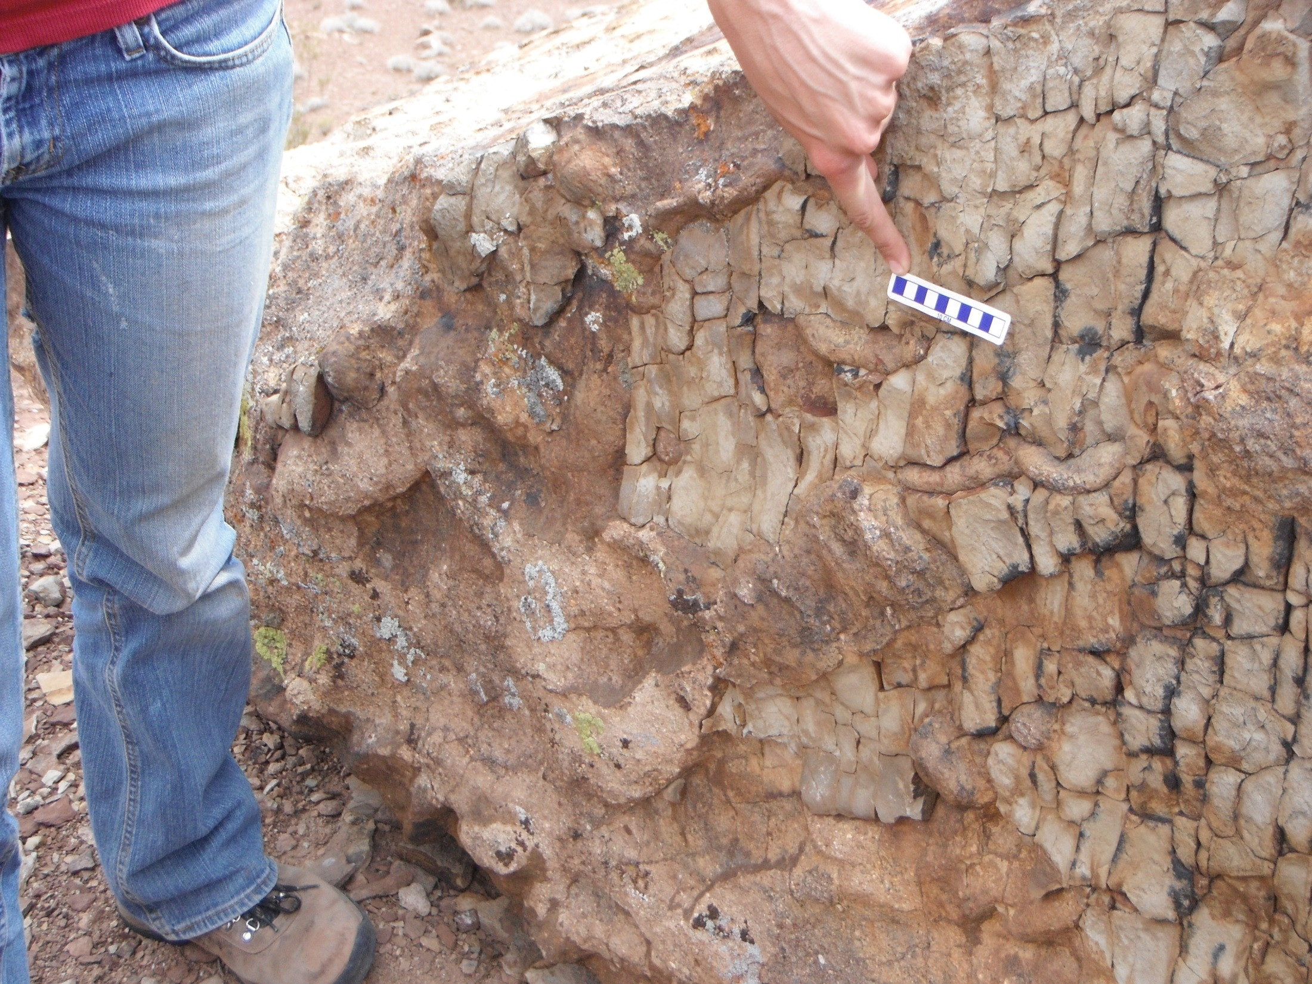
Load casts

Slide 20
Load cast
Load cast

Slide 21
The evidence is not compatible
With a long period of time
Load casts

Slide 22
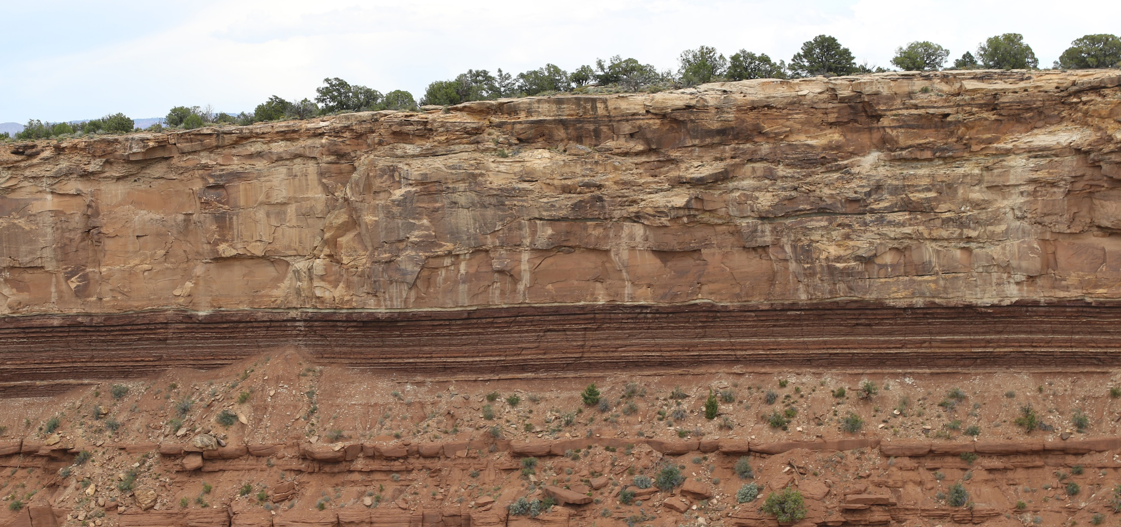
Continuity of layers – over long distances Not local deposition

Slide 23
Continuity of layers
Continuous over long distances.
Demonstrates lack of erosion.
Challenges any naturalistic depositional model.

Slide 24
Continuity of layers
Continuous over long distances.
Demonstrates lack of erosion.
Challenges any naturalistic depositional model.

Slide 25
evidence: Shinarump/Moenkopi Unconformity
Flat contact
Continuity of beds for great distances
Almost no bioturbation in Moenkopi
Evidence of uncemented (soft) Moenkopi at contact
Load casts
Porcellanite bed at contact, with load casts
Continuity of beds for great distances

Slide 26
Conclusions: no TIME AT THE CONTACT
Clearly the Moenkopi did not sit for 10-35 million years without erosion, or deposition, or lithification.
This is not an isolated example. There are many such paraconformities, with no evidence for long time.
These episodes of “non-deposition” are most readily explained by a model of rapid deposition and burial, consistent with short time.

Slide 27
Conclusions: no TIME AT THE CONTACT
Use of a biblical model encouraged quality science.
A biblical worldview opened our eyes to find better explanations.

Slide 28
Conclusions: no TIME AT THE CONTACT
The God of the Bible is the best geologist, ever!

