Slide 1
ASPECTS OF THE GEOLOGY OF OGUN STATE, SOUTHWESTERN NIGERIA: SIGNIFICANCE FOR ORIGINS
OLUWOLE A. OYEDEJI

Slide 2
PRESENTATION OUTLINE
Sedimentary Basins
Location
Dahomey OR Benin Basin –Origin and Morphology
Geology of Ogun state
Economic Geology
Geotourism sites
Origins
Significance for a young age
Conclusions

Slide 3
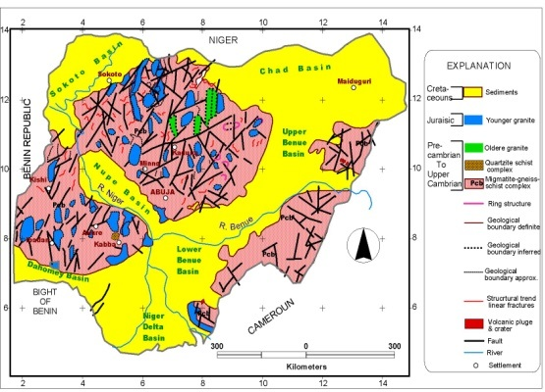
LOCATION OF OGUN STATE, SW NIGERIA
THE SEDIMENTARY BASINS IN NIGERIA
Ogun state falls within the Dahomey or Benin Basin
One of the seven Basins in Nigeria
Others are Sokoto or Iullemeden, Benue trough, Chad Basin, Bida or Nupe Basin, Anambra Basin, Niger Delta and Dahomey
Except the Anambra and the Bida Basins, all traverse international boundaries

Slide 4
SEDIMENTARY BASINS
Regions of earth where long-term subsidence have created accommodation space for filling by sediments
Occur in diverse geologic settings usually associated with plate tectonic activity-Divergent, Convergent, transform, hybrid
Crustal extension- Rifting e.g. Benue trough, may be intracratonic e.g, Chad, Passive Margin e.g. Dahomey or Benin
Others-Subduction, strike-slip faulting
The rock sequences that fill up Basins constitute the stratigraphic record useful for the reconstruction of tectonic history

Slide 5
THE WILSON CYCLE
The Wilson cycle is named after the Canadian geophysicist J. Tuzo Wilson (1908-1993
The cyclical opening and closing of ocean basins caused by movement of the Earth’s plates.
The Wilson cycle begins with a rising plume of magma and the thinning of the overlying crust.
As the crust continues to thin due to extensional tectonic forces, an ocean basin forms and sediments accumulate along its margins.
Subsequently subduction is initiated on one of the ocean basin’s margins and the ocean basin closes up.
When the crust begins to thin again, another cycle begins.
Source: https://www.geologypage.com/2013/01/wilson-cycle.html

Slide 6
DAHOMEY OR BENIN BASIN
One of the many marginal Basins along the coasts of Africa and Brazil
A sinistral wrench fault feature at the southernmost end of the Benue Trough
Occurs as a coast-parallel depression stretching the western limit of the Niger Delta westwards through Benin Republic and Togo
Terminates east of Accra in Ghana
Has a latitudinal stretch of about 500km
Attains its widest onshore expanse of about 170km around the Nigeria-Benin frontier

Slide 7
ORIGIN OF THE DAHOMEY BASIN-WORLDVIEW
Source: gstatic.com/images

Slide 8
strike-slip fault, also called transcurrent fault, wrench fault, or lateral fault,
Fracture in the rocks of Earth’s crust in which the rock masses slip past one another
Caused by horizontal compression,
Energy is released by rock displacement in a horizontal direction
Source: Universidad Fernando Pessoa

Slide 9
GEOLOGICAL FRAMEWORK OF THE BASIN (After Billman, 1992) showing the wrench faulting
Outcrop area is concave seaward, roughly reflecting the succession of ancient coastlines
Four broad geomorphic zones—Northern uplands, Ewekoro Depression, southern uplands and the Coastal Margin

Slide 10
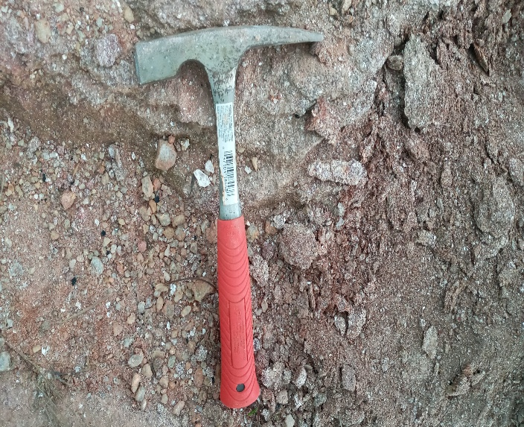
GEOLOGY OF OGUN STATE
Underlain in the south by sedimentary rock (Jones and Hockey, 1964) lying unconformably on the Basement
The Cretaceous --Abeokuta Group the Cenozoic units (Ewekoro, Ilaro and the Coastal plain sands
Underlain to the north by rocks which belong to the Basement complex of Nigeria
Porphyritic Granite
Mica Schist

Slide 11
The sedimentary Formations in Ogun state
Ewekoro Formation– Predominantly limestone, marl, and overlying shales. It is fossiliferous in places
Ilaro Formation– Predominantly sand but with considerable fractions of clay and shale. It is also fossiliferous and phosphatic
Coastal plain sands– soft, very poorly sorted Sands, pebbly in places,

Slide 13
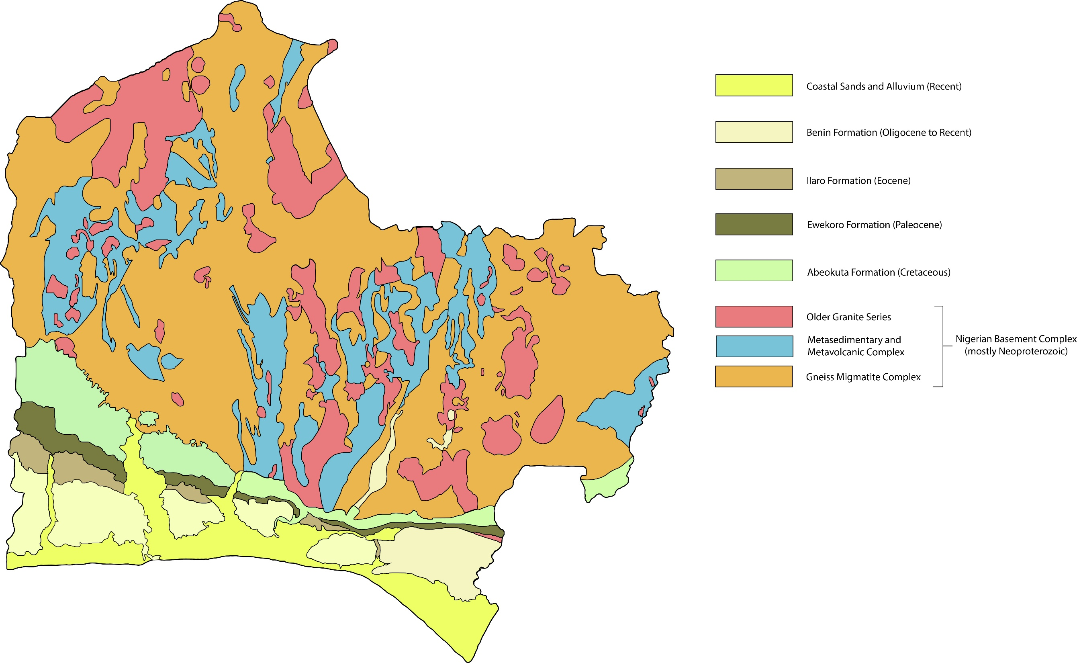
SIMPLIFIED GEOLOGICAL MAP OF SOUTHWESTERN NIGERIA

Slide 14
BRIEF DESCRIPTIONS OF THE FORMATIONS
Abeokuta Formation-- Predominantly coarse- grained sands, consolidated in places, with intercalations of hard ferruginous pans, silt, mudstone and clays
Babcock University is underlain by the Abeokuta Formation
Hosts the bitumen/tarsand deposit (Yemoji)
Abeokuta Formation is the oldest Formation in the Basin
Notes:
ces

Slide 15
HISTORY/STRATIGRAPHY OF THE SEDIMENTARY ROCKS IN THE DAHOMEY BASIN(Adapted After Kogbe, 1989)
ERA | PERIOD | Age millions OF YEARS | Formation
CENOZOIC | TERTIARY | Eocene (57.8-36.6) | Ilaro Formation Oshosun Formation
 |  | Palaeocene (66.4-57.8) | Akinbo Formation Ewekoro Formation
MESOZOIC | CRETACEOUS | Maastrichtian (72.0-66.0) | Abeokuta Formation
PALAEOZOIC | PRECAMBRIAN | > 545 | BASEMENT COMPLEX
The ages assigned were based on the Macro faunal content and radioactive methods All the authors do not agree on the dating.

Slide 16
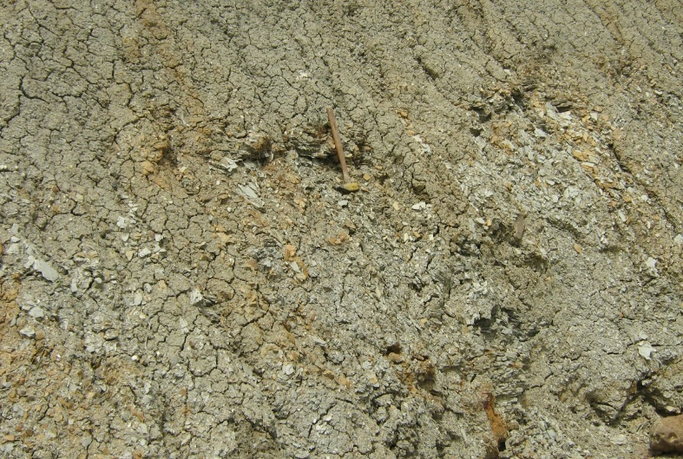
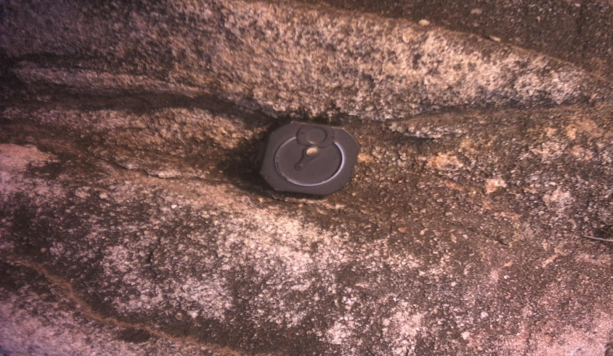
Clastic Sediments in Ogun state
Formed of fragments of weathered rocks or shells - Sand, clay, boulders and shell fragments are examples.
Clastic sedimentary rocks are named according to the sizes of the particles.
Abeokuta Formation, Ilaro Formation which comprise sandstone and shale

Slide 17
Exposure of Abeokuta Formation at a quarry

Slide 18
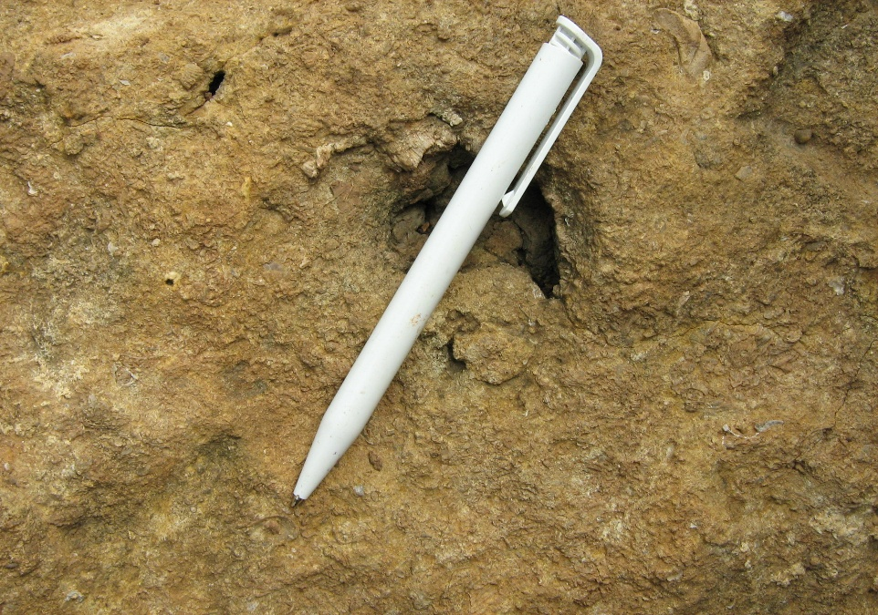
NON-CLASTIC OR CHEMICAL SEDIMENTS IN OGUN STATE –EWEKORO FORMATION(LIMESTONE)

Slide 19
SECTION OBSERVED AT THE LAFARGE QUARRY, EWEKORO (Oyedeji and Ezeribe, 2007)
Limestone
Shale

Slide 20
PALEONTOLOGY (After Jones and Hockey, 1964)
FORMATION | TYPE OF ASSOCIATED FOSSILS
ABEOKUTA
EWEKORO | Micro fossils (Foraminifera, Ostracods)
Ilaro | Fish Molluscs (Gastropods, Bivalves) Microfossils (Ostracods)
Coastal plain sands

Slide 21
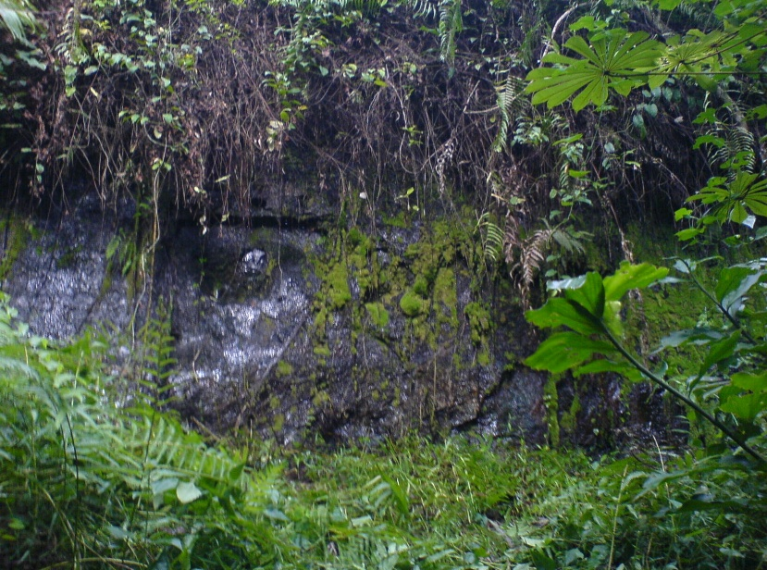
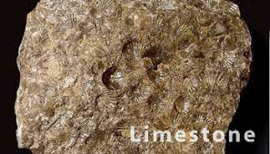
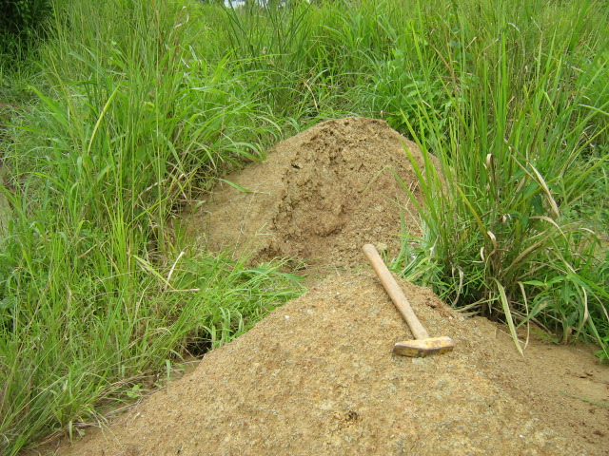
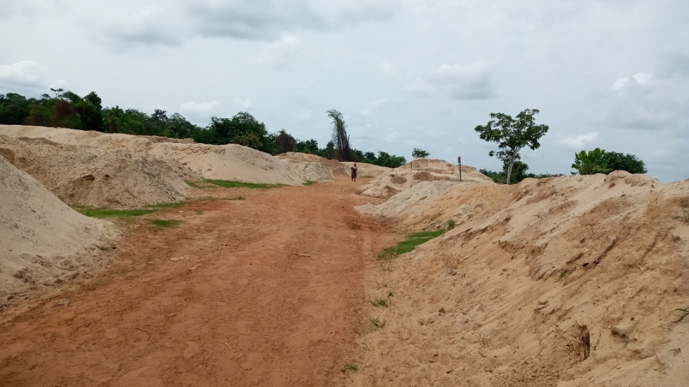
ECONOMIC GEOLOGY
Limestone,
Construction materials—Sand, brick clay, crushed stones and aggregates,
Phosphates,Tar sands/Bitumen
BITUMEN
BRICK CLAY
SAND FOR CONSTRUCTION

Slide 22
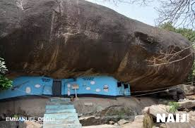
GEOTOURISM SITES
Olumo rock
Tar sand oozing site, Yemoji
Cement factories-Ewekoro, Sagamu,
Ibeshe

Slide 23
standard model FOR THE ORIGIN OF THE SEDIMENTARY ROCKS
Clastic – Formation involves erosion, transportation and deposition followed by lithification and diagenesis
Shale: Formed from clay deposited in a low energy environment, usually considered to be deposited slowly from quiet water in a marine or lake environment
Non-clastic e.g. Limestone- CaCO₃ is precipitated by organisms usually to form a shell or other skeletal structure. Accumulation of these skeletal remains results in a limestone This would seem to take time
Tarsands/bitumen- Semiliquid- semisolid to solid petroleum in rock.

Slide 24
HOW WERE THE CLASTIC SEDIMENTS FORMED?

Slide 25
HOW WERE THE NON-CLASTICS CHEMICAL AND ORGANIC ROCKS FORMED?
Non-clastic rocks are created when water evaporates or from the remains of plants and animals.
ORGANIC-- formed from the dead remains of plants. Millions of years ago, plants fell into swamps.
They were covered with layers of sediment and did not rot.
Over long period of years, as the remains were buried deeper under more and more layers of sediment, they were changed by pressure

Slide 26
ORIGIN OF THE ROCKS AND THE BASIN in light of BIBLICAL HISTORY
The sediments deposited have widespread occurrence
They are predominantly clastic
Deposition may not require long time as assigned
Fossil assemblage in the sands are different from the overlying limestone and shale
These are more consistent with catastrophic transport, then burial during or after the massive global flood of Noah’s day.

Slide 27
ILLUSTRATION OF HIGH –ENERGY TRANSPORTATION AND QUICK SEDIMENTATION (Oyedeji 2019)

Slide 28
ILLUSTRATION OF UNDERWATER DEPOSITION (Flood Model)
The flood covered all the high mountains Gen 7:19,20 and all living things were blotted out. Gen 7:23
The flood was accompanied by earthquakes, which triggered tsunamis, and erosion and sedimentation on a large scale.
The opening of the fountains of waters (Gen. 7:12) may refer to underwater volcanism or materials from deep inside spewing out into the ocean basins.

Slide 29
SIGNIFICANCE OF THE ROCKTYPES FOR A YOUNG AGE
The beds are almost horizontal
Little evidence of faulting,
No Folding

Slide 30
Questions that still need to be answered
Do basement rock represent pre-flood history?
Are the sedimentary events related to the main part of the flood?
Or were they post flood?

Slide 31
WORK IN PROGRESS (Nalin, Clausen, Oyedeji and others)
Provenance and geochronology of Cretaceous to Holocene deposits of the Dahomey Basin, Nigeria, by means of U-Th dating of detrital zircons
Samples collected: Sediments and Bedrock
Goals:
Peaks of crust formation and magmatic history of the African continent - Stability of sediment transport after Pangea break-up (post flood)
Results so far
The post break-up provenance patterns will be useful in organizing a Biblical approach to earth history for the African continent.

Slide 32
Individual zircon crystals from the Schist

Slide 33
CONCLUSIONS-1
The sedimentary aspect of the geology of Ogun state has been presented
The scientific worldview for the origins of the rocks have also been presented.
Biblical view on the origin of the rocks has also been presented
The events as described by the standard model are real, though we may not agree with the time and ages assigned.
The ages have contentious issues
Organic origin for the tarsands and bitumen can be assumed. (i.e., the conversion of sedimentary organic matter as a result of heating and transformation to form oil and gas).

Slide 34
CONCLUSIONS -2
In the beginning, the Bible says God created the heavens and the earth Genesis 1:1,
Nothing was made without Him. John 1:3
Issues of conflict over origins need to be aggressively researched so that we can have models to support Biblical creation

Slide 35
THANK YOU!!!

