Slide 1
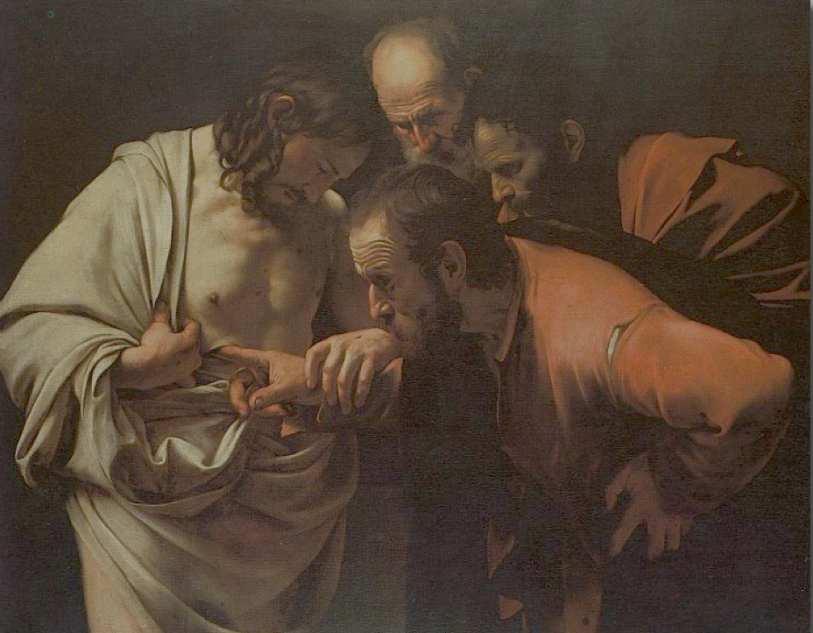
Faith and Science: Can They Coexist?
“Unless I see in His hands the print of the nails, and put my finger into the print of the nails, and put my hand into His side, I will not believe”
Thomas known as Didymus, John 20:25
Notes:
For people of faith, Thomas is often presented as a bad example. Is science bad for your faith? One could also ask the opposite question: is Faith bad for your Science?

Slide 2
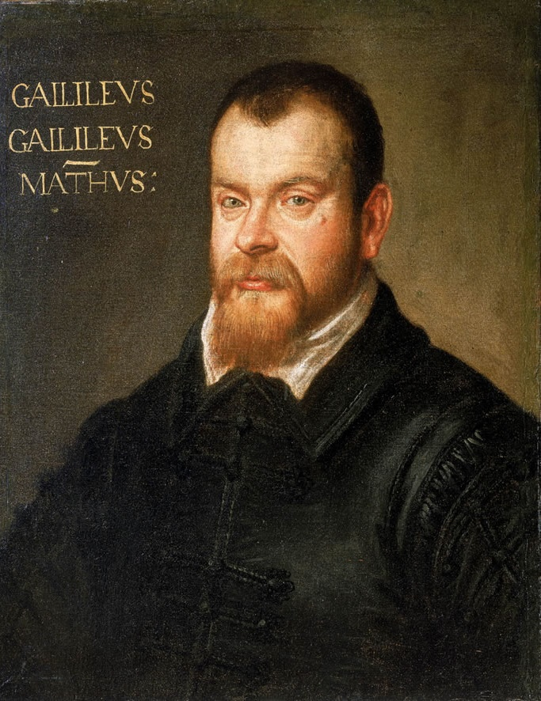
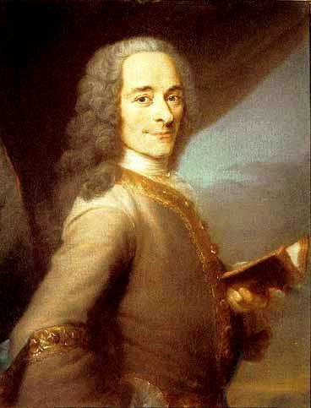
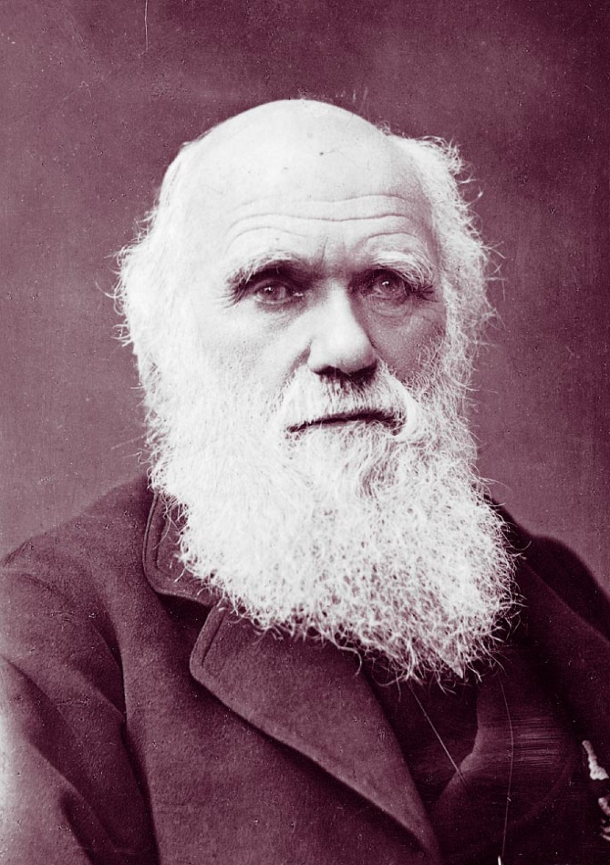
Modern era: conflict between faith and science
Notes:
We live in an interesting time. In contemporary western culture we have this notion of an ongoing conflict between faith and science. Usually, faith is presented as an obscurantist fundamentalist force opposing the progressive illuminating advance of science. Classic chapters in this narrative include Galileo Galilei and the clash with the Catholic Church, the Age of Enlightenment, Darwin

Slide 3
Informal definitions
“Faith”: worldview based on biblical revelation
“Science”: approach that uses solely physical evidence to understand reality
Question:
Can we hold on to a biblical worldview and embrace the practice of science?
Notes:
The question that we are going to try to answer today is this. Can these two worlds really coexist? Is conflict the only possible way? Can we hold on to a biblical worldview and embrace the practice of science?

Slide 4
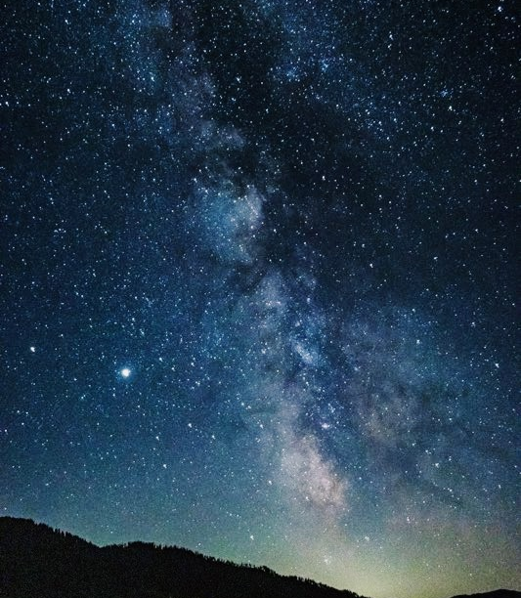
Scripture and Nature
“bear the impress of the same master mind””
Notes:
As Seventh-day Adventists, we believe the Scriptures are the written Word of God, given by divine inspiration, and trustworthy record of God’s acts in history. We also believe that God created the universe, and “the heavens and the earth, the sea, and all that is in them.” So, we are blessed with God’s self-revelation in the Bible and a physical reality (the world we live in) that results from His will and power. Sometimes these are also known as the “two books,” the book of nature and the book of revelation. Because they “bear the impress of the same master mind,” these two books speak in harmony in pointing us towards deep truths. In the natural sciences we study an immense universe, regulated by laws, with living beings displaying incredible design and complexity, which makes perfect sense in light of the biblical revelation of the power, wisdom, and intentional love of our Creator God.

Slide 5
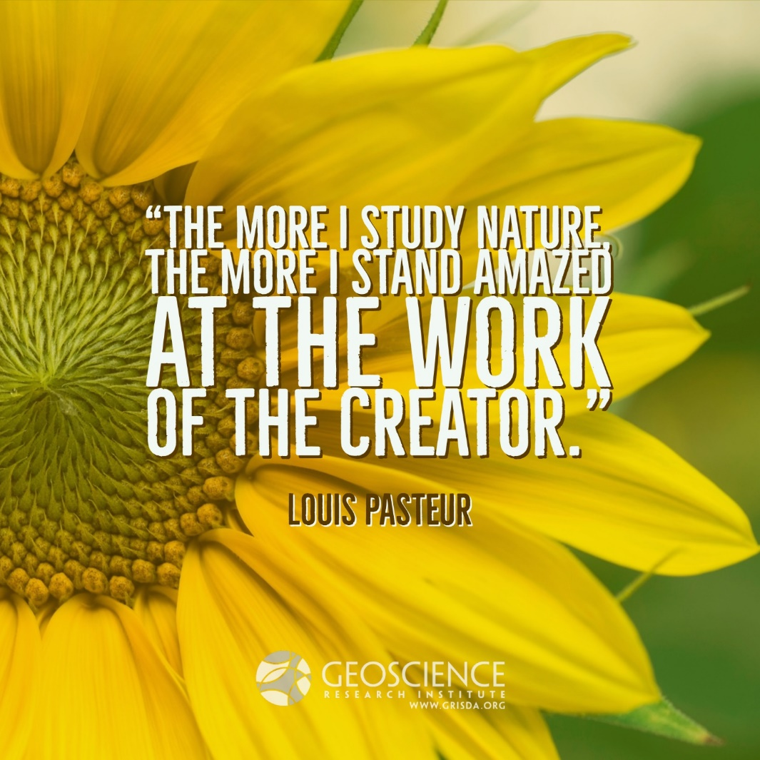
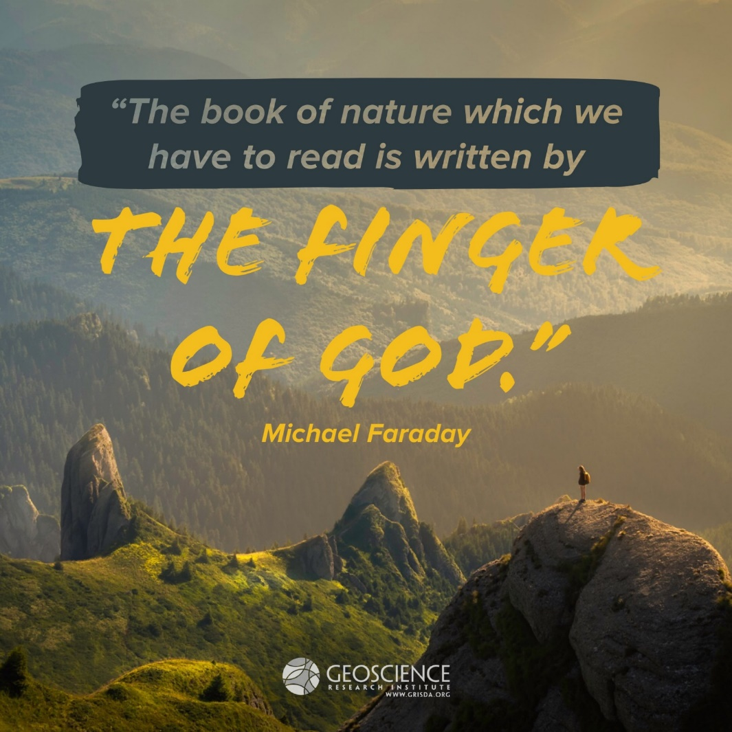
The good news
Many great scientists were/are people of faith

Slide 6
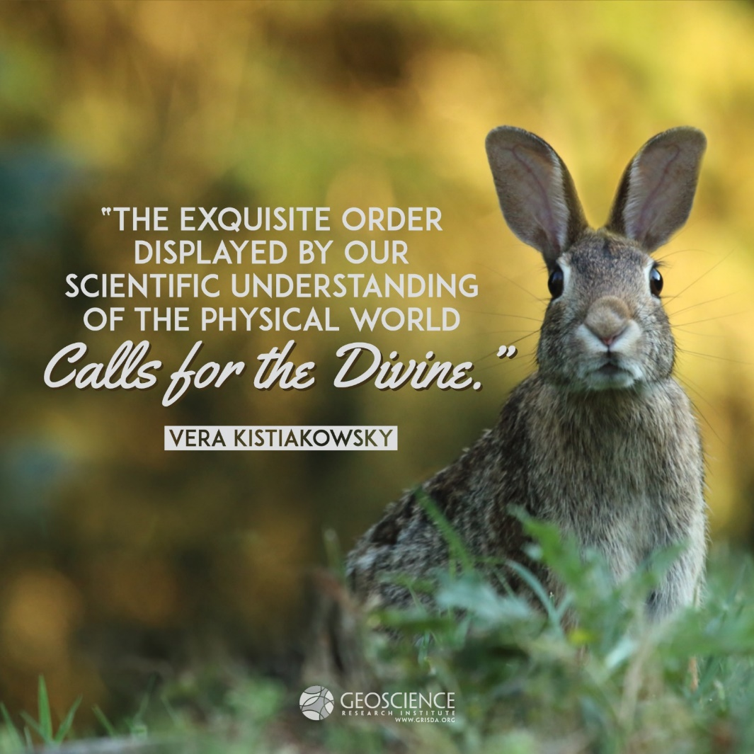
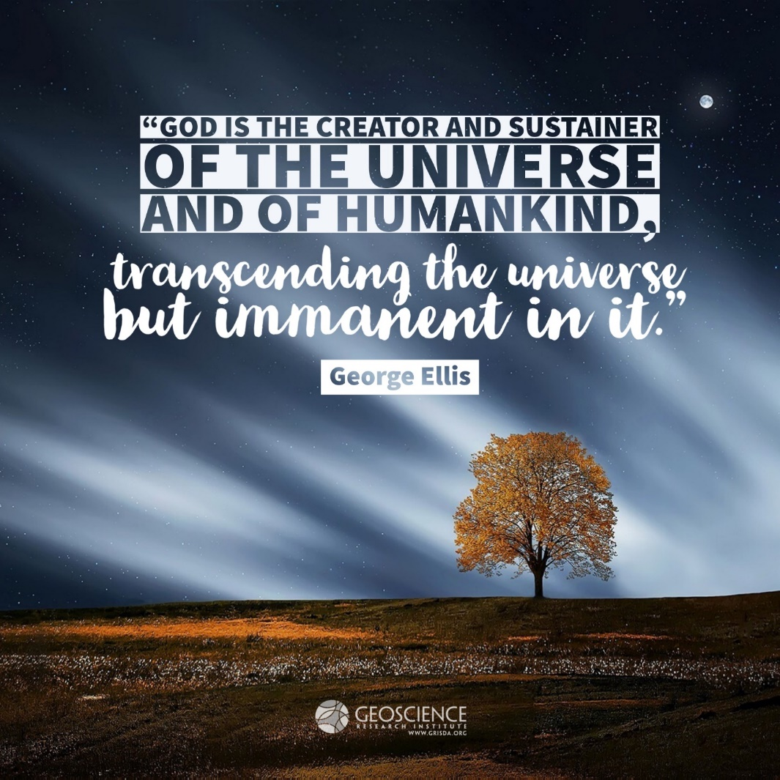
The good news
Many great scientists were/are people of faith
Notes:
Vera: Physicists
Ellis: Cosmologist

Slide 7
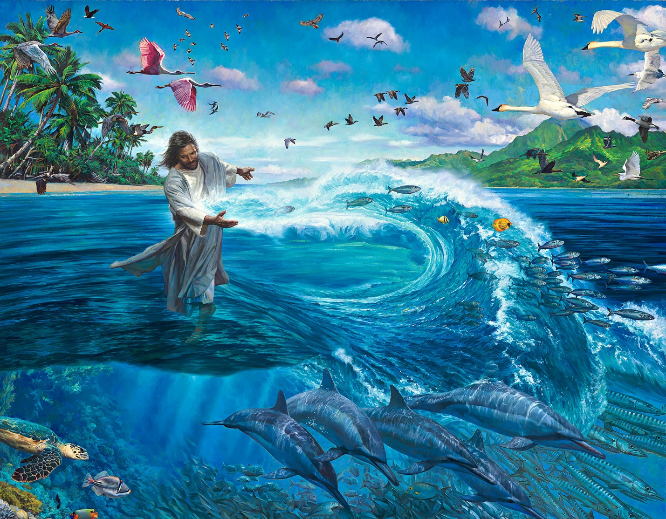
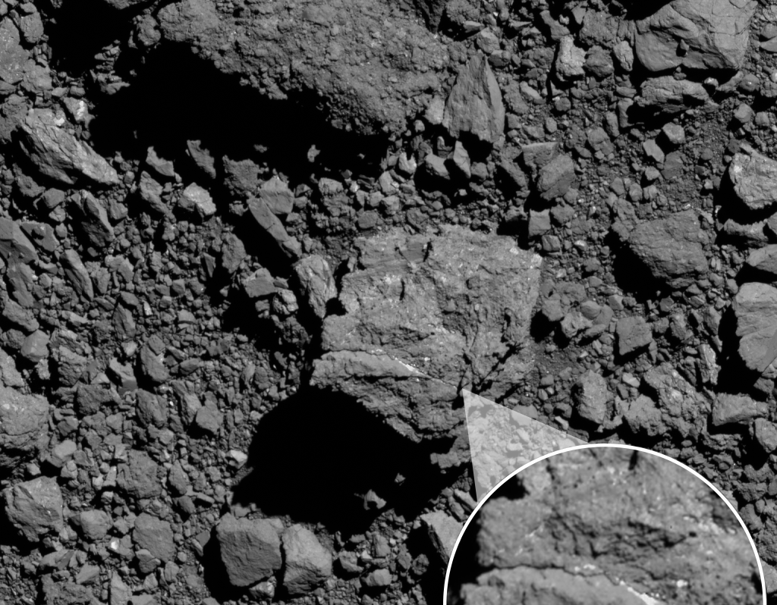
Examples of conflict
Origin of living creatures
Nathan Greene, Days of Creation, Day 5. Used with permission
Credit: NASA/Goddard/University of Arizona
Notes:
Here are three very specific examples of contrasting narratives:
First, the origin of life and living creatures on the Earth. According to Scripture, life was created by God, recently, during creation week, with fully formed, distinct groups of plants and animals. But the predominant model in the natural sciences posits that life emerged spontaneously from inorganic material and evolved over billions of years from an original single celled organism into myriads of biological forms.

Slide 8
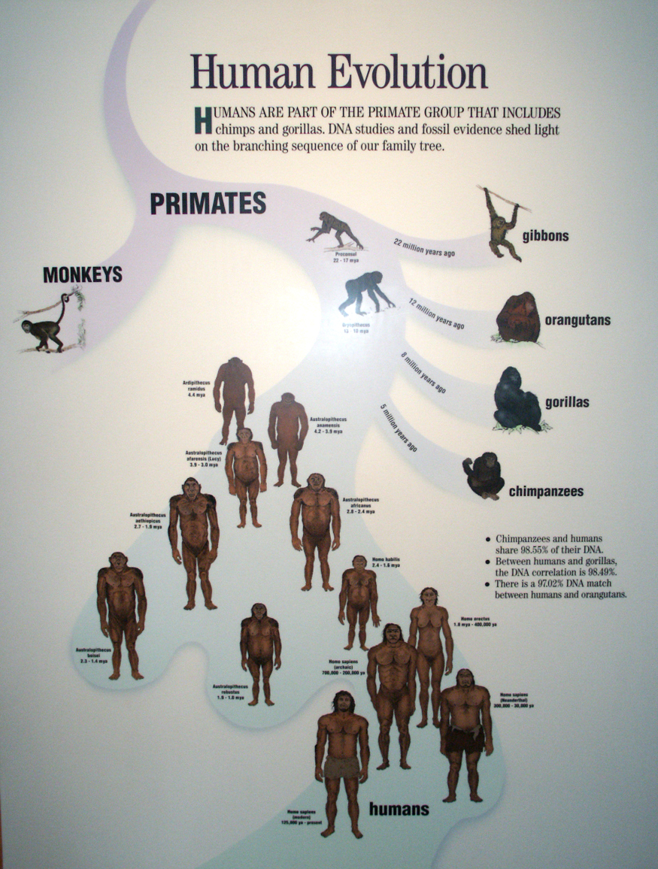
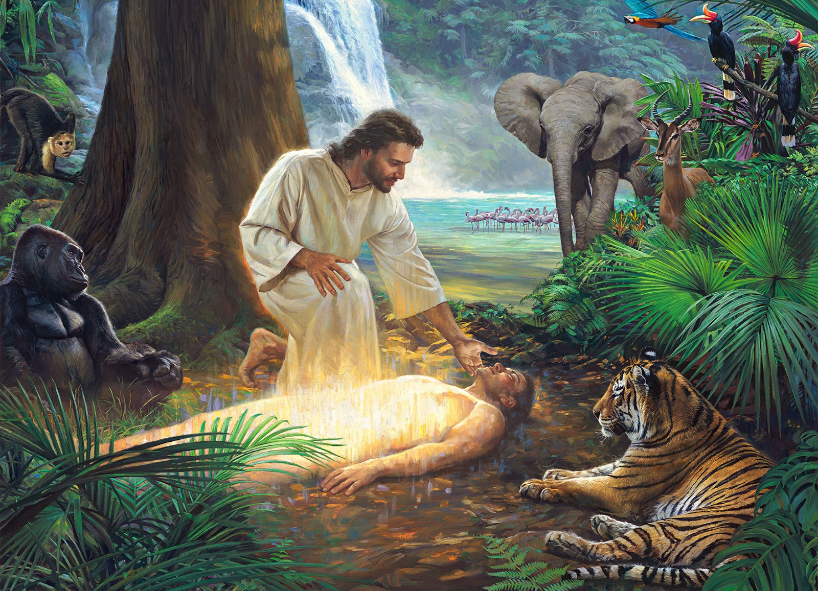
Examples of conflict
Origin of humans
Nathan Greene, Days of Creation, Day 6. Used with permission
Denver Museum of Nature and Science
Notes:
More specifically, the origin of human beings is presented in the Scriptures as an act of special creation by God, during the sixth day of creation week. But the standard scientific narrative traces the evolutionary ancestry of humans to extinct apes, evolving over several millions of years under the same kind of natural selection and biological contingencies as any other organism evolved on the Earth.

Slide 9
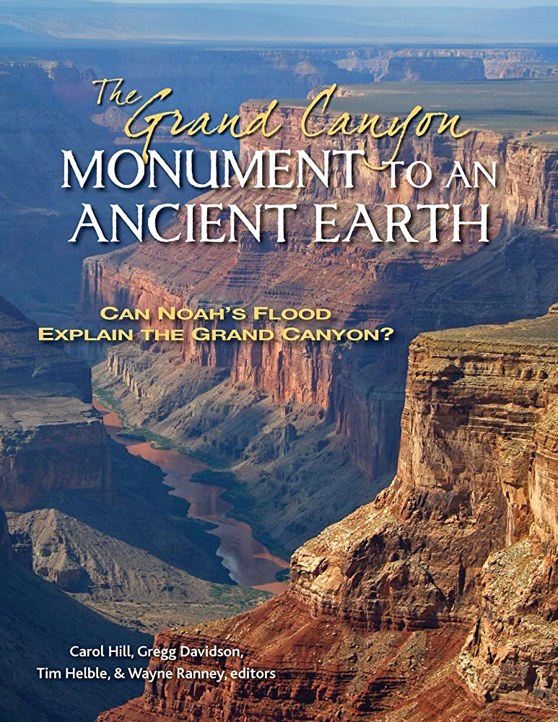
Examples of conflict
A global flood
Notes:
Finally, the Scriptures describe a catastrophic global flood that occurred after creation week and destroyed most life on earth. Most geologists moved away from this notion of a universal flood by the end of the 19th century and see no use today for this concept in interpreting the rock record.

Slide 10
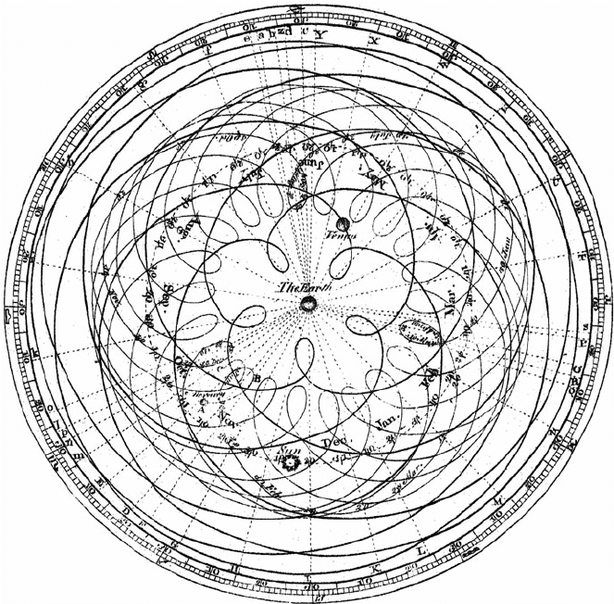
Galileo Galilei: Word vs Senses
Notes:
We will now explore some of the strategies that have been suggested for dealing with this conflict. To illustrate the first approach, we will use a well known figure, the Italian mathematician Galileo Galilei. Galileo lived at a time when the traditional geocentric model of the solar system was being challenged. Galileo definitely embraced the Copernican heliocentric model. Unfortunately, some of his opposers were beginning to attack him on Scriptural grounds. So Galileo feels compelled to write a short treatise (in letter form), to explain his view of how to deal with this kind of perceived conflict.

Slide 11
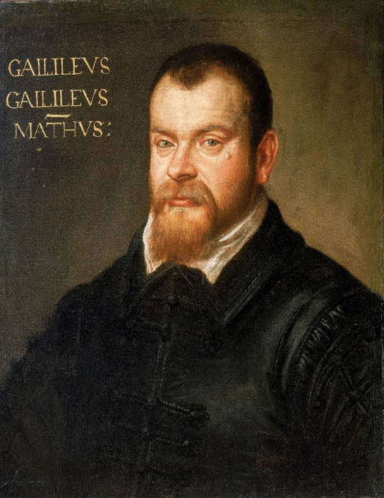
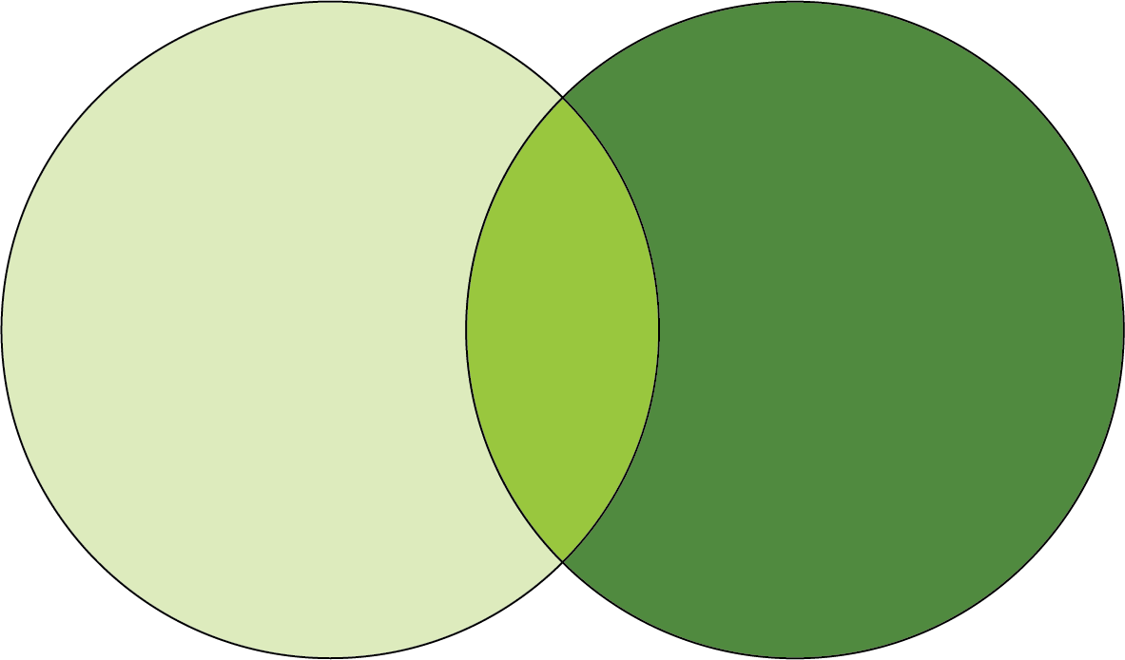
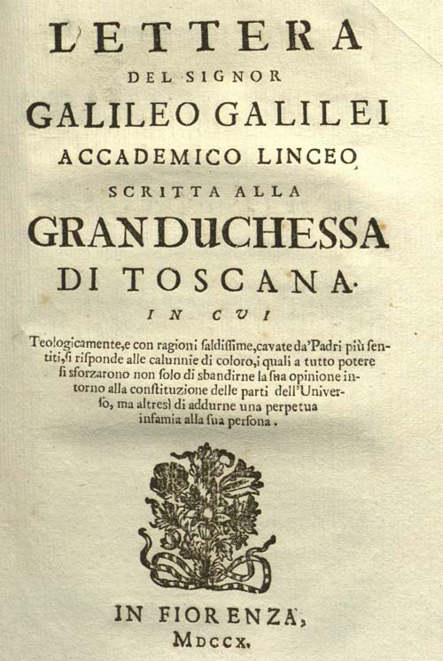
Galileo Galilei: Word vs Senses
Demarcation (non-overlapping magisteria)
“The intention of the Holy Ghost is to teach us how one goes to heaven, not how heaven goes.”
Notes:
His first strategy is to try to diffuse the conflict by keeping the Scriptures and senses separate in their goals and domains of authority. In modern times, this strategy is also known as “Non overlapping magisteria…” Don’t push the use of the Bible as physics/natural sciences textbook, and we could also say don’t push the science as a philosophical/theological tool (although Galileo seems more concerned with the former problem than the latter…). There is certainly some wisdom in this approach, there areas of knowledge with no overlap and where each of the two disciplines is sovereign, and where relying only on one domain seems an unnecessary limitation. But this approach does not solve the key problems; Because Scriptures have propositions about the origin and history of things, and science also presents scenarios about the origin and history of things. And so, there is overlap. And Galileo knew that, that’s why he lays out a more specific strategies of his view of how to deal with conflict.

Slide 12
Galileo Galilei: Word vs Senses
Supremacy of Senses
“I think that in disputes about issues in nature we ought to begin not from the authority of scriptural passages but from sense experiences and necessary demonstrations.”
Notes:
For Galileo, when there is conflict between sense-based reconstructions and Scriptural information, priority should always be given to the former. Science is in the driver seat, and Scripture is the passenger, being carried around. And Galileo articulates several reasons why, in his opinion science, in disputes about natural phenomena, is the superior guide over Scripture.

Slide 13
Word vs Senses
Supremacy of Senses
Notes:
The irony (or tragedy) of the times we live in, is that Galileo’s argumentations actually make a lot of sense if applied to the region of non-overlap, where Scripture is not trying to make claims about the mechanics of natural process. But the “supremacy of sense” approach has engulfed not only the area of interaction between Scripture and Nature, but the whole domain of Scripture. For example, Galileo argued that the account of Joshua’s long day did not have the intent of explaining celestial mechanics. But he never challenged the factuality of the miracle of the long day itself. Conversely, nowadays, it is not simply the mechanics of creation week that are challenged, but the actuality of a creation week itself. Not the specific processes at play during the flood, but the reality of an actual flood. Not the physics of assembling Adam and Eve, but the existence of a historical Adam and Eve. And at the deepest, metaphysical level, not the actions of a Creator God, but the very existence of a creator God.

Slide 14
Biblical Insight: Word vs Senses
“Did God really say, ‘You must not eat from any tree in the garden’?”
The woman said to the serpent, “We may eat fruit from the trees in the garden, but God did say, ‘You must not eat fruit from the tree that is in the middle of the garden, and you must not touch it, or you will die.’”
“You will not certainly die,” the serpent said to the woman. “For God knows that when you eat from it your eyes will be opened, and you will be like God, knowing good and evil.”
When the woman saw that the fruit of the tree was good for food and pleasing to the eye, and also desirable for gaining wisdom, she took some and ate it. She also gave some to her husband, who was with her, and he ate it. (Gen. 3:1-6)
Notes:
It is quite revealing that at the very beginning of Scripture we have a situation of conflict between God’s Word and human assessment of physical evidence. We could say that this dynamic is presented as central to the human condition and human predicament in this world. There is an hermeneutical challenge first (does the word really say what it says?), and then a conflict between word and senses.

Slide 15
Biblical Insight: Word vs Senses
“God did say, ‘You must not eat fruit from the tree that is in the middle of the garden, and you must not touch it, or you will die.’”
“You will not certainly die,” the serpent said to the woman. (Gen. 3:3-4)
Notes:
In this case, unfortunately, we have an exemplification of what happens when the choice is to discount the Word of God, a sobering outcome.

Slide 16
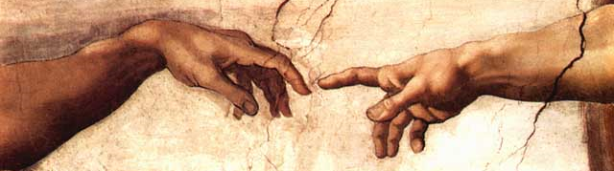
Biblical Insight: Word vs Senses
“He was in the world, and the world was made through Him, and the world did not know Him” (John 1:10)
Notes:
An empirically based approach may fail to acknowledge the most fundamental evidence (God’s existence and His role as Creator). Sometimes we say: if God physically revealed Himself all would believe Him. But God did exactly that and most rejected Him.

Slide 17
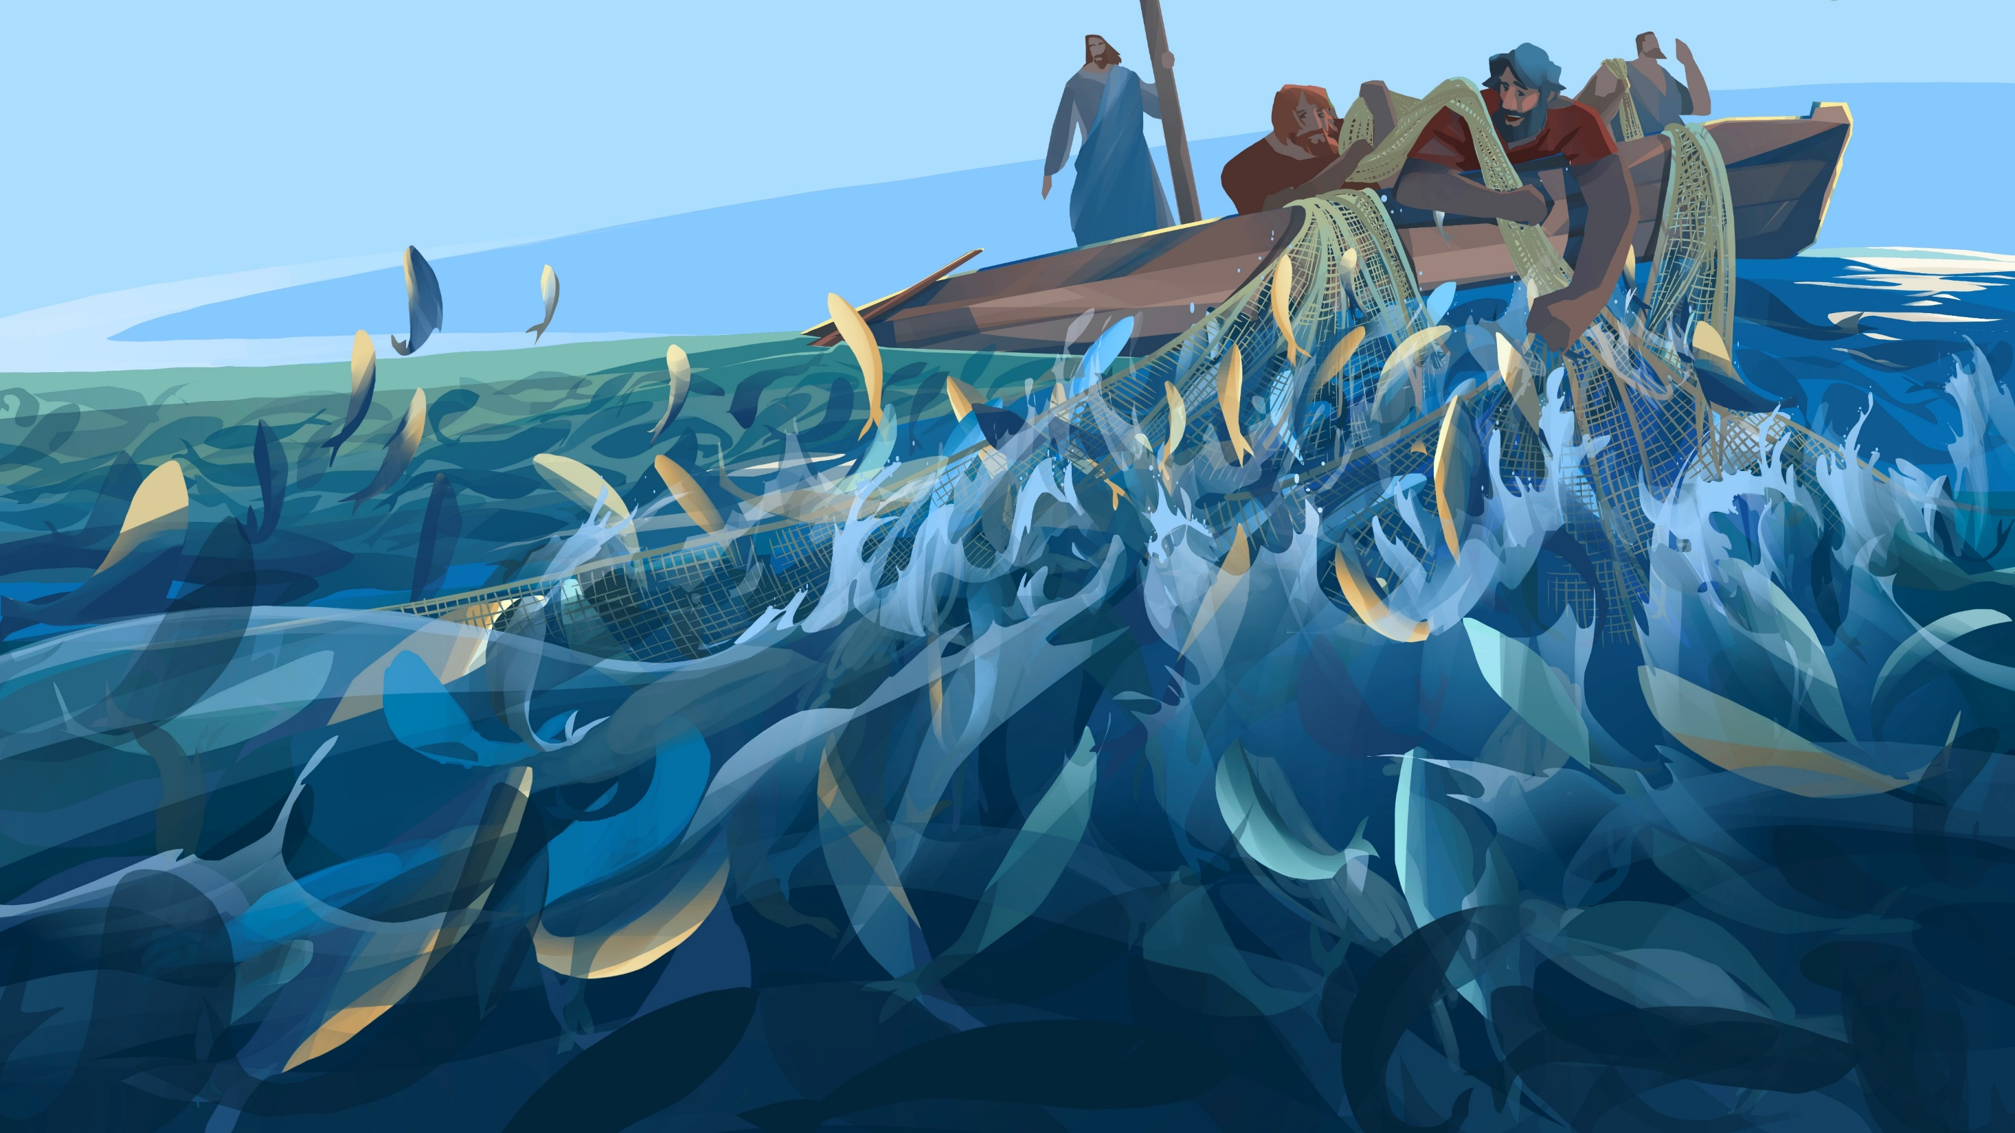
Biblical Insight: Word vs Senses
“Put out into deep water, and let down the nets for a catch.”
Simon answered, “Master, we’ve worked hard all night and haven’t caught anything. But because you say so, I will let down the nets.” (Luke 5:4-5)
Notes:
But we also have examples in the Bible of the opposite choice, where in situations of tension someone decided to rely on the Word of God, with an encouraging outcome. There are other passages that we could use to illustrate this point, but the Scriptures clearly reveal that our only sure foundation in situations of conflict is the Word of God.

Slide 18
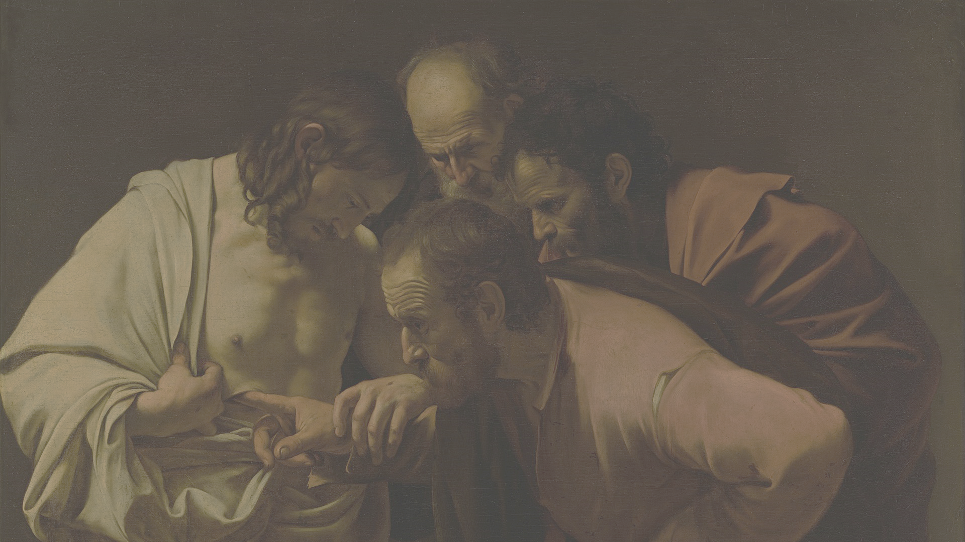
Word vs Senses: Avoid False Dichotomy
“That which was from the beginning, which we have heard, which we have seen with our eyes, which we have looked upon, and our hands have handled, concerning the Word of life…” (1 John 1:1)
“For we did not follow cleverly devised stories when we told you about the coming of our Lord Jesus Christ in power, but we were eyewitnesses of his majesty” (2 Peter 1:16)
Notes:
At this stage I want to clarify that choosing the Word of God as our only sure foundation does not mean that empirical evidence has no place in the journey of faith. I want to be careful not to create a false dichotomy. In fact, the testimony of the apostles themselves emphasizes the historical and empirical component of faith. Jesus really came to Earth, God really made the world, God really exists. If these were not realities, we would indeed be following cleverly devised fables. The Word of God is not a piece of literary creativity portraying an imaginary reality. God’s revelation is rooted in history.

Slide 19
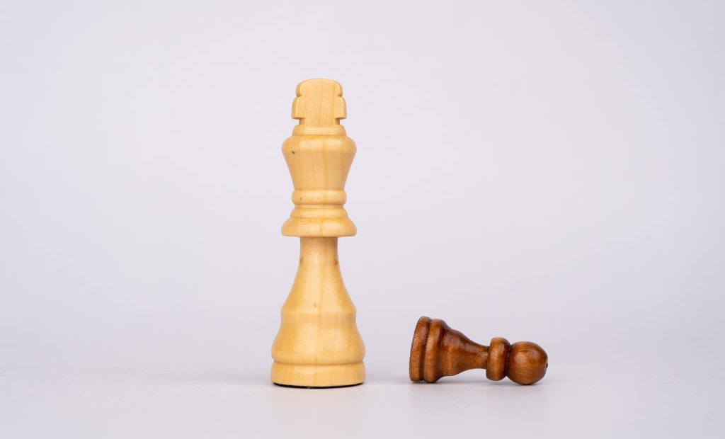
Word vs Senses: Avoid False Dichotomy
Notes:
Additionally, establishing the supremacy of the Word of God as our foundation does not mean refraining from the study of the natural world. Theologians could say: if Scripture rules, why do we need anything else. Let’s just study Scripture and not bother with science in our educational systems… Except that we live in the world, move and have our being in physical reality. Remember how we discussed that there are vast areas of non overlap where restricting focus only on one domain is an unwise and unnecessary limitation. If Scripture is foundational to understand the world, we still need the building to build upon that foundation!

Slide 20
Scripture and Nature: Harmonious Testimony
"Since the book of nature and the book of revelation bear the impress of the same master mind, they cannot but speak in harmony. By different methods, and in different languages, they witness to the same great truths. Science is ever discovering new wonders; but she brings from her research nothing that, rightly understood, conflicts with divine revelation. The book of nature and the written word shed light upon each other.” Ellen G. White, Education, p. 128
Distinctiveness
Interface
Hermeneutics
Notes:
What is then the proper way to incorporate the study of nature in our biblical paradigm? I find that one of the best descriptions of the ideal way is found in the book Education. I also have to share my personal conviction that this ideal will be fully accomplished only when Jesus comes back, and there will always be elements of tension in this world, where we do not fully reach harmony. However, I find that this description has 3 very insightful perspectives. 1) It affirms the distinctiveness of the two domains, each with its own methods and language. 2) It affirms that there is an area of interface between these two domains, the possibility of reciprocal influence in highlighting various aspects. 3) It affirms the need for proper understanding and interpretation of the primary data.

Slide 21
Scripture and Nature: Harmonious Testimony
SCIENCE INTERFACE THEOLOGY
Hypothesis testing
Development of religious concepts
Hypothesis development
Testing of religious concepts
after L. Brand, 1997
Notes:
The best way in which I have seen this quote by EG White expressed in diagrammatic form is by Dr Brand, in his book Faith Reason and Earth History. The diagram represents the fact that there are two distinct domains, which are methodologically separate. Science and its methods do not dictate Biblical interpretation, neither biblical exegesis dictates the outcome of scientific investigation. Both domains have independent hermeneutical rules, involving primary data and their interpretation. The diagram acknowledges the presence of an area of interface. The way this interface works, when conflict arises, is respectful of the distinctiveness and methods of each discipline. Data from science can lead to reevaluation of proper biblical hermeneutics, as in the case of astronomy and heliocentric interpretations of biblical passages. But the opposite is also true, that biblical concepts can lead to the development (or challenge) of scientific hypotheses (to be tested with the methods of science). Within this interface, science does provide a context for looking at Scriptural statements and Scripture does provide a basis for formulation of scientific investigations.

Slide 22
“Rightly understood:” Hermeneutics and fact checking
“When the Bible makes statements of facts in nature, science may be compared with the written word, and a correct understanding of both will always prove them to be in harmony.” E.G. White, Signs of the Times, 10:[161], 162, March 13, 1884.
Notes:
The diagram also helps us highlight the risk of assuming for “facts” (both in science and theology) concepts or hypotheses that upon closer examination may not be as simple or clear cut as a superficial inspection would warrant. It is important to be aware of the method used (both in science and theology) to arrive at certain conclusions, and of underlying assumptions adopted in the method used. Therefore, especially in the areas that are challenging at this Scripture and science interface, we need to be extremely informed and knowledgeable. Adventist should never be fact deniers or ignorant of the primary data… If we cannot have a resolution of the conflict, we do need a clear exposition of the issues.

Slide 23
Why Do We Have “Science Issues?”
E.G. White Testimonies for the Church, v.8 — “God in nature”
“While it is true that in the beginning God could be discerned in nature, it does not follow that after the Fall a perfect knowledge of God was revealed in the natural world to Adam and his posterity.”
“Deprived of the heavenly light, they could no longer discern the character of God in the works of His hand.
And through man's disobedience a change was wrought in nature itself.” (changes in the subject and the object)

Slide 24
Why Do We Have “Science Issues?”
“The greatest minds, if not guided by the word of God, become bewildered in their attempts to investigate the relations of science and revelation. The Creator and His works are beyond their comprehension; and because these cannot be explained by natural laws, Bible history is pronounced unreliable.”

Slide 25
Why Do We Have “Science Issues?”
“In true science there can be nothing contrary to the teaching of the word of God, for both have the same Author. A correct understanding of both will always prove them to be in harmony. Truth, whether in nature or in revelation, is harmonious with itself in all its manifestations.”
“But the mind not enlightened by God's Spirit will ever be in darkness in regard to His power. This is why human ideas in regard to science so often contradict the teaching of God's word.”

Slide 26
Sola Scriptura and times of conflict
The value of keeping at doing science: 1) Operational vs historical science 2) Acquisition of new data 3) Better evaluation of existing data 4) Better understanding of the secular mindset 5) Test of faith
Notes:
As Adventists, we have chosen to make the Bible our only foundation to understand our origins, meaning, and purpose. What this Sola Scriptura principle means, is that Scripture is the canon through which we will measure everything else, even scientific models of origins. It will be the foundation of our core understandings, and what we will chose to trust in times of conflict. When word and senses conflict, I will chose to trust the Word. However, does that mean that we should give up exploring the world with our senses? What is the value of continuing to pursue scientific research in the very areas that are controversial? Here is a series of reasons that I have found compelling, based on my personal experience. 1) Models of geologic and biologic processes that are extrapolated to the past, can actually be really good description of what is happening now, irrespective of past history. In the same way in which we can distinguish between the punctual creative act of God and His sustainment of creation, we can build on the distinction between operational and historical science and highlight the value of understanding the regular workings of the natural world we are part of; 2) because the process of scientific testing of hypotheses spurs the acquisition of new data, making us better acquainted with nature and its facts. Continual discovery and increase in knowledge teach us a certain humbleness and can lead to awe and reverence for the Creator of the universe; 3)because we learn to better evaluate the nature of data and their limitations, with the potential to help develop alternative models that ease some of the tension; 4) because we gain a better understanding of the secular mindset and learn how to effectively engage with it; 5) and because faith is truly tested when we do not have all the answers.
We have been dwelling a lot on the conflictual aspects of this relationship between the two books. On sabbath, during the sermon, I will share a positive perspective to illustrate how, a Bible-based epistemology of origins also has much to offer in terms of new avenues for understanding our existence and our world.

Slide 27
The Necessity
E.G. White Testimonies for the Church, v.8 — “God in nature”
“Both in divine revelation and in nature, God has given to men mysteries to command their faith. This must be so. We may be ever searching, ever inquiring, ever learning, and yet there is an infinity beyond.”
Notes:
This is not an invitation to quit searching, inquiring, and learning. On the contrary. But it is an affirmation that the reward of our study, the conclusion of our finest efforts, will be a greater appreciation of God’s greatness and His nature and a renewed trust and faith in His wisdom, not ours.

Slide 28
Summary
Scripture and nature proceed from God,
We are not always able to understand them harmoniously
In situations of conflict, some prioritize sense over word to establish truth
We chose a foundational role for Scripture instead
This posture still recognizes that: theology and science have their own methods and language; 2) there is an area of interface between these two domains; 3) there is need for proper understanding in both domains.
It also fosters a balanced sense of self, where discovery is accomplished in humbleness and leads to an appreciation of God’s greatness

Slide 29
Resources
www.grisda.org
www.creationsabbath.net
FB: @Geoscienceresearchinstitute
Instagram: @geoscienceresearchinstitute

