Slide 1
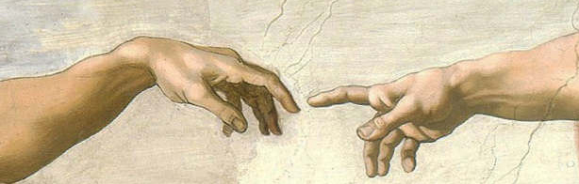
What does the fossil record of humans look like?
Then God said, “Let us make man in our image, in our likeness”
Genesis 1:26
Notes:
To be honest with you, I am concerned about giving this talk. My concern is that at the end of a 30 minutes talk about the fossil record of humans I will leave you more confused than enlightened. So, I had an idea. In a school there are different grades because kids can understand progressively more complex things. So I am going to divide my talk in two levels. The first part is the first grade level version of the talk. You can stop there if you want. For those who want to go a bit deeper, there is a second part to the talk and some of you will enjoy it, some will perhaps find it confusing. But I hope all will at least graduate from the first level part. So, let’s begin with the 101 level: This is how the Bible says humans came to be: special creation by God.

Slide 2
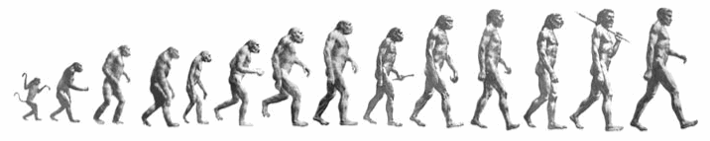
“March of progress” popular perception:
From F.C. Howell, Early Man, Time-Life International, New York,1965
- Origin form ancestral ape
- Gradual
- Progressive
Notes:
This is how many today (including a lot of scientists) believe humans came to be: evolution from an ancestral ape over several millions of years

Slide 3
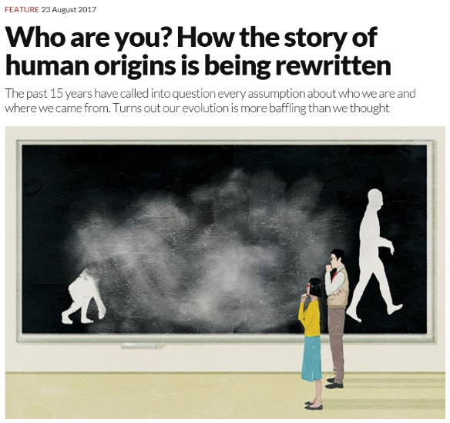
Not so simple,
after all…
New Scientist (2017), v. 235/3140, p. 28.
Notes:
But when you look at the fossils, the picture portrayed by evolution is not so clear

Slide 4
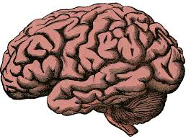
From F.C. Howell, Early Man, Time-Life International, New York,1965
Notes:
Therefore, if you believe this, and are critical of this, it does not mean that you are switching off this. End of the 101 presentation!

Slide 5
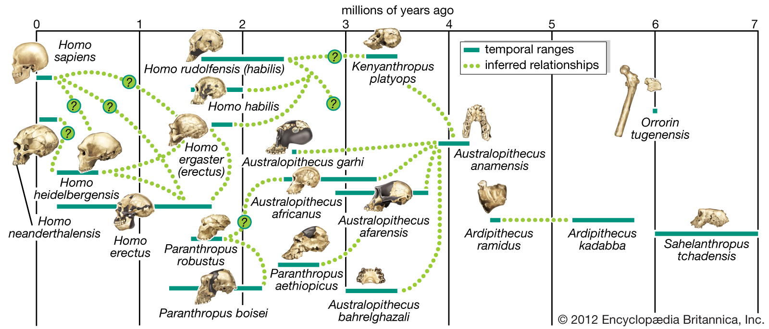
The fossil record of hominins
Dashed lines (discontinuity) and question marks (uncertainty) but overall narrative is not one of special creation
Notes:
Now into the advanced level presentation: here is a summary plot of the fossil record of hominins, as understood from an evolutionary perspective. It is not the most current, but I like the way it is constructed and displayed.

Slide 6
Goals of this part of the presentation:
- Provide a brief summary of hominin fossils and how they are studied
- Briefly evaluate some strengths and weaknesses of the evolutionary scenario
- Offer suggestions on how these fossils could be interpreted within a biblical worldview of origins

Slide 7
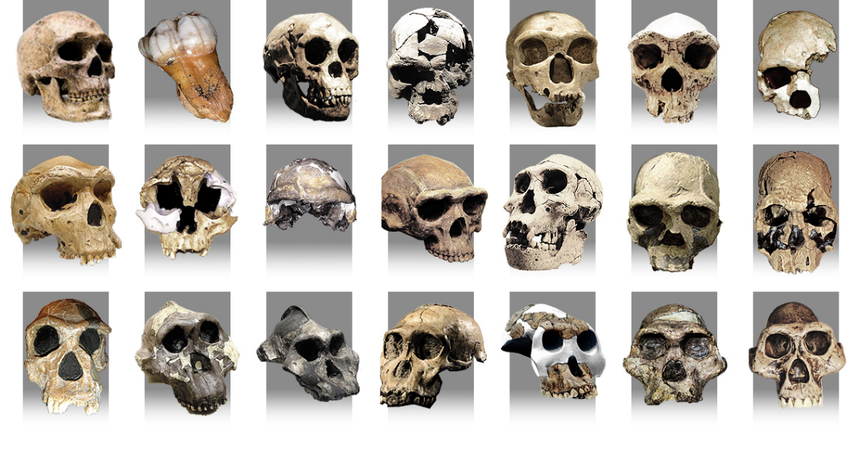
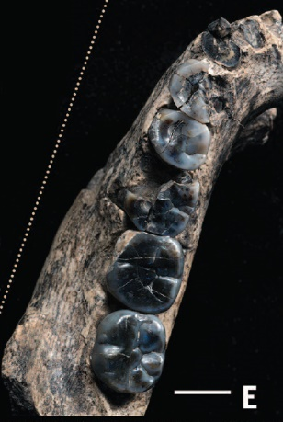
How good is the record: the good, the bad, the ugly
- The good:
Homo neanderthalensis: 500
Homo erectus: 150
Australopithecus africanus: 130
Australopithecus afarensis: 120
Paranthropus robusts: 90
Homo naledi: 15
- The bad:
Ardipithecus ramidus: 35
Homo floresiensis: 9
Australopithecus sediba: 6
Homo luzonensis: 3
Australopithecus garhi: 1
Image from http://www.bradshawfoundation.com/origins/index.php
Note that these numbers rarely represent relatively complete individuals, more often just fragments
- The ugly:
Lower Pleistocene fossil gap, only a few fragments of putative ancestral Homo species
From Villmoare et al., 2015, Science 347/6228, 1352-1355

Slide 8
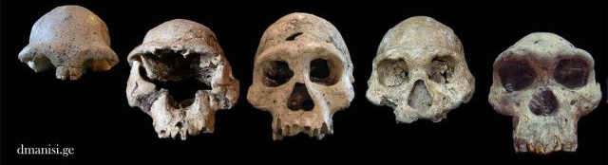
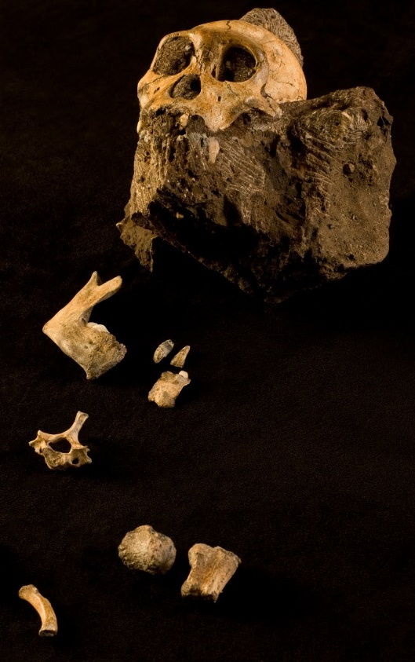
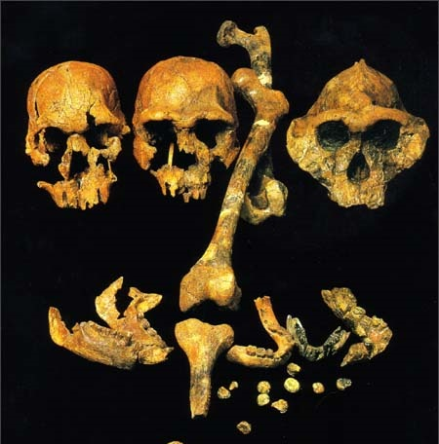
What is the research question?
What are they?
Are they related?
If yes, how?
Both for creationist and evolutionist models
How are these questions addressed?
Stratigraphy
+
Morphometry/
Statistics
From http://www.jasondejong.ca/Muses/Hominid_Fossils.html; http://dmanisi.ge/page?id=12&lang=en; https://3.bp.blogspot.com/_7ZYqYi4xigk/S73kcrBV2nI/AAAAAAAAF0U/a973pLg8QEk/s1600/hominid2.jpg

Slide 9
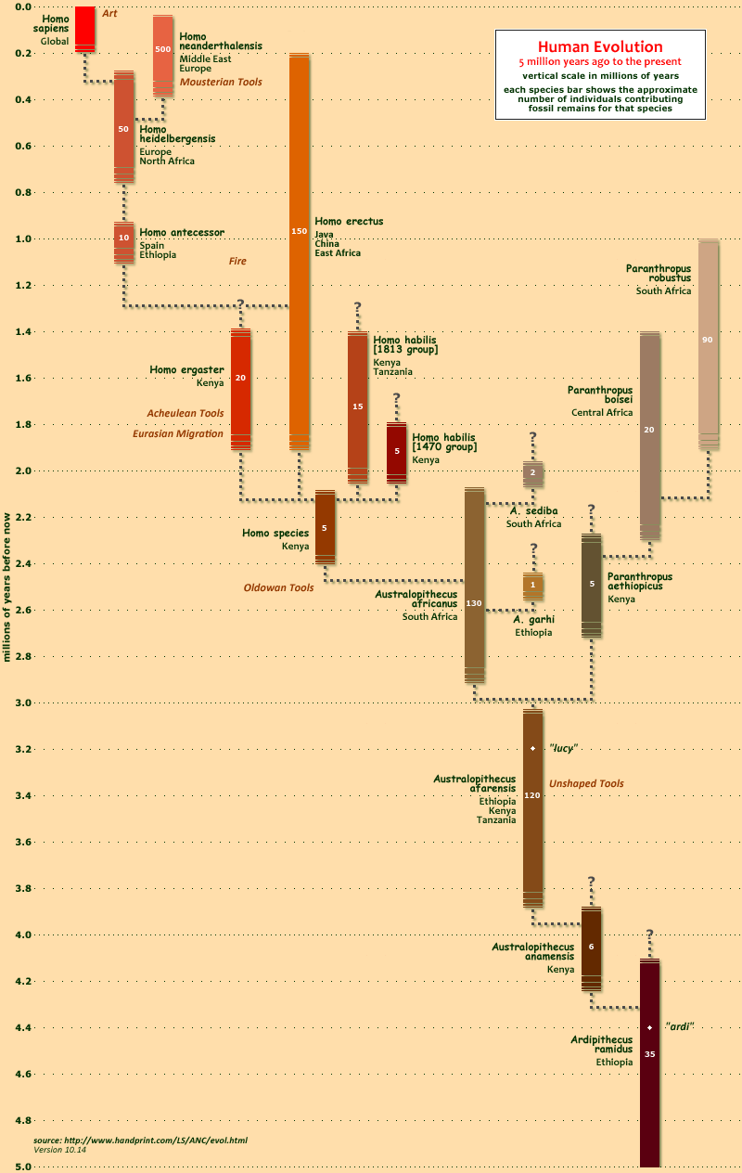
Stratigraphy: what’s younger, what’s older
Basic principle of superposition:
what’s below is older than what’s above
- Does not provide absolute age
From http://www.handprint.com/LS/ANC/evol.gif

Slide 10
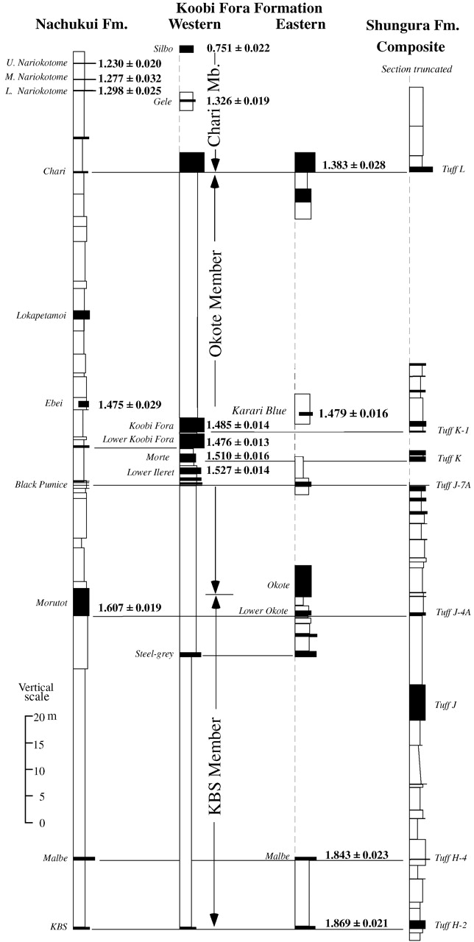
Stratigraphy: what’s younger, what’s older
2) Absolute dating: Numerical ages
Typical methods in paleoanthropology:
- Carbon dating (only up to 40k)
Luminescence and ESR dating (up to 300k)
Radiometric dating (tuffs, volcanics, flowstones)
From McDougall & Brown (2006), J. Geol. Soc. 163, 205-220

Slide 11
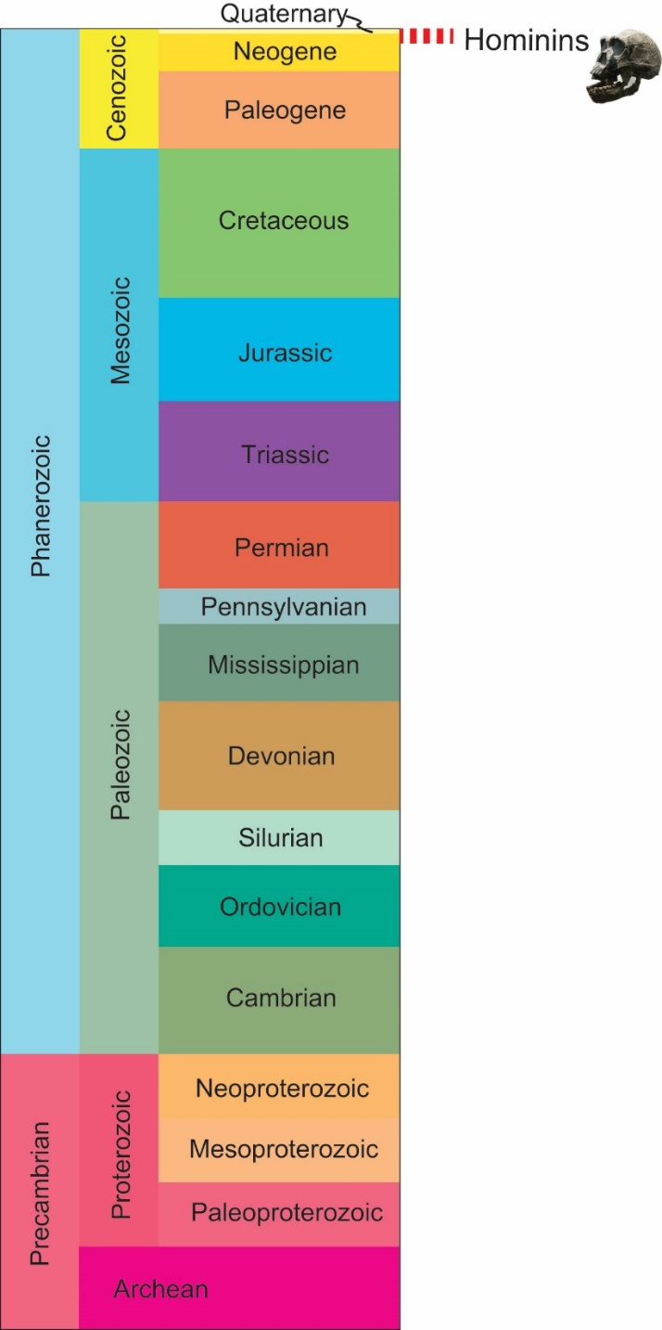
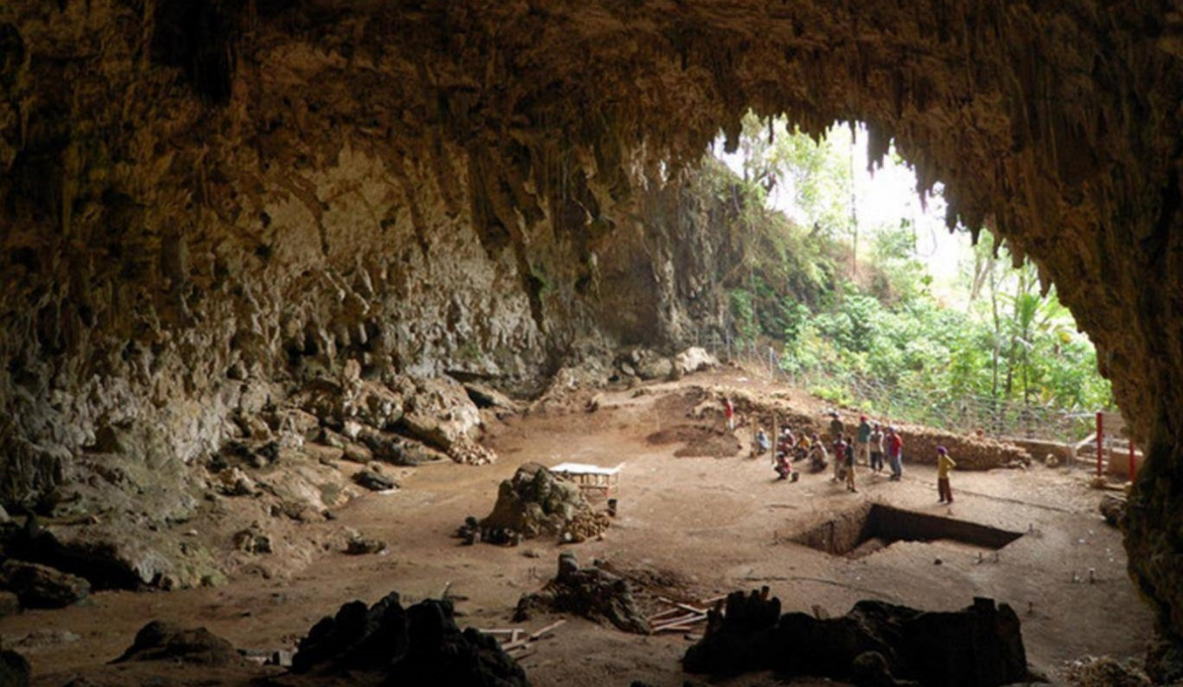
Stratigraphic Distribution
Restricted to upper Neogene-Quaternary
Often in superficial deposits (cave floor deposits, alluvial/lacustrine deposits)
At times, combined with evidence of occupation (hearths, burials, paintings)
Image from: https://www.independent.co.uk/news/science/flores-hobbits-indonesia-human-migration-africa-a7702196.html
Inference: post-flood fossils

Slide 12
What is the research question?
What are they?
Are they related?
If yes, how?
Both for creationist and evolutionist models
How are these questions addressed?
Stratigraphy
+
Morphometry/
Statistics
From http://www.jasondejong.ca/Muses/Hominid_Fossils.html; http://dmanisi.ge/page?id=12&lang=en; https://3.bp.blogspot.com/_7ZYqYi4xigk/S73kcrBV2nI/AAAAAAAAF0U/a973pLg8QEk/s1600/hominid2.jpg

Slide 13
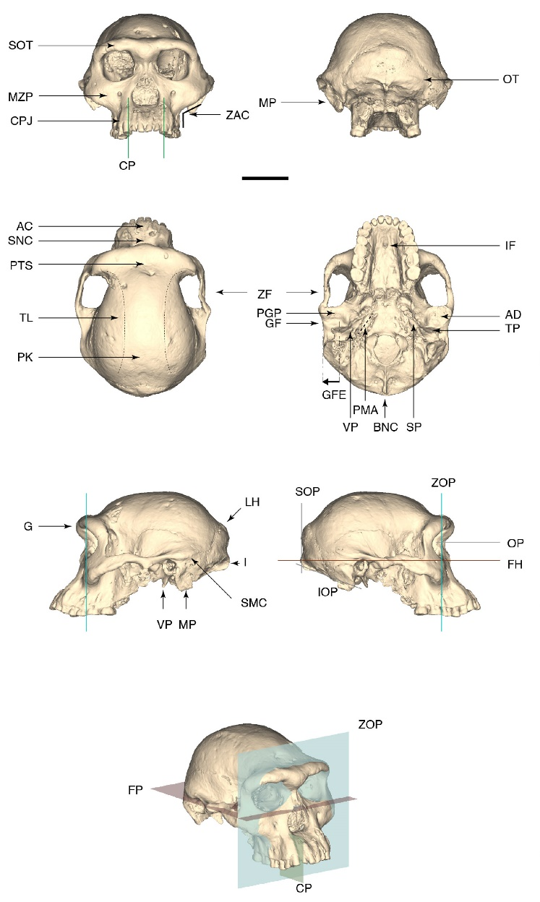
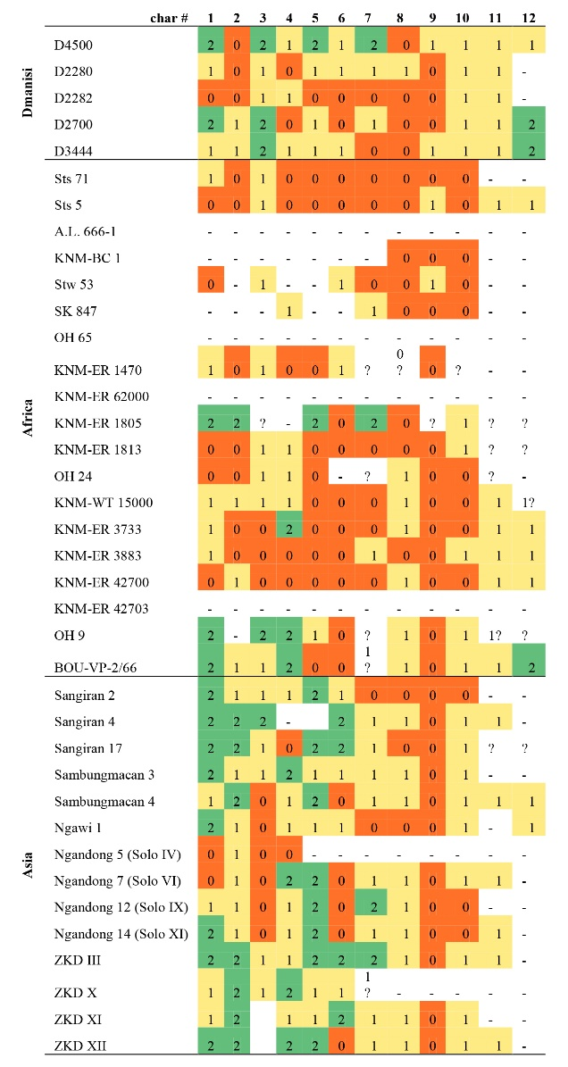
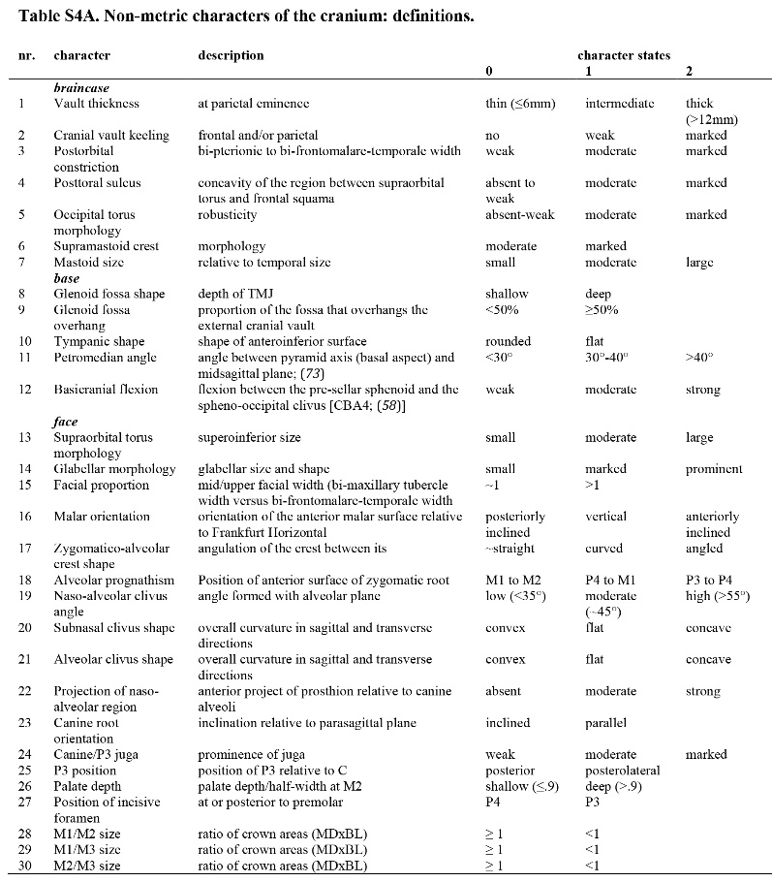
Morphometry/Statistics: What’s most similar to what
Way of quantifying similarity in morphology between different specimens
Build character matrixes and apply statistical methods to cluster specimens
From Lordkipanidze et al. (2013), Science 342, 326

Slide 14
Morphometry/Statistics: what’s most similar to what
Metric and non-metric characters
From Lordkipanidze et al. (2013), Science 342, 326

Slide 15
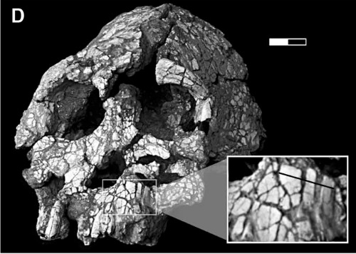
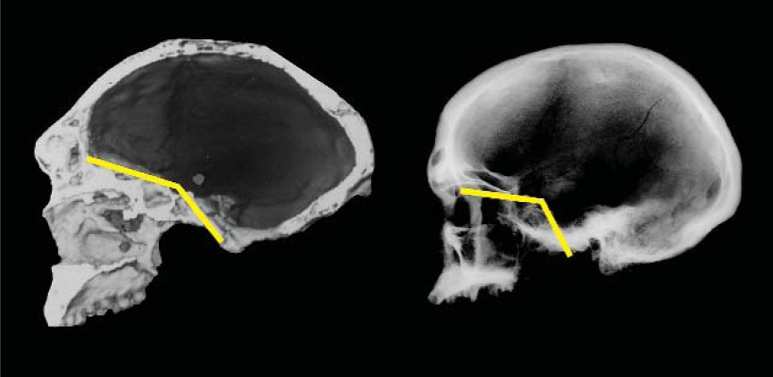
Morphometry/Statistics: some limitations of the approach
Methodological
- Fragmentary record (cannot always compare)
- Distortion (post-mortem)
Balter, 2002. Science, v. 295, p. 1219-1225
From White (2003), Science 299, 1994-1996
- Choice of characters: could be correlated instead of independent
(e.g., globosity and prognathism controlled by size and inclination of cranial base)

Slide 16
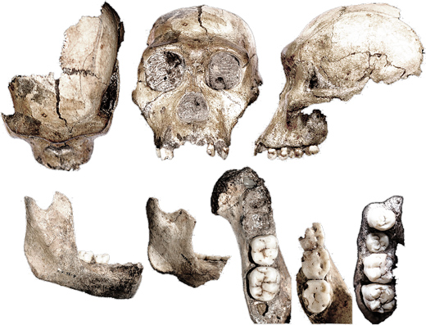
Morphometry/Statistics: some limitations of the approach
Intraspecific Variability
Australopithecus sediba
- Male/Female
- Adult/Juvenile
“The proposed hominin species Australopithecus sediba, from the Malapa Cave in South Africa, seems to actually consist of two species, each of which represents a different hominin genus: Homo and Australopithecus.”
http://www.bradshawfoundation.com/origins/australopithecus_sediba.php
Rak et al., 2021
“We found that key aspects of MH 1’s resemblance to Homo are accounted for by its immaturity.” Kimbel & Rak, 2017

Slide 17
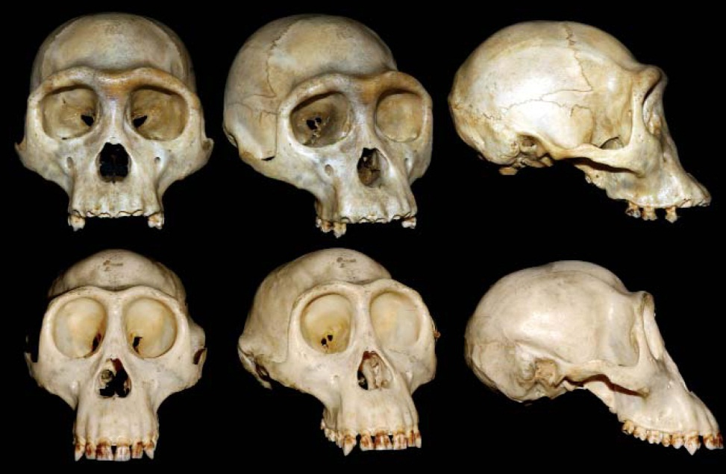
Morphometry/Statistics: some limitations of the approach
Intraspecific Variability
- Dimorphism
- Adult/Juvenile
- Range of variability in population
Craniofacial variability in female bonobos
From White (2003), Science 299, 1994-1996

Slide 18
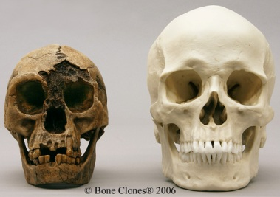
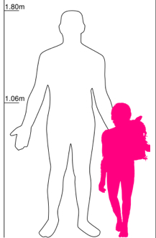
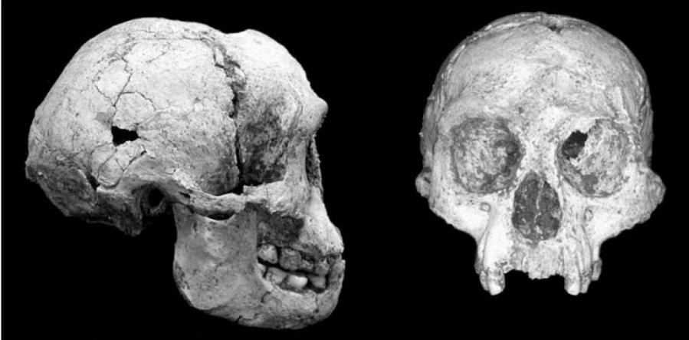
Morphometry/Statistics: some limitations of the approach
Intraspecific Variability
- Dimorphism
- Adult/Juvenile
- Range of variability in population
- Disease
Homo floresiensis (from the island of Flores, Indonesia)
http://www.incitoprima.com/details.php?catid=6&aid=48
From Brown et al. 2004, Nature 431, 1055-1061

Slide 19
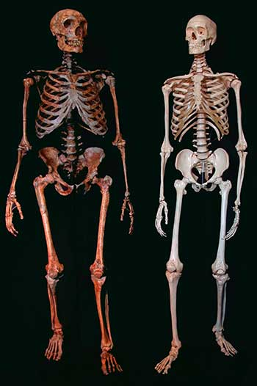
Morphometry/Statistics: some limitations of the approach
Intraspecific Variability
- Dimorphism
- Adult/Juvenile
- Range of variability in population
- Disease
- Lifetime effects
Robusticity related to function;
Diet;
Stress factors influencing age of maturation
Can morphological difference be a reliable indicator of distinct biological species?
From http://1.bp.blogspot.com/-o7Lf08Nuz_E/TiVyEB4D4XI/AAAAAAAAHPY/RLpR9BAkBkk/s1600/Mapping_The_Neandertal_Genome_Image_1.jpg
Notes:
Even if we can determine things look different, can we really conclude they are distinct?

Slide 20
Trying to organize the data…
Ardipithecus
3 groups:
Australopithecines
Homo

Slide 21
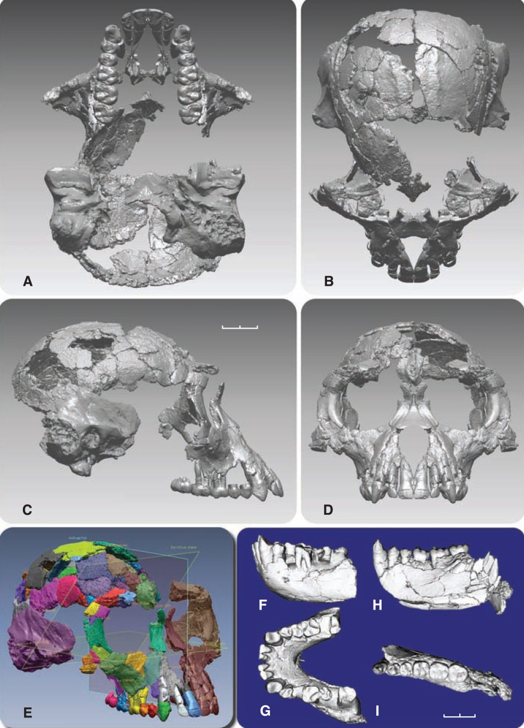
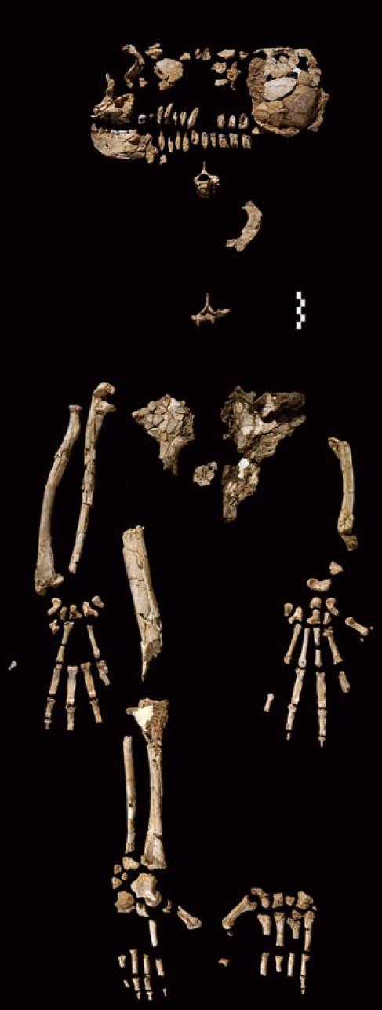
Ardipithecus ramidus
Locality: Ethiopia, Afar region
Specimens: fragments from an adult female and several other individuals
Size: ~120 cm
Brain size: 300-350 cc
Results: woodland not grassland, bipedal + arboreal (opposing big toe, but modified pelvis), small teeth and incisors
From Suwa et al., 2009. Science 326, 68
“enormous taxonomic jump to Australopithecus” (Kimbel in Gibbons, 2009. Science 326, p.39)
From White et al., 2009. Science 326, 64

Slide 22
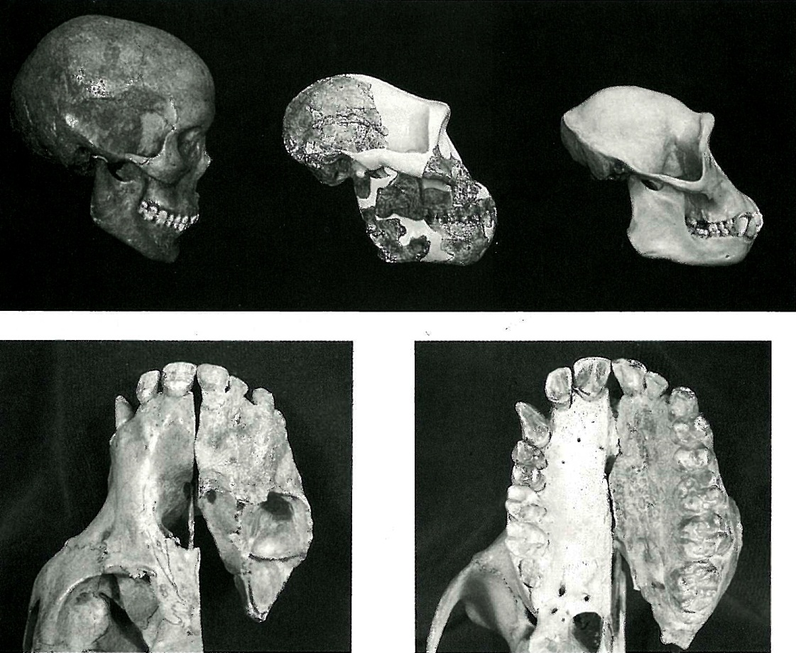
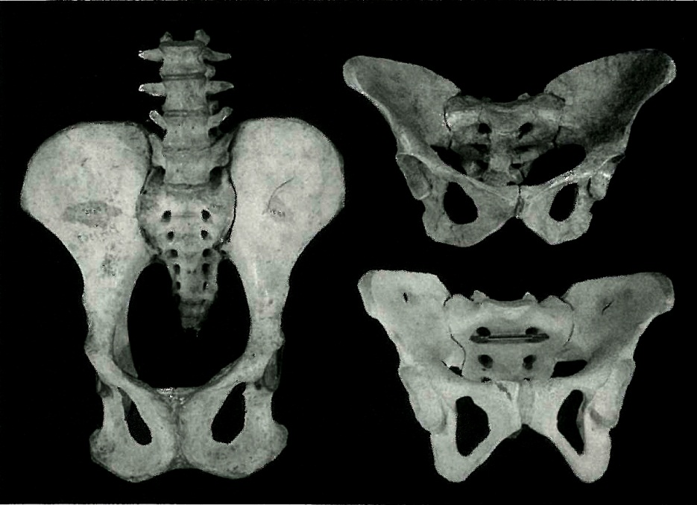
Australopithecines and humans: general remarks
Comparison modern human, Australopithecus afarensis, modern chimp
Skull very similar to chimp (morphology, brain volume, teeth size)
Some differences in dental features (larger molars, reduced canines)
From Lovejoy, 1993; in Rasmussen: the Origin and Evolution of Humans and Humanness
From Lovejoy, 1993; in Rasmussen: the Origin and Evolution of Humans and Humanness
Overall: clearly distinct from humans, in many aspects (size, brainsize, skull morphology).
More similar to humans in other aspects (e.g., pelvis: possible bipedal locomotion; reduced canine size)

Slide 23
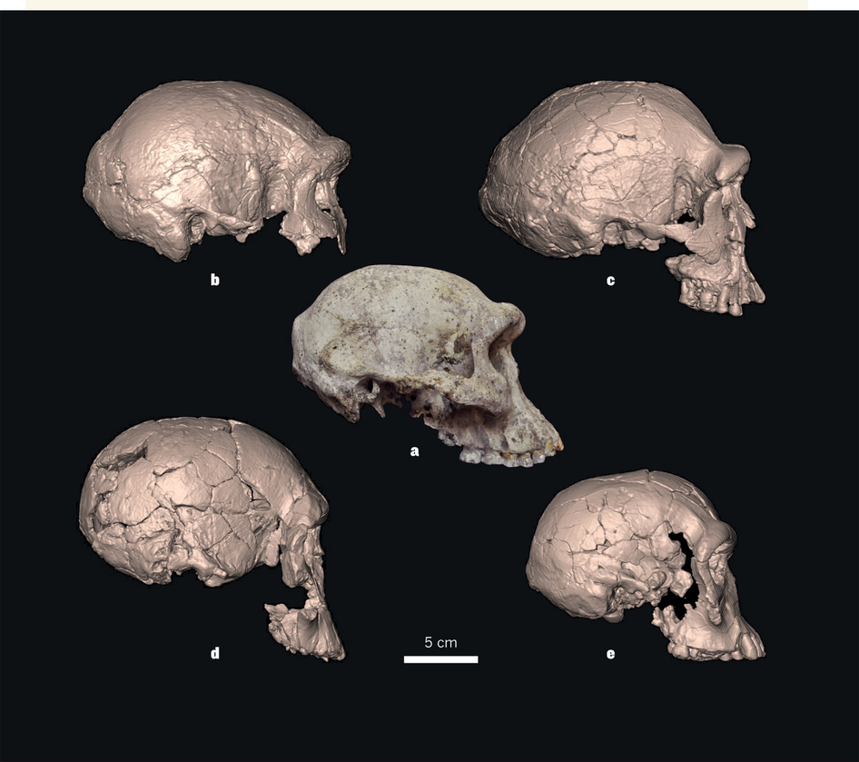
“Early” Homo fossils and variability: splitters and lumpers
Homo ergaster, KNM-ER 3833
Homo ergaster, KNM-ER 3733
Homo erectus, D4500
Homo rudolfensis, KNM-ER1470
Homo habilis, KNM-ER1813
From http://www.nature.com/nature/journal/v502/n7472/fig_tab/502452a_F1.html

Slide 24
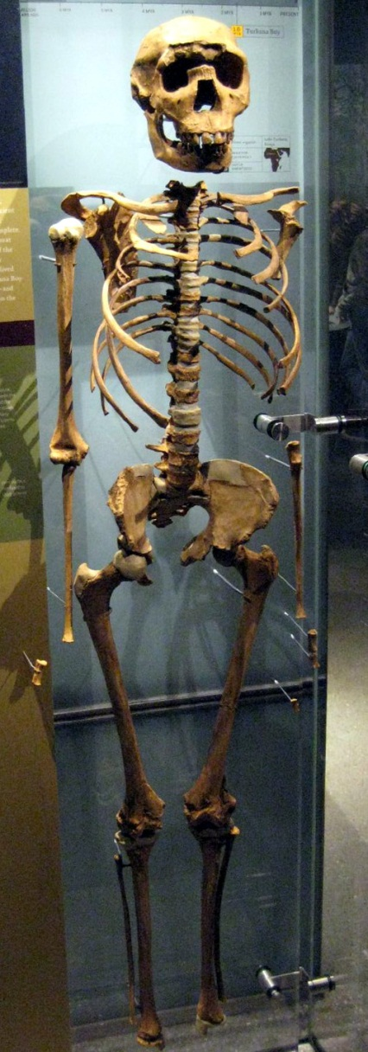
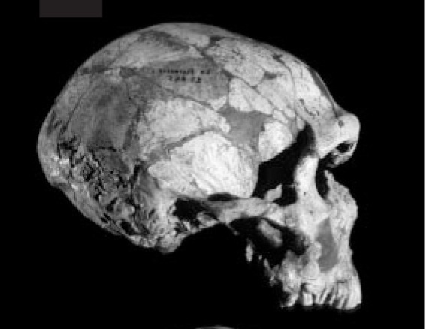
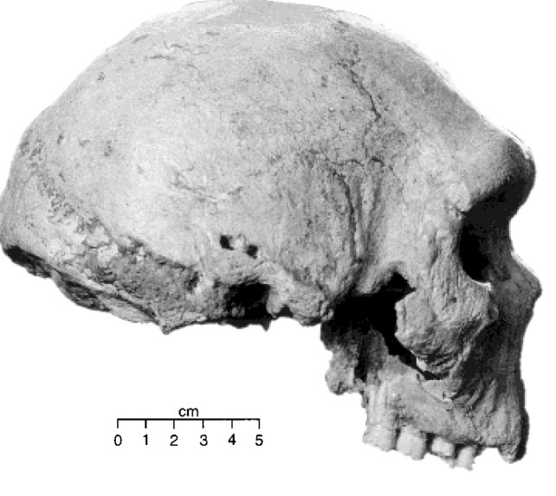
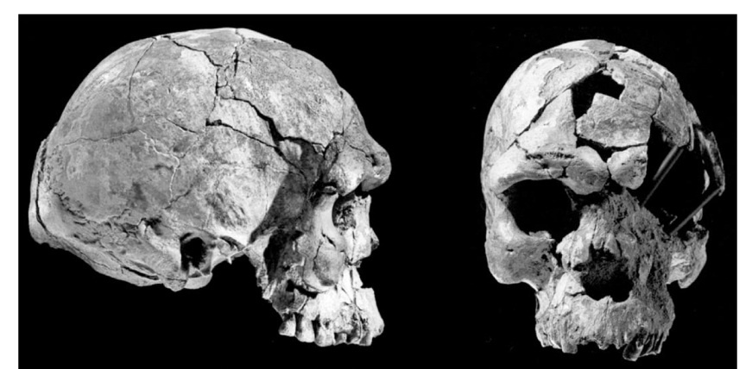
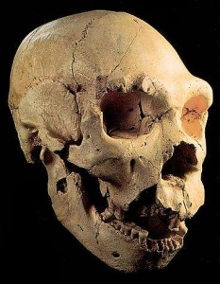
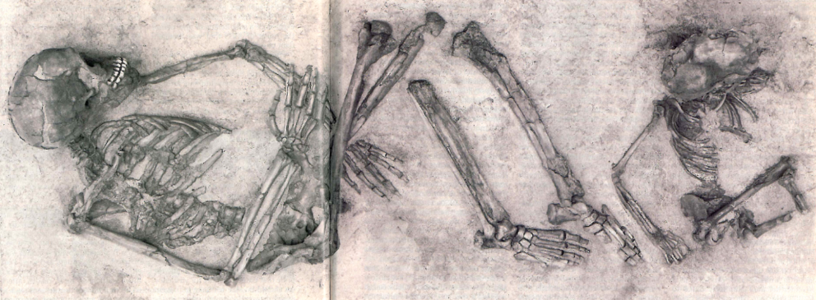
Homo neanderthalensis,
La Ferrassie
Homo heidelbergensis, Petralona, Greece, Middle Pleistocene
Homo erectus, Nariokotome (or Turkana) boy, KNM-WT 1500, Kenya
From White et al., 2003. Nature 423, 746
Homo sapiens, Herto, Ethiopia
From Rightmire, 1998. Evol. Anthropol. 6, 222
Homo heidelbergensis, Atapuerca, Spain, Middle Pleistocene
Homo sapiens, Qafzeh, Israel
From http://www.paleontologiaumana.it/heidelbergensis.htm
From http://upload.wikimedia.org/wikipedia/commons/2/2d/Turkana_Boy.jpg
From Bar-Yosef and Vandermeersch, April 1993. Scient. Am., 94-95
Notes:
Larger cranial capacity, brachial index, more vertical face, dentition, etc.

Slide 25
1) A gap between Australopithecus and Homo
William H. Kimbel, a paleoanthropologist at the Institute of Human Origins at Arizona State University, said that the million-year period “has long been the source of frustrating gaps” in the hominid fossil record. “It’s not that sites containing rocks this age are particularly rare, or that the time period in eastern Africa has not been searched by several groups,” Dr. Kimbel said. “The problem is that the fossil yield has thus far been low or poorly preserved, compared to the time periods on either side of this interval.”
From NYT, Lost in a Million-Year Gap, Solid Clues to Human Origins, Wilford, Sept. 18, 2007
From http://www.handprint.com/LS/ANC/evol.gif

Slide 26
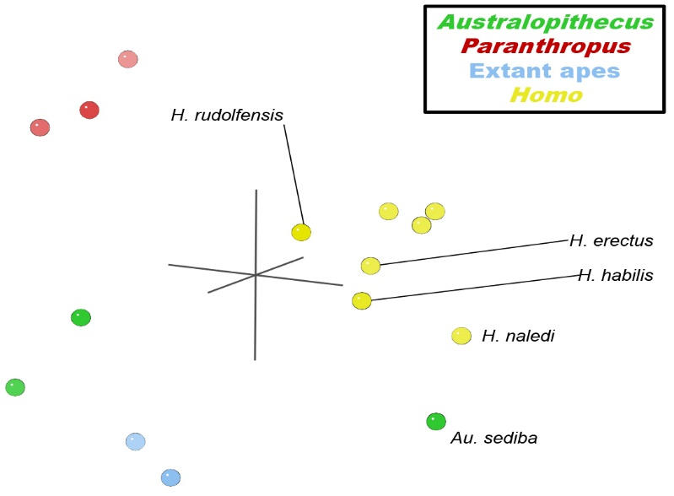
1) A gap between Australopithecus and Homo
From Wood, 2016
Statistical analysis groups Homo and clear separation with Australopithecus (but A. sediba clusters closer to Homo)

Slide 27
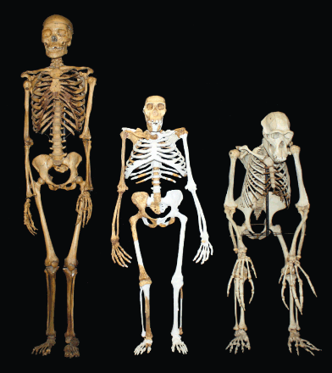
2) The issue of mosaic distribution of characters
e.g., Australopithecus sediba, Homo floresiensis or Homo naledi
Mosaic distribution of characters (skeletal traits): some human-like but some ape-like.
No particular order in the way in which the traits are mixed in different forms.
http://www.sciencemag.org/content/340/6129/163.full

Slide 28
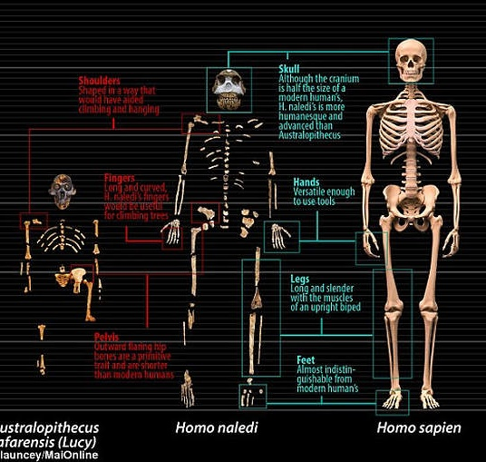
2) The issue of mosaic distribution of characters
Homo naledi
Mosaic distribution of characters: some human-like (lower limb, hand, teeth, general shape of the cranium) some ape-like (pelvic area, shoulder region, ribcage)
“Overall, H. naledi resembles more primitive species of Homo such as H. erectus, H. habilis, or H. rudolfensis much more than it resembles archaic or modern humans. H. naledi does, however, possess a number of derived features that are otherwise known only from modern humans and Neandertals”
Hawks et al., 2017
From https://s-media-cache-ak0.pinimg.com/originals/cb/e3/c5/cbe3c5a0482f331309ee9431dfe4a91c.jpg

Slide 29
2) Mosaic forms: how did they come to be?
3 hypotheses (Antón et al., 2014)
Environmental conditions (availability of food + low risk of mortality = extend growth + delayed puberty = larger body size + slower maturation)
Isolation. Migration or geographical barriers - leads to diversification: possible role of inbreeding?
Hybridization between different groups
“It is also conceivable that […] such derived similarities may have resulted from introgressive hybridization between H. naledi and other hominin lineages.” Hawks et al., 2017

Slide 30
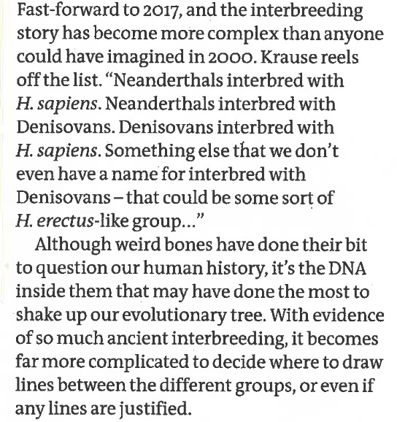
2) Mosaic forms: how did they form?
Ancient DNA data and hybridization
“These developments […] prompted a re-examination of the role of hybridization in human evolution, a process that occurs at greater rates than previously appreciated even among commonly accepted extant mammalian species”
Harvati & Reyes Centeno, 2022
Barras, New Scientist, 2017

Slide 31
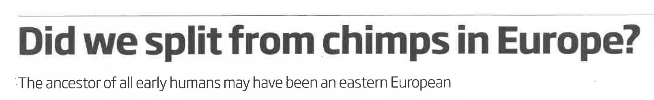
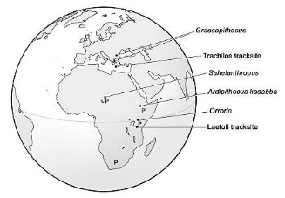
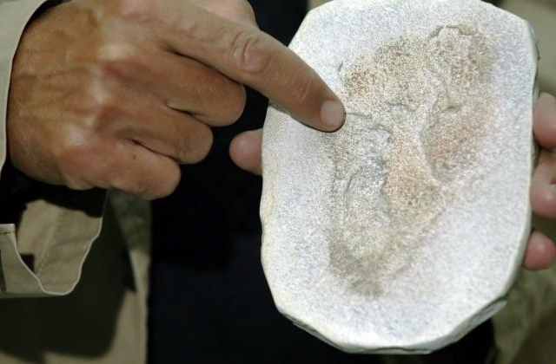
3) A tale of migrations
Out of Africa or Out of Ararat?
- Common ancestor of hominines (gorillas, chimps, humans)
Homo
Anatomically modern humans
New Scientist, 27 May 2017
Image from http://www.news.com.au/technology/science/evolution/footprint-find-on-crete-may-push-back-date-humans-began-to-walk-upright/news-story/2e60cbd7386573dd2a45c5cc9d79297d
Image from http://scienceinpoland.pap.pl/en/node/25409
Notes:
If these fossils are post flood, we should be able to see a dispersal from the Ararat region.
Rich fossil record of great apes not only in Africa but also in eastern Europe, with evidence of bipedalism
Usually hominins thought to be derived from an African ancestor. Some have challenged this model

Slide 32
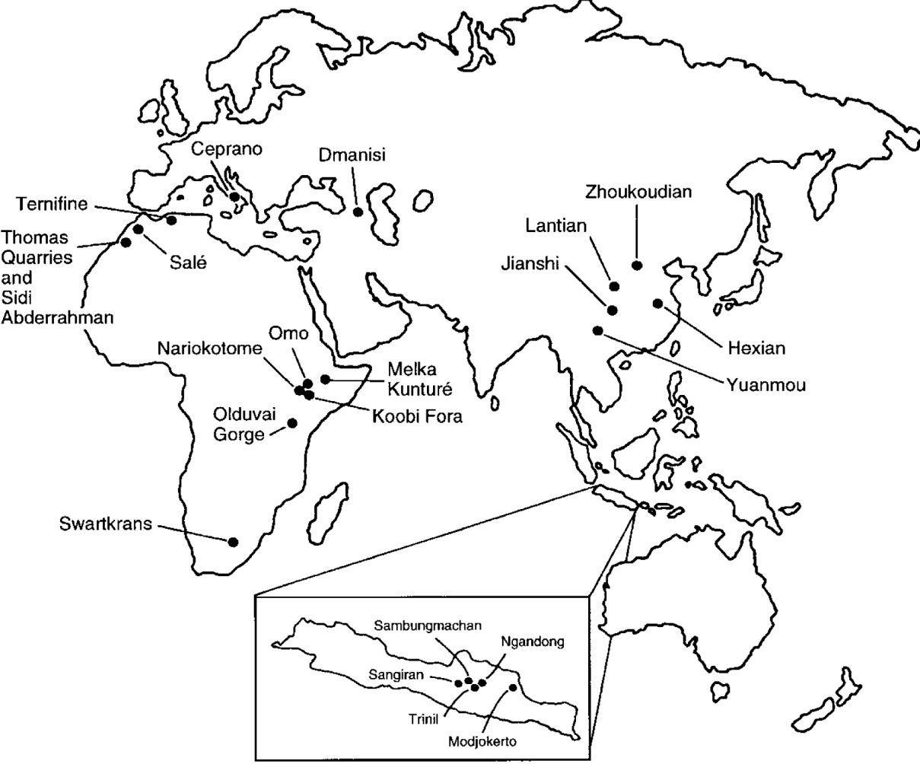
3) A tale of migrations
Homo erectus,
widespread radiation
Africa, Caucasus, China, Java
From Rightmire, 1998. Evol. Anthropol. 6, 219

Slide 33
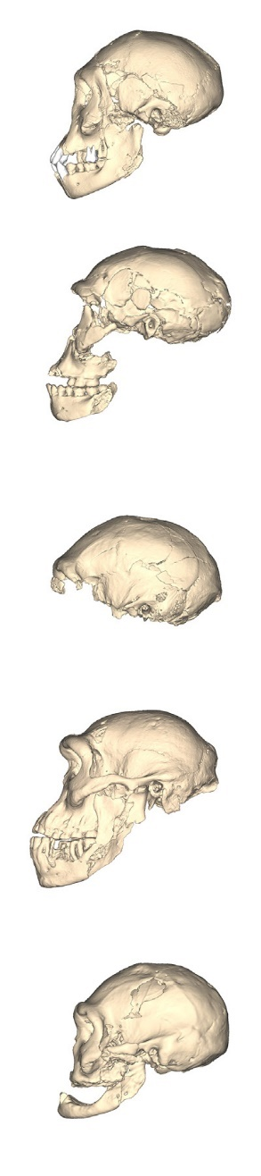
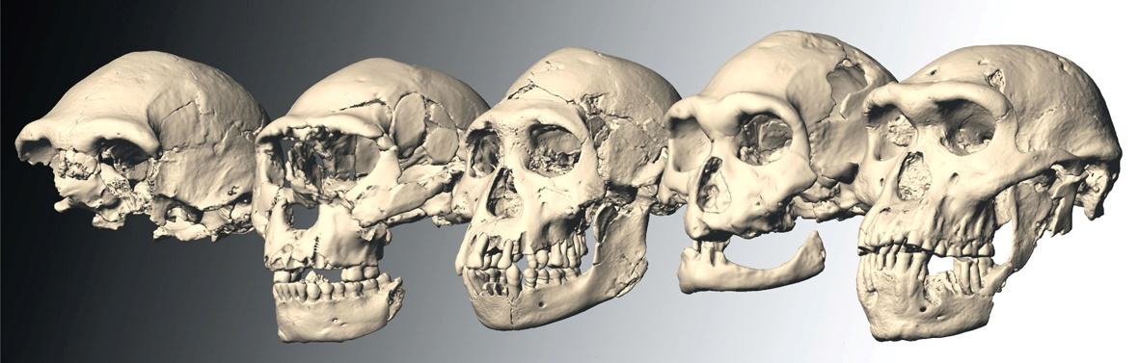
Extremely high-variability within some of the earliest Homo populations
From http://www.sciencemag.org/content/342/6156/297/F1.large.jpg

Slide 34
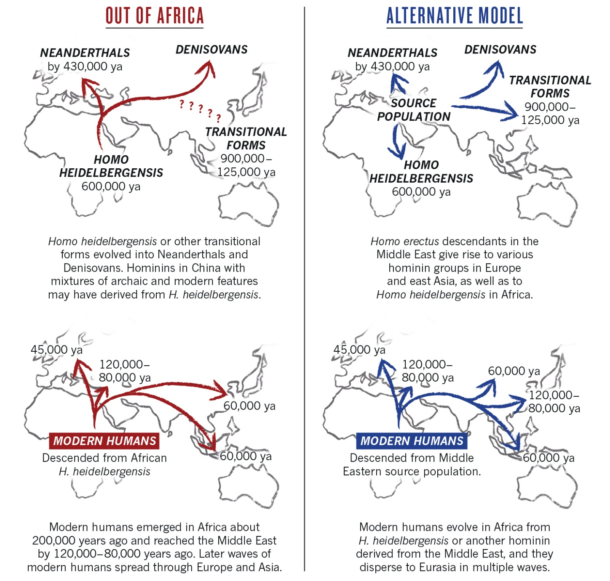
3) A tale of migrations
Spread of Homo heidelbergensis
Dispersal of anatomically modern humans
From Qiu, 2016. Nature 535, p. 218

Slide 35
Discussion
Problematic aspects of evolutionary model:
a) Fragmentary nature of the record (many gaps, low numbers of specimens)
b) Transition from australopithecines to Homo: a stratigraphic and morphologic gap
c) Mosaic distribution of characters: no simple way to arrange different forms
Problematic aspects of creationist model:
a) No fossils of humans in flood deposits
b) Stratigraphic order (modern combination only at top)
c) Mosaic distribution of characters

Slide 36
Suggestions of a creationist model
Hominin fossil record is post-flood
Australopithecines were not humans but a distinct type of apes that lived after the flood
As humans spread after the flood, some expressed morphological characteristics different than ours.
Isolation/Inbreeding, Hybridization, Environment
Morphological variability was higher in the past and diminished with time
Western Asia is receiving more attention as a region of dispersal of different migratory waves with rapid colonization of the old world (Noah’s ark - tower of Babel dispersals?)

Slide 37


Worldviews and data
“Everyone who is of the truth listens to My voice” (John 18:37)
Notes:
Let me conclude with a broader reflection. We all like stories of crushing victories over the opponent, and this is true for both sides. But what if the data are more ambiguous and there are things that fit and don’t fit in both models? What is it then that becomes crucial? Your worldview. You are led to make a choice…you have to think more carefully and make a conscious decision about the foundation you want to adopt. There are times when this game may look like a close one that is going to go to extra time. But the real question is: which team will we play on?
Did we choose the Word of God as the foundation that guides our search for understanding? In John 18 Jesus says, all who are of the truth listen to my voice. If you choose to listen to the voice of Christ, raise with me as we pray together. Dear Jesus, you are our king. You were born and came into this world to bear witness to the truth. We open our hearts today so that the Holy Spirit may help us to hear your word, listen to your word, and rely upon your word. Amen.

Slide 38

Resources
www.grisda.org
Facebook: Geoscienceresearchinstitute
Instagram: Geoscienceresearchinstitute

