Slide 1
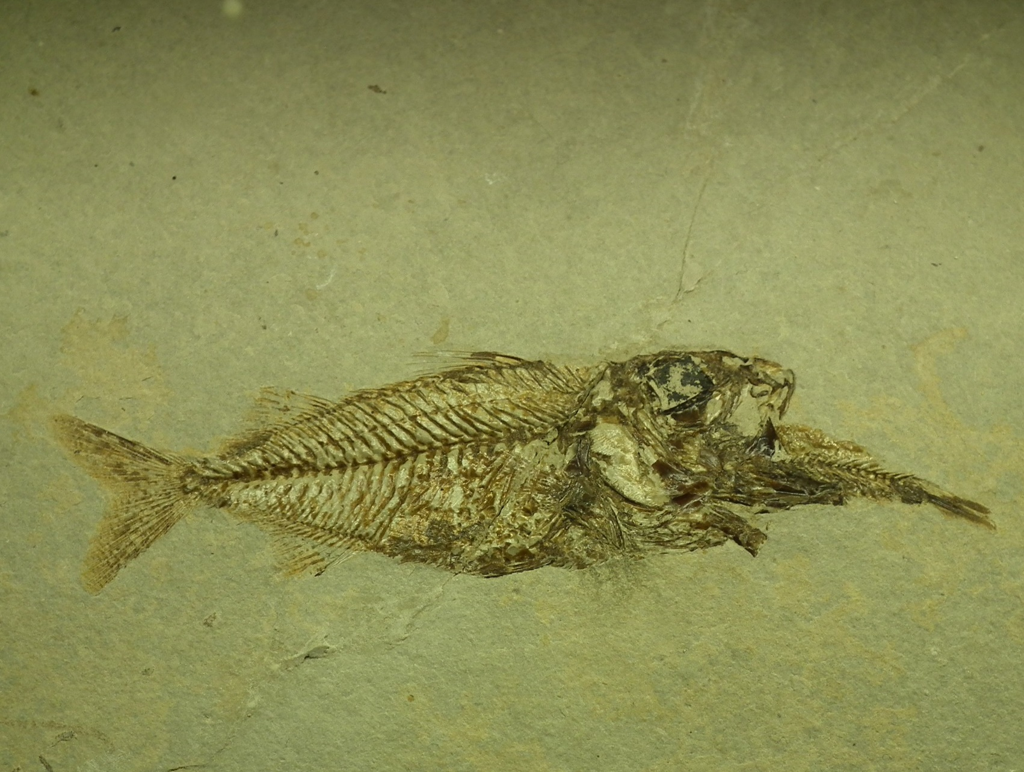
Introduction to the Fossil Record
“Every living thing on the face of the earth was wiped out; people and animals and the creatures that move along the ground and the birds were wiped from the earth.”
(Gen 7:23)

Slide 2
Goals of the presentation
What is a fossil and why should we care
Review some of the “big picture” patterns observed from the study of the fossil record
Show how a biblical worldview impacts our understanding of the fossil record

Slide 3
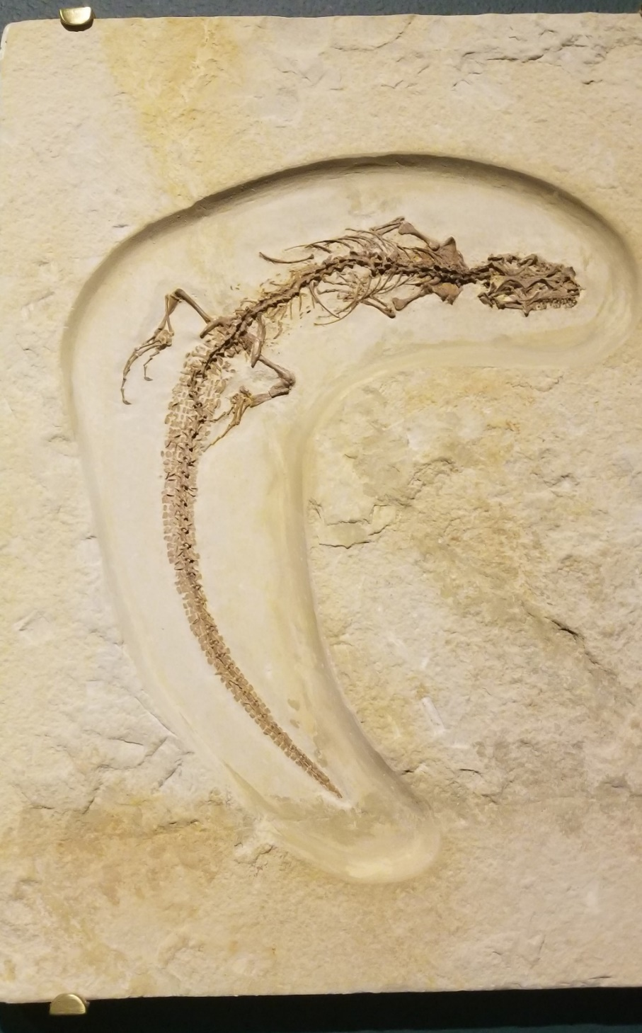
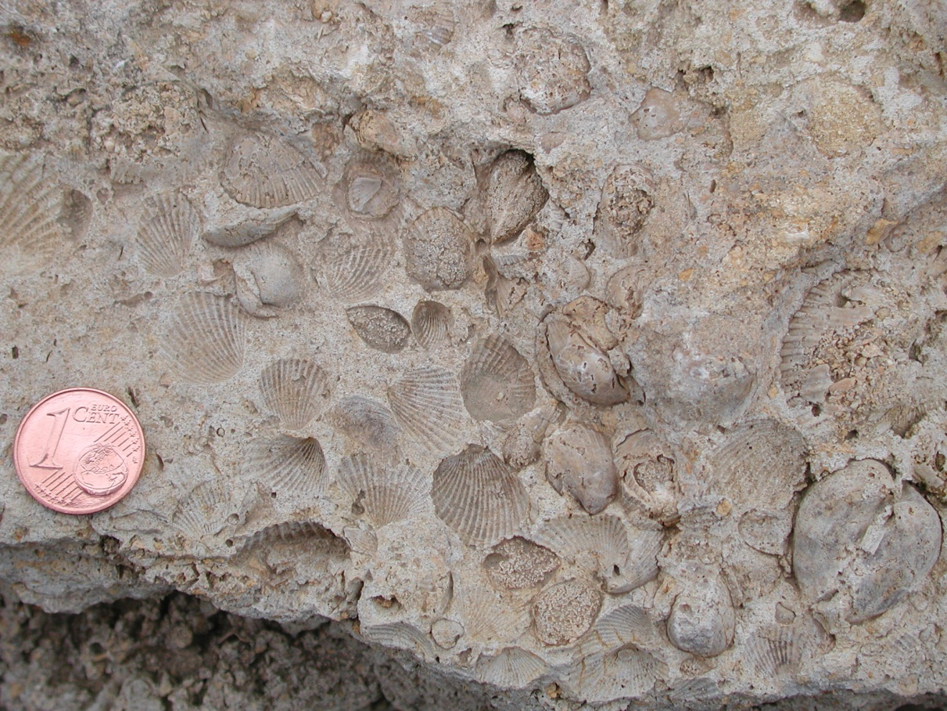
WHAT is a Fossil? remains or traces of once living organisms, preserved in the rock record
Internal and external moulds of original organism
Actual remains from the original organism (skeletal parts, organic matter)

Slide 4
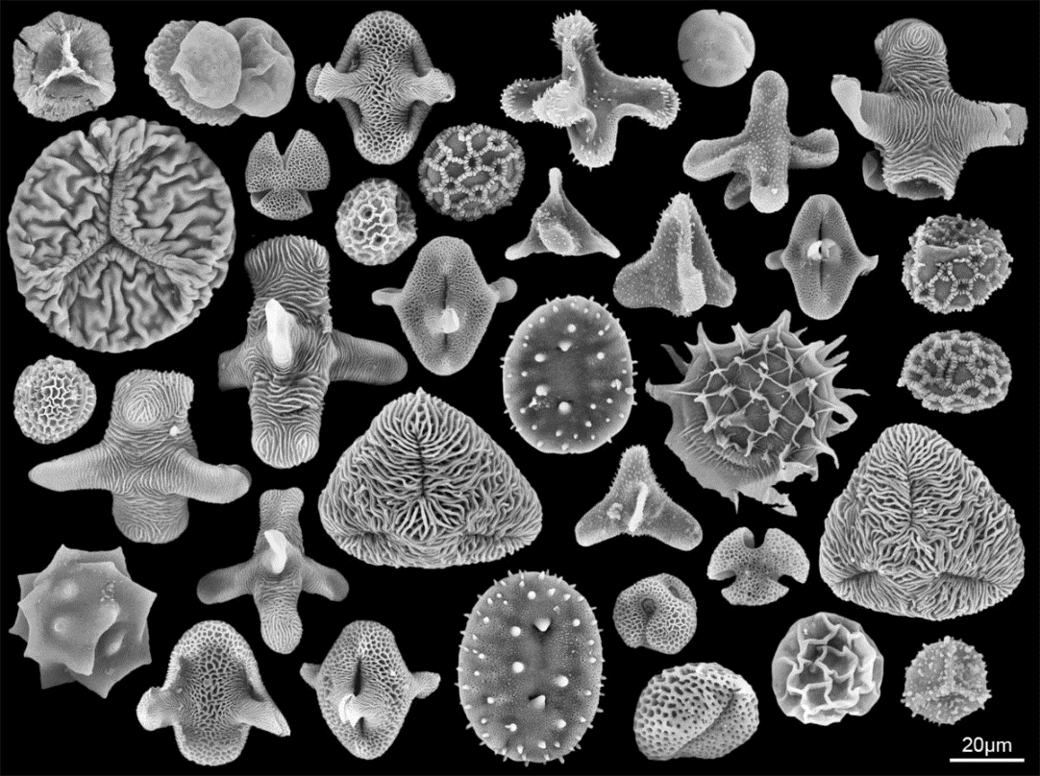
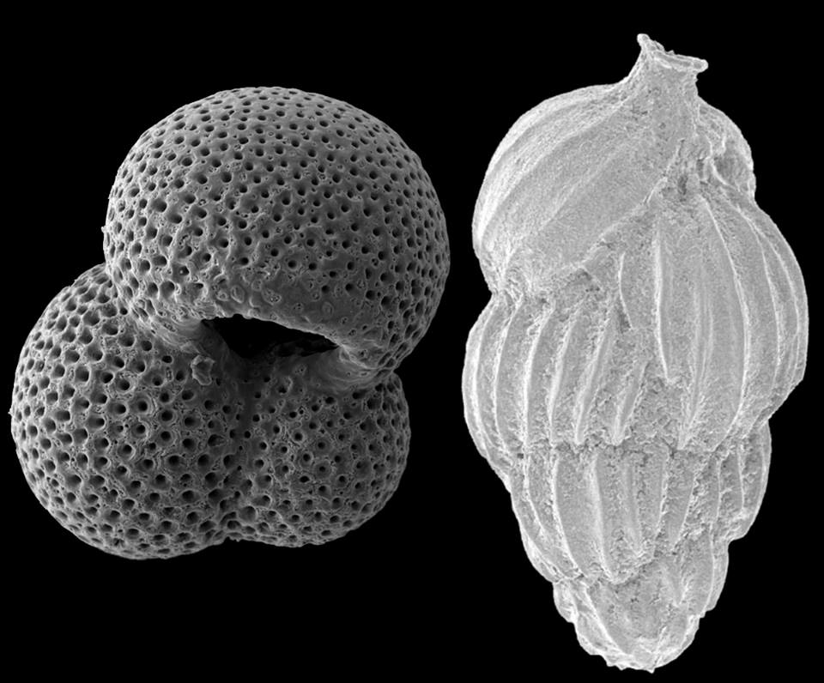
Fossils: remains or traces of once living organisms, preserved in the rock record
Microfossils
0.5 mm
Image from http://nmnh.typepad.com/100years/2015/06/tiny-grains-of-fossil-pollen-tell-a-big-story.html (© Antoine Bercovici)

Slide 5
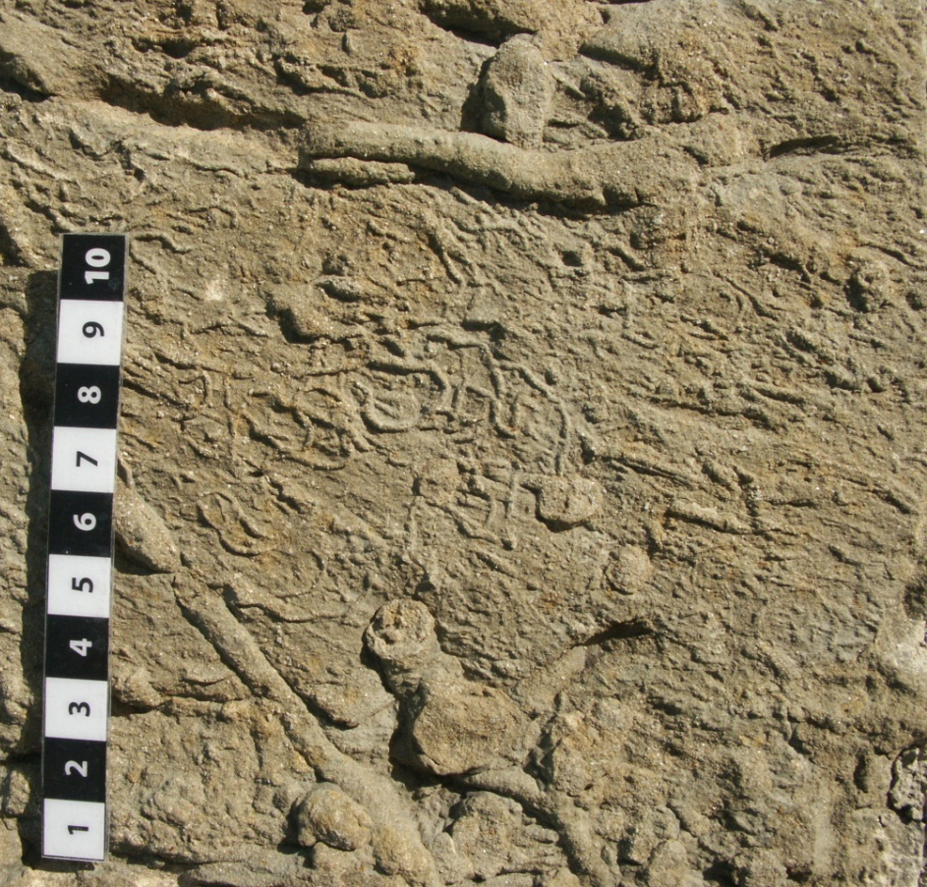
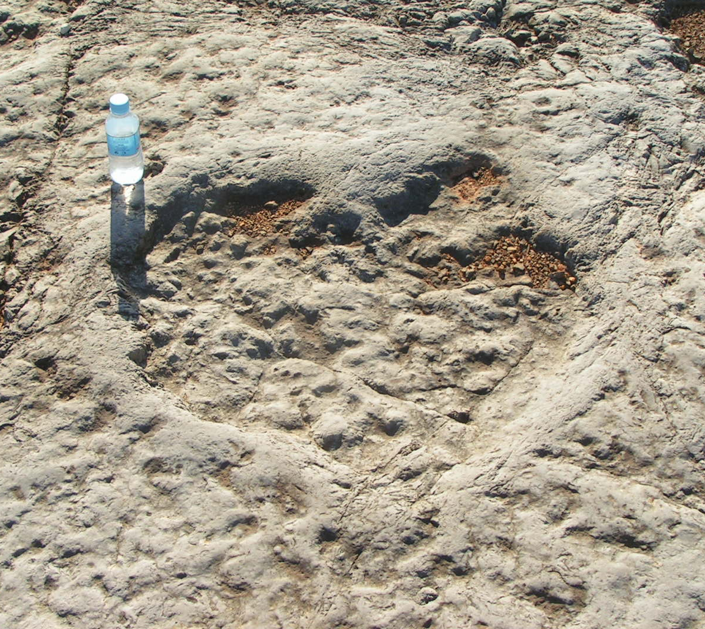
Fossils: remains or traces of once living organisms, preserved in the rock record
Trace fossils (moving, feeding, resting)
Sediment bioturbation by marine invertebrates
Dinosaur footprint

Slide 6
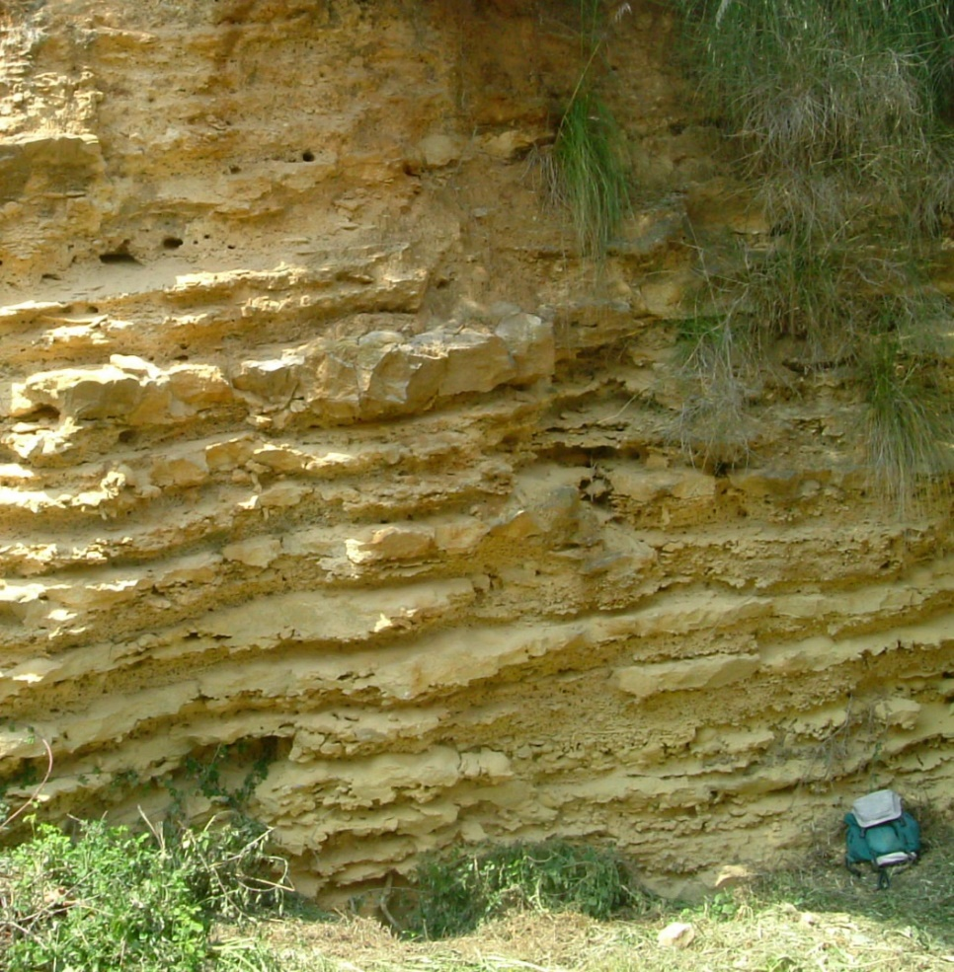
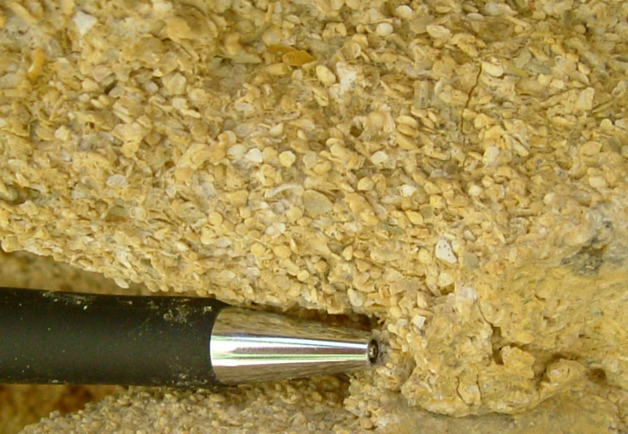
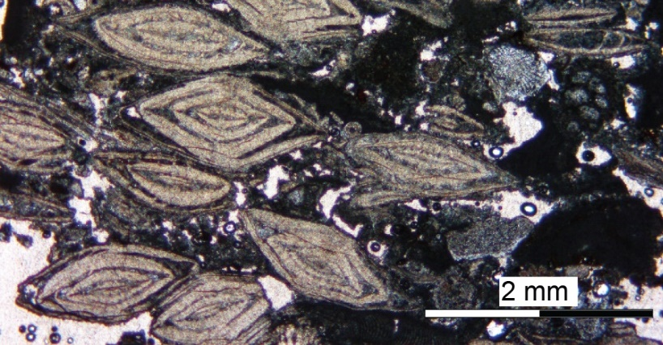
How many fossils?
Are fossils common or rare?
- Billions of fossils
- Sedimentary rocks likely to have some type of fossil
- Some sedimentary rocks (e.g., carbonates) can consist almost entirely of fossils

Slide 7
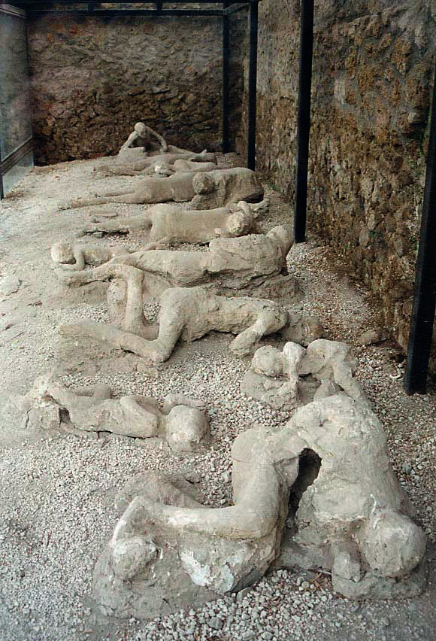
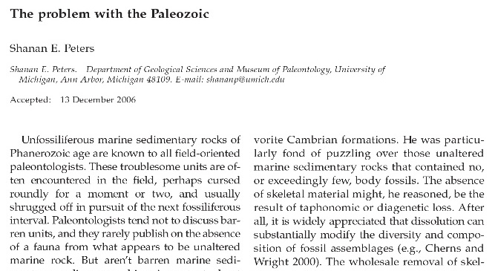
How many fossils?
- No fossils in igneous rocks (rare exceptions in some volcanics)
- Generally, no fossils in metamorphic rocks (except low-grade metasediments)
- Rare or no fossils in some sedimentary formations
From https://upload.wikimedia.org/wikipedia/commons/b/bc/Pompeii_Garden_of_the_Fugitives_02.jpg

Slide 8
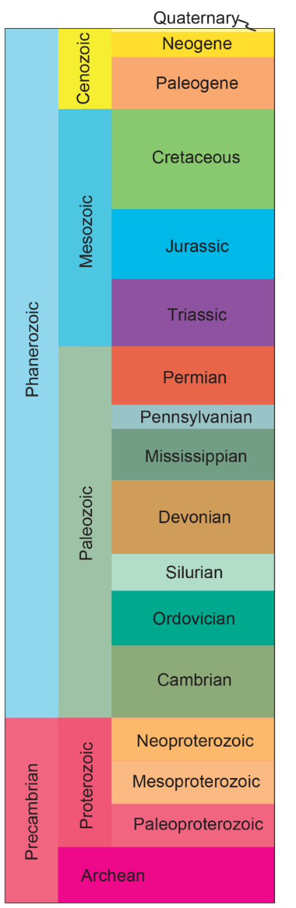
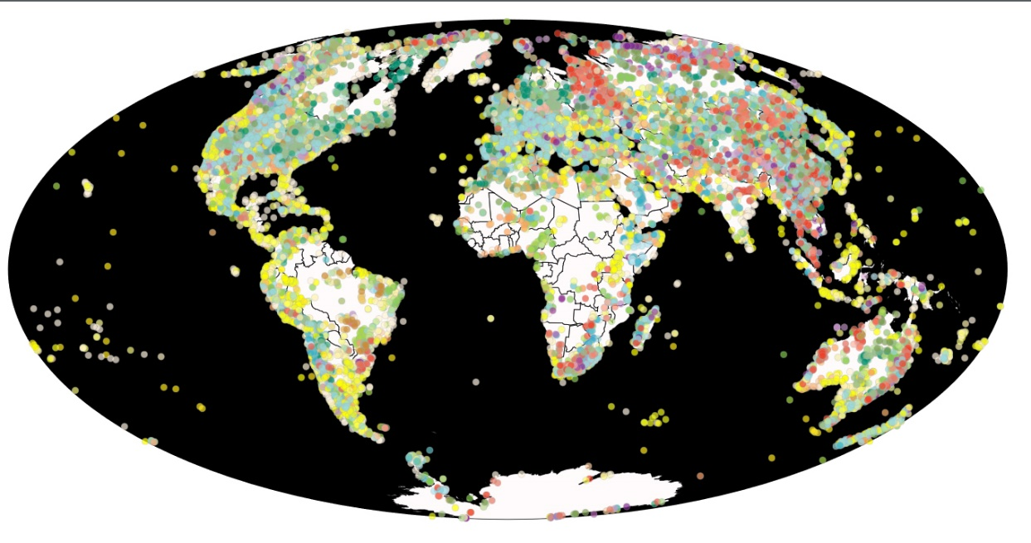
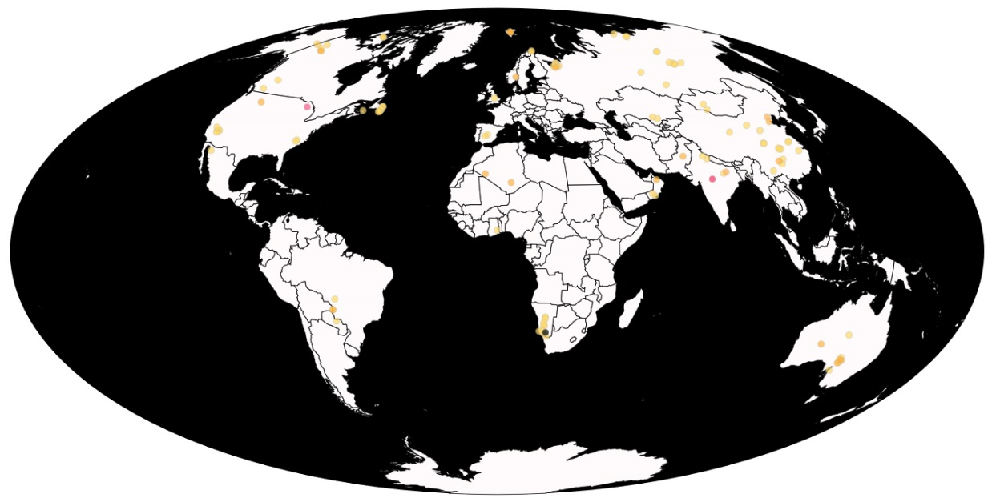
How many fossils?
Data from PDBD, available at https://paleobiodb.org/navigator/
Notes:
Important discontinuity. Especially macroscopic fossils become more represented in the Phanerozoic (that is the reason for the name…). Precambrian rocks have less fossils and there are actually less sedimentary rocks. Note white areas on the maps: crystalline basement of the cratons or ice-covered areas.

Slide 9
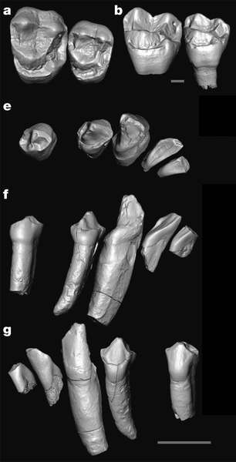
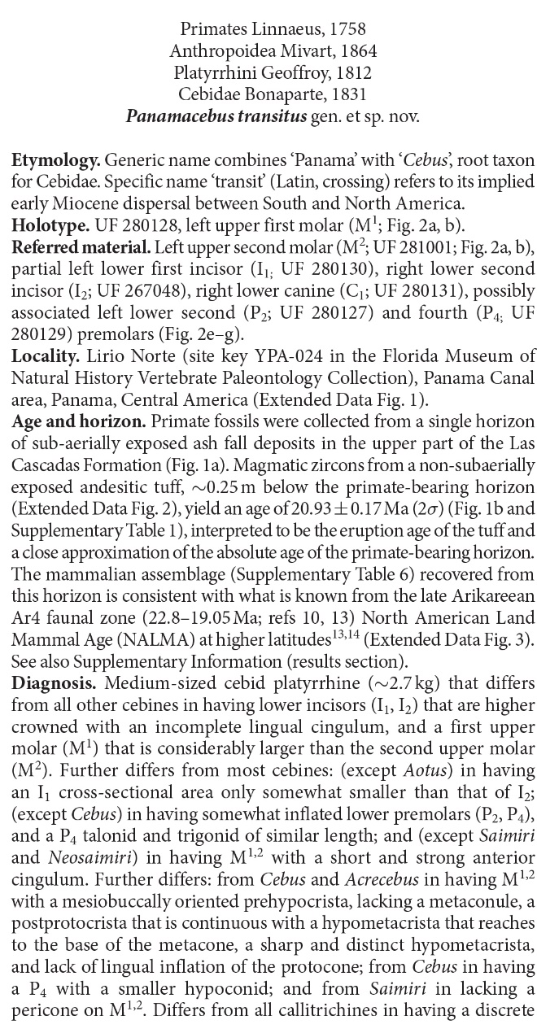
What can we learn from fossils and why should we care?
1) Taxonomy (science of classification)
- Fossils are the only direct evidence of what kind of creatures lived in the past
- Taxonomy organizes this record and forms the basis for all other types of reconstructions
From Bloch et al., Nature 533, 243–246 (12 May 2016)

Slide 10
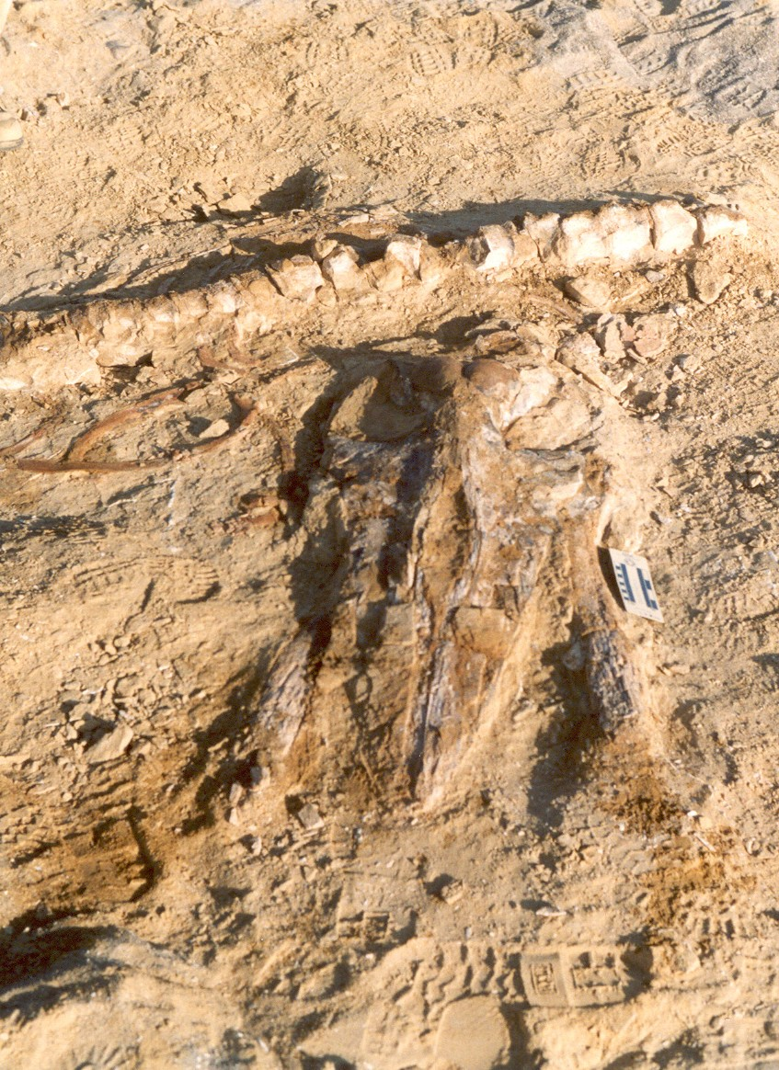
What can we learn from fossils and why should we care?
2) Taphonomy (science of decay and fossilization)
- How much time from death to fossilization (rapid or slow)
What kind of processes (common or uncommon)
What kind of depositional environment (marine, terrestrial, etc.)

Slide 11
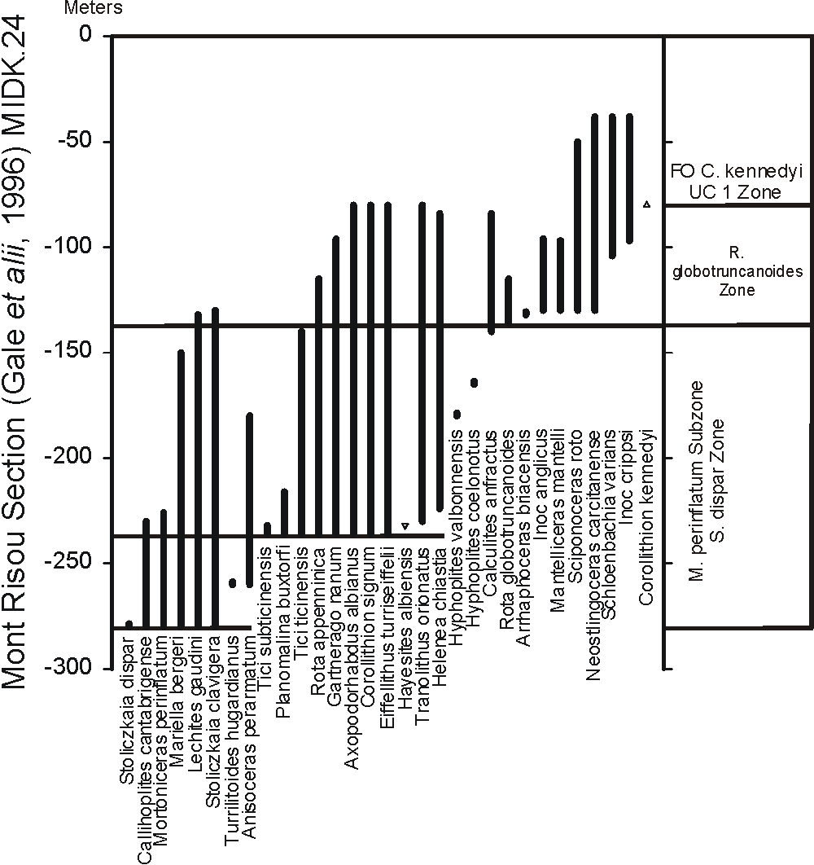
What can we learn from fossils and why should we care?
3) Biostratigraphy (science of ordering in space and time)
- How are fossils distributed in the rocks (patterns or randomness)?
Are there diversity trends?
What controls the observed distribution?

Slide 12
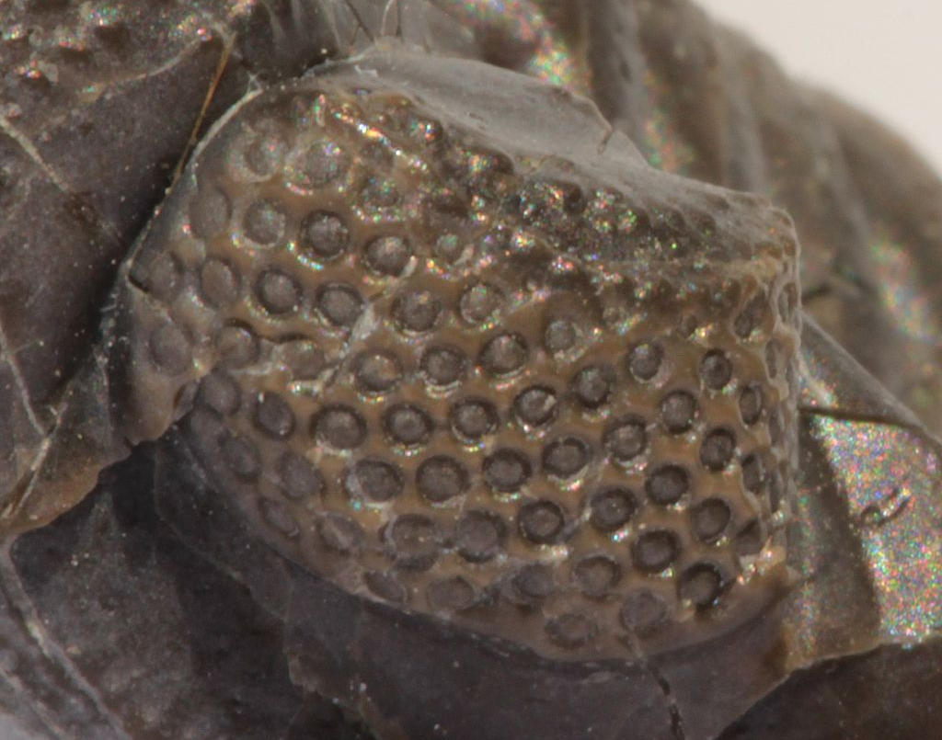
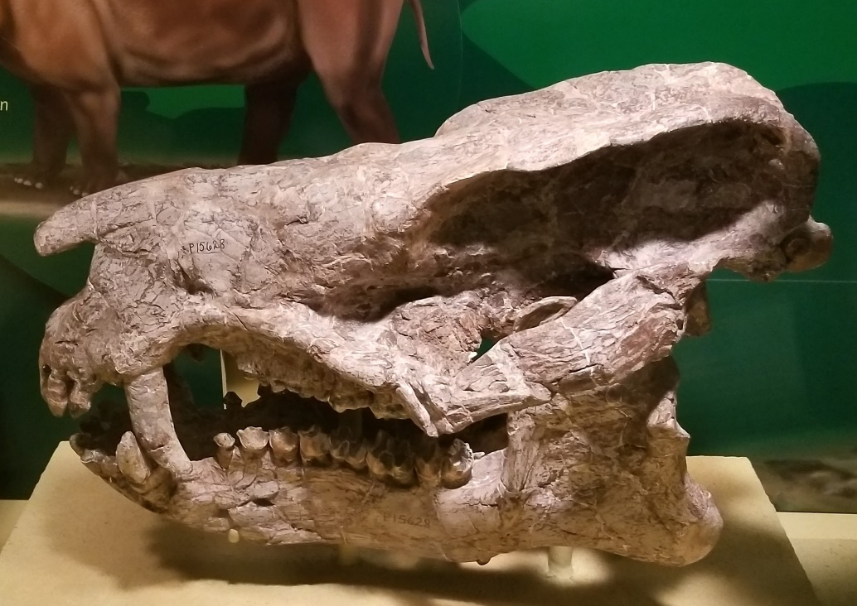
What can we learn from fossils and why should we care?
4) Paleobiology (science of reconstructing life mode of extinct organisms)
Design and complexity
Evil in nature (predation, envenomation, disease, etc.)
Past environmental conditions
From https://en.wikipedia.org/wiki/Phacopina#/media/File:Phacops_rana_crassituberculata_eye_3.jpg

Slide 13
Why should we care about fossils?
“In the days of Noah, men, animals, and trees, many times larger than now exist, were buried, and thus preserved as an evidence to later generations that the antediluvians perished by a flood. God designed that the discovery of these things should establish faith in inspired history.”
Ellen G. White, Patriarchs and Prophets, p.112.
Notes:
Divine design in the study of fossils. It’s the only record of the world that was. Biological change can be observed over generations, but Darwinian theory suggests this change is minimal over what natural selection has driven over time. Only fossils can provide an actual test of the theory (the extrapolation of this change over time).

Slide 14
Why should we care about fossils?
The fossil record is a key pillar of the evolutionary model, the kind of empirical evidence that is thought to provide support for the theory of evolution
Notes:
Divine design in the study of fossils. It’s the only record of the world that was. Biological change can be observed over generations, but Darwinian theory suggests this change is minimal over what natural selection has driven over time. Only fossils can provide an actual test of the theory (the extrapolation of this change over time).

Slide 15
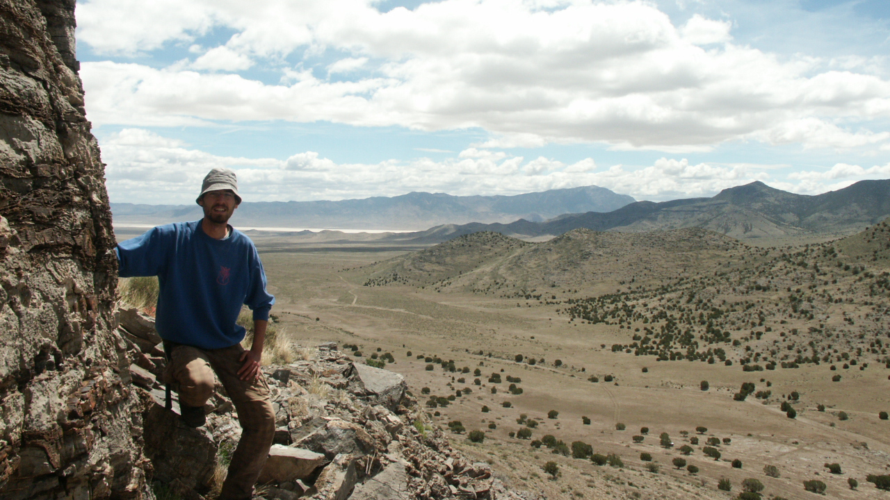
Studying the fossil record
Notes:
Only one of the two models is correct. When we go to the field and we lean on some rocks…e.g. Upper Cambrian limestones

Slide 16
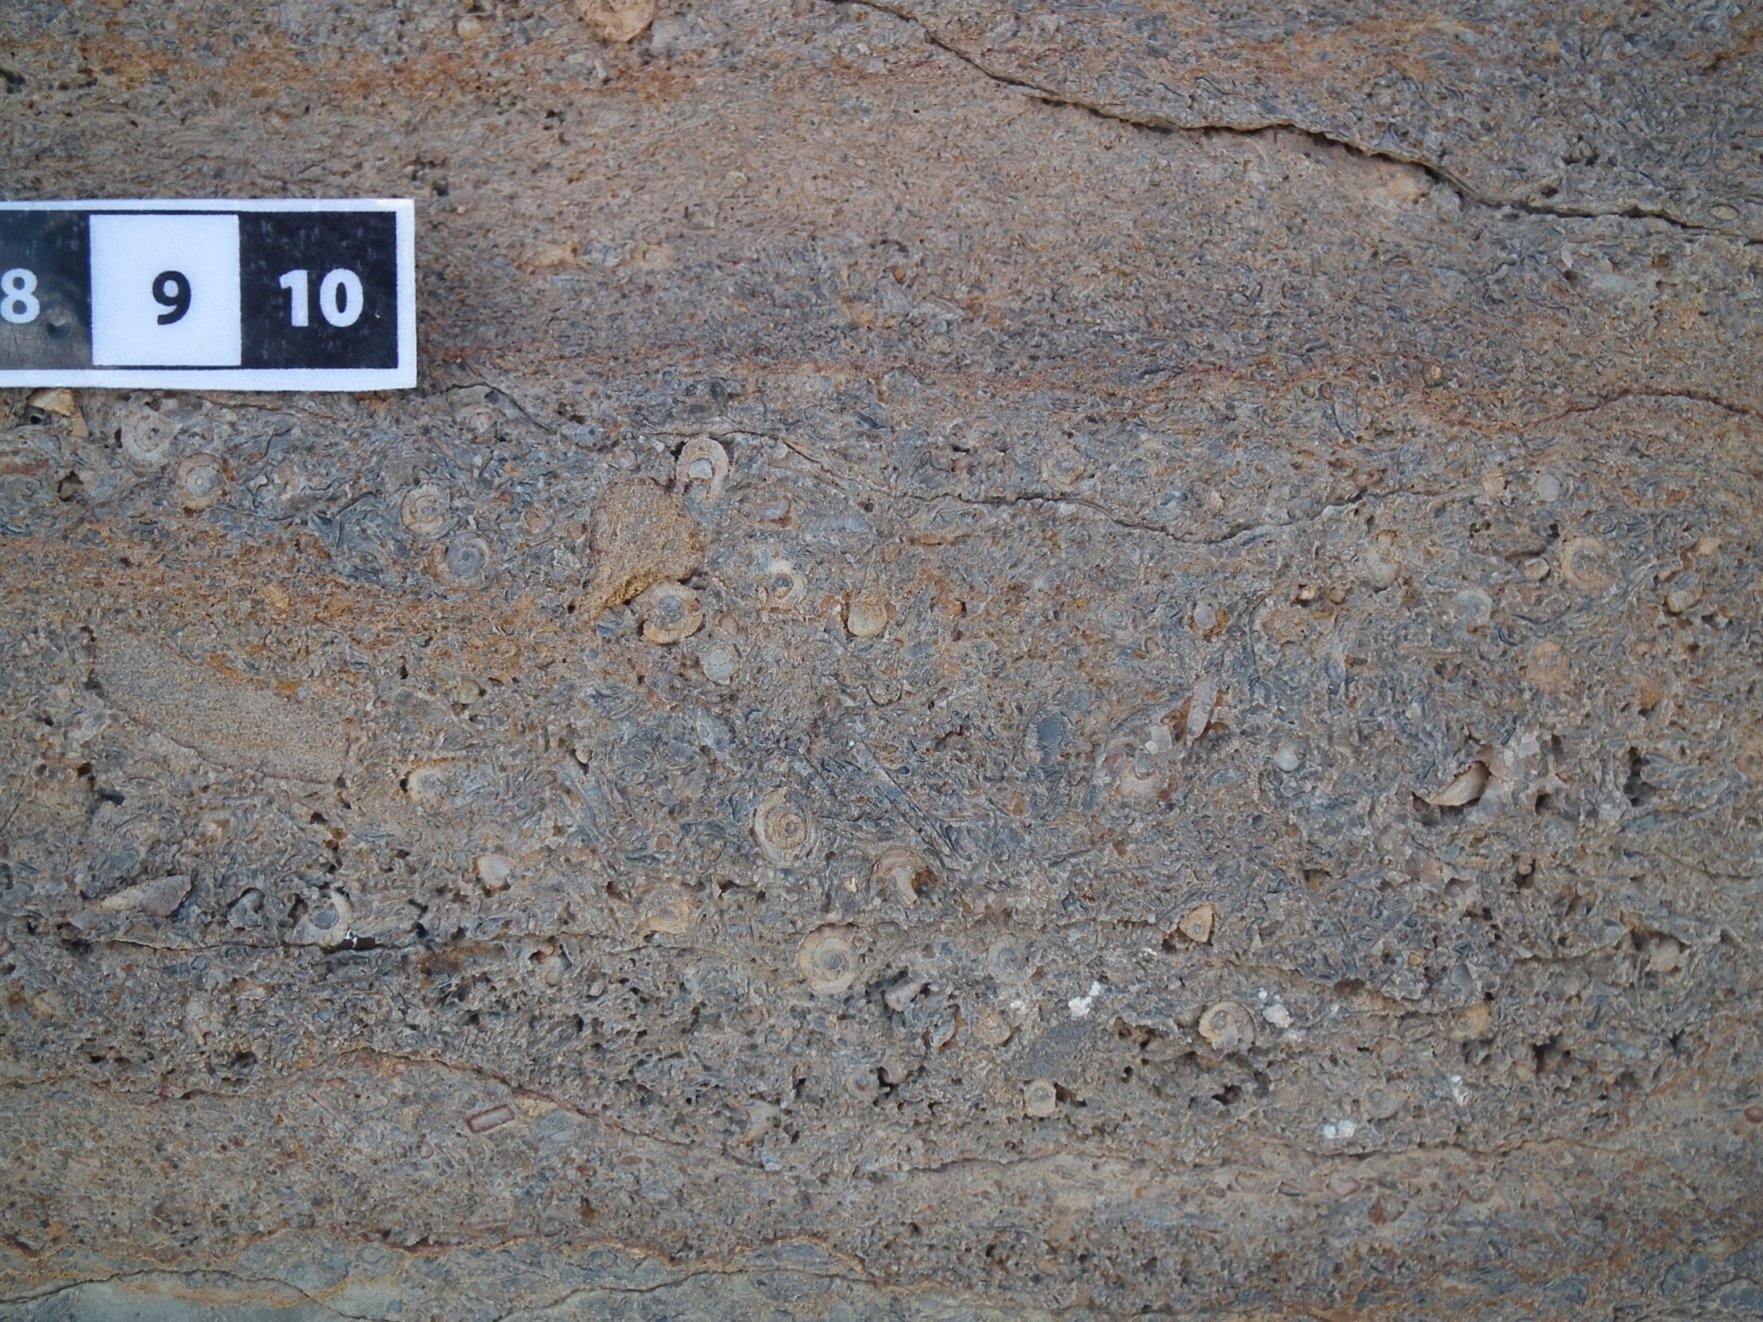
Notes:
Skeletal fragments in the rocks, remains of organisms.

Slide 17
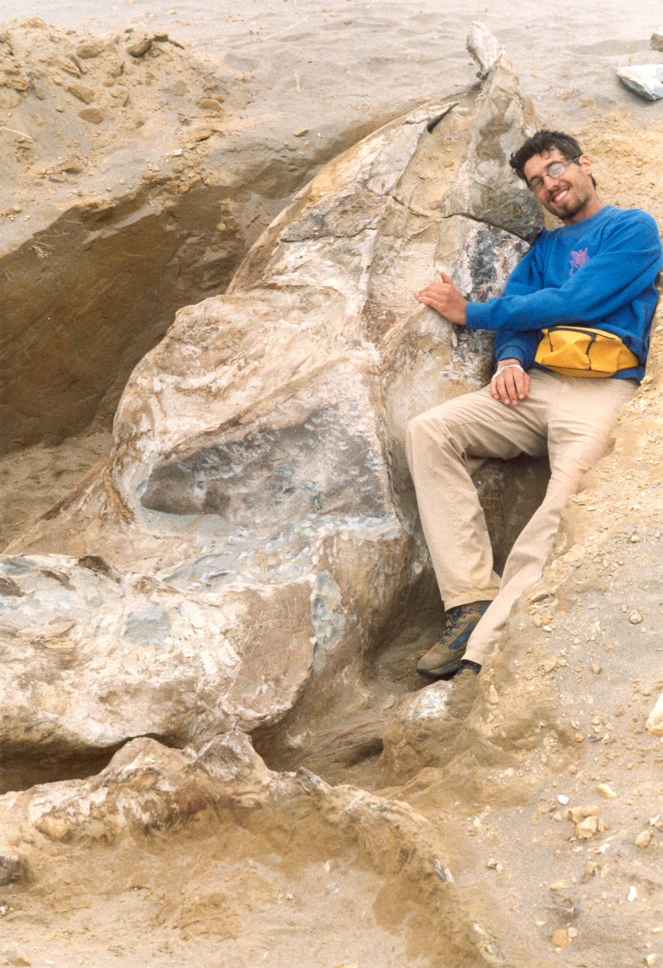
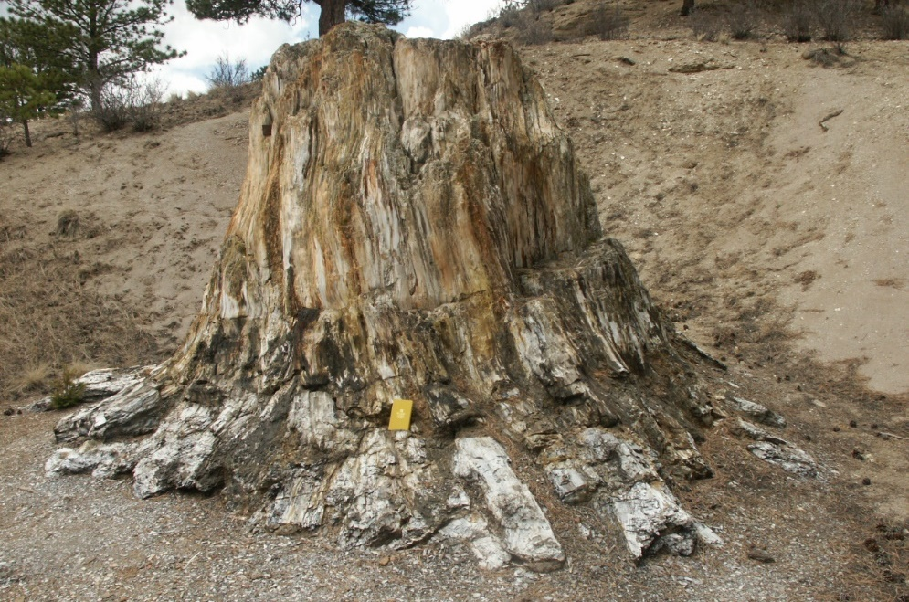
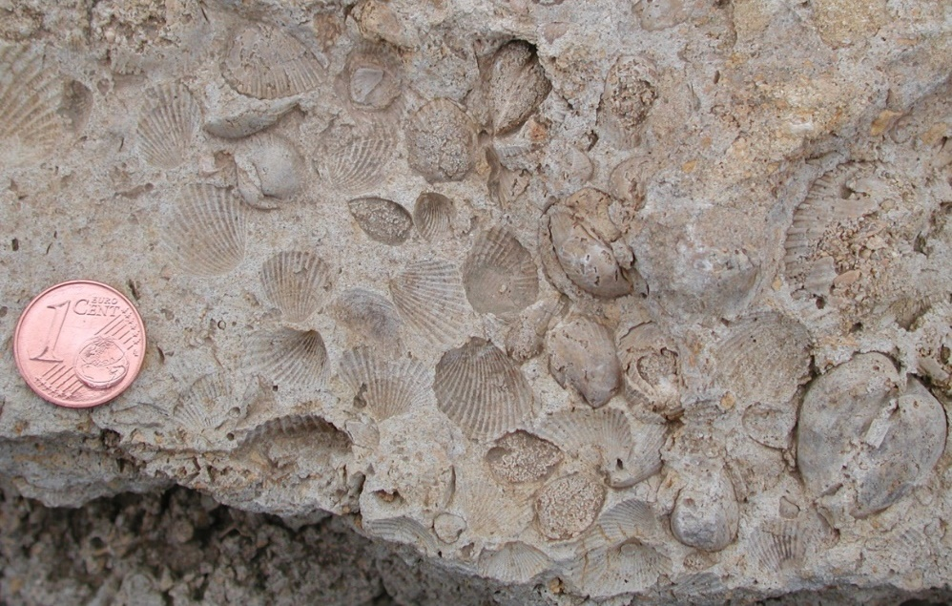
A record of death
Notes:
Although I look quite happy and excited next to this fossil whale, every fossil shell, every fossil vertebrate, every fossil plant constitutes the remains of an organism that was once alive and then died. It’s true that these fossils are the only direct evidence of past forms of life, but they also witness to the reality of death across the biological spectrum.

Slide 18
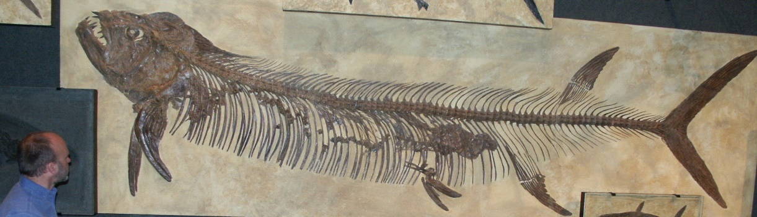
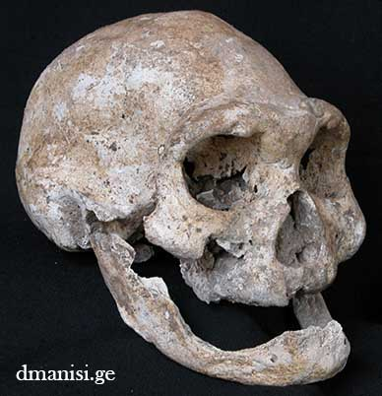
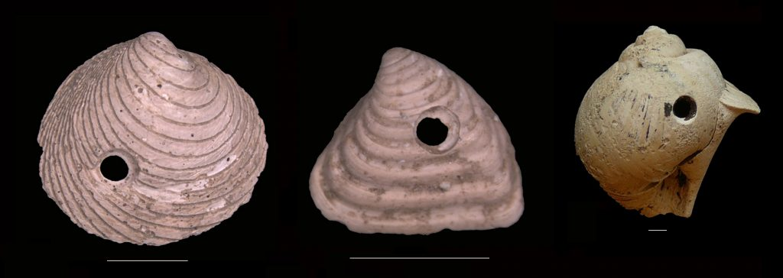
A record of predation and disease
Image from http://ucmp.berkeley.edu/blog/archives/4399
Notes:
Fish with its meal, edentulous human, drill holes in molluscs…we could add broken bones, infections/tumors, a variety of predatory strategies, envenomation, etc.

Slide 19
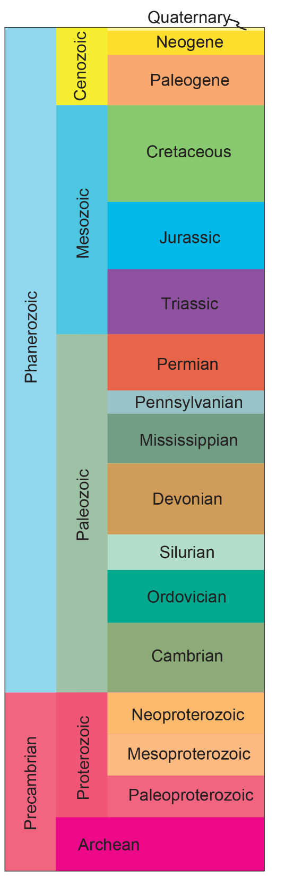



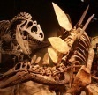
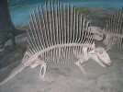






The uniformitarianist model: evolution over long time
Hominins
Mammals
Birds
“No vestige of a beginning, no prospect of an end:”
Death, competition, natural selection have always been part of how biology works
Contrast: Recent and literal creation
The goodness of creation and its Creator
Dinosaurs
Reptiles
Amphibians
Fish
Brachiopods
Trilobites
Ediacara fauna
Unicellular organisms
Notes:
This model impacts our understanding of what good means for God

Slide 20
The biblical model
“God created/made … according to their kind (humans in His image)” (Gen 1:21,25,27)
Creation: Kinds
“Now the earth was corrupt in God's sight, and the earth was filled with violence. And God saw the earth, and behold, it was corrupt, for all flesh had corrupted their way on the earth.” (Gen 6:11-12)
Corruption: Violence
“Every living thing on the face of the earth was wiped out; people and animals and the creatures that move along the ground and the birds were wiped from the earth.” (Gen 7:23)
Catastrophe: Flood
Notes:
Three guiding principles that can help make sense of the fossil record. Original polyphyly; escalation hypothesis in the fossil record + A major event responsible for a lot of fossilization.

Slide 21
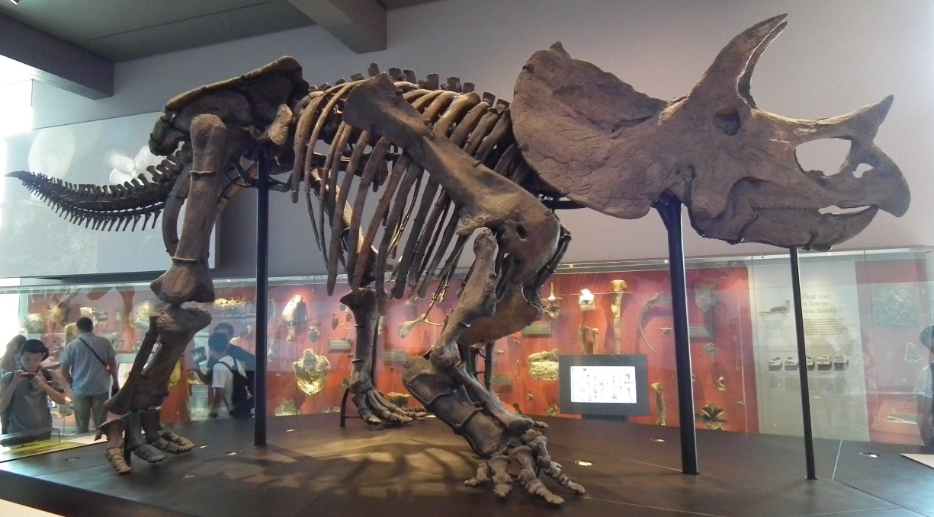
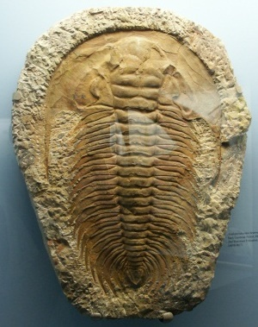
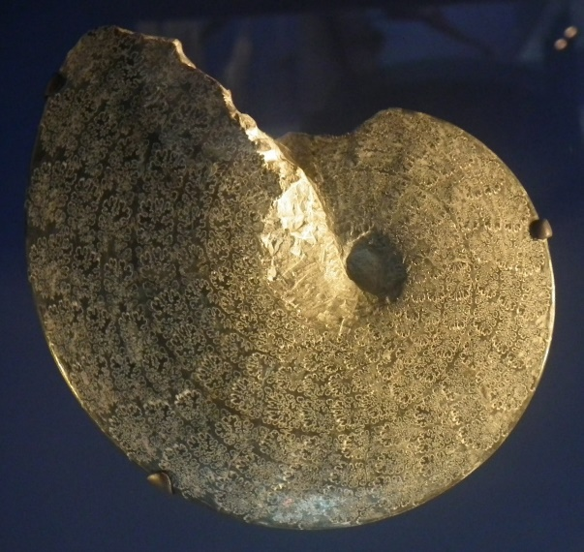
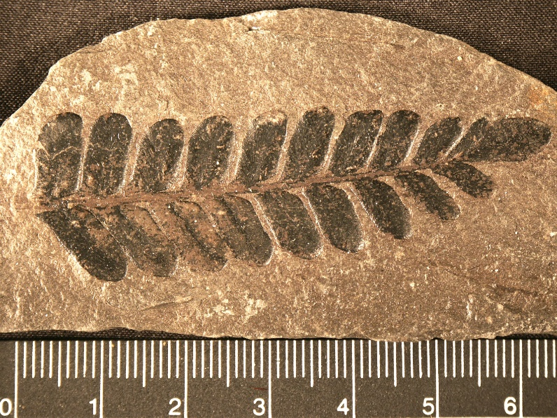
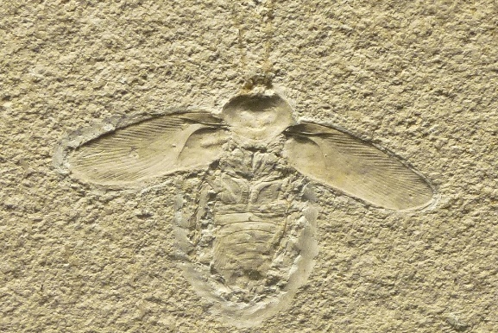
How much change?
Notes:
We encounter pretty bizarre things, most of which are extinct. However, at the same times, they fit into same larger categories/groups of living things we have today (plants, invertebrates, vertebrates, reptiles, arthropods, mollusks, insects, etc.).

Slide 22
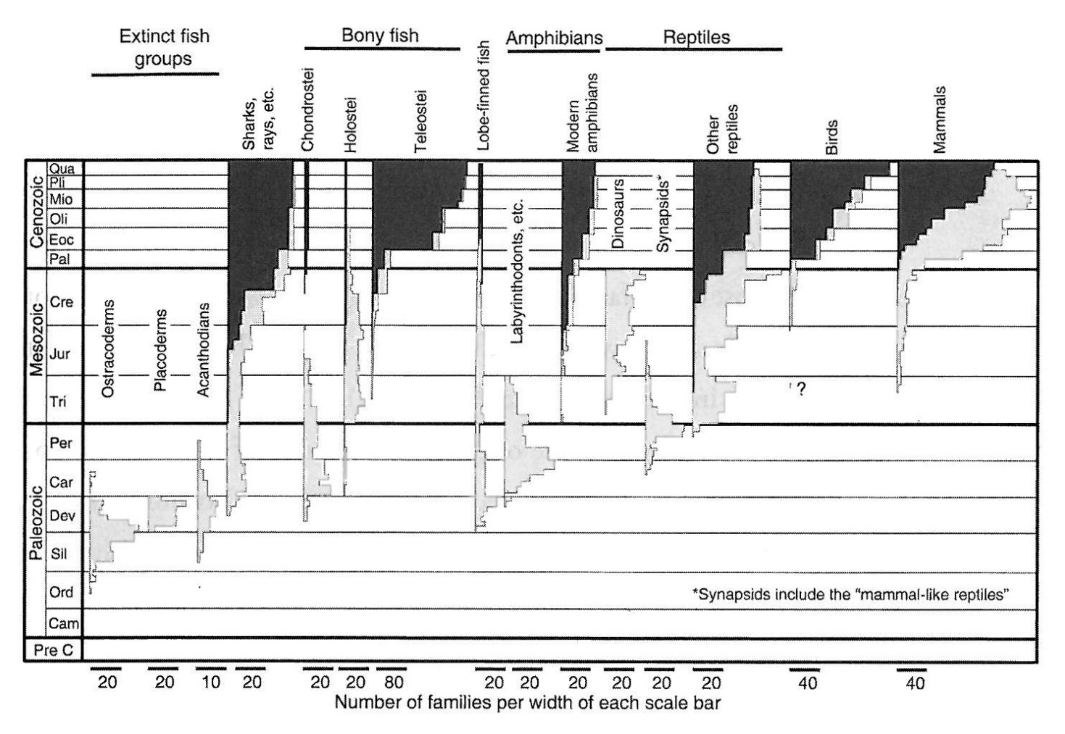
How much change?
From L. Brand, 2009
Increasing modernity in the Cenozoic
Notes:
The organisms more similar to those living today are found mostly in the upper part of the geologic column.

Slide 23
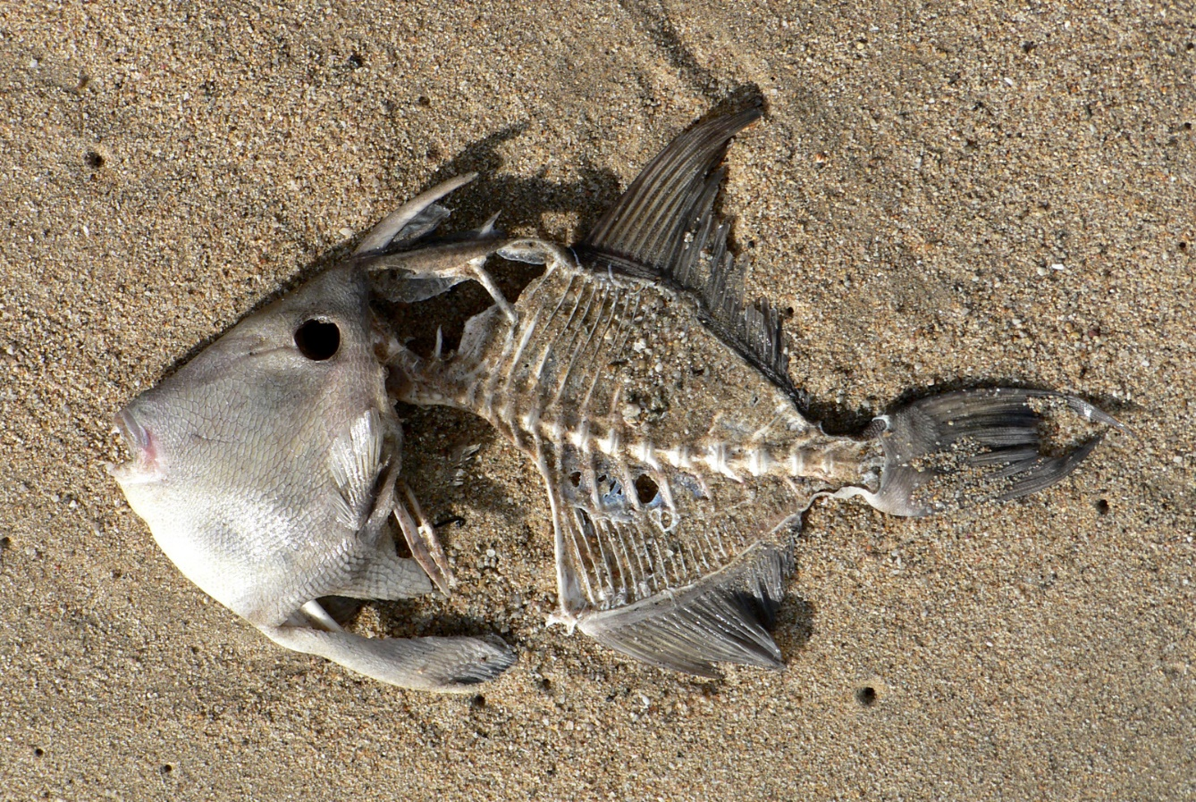
How much catastrophe?
Factors favoring fossilization:
Hard parts
Rapid Burial
Early mineralization (often through permeating solutions)
Rapid Burial
Early mineralization (often through permeating solutions)
Notes:
Especially these two conditions would be greatly enhanced during a global flood. Would be favorable for much fossilization

Slide 24
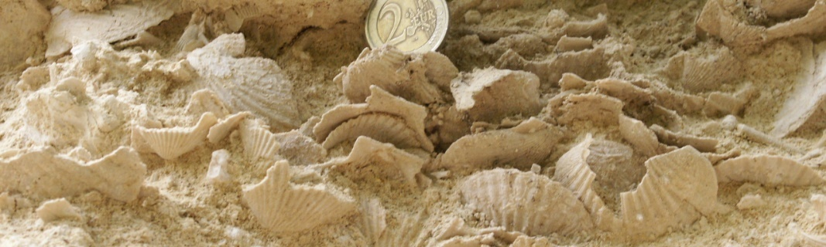
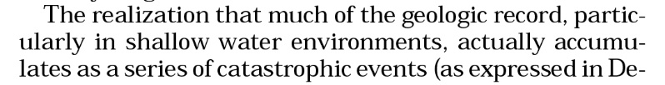

Many examples of catastrophic deposition of fossils in the rock record
(bonebeds/shellbeds related to storm events or sediment gravity flows)
How much catastrophe?
From Brett et al., 2007
Notes:
You are going to learn more about one such bonebed which has been studied extensively by DR Chadwick and his team.

Slide 25
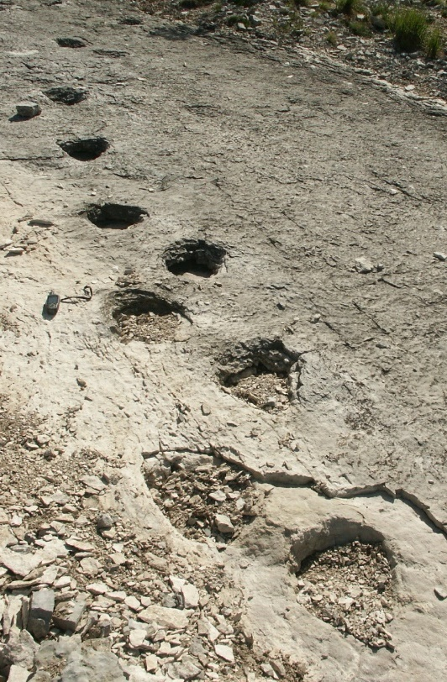
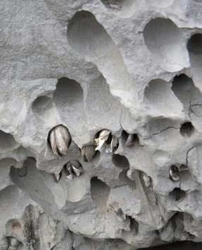
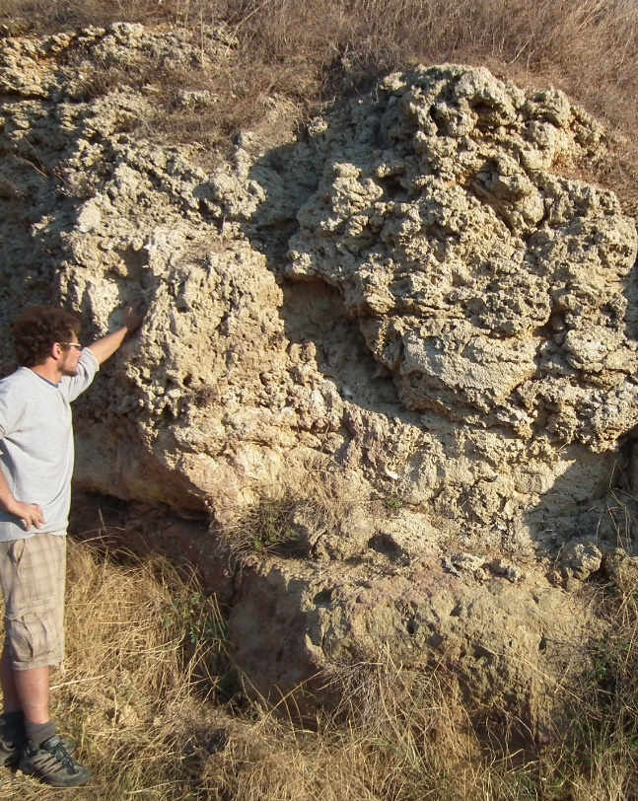
However, not everything sudden/instantaneous, also examples indicative of some passage of time
How much catastrophe?
Image from http://forum.rocktumblinghobby.com/thread/66859/lithophaga-means-stone-eater-genus
Trackways, trace fossils
Bioerosion, encrustation
Build-ups, bioconstructions
Active research areas…
Notes:
Estimate of how much of the fossil record has been deposited catastrophically. Patterns of distribution of bioerosion in the geologic record.

Slide 26



Stratigraphic distribution of fossils
Stratigraphic order
Non random distribution of fossils, occurrence in specific intervals of the geologic column
True for higher taxonomic ranks but especially at the genus/species level
Notes:
Give some examples: tetrapods, four limbed vertebrates from Devonian upward; Flowering plants from Cretaceous upward.

Slide 27
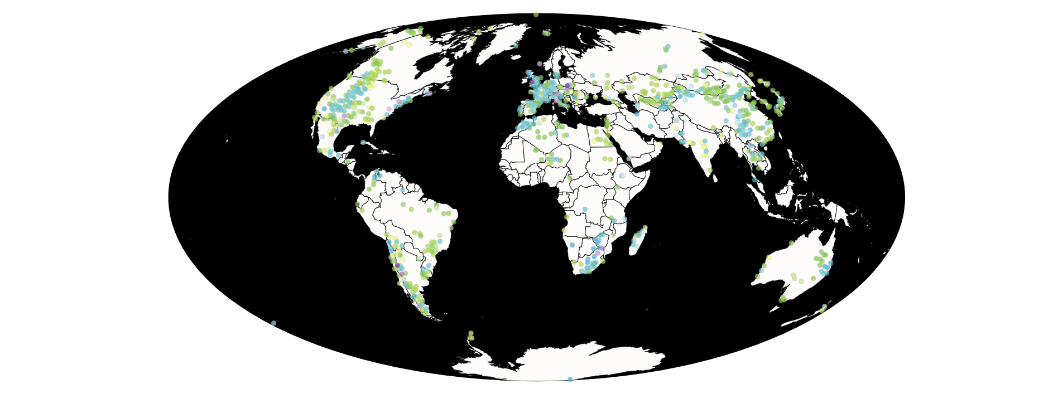
Stratigraphic distribution of fossils
Stratigraphic distribution of dinosaurs
Data from PDBD, available at https://paleobiodb.org/navigator/
Note also cosmopolitan occurrence (all continents)

Slide 28
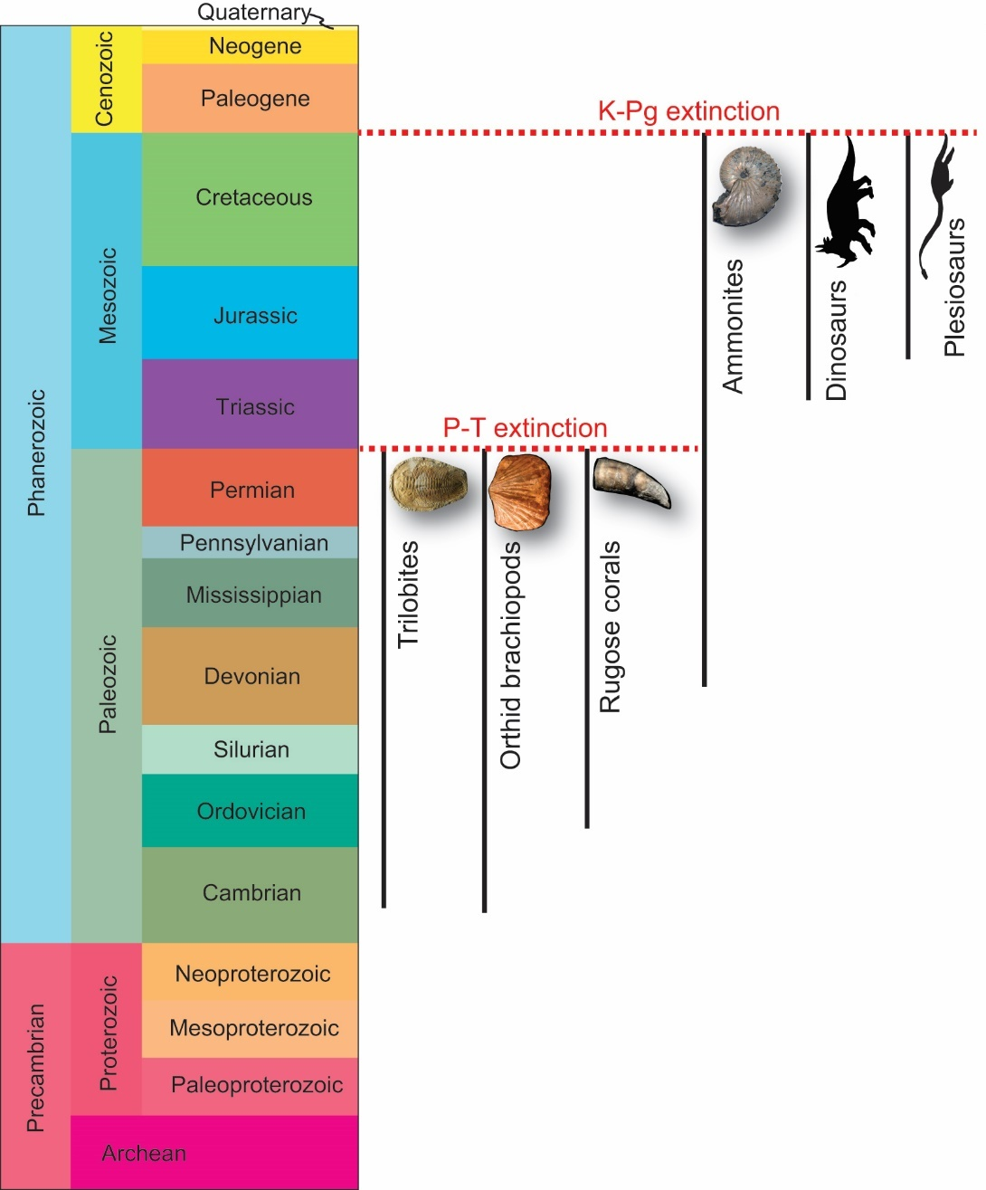
Patterns of distribution in the fossil record
Stratigraphic order
Coordinated disappearance (extinction)

Slide 29
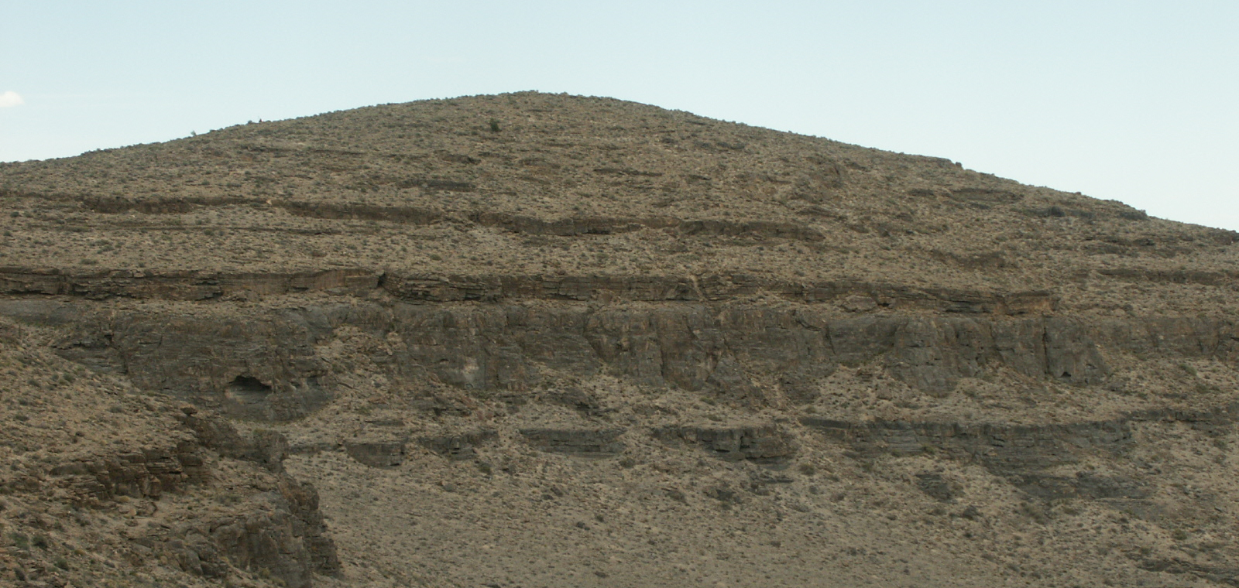
Stratigraphic distribution of fossils
Order at the species level
Notes:
Sampling for microfossils:

Slide 30
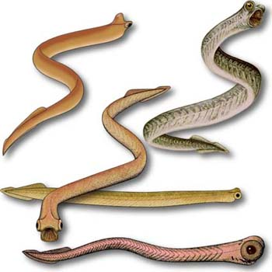
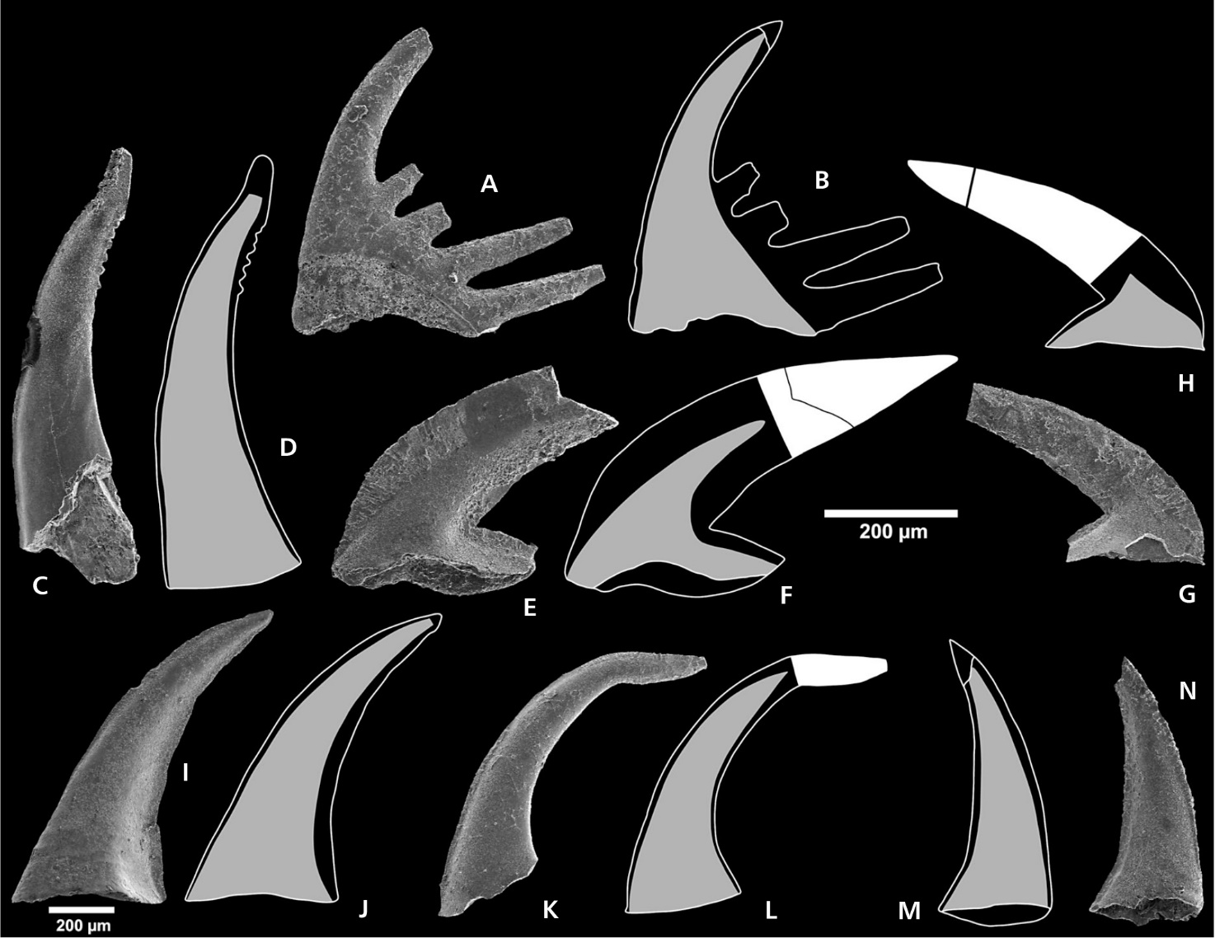
Stratigraphic distribution of fossils
Image by M. Purnell https://www.le.ac.uk/geology/map2/abstractsetc/cavhet.html
From Miller et al., 2011, Bull. of Geosciences
Notes:
Sampling for microfossils: conodonts/conodont elements (digest the rock). KLMN Eoconodontus notchpeakensis

Slide 31
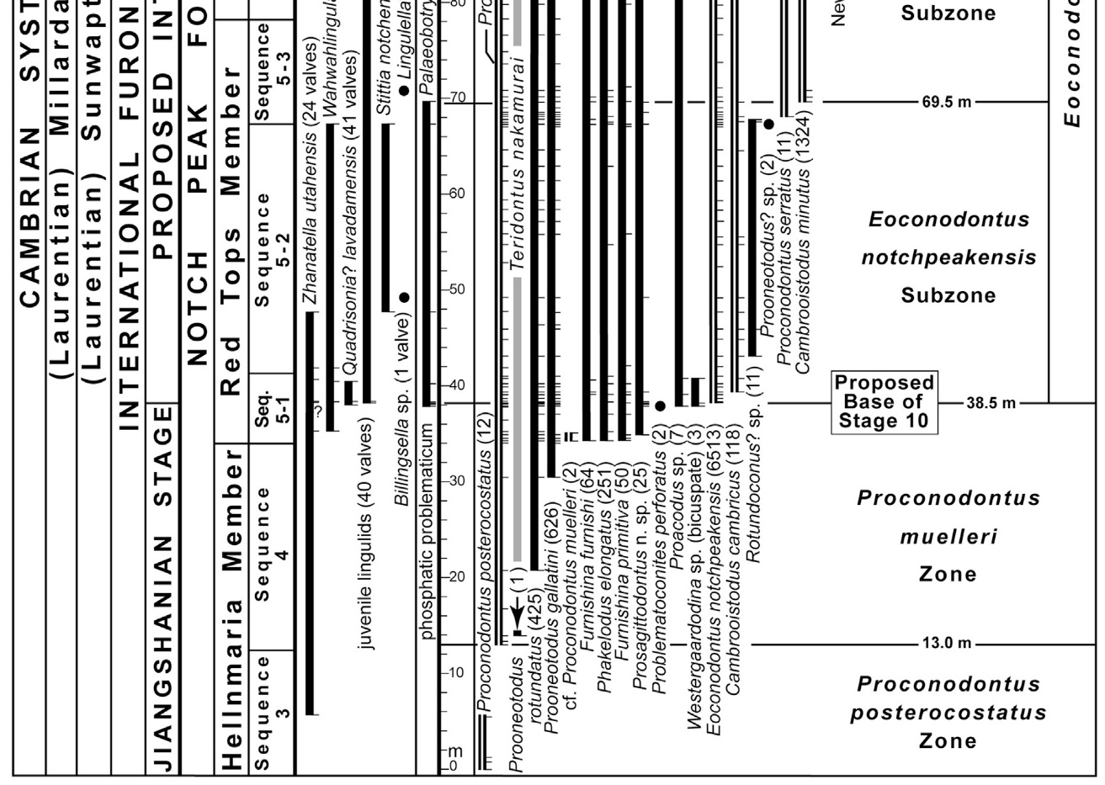
Stratigraphic distribution of fossils
From Miller et al., 2015, Ann. de Paleont.
Order at the species level
Notes:
Notice that the FAD corresponds with a stratigraphic discontinuity…
So, in the evolutionary model, this would be explained by the fact that these species did not exist before, and they appear because they evolved from other species. Seems to make sense… except that we have a problem

Slide 32

Stratigraphic distribution of fossils
Coordinated appearance (radiation)
From Barton et al., 2007, Evolution, Cold Spring Harbor Laboratory Press
Notes:
These appearances are often abrupt, without clear series of intermediates. The most astounding of these sudden appearances is the so called Cambrian explosion. Most phyla and body plans ins narrow stratigraphic interval.

Slide 33

Radiations and appearance of new body plans
From Darwin, C. R., 1859
Evolutionary model:
Differences between organisms emerge with time.
Higher taxonomic categories should appear gradually and progressively as diversification proceeds.

Slide 34

Radiations and abrubt appearance
Numerous orders of marine reptiles (Triassic)
Notes:
The oldest trilobite body fossils around the world, at or near the Terreneuvian–Cambrian Series 2 boundary (ca. 521 Ma), already show established diversity, phylogenetic disparity, and biogeographic provincialism. Same could be applied to many other examples at the order and family level: fish, marine reptiles (e.g., ichthyosaurs), synapsids, pterosaurs, dinosaurs, angiosperms, modern mammals

Slide 35
Stratigraphic distribution of fossils
Coordinated disappearance (extinction)
Notes:
By the way, a similar pattern can also be seen for the disappearance of fossil types.

Slide 36

A creationist model of ordered distribution
The Order of the Fossils : Beyond Is Genesis History? https://www.youtube.com/watch?v=_Mj9bR9BiqI
Ecological Zonation Theory (Biome Succession)
Instead of evolution + time,
depositional processes +
coeval ecologically distinct communities
Notes:
The million dollar question: what are these waves or bursts? If they are not evolutionary

Slide 37
Patterns of distribution in the fossil record
From Miller et al., 2015, Ann. de Paleont.
Appearance above stratigraphic discontinuity
Notes:
Relate biodiversity trends to sedimentary processes rather than evolution.
The possibility also remains for some of the major radiations and disappearances (post-flood or pre-flood)
to be true “evolutionary” events or extinctions but within a short chronology framework

Slide 38
Conclusions
Fossils are extremely valuable in providing a record of past life forms
The Bible provides important guiding principles to help us interpret the fossil record: creation of distinct kinds; change after the fall (corruption); and a global flood (catastrophe)
We can build a big picture framework of how to interpret patterns in the fossil record based on these guiding principles
Much work remains to be done at a higher resolution. Areas in need of improvement include: integration of sedimentary/tectonic processes with distribution of fossils; time implications of certain types of fossils/traces; demarcation of flood vs non-flood related fossils
Notes:
If our biblical worldview presents us with some unsolved questions when looking at the fossil record, it will certainly also give us the ability to ask different questions than the standard uniformitarian approach and hopefully contribute valuable results. In the process, by the grace of God, we’ll stay humble, learn how to balance our strengths and limits, increase understanding, and keep our foundations anchored in God and His trustworthy Word.

Slide 39

A record of death: from past to future…
“For the creation was subjected to futility, not willingly, but because of him who subjected it, in hope that the creation itself will be set free from its bondage to corruption and obtain the freedom of the glory of the children of God. For we know that the whole creation has been groaning together in the pains of childbirth until now. And not only the creation, but we ourselves, who have the firstfruits of the Spirit, groan inwardly as we wait eagerly for adoption as sons, the redemption of our bodies.”
Romans 8:20-23

