Slide 1

is the earth SPecial?
Thinking of Planetary habitability from the biblical perspective
Ronny nalin, phd
Notes:
Greetings from the Geoscience Research Institute. In today’s presentation we will reflect about our planet, considering data acquired from scientific investigation and interfacing it with the biblical perspective.

Slide 2
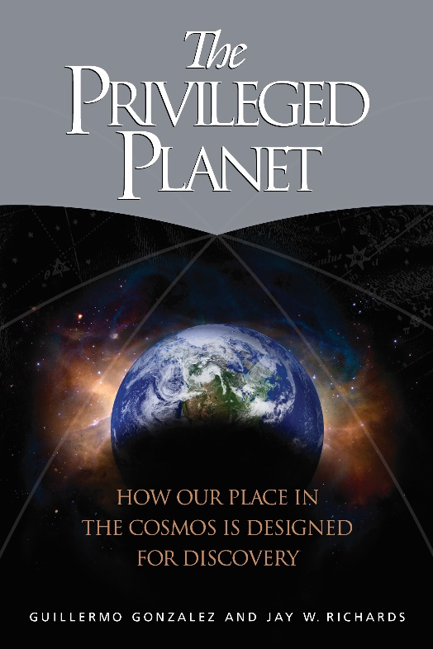
Our planet is exquisitely fit not only to support life, but also to give us the best view of the universe, as if Earth were designed both for life and for scientific discovery
Notes:
Is the earth special? The opinions on this differ. For example, in their book “The Privileged Planet, Gonzalez and Richards build a case for our planet not only being exquisitely fit to support life, but also to give us the best view of the universe as if earth were design both for life and scientific discovery.

Slide 3
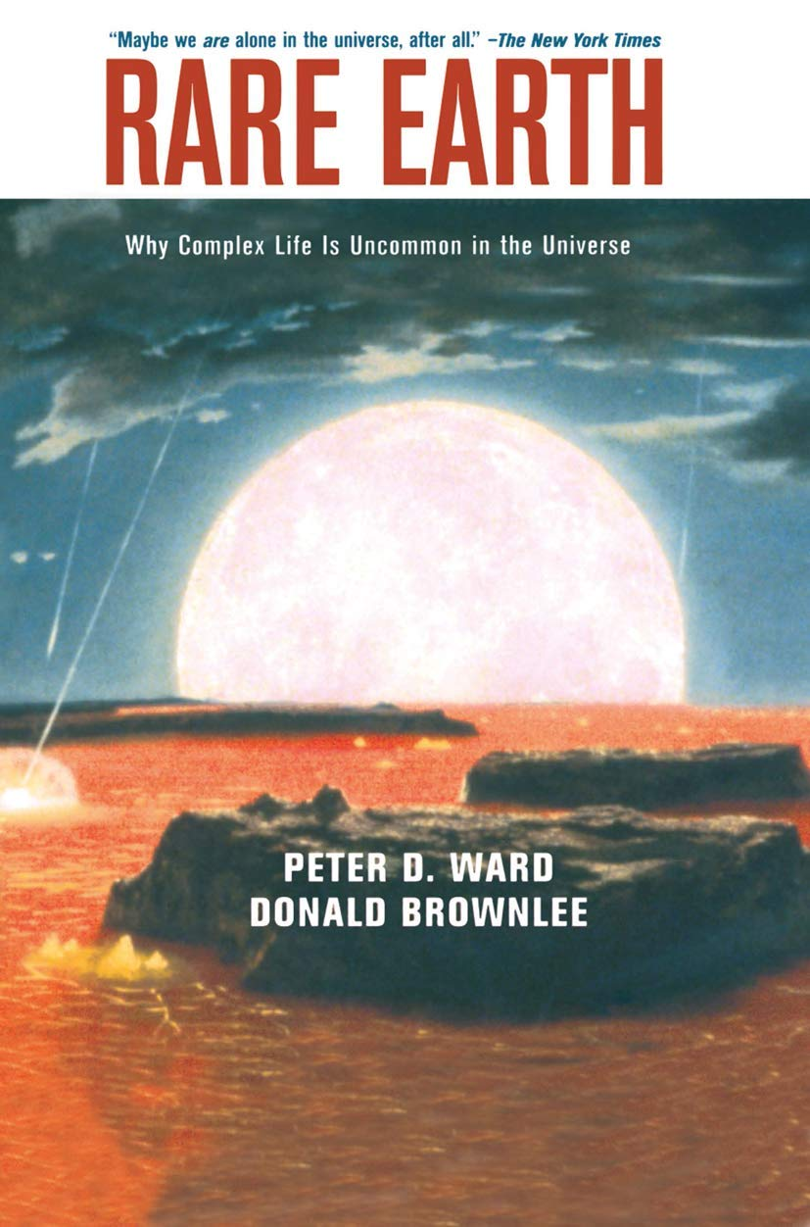
“Complex life is less pervasive in the Universe than is now commonly assumed”
Notes:
In another influential book, Ward and Brownlee, stay away from the concept of design and adopt a naturalistic model of earth history. However, they do come to the conclusion that the earth is probably to be considered “special” or “rare” as the title of the book suggests, because they suggest that complex life is less pervasive in the universe than I snow commonly assumed.

Slide 4
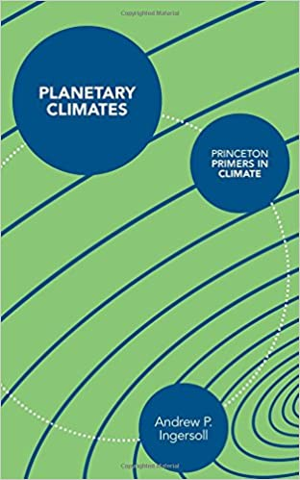
“Earth seems to be a typical planet orbiting a typical star, with a typical collection of raw materials that constitute the building blocks of life. There is no reason to believe we are alone.”
Notes:
Finally, Andrew Ingersoll concludes his book on planetary climates with a statement that presents yet another view, minimizing earth’s uniqueness: “Earth seems to be a typical planet orbiting a typical star, with a typical collection of raw materials that constitute the building blocks of life. There is no reason to believe we are alone”

Slide 5
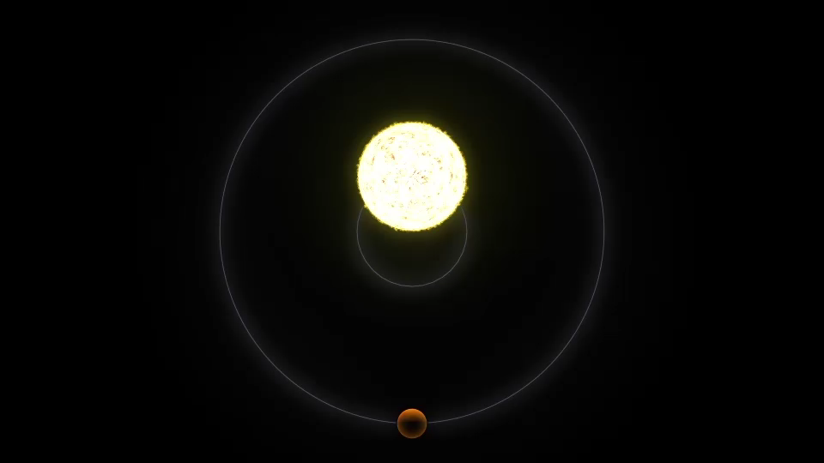
exoplanets
Radial Velocity Method
From https://exoplanets.nasa.gov/alien-worlds/ways-to-find-a-planet/
Notes:
From a scientific perspective, however, a new way to more directly investigate the question of how special the Earth is, has opened in the relatively recent past, with the discovery of exoplanets. Exoplanets are planets outside the solar system. Although their existence had been postulated earlier, their detection only occurred starting from the 1990s. There are several ways of detecting exoplanets, but two are the most common. Start animation here The first, known as the radial velocity method is based on the fact that if a planet orbiting a star is quite massive, the center of mass of the rotational system will be a little off the star, meaning that the star too will be wobbling around the center of mass. As we observe this rotating system from the earth, in a radial direction, the electromagnetic waves coming from the star will be compressed or dilated as the star move closer and further respectively in its wobbly motion. This shift in wavelength, illustrated in the animation, will be periodical, and from it one can estimate a minimum mass for the orbiting planet and its distance from the star.

Slide 6
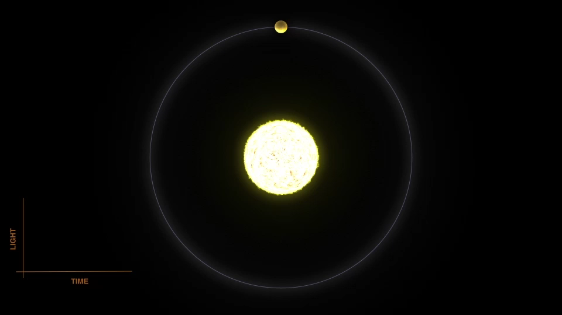
exoplanets
Transit Method
From https://exoplanets.nasa.gov/alien-worlds/ways-to-find-a-planet/
Notes:
The second method, the transit method, Start animation here has been the most fruitful in the detection of exoplanets so far. It is based on the fact that a planet transiting in front of a star will block some of the light that is received from an observer more or less aligned along the orbital plane. The dip in luminosity will be greater if the planet’s radius is larger. Also, the dip in luminosity will be observed periodically as the planet keeps revolving around the star, allowing to calculate the duration of a full revolution and the distance of the planet from the star. One implication of these detection methods, as we will see form the next slides, is that they are biased towards finding larger planets orbiting close to the star.

Slide 7
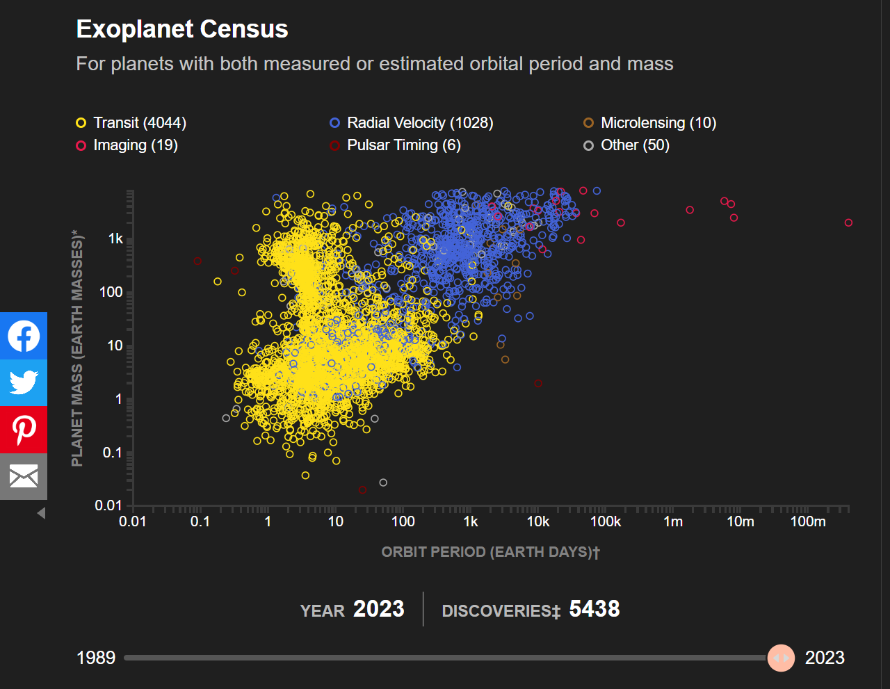
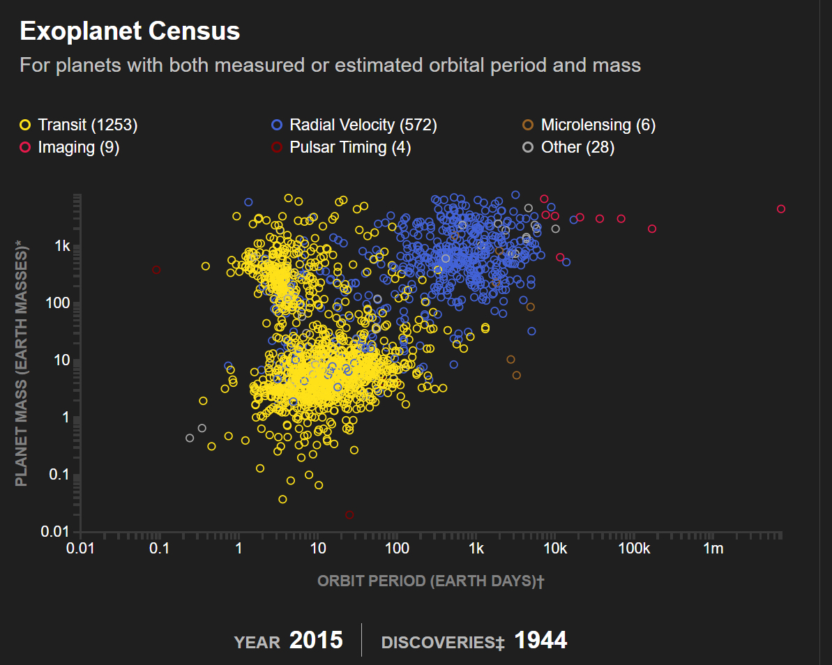
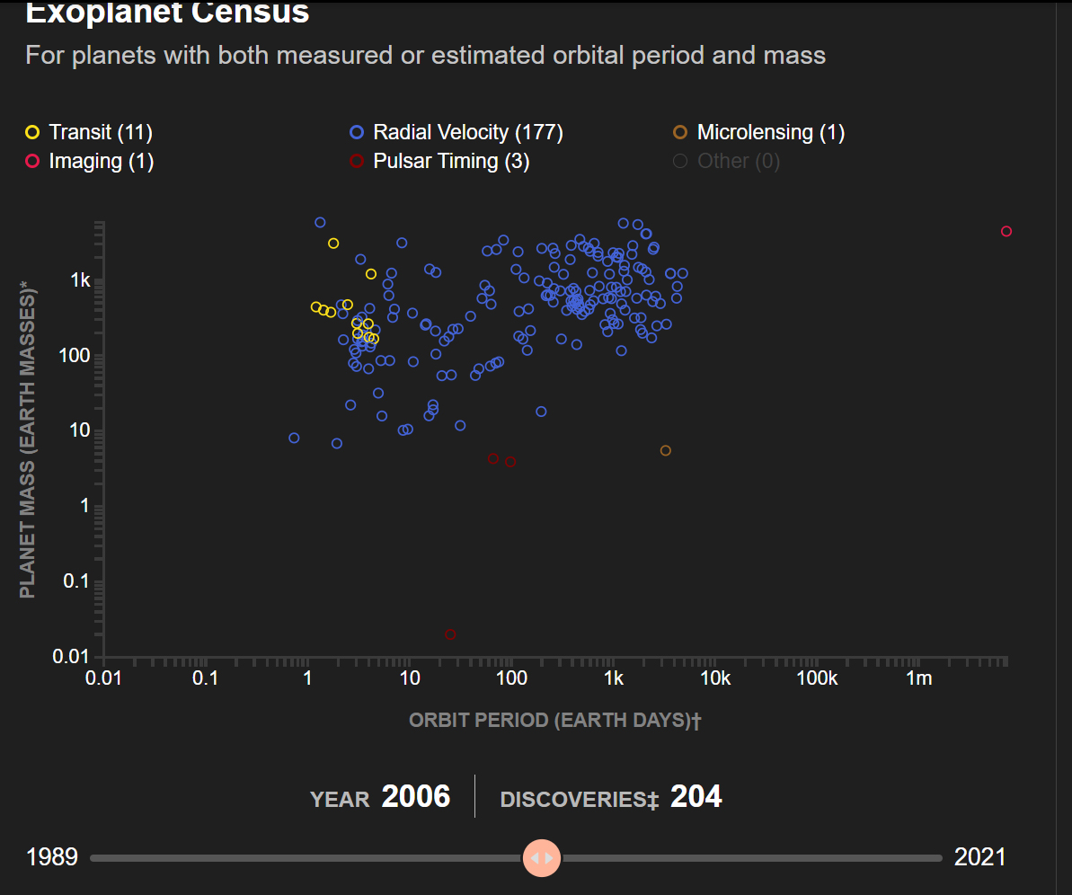
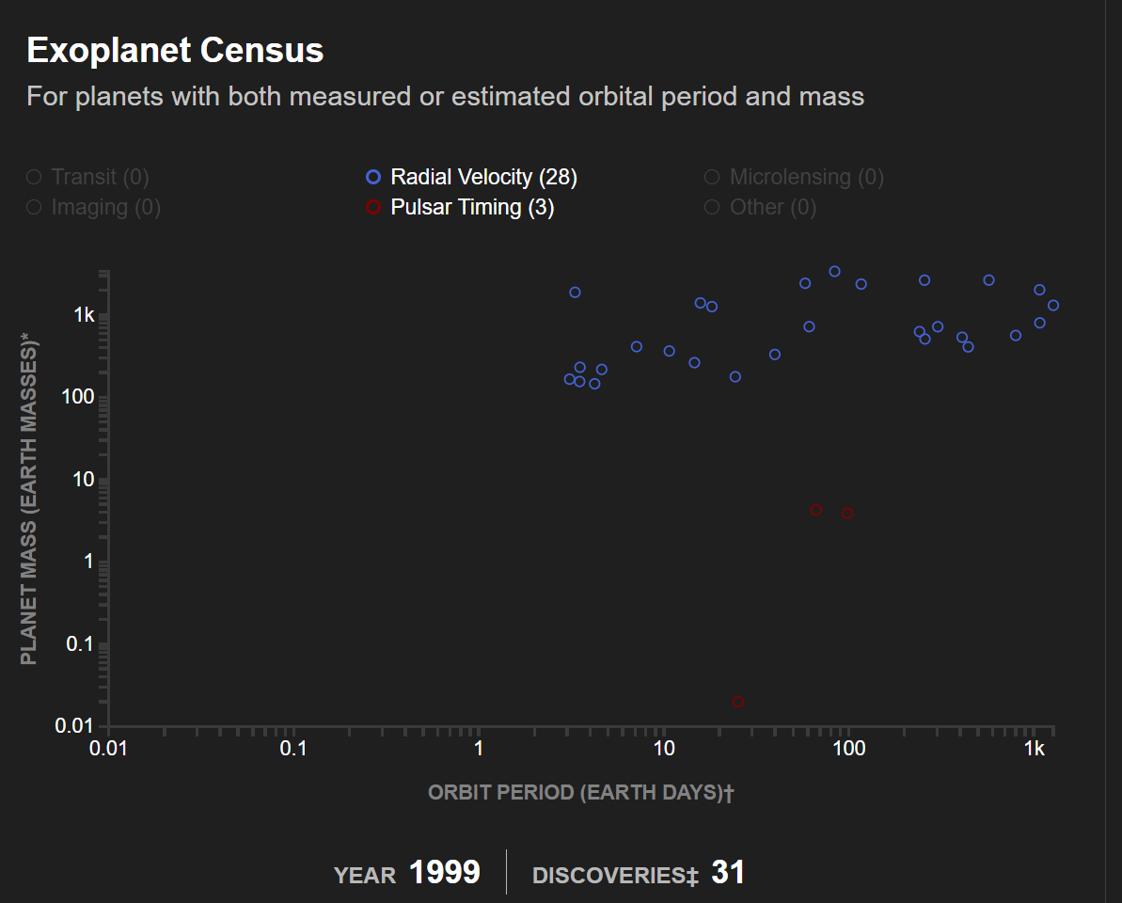
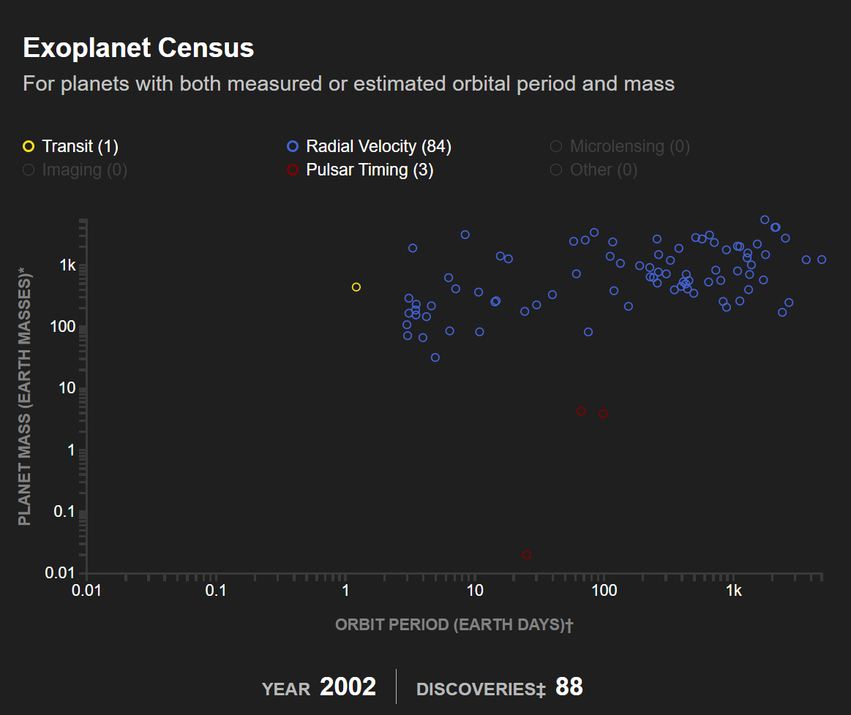
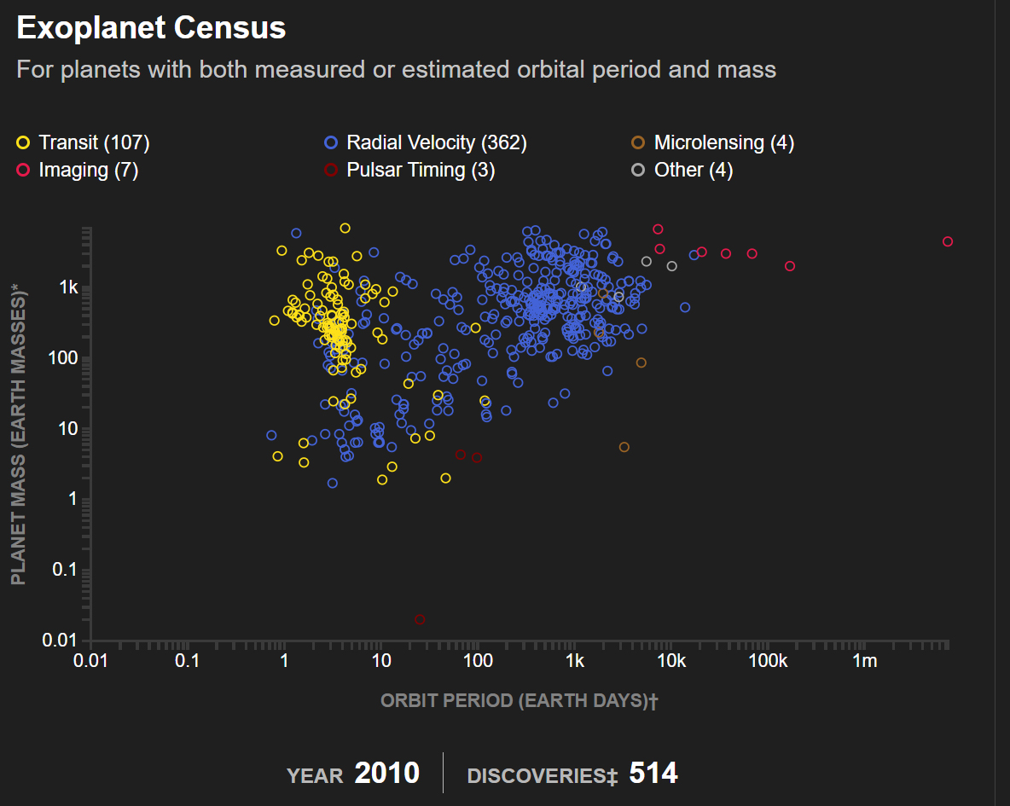
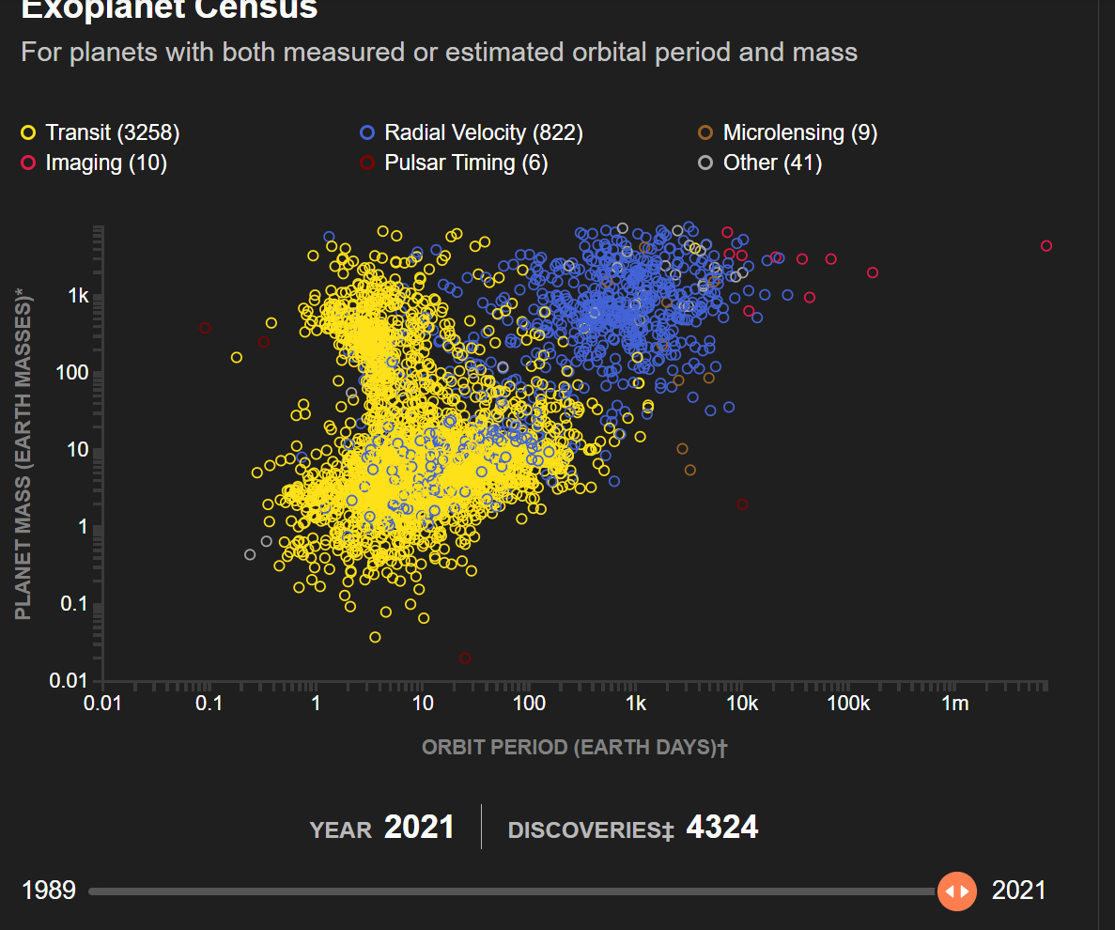
From https://exoplanets.nasa.gov/
Notes:
With the application of these and other methods of detection, we can see how the number of confirmed exoplanets has increased over time. The plots in this time series have duration of the orbital period (or year) in earth days on the x axis, and mass of the planet (in earth masses) on the y axis. The scale I logarithmic in both axes. We can see that in the early years detections were based mostly on the radial velocity method and included only very massive planets, but then, Move rapidly through the images until you get to the 2023 data at the end of this sentence especially with data from the transit method, the catalogue expanded to include planets with masses less than 10% of Earth’s mass and with a recent count in excess of 5400. The plot does not show yet a real overlap with our planet in terms of orbital period and mass: the confirmed exoplanets with similar or smaller mass are closer to their star, and the planets with similar or greater orbital period are more massive than the earth. However, it is expected that with improvements in detection methods, this field will continue to be populated. The discovery of exoplanets has allowed the formulation of a flood of new questions, questions like: what kind of stars have planets? What ratio of stars have planets? How common are earth sized planets? Is there a relationship between planet type and size and their distance from the star? What fractions of exoplanets are in the so called habitable zone? As all these questions are being investigated, one thing is already clear: the number and diversity of exoplanets is much larger than number and diversity of planets in our solar system. As the catalogue grew, it included unexpected surprises such as the occurrence of gas giants, like Jupiter in our solar system, but orbiting very close to their star. Most importantly, the exoplanet census illustrates that the possible set of planetary types and conditions is vast, so that Earth-like conditions are not a default in the universe.

Slide 8
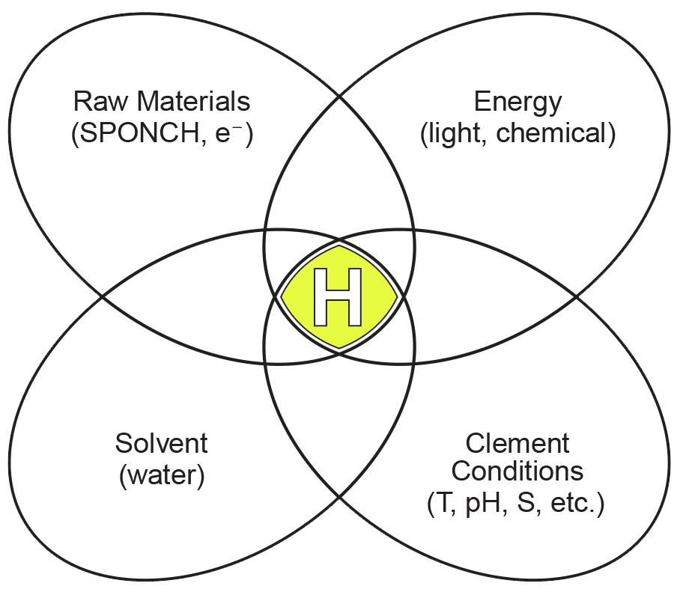
Planetary habitability
“We define a ‘potentially habitable’ planet to be one that is mostly rock, with a small (≤100 bar), high molecular weight atmosphere, and with energy sources and an internal structure such that the surface temperature and pressure permit liquid water for geological timescales.”
Barnes et al. (2015), The Astrophysical Journal, 814:91
From Hoeler (2007), Astrobiology, 7:824-838
Notes:
Let’s then review together some of the parameters that astrobiologists (the scientists who investigate the conditions necessary to sustain life in the cosmos) are considering important for a planet to be a good place for complex organisms like us to live on. Here is an example of a definition:… Note that the key elements are: “mostly rock” click therefore a terrestrial planet, not a gaseous one; a planet that can retain an atmosphere with certain specifications click ; a planet that has availability of energy sources with certain specifications click ; a planet where liquid water is present click; and a planet that can keep these sets of parameters stable over time click. This is one definition of habitability, but no matter the specifications chosen to define habitability, it is clear that habitability is not a function of a single variable, click but lies at the intersection of multiple factors that have to coexist. It is a much smaller subset out of the possible physico-chemical conditions present in the cosmos.

Slide 9
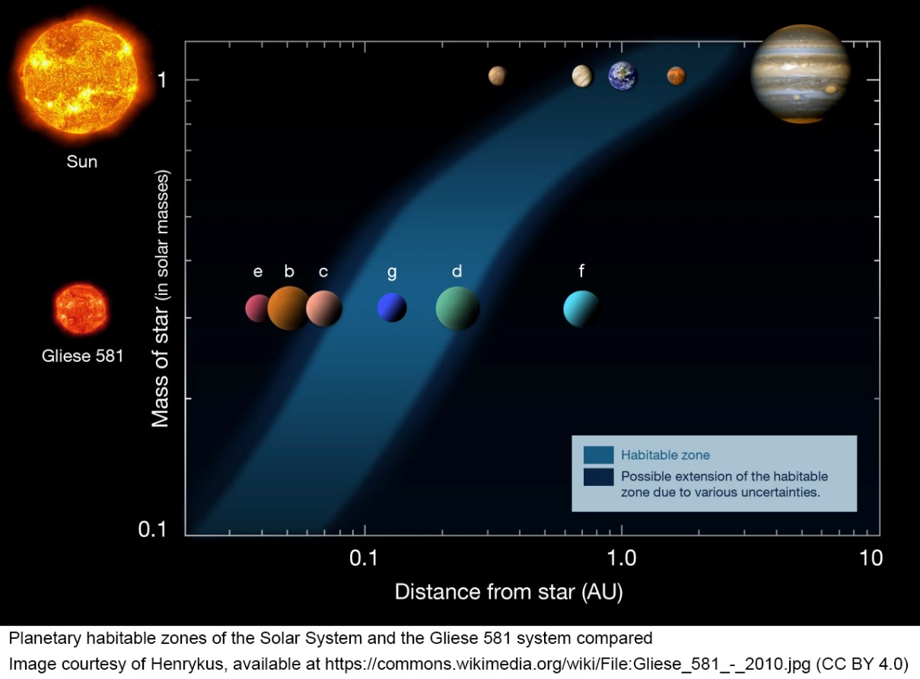
Light from a star
“A biosphere can have effects on a global scale, and hence be detectable over interstellar distances, only when it is powered by light.”
McKay (2014), PNAS, 111(35):12628–12633
Notes:
Let’s then review more in detail some of the commonly recognized parameters for planetary habitability. Although there are possible sources of energy that could be used to sustain life originating from the interior of a planet, the most important source of energy is light from the star around which a planet is orbiting. It is not only crucial as a source of energy for living organisms (for example, on the earth, through photosynthesis), but, most crucially it controls the possibility of having the right T for availability of liquid water on the surface of the planet. Click T on the surface of a planet is a function of the distance of the planet form the star. Too close, and it will be too hot for liquid water to be a stable phase. Too far, and we will reach the frost line, where water will turn into ice, as temperatures go below the freezing point. This band, or distance interval, is called the Goldilocks zone or habitable zone. And obviously, as you can see from the upper part of the illustration, the Earth is located within the habitable zone. For a less massive star, like the one in the lower part of the figure, the habitable zone will be shifted closer to the star because of the smaller energy flux radiating from the star.

Slide 10
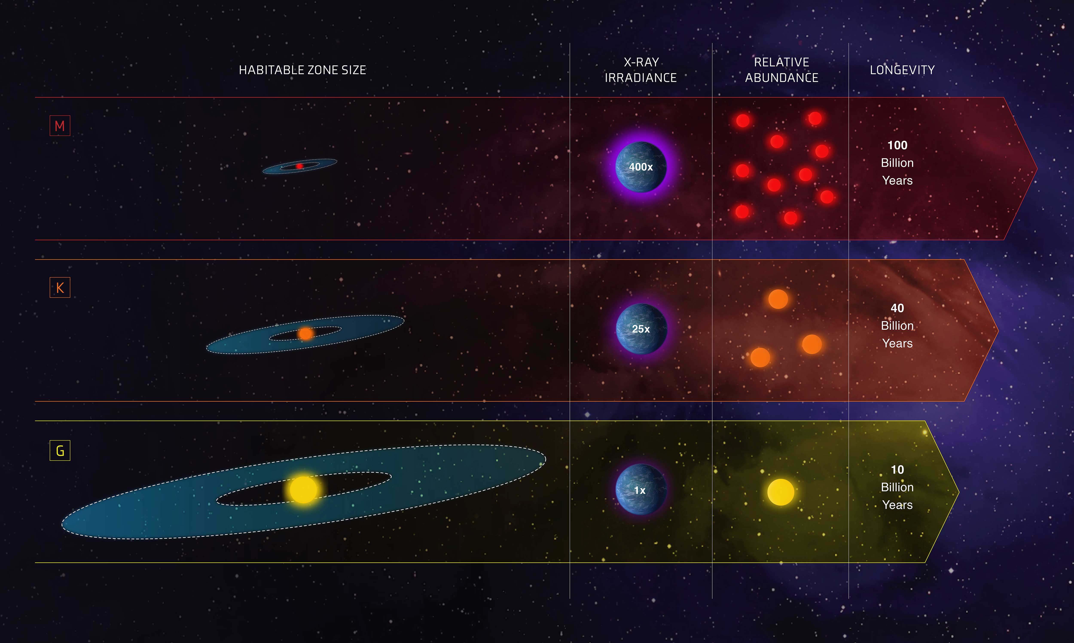
Light from a star
From https://www.nasa.gov/feature/goddard/2020/goldilocks-stars-are-best-places-to-look-for-life. Credits: NASA, ESA and Z. Levy (STScI)
Notes:
It turns out that not all stars are created equal. In our galaxy, stars less massive than the sun, like M stars at the top of this illustration, are more abundant than sun-like G stars, at the bottom of the figure. Being less luminous, their habitable zone is located closer to the star. However, the M stars are also characterized by very high levels of emission of X-ray and ultraviolet (UV) radiation, which can be up to hundreds times more intense than what Earth receives from the Sun. These energy flares and bombardment of high-energy particles would affect the planets in the closely located habitable zone, making it difficult to preserve an atmosphere and creating devastating effects for life. Moreover, at such close orbital range, a phenomenon which we will discuss later, called tidal locking, is also likely to take place, and this would also decrease overall habitability. Therefore, even if there may be many planets in the habitable zone of their star, the kind of star and the type of radiation emitted are important parameters to consider for habitability.

Slide 11
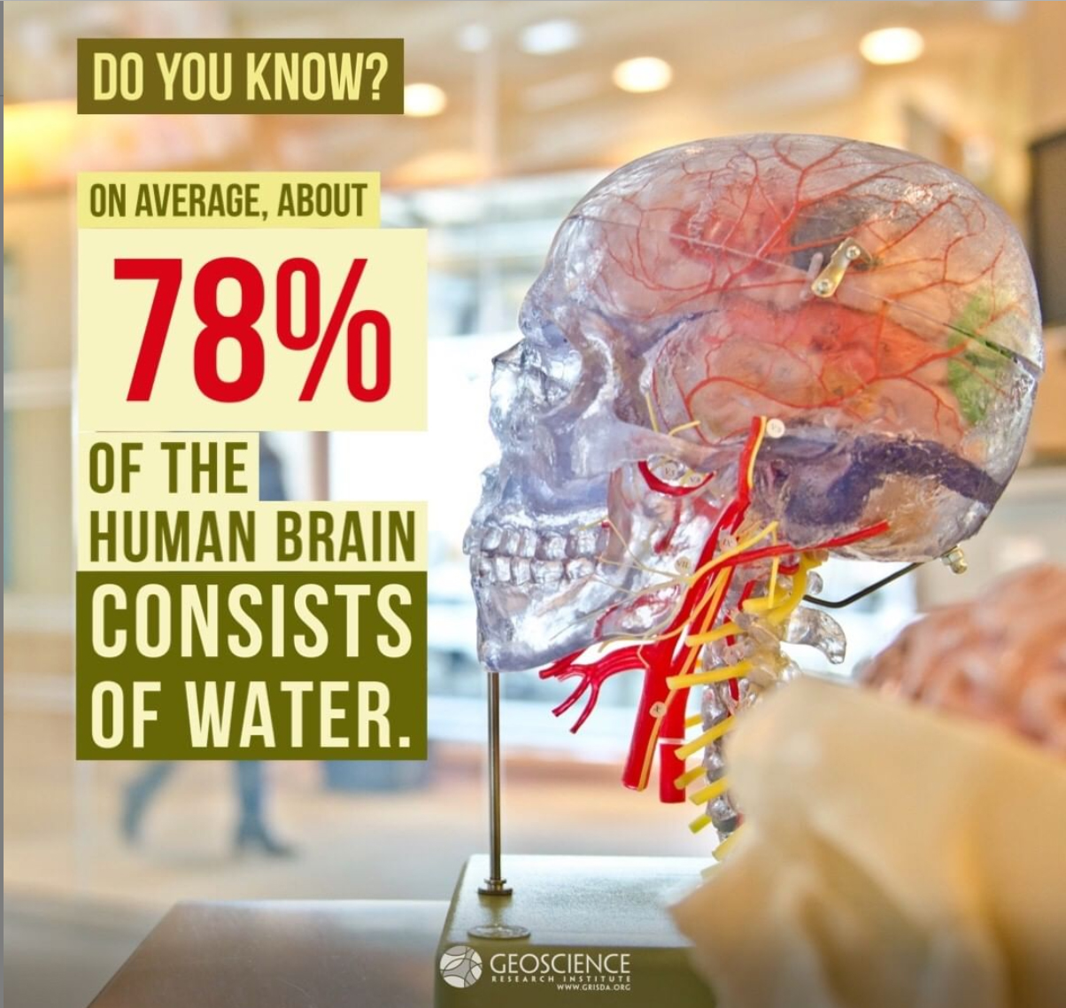
Liquid water
“Liquid water is not a ‘bit player’ in the theatre of life — it’s the headline act.”
M. Chaplin (2006), Nature Reviews Molecular Cell Biology, doi:10.1038/nrm2021
Notes:
But why bothering so much about liquid water and even calling “habitable” the zone where temperatures are appropriate for the existence of liquid water on the surface of a planet? We are all familiar with the fact that water is an important constituent of our bodies. What perhaps most do not realize is how intrinsic liquid water is to the life and metabolism of any living organism on earth. Click As pointed out by Chaplin, in an excellent review article,… Liquid water is essential for the folding, structure, stability and activity of proteins. It plays a part in both proton and electron transfer reactions, in the structure of DNA and the recognition of specific DNA sequences by proteins, and in the metabolic activity in the cell. In other words, liquid water is essential for the biochemistry of life. No liquid water, no life.

Slide 12
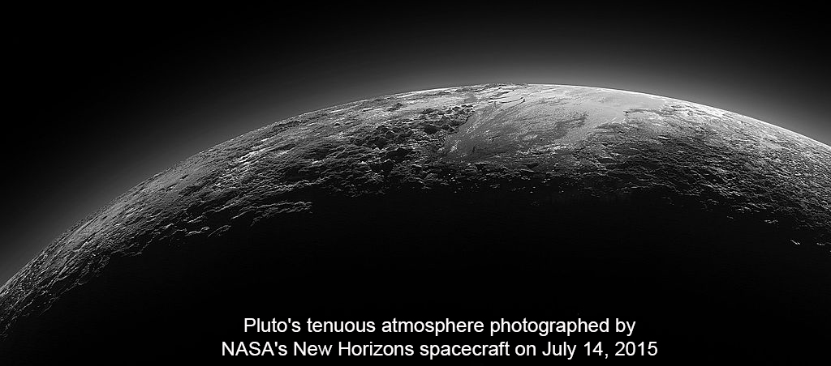
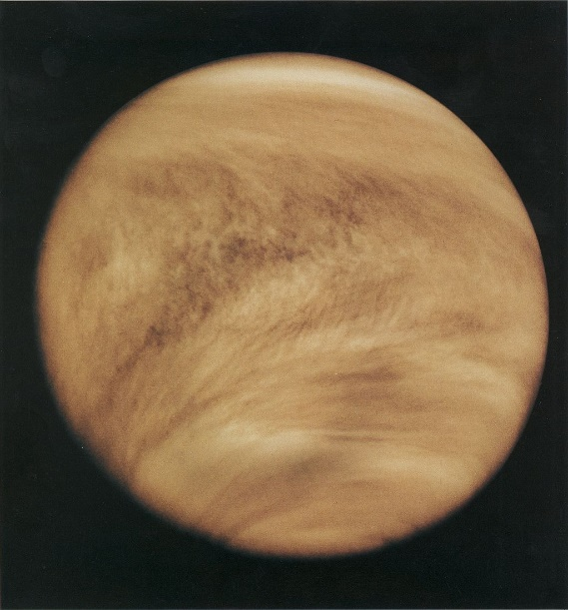
atmosphere
Notes:
Let’s now consider another important parameter for habitability, the atmosphere. The atmosphere of a planet is important for life not only for aerobic respiration, but also for temperature regulation by trapping some of the heat radiated from the planet. It controls climate, it provides a shield against some damaging solar radiation, and it interacts with the hydrosphere and lithosphere for the cycling of elements important for life. When a planet is too small, its mass is too little to gravitationally maintain a stable thick atmosphere. For example, in this image we can see the thin, likely ephemeral atmosphere of Pluto. However, a thick atmosphere can also have negative consequences. Click Take Venus. Its thick atmosphere is rich in C02, a greenhouse gas. Trapping the heat irradiated form the planet, it leads to higher temperatures, increasing the saturated vapor pressure of water, which is also a greenhouse gas. This trigger a Runaway Greenhouse effects, which is thought to have led to surface T on venus of over 450 C and loss of water from the planet. On the Earth, CO2 is dissolved in the oceans and trapped in limestone rocks, preventing this runaway process. This is yet another example of balanced interrelation between different components of a planet. In fact, it is thought that even the interior of the earth is linked to the preservation of its atmosphere. The core is where the earth’s magnetic field is generated, and that field helps deflect some of the particles that could eroded our atmosphere.

Slide 13
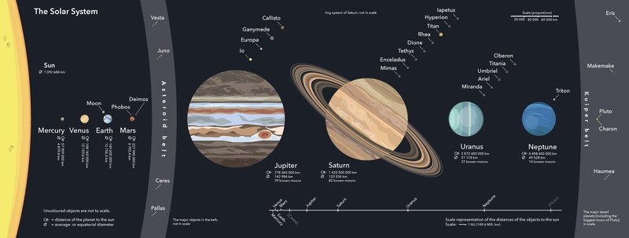
Rocky planet
Image by Beinahegut, available at https://upload.wikimedia.org/wikipedia/commons/6/64/Solar-System.pdf; Creative Commons Attribution-Share Alike 4.0 International
Notes:
As we have seen in the definition of habitable planet, one important requirement is for it to be a terrestrial planet, to have a solid, rocky crust. This is not just because it would be hard for us to walk suspended in the atmosphere of a gas giant like Jupiter…More importantly than having a solid bedrock to walk on is the availability of heavier elements on the planet’ surface, which are important for life. Click Note how in the solar system the terrestrial planets, highlighted by the rectangle, are also located in or near the habitable zone, closer to the sun. The study of exoplanets has shown that this is not a given, since there are other situations where instead of finding terrestrial planets closer to the star, we have gas giants at short distance from the star. One should also note that the sun does not produce the heavy elements found in the earth’s crust. Models of planetary formation suggest terrestrial planets form from accretion of material out of a protoplanetary disk. If this is indeed the way terrestrial planets form, it means that the protoplanetary disk must have the right initial composition to include heavy elements. Therefore, not all stars will be orbited by terrestrial planets of the right composition.

Slide 14
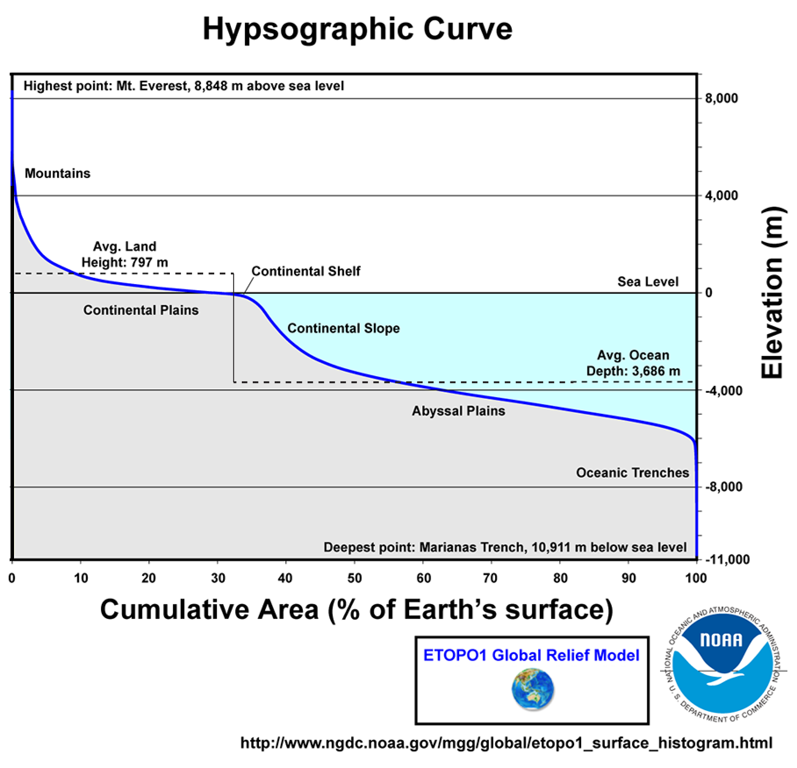
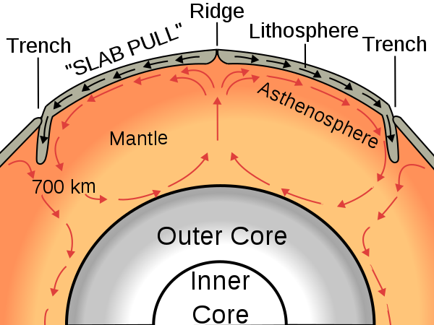
Rocky planet
Image Courtesy of Surachit and USGS, Creative Commons Attribution-Share Alike 3.0 Unported, 2.5 Generic, 2.0 Generic and 1.0 Generic license.
Notes:
Furthermore, some have suggested that being a terrestrial planet may not be enough. It could be that the presence of active plate tectonics could be an additional requirement. Plate tectonics could be important for the maintenance of a magnetic field through interactions at the core mantle boundary. It could be important for cycling, buffering, and availability on the surface of chemicals important for life. Click And finally, through the process of crustal differentiation, plate tectonics could be responsible for the unique bimodal elevation profile of the earth’s crust. As seen in the diagram to the right, the earth’s crust has more buoyant continents, with average land elevation of 800m, and depressed oceanic basins, with average depth of 3.6 km below sea level. This difference allows for the existence of landmasses above sea level.

Slide 15
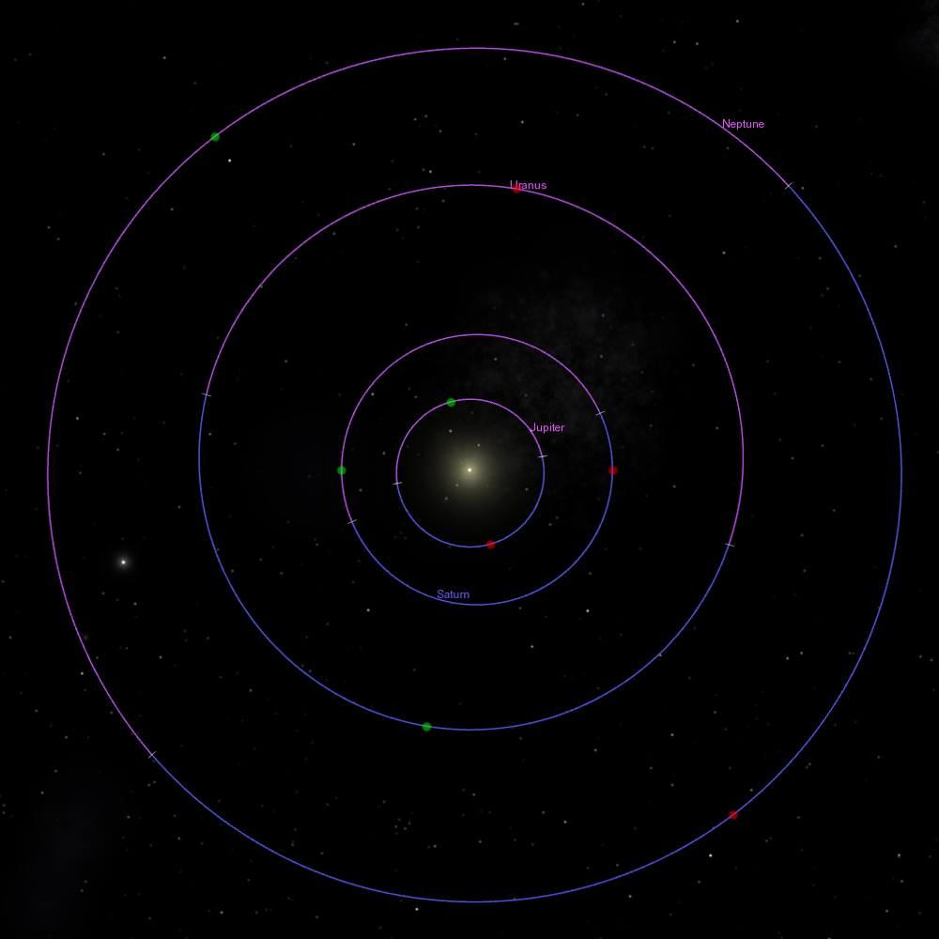
Orbital parameters
“A power-law correlation has previously been found between the multiplicity of a planetary system and the orbital eccentricities of its components. […] the Solar system might not show uncommonly low eccentricities (as often speculated) but rather uncommonly many planets compared to a ‘standard’ planetary system. […] we estimate that the probability of a system having eight planets or more is of the order of 1 per cent.”
Bach-Møller & Jørgensen (2021), Monthly Notices of the Royal Astronomical Society, 500:1313–1322
Notes:
One more element to consider for planetary habitability is the stability of orbital parameters. With this term we mean things like the eccentricity of the orbit, the inclination of the axis of rotation, and the relation between the speed of rotation and revolution, which are connected to familiar rhythms like the year, seasons, and the day.
It turns out that when compared with other exoplanets, the earth and the planets of the solar systems have unusually low orbital eccentricity. Their orbits are nearly circular. This implies more stability and less risk of disruptive gravitational interactions, but also stable rates of solar radiation over the year. More squeezed orbits would mean periodically getting in and out of the habitable zone. Click In a recent paper Bach-Moller and Jorgensen conclude that low eccentricities are typical of systems with multiple planets. So what makes our solar system special is the fact that it has eight planets and so the orbits have low eccentricity. Their estimate is that only 1% of exoplanetary systems have eight or more planets.

Slide 16
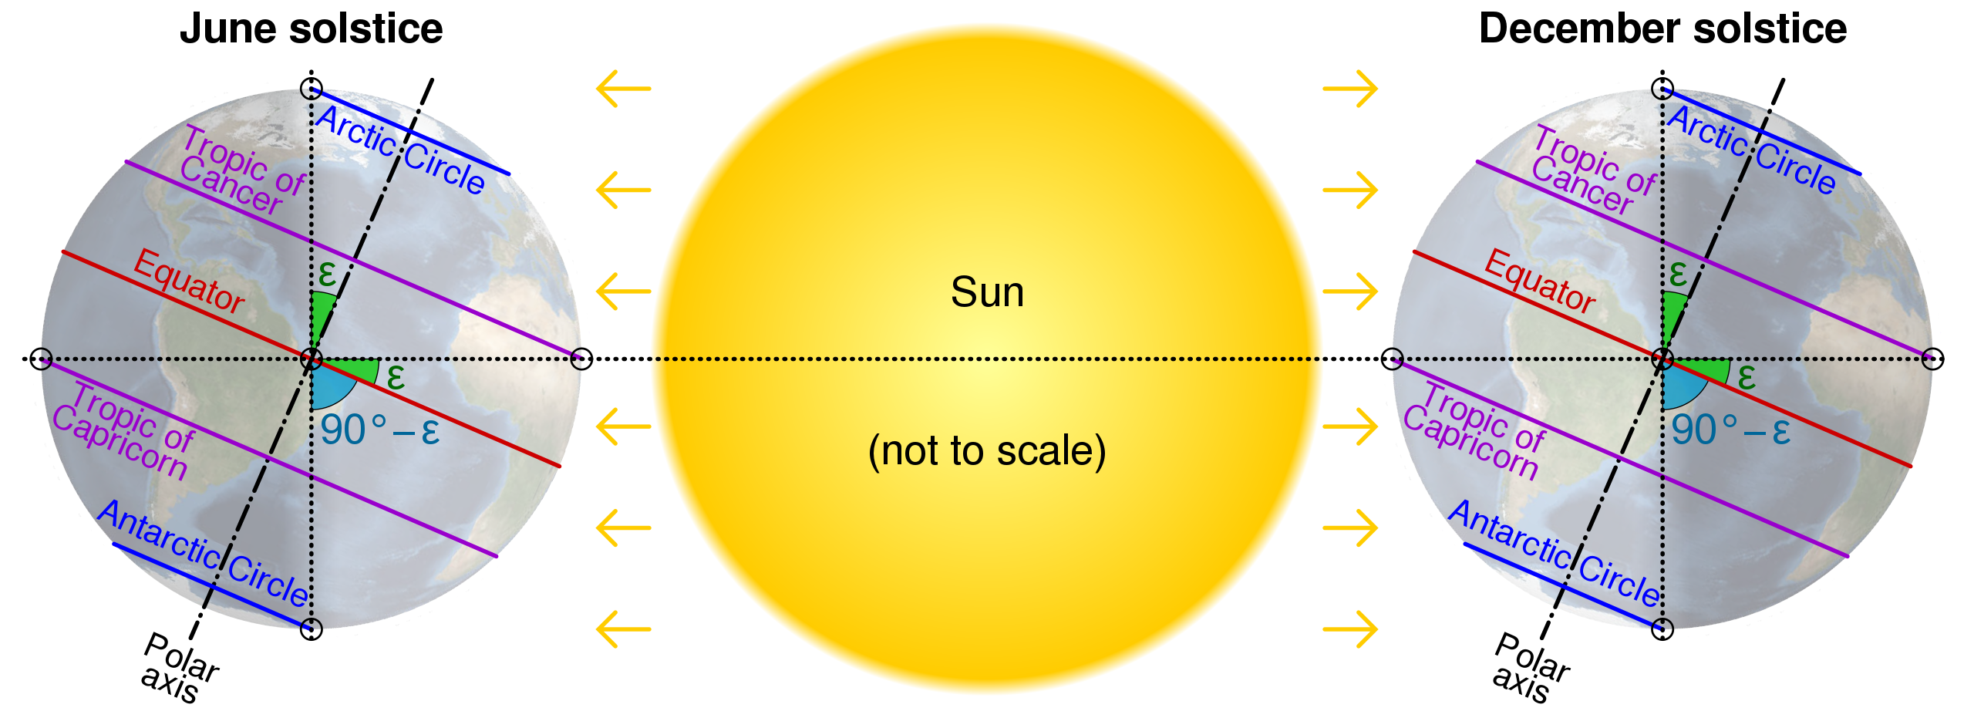
Orbital parameters
Notes:
The axial tilt of the earth is also another important factor that controls the seasonal cycle. It’s inclination at about 23.5 degrees allows a good distribution of insulation over the year cycle even at high latitudes. Lower or higher tilt could result in thermal extremes across latitudes or over the year. Moreover, the large mass of the earth’s satellite, the Moon, stabilizes the axial tilt over time. It is thought that without the moon the earth’s tilt could swing widely with dramatic consequences for its ability to retain an atmosphere.

Slide 17
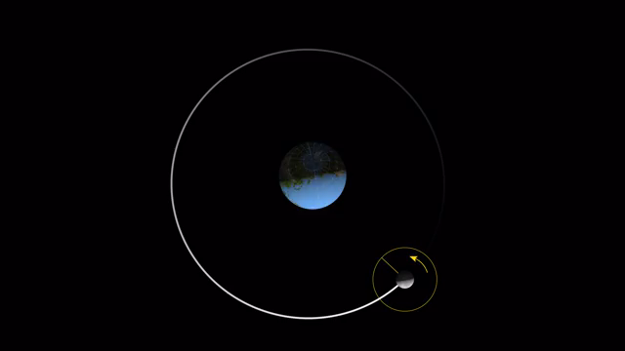
Orbital parameters
“Tidal locking is possible for most planets in the habitable zones of GKM dwarf stars. […] The process of tidal locking is a major factor in the evolution of most of the potentially habitable exoplanets to be discovered in the near future.”
Barnes (2017), Celest Mech Dyn Astr 129:509–536
Notes:
The animation can start from the beginning Another orbital parameter we take for granted is the fact that on the earth we experience the day and night cycle. This is because the period for a full rotation of the earth (the day) is much shorter than the period for a full revolution (the year). However, it is possible for orbiting objects to slow down their rotation and attain a condition known as tidal locking, where the rotation and revolution periods are synchronous. This is better illustrated by considering the Earth’s and the moon rotational system. Have you ever paid attention to the fact that we always see the same face of the Moon? It is not because the moon does not rotate, but it is because the moon rotates around its axis in about 29.5 days, the same time it takes for the moon to revolve around the earth. Therefore the moon is in synchronous tidal locking with the earth. Now, imagine a planet in tidal locking with its star. One hemisphere would always be exposed to the light of the star reaching very high temperatures and the other would be always in darkness at freezing temperatures, with clear negative implications for habitability. How important is this tidal locking phenomenon? Click Is it unlikely that exoplanets would be attaining this condition or does it seem likely? In a paper on tidal locking of habitable exoplantes, Barnes concludes:

Slide 18
Genesis 1 and planetary habitability
The connection between structure and life: organizing the space, filling the space ---- “Tohu” (without form) and “bohu” (void)
Light (energy source)
Liquid water
Atmosphere and its connection with hydrosphere (waters above and below)
Rocky planet (crustal differentiation, plate tectonics?)
Orbital parameters
Notes:
Starting from this overview on planetary habitability let’s now shift to the biblical perspective and what we encounter in the creation account, in Genesis 1. The earth is presented with an initial state of being without organization and without life, tohu wabohu. What follows is God’s action through the 6 days, which proceeds by organizing the spaces and filling them with life. What we have therefore, is an extremely modern understanding of the connection between planetary organization and conditions as essential for life. In the six days creation, the “forming” is presented as an essential prerequisite and as integral to the “filling”.
Click It is also very modern in its account of the essential parameters organized by God. We begin with light, the energy source, liquid water on the surface and the separation of the waters above, implying a connection between the atmosphere and the hydrosphere, the appearance of dry land, which signify the rock nature of this planet but also potentially a process of crustal differentiation, and finally, on day 4, the establishment of stable cycles (years, seasons, days) related to orbital parameters.

Slide 19
Area of tension
The issue of process
Time
Naturalistic
 | Passive gap?
 | Trust God’s Word
Notes:
Although the Biblical perspective and scientific insight integrate well when it comes to planetary habitability, we need also to acknowledge an important area of tension, the question of process. Click First of all, scientific models of planetary formation and earth’s planetary evolution are based on a long chronology of millions to even billions of years. Secondly, these mechanistic models rely on a naturalistic approach that denies any divine intervention. Let me just interject at this point that even if we had a perfectly naturalistic model for creating a habitable planet, that does not ensure that there will be life on it. There is no naturalistic model that can presently account for the emergence of life from inanimate matter. Planetary habitability is necessary but not sufficient for life.
Click This clarification aside, how do I deal with this tension? When it comes to the question of time, the passive gap theory, suggesting that the universe and the planet without life in are much older than creation week, could alleviate some tension. But the recent creation week still includes significant planetary organization that would generally be accommodated, in standard models, over long time. In facing the naturalistic alternative, the Word of God remains my anchor. I confess my ignorance about the actual process God used for planetary organization, if through accelerated process, by fiat, or on a pre-existing Earth, but I trust He did it, and in a recent creation week. What do we do then with the amazingly insightful and sophisticated mechanistic models of planetary accretion and evolution? Do we throw them out of the window? Not at all. My attitude is to keep learning and exploring, there is much value in knowing and hypothesizing; the synthesis, when it is not there, will come, one day. Moreover, the practice of science teaches you a certain humbleness and gives a better acquaintance with nature and its facts that would not otherwise be gained.

Slide 20
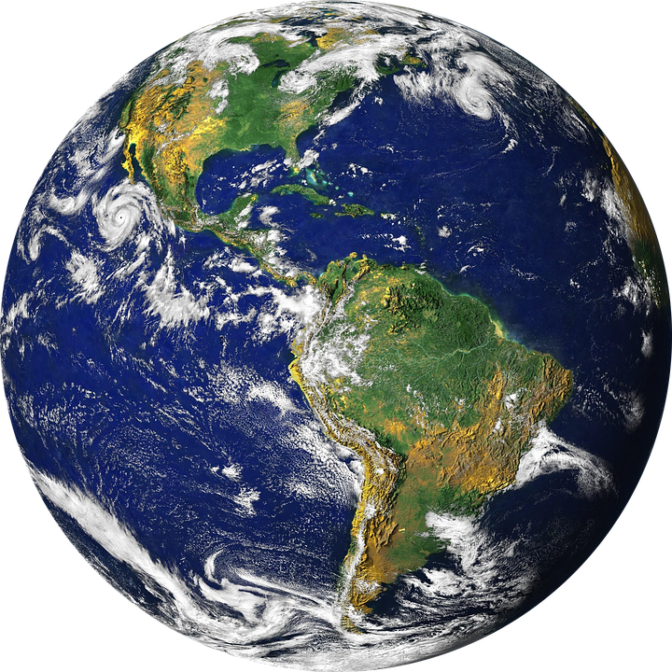
Is the earth special?
“We provide several estimates of the […] frequency of potentially habitable, rocky planets orbiting Sun-like stars. For planets with sizes 0:75-1:5 R○ orbiting in a conservatively defined habitable zone (0:99-1:70 AU) around G-type stars, we place an upper limit (84.1th percentile) of < 0:18 planets per star.”
Kunimoto & Matthews (2020), The Astronomical Journal, 159(6):248
Notes:
We are back, then, to our original opening question. Is the earth special? Perhaps it is too early to tell. Click Recently, Kunimoto and Matthews have published probabilistic estimates suggesting that the probability for a G star like the sun to have a rocky planet of a size similar to the earth’s and orbiting within the habitable zone is less than 18%, which would translate into about less than 6 billions in the Milky Way Galaxy. However, as we have seen, there is much more to habitability than just radius, distance from star and type of star… click In any case, many there be many or just one, what counts is that we live in a universe where the Earth, our earth, is habitable and there is life on it. That is the most amazing fact confirmed by science. You and I are that miracle. Scientific insight helps us appreciate the complexity of life and how, among a myriad of possible combinations of different parameters, the earth is a marvelously suitable space for us to live our lives.

Slide 21
Is the earth special?
For this is what the Lord says—
He who created the heavens, He is God;
He who fashioned and made the earth, He founded it;
He did not create it to be empty,
but formed it to be inhabited—
He says: “I am the Lord, and there is no other.”
Isaiah 45:18
Notes:
The Bible cuts through the noise and reveals in straightforward terms why this is so: because God wanted it and did it. The Lord created the heavens; he fashioned and made the earth, he founded it; he did not create it to be empty, but formed it to be inhabited In considering the miracle of our existence, today, on planet earth, you and I face a choice. God has made a claim of ownership. We can reject it or embrace it. My invitation? Embrace it! Because it’s the truth, and it will set you free.

