Slide 1

The garden of education
Are there forbidden fruits in faith and science?
Ronny Nalin, PhD

Slide 2

A wonderful world
or a dangerous world?
Notes:
These are my two precious daughters, Gioia and Chiara. Nothing in the world matters as much to me as them. I care about their well being deeply, I care about their future. You are parents or have responsibility for someone else’s children/students. So let me ask you a question. When you think of them, and look at them, what kind of world do you see for them, wonderful or dangerous?

Slide 3
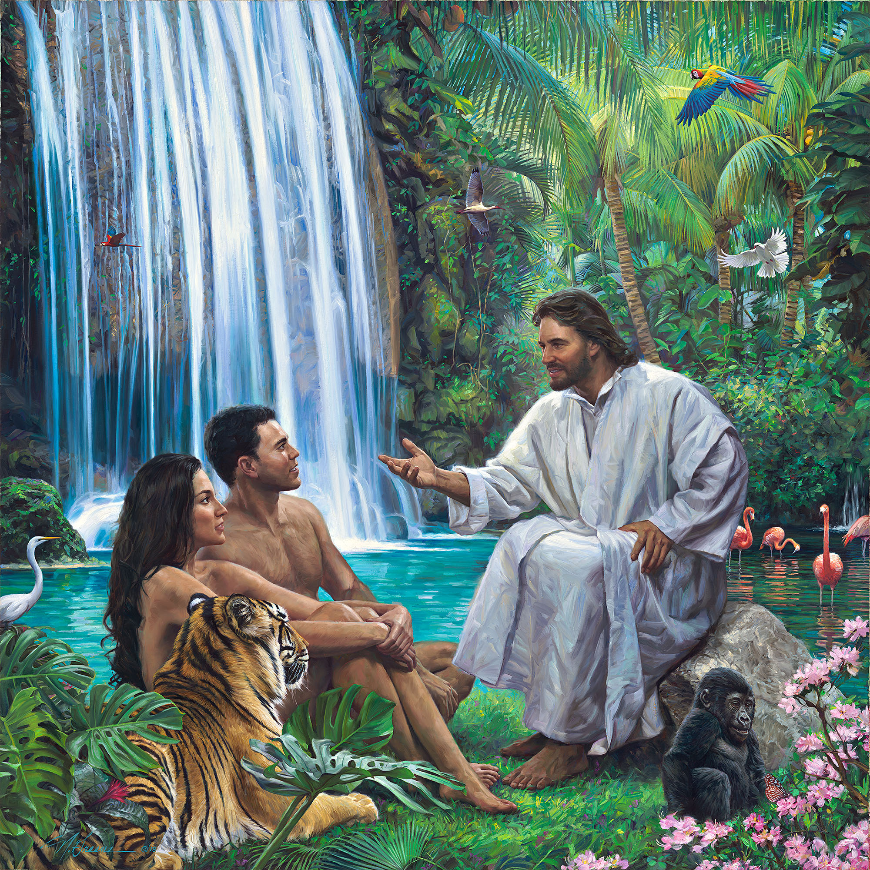
A wonderful world
or a dangerous world?
© by Nathan Greene, All Rights Reserved,
used with permission
Notes:
When God placed Adam and Eve in Eden, how do you think He thought of them, and looked at them, what kind of world did He see for them, wonderful or dangerous?

Slide 4
“Vast was the scope offered for their exercise, glorious the field opened to their research. The mysteries of the visible universe—the "wondrous works of Him which is perfect in knowledge" (Job 37:16)—invited man's study. Face-to-face, heart-to-heart communion with his Maker was his high privilege.”
EG White, Education, p.15
© by Nathan Greene, All Rights Reserved,
used with permission

Slide 5
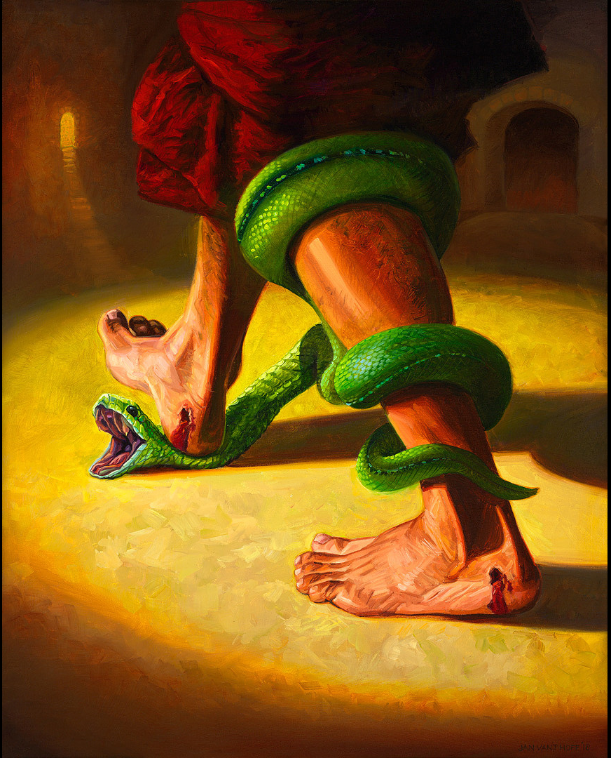
The difference
“Not only intellectual but spiritual power, a perception of right, a desire for goodness, exists in every heart. But against these principles there is struggling an antagonistic power. The result of the eating of the tree of knowledge of good and evil is manifest in every man's experience. There is in his nature a bent to evil, a force which, unaided, he cannot resist.”
EG White, Education, p.30
© Jan van 't Hoff, Gospelimages.com
(CC BY-NC-ND 4.0)
Notes:
What is, then, the key difference between today’s world and the garden of Eden world?

Slide 6

Default Change
CHOICE
CHOICE
Adam and Eve
Independence from God
CHOICE
Our students
Salvation in Christ
Notes:
When it comes to the most important choice humans can make, we can say that in the present we are truly in an opposite default condition than Adam and Eve.
What they wanted to move away from, what they wanted to change (through their choice) is the total opposite of what we want to change.
Adam’s and Eve’s choice was to change from a default condition of communion with God. They ate the fruit of independence from God.
Today, our greatest desire is to help our children and our students to make the opposite choice: change from a default condition of alienation from God to eating the fruit of salvation offered in Christ, in being one with Him.

Slide 7
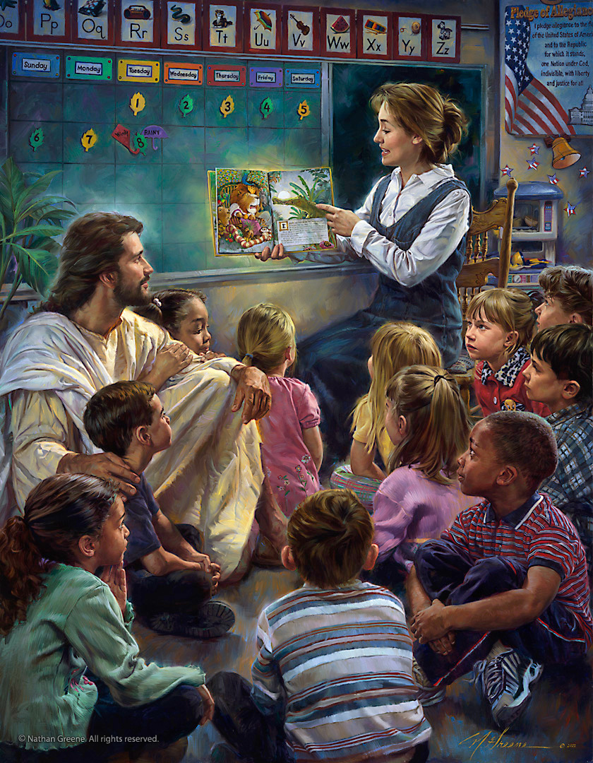
SDA EDUCATIONal system
VISION:
A “Garden of Education” where this CHOICE takes place
© by Nathan Greene, All Rights Reserved,
used with permission
Notes:
Based on this understanding, we can find a clear foundation to build the vision for our Educational System: Our Education is the place, the space, the Garden where this reverse choice, of choosing to eat the fruit of salvation in Christ, takes place. Ours schools, our materials, our events, our digital resources, our activities, will be the place where our students can be exposed to the character of God, experiment His goodness, gain a deeper knowledge of God, truth, creation, and history… and make, within this environment, the CHOICE of giving their life to Christ.

Slide 8
SDA EDUCATIONal system
Garden of Education
“The Garden of Eden was a representation of what God desired the whole earth to become, and it was His purpose that, as the human family increased in numbers, they should establish other homes and schools like the one He had given. Thus in course of time the whole earth might be occupied with homes and schools where the words and the works of God should be studied, and where the students should thus be fitted more and more fully to reflect, throughout endless ages, the light of the knowledge of His glory.”
EG White, Education p.22
Notes:
This purpose for education, with a direct connection to the school God established in Eden, is not a novel idea. It builds on God’s original plan and intention for humans before the fall, when they would be fruitful and multiply… It is incredible to think that we can still be part of this plan, with even greater responsibility in the changed circumstances of a sinful world.

Slide 9

Garden of education
Pharisaic Garden
Control of others
No true godliness
“Woe to you, teachers of the law and Pharisees, you hypocrites! You shut the door of the kingdom of heaven in people’s faces. You yourselves do not enter, nor will you let those enter who are trying to.” Mt 23:13
“Woe to you, teachers of the law and Pharisees, you hypocrites! You are like whitewashed tombs, which look beautiful on the outside but on the inside are full of the bones of the dead and everything unclean. In the same way, on the outside you appear to people as righteous but on the inside you are full of hypocrisy and wickedness.” Mt 23:27-28
Notes:
But more specifically speaking, what does this garden look like? What are some of the essential components that our educational system and institutions should have to be such place?
Perhaps, it is easier to start from what the garden should not look like: a Pharisaic Garden. We have to resist the temptation to create a terrible, defective garden. The garden of education cannot be a hyper-perscriptive space, full of prohibitions, bent on CONTROL. Where, sadly, teachers appear from the outside to be very zealous and devout, but lack true connection with God and hide filth and corruption inside. Where human requirements are placed on others that are not really divine requirements. Jesus has very strong words of condemnation for this type of teacher: READ texts. How many times have you and I been this kind of teacher? A Pharisaic rabbi or scribe?

Slide 10
Garden of education
Pharisaic Garden
Control of others
No true godliness
“Life had become false and artificial. The Jews, destitute of the power of God's word, gave to the world mind-benumbing, soul-deadening traditions and speculations. The worship of God "in Spirit and in truth" had been supplanted by the glorification of men in an endless round of man-made ceremonies. Throughout the world all systems of religion were losing their hold on mind and soul. Disgusted with fable and falsehood, seeking to drown thought, men turned to infidelity and materialism. Leaving eternity out of their reckoning, they lived for the present.”
EG White, Education pp. 75-76
Notes:
Look at this passage: the issues: false and artificial instead of true; human-centered and devised, not spirit-filled; fable and falsehood… no truth in content and no truth in behavior; results: infidelity and materialism…living for the present (seek instant gratification).

Slide 11
Garden of education
“Did God really say, ‘You must not eat from any tree in the garden’?” Gen 3:1
“You are free to eat from any tree in the garden; but you must not eat from the tree of the knowledge of good and evil, for when you eat from it you will certainly die.” Gen. 2:16-17
Notes:
The “control-centered” version of the garden will give credibility to Satan’s original accusation: God does not want you to try anything, touch anything, eat anything… He wants to control you. But that was not true right? That was not how the Garden was.
But then, you may ask, how do we protect our students from evils and negative influences? Great question. Let’s look at what God did: TEXT. Clear explanation and definition of what is good and what is evil and clear explanation of the consequences. But it did not take over control. It did not constrain or coerce. The tree was there in the middle. If God values free choice so much, this tells us of another thing that our garden of education cannot be:

Slide 12

Garden of education
Pavlovian conditioning camp
Notes:
It cannot be a “Pavlovian conditioning camp” where we establish behavior and belief through repeated reward and punishment. In his dystopian novel “Brand New World” Huxley imagines a world were humans are conditioned since their infancy with repetition of messages while they are sleeping and awake, in essence brainwashing the human population into compliance with certain behaviors and taking away agency and individuality.

Slide 13
Every human being, created in the image of God, is endowed with a power akin to that of the Creator— individuality, power to think and to do. The men in whom this power is developed are the men who bear responsibilities, who are leaders in enterprise, and who influence character. It is the work of true education to develop this power, to train the youth to be thinkers, and not mere reflectors of other men's thought.
EG White, Education p. 17
Notes:
This individuality, this agency, is so important that to affirm it in our students is called by sister White the work of true education...TEXT
Here is the complicated part. We want to expose our students to and surround them with the principles that are true and good. I have taught my daughters (and I have been taught) since infancy songs, Bible verses, basic lessons from Bible stories. How would you respond to someone that accuses you of conditioning/brainwashing your students? The key response is that we do not use these activities as human tools for domination, the goal of our garden of education is not to control but to bring the individual to a living encounter. Everything we teach and do has to be a vessel for connecting God and the student, not for us to manipulate the will and choices of a student.

Slide 14
Garden of education
“Whatever line of investigation we pursue, with a sincere purpose to arrive at truth, we are brought in touch with the unseen, mighty Intelligence that is working in and through all. The mind of man is brought into communion with the mind of God, the finite with the Infinite. The effect of such communion on body and mind and soul is beyond estimate.
In this communion is found the highest education. It is God's own method of development. "Acquaint now thyself with Him" (Job 22:21)”
EG White, Education p.14
Notes:
This is how Ms White puts it…
where is the highest education found? In the communion with God. The Garden is the space we create for that communion between God and the student to occur, a communion of which we are spectators, not arbiters.

Slide 15
Summary
Default Change
Garden of Education:
Garden of Education: where this CHOICE takes place
Garden of Education: not a way to control
Garden of Education: active communion with God
Notes:
We can now summarize the basic principles affirmed so far:
- We believe we live in a time when our students have the reverse choice to make than the one Adam and Eve did. Changing their condition from alienation to active communion with God. And we have described the mission of our educational system as the creating a place where this choice occurs. This garden is not full of human prescriptions and does not seek to control and dominate the mind and will, but strives to provide vessels and environments where an encounter with God and His power takes place.

Slide 16
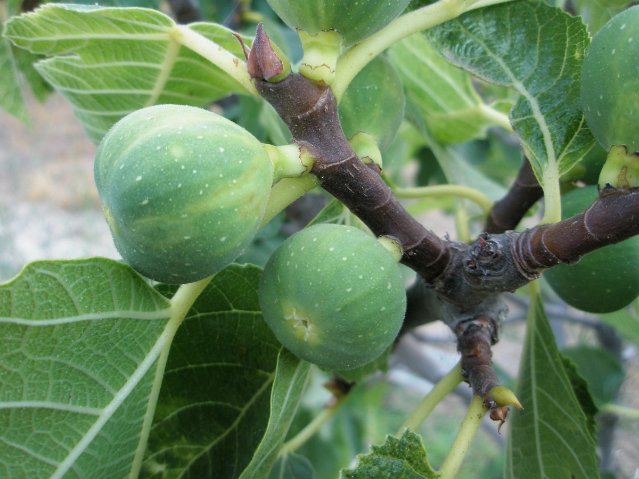
Garden of education: Faith and Science Section
What is the forbidden fruit?
What are we most afraid of for our science students?
Notes:
Having established these principles, let’s now move to the faith and science section of the garden, because you know very well that there is such section (with plenty of fruit trees) in our garden of education. Among these many trees, there is perhaps a fruit that is dangerous and that is why we are afraid of having a science section in our garden of education. What is…

Slide 17

Forbidden fruit
Science engendering a view of us and the world that is INDEPENDENT of God.
a) Orphan world
(no God or distant God)
Notes:
Perhaps the greatest worry is that by engaging in the science section of the garden, our students will develop a worldview that is INDEPENDENT of God, basically the complete opposite of what we are trying to accomplish through the garden of education. This independence from God can be manifested in two ways. The first is a view of the world as “orphan,” there is no God or He is a distant God that does not interact with the world. You probably know this famous picture taken from spacecraft Voyager 1: The Pale Blue Dot, is the Earth, photographed from a distance of 6 billion kilometers. A science that refuses God conveys a sense of marginality, a certain kind of randomness to our existence rather than divine intentionality.

Slide 18

Dennis Overbye, science writer for the NYT
“The universe doesn’t care. I mean, the stars in the sky, they don’t know about us. We’ll never know whether anybody’s living there or not. Probably not. And eventually, in a billion years, there will be no life on Earth because the sun will warm up and boil away the oceans. The human race will be forgotten. So in the far, far fullness of time, nothing will remain.”
Cosmic Questions, The Daily podcast, August 19, 2022, https://www.nytimes.com/2022/08/19/podcasts/the-daily/cosmos-space-black-holes.html?
Notes:
This “orphan” world view is real, it can be encountered quite often in science and its popularization. To give you an example, just a few weeks ago I was listening to this podcast…

Slide 19
Forbidden fruit
Science engendering a view of us and the world that is INDEPENDENT of God.
Orphan world (no God or distant God)
No need for God
“You will not certainly die,” the serpent said to the woman.
“For God knows that when you eat from it your eyes will be opened, and you will be like God, knowing good and evil.” Gen. 3:4-5
Notes:
Science can also provide another path of independence from God when it takes Him out of the picture. We learn how things work, their mechanics, we see they are quite predictable, divine agency does not seem directly involved, so we have no need for God, the system is closed. Also, we learn of our freedom to tinker, create, rearrange, and no one is there to stop us, to tell us what is good and what is evil, we have the exhilaration of making that decision. In the words of the serpent we catch the essence of this temptation:

Slide 20
Science engendering a view of us and the world that is INDEPENDENT of God.
"In the beginning God." Genesis 1:1. Here alone can the mind in its eager questioning, fleeing as the dove to the ark, find rest. Above, beneath, beyond, abides Infinite Love, working out all things to accomplish "the good pleasure of His goodness." 2 Thessalonians 1:11.
EG White, Education p.135
Notes:
Contrast this path towards independence with the opposite trajectory for education:… an eager mind can only find peace and rest in the knowledge of God’s creatorship and love over the world.

Slide 21
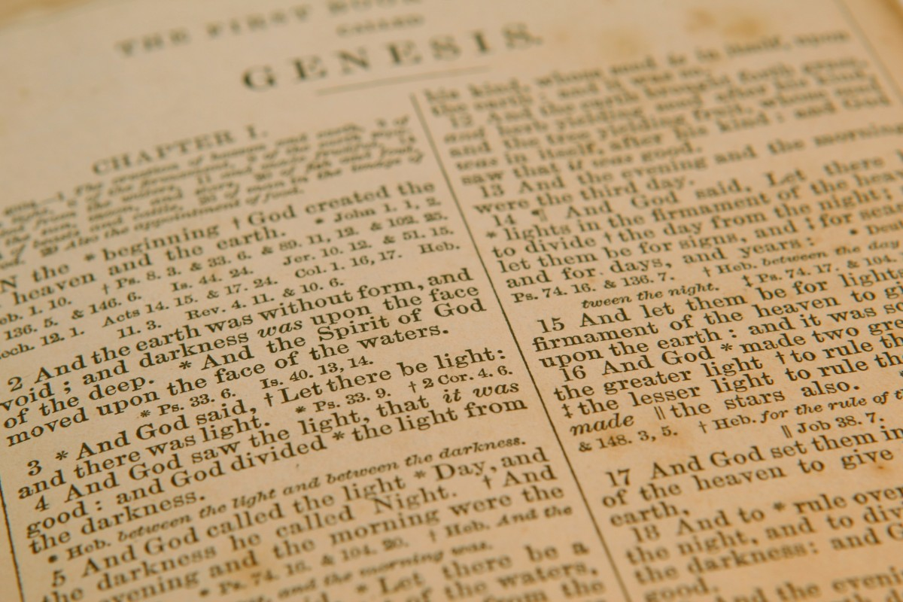
Forbidden fruit
Science engendering a view of us and the world that is INDEPENDENT of God.
Science causing an erosion of trust in the Bible, the word of God
Notes:
The second forbidden fruit that we fear the most in the science section of the garden of education is that science will cause a loss of trust in the Word of God: we fear that what we discover in science will challenge what God says in the Bible, so especially when it comes to origins, the Bible is not really true and reliable.

Slide 22
Science causing an erosion of trust in the Bible, the word of God
“In the study of science, as generally pursued, there are dangers equally great. Evolution and its kindred errors are taught in schools of every grade, from the kindergarten to the college. Thus the study of science, which should impart a knowledge of God, is so mingled with the speculations and theories of men that it tends to infidelity.
Even Bible study, as too often conducted in the schools, is robbing the world of the priceless treasure of the word of God. The work of "higher criticism," in dissecting, conjecturing, reconstructing, is destroying faith in the Bible as a divine revelation; it is robbing God's word of power to control, uplift, and inspire human lives.” EG White, Education p.227
Notes:
This danger was well understood by sister White, who traces a direct connection between naturalistic models of origins combined with higher criticism of God’s word and a consequent loss of faith (in the Bible as the word of God and in God Himself).

Slide 23
Summary
Default Change
Garden of Education:
Garden of Education: where this CHOICE takes place
Garden of Education: not a way to control
Garden of Education: active communion with God
              __________________________
Forbidden fruit: isolation from God
Forbidden fruit: loss of trust in God’s word
Notes:
We are now at a point where it would be good to bring up this summary again: we have seen that our vision for the Garden of Education is a place where our students make a choice for active communion with God. But we have also seen that in the science section there are some very dangerous fruits with tragic consequences.
The key question for us as educators then becomes: how do we protect our students from taking this fruit while studying science?
The first instinct could be… simply eliminate this section of the garden! Don’t cover science if it presents some dangers. Don’t develop departments and curricula in these areas. Or skip the tricky units. But that is not what God Himself did... In fact he placed the tree in the middle of the garden. God Himself did not take away the possibility for us not to choose and not to trust Him. This possibility will be in the garden of education… we are keenly aware of it, we cannot pretend it is not there. Our students will face this choice. So, rather than pretending that they will not, what things can we do so that they will recognize the fruit for what it is, when studying science? I suggest there are 3 things that we can do.

Slide 24
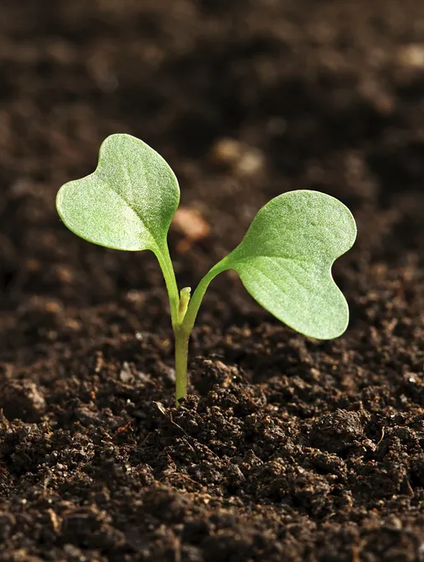
Dealing with the forbidden fruit
1) Create hands-on opportunities for true encounter with God
Notes:
First, we need to create hands-on opportunities for a true encounter with God

Slide 25
“So far as possible, let the child from his earliest years be placed where this wonderful lesson book shall be open before him. Let him behold the glorious scenes painted by the great Master Artist upon the shifting canvas of the heavens, let him become acquainted with the wonders of earth and sea, let him watch the unfolding mysteries of the changing seasons, and, in all His works, learn of the Creator.
In no other way can the foundation of a true education be so firmly and surely laid.”
EG White, Education pp. 101-102
Notes:
Let me stress how important it is for this approach to be hands on: God followed the same principle in the Garden of Eden, directing humans to name the animals, eat the fruit of all trees, tend and keep the garden, subdue the earth, have dominion over the animals… It is very practical more than theorical, otherwise a true encounter with God and His character may not take place:

Slide 26
“Instead of confining their study to that which men have said or written, let students be directed to the sources of truth, to the vast fields opened for research in nature and revelation. Let them contemplate the great facts of duty and destiny, and the mind will expand and strengthen.”
EG White, Education pp. 17-18
Notes:
The garden of education is the space where our children and students will encounter the knowledge of God and His character and will learn to trust Him and His word, even in science.

Slide 27
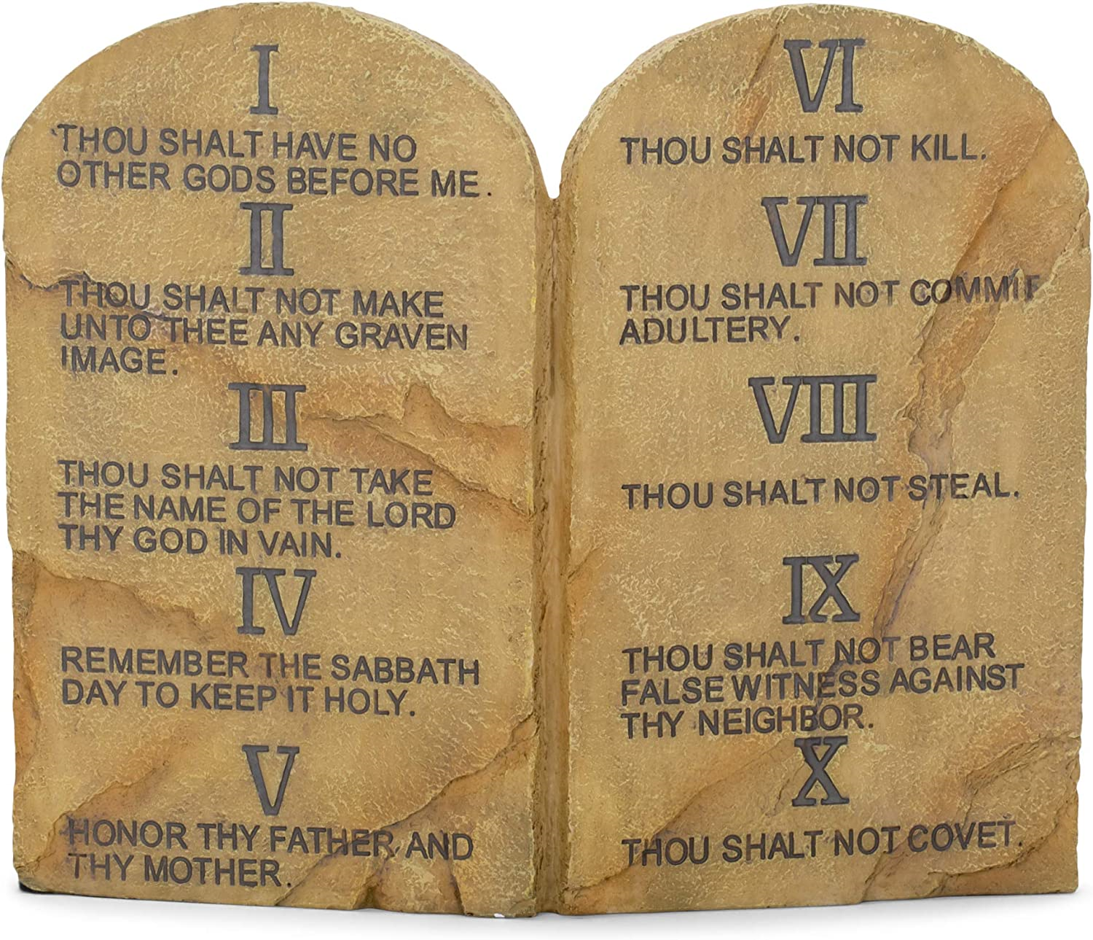
Dealing with the forbidden fruit
Create hands-on opportunities for true encounter with God
Call good good and evil evil
Notes:
Second, we need to make our students aware of what the fruit is and the consequences of eating it. This is the complimentary side of point one: on one side our education creates opportunities to encounter God, but it also creates opportunities to explain what it means to isolate from God and its consequences. It explains naturalistic thinking and exposes the consequences of embracing a view of science without God. God followed also this second principle in the Garden of Eden, when he explained the consequences of eating the fruit.

Slide 28

Dealing with the forbidden fruit
Create hands-on opportunities for true encounter with God
Call good good and evil evil
Be a living example
Notes:
Third, we can demonstrate to our students a living example of how the garden of education worked for us

Slide 29
Not as a dry theory were these things to be taught. Those who would impart truth must themselves practice its principles.
EG White, Education p. 41
Notes:
The encounter with God is modeled more by example than by words.

Slide 30
Being a living example
Loves God and has chosen Him
Trusts the Bible, God’s Word
Engages in the study of nature
Notes:
What does it mean to be a living example in the science section of the garden of education? If you are a teacher or superintendent in the area of science, for me it means these 3 things: being a teacher who…
All 3 components are required to be a true living example, especially 3rd one. At the appropriate educational level, what does that look like? Take Biology for example: At the elementary level, we want teachers who love basic biology (cannot be teaching biology without marveling at the cell and its complexity or animals and plants); High school: we want teachers who have some practical experience: field or lab work, undergraduate classes, or certification. Tertiary: is involved in some form of biology research.

Slide 31
Summary
Garden of Education: Default Change
Garden of Education: where this CHOICE takes place
Garden of Education: not a way to control
Garden of Education: active communion with God
Forbidden fruit: isolation from God
Forbidden fruit: loss of trust in God’s word
--------------------------------------------
Dealing with the fruit: hands-on opportunities for encounter with God
Dealing with the fruit: call good and evil by their name
Dealing with the fruit: be a living example (loves God, trusts the Bible, studies nature)

Slide 32
questions
-If I look at the teaching curriculum in my class/school/district, are origins/biology/physics/geology/chemistry classes explicitly structured as a place for a divine encounter?
- If I look at the teaching curriculum in my class/school/district, how am I explaining the difference between a good fruit and bad fruit when it comes to science?
- If I look at the teaching curriculum in my class/school/district, how are the students experiencing the trees of the garden? What kind of hands on direct activity are they engaged in?
- Are you providing or are you provided with opportunities for science training/certification?

