Slide 1
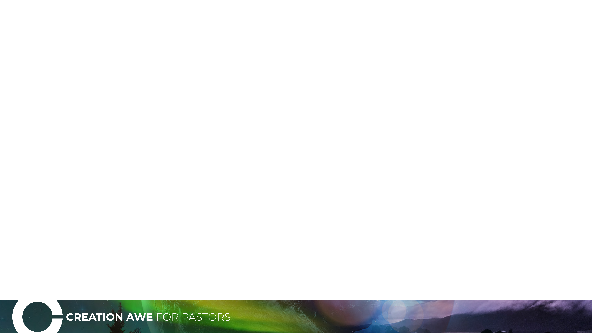

“This is my Father’s World”
A Geological Meditation
Ronny Nalin, PhD

Slide 2
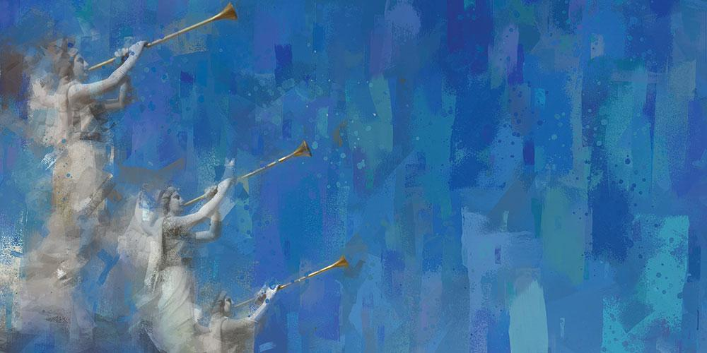
“…Worship him who made the heavens, the earth, the sea and the springs of water.”
Image credit: https://www.adventistreview.org/2010-18

Slide 3

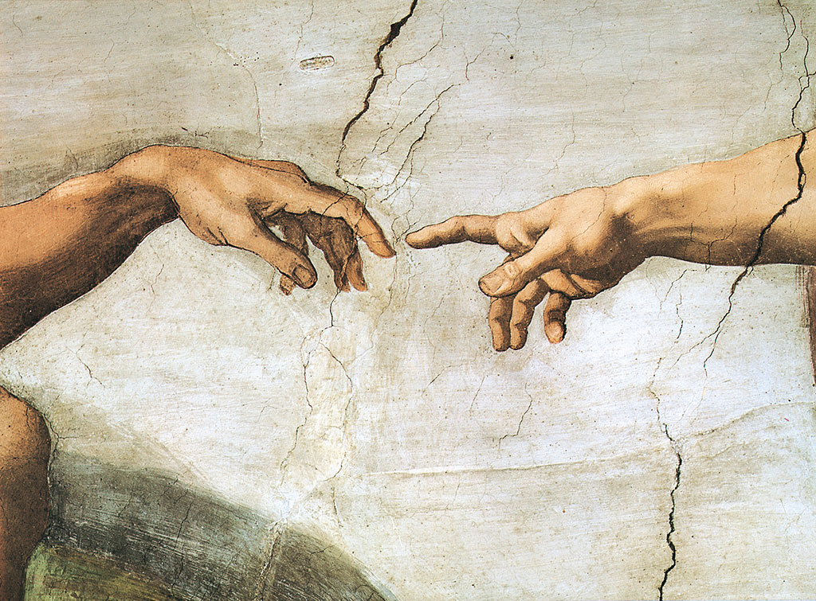
“He who comes to God must believe that He is, and that He is a rewarder of those who diligently seek Him.”
Hebrews 11:6

Slide 4

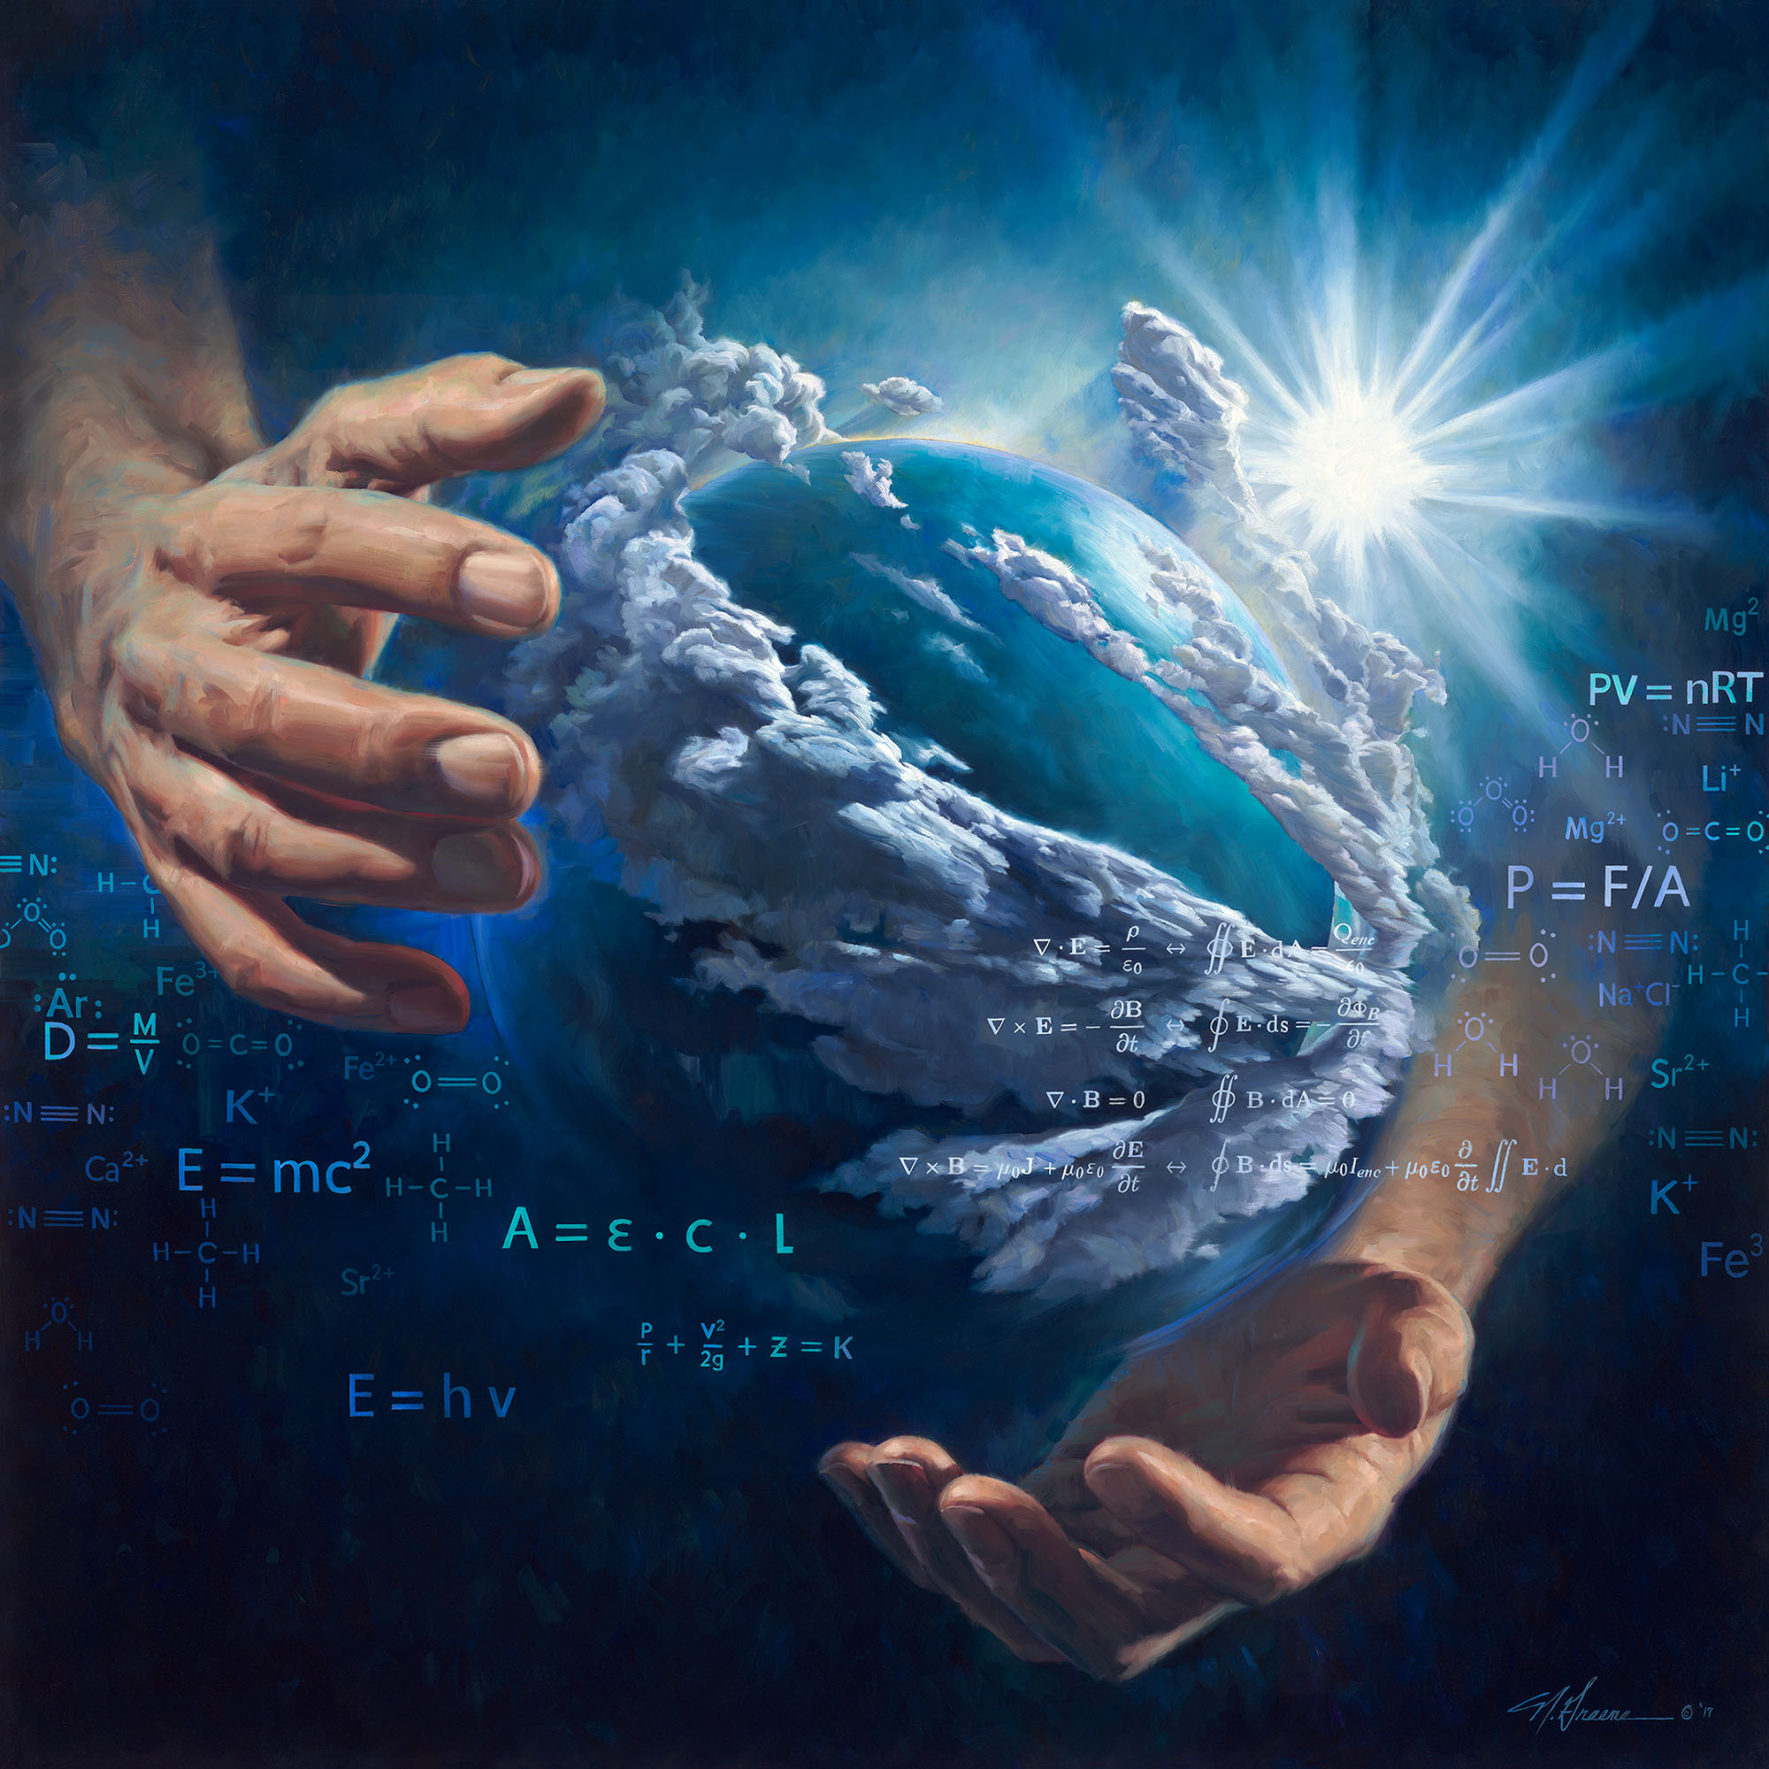
“He who comes to “Our Father in heaven...”
Matthew 6:9
“Days of Creation: Day 2”
by Nathan Greene.
Used with author’s permission.

Slide 5

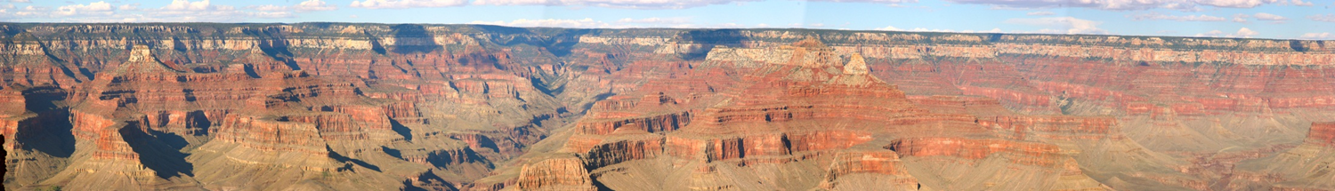
5 geology-based reflections on the Creator and His creation

Slide 6

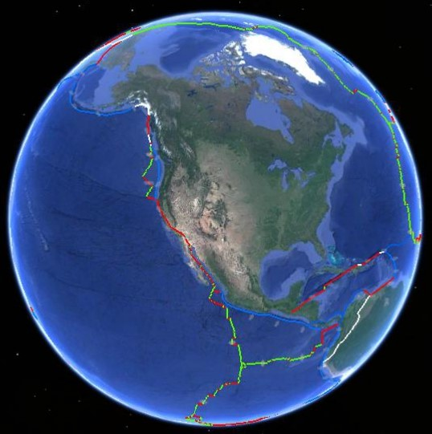
1. A richly-textured world
“Marvelous are Your works, and that my soul knows very well.” Ps 139:14
Plate boundary
Wide region of deformation at the margin of the continent
Image credit: Google Earth, USGS

Slide 7
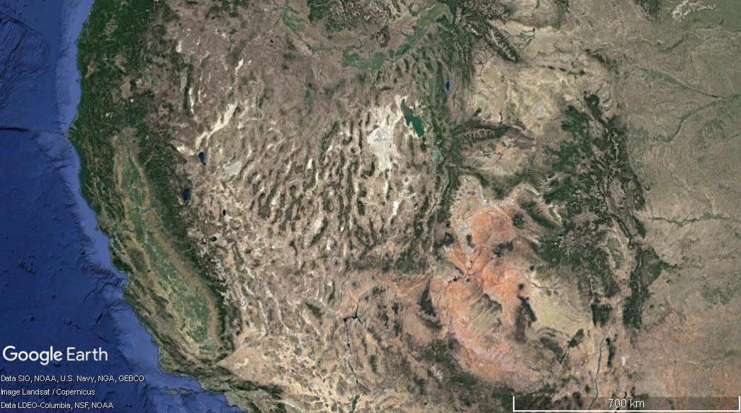
1. A richly-textured world
Basin and Range
Colorado Plateau
Rocky Mountains
Geographic provinces with different topography

Slide 8
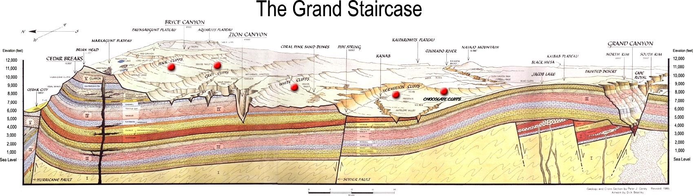

1. A richly-textured world

Slide 9
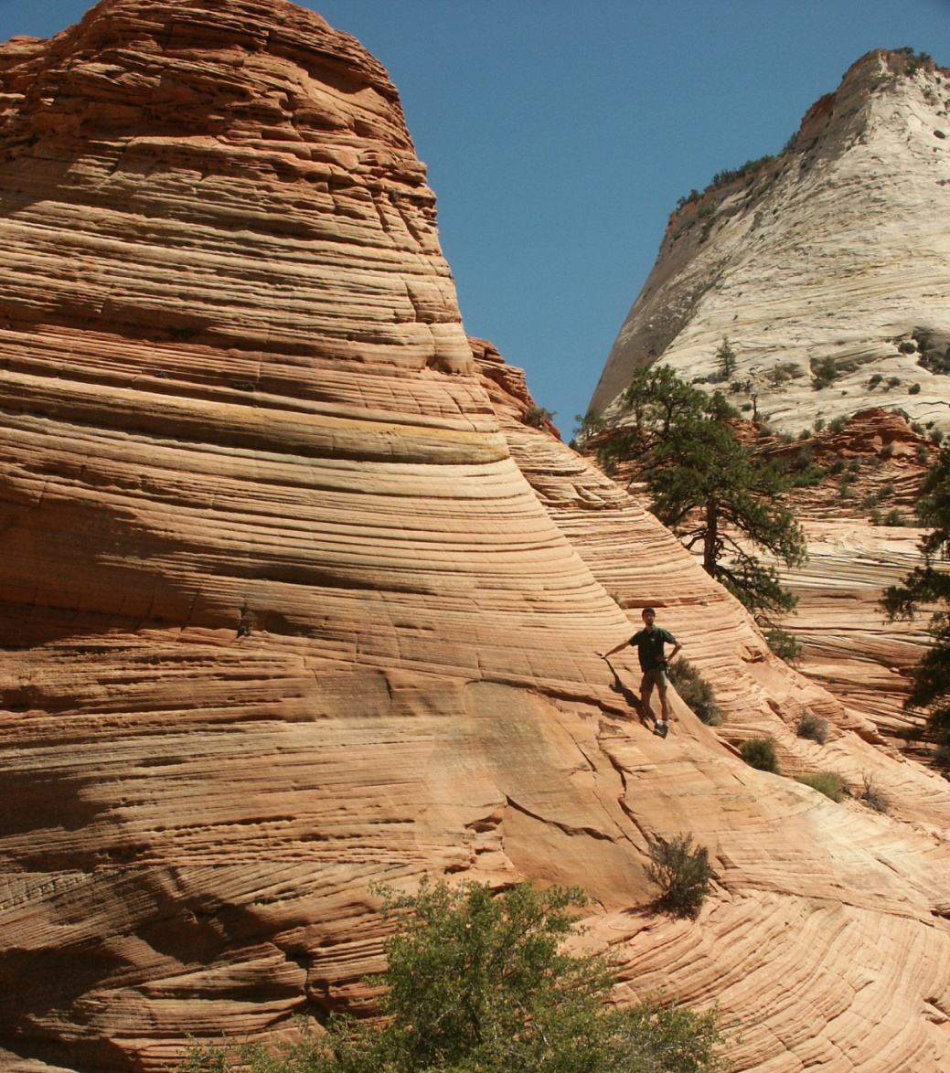
1. A richly-textured world

Slide 10
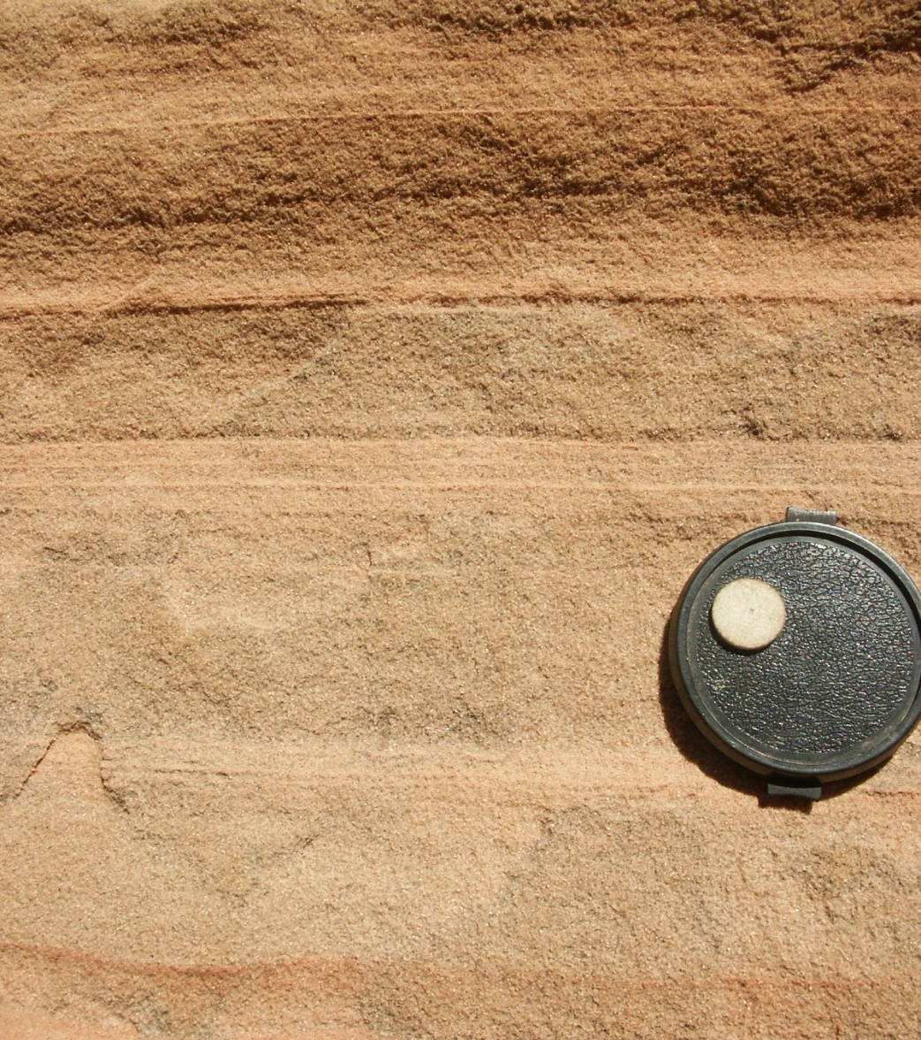
1. A richly-textured world

Slide 11
1. A richly-textured world

Slide 12
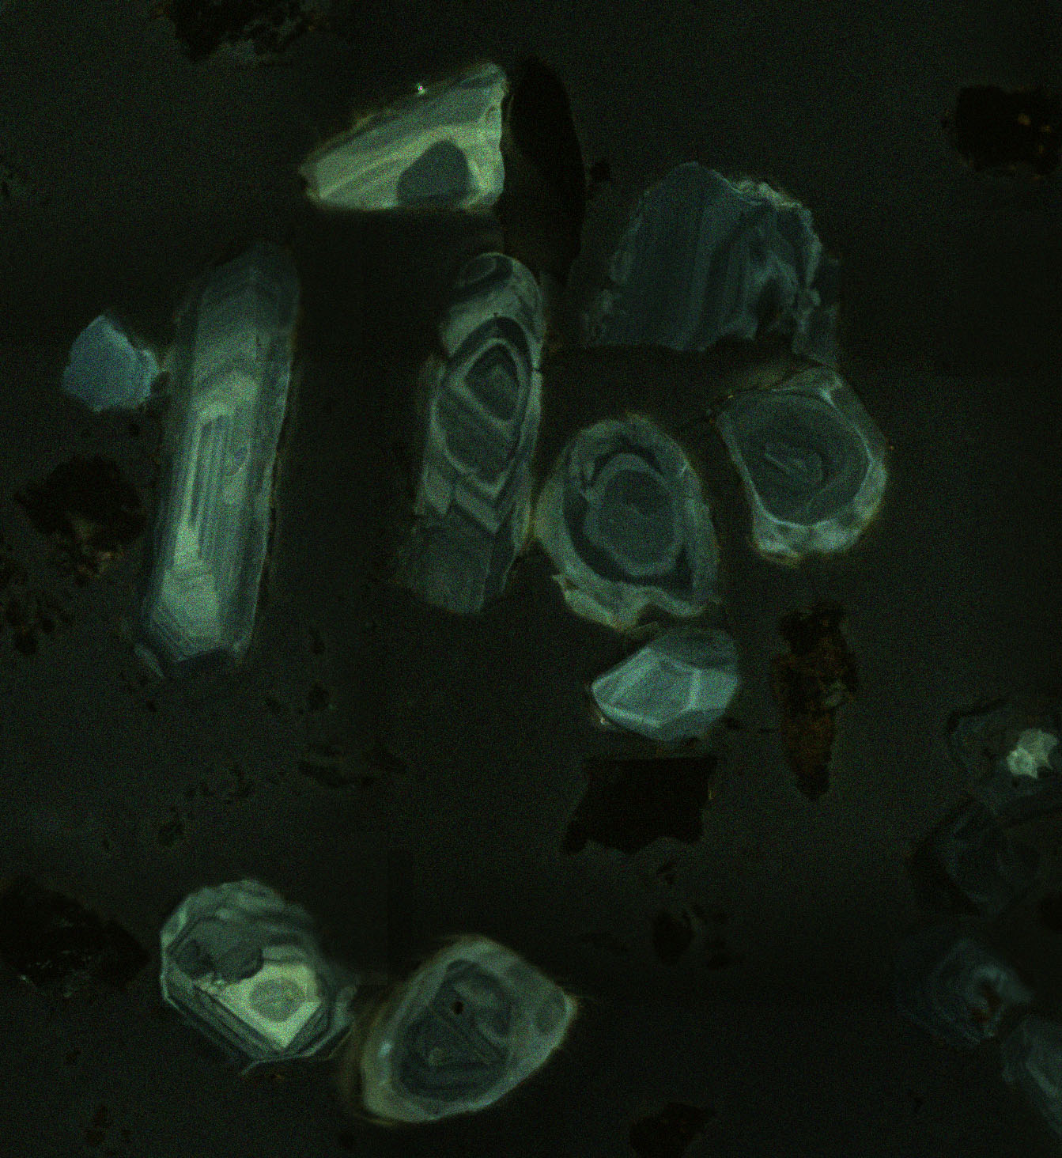
1. A richly-textured world

Slide 13
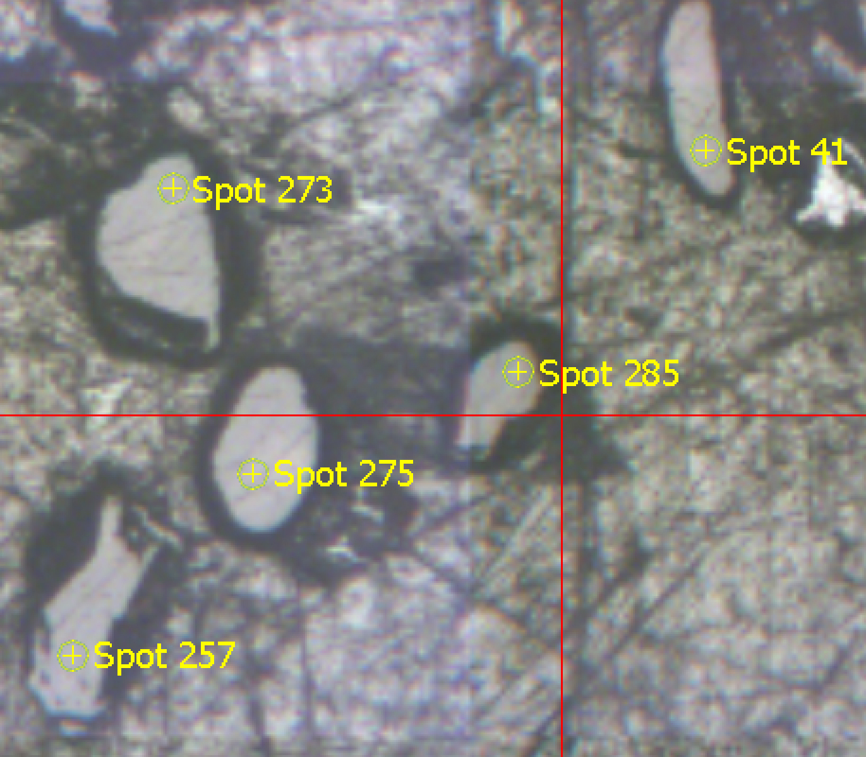
1. A richly-textured world
“Marvelous are Your works, and that my soul knows very well.” Ps 139:14

Slide 14

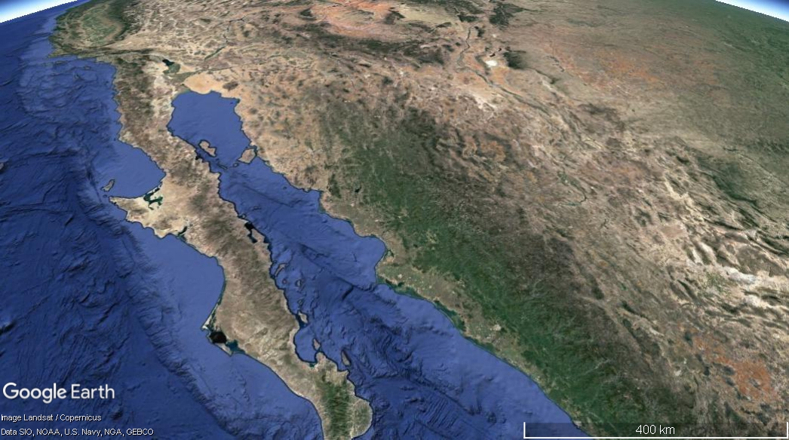
2. A world we can explore
“Oh, taste and see that the Lord is good.” Ps 34:8

Slide 15
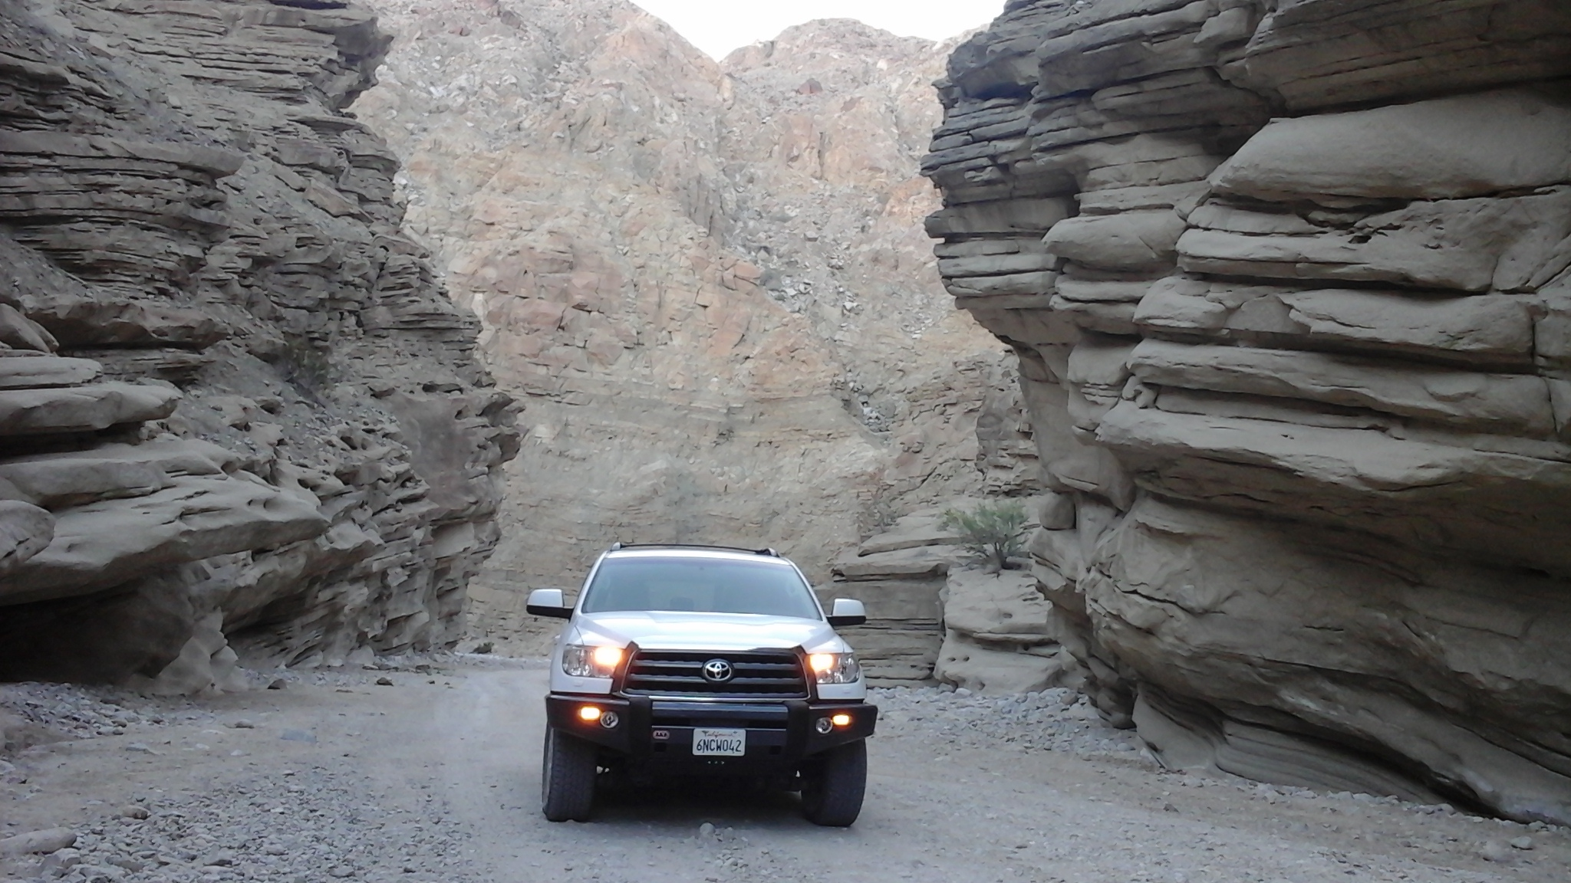
2. A world we can explore

Slide 16
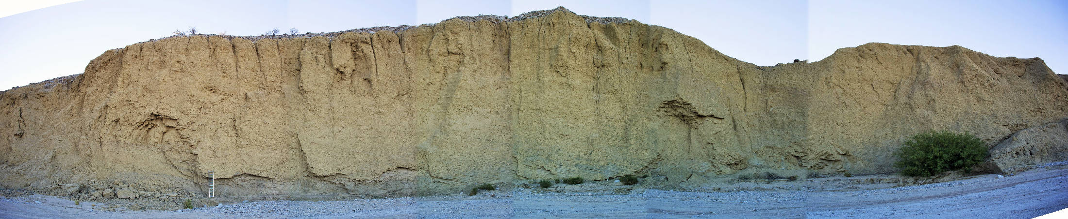
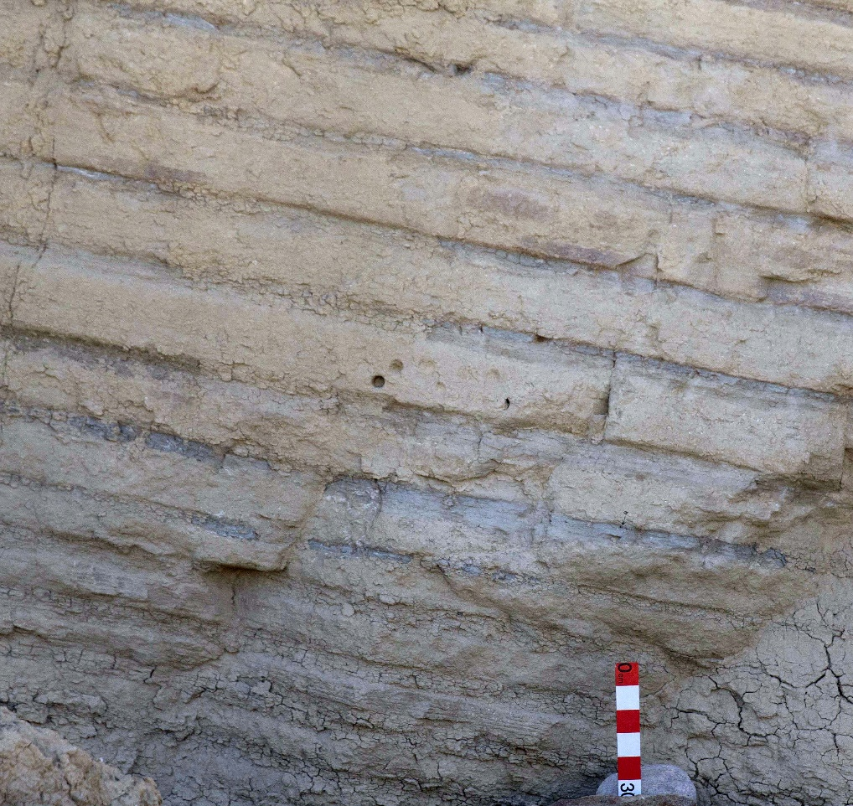
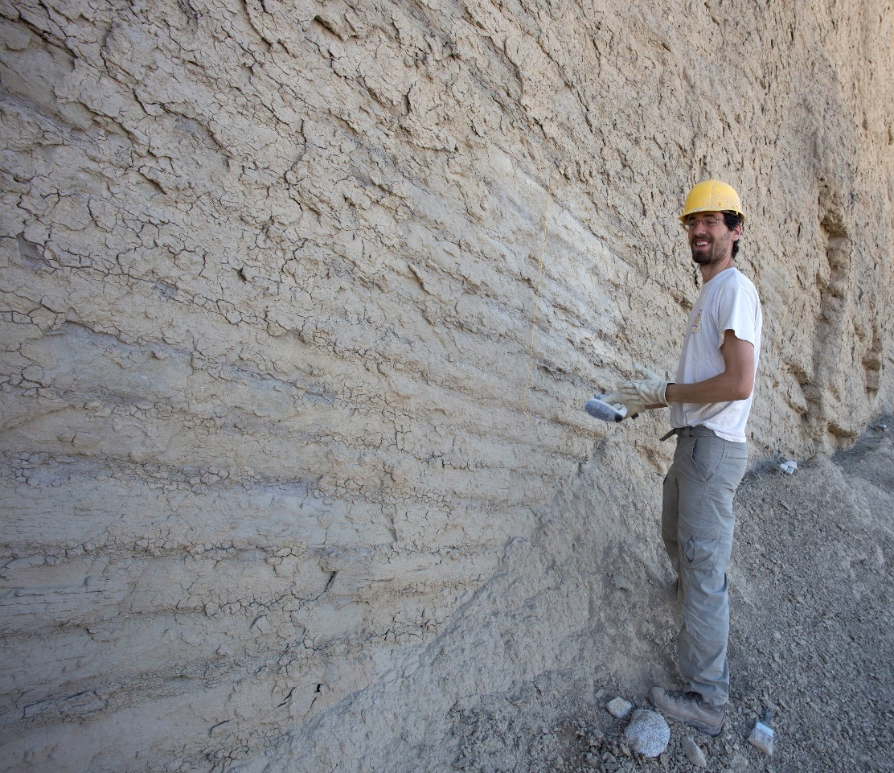
The “rhythmite wall”

Slide 17
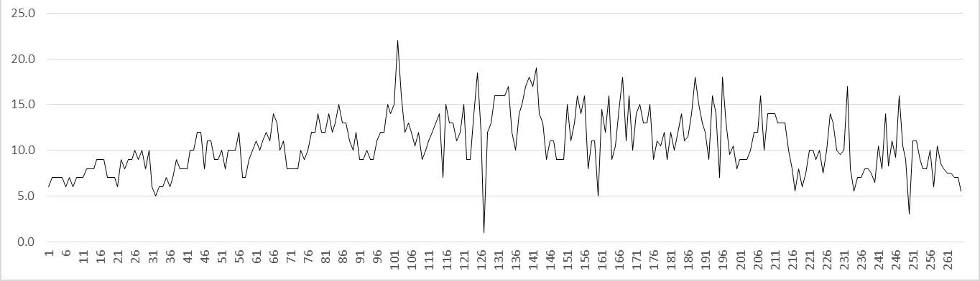
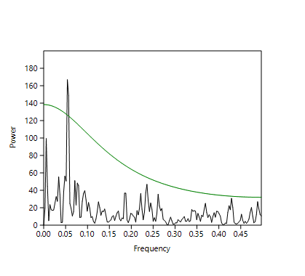
2. A world we can explore

Slide 18
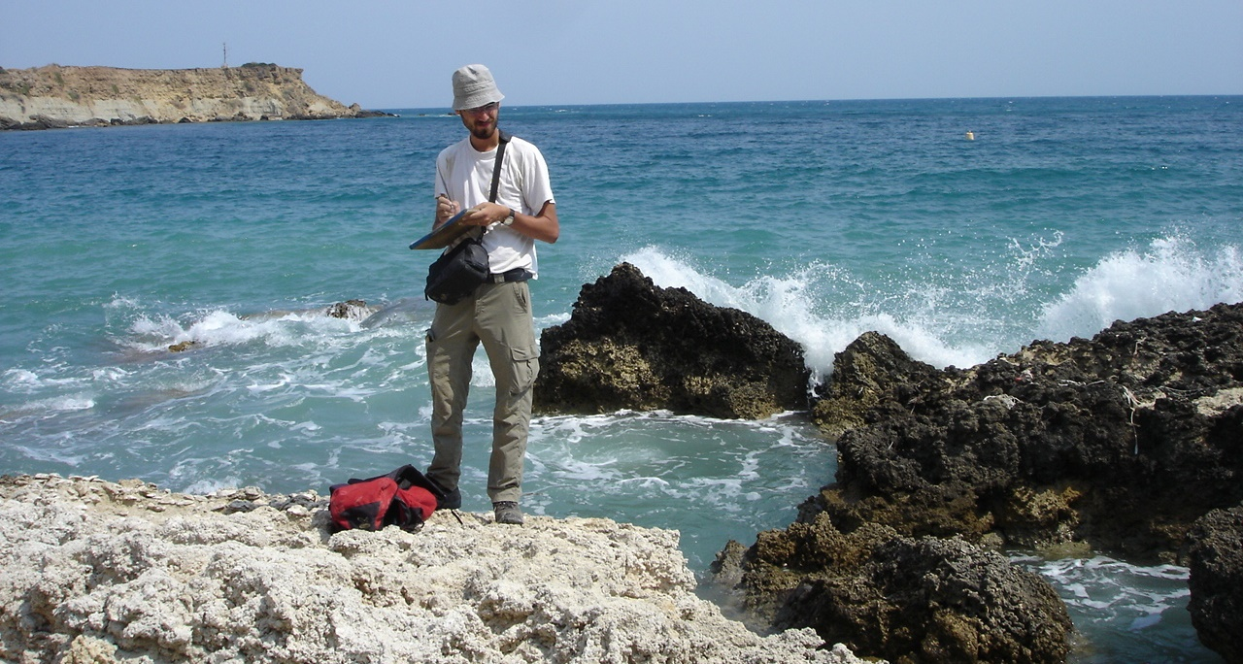
2. A world we can explore

Slide 19
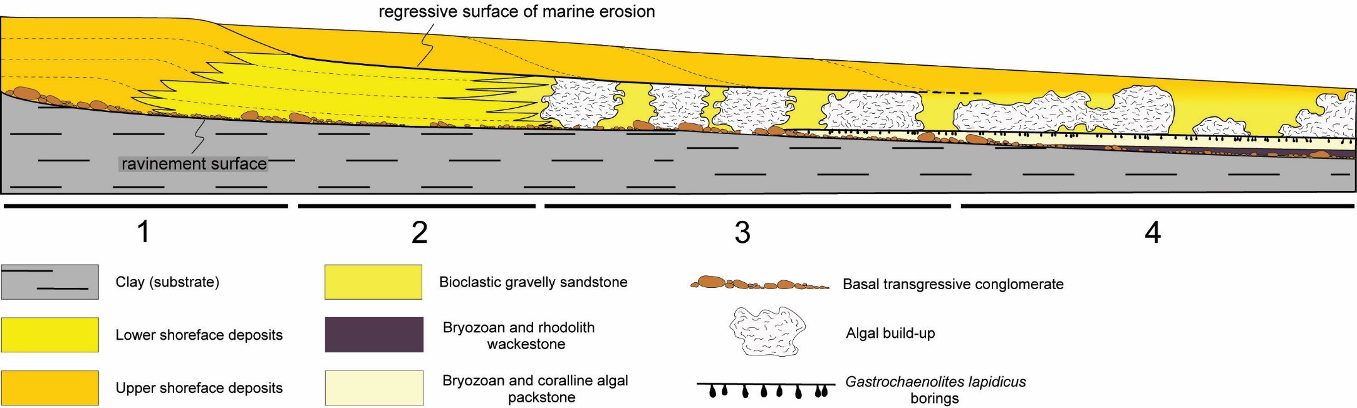
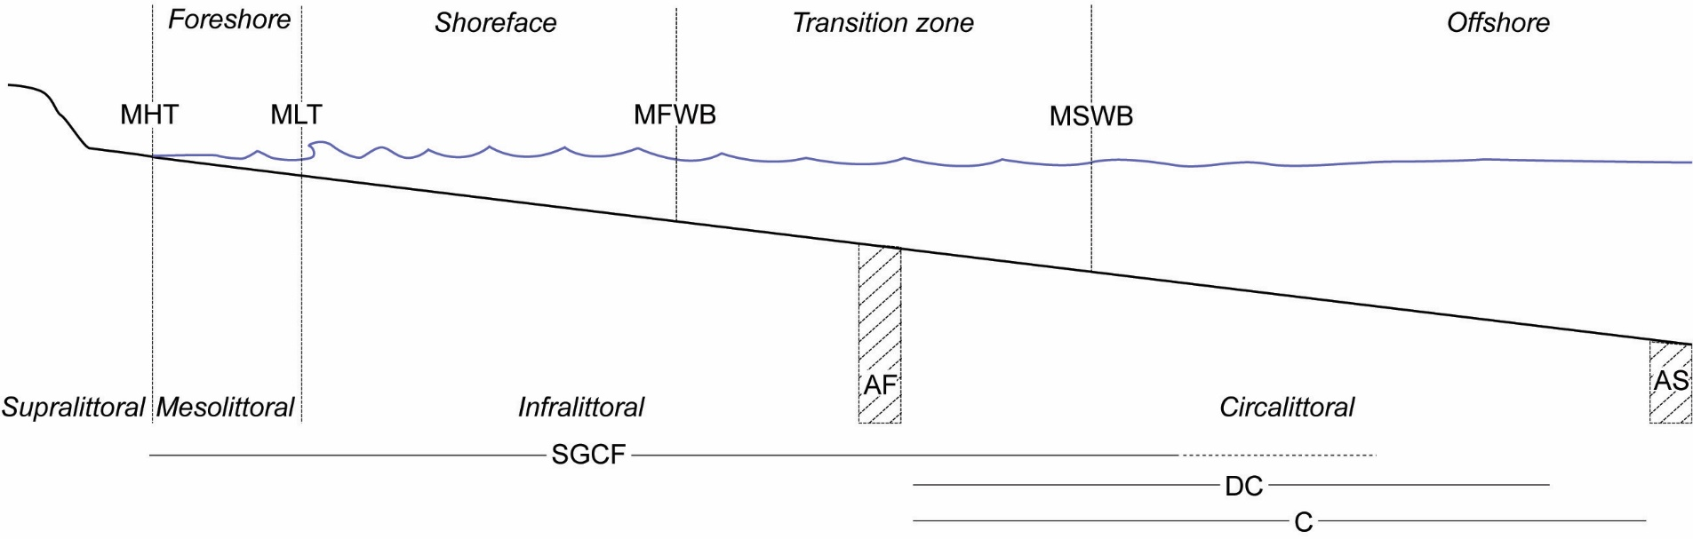
2. A world we can explore

Slide 20
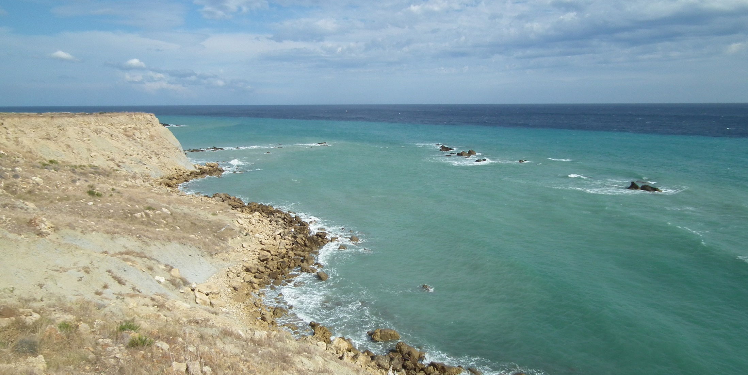
2. A world we can explore
“Oh, taste and see that the Lord is good.” Ps 34:8

Slide 21
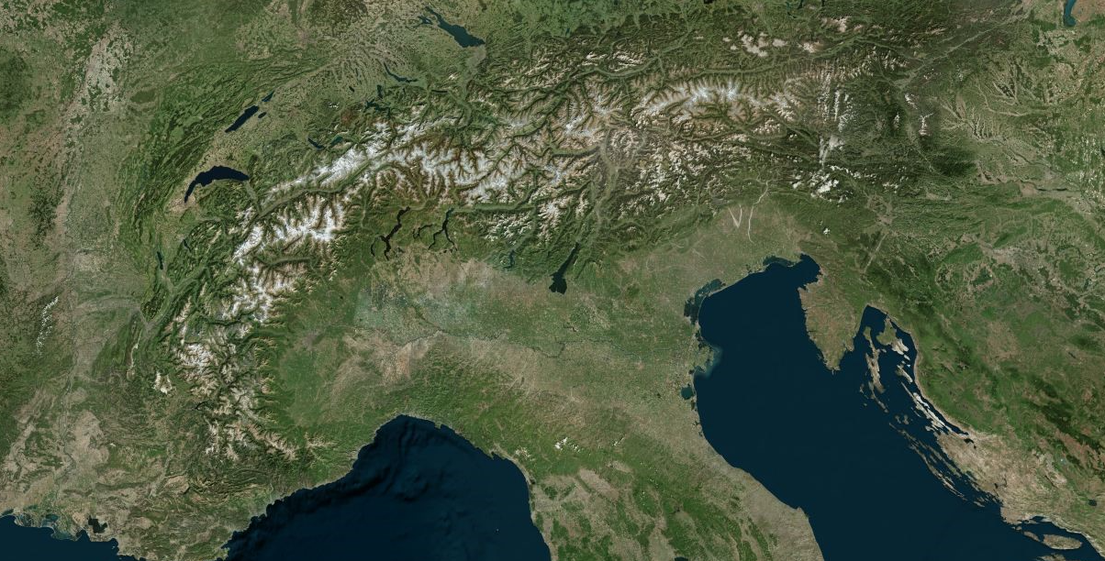
3. The Mighty Power
“Now to Him who is able to do exceedingly abundantly above all that we ask or think, according to the power that works in us…” Eph 3:20

Slide 22
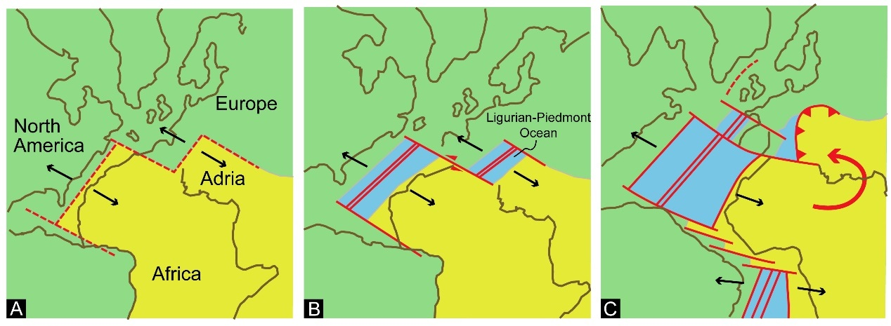
3. The Mighty Power
https://www.ngdc.noaa.gov/mgg/global/global.html

Slide 23
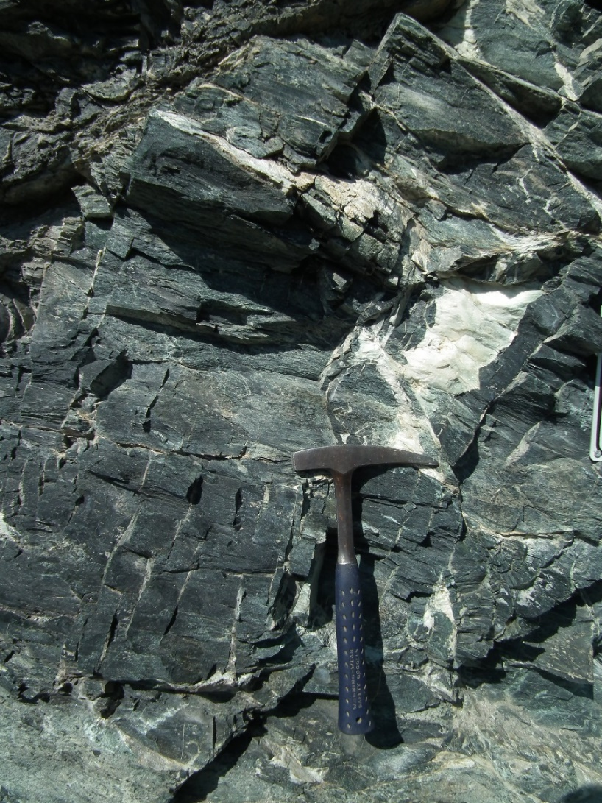
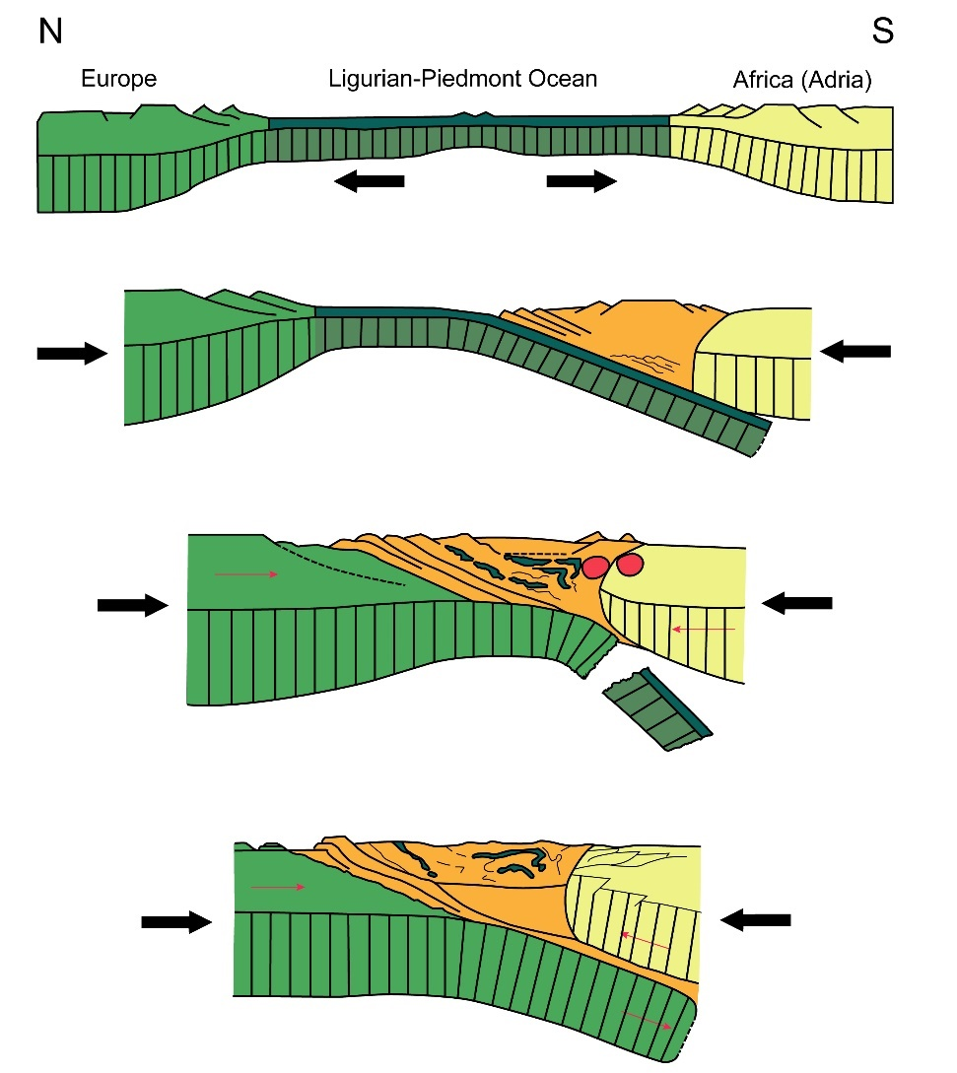
3. The Mighty Power

Slide 24
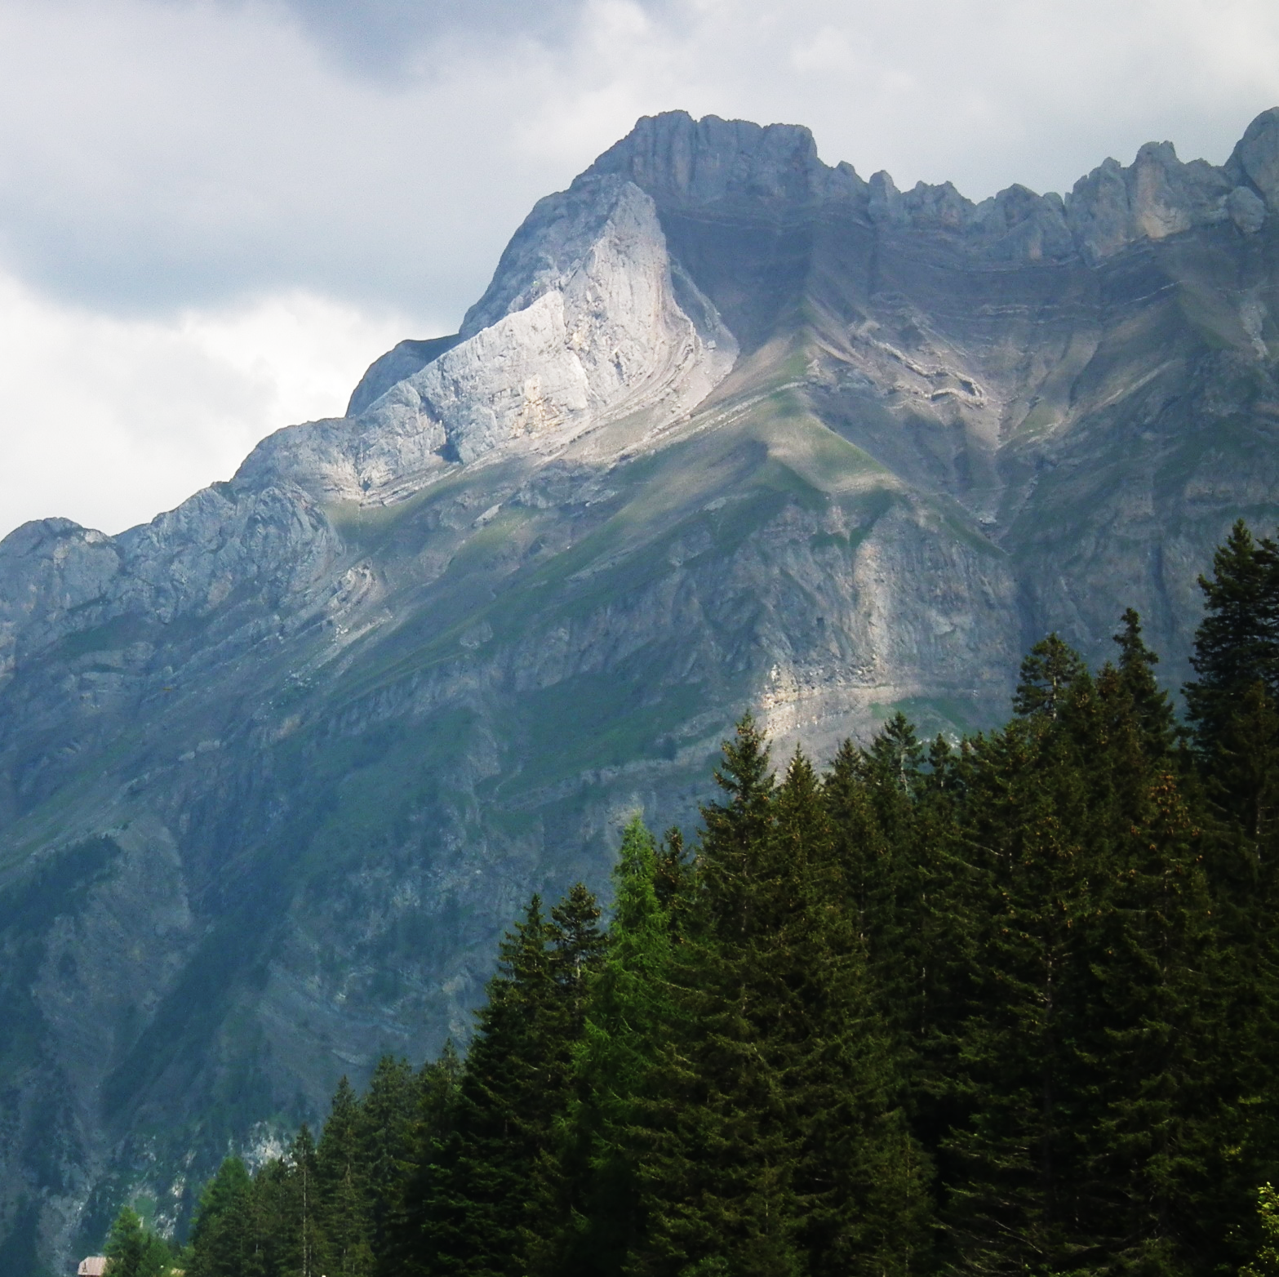
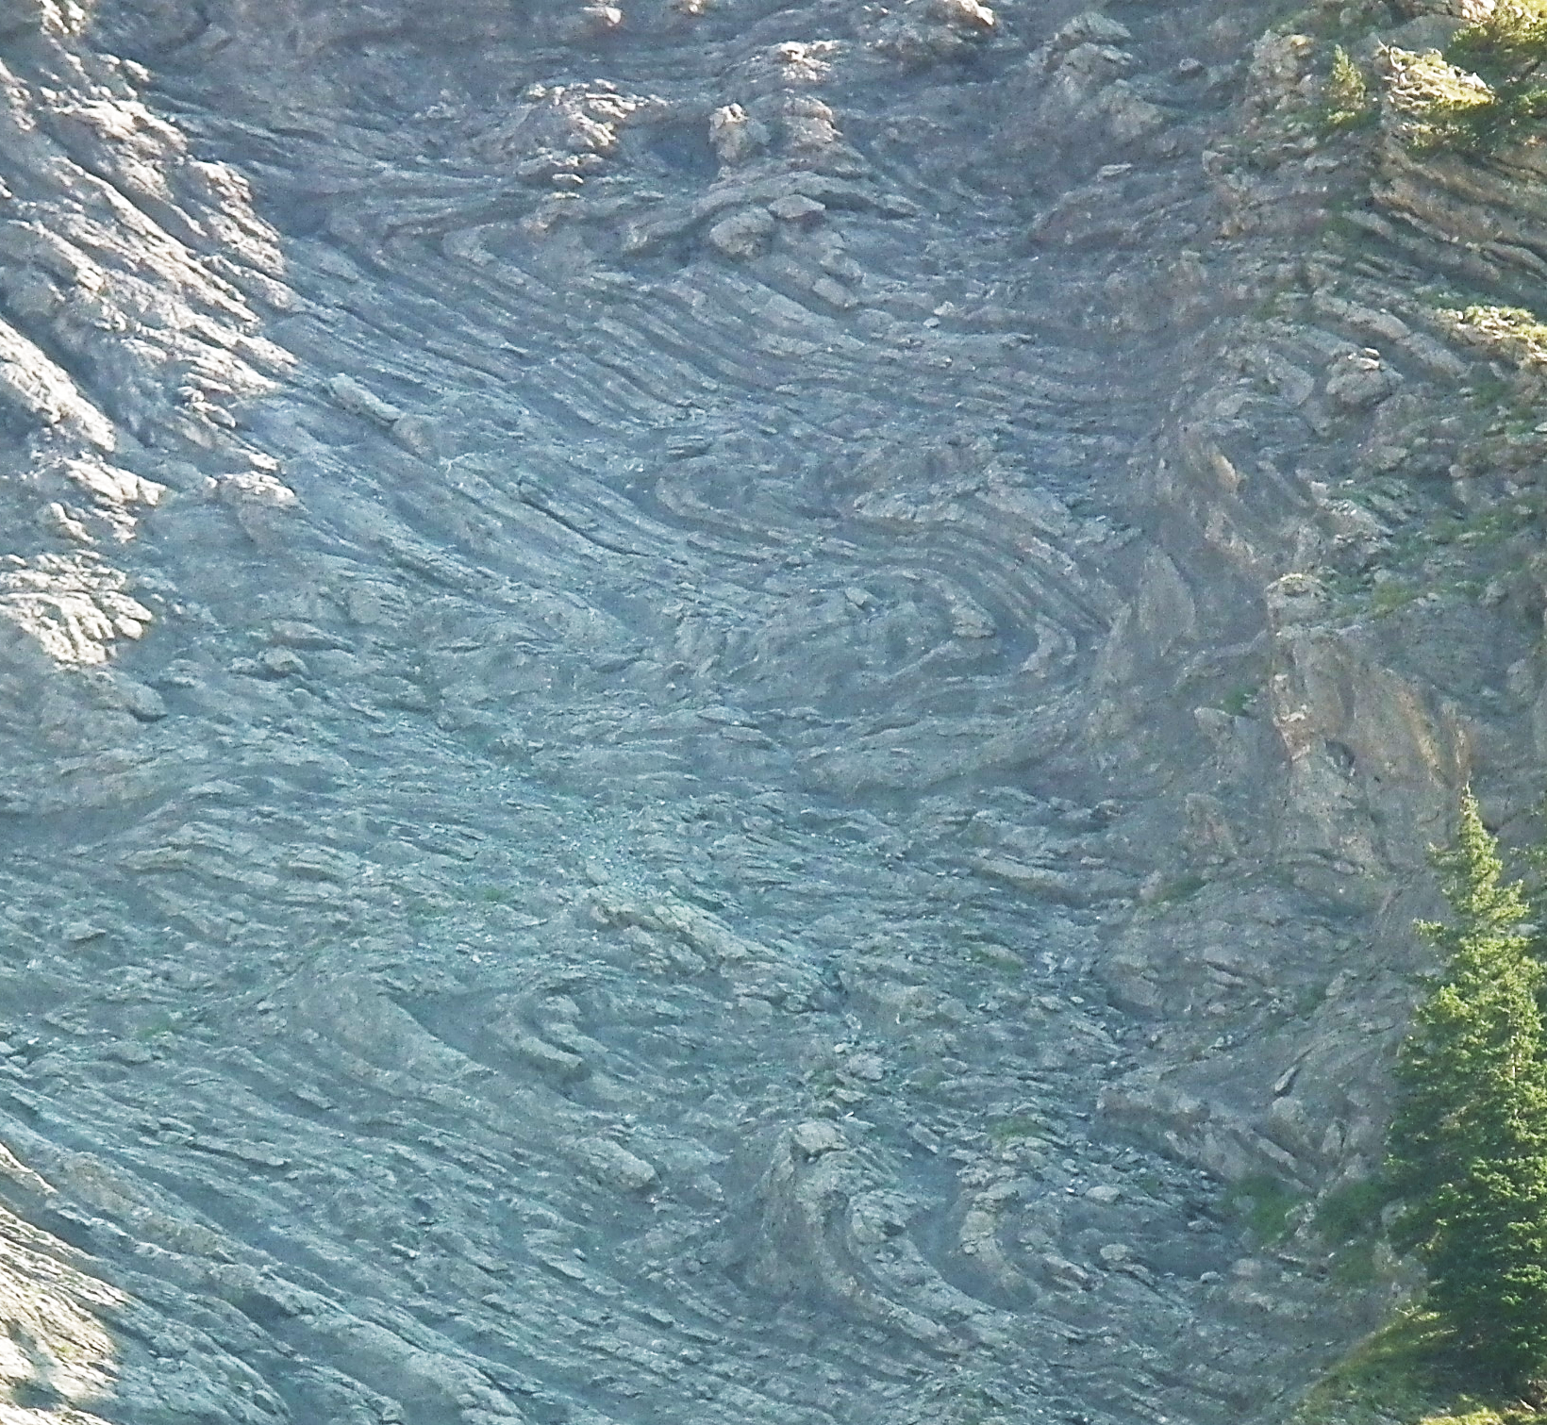
3. The Mighty Power
“Now to Him who is able to do exceedingly abundantly above all that we ask or think, according to the power that works in us…” Eph 3:20

Slide 25
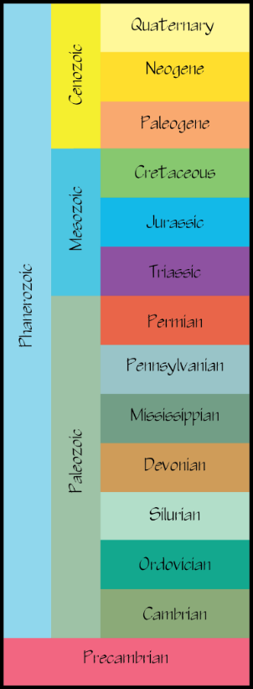
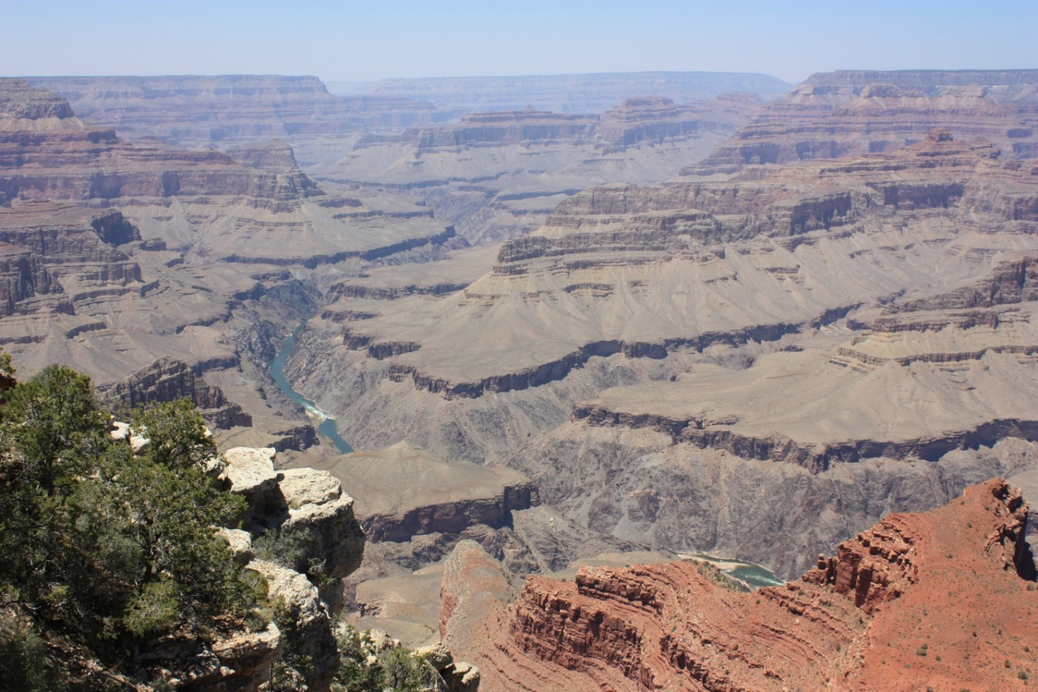
4. Directionality
“ ‘Where is the promise of His coming? For since the fathers fell asleep, all things continue as they were from the beginning of creation.’ For this they willfully forget: By the word of God the heavens were of old, and the earth standing out of water and in the water, by which the world that then existed perished, being flooded with water.” 2 Peter 3:4,5

Slide 26
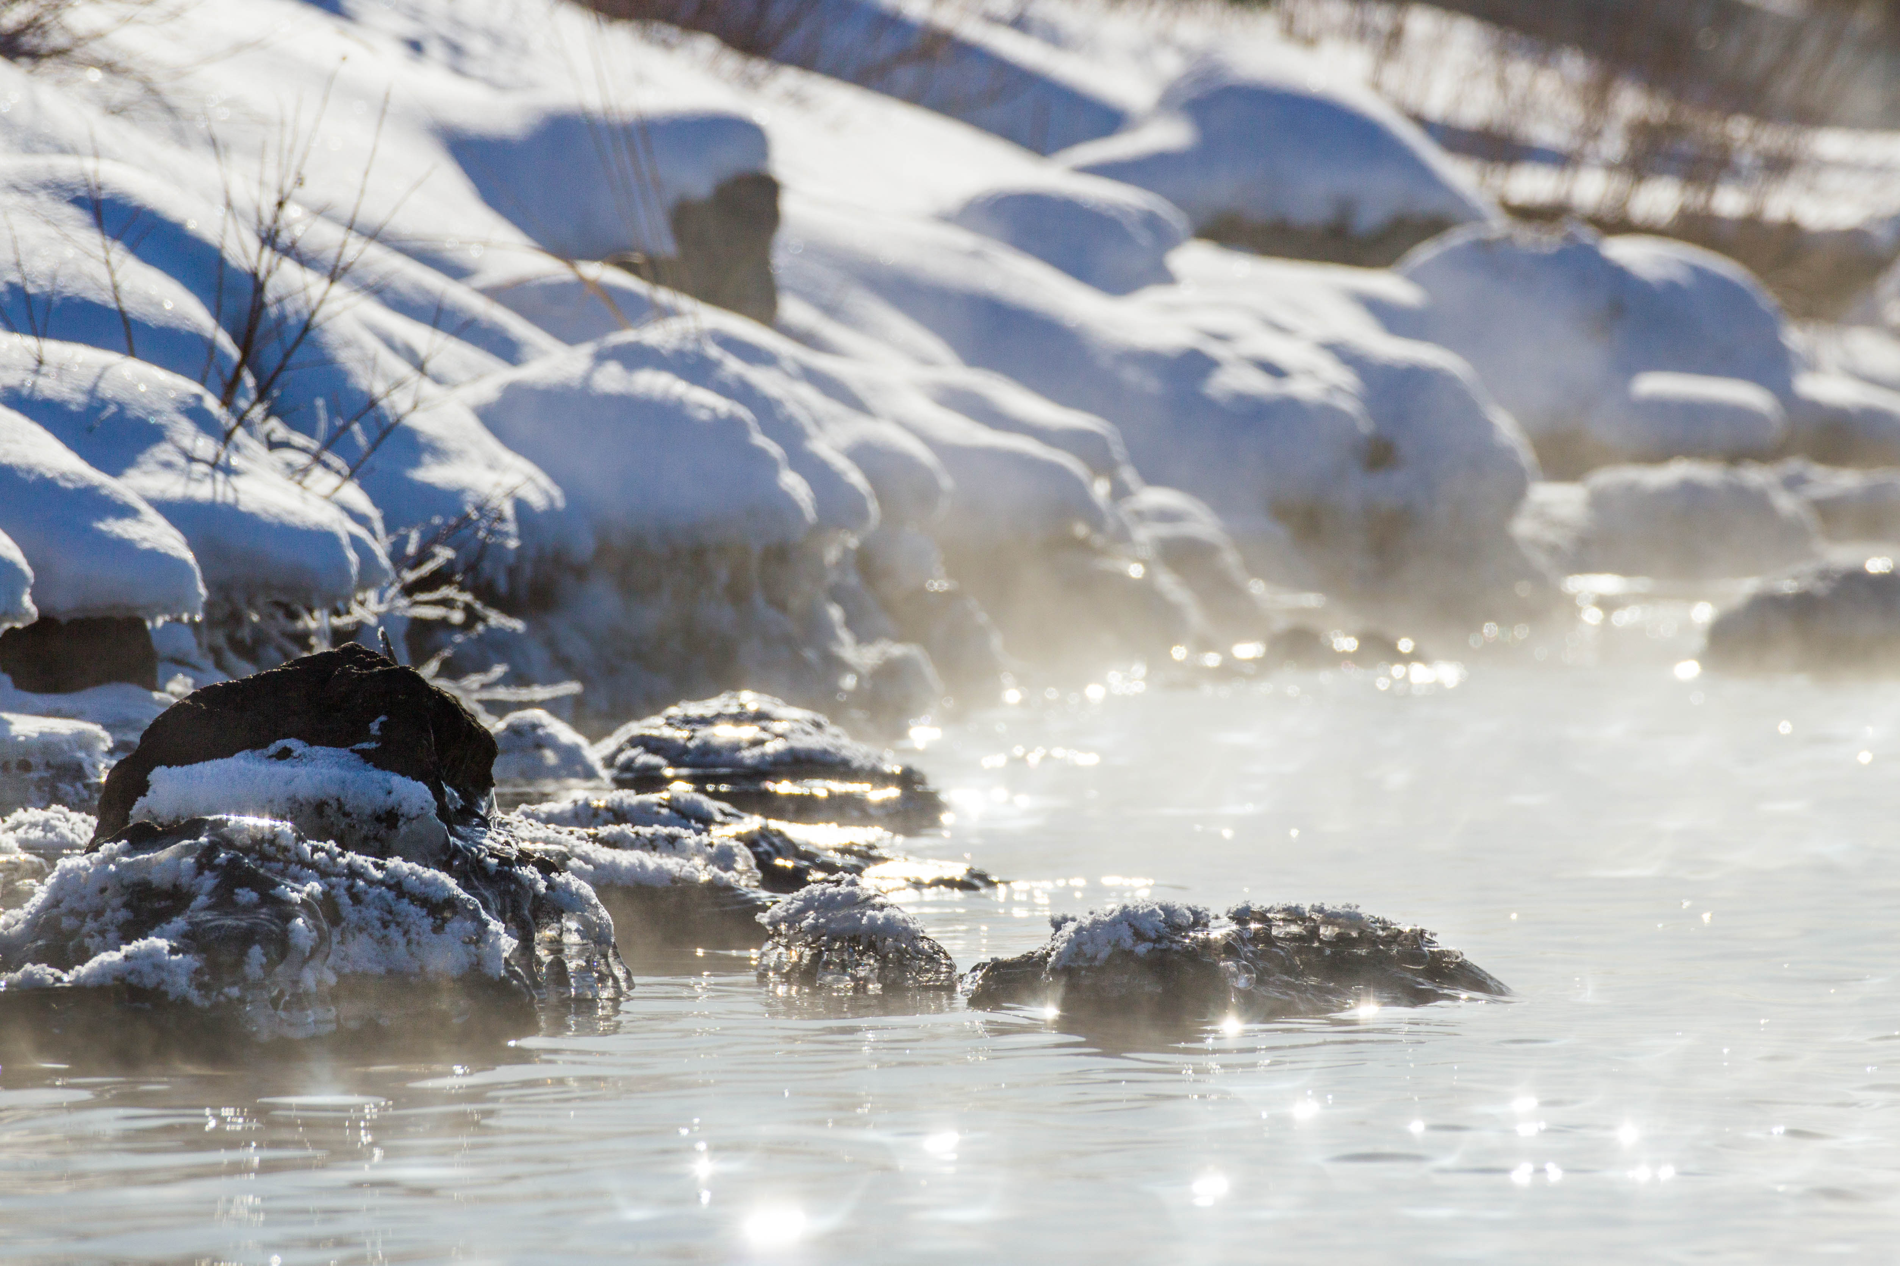
5. Balances and unbalances
“For we know that the whole creation groans and labors with birth pangs together until now.” Rm 8:22
Photo credit: Marko Kotilainen, https://www.flickr.com/photos/mkotilai/25670996447 (CC BY-NC 2.0)

Slide 27
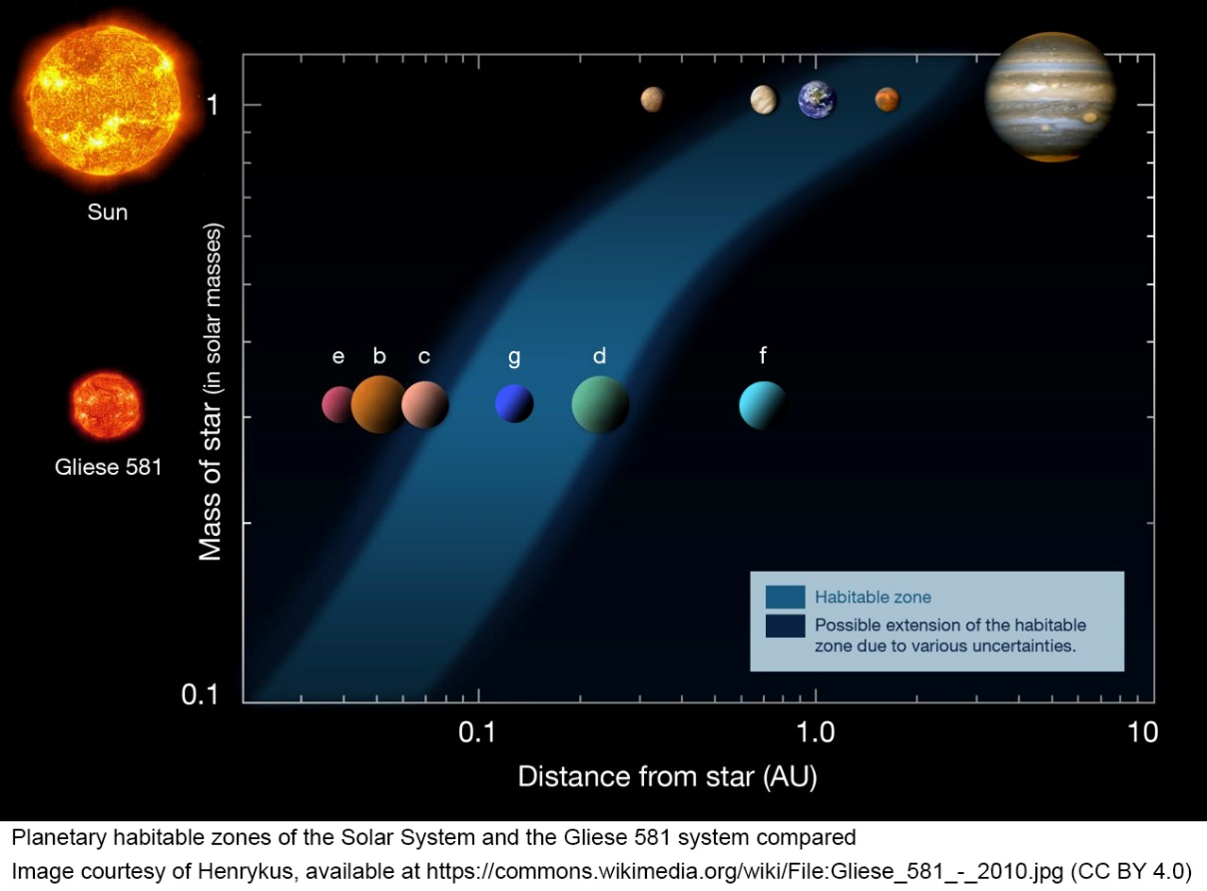
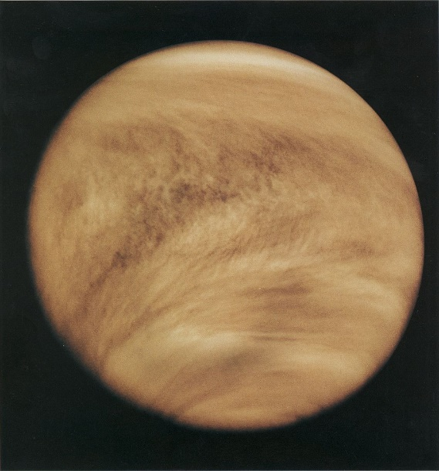
5. Balances and unbalances

Slide 28
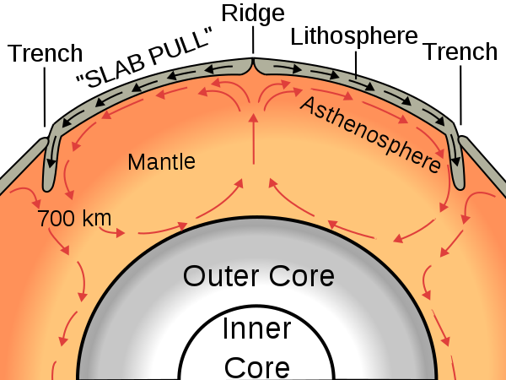
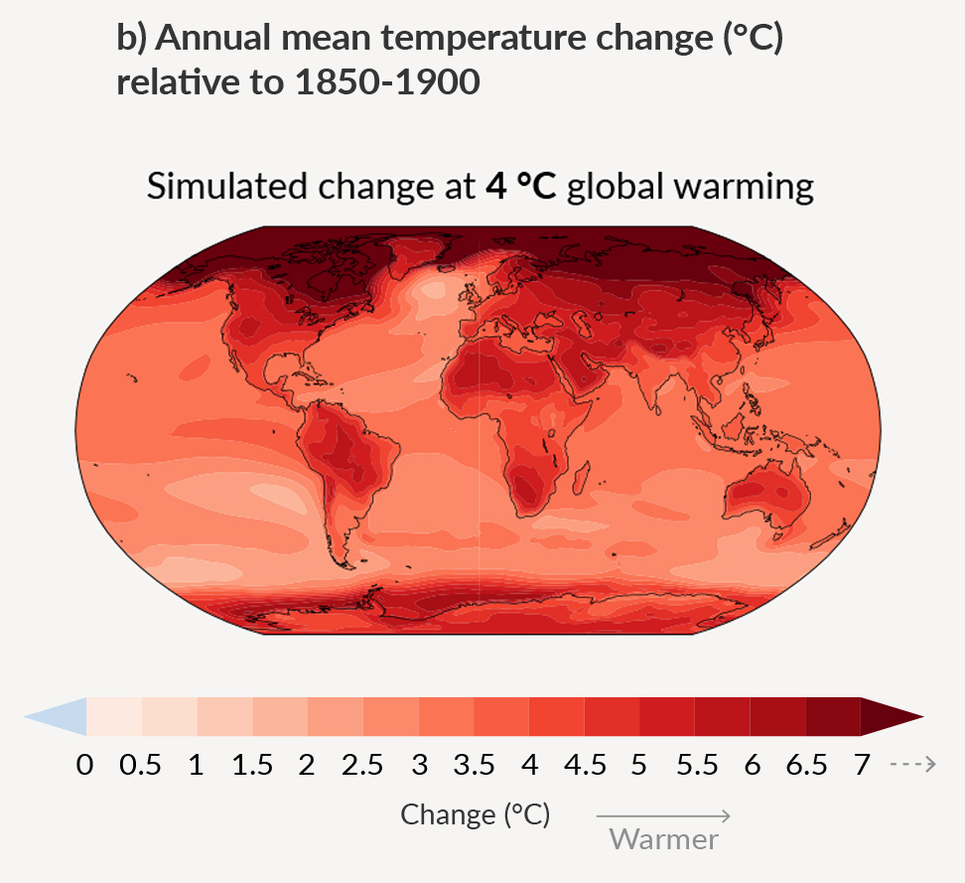
5. Balances and unbalances
Image Courtesy of Surachit and USGS, Creative Commons Attribution-Share Alike 3.0 Unported, 2.5 Generic, 2.0 Generic and 1.0 Generic license.
From IPCC, 2021: Summary for Policymakers. In: Climate Change 2021: The Physical Science Basis [Masson-Delmotte,et al. (eds.)]. Cambridge University Press. In Press.

Slide 29
A richly-textured world
A world we can explore
A powerful God
The God of History
A state of conflict
An infinitely wise and powerful God made me, and placed me in a world full of meaning and opportunities for growth.
His plan for this planet is unfolding, and looking into the past I can find hope for the future.
“Who has performed and done it,
Calling the generations from the beginning?
‘I, the Lord, am the first;
And with the last I am He.’” Is 41:4

