Slide 1
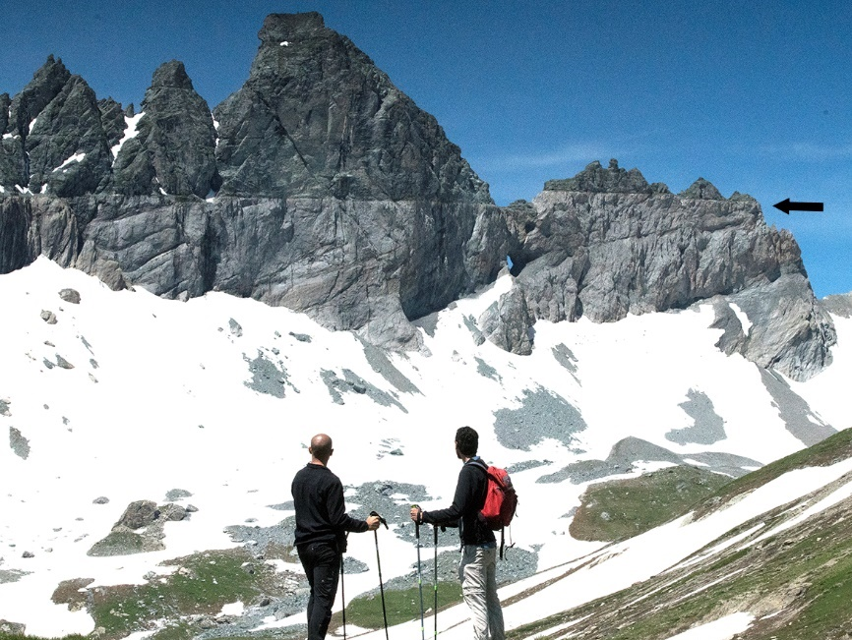
Science, Worldviews, and Controversies in the History of Geology: An Alpine Perspective
“The grass withers, the flower fades; but the word of our God will stand forever.”
Isaiah 40:8

Slide 2
Purpose of the talk
World (cosmos) and Word (Logos)
The two elements come together in a WORLDVIEW
How does a worldview influence our understanding of nature and how does the study of nature influence worldviews?
4 stories: Setting: European Alps Area of science: Geology 1) Dualism Heavens and Earth
2) Plutonists vs Neptunists
3-4) Fixists vs Mobilists

Slide 3
1) Galileo and the Craters of the Moon (Dualism Heavens and Earth)
Padova and Venice
Photo courtesy of NASA

Slide 4
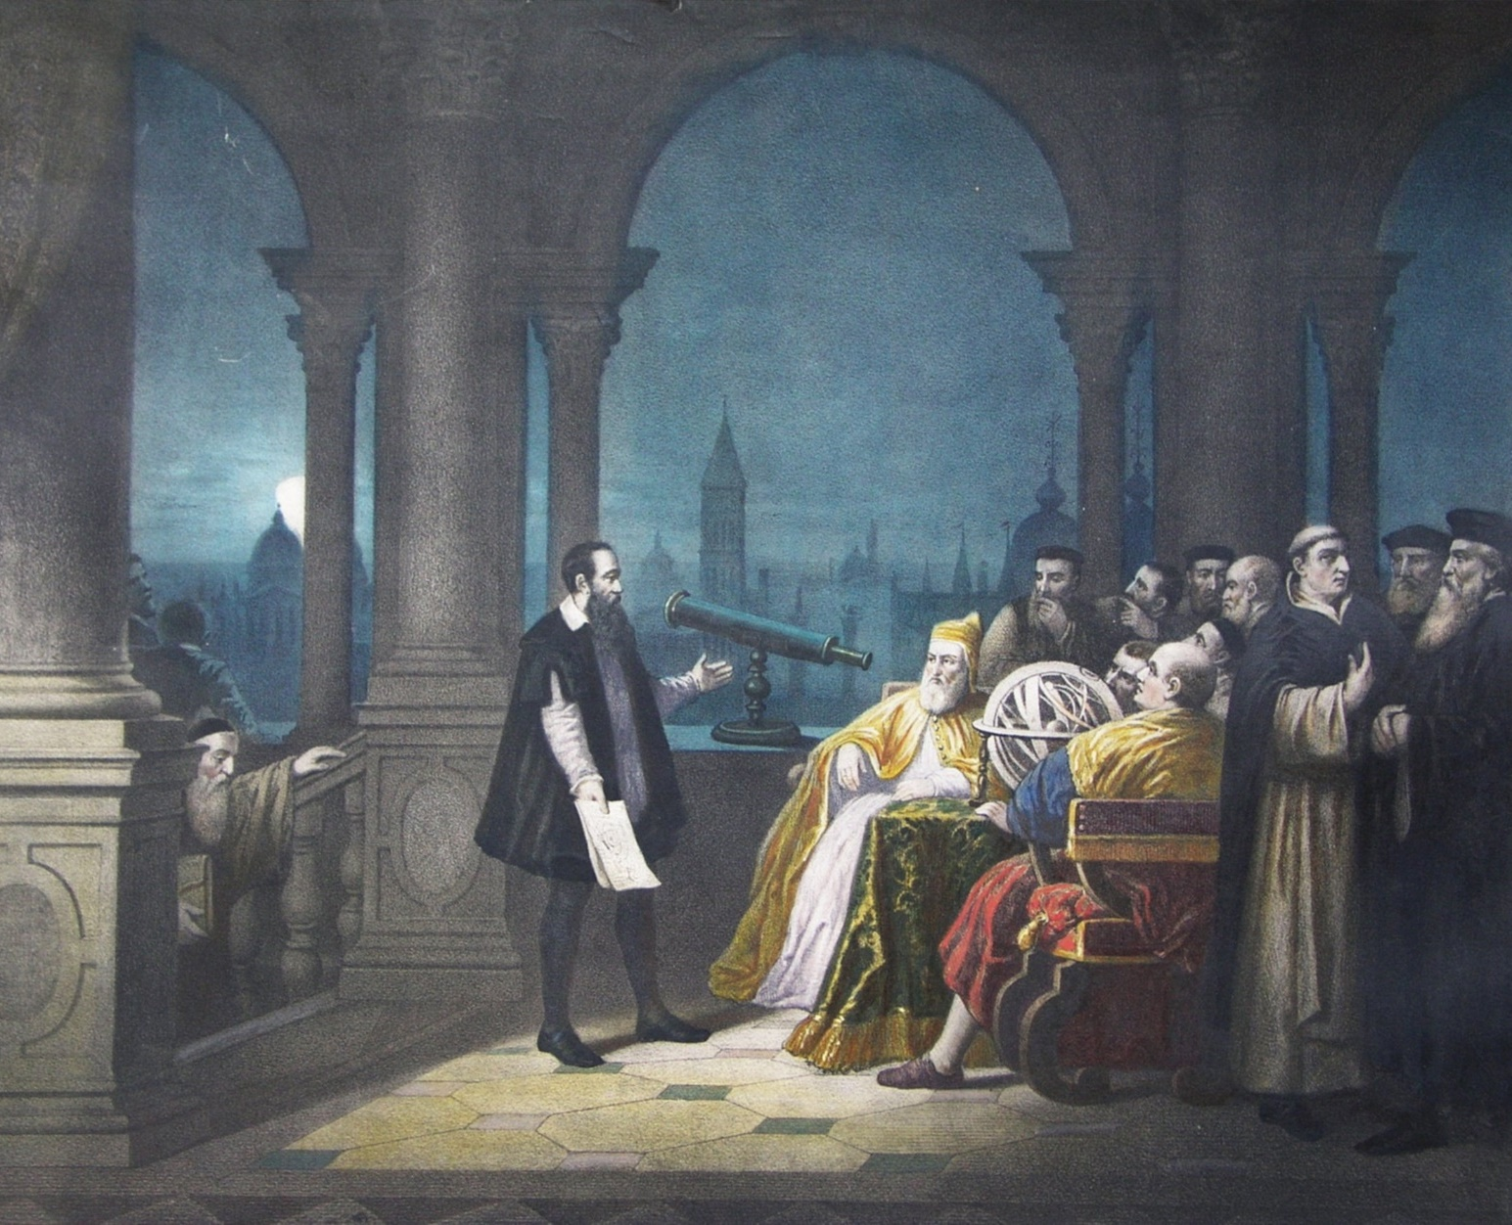
1) Galileo and the Craters of the Moon (Dualism Heaven and Earth)
August 1609: Galileo demonstrates telescope to Senate of the Republic of Venice
Fall 1609 (Padova): Galileo points telescope at the sky and begins making astronomic observations

Slide 5
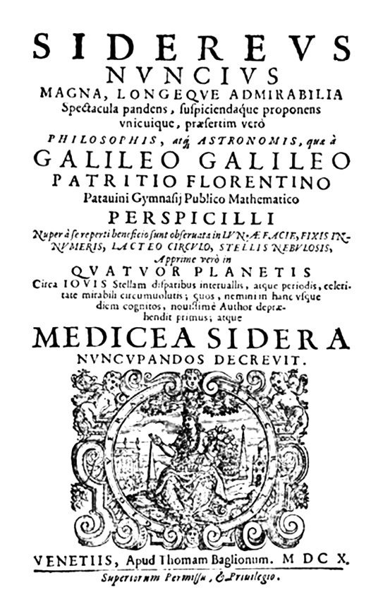
Sidereus Nuncius (“Message from the Stars”)
Published on March 13, 1610
Observations on - Moon - Milky Way - Some constellations - Satellites of Jupiter

Slide 6
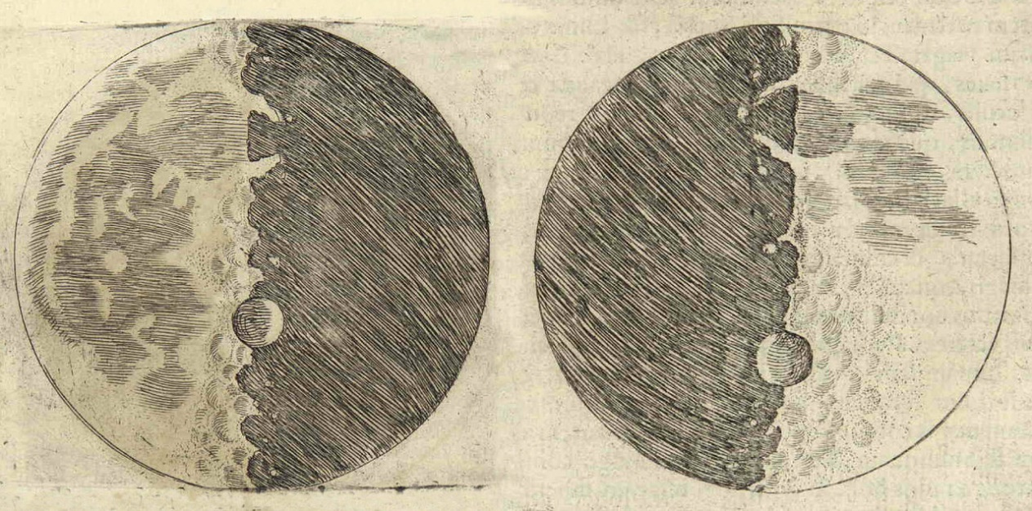
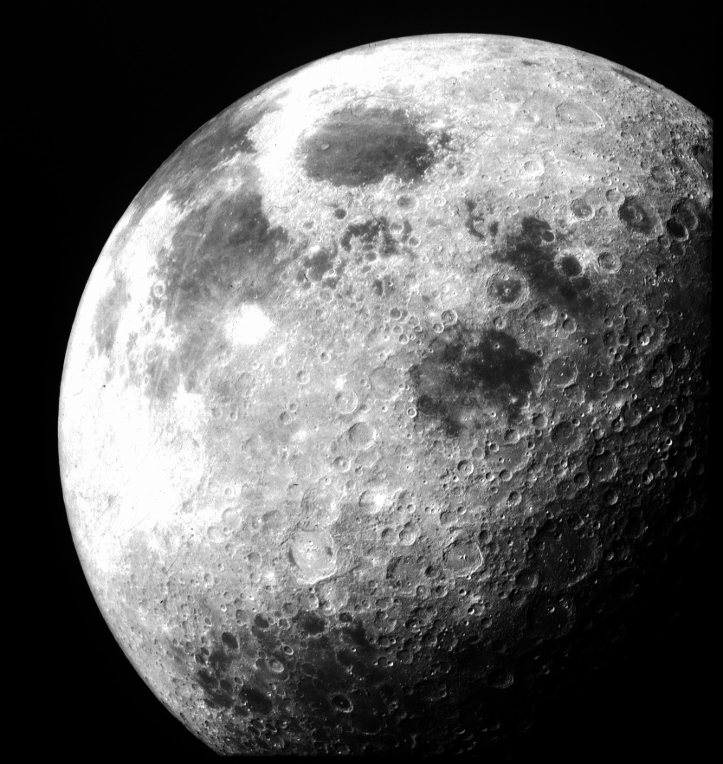
“The boundary which divides the part in shadow from the shining part does not extend continuously in an ellipse, as would happen in the case of a perfectly spherical body, but it is marked out by an irregular, uneven, and very wavy line.”
“I feel sure that the surface of the Moon is not perfectly smooth, free from inequalities and exactly spherical, as a large school of philosophers considers with regard to the Moon and the other heavenly bodies, but that, on the contrary, it is full of inequalities, uneven, full of hollows and protuberances, just like the surface of the Earth itself, which is varied everywhere by lofty mountains and deep valleys.”
Photo courtesy of NASA

Slide 7
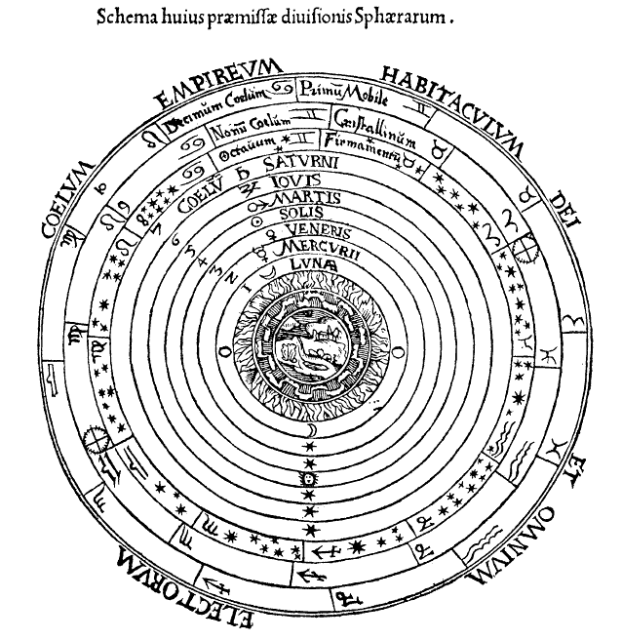
Aristotelian and Scholastic division between celestial (perfect, immutable, circular motion) and sublunary spheres (imperfect, changing, linear motion)
Galileo breaks the dualism: same matter, same processes. Birth of Planetary Geology
Not necessarily against the Bible, but against Aristotelian worldview with superimposed theological concepts

Slide 8
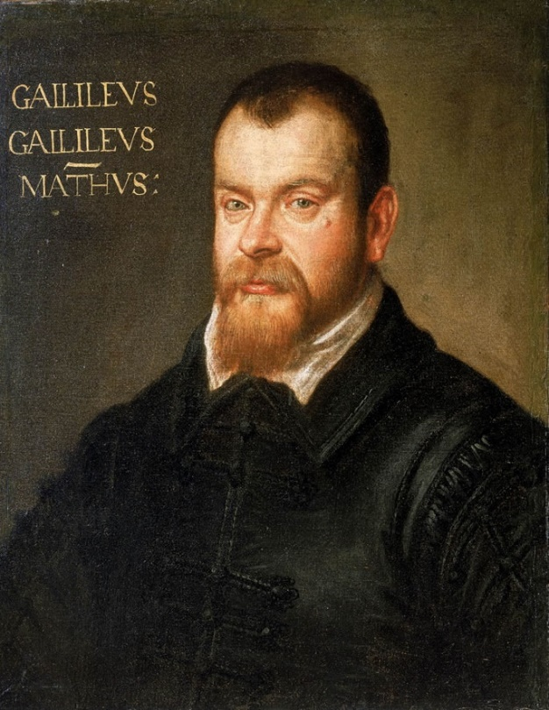
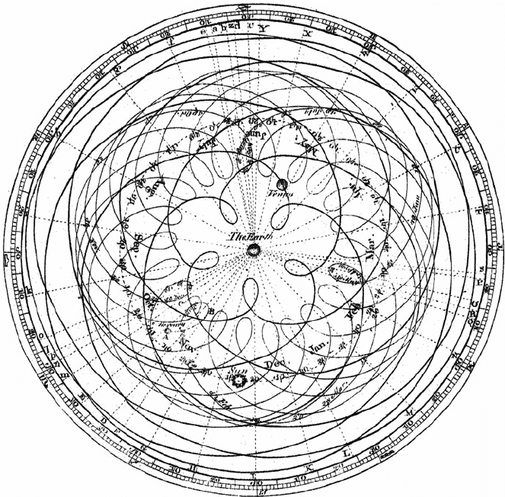
Galileo Galilei: Word vs Senses
Notes:
We will now explore some of the strategies that have been suggested for dealing with this conflict. To illustrate the first approach, we will use a well known figure, the Italian mathematician Galileo Galilei. Galileo lived at a time when the traditional geocentric model of the solar system was being challenged. Galileo definitely embraced the Copernican heliocentric model. Unfortunately, some of his opposers were beginning to attack him on Scriptural grounds.

Slide 9
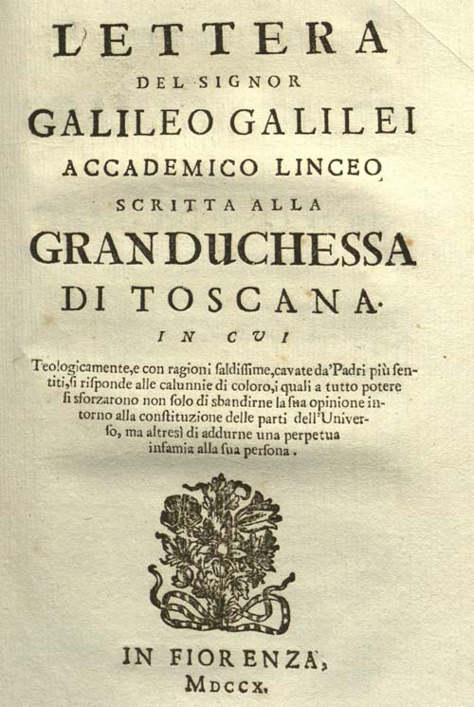
Galileo Galilei: Word vs Senses
“The reason produced for condemning the opinion that the earth moves and the sun stands still is that in many places in the Bible one may read that the sun moves and the earth stands still.
Since the Bible cannot err; it follows as a necessary consequence that anyone takes a erroneous and heretical position who maintains that the sun is inherently motionless and the earth movable.”
Notes:
Their charge is that the heliocentric model contradicts Scripture, so advocating for it is a challenge to the authority of the Scriptures. And in the time and place where Galileo lives, a challenge to the authority of Scriptures can have very bad practical consequences… So Galileo feels compelled to write a short treatise (in letter form), to explain his view of how to deal with this kind of perceived conflict.

Slide 10
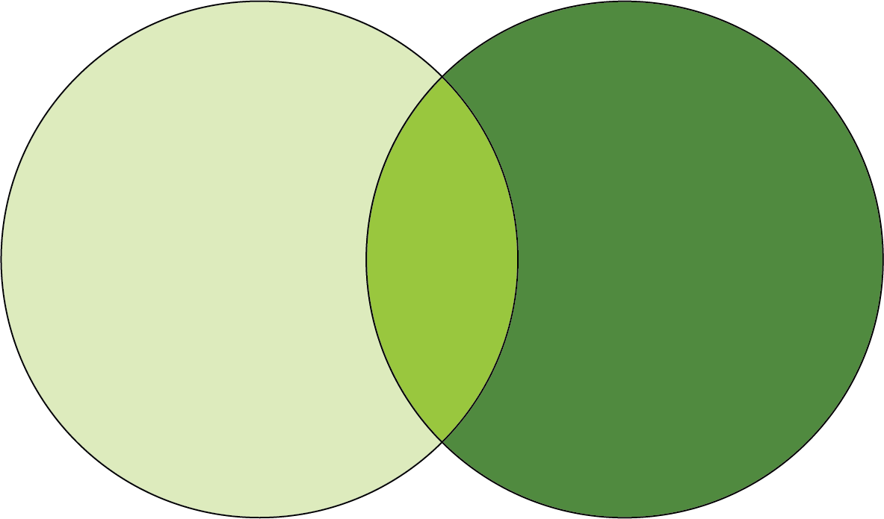
Galileo Galilei: Word vs Senses
Demarcation (non-overlapping magisteria)
“The intention of the Holy Ghost is to teach us how one goes to heaven, not how heaven goes.”
Notes:
His first strategy is to try to diffuse the conflict by keeping the Scriptures and senses separate in their goals and domains of authority. In modern times, this strategy is also known as “Non overlapping magisteria…” Don’t push the use of the Bible as physics/natural sciences textbook, and we could also say don’t push the science as a philosophical/theological tool (although Galileo seems more concerned with the former problem than the latter…). There is certainly some wisdom in this approach, there areas of knowledge with no overlap and where each of the two disciplines is sovereign, and where relying only on one domain seems an unnecessary limitation. But this approach does not solve the key problems; Because Scriptures have propositions about the origin and history of things, and science also presents scenarios about the origin and history of things. And so, there is overlap. And Galileo knew that, that’s why he lays out a more specific strategies of his view of how to deal with conflict.

Slide 11
Galileo Galilei: Word vs Senses
Supremacy of Senses
“I think that in disputes about issues in nature we ought to begin not from the authority of scriptural passages but from sense experiences and necessary demonstrations.”
Notes:
For Galileo, when there is conflict between sense-based reconstructions and Scriptural information, priority should always be given to the former. Science is in the driver seat, and Scripture is the passenger, being carried around. And Galileo articulates several reasons why, in his opinion science, in disputes about natural phenomena, is the superior guide over Scripture.

Slide 12
Galileo Galilei: Word vs Senses
Supremacy of Senses
1) Natural themes are peripheral
“…speaking but casually of the earth, of water, of the sun, or of any other created thing? Especially in view of the fact that these things in no way concern the primary purpose of the sacred writings, which is the service of God and the salvation of Souls”
“If the sacred scribes had had any intention of teaching people certain arrangements and motions of the heavenly bodies, or had they wished us to derive such knowledge from the Bible, then in my opinion they would not have spoken of these matters so sparingly”
Notes:
The first argument is that Scripture is not overly concerned with discussing natural facts, both as a subject and purpose. This is basically a reiteration of the Non Overlapping Magisteria argument… If this was truly the case, there would be on conflict. So, there very fact that we have conflict implies that Scripture makes substantive propositions about nature.

Slide 13
Galileo Galilei: Word vs Senses
Supremacy of Senses
Natural themes are peripheral
Scripture “accommodates” human ignorance
“These propositions uttered by the Holy Ghost were set down in that manner by the sacred scribes in order to accommodate them to the capacities of the common
people, who are rude and unlearned.”
Notes:
The second argument is that the messages of Scripture incorporate incorrect information to meet people where they are. So, we cannot assume accuracy and inerrancy at face value in the information presented. Not that Galileo does not challenge the concept of divine inspiration of the Scriptures.

Slide 14
Galileo Galilei: Word vs Senses
Supremacy of Senses
Natural themes are peripheral
Scripture “accommodates” human ignorance
Words are vague, nature is exact
“For not every biblical proposition is chained to conditions as strict as those which govern each effect of nature.”
“It is necessary for the Bible, in order to be accommodated to the understanding of every man, to speak many things which appear to differ from the absolute truth so far as the bare meaning of the words is concerned. But nature, on the other hand, is inexorable and immutable; she never transgresses the laws imposed upon her, or cares a whit whether her abstruse reasons and methods of operation are understandable to men.”
Notes:
The third argument is that words can be ambiguous and propositions adjust to different audiences, but the laws of nature are inflexible and they don’t care about the audience. So, for Galileo, sense-based experiences and demonstration represent a more solid platform to describe nature.

Slide 15
Galileo Galilei: Word vs Senses
Supremacy of Senses
Natural themes are peripheral
Scripture “accommodates” human ignorance
Words are vague, nature is exact
God gave us senses and reason to use them
“But I do not feel obliged to believe that the same God who has endowed us with senses, discourse, and intellect has intended us to forego their use, and by some other means to give us knowledge which we can attain by them. He would not require us to deny sense and reason in inferences from nature, which are set before our eyes and minds by direct experience or necessary demonstrations.”
Notes:
Finally, Galileo appeals to a separate line of reasoning that is more exhortative than methodological. For him, why would God give us the ability to learn from nature with our senses only to lead us not to trust them?

Slide 16
Galileo Galilei: Word vs Senses
Supremacy of Senses
Science is the filter to interpret Scripture
“Having arrived at any certainties in inferences from nature, we ought to utilize these as the most appropriate aids in the true exposition of the Bible, and in the investigation of those meanings which are necessarily contained therein, for these must be concordant with demonstrated truths.”
“It is the function of expositors to seek out the true senses of scriptural texts. These will unquestionably accord with the physical conclusions which manifest sense and necessary demonstrations have previously made certain to us.”
Notes:
Following this natural trajectory, Galileo arrives to the point of suggesting that science is the supreme prism that can lead to a proper reading of Scripture. Sounds familiar? It should. Welcome to the modern era. In fact, today, in postmodernism, some of this utter trust in our senses/reasoning sounds naïve, some aspects of the objectivity of science have been challenged. But we definitely live in a paradigm where the ultimate canon of truth is based on science. -Scripture is more nuanced than his view, starting from Eve and her trust in her own evaluation of the fruit, and the danger of giving supremacy to our evaluations and constructs over God’s word.

Slide 17
Word vs Senses
Supremacy of Senses
Notes:
The irony (or tragedy) of the times we live in, is that Galileo’s argumentations actually make a lot of sense if applied to the region of non-overlap, where Scripture is not trying to make claims about the mechanics of natural process. But the “supremacy of sense” approach has engulfed not only the area of interaction between Scripture and Nature, but the whole domain of Scripture. For example, Galileo argued that the account of Joshua’s long day did not have the intent of explaining celestial mechanics. But he never challenged the factuality of the miracle of the long day itself. Conversely, nowadays, it is not simply the mechanics of creation week that are challenged, but the actuality of a creation week itself. Not the specific processes at play during the flood, but the reality of an actual flood. Not the physics of assembling Adam and Eve, but the existence of a historical Adam and Eve. And at the deepest, metaphysical level, not the actions of a Creator God, but the very existence of a creator God.

Slide 18
2) Fire, Water, and the Origin of Rocks (Plutonists vs Neptunists)
Predazzo
Photo courtesy of NASA

Slide 19
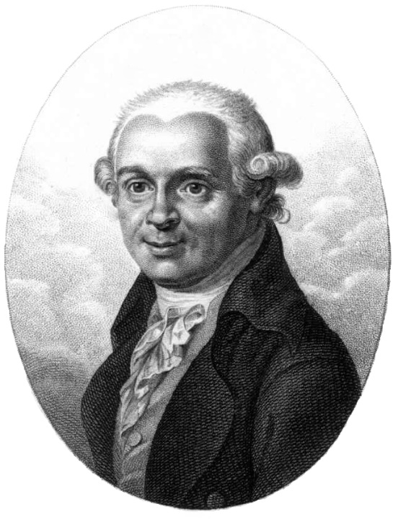
Abraham Gottlob Werner (1749-1817)
Kurze Klassifikation und Beschreibung der verschiedenen Gebirgsarten (Short Classification and Description of the different kinds of rock) Published in 1786
Rocks classified in 4 periods of formation:
Primeval (uranfangliche)
Stratified (Flötz)
Volcanic
Alluvial

Slide 20
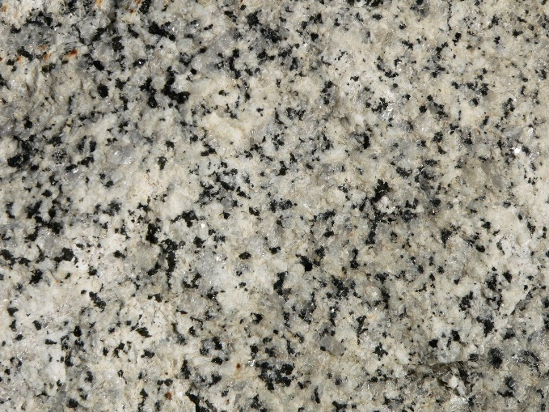
The rocks of the Primeval and Flötz periods precipitated or were deposited from the waters of a universal ocean (Neptunism).
From Prothero & Dott, 2009
The most primordial rocks to have precipitated were granites

Slide 21
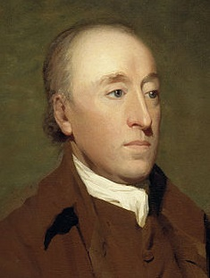
James Hutton (1726-1797)
Theory of the Earth (Published in 1788): Two ideas in conflict with Werner’s model:
1) Heat instead of water: Plutonists
2) Cyclical view of Earth history (instead of Directional view)

Slide 22
Hutton on granites (1794):
- They are not primary - They formed from hot magma, not water

Slide 23
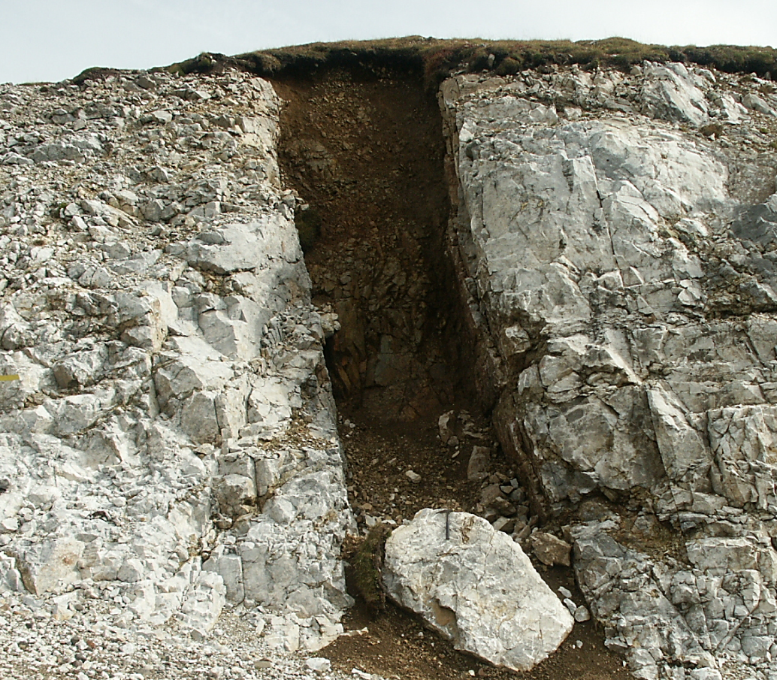
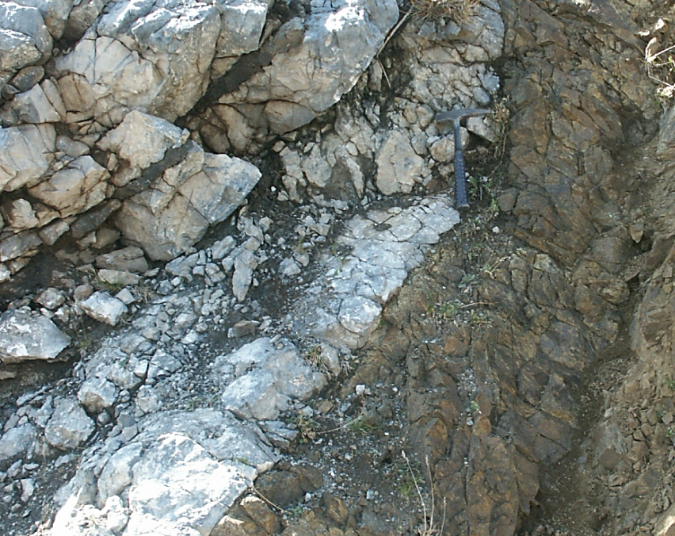
Discovery in Predazzo (1820)
Granite resting above stratified secondary rock
Magma cutting across the secondary rocks and “cooking” them with heat
Implication: granite cannot be primary rock, vindication of plutonism
However, modern geological thinking is a mixture between Werner’s directionalism and Hutton’s cyclical view

Slide 24
3) Do mountains move around? (Fixist vs Mobilists, part 1)
Glarus
Photo courtesy of NASA

Slide 25
Mountains, folded and vertical strata: evidence for motion of the Earth’s crust
Predominant model in early 1800s: Fixism, mostly VERTICAL movement, related to pushing up of hot magma or subsidence when cooling

Slide 26
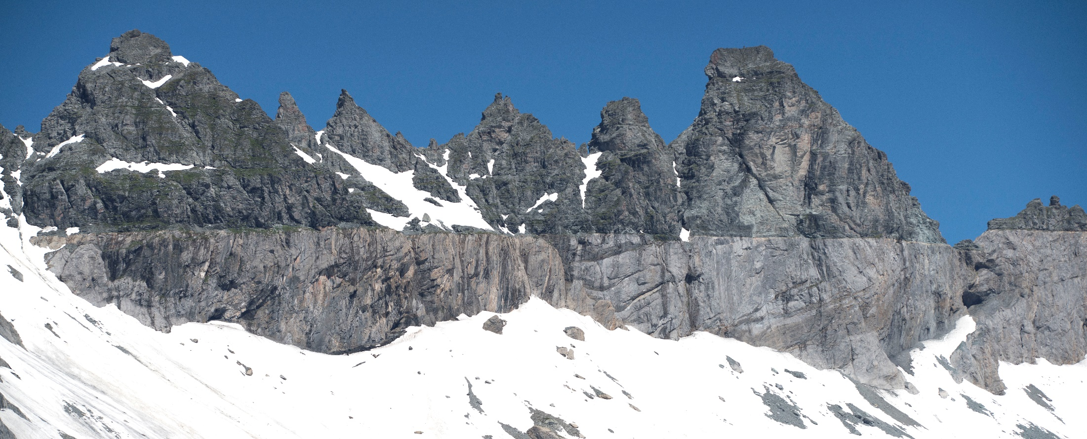
Arnold Escher (1807-1872)
Works in the Glarus Alps (Switzerland)
Extensive horizontal contact
Younger rocks below and older rocks above
older
younger

Slide 27
Arnold Escher (1807-1872)
Works in the Glarus Alps (Switzerland)
Arrangement required “colossal” lateral movement, difficult to reconcile with verticalist model
older
younger

Slide 28
Escher and his student, Albert Heim, develop a model to explain the arrangement without invoking large scale lateral movement: the Double Fold model

Slide 29
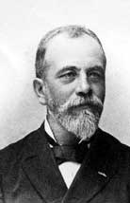
In 1884, Belgian geologist Marcel Bertrand writes a paper based on his readings on the double fold model, and suggests a different alternative
Gliding surface model
(Surface de glissement)

Slide 30
Verticalist model, Escher & Heim
Mobilist model, Bertrand, involves significant lateral movement
Mobilist model encounters fierce resistance but will be accepted at the beginning of the 20th century

Slide 31
4) Do continents move around? (Fixist vs Mobilists, part 2)
Totalp
Photo courtesy of NASA

Slide 32
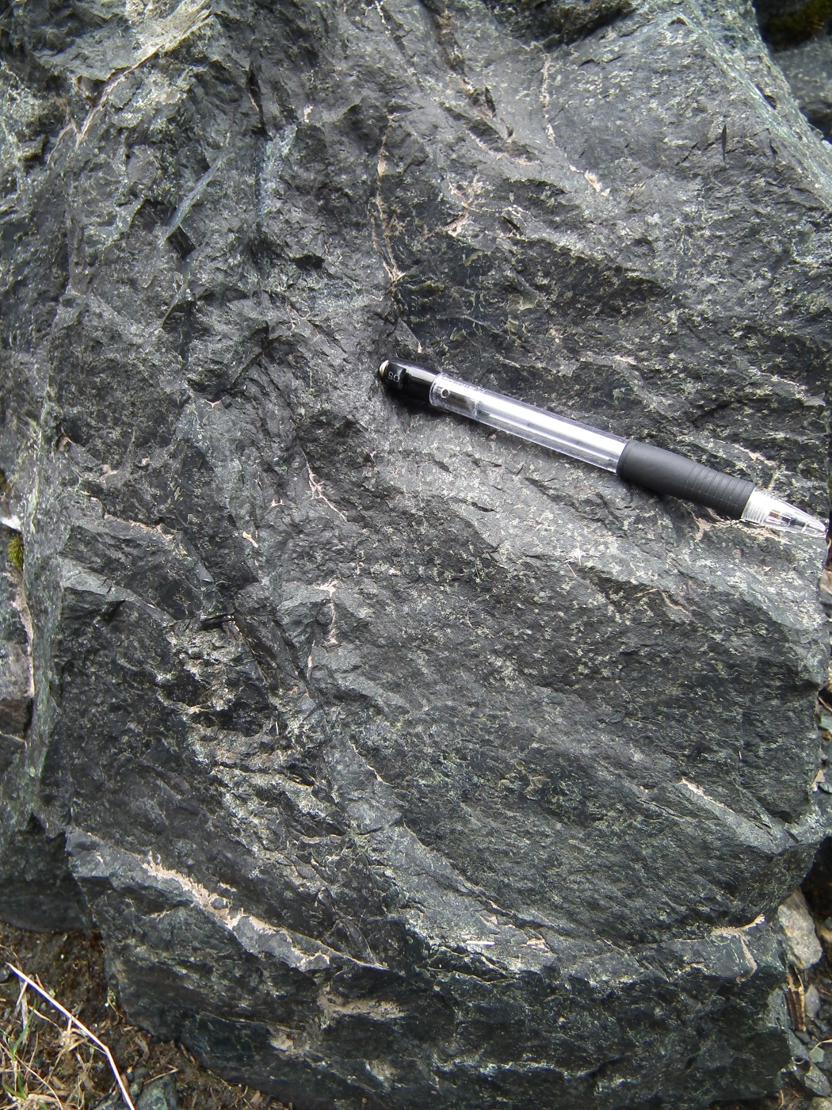
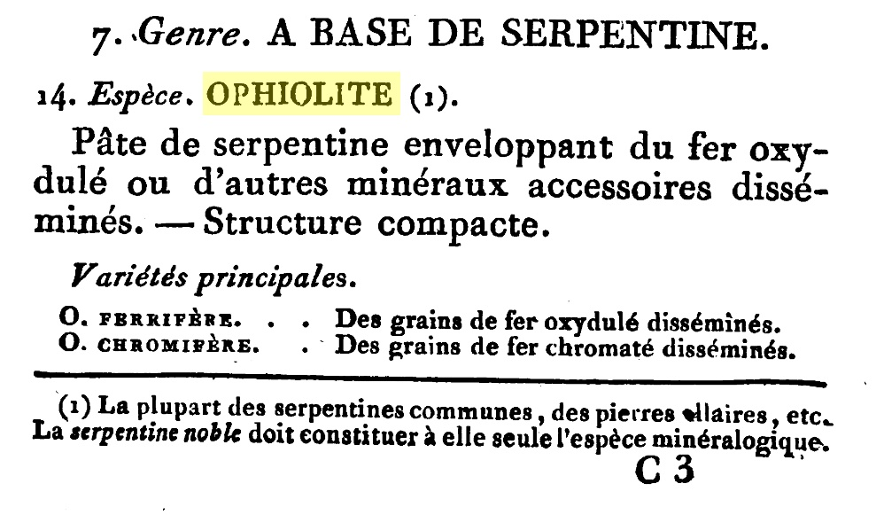
In 1813, French geologist Alexandre Brongniart coins a new name for a type of dark rocks: “ophiolite.”
Name comes from the Greek words for “snake” and “rock,” (these smooth dark green rocks are vaguely reminiscent of snake skin)

Slide 33
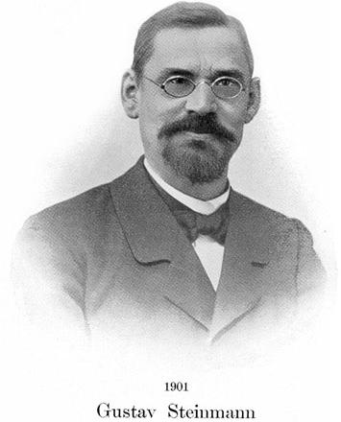
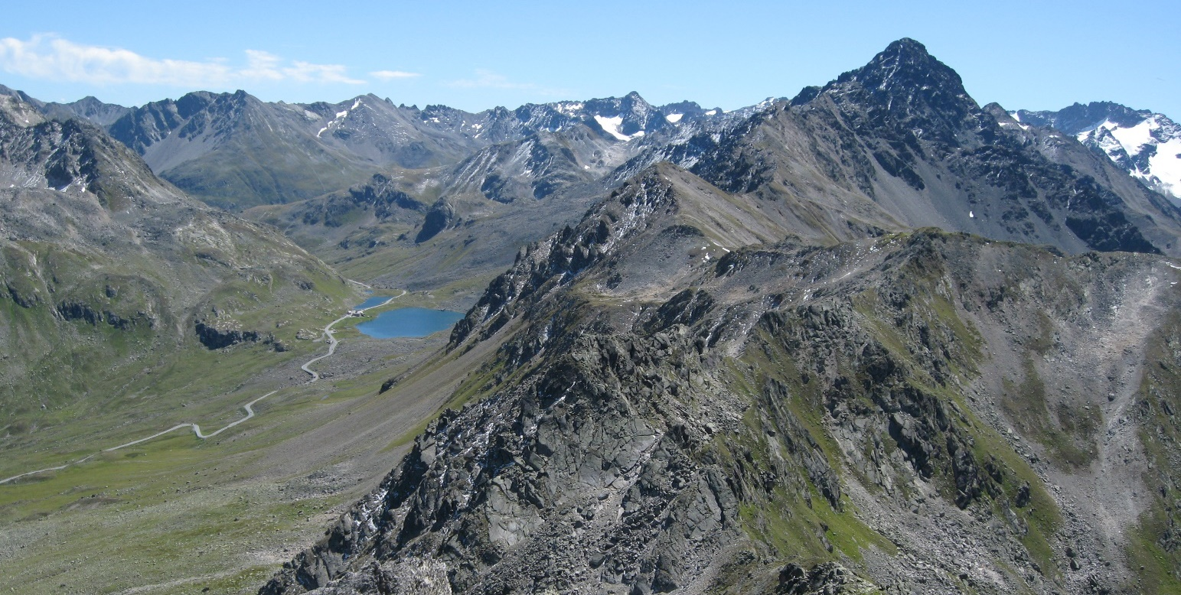
European geologists knew these dark rocks from several parts of the Apennines and Alps.
In the early 1900’ the German geologist Gustav Steinmann publishes several studies on ophiolites
Totalp ophiolites (Switzerland)

Slide 34
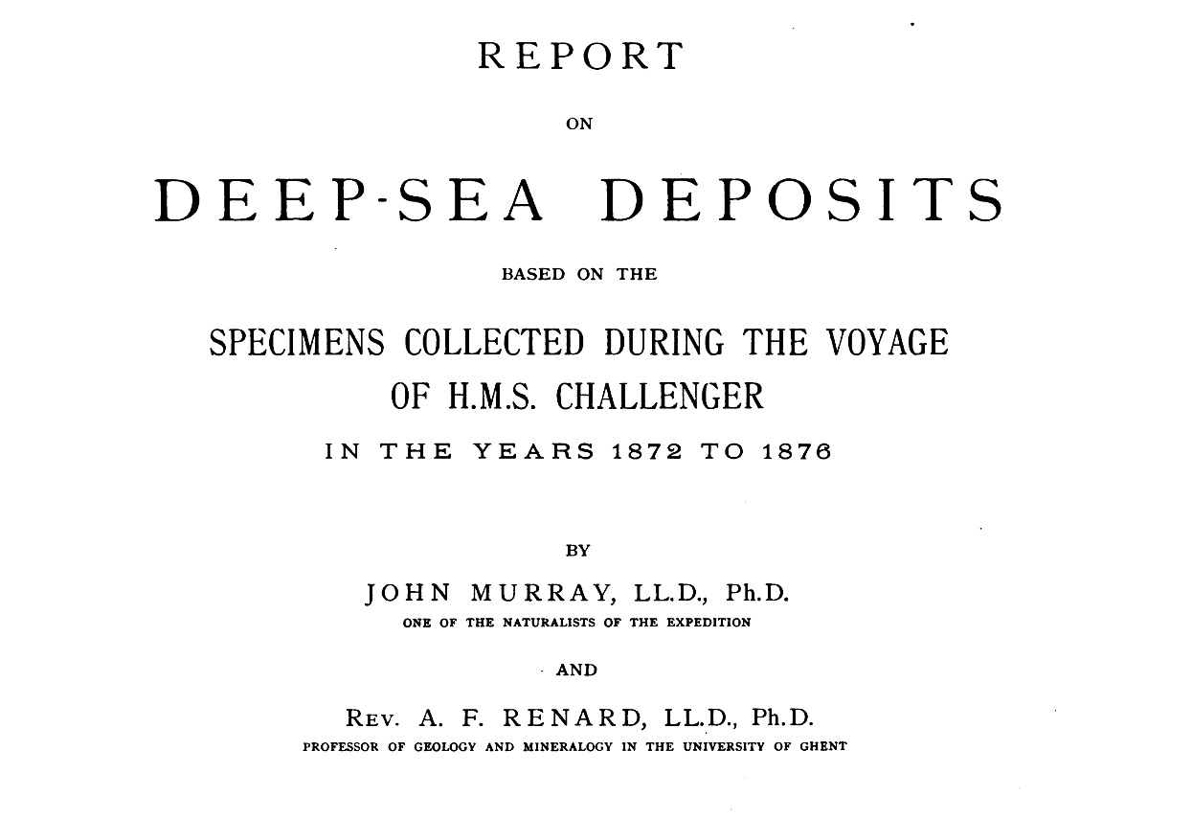
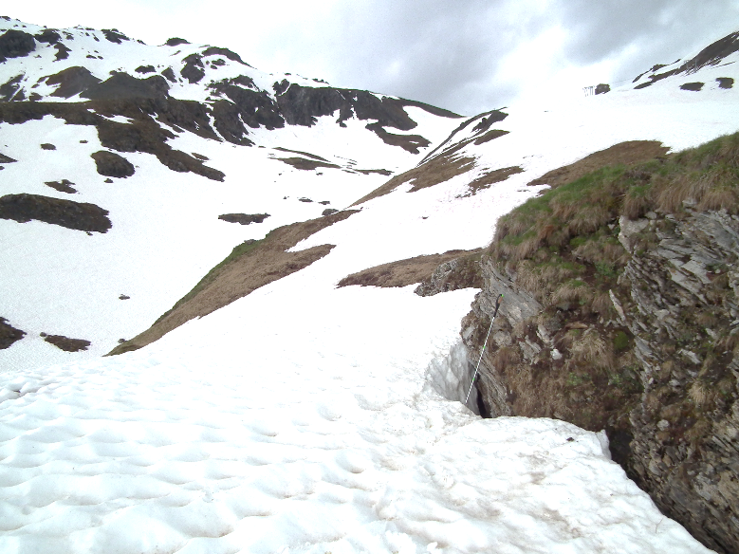
Steinmann observes that ophiolites are consistently associated with limestone and chert deposits
Sediments of similar composition (lime and silica ooze) had been recently retrieved from the deep seafloor, during the earliest oceanographic expeditions.

Slide 35
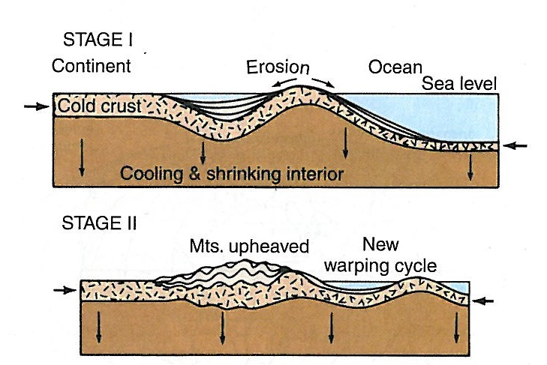
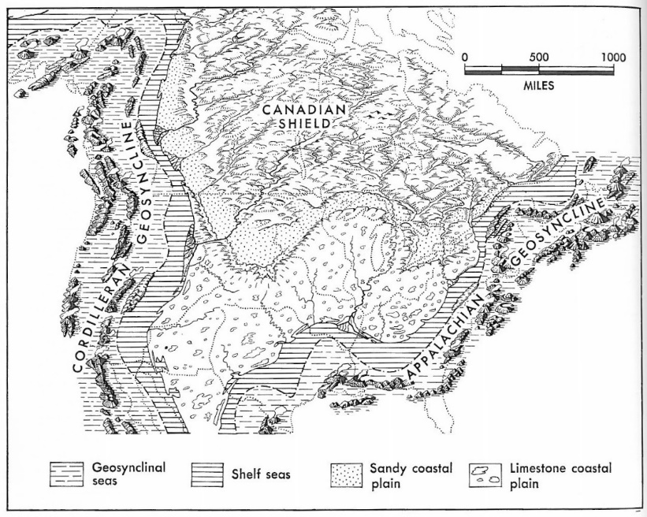
Steinmann becomes convinced that ophiolites and the associated sediments must have formed on the deep ocean floor. But how could rocks from the deep ocean floor have been uplifted several kilometers above sea level?
The geosyncline model (end of 19th century up to 1960)
Depression at margin of continent caused by accumulation of sediments
Lateral displacement of crust causes uplift
Explained well mountain belts at continental margins
From Clark & Stearn, 1968

Slide 36
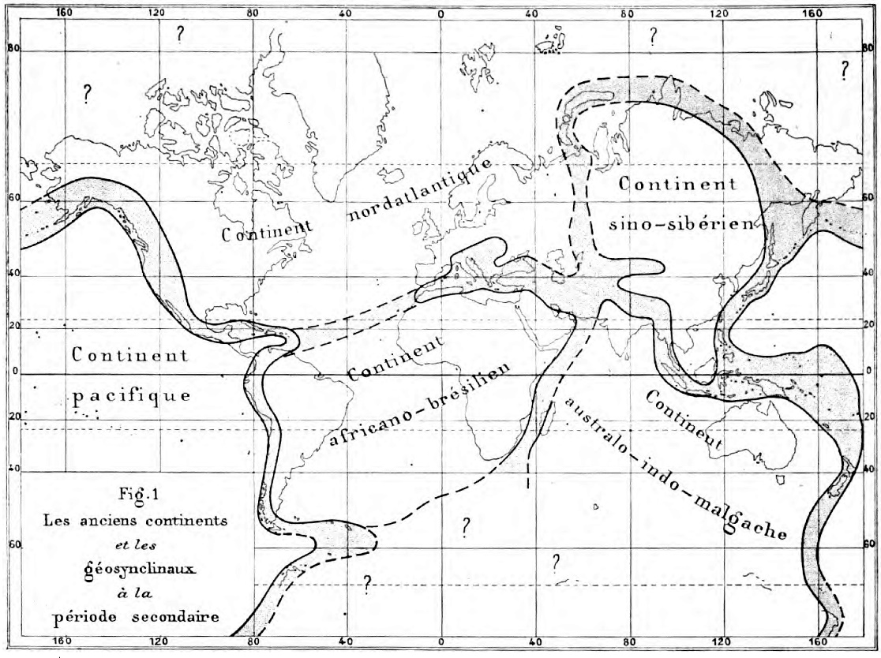
The geosyncline model (end of 19th century up to 1960)
Continents and oceans seen as essentially static, occupying fixed position through time. Only margins subject to substantial modifications.
Alpine chain interpreted as one of these depressions between relatively stable continents (Thetys geosyncline)
From Haug, 1900, “Les géosynclinaux et les aires continentales.”
From R. Staub, 1924, “Bou der Alpen.”

Slide 37
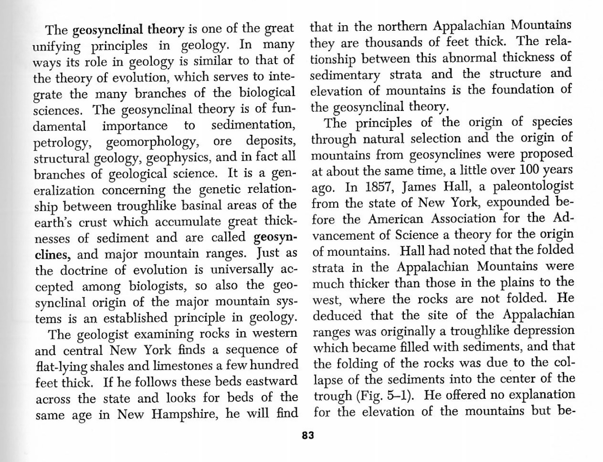
The geosyncline model (end of 19th century up to 1960)
Example of major paradigm shift
Knopf, 1948, GSA Bulletin
Clark & Stearn, 1968

Slide 38
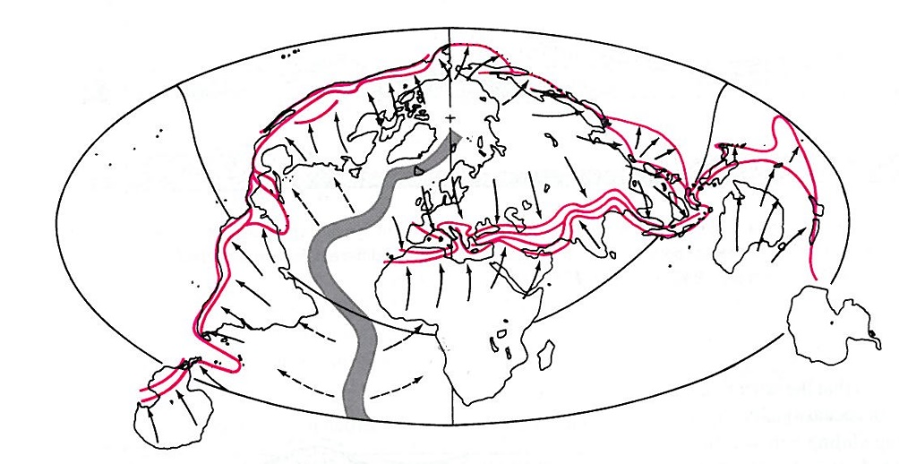
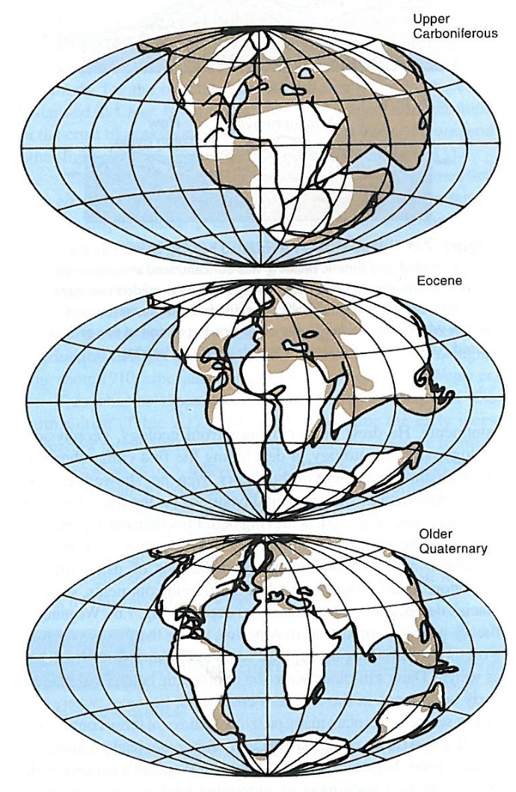
The drift model
Taylor and Holmes, beginning 1900.
A. Wegener develops the drift model further (1912-1929)
Resistance:
Too “catastrophic”
No accepted mechanism (he suggests wobble effects, centrifugal effects of the Earth’s spin, tidal effects)

Slide 39
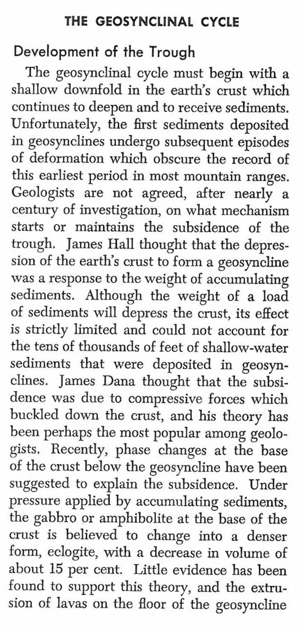
The geosyncline model (end of 19th century up to 1960)
However, notice how the mechanisms driving the geosyncline model were also unclear…
Preferred over continental drift probably because of better adherence to the dominant paradigm
Clark & Stearn, 1968

Slide 40
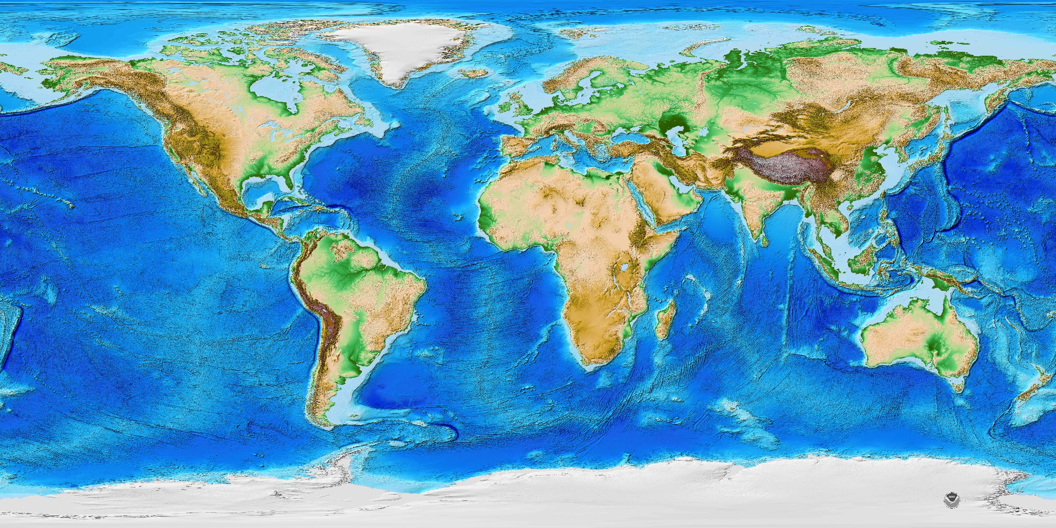
The drift model
1940-1960: - Study of seafloor topography: more rugged than thought before (oceanic ridges). Heat flow. Seismicity. Little sediment: young crust? - Study of paleomagnetism

Slide 41
Plate tectonics
Paradigm shift in the late 1960s. Oceans are formed and consumed, continents move around and collide. Alpine ophiolites are remnants of a lost ocean trapped between collision of continents

Slide 42
Lessons and Conclusions
1) Impact of new observations/discoveries (telescope, new outcrops, oceanography). Data from nature can trigger worldview adjustments
2) Tying of philosophy/theology to nature (scholastic philosophy, huttonian cyclical view, uniformitarianism). Worldviews influence the way we interpret data from nature
3) Dynamic nature of science. Not only new discoveries that add to existing knowledge, but important revolutions in thinking and reinterpretations of data, especially in the historical sciences

Slide 43
Resources
Series of Short Videos:
http://grisda.org/resources1/audio-visual-media/video-series-clash-of-ideas/

