Slide 1
Arguments Creationists Should Not Use
When It’s Better to Be Silent
Presented by Dr. Suzanne Phillips, Loma Linda University
compiled and written by Dr. Raúl Esperante, Geoscience Research Institute
Notes:
Suzanne Phillips will not talk present any of the “HIDDEN” slides. Only the visible slides will be presented in Nigeria 2023.

Slide 2
Do Not Use Bad Arguments
Some creationists are known for using bad scientific arguments against long ages and evolution.
Evolutionists also use many bad arguments against creation.
The use of bad arguments by creationists has inflicted much damage to genuine creation scientists.
The Bible doesn’t need Christians using bad arguments or forcing evidence to prove itself.

Slide 3
Thou Shall Not Use Bad Arguments
Scientists in the SDA church have consciously decided that they would do top tier, peer-reviewed, publishable research that supports the bible as opposed to merely attacking the interpretations of evolutionists
Scientists of the SDA church have consciously decided that when they build presentations or papers defending the belief of the bible, they will only cite peer-reviewed publications (we will avoid internet-only citations!)

Slide 4
1) Darwin Recanted from his Ideas
Many sincere Christians believe that Darwin renounced evolution on his deathbed.
He died in April 1882 and was buried in Westminster Abbey and within days of his death, news of a conversion experience began to circulate.
The evidence though, does not support any conversion.

Slide 5
The evidence most often cited is the alleged visit that Lady Hope (Elizabeth Reid Cotton) paid to Darwin before he died.
In 1877 she married Admiral Sir James Hope, so she became Lady Hope.
Lady Hope and her father were active evangelists in Kent, near Darwin’s home.
On a visit to Massachusetts for a conference in 1915 she told about the visit she had with Charles Darwin before his death.

Slide 6
She later wrote an account of this visit, which was then published in the Watchman-Examiner, a national Baptist magazine, on August 19, 1915.
In the article, Lady Hope claimed to have visited Darwin at his home and found him reading the Bible, which she claimed he was always studying.
Lady Hope claimed that before her departure Darwin asked her to return and talk to his servants about Jesus Christ.
The inconsistencies in this report make the story untenable.

Slide 7
There is no indication that Darwin was always (or any time at all) studying the Bible.
  Emma, his wife, was a devout Christian, who would have been delighted to say to the world that her husband was an avid reader of the Bible, or that he had converted to the faith.
  But Emma never claimed that during Darwin’s life or after his death.

Slide 8
Even if Darwin was reading the Bible, Lady Hope never says that Darwin renounced evolution or became a Christian.
His children explicitly denied that possibility.
In a letter to James Howe, Darwin’s son Francis wrote in 1915: “He [Darwin] could not have become openly and enthusiastically Christian without the knowledge of his family, and no such change occurred.”
Francis accused lady Hope of falsehood, an accusation to which she never replied.
Darwin’s daughter Henrietta, who was present at his deathbed, said in 1922 that Darwin “never recanted any of his scientific views, either then or earlier.”

Slide 9
Earth’s Axis was Vertical Before the Flood
The axis of planet earth is inclined 23.5 degrees.
The tilt causes the seasons.
Some creationists suggest that it wasn’t so after Creation and before the Flood: the Earth’s axis must have been vertical.
They say that the vertical axis caused the weather in pre-Flood times to be uniform throughout the planet.

Slide 10
This claim has several problems.
First, the idea that the weather must have been uniform before the Flood is an assumption, not something that we derive from either geological data or Scripture.
Second, there is no scientific basis to believe that the Earth’s axis was not tilted before the Flood.
  Seasons are mentioned in Genesis 1:14, before the Flood
  This suggests an axial tilt from the beginning.
  That suggests some degree of weather variability.

Slide 11
However, there are Scriptural issues to be considered:
Some versions say “seasons”, and others say “festivals”, “sacred times”.
The tilting of the earth, whether it existed or not, may not have had anything to do with weather.
Although possible, the idea of the tilting of the Earth is speculative and there is no sufficient evidence to defend it scientifically.

Slide 12
Earth’s Division in the Days of Peleg Refers to Splitting of the Continents
Genesis 10:25—Two sons were born to Eber: One was named Peleg, because in his time the earth was divided; his brother was named Joktan.
This passage has been interpreted in various ways.
  Ellicott’s Commentary for English Readers: “Cyril Graham considers that the name refers to ‘the first cutting of some of those canals which are found in such numbers between the Tigris and the Euphrates.’ This is made more probable by the fact that Peleg in Hebrew means water-course”.

Slide 13
Most commentators interpret the ‘division’ as the confusion of tongues and consequent dispersion of mankind after the attempt to build the Tower of Babel.
Nothing in Scripture indicates that this division was the separation of continents.
Besides Genesis 10:25, the Hebrew verb pelag is used only in two other passages in the Bible.
  Job 38:25: “Who cuts a channel for the torrents of rain, and a path for the thunderstorm”
  Psalm 55:9: “Lord, confuse the wicked, divide their tongues, for I see violence and strife in the city”.
    This is good internal evidence that there is a reference to the division of tongues in the Genesis text as well.

Slide 14
The concept of continental split and separation was first brought forth by a Christian geologist named Antonio Snider in 1859.
He publicly commented on the apparent fit of all the continents based on their shape.
He believed the spreading apart and separation of the continents occurred catastrophically during the Genesis Flood.

Slide 15
There is good observational evidence that is consistent with an original supercontinent in the past that was split apart.
The difficult issue for a model based on a Recent Creation and Flood is the timing.
We don’t know what that Genesis text actually means.
There is a danger in having Geology interpret Scripture.
The Bible was not written as a scientific text.
Nevertheless, geologic implications should not be ruled out without further study.

Slide 16
Giant Human Skeletons
The Bible mentions the existence of ‘giants’ among humans.
The word appears in modern version as the translation of the Hebrew words
  nephilim ( Gen 6:4; Num 13:33 );
  repha'im ( Deut 2:11,20; 3:11,13; Jos 12:4 , etc.);
  rapha' ( 1Chron 20:4,6,8 ),
  raphah ( 2Sam 21:16, 18, 20, 22 );
  in one instance of gibbor, literally, "mighty one" ( Job 16:14 )
Notes:
(Suzanne Phillips will NOT read through these slides. I will only reference them as presenting all the places “giants” were talked about in the bible)

Slide 17
Genesis 6:4—There were giants in the earth in those days.
Genesis 14:5-7—In the fourteenth year Chedorlaomer and the kings that were with him came and attacked the Rephaim in Ashteroth Karnaim, the Zuzim in Ham, the Emim in Shaveh Kiriathaim, and the Horites in their mountain of Seir . . . . Then they turned back and came to En Mishpat (that is, Kadesh), and attacked all the country of the Amalekites, and also the Amorites who dwelt in Hazezon Tamar.
Genesis 14 does not reveal that the Rephaim, Zuzim, Emim, or Amorites were giants, but this information can be found in other places.

Slide 18
Amos 2:9—Yet I destroyed the Amorites before them, though they were tall as the cedars and strong as the oaks…
The report of the spies sent to spy out the land of Canaan includes the Amorites.
  Numbers 13:29—The Amalekites dwell in the land of the South; the Hittites, the Jebusites, and the Amorites dwell in the mountains; and the Canaanites dwell by the sea and along the banks of the Jordan.
  The spies claimed that “all the people whom we saw in it are men of great stature” (Numbers 13:32).

Slide 19
Deuteronomy 2:10-11— The Emites used to live there—a people strong and numerous, and as tall as the Anakites. Like the Anakites, they too were considered Rephaites, but the Moabites called them Emites.
Deuteronomy 2:20-21—That too was considered a land of the Rephaites, who used to live there; but the Ammonites called them Zamzummites. 21They were a people strong and numerous, and as tall as the Anakites. The Lord destroyed them from before the Ammonites, who drove them out and settled in their place.

Slide 20
The most common term used in the Bible to refer to giants is rephaim.
  Deuteronomy 3:11, 13—Og king of Bashan was the last of the Rephaites. His bed was decorated with iron and was more than nine cubits long and four cubits wide…The rest of Gilead and also all of Bashan, the kingdom of Og, I gave to the half-tribe of Manasseh. (The whole region of Argob in Bashan used to be known as a land of the Rephaites).
  The size of his bed is significant: 4 m long, and almost 2 m wide.

Slide 21
The nephilim are first mentioned in the Bible just before the Flood.
  Genesis 6:4—There were giants [nephilim] on the earth in those days, and also afterward, when the sons of God came in to the daughters of men and they bore children to them. Those were the mighty men who were of old, men of renown.
There has been much debate about the meaning of the Hebrew word nephilim.
They are also mentioned in the report by the ten spies that explored Canaan (Number 13:32-33).
The truth is that the Bible does not clearly explain what the ‘giants’ were like compared to average size of humans of that time or the present.

Slide 22
In the nineteenth century discoveries of ‘giant’ humans were popular, though no concrete evidence had been put forth of any of them.
Most likely the discoveries were hoaxes created for various reasons, including bad science, to achieve fame, or excessive zeal to support the claims of the Bible.
THERE HAVE BEEN NO VERIFIABLE, PEER-REVIEWED SCIENTIFIC PUBLICATIONS ABOUT GIANT SKELETONS. While SDA’s BELIEVE in the bible, and we belief that there were giants on the earth, because there is no scientific research done to show verifiable remains, and we do not want to promote what usually turn out to be a hoax, we do NOT talk about purported giant skeletal remains.
The number of supposed discoveries have skyrocketed since the beginning of the 21st century…

Slide 23
http://www.designcrowd.com/community/contest.aspx?id=1679918

Slide 24

Notice the giant pistol
http://www.designcrowd.com/community/contest.aspx?id=1679918

Slide 25
From: http://www.designcrowd.com/community/contest.aspx?id=1679918 “Scientists have discovered the missing link between man... and man's best friend. This half dog, half human species was found off the coast of Madagascar.”

Slide 26
http://www.designcrowd.com/community/contest.aspx?id=1680804

Slide 27
The images of giant humans circulating on internet are hoaxes.
Many of them have been created by artists using image retouching software like Photoshop.
The images are manipulations and enhancements of other photographs, and therefore are not valid scientific evidence.
A number of them can be found under “Archaeological Anomalies 2” (Archaeological Anomalies 3, etc.) on the web page http://www.designcrowd.com.

Slide 28


Slide 29
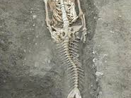

Slide 30
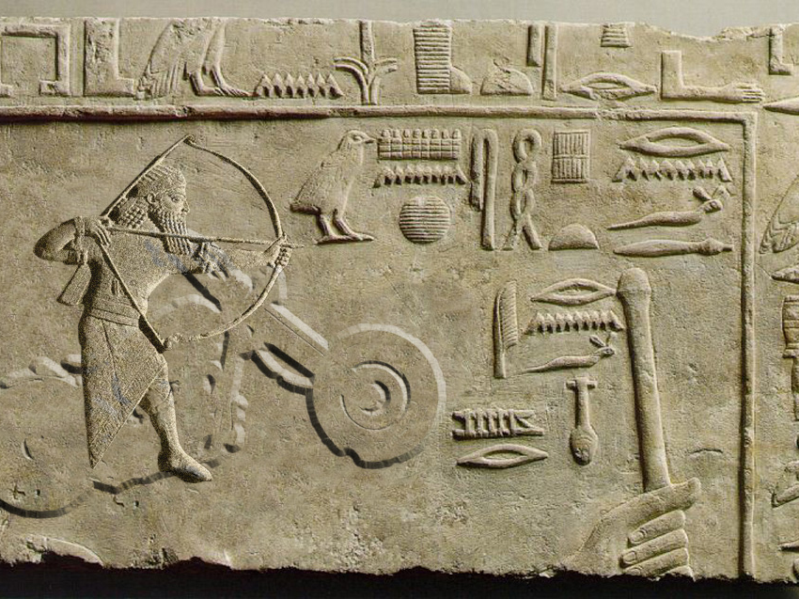

Slide 31
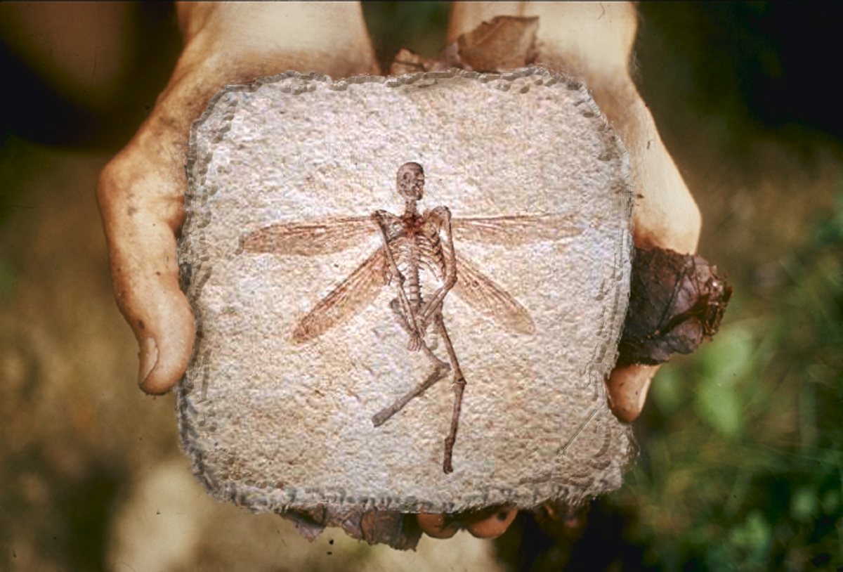

The dragonfly woman

Slide 32
Ancient Human Footprints
Ancient human footprints are extremely rare in the geological record.
Very few genuine fossil footprints have been reported:
  South Africa (Roberts and Berger 1997)
  Turkey (Osanzoy 1969)
  Australia (Webb et al 2006)
  Mexico (Gonzalez et al 2006)
  Ileret (Kenya)
  Danakil (Eritrea)
  Roccamonfina (Italy)

Slide 33
Many people believe that footprints of giant antediluvian humans have been found.
The number of images available on the Internet is very large.

Slide 34
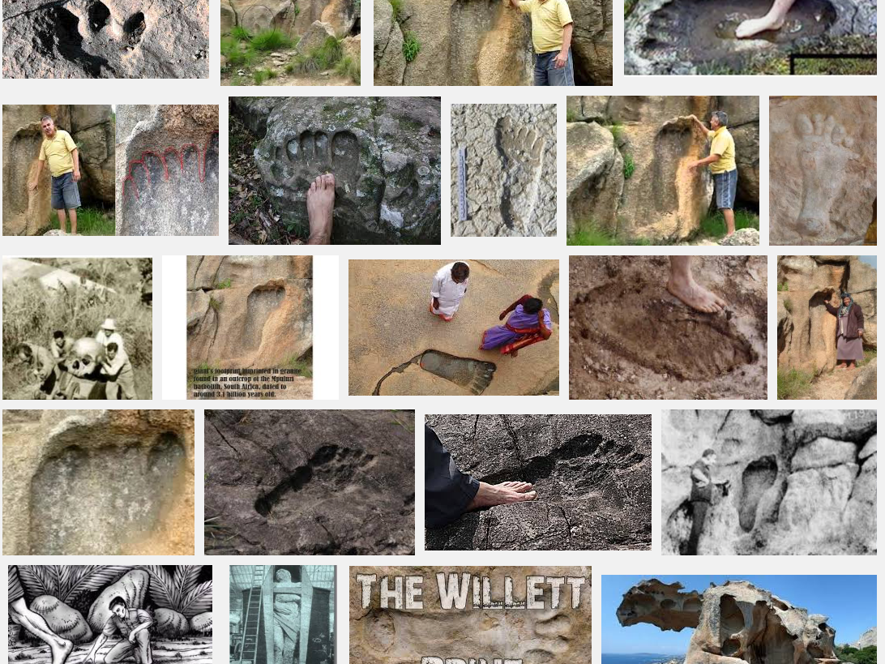
Results of Google Image Search

Slide 35
These are shapes in the rock that resemble human footprints, some of them of very large size.
Upon close examination, they can be explained away by several mechanisms:
  Erosion of the rock by water or flood water.
  Erosion and modification of pre-existing dinosaur footprints that leave a shape similar to a human footprint.
  Intentional carving of a footprint or modification of a dinosaur footprint or a natural erosional cavity.
  Photo manipulation.

Slide 36
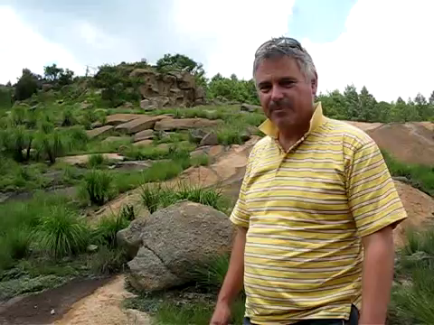
https://www.youtube.com/watch?v=dRuxw-nZoJw

Slide 37
This video is also sensational, but lacks any scientific rigor…
ONCE AGAIN, while SDAs believe that humans were walking the earth just a single day after the animals, because there is no peer-reviewed publication of human footprints found very low in the geological column, or human footprints found with dinosaur, or other ancient animal footprints, this then becomes a poor argument to use as evidence because much has been shown to be fake.

Slide 38
Some flaws:
  The narrator describes the rock as ‘granite’, which probably is correct based on the texture.
  Then he goes on to describe the bulge sticking out of the ‘footprint’:
    “It is like when you put your foot in mud, and you pull it out, your toes are lifted up, a little mud [is pushed out], where your toes were in. It is exactly what seems to have happened here. This rough granite…seems to have…[being pushed up]… It’s spectacular.”
Notes:
Suzanne Phillips will not read through this slide

Slide 39
This explanation makes no sense.
Granite rocks are not made of mud, and their properties are not suitable for the impression of footprints of any kind, even of a giant human.
Mud is soft and would be deformed under the pressure of a human footprint.
Granite is a solidified magma
  The footprint impression could not have been formed before cooling (solidification) for obvious reasons.
  After solidification, the magma is solid, not deformable by the pressure of any organism.
Notes:
Suzanne Phillips will not read through this slide

Slide 40
Humans and Dinosaurs
Some people claim that there is evidence in the rocks for the co-existence of humans and dinosaurs in the past.
They claim that human and dinosaur footprints have been found together.

Slide 41
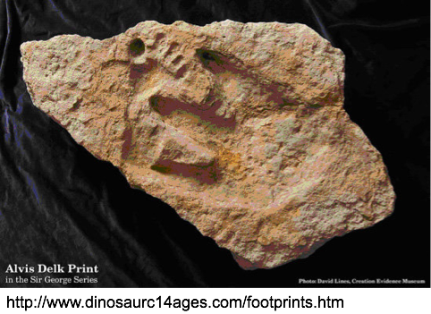

dinosaur
footprint
human
footprint

Slide 42
The most significant of these claims are the Paluxy River footprints.
These are alleged human footprints and trackways along with dinosaur footprints occurring in the same sedimentary layer near Glen Rose, Texas.
Some of the alleged human footprints are giant.
The rock is Cretaceous limestone, supposed to be 80-100 million years old in the standard geological time scale.

Slide 43
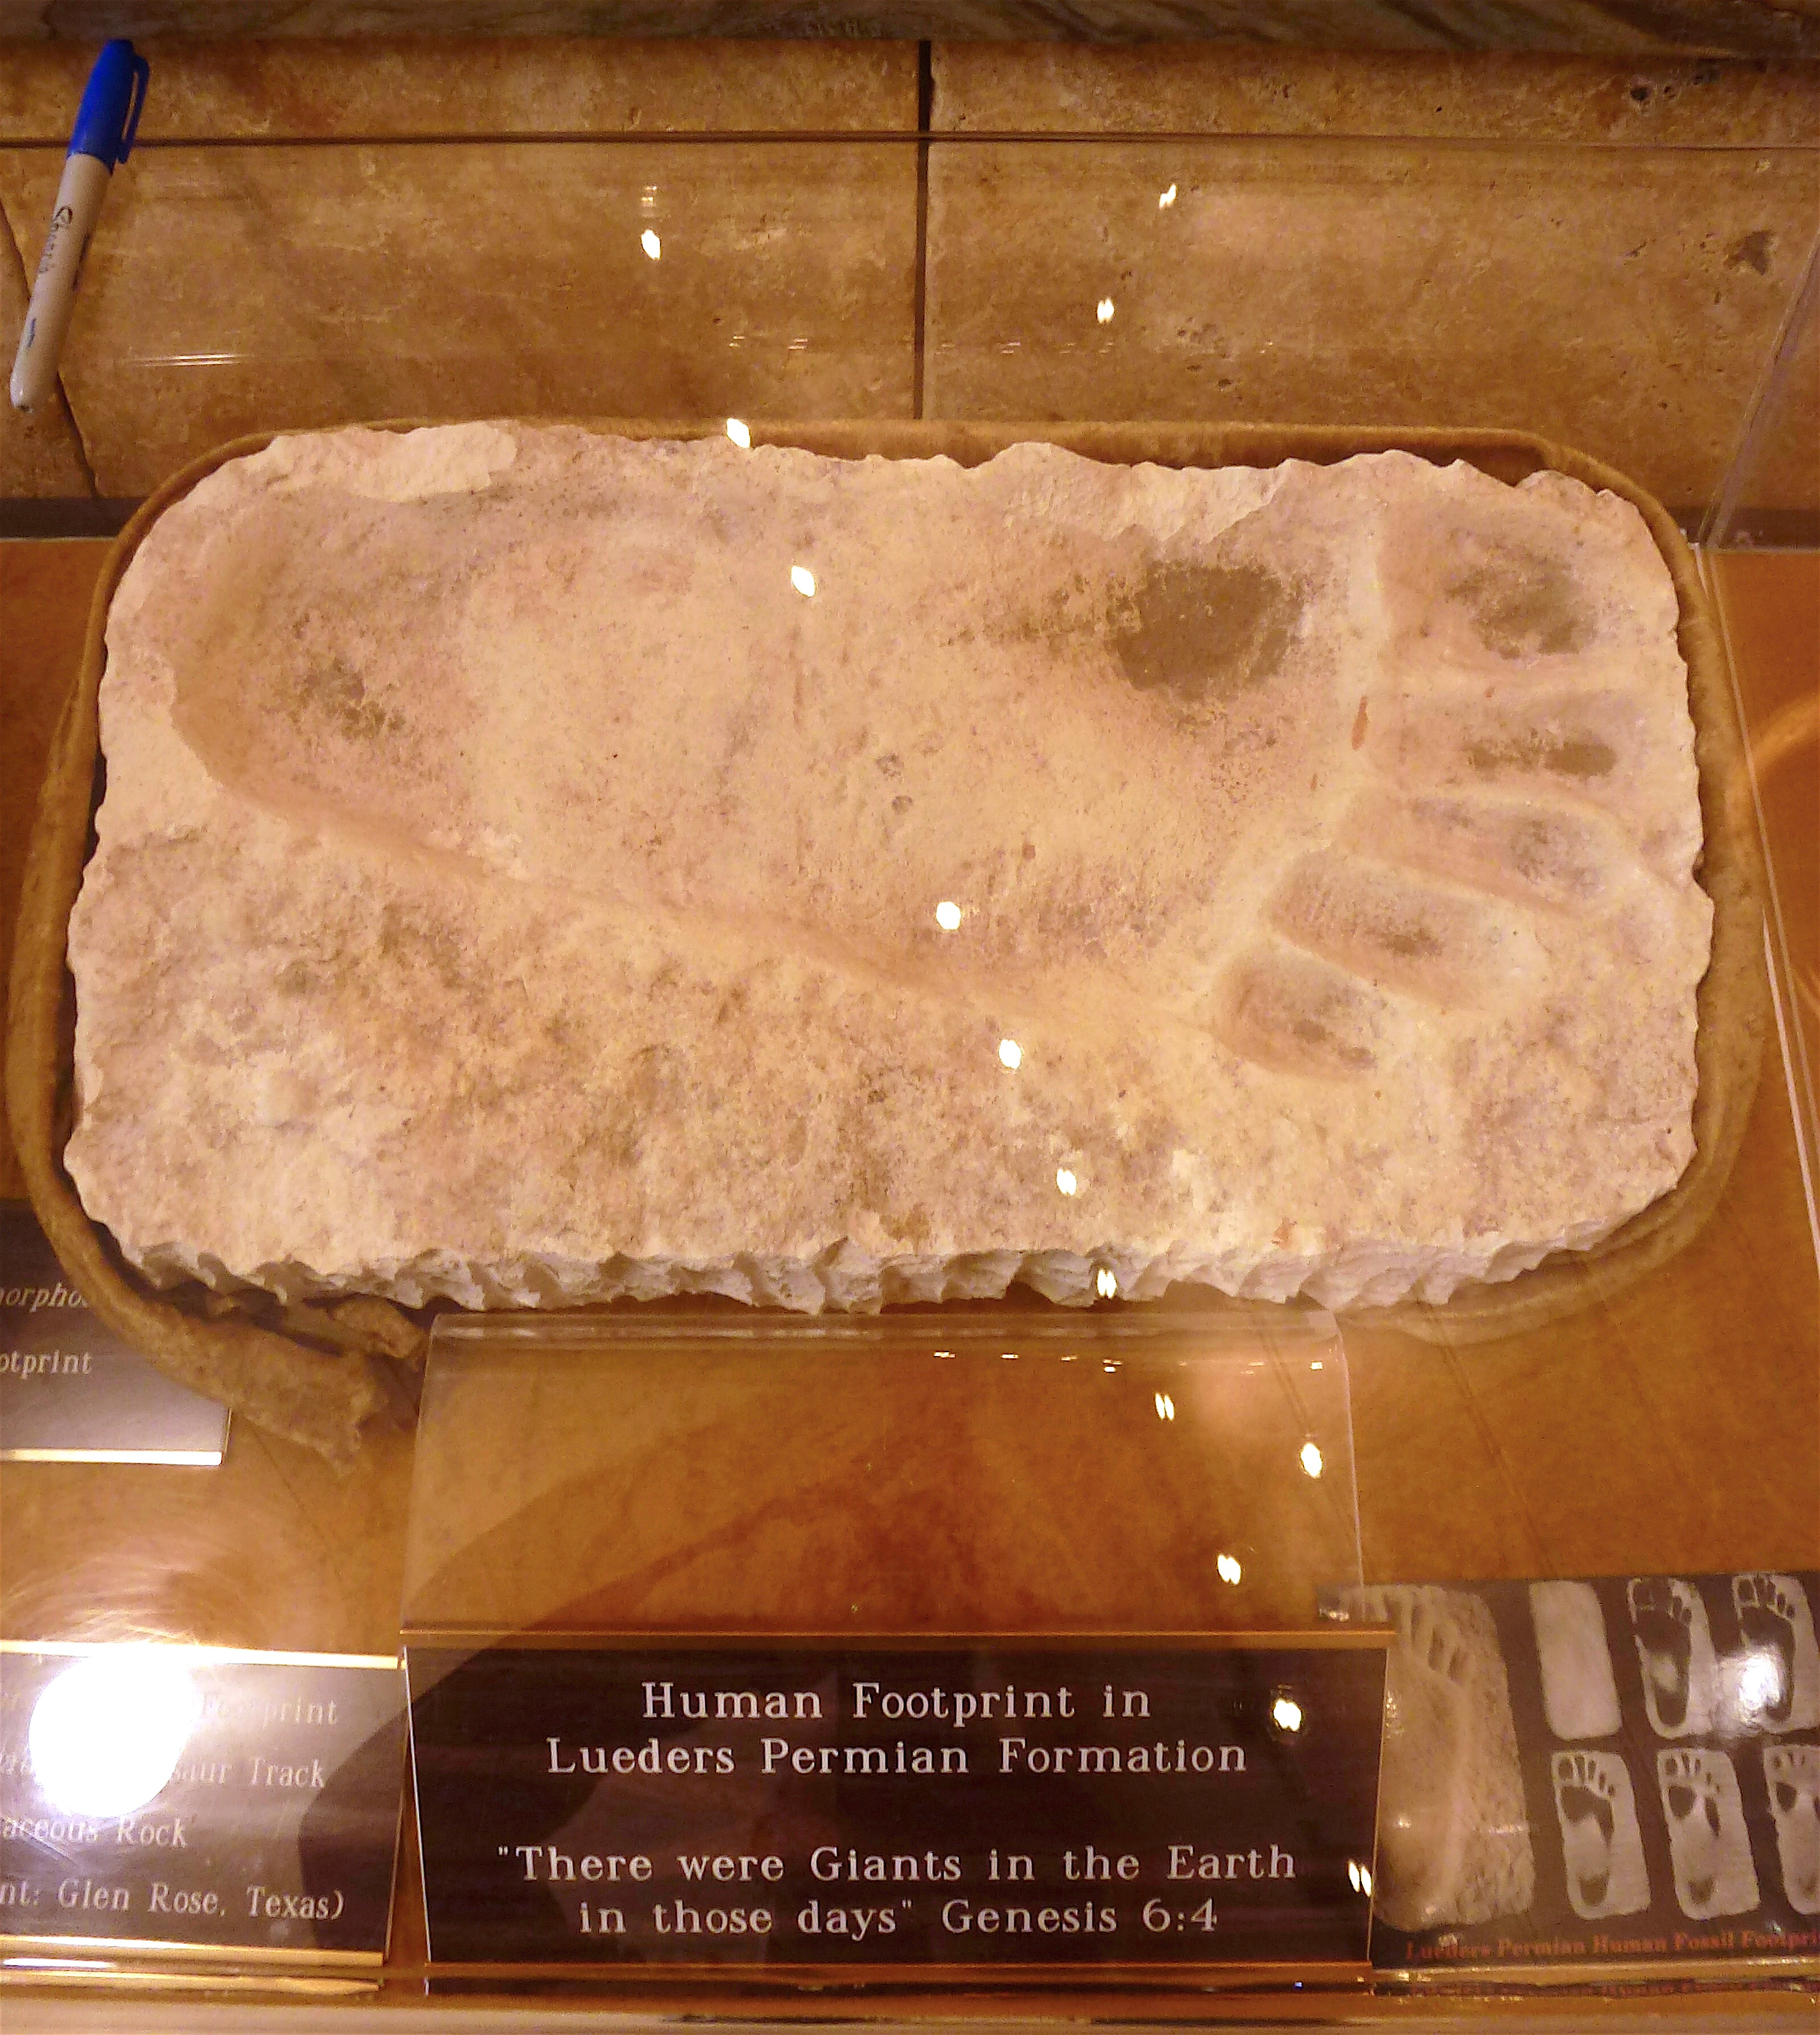
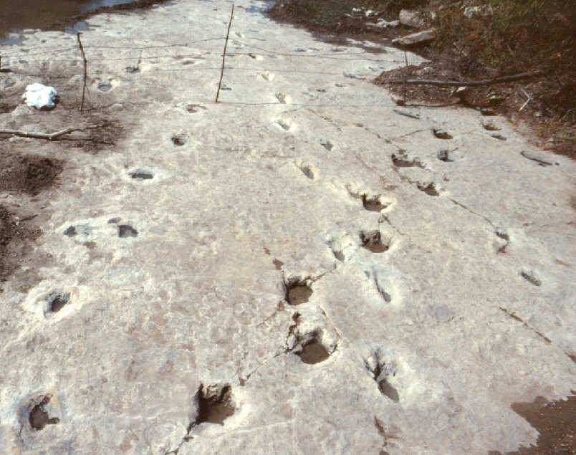
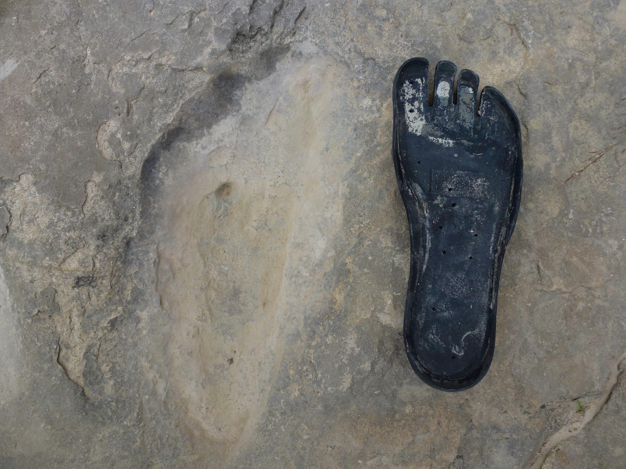
humanoid
dino
Paluxy River bed. Photo by Glen Kuban. http://paleo.cc/paluxy/paluxy.htm
Alleged human footprint. Creation Evidence Museum, Glen Rose, Texas.
Photo by Raúl Esperante
Paluxy River bed. Erosional structure that resembles
a human footprint. Photo by Raúl Esperante

Slide 44
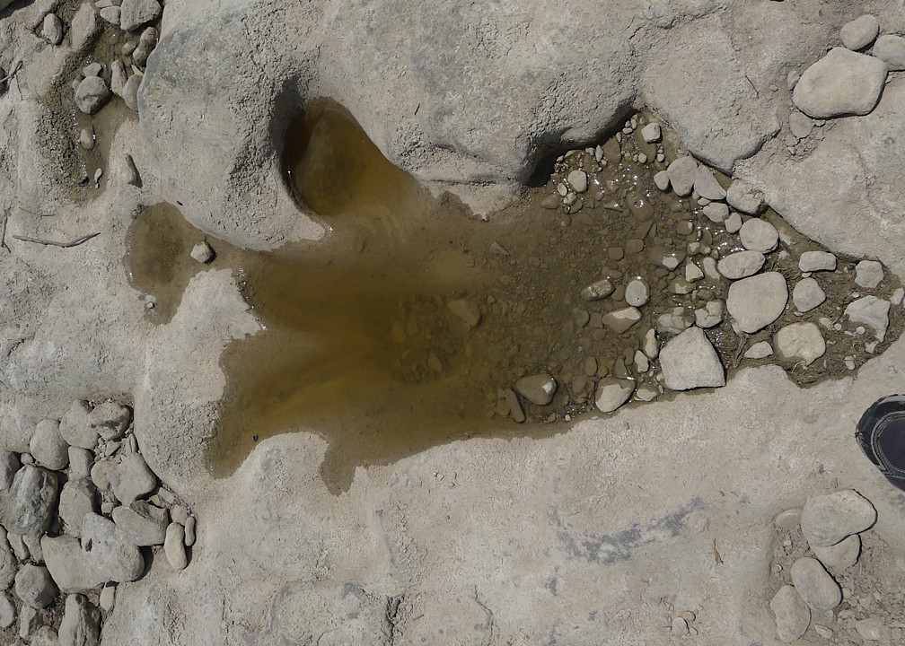
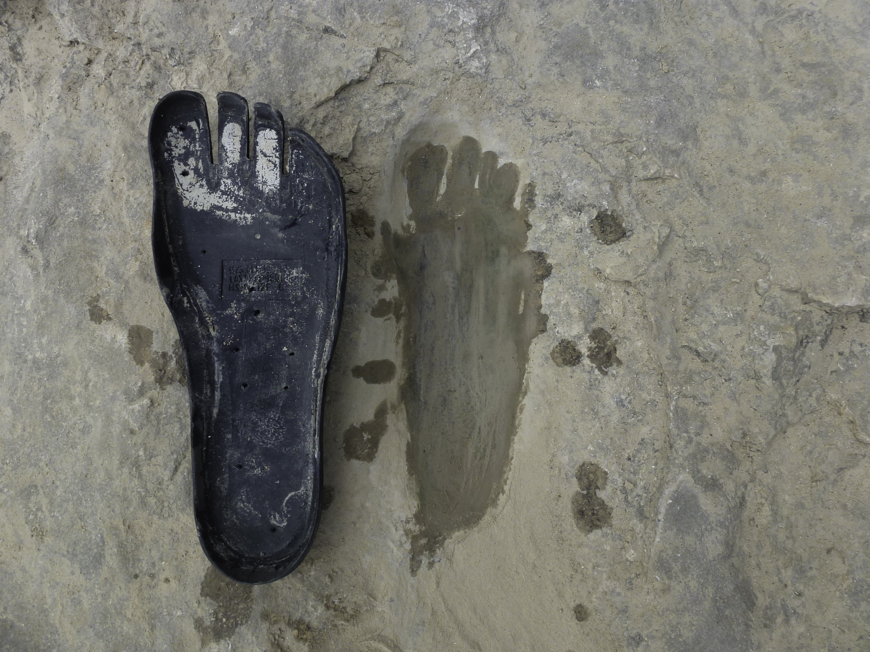

Slide 45
Some enthusiastic creationists who had visited the site had claimed that the structures in the bed were real giant human footprints alongside dinosaur footprints.
Other creationists and other scientists in general were skeptical.
The tracks had a clear humanoid appearance, but lacked some of the most important characteristics.

Slide 46
The tracks show no clear pentamerous (5-digit) feet.
The profile was more elongate and narrow than one would expect for a human track.
Careful examination revealed that several of the tracks bore three unmistakable divisions at the anterior end.
  These tracks may have been made by theropods and then altered by erosion.
Some of the poorly defined tracks exhibit the elongate appearance of “human tracks”.
  However, further down these tracks become clearly defined as dinosaurian.
  Therefore the structures attributed to humans were no other than dinosaur footprints altered or just originally poorly shaped.

Slide 47
Nevertheless, several unmistakably human footprints had been reported from the Paluxy River layers, accompanied by written accounts of their origin.
Several scientists have investigated these claims.
For example, Berney Neufeld examined several man-like and dinosaur tracks supposed to have been removed from the Paluxy Riverbed and housed in Columbia Union College (now Washington Adventist University) in Maryland.
A series of cuts in both the dinosaur and human tracks led to the conclusion that both were artful carvings.

Slide 48
In the 1980s several enthusiastic people and scientists continued to investigate the claims about the Paluxy River tracks.
  The most relevant were Glen Kuban, Ron Hastings, Carl Baugh, several scientists from the Institute for Creation Research (ICR) in San Diego, and some paleontologists.
  Cuban and Hastings discovered that surrounding and superimposed on some of the ‘human-tracks” were discolored haloes having the unmistakable form of tridactyl theropod tracks.
  While the origin of the discolorations was not clear, the evidence was clear: the tracks had to be dinosaurian.

Slide 49
Glen Kuban thoroughly investigated hundreds of shapes in the Paluxy River area beds and concluded that
  Many of the structures were true dinosaurian footprints.
  Others were erosional features
  Many were what he called as “metatarsal dinosaur tracks”: impressions of the heels and soles of the dinosaurs’ foot (the metatarsal or metapodial segments), which are normally held above the ground by bipedal dinosaurs.
  He suggested these dinosaurian track makers, for some reason, walked in a flat-footed or plantigrade manner, rather than digitigrade or impressing only their toes, as more typical of bipedal dinosaurs.

Slide 50
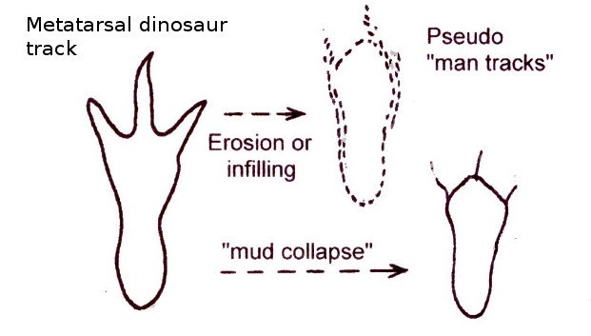
Kuban explains the formation of the metatarsal dinosaur track with this illustration:

Slide 51
In 1980, John D. Morris, then director of ICR, wrote a book on the tracks defending the creation model based on the Paluxy River tracks.
In 1986, Morris published a retraction of the positions he and the Institute had taken on the origin and significance of the tracks.
By the middle 1980s scientists had stopped interpreting the Paluxy River structures as human-made.
All but Carl Baugh.

Slide 52
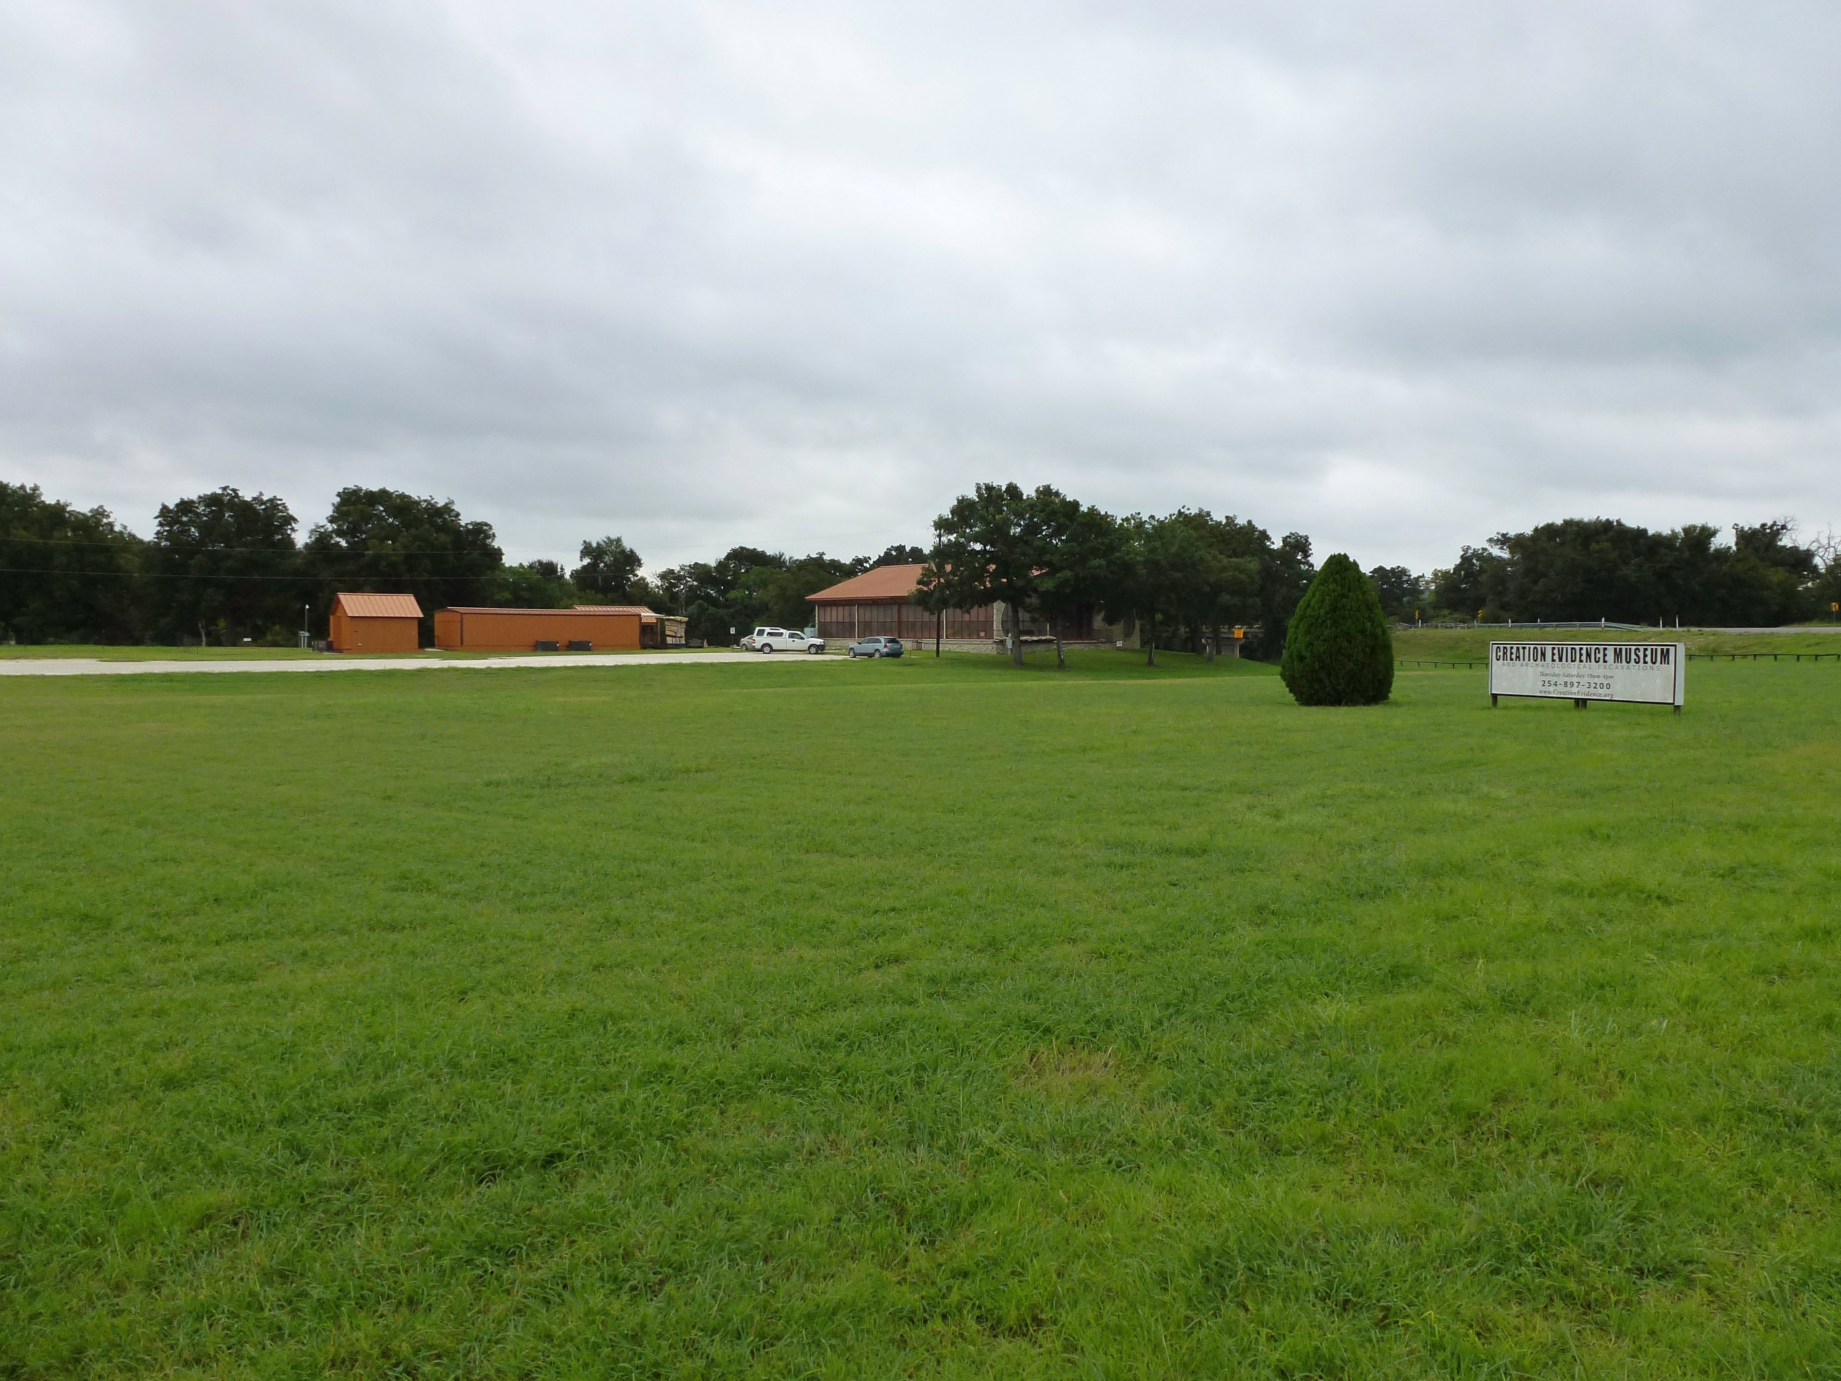
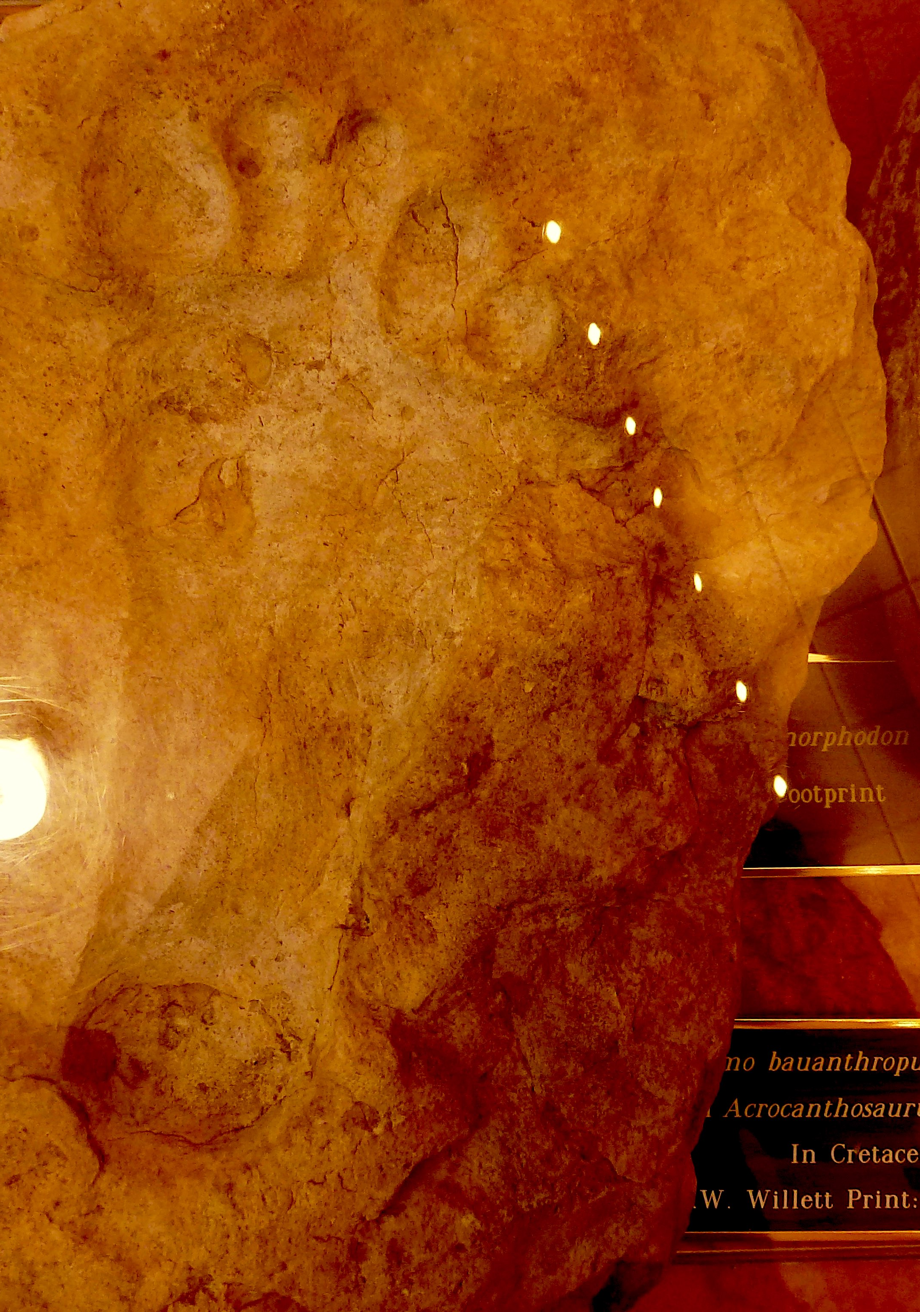
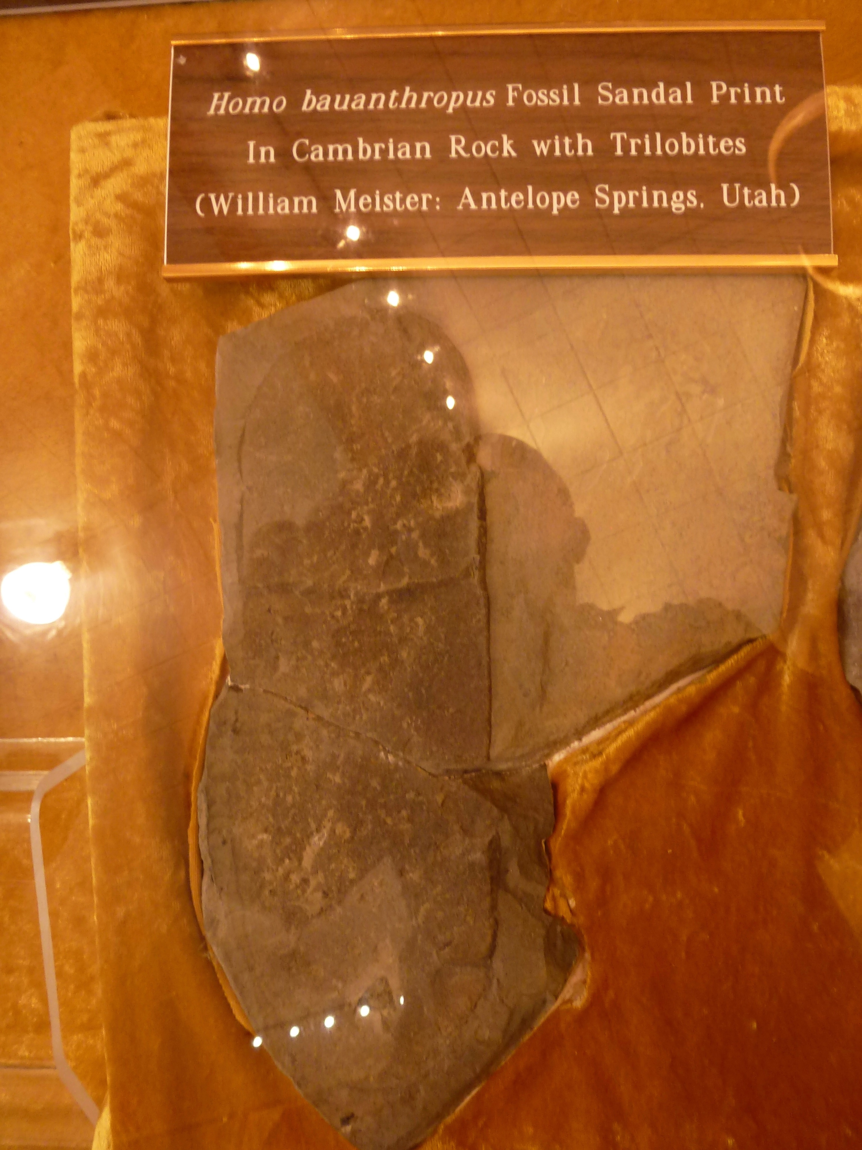
Creation Evidence Museum Glen Rose, Texas

Slide 53
The Creation Evidence Museum displays samples that could be categorized in three groups:
  True dinosaur footprints.
  Carved human-like footprints.
  Metatarsal dinosaur tracks naturally modified that resemble human footprints.
Also, in the field sites we can find shapes that are the result of erosion by water and resemble human footprints.

Slide 54
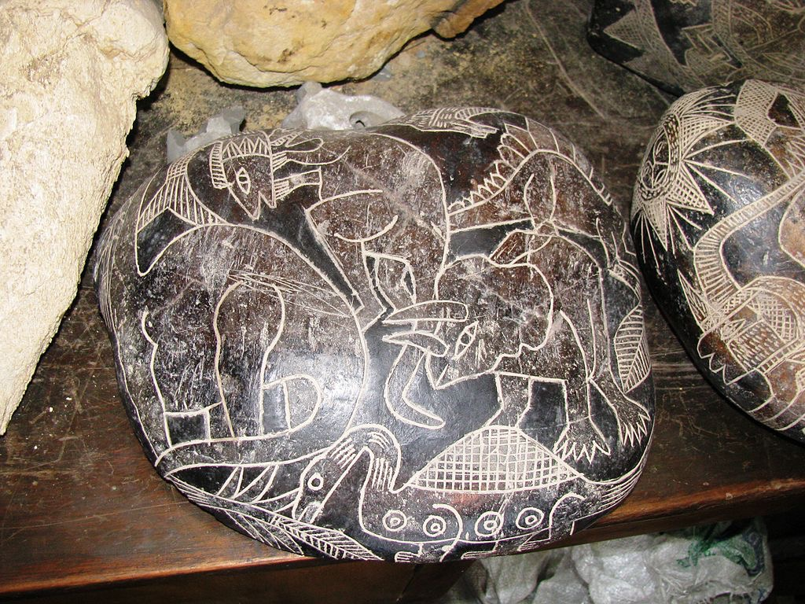
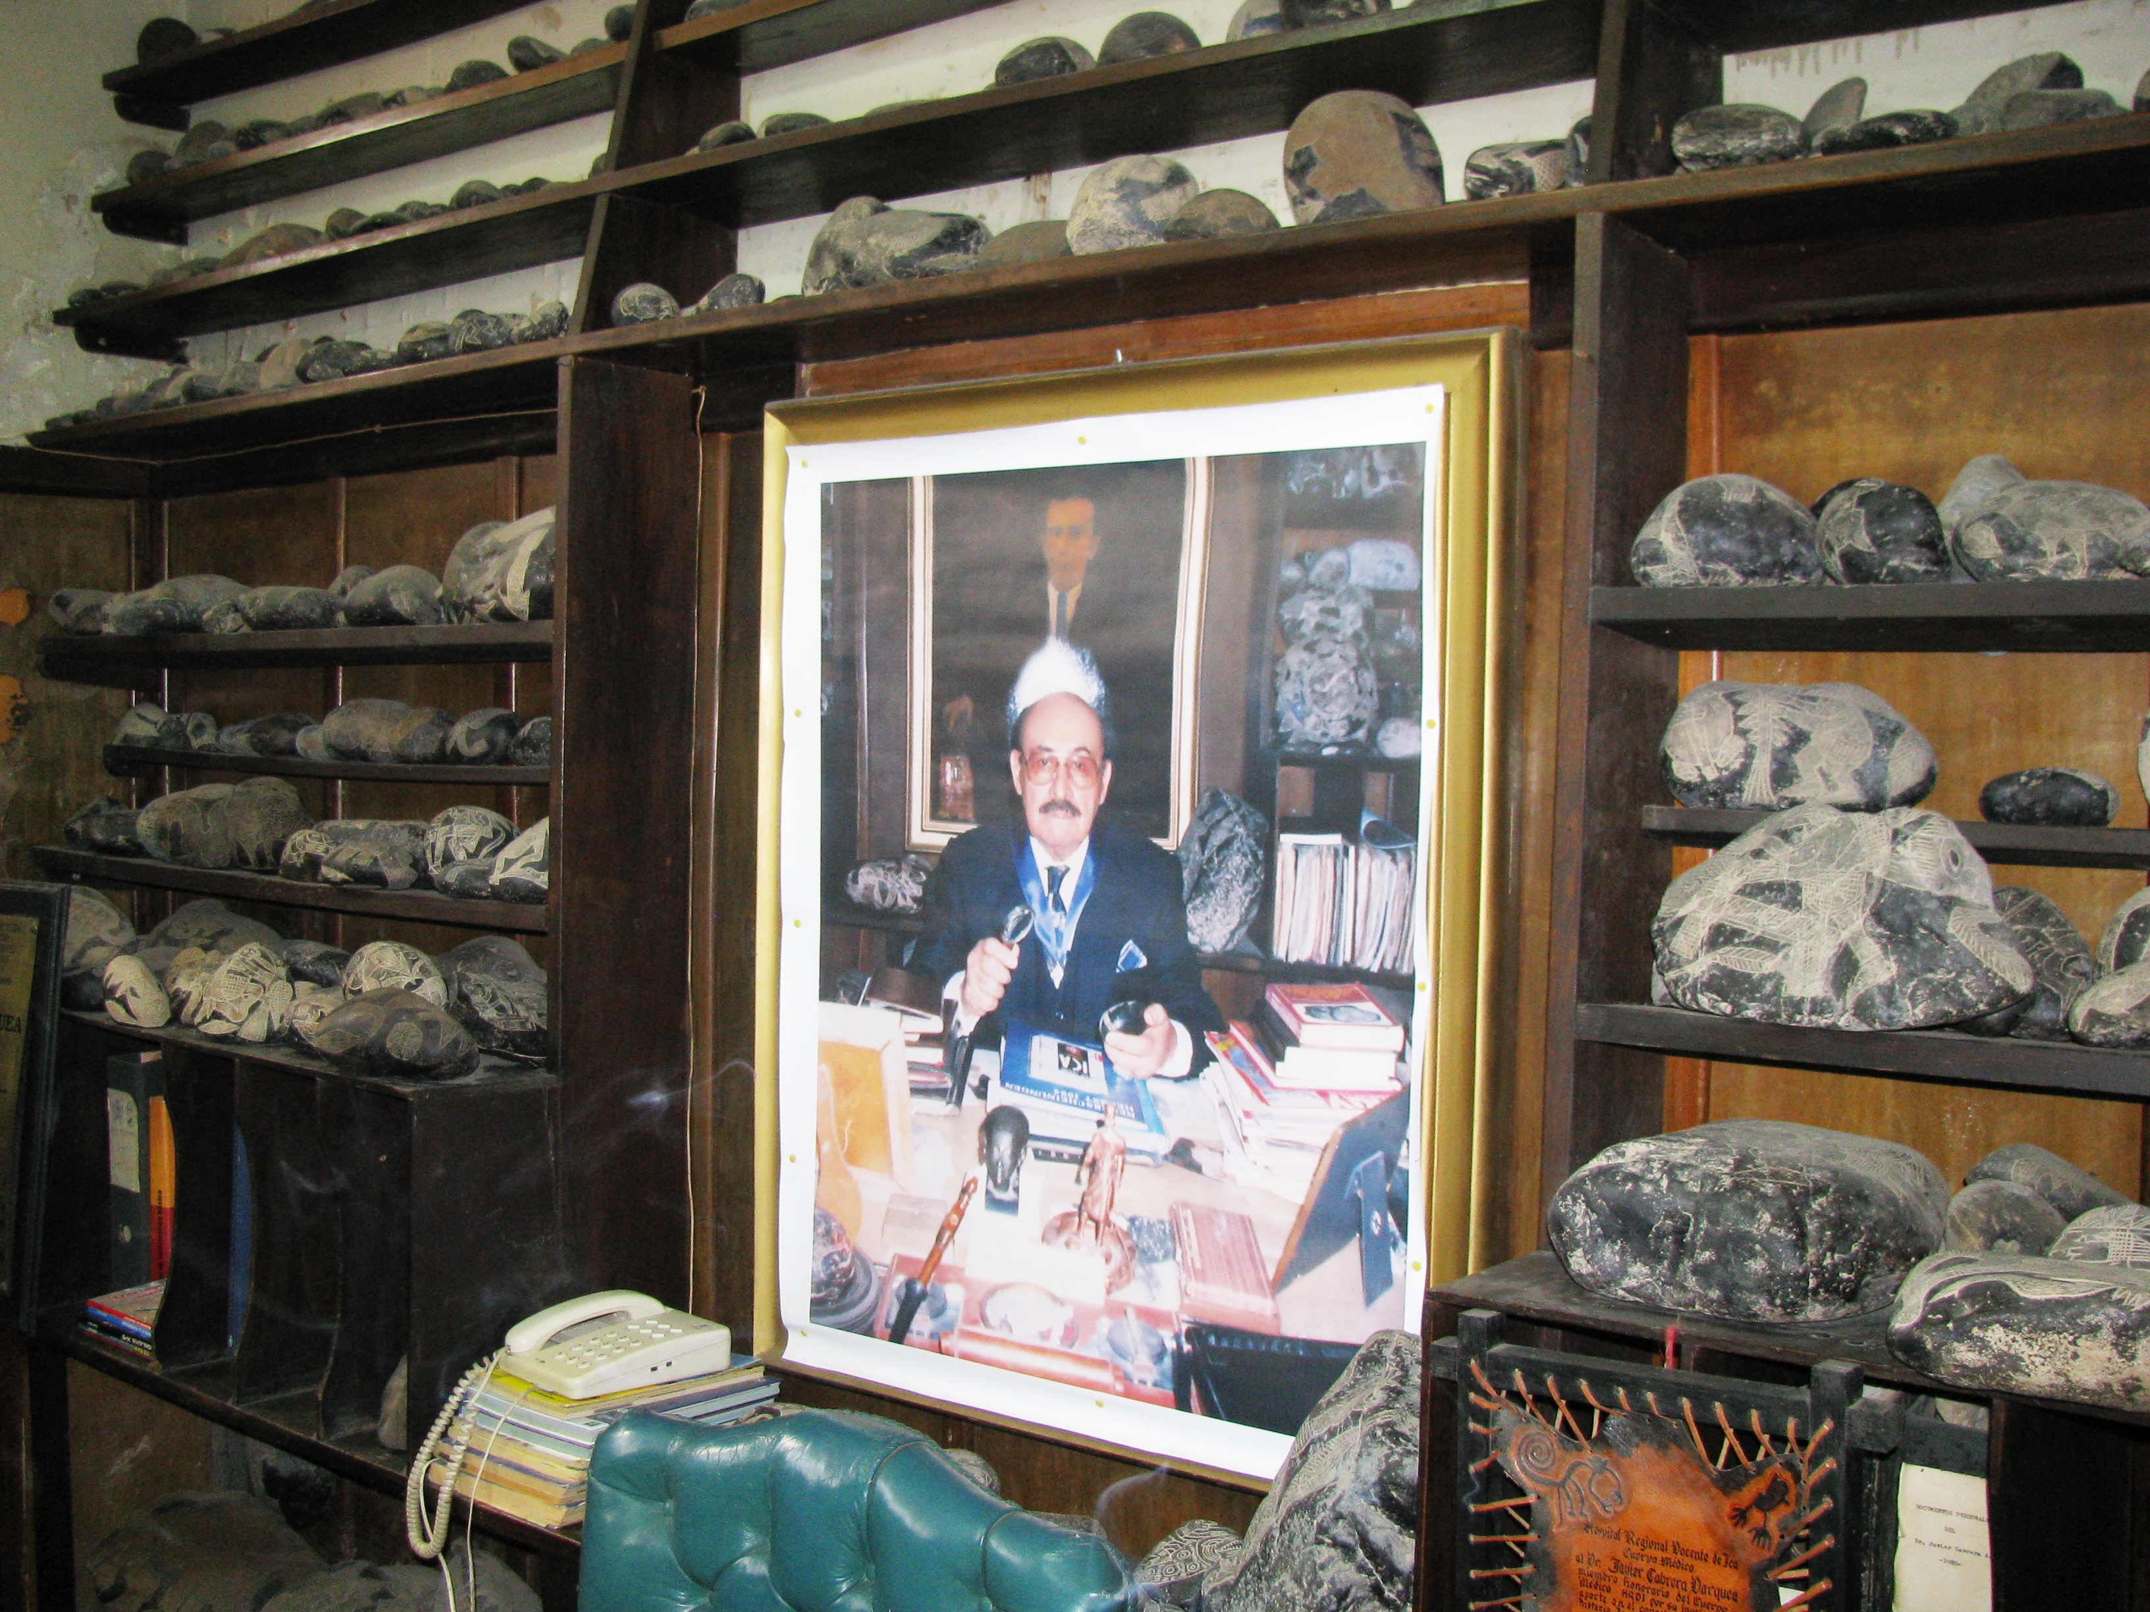
Ica Stones
Stones have been found with engravings of dinosaurs and other ancient creatures.
Popularized by Peruvian medical doctor Javier Cabrera, who opened a museum in the town of Ica.
By Brattarb - Own work, CC BY-SA 3.0,
https://commons.wikimedia.org/w/index.php?curid=15219207
By Brattarb - Own work, CC BY-SA 3.0,
https://commons.wikimedia.org/w/index.php?curid=15219098

Slide 55
Investigations have shown that these alleged ancient drawings on rock were made and sold by two families in the town of Ocucaje, 30 km south of Ica.
They created the carvings and produced a patina by baking the stones in cow dung and other things, and then burying them for several weeks.
This author has personally met one the creators of these carved rocks, Emma Gutiérrez, from Ocucaje, who confirmed she made hundreds of stones over a period of more than forty years.

Slide 56
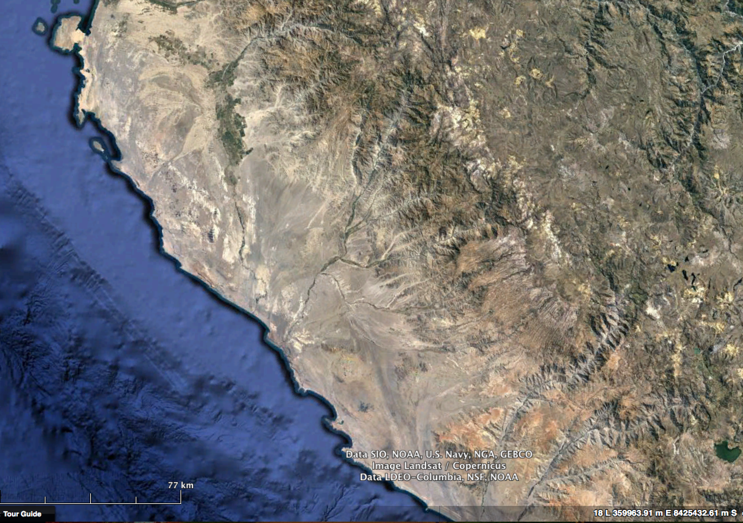
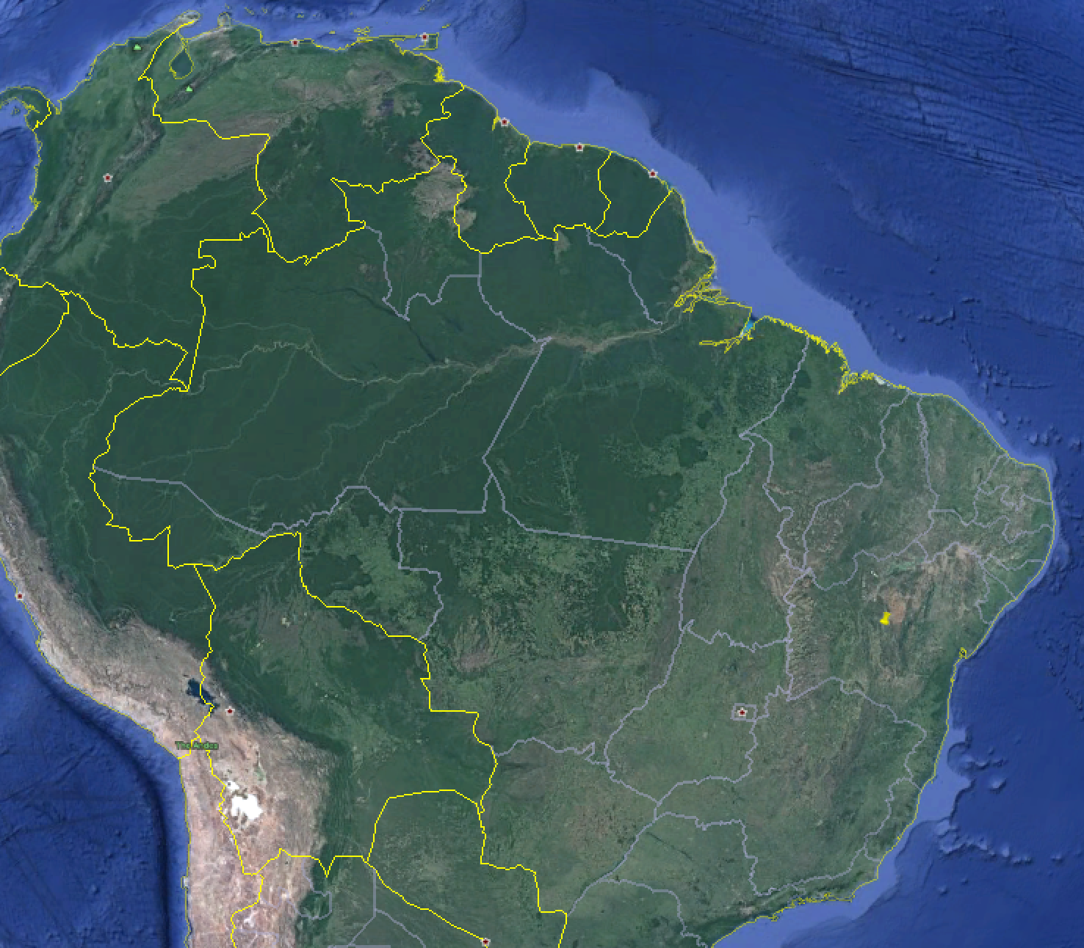
Ica
Ocucaje

Slide 57

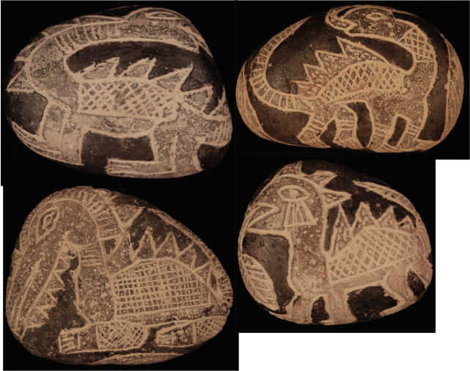

Slide 58
Noah’s Ark
Claims that Noah’s Ark has been found on Mt. Ararat abound.
Different people have suggested various locations for the Ark with many expeditions carried out with little or no success.
A detailed summary of the expeditions and people related to the search of Noah’s Ark is found in Wikipedia: “Searches for Noah’s Ark”: https://en.wikipedia.org/wiki/Searches_for_Noah%27s_Ark

Slide 59
In the 1980s and 1990s Ronald Wyatt an adventurer and former nurse anesthetist, advocated the Durupinar site as the site of Noah’s Ark.
The Durupinar site is a large geological structure on Mount Tendürek in eastern Turkey, very near the Iranian border, at an elevation of 1,966 m a.s.l.
The shape and size of the rock structure has led some people to claim that this is the original Noah’s Ark, now made into rock.

Slide 60
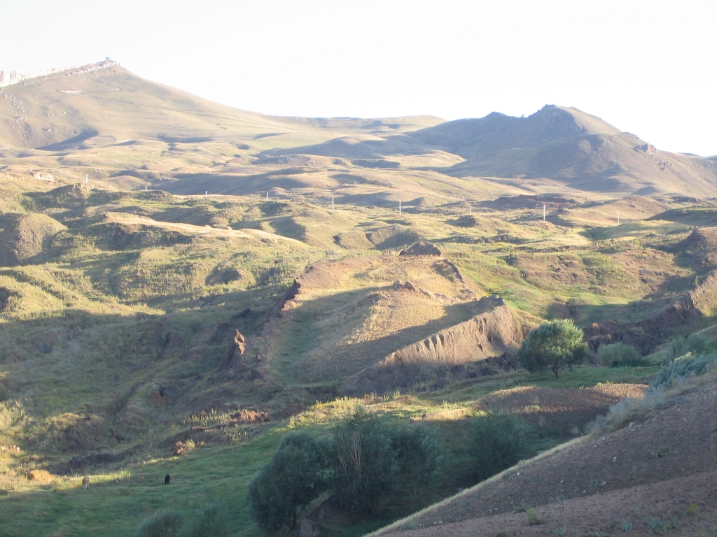
By Mfikretyilmaz - Own work, CC BY 3.0,
https://commons.wikimedia.org/w/index.php?curid=8882591

Slide 61
Local reports indicate that heavy rains and three earthquakes exposed the rock structure from the surrounding mud in May 19, 1948.
Turkish Army Captain Ilhan Durupinar identified it on aerial photographs after a military mapping mission.
A group of the Archaeological Research Foundation surveyed the area, including the ‘boat-shaped’ formation, in September 1960.
The research concluded that there were no visible archaeological remains.

Slide 62
In 1977 Ron Wyatt rediscovered the formation and throughout the 1980s tried to promote the site as the structure of Noah’s Ark.
Wyatt’s claims can be summarized as follows:
  Basalt rock formation with an oval shape (shape of a ship) and vertical walls protruding from the surrounding mud
  Lab tests identify abundant laminated petrified wood.
  There is a regular metallic pattern (Turkish scientists found metal pieces)
  Turkish commission states “it’s a boat”.

Slide 63
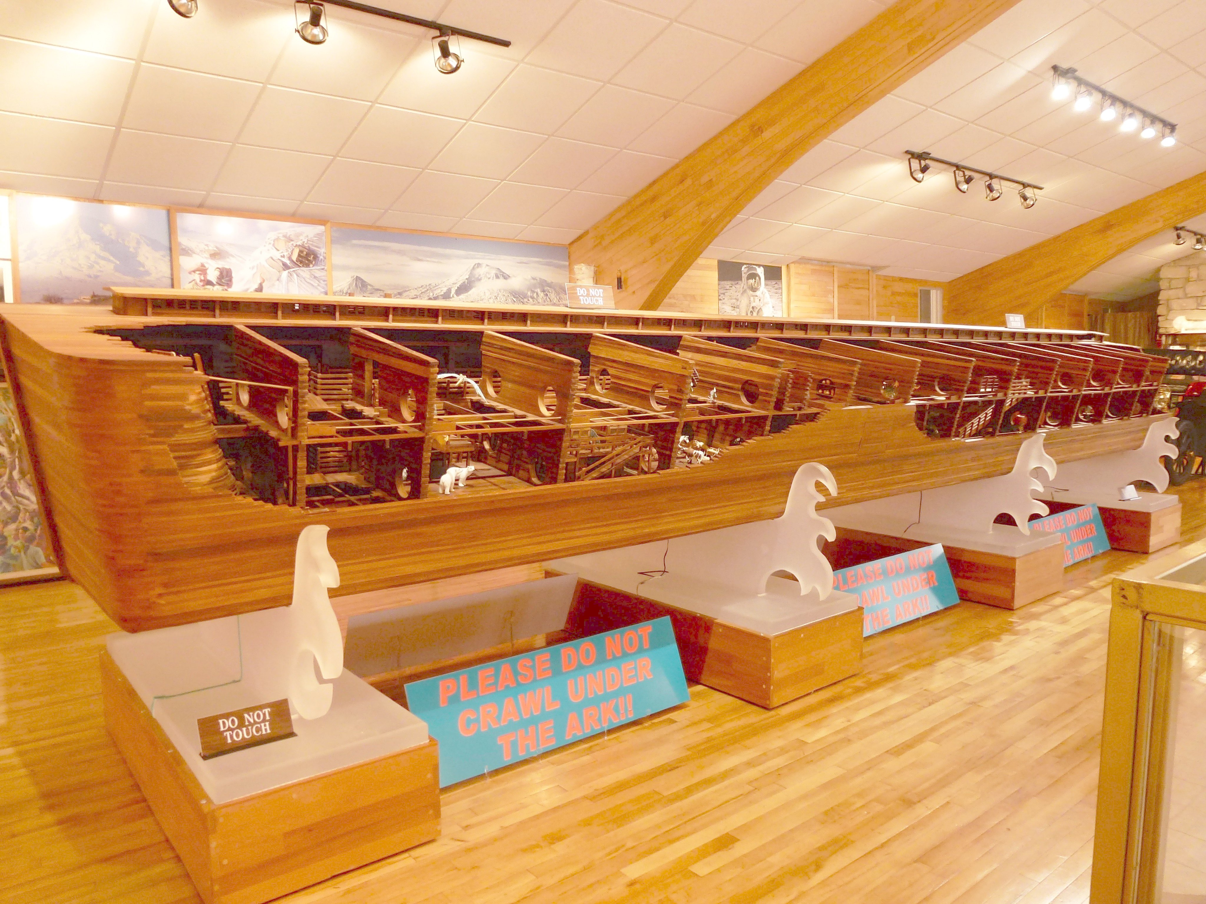
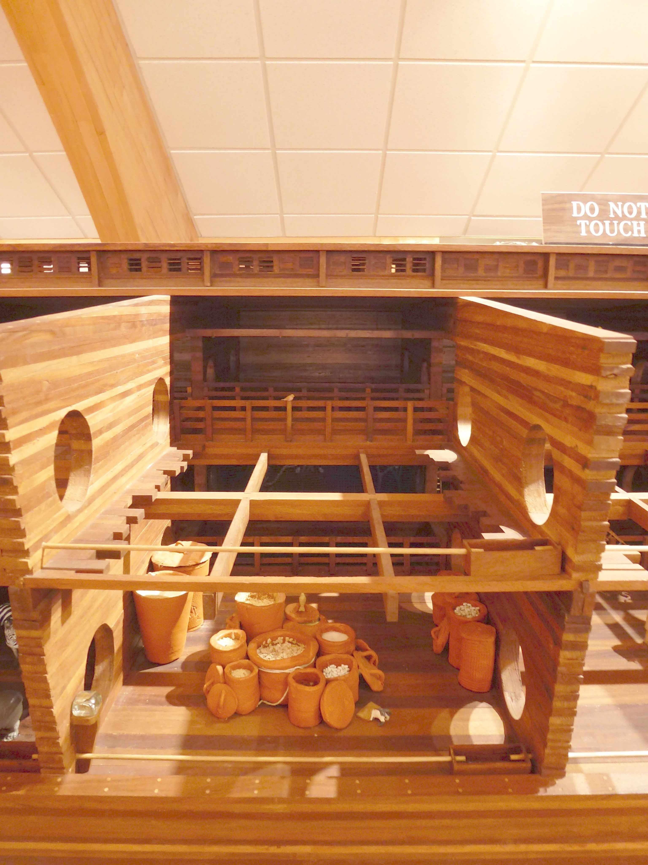
Wyatt claimed that ‘iron lines’ have also been verified using subsurface techniques including ground penetrating radar.
These radar scans showed the internal structure of a boat’s framework (walls, bulkheads, ribs, etc.)
Wyatt also claimed that his radar scans show stairs.
These claims are not supported by the scientific evidence.
Creation Evidence Museum.
Photos by Raúl Esperante

Slide 64
Wyatt claimed that metal detectors found areas (lines) of high metal concentrations, which allegedly correspond with the structure of the boat.
  But they were randomly distributed within the basalt rock.
  The basalt contains iron oxides that make the metal detectors respond.
  The surrounding mud does not contain concentrations of iron metals.
  No “lines” were detected, but only concentration spots.

Slide 65
The alleged iron lines are only an interpretation based on the use of an unreliable instrument.
They have not been verified with any scientific surveying technique, including standard high resolution metal detection or any magnetometers used in standard geological survey.
Wyatt’s radar records were taken only from a small area of the boat-shaped structure.
Wyatt's interpretation does not take into account the topographic variations across the site.

Slide 66
Wyatt claims that walls of the boat were detected.
These walls stand in places some 20-30 m above the immediate ground.
However,
  These walls are simply hardened mud, containing boulders of basalt.

Slide 67
Many have placed their hopes in the idea that this boat-shape could be Noah’s Ark.
The Bible does not say that the Ark would be preserved as a witness to future generations.
Only the rainbow is mentioned.
It would be interesting to find the Ark.
So far, no reliable evidence of the Ark has been found.

Slide 68
Let’s be Honest
History of science and the interpretation of Scripture teach us that it is unwise to commit too strongly to a particular scientific interpretation or model.
The same danger exists when we try to force the Bible to say what it doesn’t say.

Slide 69
This does not mean that believers in Creation and the Flood should never make use of scientific data.
Instead, they should do more use of scientific data, but they should do so more cautiously.
And they should study Scripture more rigorously.

Slide 70
We do not have key physical evidence of artifacts like.
  Noah’s Ark
  Tower of Babel
  The Ark of the Covenant
  The true Mount Sinai
  The chariots of Pharaoh’s drowned army
  The tablets of the Ten Commandments
  Jesus’ cross.
  The true places of Jesus’s baptism, death and resurrection.
  Etc.

Slide 71
Why?

Slide 72
We don’t know why.
However, a few reasons are possible:
  Perhaps God wanted to prevent humanity to turn into worshipping those objects.
  Perhaps God does not want us to believe Him based on objects.
Perhaps some day we will find those artifacts.
  It will be when God considers it appropriate.
  Christians will see their faith strengthened.

Slide 73
In the meantime, we must
  Be honest with both biblical and scientific evidence.
  Not overstate the evidence.
  Rigorously examine all evidence.
We may not need that evidence anyway.
How many would convert to Christianity if we ever found Noah’s Ark?

Slide 74
Probably not many.
God came to earth and almost nobody noticed it.
Only a few did (the Wise Men from the East).
People asked Jesus for a miraculous sign from heaven (Matthew 12:38-39).
  He called them wicked and adulterous.
  “but none will be given it except the sign of the prophet Jonah” (NIV)

Slide 75
Another time Jesus said: "If people don't see miracles and amazing things, they won't believe.” (John 4:48, God’s Word Translation).
  But it seems that at one point not even miracles caused people to believe any more.
    “If your brothers do not listen to Moses and the Prophets, they will not be persuaded, even if someone were to rise from the dead.” (Luke 16:31)
It seems that people that don’t want to believe won’t believe regardless the evidence.
The discovery of Noah’s Ark will likely not lead many people to believe the Bible.

Slide 76
A Guide to Selection of Good Arguments
When examining arguments, we must check their validity using our reason.
When considering arguments in support of a recent Creation and a Flood, we ought to reason taking into account important issues that stem from:
  Revelation (Scripture)
  Science
  Philosophy
  History

Slide 77
The ultimate end or goal of supporting Creation and the Flood does not justify the use of wrong arguments.
  The use of wrong arguments is a disservice to our witness for Christ by not being truthful to his Word and the ability to reason he has given us.
Is the argument consistent with the Bible?
  The Bible claims that humans were created in the sixth day of the Creation week and did not evolve from an ancestral ape.
  Claims that try to accommodate the Creation story with interpretations of science only complicate things and do not solve problems.

Slide 78
Are the arguments rational?
  God created our minds and expects us to use good, sound reasoning.
  Isaiah 1:18—Come now, and let us reason together…”
  When evaluating scientific arguments we must check if they are logical.

Slide 79
Are the arguments based on examination of evidence that has been carefully scrutinized?
Creationism does not need bad arguments for its support.

Slide 80
Distinguish between the Creation story in the Bible and Creation models.
  The Creation story is God’s revelation and it is accepted by faith.
  We find abundant scientific support of the belief in a Creator God who created the universe and life on Earth.
  We also believe that there was a universal Flood that changed the face of the Earth and ecosystems.
  The (scientific) models or hypothesis we construct based on evidence may be able to explain some aspects of Creation and the Flood, but may not be right.
    Our models are not infallible
    Our models are not necessarily inspired, as the Word of God is.

Slide 81
Positive Evidence that Supports Creation and the Flood
Design in the universe
  Physics and contemporary cosmology offer clues that the universe is especially subjected to the possibility of life.
  “Physicists have encountered signals that the universe is tuned for life and consciousness.” (Sharon Begley, Newsweek, July 20, 1998)
  Scientists have determined that there are over 100 parameters of chemistry and physics (physical constants) that must be finely adjusted in order for life to exist (Barrow and Tipler 1988).

Slide 82
Design and irreducible complexity in nature
  At the molecular level (DNA, proteins, enzymes)
  At the organ level (reproductive organs, eyes, brain, etc.)
  At the ecological level (stability of ecosystems, reefs, lakes, rivers, coasts, etc.)
  Behavior (migratory birds, social insects behavior, survival strategies, pollination strategies, etc.)

Slide 83
Human consciousness and the mind
  Molecules don’t have the capacity to develop consciousness.
  Personal awareness
  Why do we have a conscious instead of nothing?

Slide 84
Morality
  Molecules don’t distinguish right from wrong.
  Evolution theory proposes contradictory scenarios for the rise moral behaviors.
  The existence of an universal moral code points out to a universal Judge and Ruler.

Slide 85
Behavior
  Behavior and attitudes of love, kindness, altruism, etc. point out to a Intelligent Designer

Slide 86
Geology, Paleontology
  Occurrence of fossils in the sedimentary layers
  Occurrence of soft tissue preserved in fossils allegedly millions of years old
  Paracomformities
  Catastrophic deposition
  Mass mortality and burial
  Lack of transitional fossils
  The Cambrian explosion

Slide 87
Sources and References
Chadwick, A. V. 1987. Of dinosaurs and men. Origins 14(1):33-40.
González, S., D. Huddart, M. R. Bennett, and A. González-Huesca. 2006. Human footprints in Central Mexico older than 40,000 years. Quaternary Science Reviews 25(3–4):201-222.
Kuban, G. 1995-2010.On the heels of dinosaurs. http://www.talkorigins.org/faqs/paluxy/onheel.html.
Morris, John D. 1980. Tracking Those Incredible Dinosaurs (and the People Who Knew Them)., San Diego, Creation-Life Publishers.
Ozansoy, F. 1969. Pleistocene fossil human footprints in Turkey. Maden Tetkik Arama Enst: Bulletin of the Mineral Research and Exploration Institute of Turkey 72:146-150.
Roberts, D., and L. R. Berger. 1997. Last interglacial (c. 117 kyr) human footprints from South Africa. S Afr J Sci. 93(8).
Webb, S., M. L. Cupper, and R. Robins. 2006. Pleistocene human footprints from the Willandra Lakes, southeastern Australia. Journal of Human Evolution 50(4):405-413.

