Slide 1

FREED
BY
THE TRUTH
M-F.A.I.T.H.

Slide 2
How WILL WAD GO?
I will GO
F
A
I
T
H
aithfully
ccountably
nnovatively
ransparently
armoniously

Slide 3
SP REFOCUSING
FRONTIER MISSION
YOUTH LEADERSHIP DEVELOPMENT
EVANGELISM
EV/PM, YM, MS & GM
INNOVATION & ENTREPRENEURSHIP OUTREACH
YOUNG AFRICAN ADVENTIST PROFESSIONALS
Revival (2023), Restoration (2024), Retention (2025)
YM, EDU, ST, APM, WM, HM
Boost job creation through empowerment and skill development
YM, EDU, WM, GM, ST, Min. Sec.
Involvement in acquaintance with and resolution of Church matters
YM, PCM, WM & WAD-LEAD
Youth's leadership, communication, collaboration, decision-making, and creativity capacities
All Department; coordinated by GM, EV, Min. Sec.
Boosting Mission in unentered areas
MAJOR EMPHASES
MAJOR PLAYERS
MAJOR TARGETS
F.A.I.T.H.

Slide 4
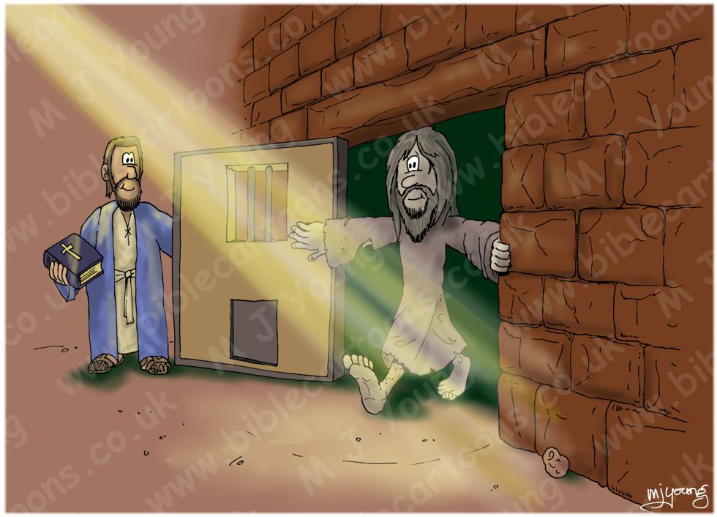
“And ye shall know the truth, and the truth shall sent you free.”
JOHN 8: 32

Slide 5
The meaningfulness of our life and living depend indispensably of our conception, representation, interpretation, and application of truth.
WRONG
Right
__conception, __representation, __interpretation, __application
of truth.
Meaninglessness of life and living
Meaningfulness of life and living

Slide 6
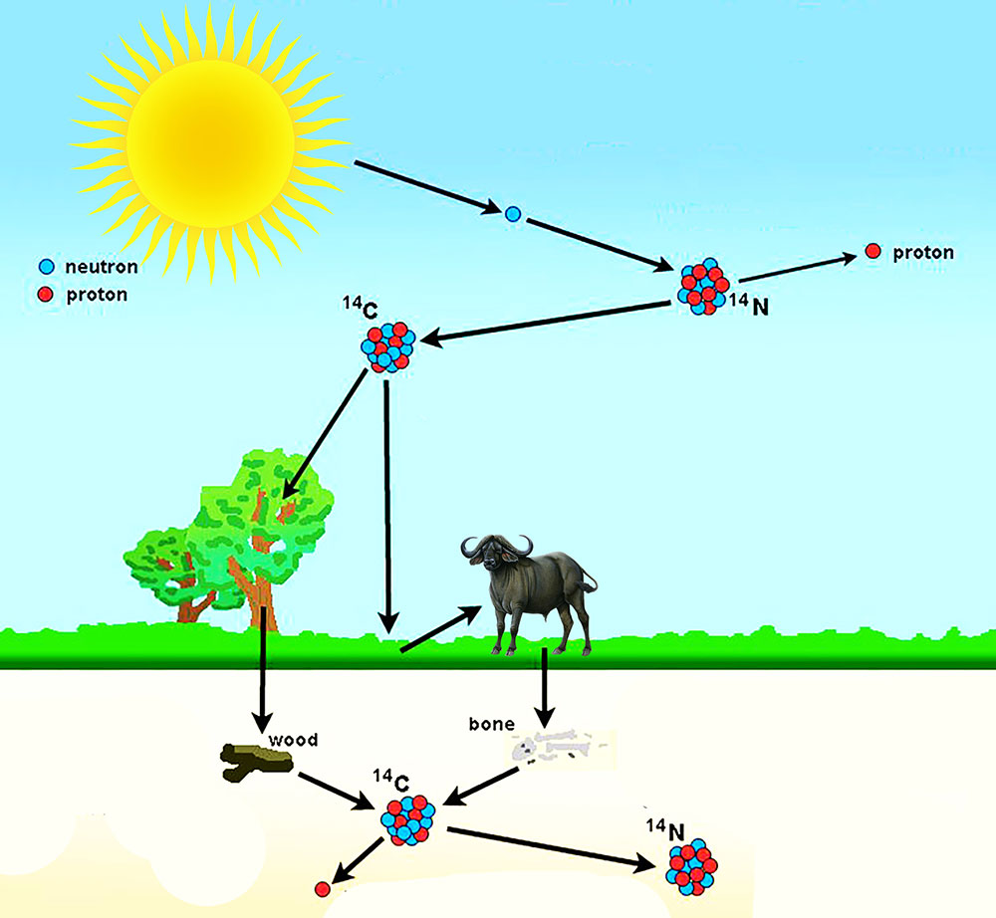
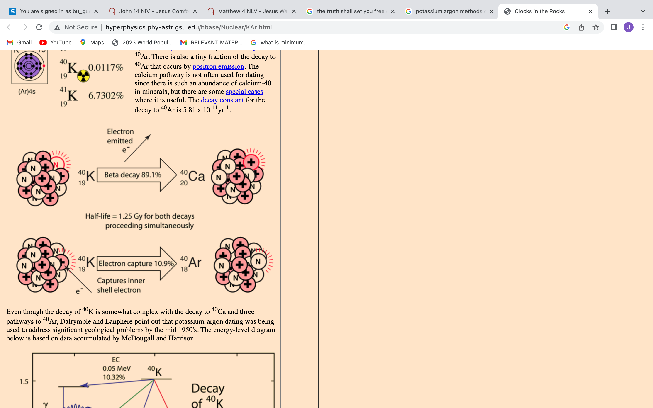
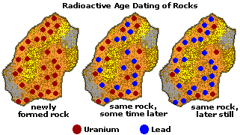
FREED FROM WHAT?
Examples:
Age of Relatively Recent Fossils
Is there a possibility of having significantly higher or less C14:C12 ratio than conventionally assumed
Age of Rocks & Old Fossils
Misconception of truth
Misrepresentation of truth
Misinterpretation of truth
Misapplication of truth
Is there a possibility of having the so-called daughter isotopes which did not necessarily derive from the so-called mother isotopes? Is there a possibility of having so-called metamorphic rocks that did not necessarily derive from the processes that described in textbook
Is there a possibility for the one who said “let there be light…” to have also said earlier, “let there be metamorphic rocks”?

Slide 7
What is is the truth? (John 18: 37-38)
Who has the truth? (who’s got the truth by Martin Weber)
If we have to be freed by the truth, this presupposes that we are chained, imprisoned.

Slide 8
Jesus’ Bitterest Teaching Experience
⁵ Thomas said to him, “Lord, we don’t know where you are going, so how can we know the way?”
⁶ Jesus answered, “I am the way and the truth and the life. No one comes to the Father except through me. ⁷ If you really know me, you will know^{[b]} my Father as well. From now on, you do know him and have seen him.”
⁸ Philip said, “Lord, show us the Father and that will be enough for us.”
The length of bachelor’s degree in Theology in WAD is three to four years
In the virtual university of Judea, department of ministerial and theological education, the length of the degree was three and half years. The curriculum hinged on communicating the truth as it relates to three main domains namely preaching, prophecy, theology, pedagogy, andragogy, healing, field work, role modeling, and disciple making. In the final semester the end of the program, the teacher is confronted with a chocking discovery about how much truth the future truth communicators know. The teacher attempt at clarifying the truth he had so far taught his students, only to discover that the students had gotten wrong perceptions and wrong interpretation, wrong application and wrong of the truth.

Slide 9
Truth will always remain meaningless and ineffectual as long as it is separated from the way, and the life
The Way: Process—Livelihood– see Ps. 119:
The Truth: Activities: Thoughts, Words, Actions—Phil. 2: 5; Matt. 11: 29
The Life: Output/End result—Lifestyle—Destiny

Slide 10
Jesus’ perception of truth:
Jesus’ representation of truth:
Jesus’ interpretation of truth:
Jesus’ application of truth:
How much truth do we know?
What is our percetion of it?
What is our representation of it?
What is our interpretation of it?
What is our application of it?

Slide 11
Jesus’ perception of truth:
John 17: 17
17 Sanctify them by Your truth. Your word is truth
Matt. 5: 18
“For verily I say unto you, Till heaven and earth pass, one jot or one tittle shall in no wise pass from the law, till all be fulfilled.”

Slide 12
Jesus’ representation of truth:

Slide 13
Jesus’ interpretation of truth:
MATT. 4: 1-11
“Thus says the Lord…”

Slide 14
Jesus’ application of truth:
JOHN 6: 38
For I have come down from heaven not to do my will but to do the will of him who sent me.

Slide 15

Freed by the Truth

Slide 16

As you set out to be freed by the truth,
Never Forget That
Self is weakness (Heb12: 12)
Self is sickness (Isa 1: 5-6)
Self is fear (Isa 41: 14)
Self is blindness (Rev. 3: 17)
Self is ignorance (Prov16: 25)
Self is mob-mindedness (Jer11: 10)
Self is sinfulness (Rom 3: 23)
Self is mortality (1Cor15: 54)
Self is disgrace (Isa 64: 6)
Christ is strength (Phil 4: 13)
Christ is health (Ex. 15: 26)
Christ is love (1 John 4: 16)
Christ is light (John 8: 12)
Christ is omniscience (1Cor1: 25)
Christ is the way John 14: 6)
Christ is holiness (Matt5 : 48)
Christ is immortality (Isa 40: 28)
Christ is grace (2Cor 12: 9)

Slide 17

May be the Enemy of wholistic freedom
Keeps Rightly Pointing At Your Daily Life, Saying:
__You were conceived in sin (Ps 51: 5)
__Your Life is like a fleeting shadow (Ps. 144: 3-4)
__Your acquaintances will keep betraying you (Ps 55: 12-14)
__Sin dwells in you and therefore evildoing
will always be your lot (Rom. 7: 17)
__You Sin is crouching at your door (Gen. 4:7)
__You are living under a curse (Mal. 3: 9)
__Hard-pressed on every side
__Perplexed
__Persecuted
__Struck down
(2Cor 4: 8, 9)

Slide 18
When the Devil Constantly Remind you
That
Respond to him Saying:
__You were conceived in sin (Ps 51: 5)
__Your Life is like a fleeting shadow (Ps.144: 3-4)
__Your acquaintances will keep betraying you (Ps 55: 12-14)
__Sin dwells in you and therefore evildoing will always be your lot (Romans 7: 17)
__Sin is crouching at your door (Gen. 4:7)
__You are living under a curse (Mal. 3: 9)
__Hard-pressed on every side (2 Cor. 4: 8-9)
__Perplexed
__Persecuted
__Struck down
__In Christ I am a new creature (2Cor 5: 17)
__My mortal will soon put on immortality (1Cor 15: 53, 54)
__Even if my mother and father forsake me, God will pick me up (Ps 27: 10)
__I have been crucified with Christ and it’s longer I who live but Christ who lives in me (Gal 2: 20)
__I will resist the devil and he will flee from me (James 4: 7)
__No weapon forged against me shall prosper (Isa 54: 17)
__Yet not crushed (2Cor 4: 8, 9)
__But not in despair
__But not forsaken
__But not destroyed

