Slide 1

REPORT ON ENCYCLOPEDIA WORK IN WAD
2023 Year-End Council
Dr. Onaolapo Ajibade
WAD Assistant Editor, ESDA

Slide 2
ARTICLES

Slide 3
REMAINING ARTICLES
REMAINING ARTICLES

Slide 4
UNIVERSITIES

Slide 5
CATEGORIES

Slide 6
POINTS TO NOTE
Author Contracts need to be signed.
There is a need to write on Women
Web address of Encyclopedia: encyclopedia.adventist.org.
    Please encourage members to read the articles.

Slide 7
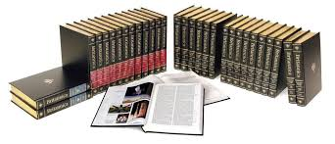
Https://Encyclopedia.adventist.org/

Slide 8
Thank you!
encyclopedia.adventist.org

