Slide 1

Day 1
The Spirit Was
UNLEASHED
DAYS OF
PRAYER
January 7-17, 2026
Notes:
Welcome everyone warmly and introduce the day’s theme.
Explain that this week’s focus is understanding how the Holy Spirit was unleashed after Jesus’ ascension.
Introduce the story’s characters — Luca and Orel — and invite the audience to imagine themselves in the story.

Slide 2
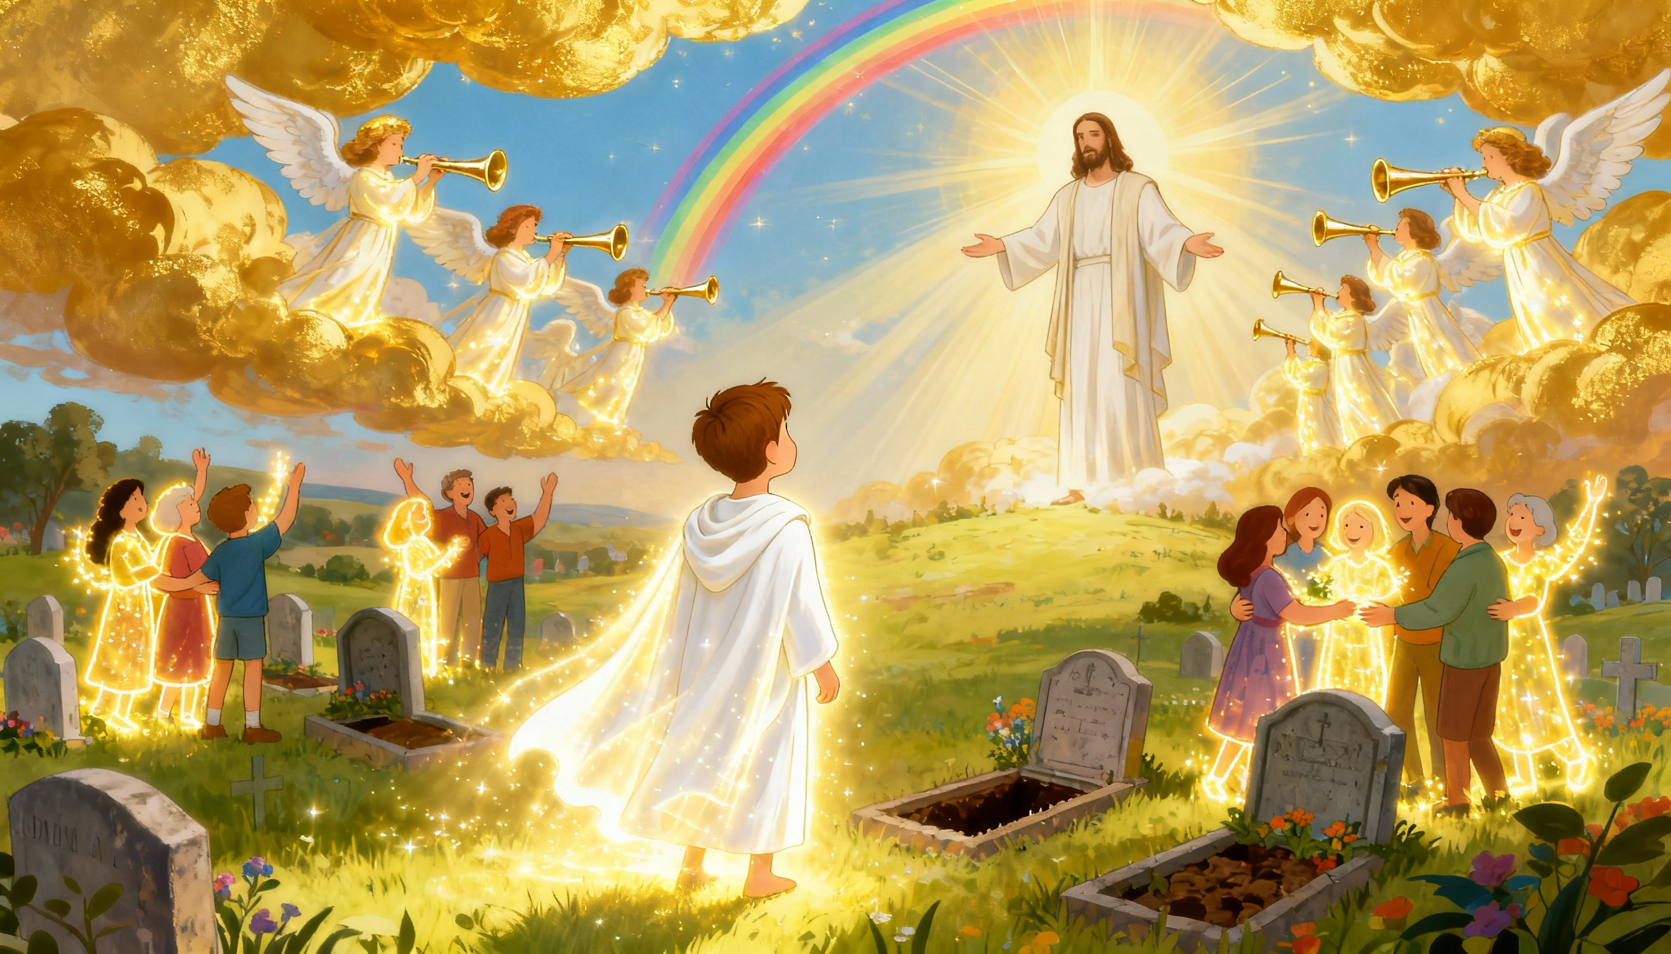
Notes:
Describe the opening vision: loud trumpets, the trembling earth, and the redeemed rising from their graves.
Emphasize the overwhelming joy and awe — this is the moment of Jesus’ return.
Encourage the audience to imagine being there, filled with light and peace.
Transition: “Among those shining with joy was a boy named Luca…”

Slide 3
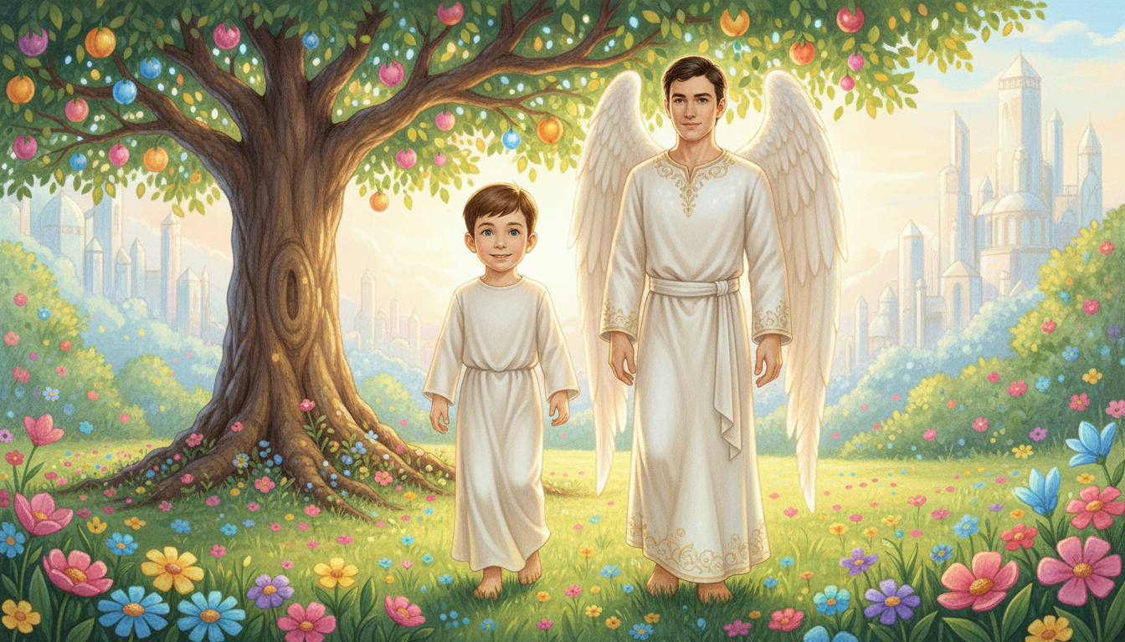
Notes:
Present Orel as the angel who has cared for Luca for eight years.
Explain the meaning of Orel’s name: “Light of God.”
Highlight their joyful reunion and Orel’s mission to teach Luca about the Holy Spirit.
Reflection prompt: “How has God sent light and guidance into your life?”

Slide 4
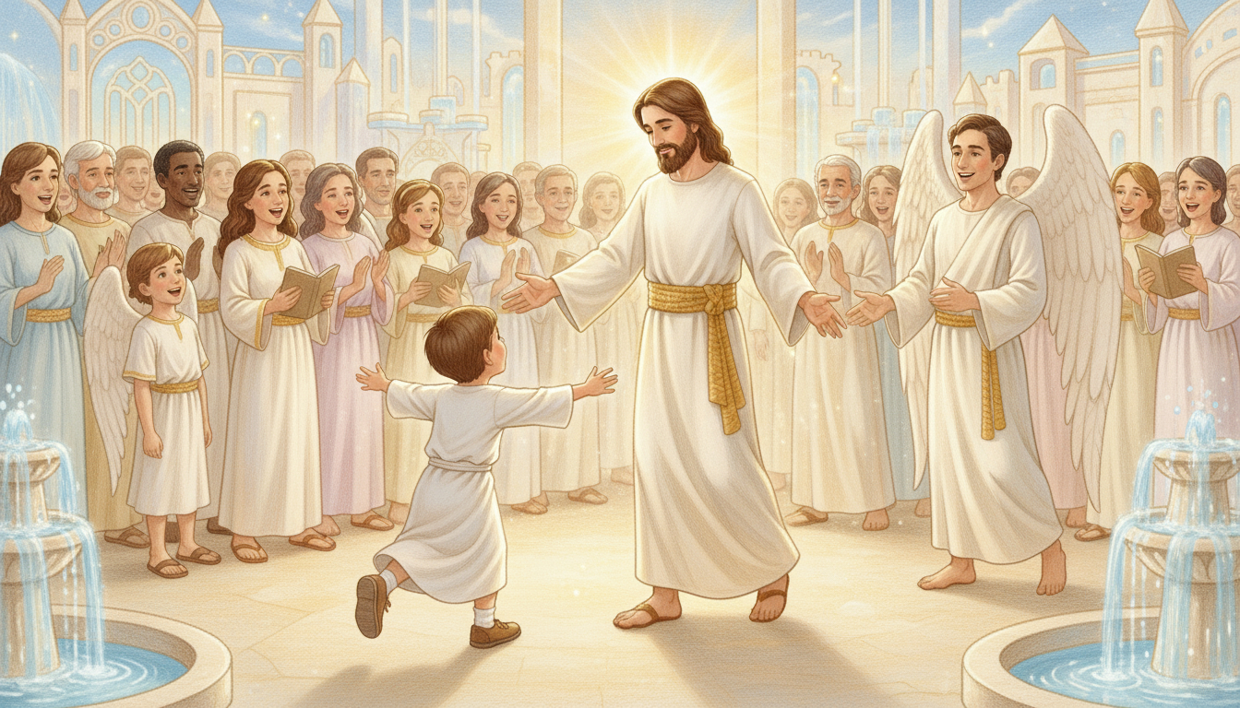
Notes:
Describe the emotional moment when Luca meets Jesus.
Emphasize Jesus’ words of love and gratitude: “I did everything for you.”
Key message: Jesus acknowledges that Luca believed because the Holy Spirit worked in his heart.
Transition to: “Let’s discover what Jesus promised about the Holy Spirit.”

Slide 5
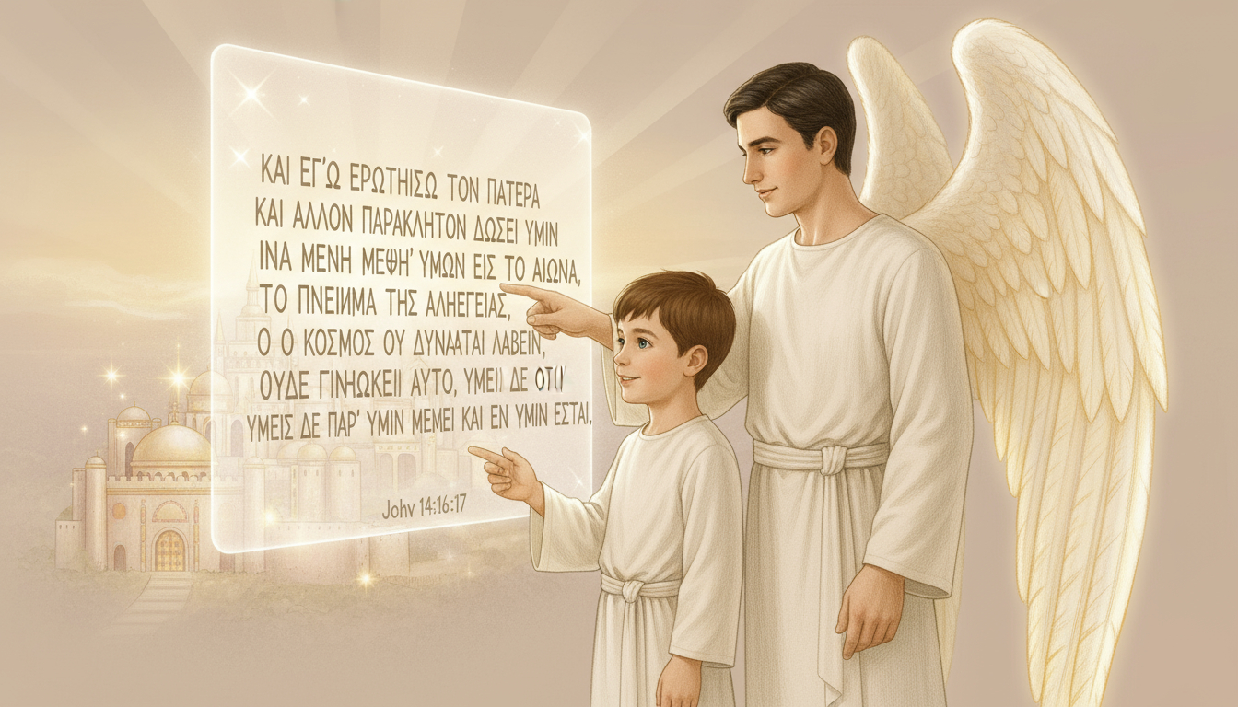
Notes:
Read or display John 14:16–17 (NIV):
“And I will ask the Father, and he will give you another advocate to help you and be with you forever — the Spirit of truth.
The world cannot accept him, because it neither sees him nor knows him. But you know him, for he lives with you and will be in you.” — John 14:16–17 (NIV)
Explain that Jesus couldn’t remain on Earth physically, so He sent the Spirit to live in us.
Highlight Orel’s explanation to Luca about how the Spirit continues Jesus’ mission.
Prompt reflection: “How can we allow the Spirit to live and guide us daily?”

Slide 6
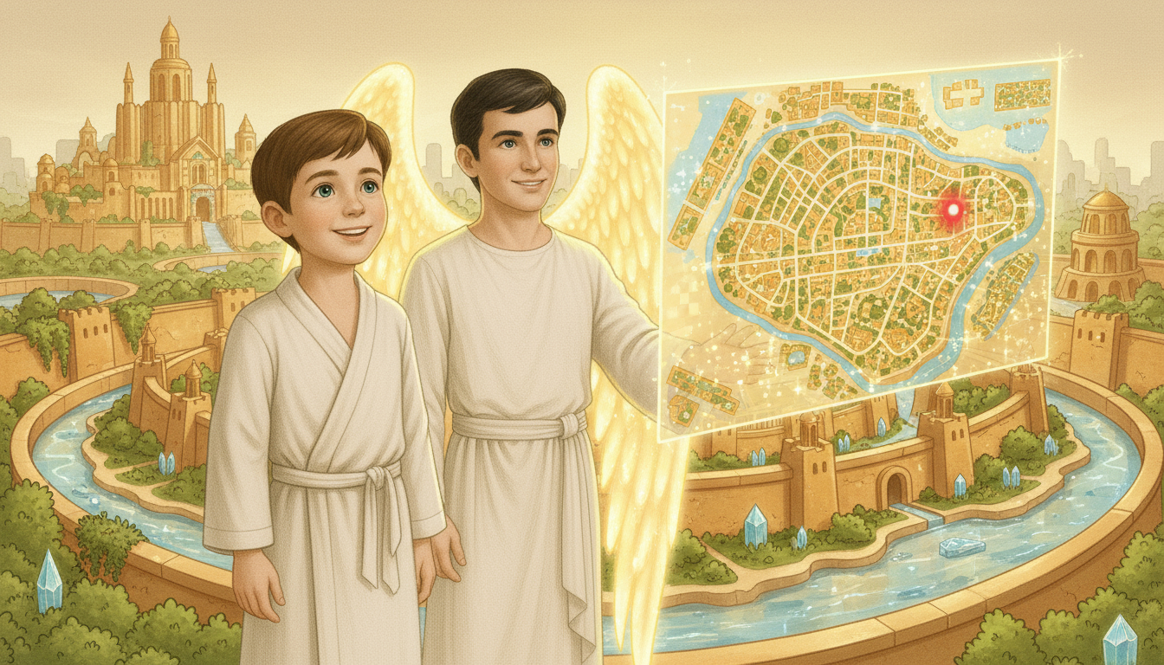
Notes:
Orel tells Luca that when Jesus ascended, the Spirit was fully unleashed on Earth.
Emphasize: The Holy Spirit works quietly but powerfully to draw people to Jesus.
Make it personal: “Each of us is proof of His power — He transforms, comforts, and leads us.”
Encourage participants to share an example of when they felt God’s presence or guidance.

Slide 7

Notes:
Invite participants to read Revelation 21:2 about the New Jerusalem.
Lead the “Let’s Get to Work” activity: draw or color the New Jerusalem and write “I want to live here.”
Conclude with prayer prompts:
• To know the Holy Spirit better and let Him be unleashed in our lives.
• For Jesus’ soon return and for us to live with Him forever.
End with a moment of quiet reflection.

