Slide 1
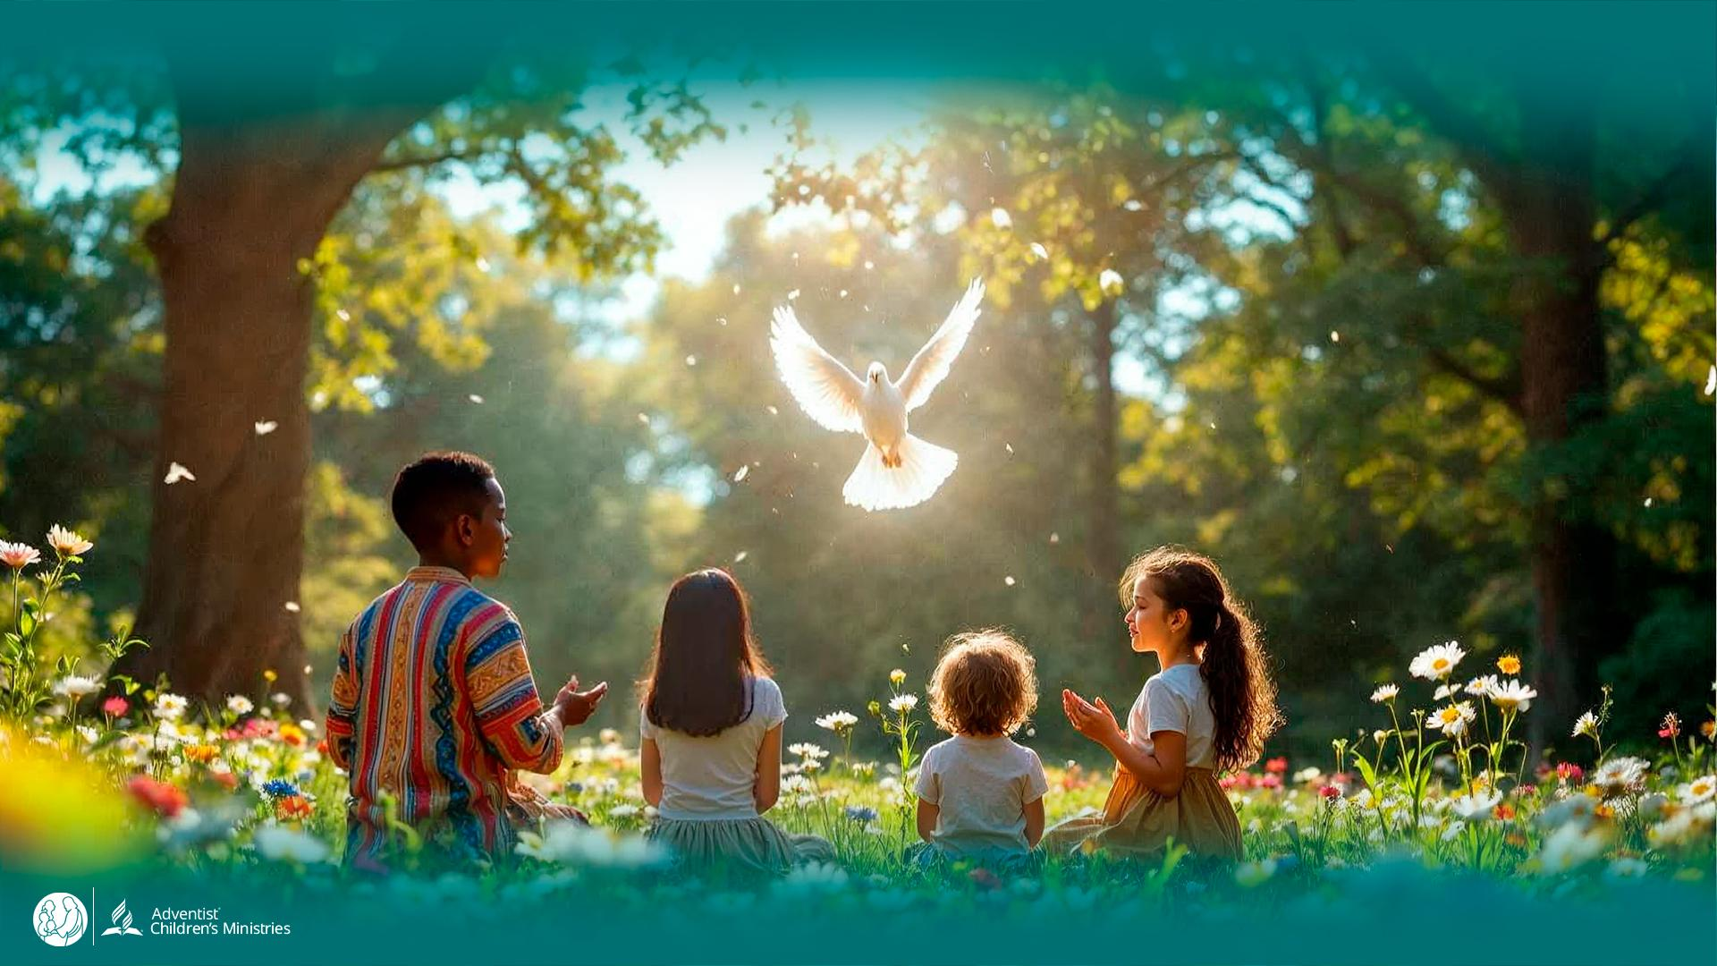

Day 2
The
UNLEASHED SPIRIT
Gives Us ExtraordinaPedapudiP@gc.adventist.orgBonjour Chantal
Dis moi, as-tu pu réaliser quelques activités avec les Bergères de la FAOC du genre:
- retraite spirituelle ? Le lieu? Nombre d’adhérents?
- réunion de routine?
- images si nécessaire
Par e-mail edanudosame@wad.adventist.orgry Abilities
DAYS OF
PRAYER
January 7-17, 2026
Notes:
Welcome to Day 2!
Yesterday, we learned how the Spirit was unleashed when Jesus returned to heaven.
Today, Luca and Orel discover how that same Spirit gives extraordinary abilities.
Let’s join them on their next adventure!

Slide 2
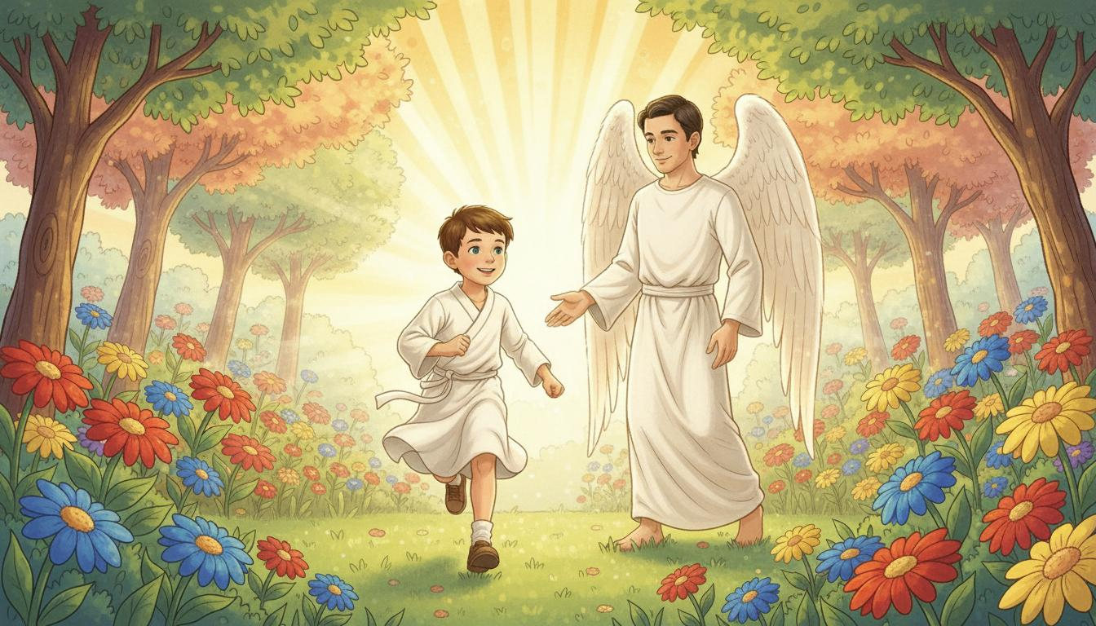
Notes:
Luca runs across shining fields, laughing.
“We’ve run for miles!” he shouts. “And I’m not even tired!”
Orel smiles. “Here, your strength is restored, just as God planned.”
Heaven is full of joy—no one grows tired or weak.

Slide 3
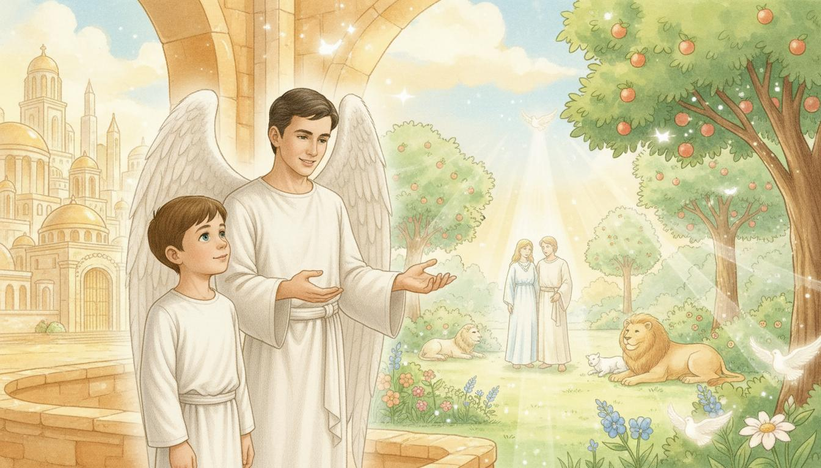
Notes:
Luca slows down. “Restored? What do you mean?”
Orel explains, “God made Adam and Eve perfect. Sin damaged everything.”
“But now,” he adds, “the Spirit has made all things new again.”
Luca looks around, amazed. “So this is what God meant us to be!”

Slide 4
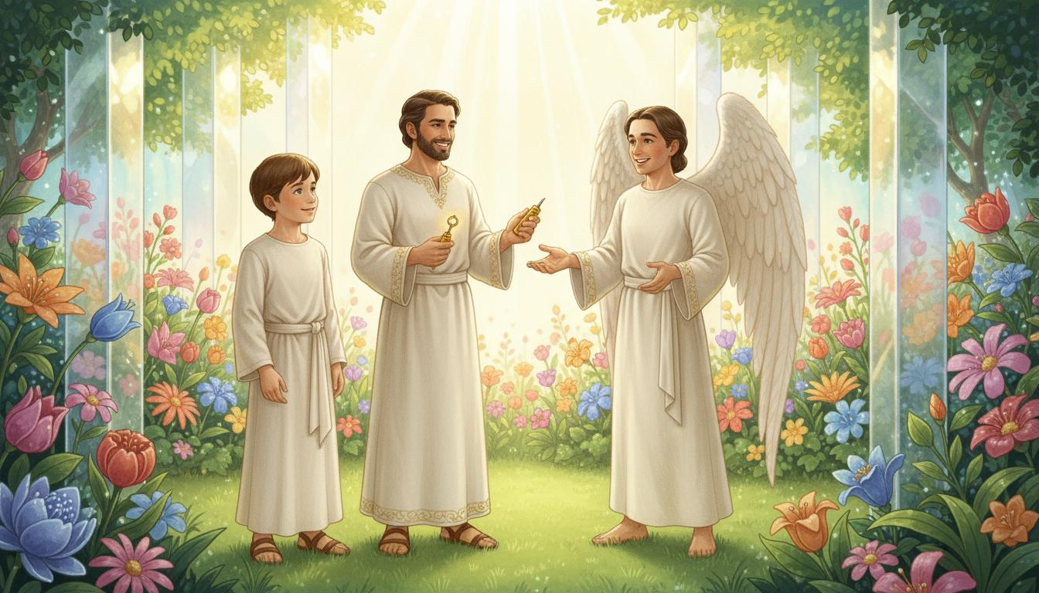
Notes:
The garden sparkles with colors that change in the light.
Luca touches the crystal wall—“Wow!”
Suddenly, he bumps into someone.
The man laughs kindly. “It’s all right, little one.”
“Luca,” says Orel, smiling, “this is Bezalel, filled with God’s Spirit long ago.”
“You built the Tabernacle!” Luca exclaims.
“Yes,” Bezalel says, “the Spirit gave me skill for God’s work.”

Slide 5
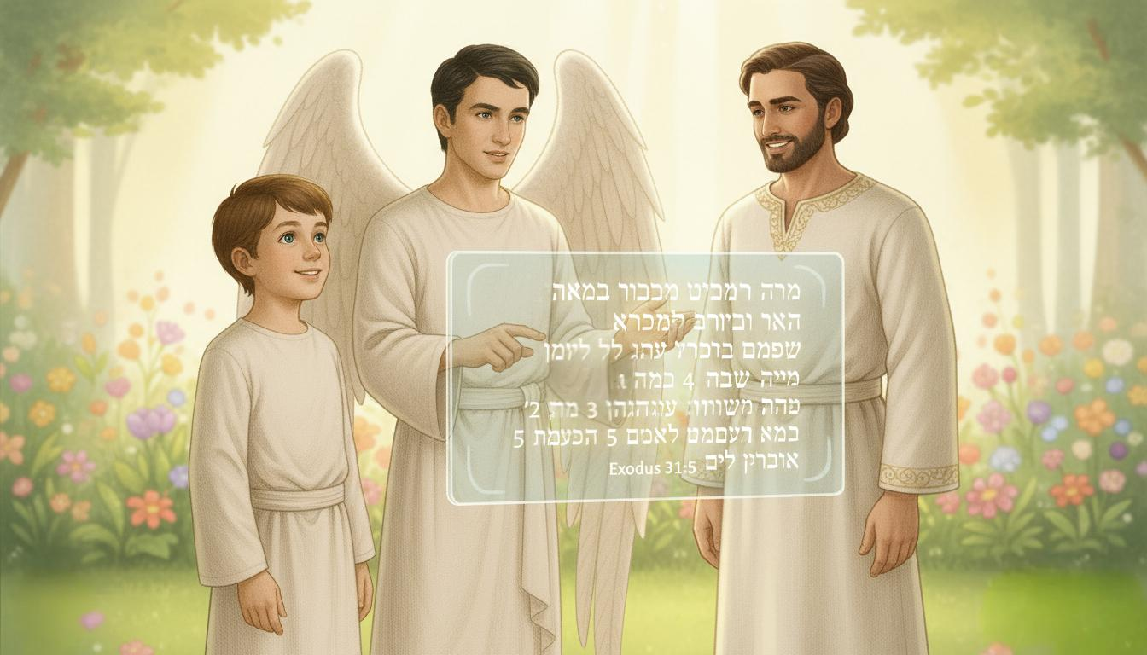
Notes:
Orel opens a glowing tablet and reads:
“See, I have chosen Bezalel… and I have filled him with the Spirit of God—with wisdom, with understanding, with knowledge and with all kinds of skills.”
“That’s me,” Bezalel says joyfully.
“The Spirit helped me create beauty for God.”
Luca smiles. “That same Spirit can help us, too.”

Slide 6
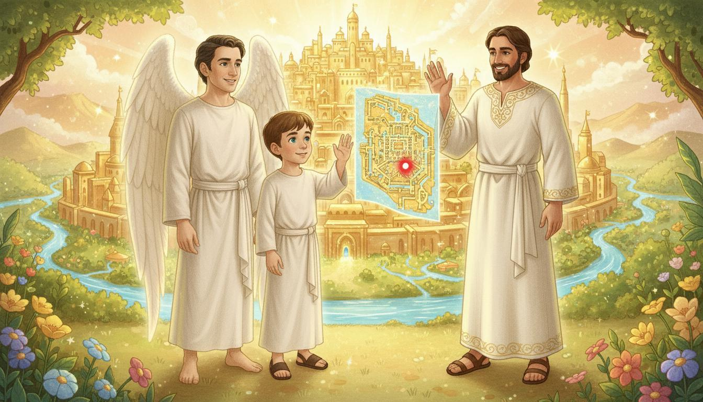
Notes:
Orel’s map glows again—another red dot appears.
Bezalel waves. “Keep discovering, Luca!”
“Thank you!” Luca calls back.
Orel smiles. “Every gift comes from the same Spirit.”
The two friends walk toward their next adventure.

Slide 7
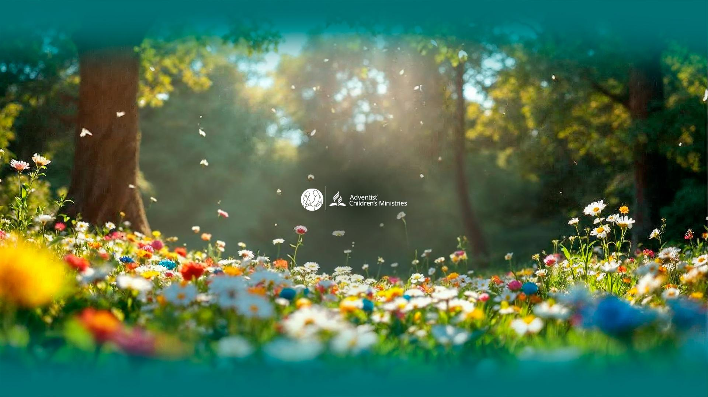
Notes:
Think about the gifts God has given you.
Write or draw them on a card and thank Jesus for each one.
Ask the Holy Spirit to give you new abilities to serve others.
Pray: “Holy Spirit, fill me and help me use my gifts for You.”

