Slide 1

Day 3
The
UNLEASHED SPIRIT
Equips Us to Lead
DAYS OF
PRAYER
January 7-17, 2026
Notes:
Welcome to Day 3!
Yesterday, Luca met Bezalel and learned how the Spirit gives abilities.
Today, he’ll discover how the Spirit equips God’s people to lead.
Let’s see what happens next!

Slide 2
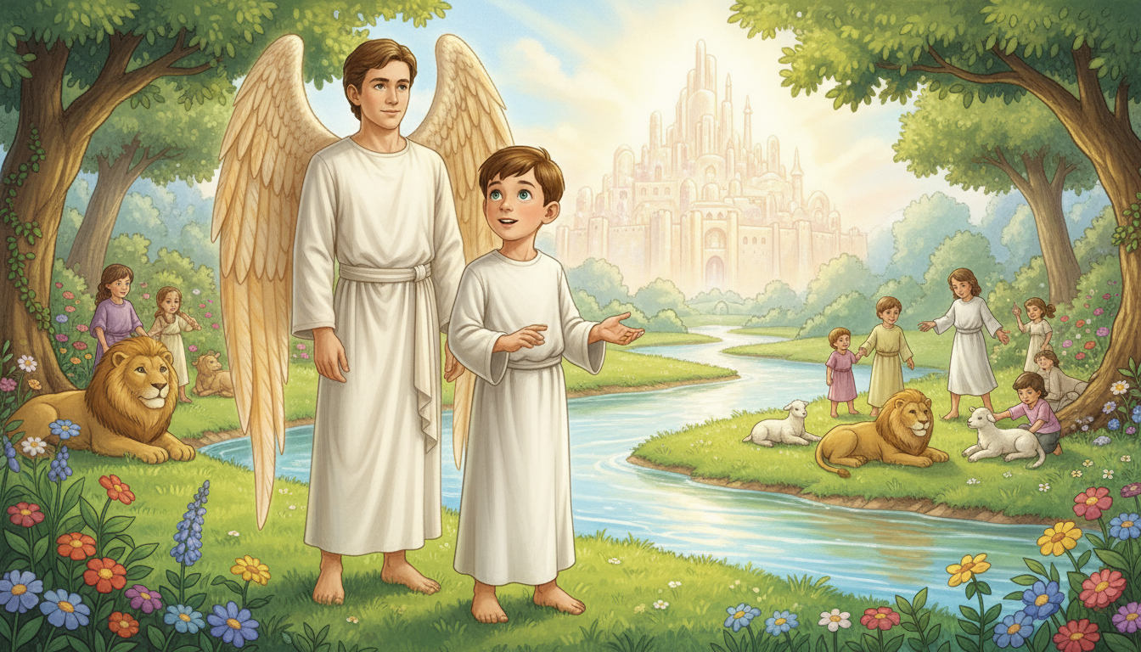
Notes:
The map’s red dot stops near a shining river.
“What is this place?” asks Luca.
“This,” says Orel, “is the Water of Life—it flows from God’s throne!”
Lions and lambs play together.
Luca runs to hug a giraffe eating fruit.
Heaven is full of peace and joy!

Slide 3
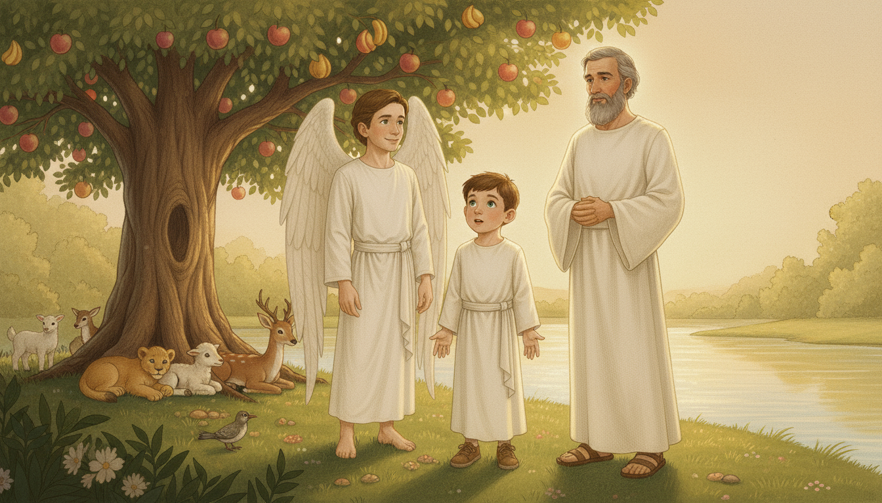
Notes:
The giraffe’s long tongue covers Luca’s head in slobber!
Orel laughs and offers him a cloth, but a voice says, “What he needs is a bath in the river!”
Luca turns and sees a man with a gentle smile and glowing face.
“You’re standing before Moses,” says Orel.
Moses laughs, “Come, wash in the river!”
Luca kneels—cool, crystal water flows through his hands.
“Wow! How refreshing!” he says with joy.

Slide 4
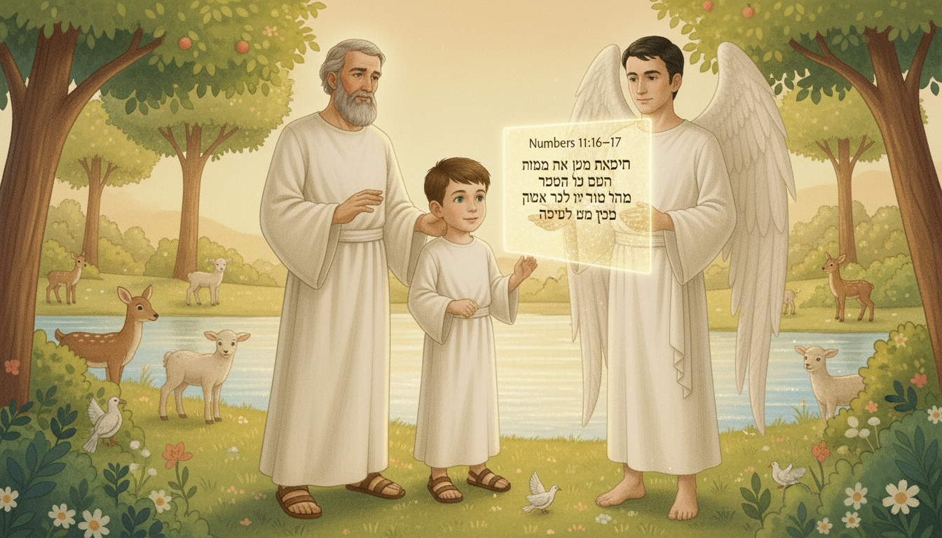
Notes:
Orel opens his floating glass screen.
“Luca, there’s something you must read,” he says.
Together they read Numbers 11 : 16–17 (NIV):
“The Lord said to Moses, ‘Bring me seventy of Israel’s elders... I will take some of the power of the Spirit that is on you and put it on them.’”
Moses nods. “Yes, I remember writing that! God kept His promise.”
Luca listens in awe—God shared His Spirit to help His people lead!

Slide 5
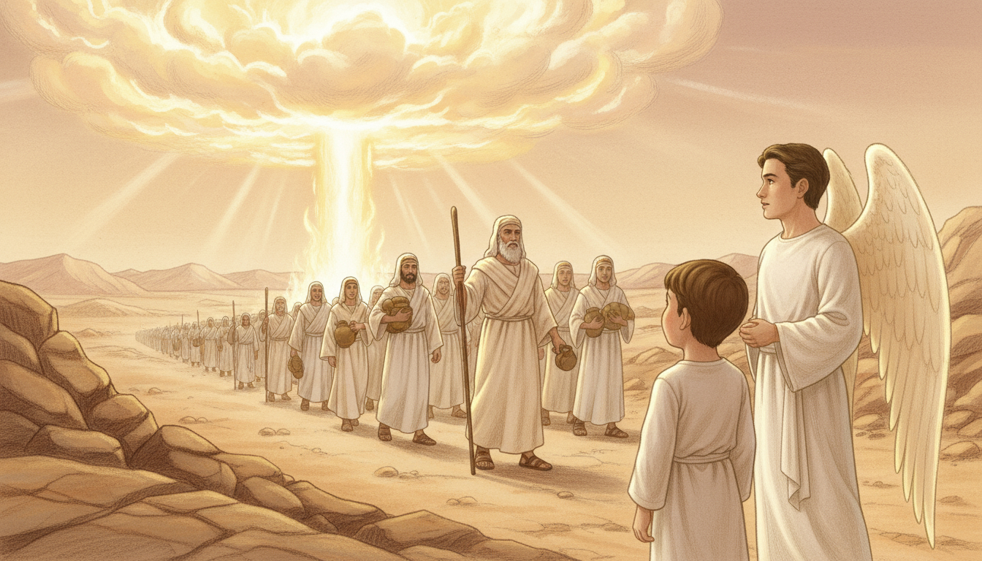
Notes:
Moses smiles. “I wasn’t special, Luca. I was just a man trying to obey God.”
“I was afraid,” he continues, “but the Spirit gave me strength to lead.”
“He guided me through the desert, gave food and water, and chose helpers to share the load.”
“The Spirit of God equips leaders to do His work!”
Luca’s eyes shine. “I want to lead like that—with the Holy Spirit’s help.”

Slide 6
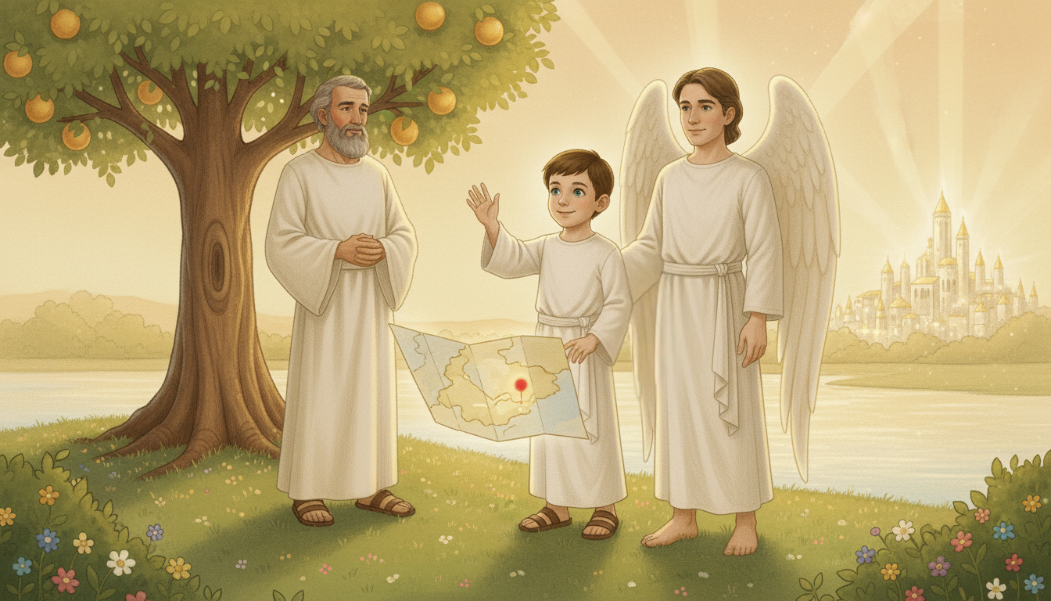
Notes:
Orel’s floating map appears again—this time with glowing spheres and a red dot far away.
“Are we going to another planet?” asks Luca, excited.
Moses smiles, “God’s universe is full of wonders. Keep learning, little one.”
Orel says, “Come, Luca, it’s time to go.”
They wave goodbye. “See you soon, Moses!”
The light around them glows brighter as they depart.

Slide 7

Notes:
The Spirit gives wisdom to lead, courage to guide, and love to serve.
Let’s Get to Work!
Draw a scene from Moses’ life—like the Red Sea or manna from heaven.
Write a short message for your pastor or church leader, promising to pray for them.
Let’s Pray!
Ask the Spirit to make you a faithful leader for Jesus.
Pray for your leaders to be filled with the Holy Spirit.

