Slide 1
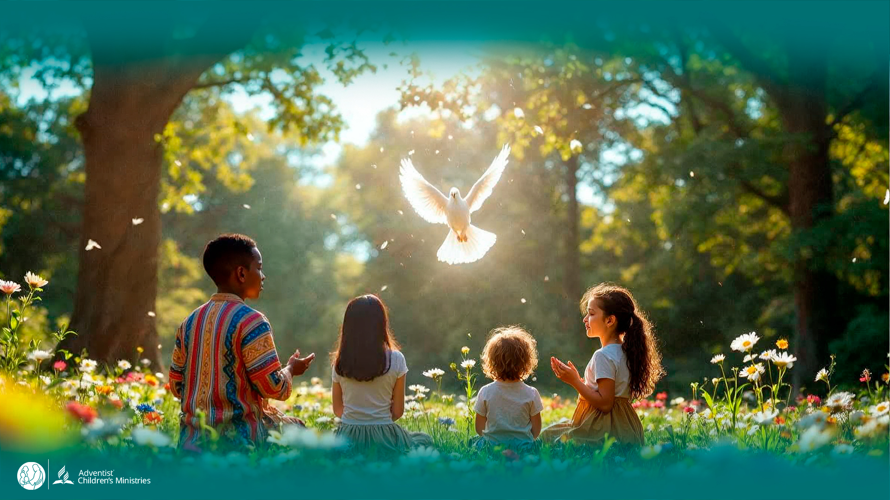
Day 5
The
UNLEASHED SPIRIT
Restores Us Despite Our Mistakes
DAYS OF
PRAYER
January 7-17, 2026
Notes:
Welcome to Day 5!
Today we’ll see how God’s Spirit restores us, even when we make mistakes.
Luca and Orel return to a very special place in heaven.

Slide 2
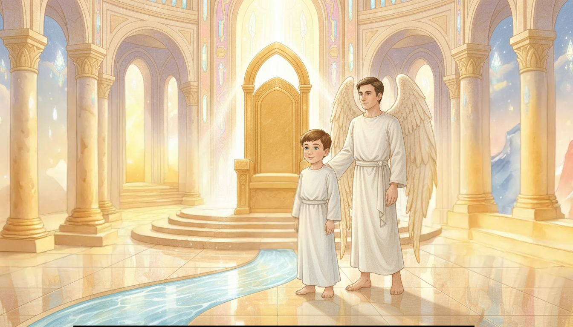
Notes:
“Wow!” says Luca. “This place is incredible!”
Orel smiles. “We’re in the throne room of God—the heart of the New Jerusalem.”
“Look, Luca—the River of Life begins right here, flowing from His throne.”
Light sparkles like crystal water, filling everything with peace.

Slide 3
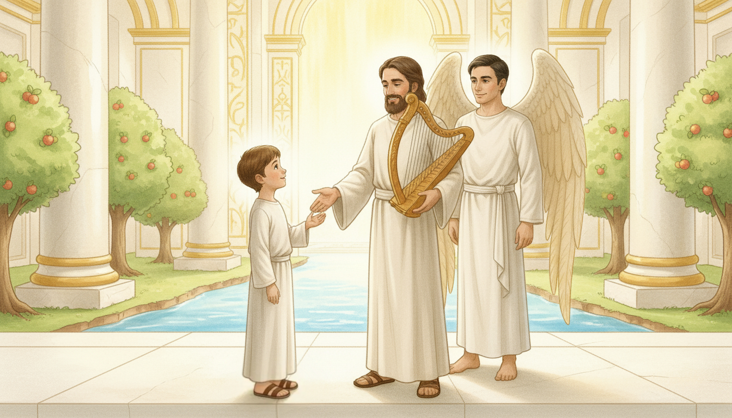
Notes:
A man dressed in a beautiful robe walks toward them.
“There you are, my friend!” says Orel joyfully.
“Luca, meet King David—the shepherd, musician, and servant of God.”
“Wow!” Luca exclaims. “King David! What a privilege!”
David smiles kindly. “Here, I’m no king—Jesus is our only King.”

Slide 4
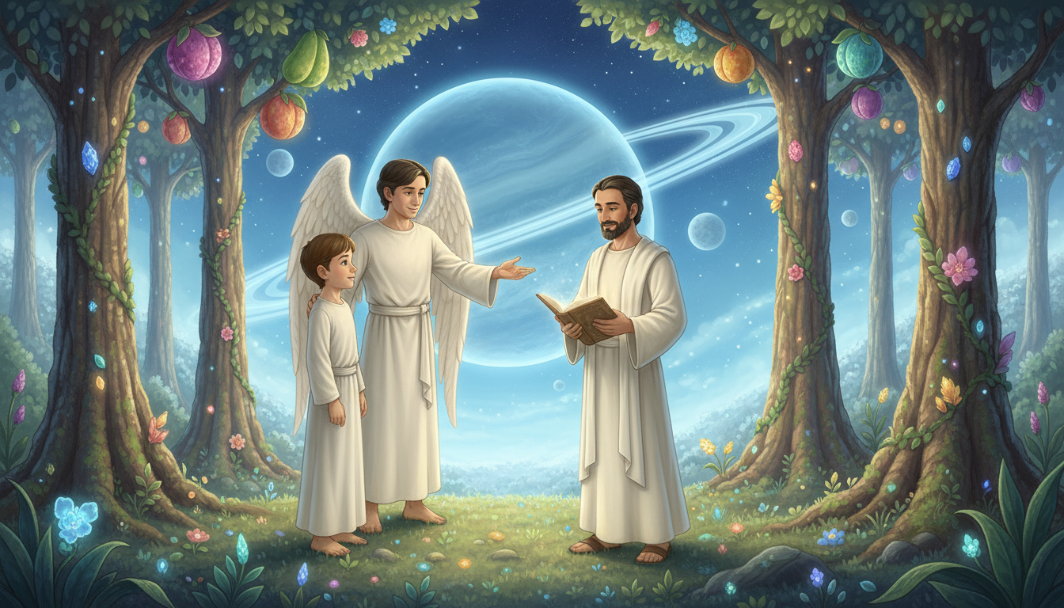
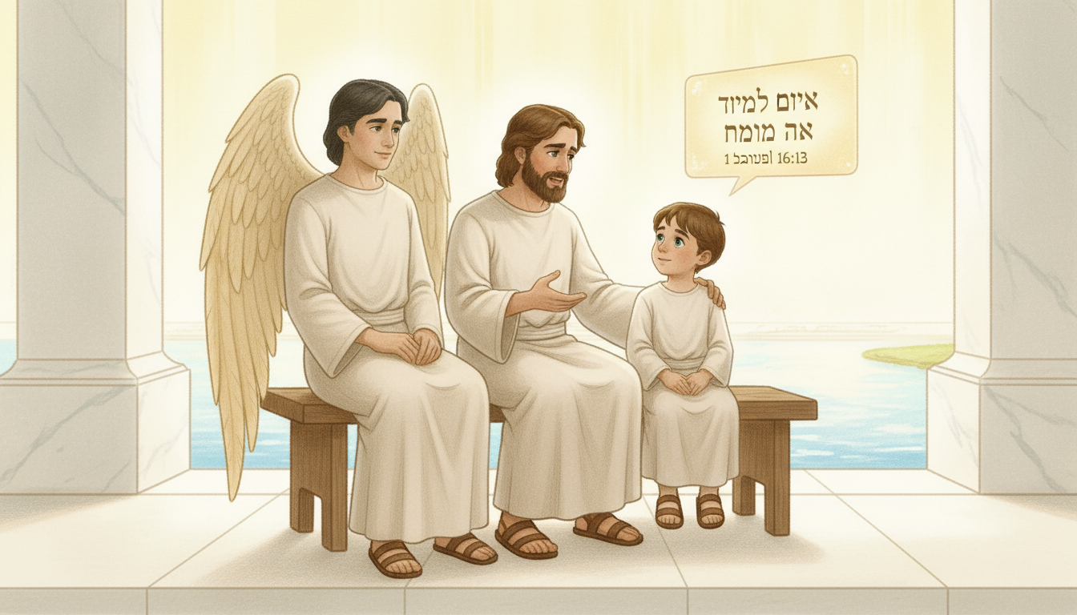
Notes:
Orel opens his floating glass. “David, could you read this verse?”
David reads 1 Samuel 16:13 (NIV):
“So Samuel took the horn of oil and anointed him… and from that day on the Spirit of the Lord came powerfully upon David.”
David nods. “That was the day God chose me.”
“The Spirit gave me wisdom, courage, and songs to praise Him.”

Slide 5
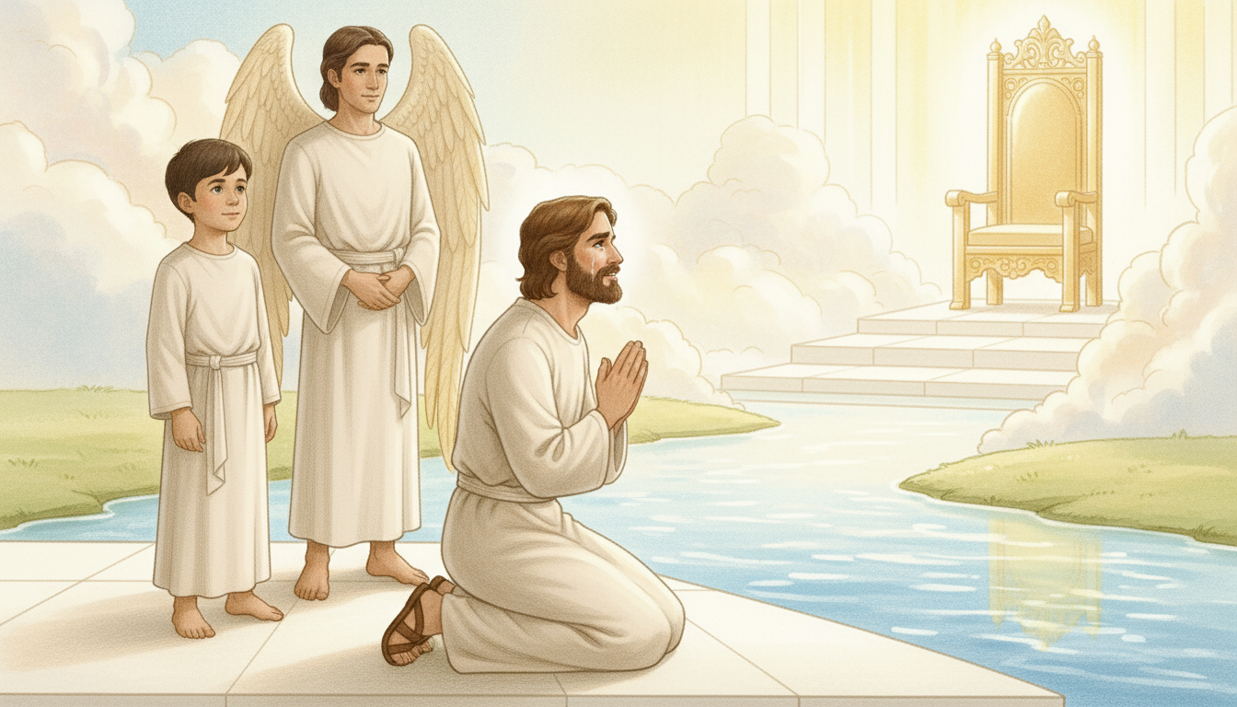
Notes:
David’s eyes grow gentle. “But I made terrible mistakes.”
“I sinned. I hurt people. I turned away from God.”
Tears fall down his face. “Yet the Lord forgave me.”
“The Spirit came again and restored my heart.”
Luca whispers, “God’s mercy is so amazing.”

Slide 6
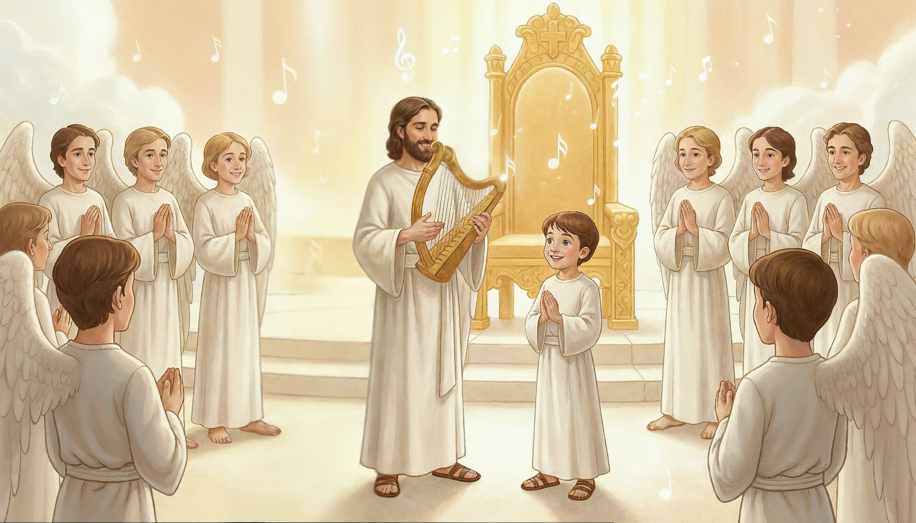
Notes:
David looks toward the throne with a gentle smile.
“I’m writing songs for God’s choir,” he says.
“Maybe one day the angels will sing them!”
“Of course we will!” Orel replies with a smile.
Luca laughs. “I was never good at music or singing…”
David answers kindly, “It’s never too late to learn — we have all eternity ahead!”
The throne room fills with light and joy.

Slide 7
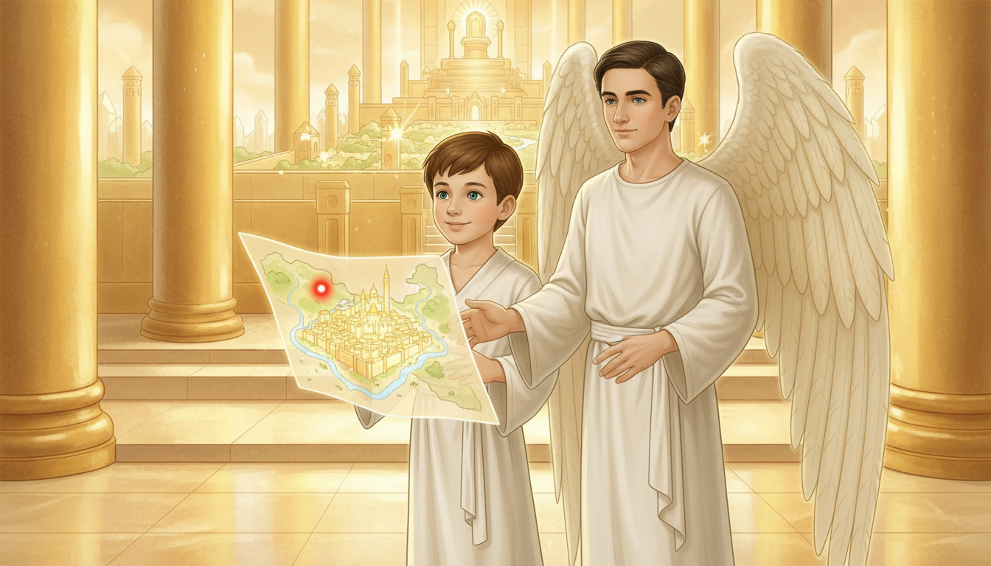
Notes:
The floating map appears—its red dot flashing brightly.
“We must go,” says Orel. “A new place awaits.”
“Goodbye, my friends,” says David kindly. “Never forget—God restores!”
“Thank you, David!” says Luca. “I’ll remember your story.”
Light fills the throne room as they rise to their next journey.

Slide 8

Notes:
The Spirit restores and gives new beginnings.
Let’s Get to Work!
If you’re baptized—take part in the next Lord’s Supper.
If not yet baptized—talk with your pastor or teacher about Jesus.
Let’s Pray!
Ask the Holy Spirit to cleanse your heart and keep you faithful.
Thank God for His forgiveness and love.

