Slide 1
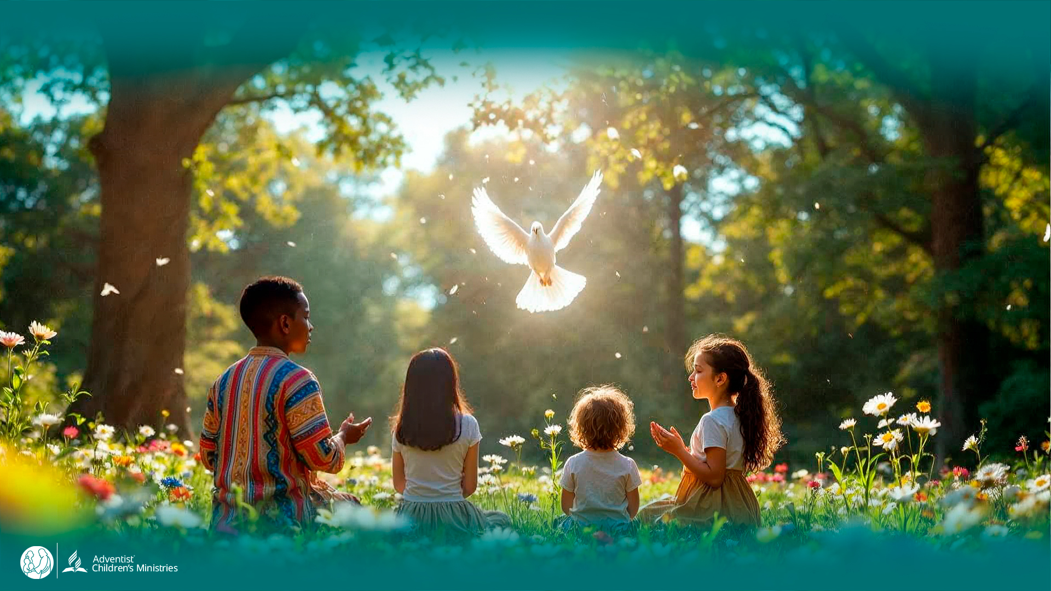
Day 6
The
UNLEASHED SPIRIT
Motivates Us to Live in Health
DAYS OF
PRAYER
January 7-17, 2026
Notes:
Welcome to Day 6!
The Unleashed Spirit motivates us to live in health.
Let’s follow Luca and Orel to the Heavenly Meadow.

Slide 2
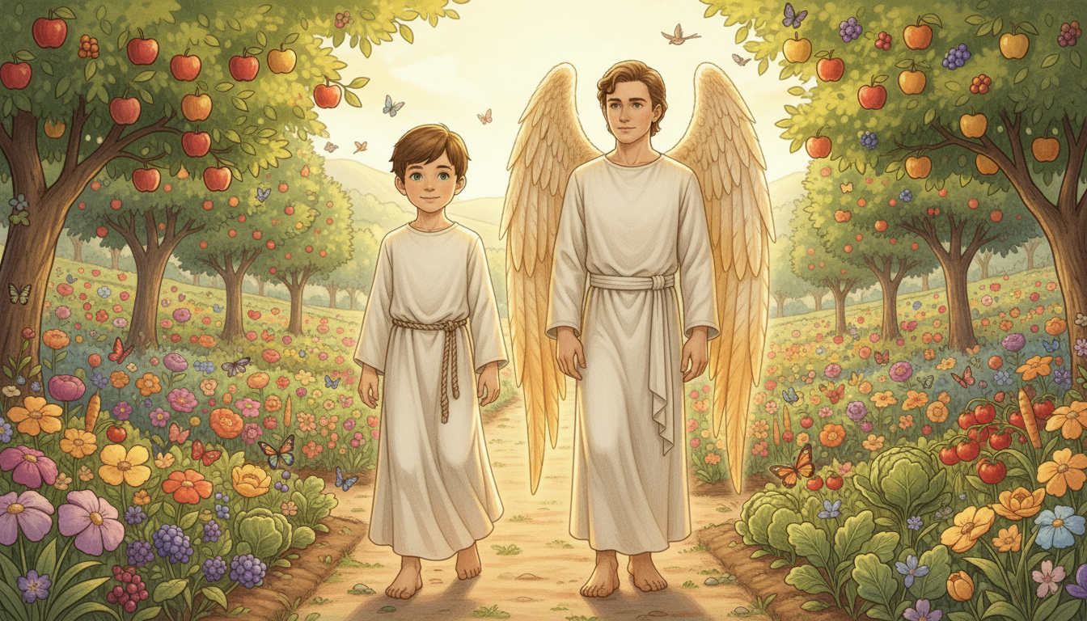
Notes:
They arrive at the Heavenly Meadow—fruits, flowers, butterflies, birds.
“Here almost every variety is planted and harvested,” says Orel, “to feed the Holy City.”
Luca laughs: “I hope broccoli tastes good here! On Earth we used to eat meat… but here no one needs that.”

Slide 3
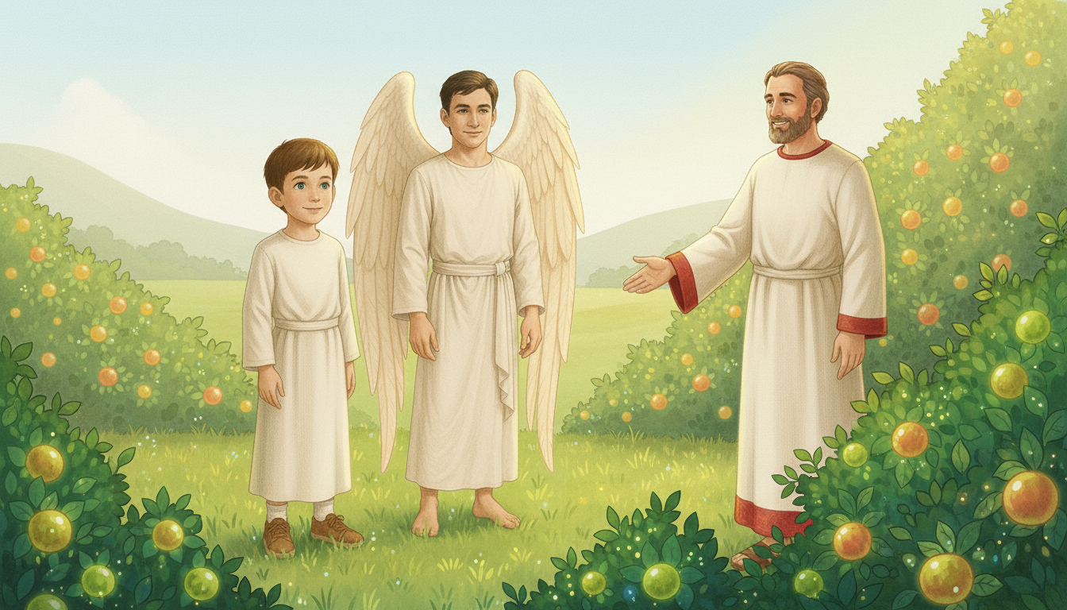
Notes:
A man steps out from the bushes in a white robe with a red border.
“The answer is simple,” he says—God’s original diet was plants and seeds.
Orel adds: after the flood, meat was allowed; clean and unclean were given, but people drifted and suffered the consequences.
The man smiles: “My name is John—the Baptist on Earth. Here, everyone is baptized by the Holy Spirit!”
“I love being here, feeling the wind, surrounded by nature,” John adds. “Jesus was my cousin—the Lamb of God.”

Slide 4
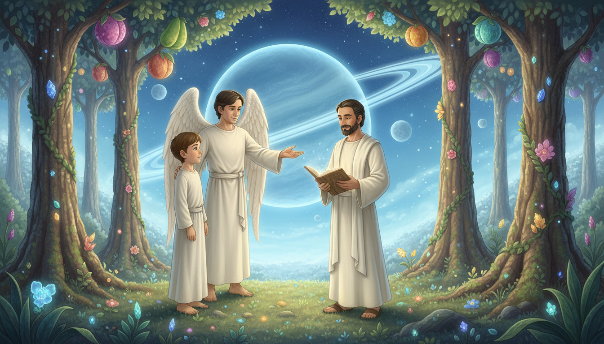
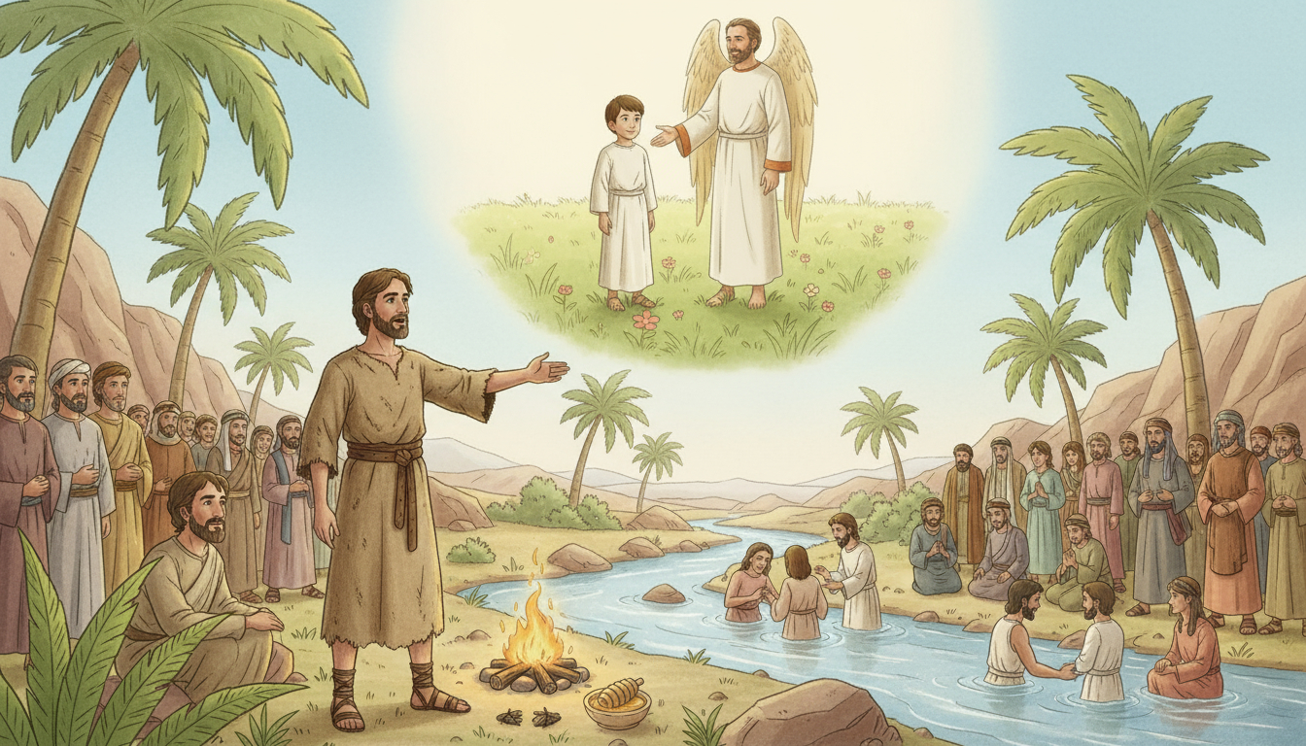
Notes:
Orel shows a verse on the floating glass and reads Luke 1:15 (NIV):
“…for he will be great in the sight of the Lord… never to take wine or other fermented drink, and he will be filled with the Holy Spirit even before he is born.”
John smiles: “My father Zechariah lost his voice until the day I was born—we still tease him about it!”

Slide 5
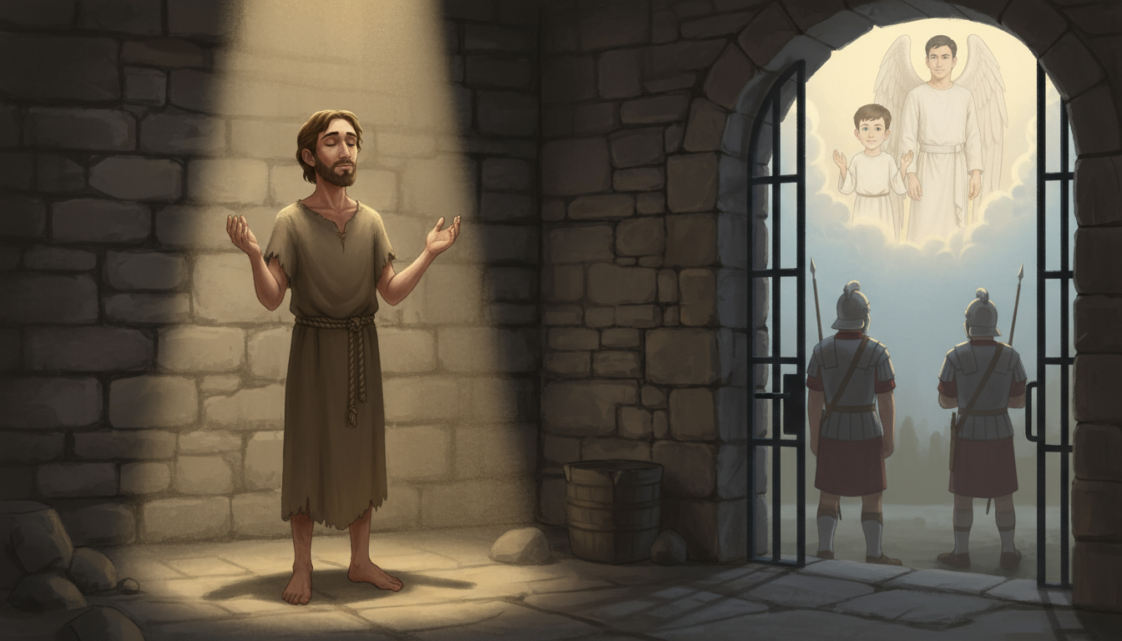
Notes:
“The Spirit was unleashed in my life from the womb,” John says.
“My mission was hard—persecution, mistreatment, rejection.”
“I held on because the Spirit taught me to live simply and in good health.”
“I climbed mountains and walked hundreds of miles carrying God’s message.”
“I even faced a tragic end—but I was resurrected with the righteous and saw my Savior.”

Slide 6
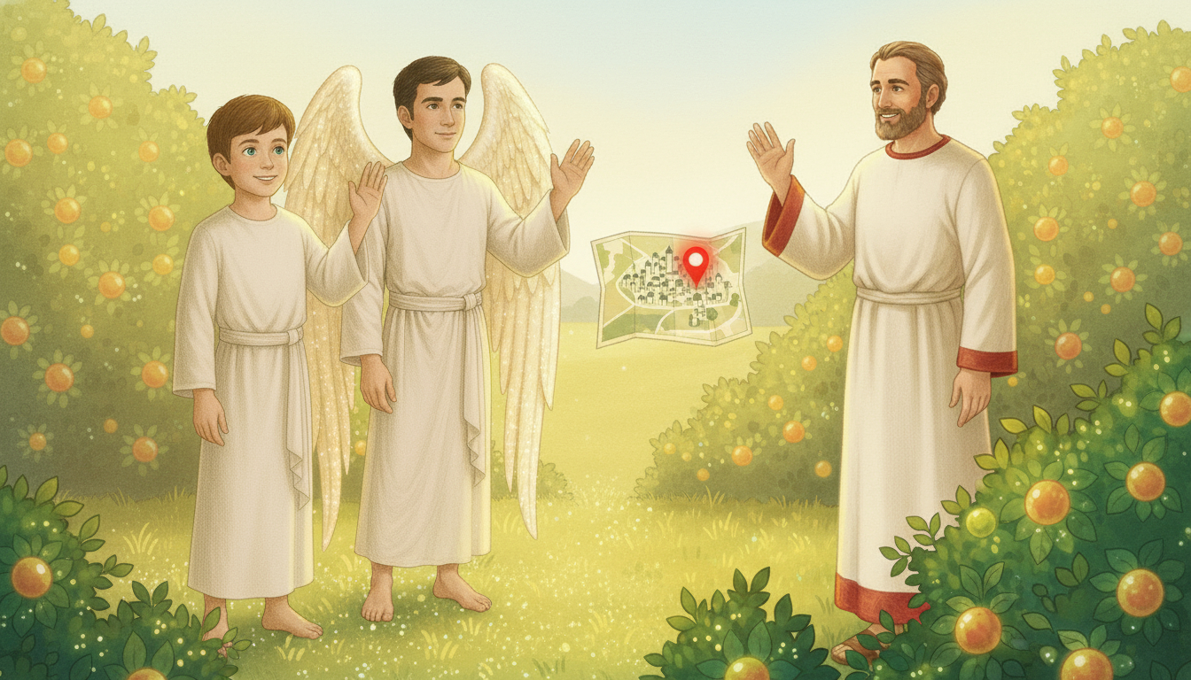
Notes:
“Now I want to learn everything about nature,” John says.
“I’m curious how plants produce flowers… and how flowers become fruit.”
“I’m learning so much here in the Heavenly Meadow—there’s eternity to discover God’s creation.”
The red dot blinks on Orel’s map. “It’s time to go,” Orel says.
“Thank you, John,” says Luca. “I’m sure we’ll meet again.”

Slide 7

Notes:
The Spirit motivates healthy living for God’s mission.
Let’s Get to Work!
Prepare a basket with healthy foods for someone in need; go with your parents or teachers; pray and share Bible verses about faith in Jesus.
Let’s Pray!
Ask the Holy Spirit to give you motivation to live in health.
Ask Him to make you a powerful instrument to preach about Jesus.

