Slide 1


Dia 7
The
UNLEASHED SPIRIT
Strengthens Us in Suffering
DAYS OF
PRAYER
January 7-17, 2026
Notes:
Welcome to Day 7!
Today we’ll learn how the Spirit gives strength in suffering.
Luca and Orel are about to meet someone who remained faithful even in pain.

Slide 2
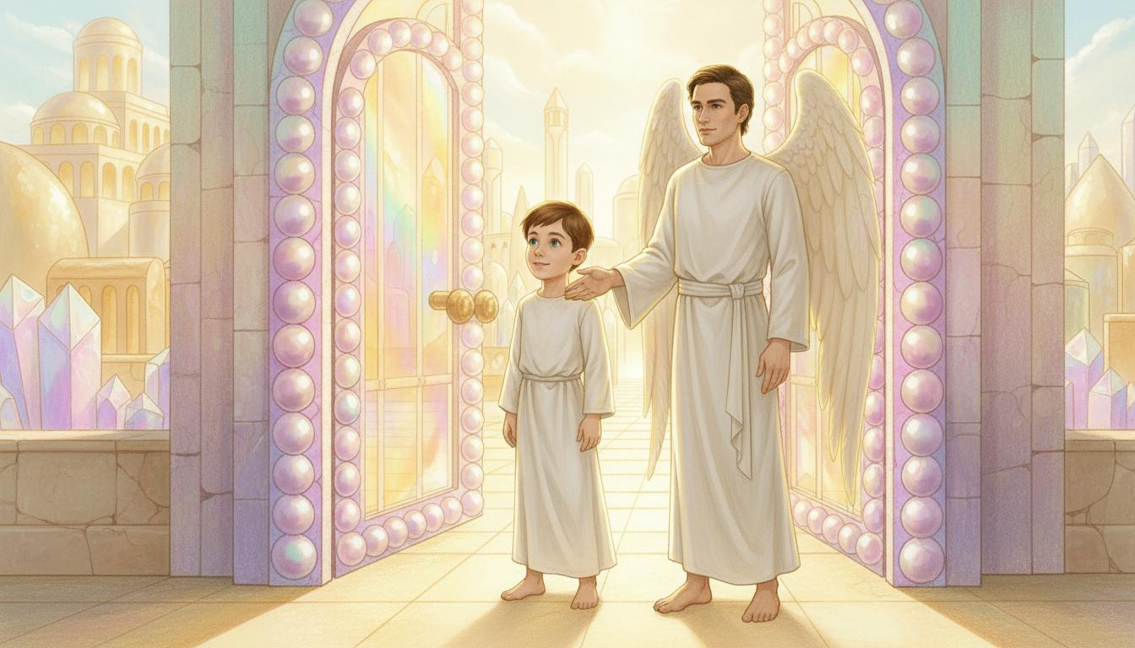
Notes:
“They’re made of pearls!” says Luca, amazed.
Pink, violet, and blue colors shine from the gates.
“There are twelve gates,” says Orel, “three on each side of the City.”
“Jesus really is a genius architect!” laughs Luca.

Slide 3
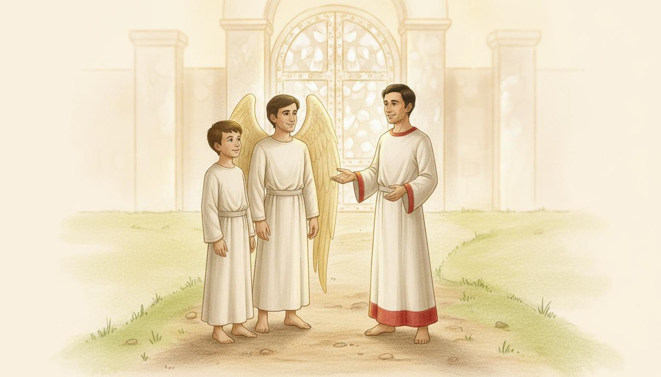
Notes:
A man stands near the gates, looking toward heaven.
“Come, Luca,” says Orel. “I’ll introduce you to Stephen.”
“Hello, servants of the Lord!” Stephen greets warmly.
“The Spirit was unleashed in my life,” he says, “and He strengthened me until the very end.”
Luca points at Stephen’s robe. “Why does it have a red border?”
Stephen smiles. “Jesus gave it to those who gave their lives for Him.
On Earth they called us martyrs, but here we’re remembered for our faithfulness.”
Orel adds, “The red reminds us of the blood they shed for Jesus.”

Slide 4
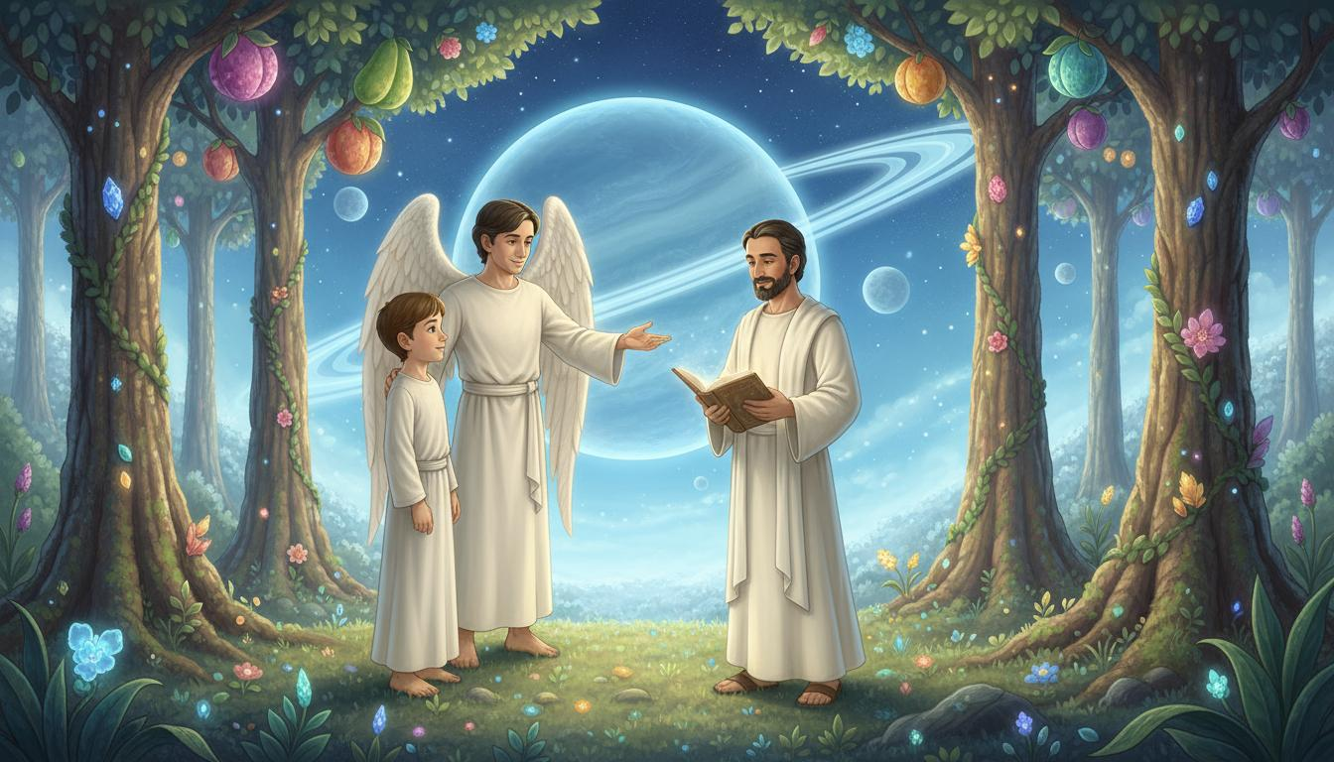
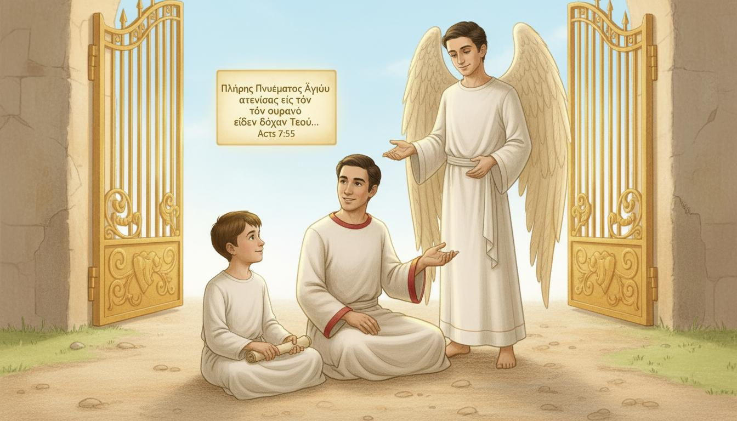
Notes:
Orel opens his glowing glass. “Luca, read this verse—Acts 7:55.”
Luca reads:
“But Stephen, full of the Holy Spirit, looked up to heaven and saw the glory of God, and Jesus standing at the right hand of God.”
Stephen nods softly. “That was my final moment on Earth.”
“The Spirit gave me peace as I faced suffering—and Jesus stood to welcome me home.”

Slide 5
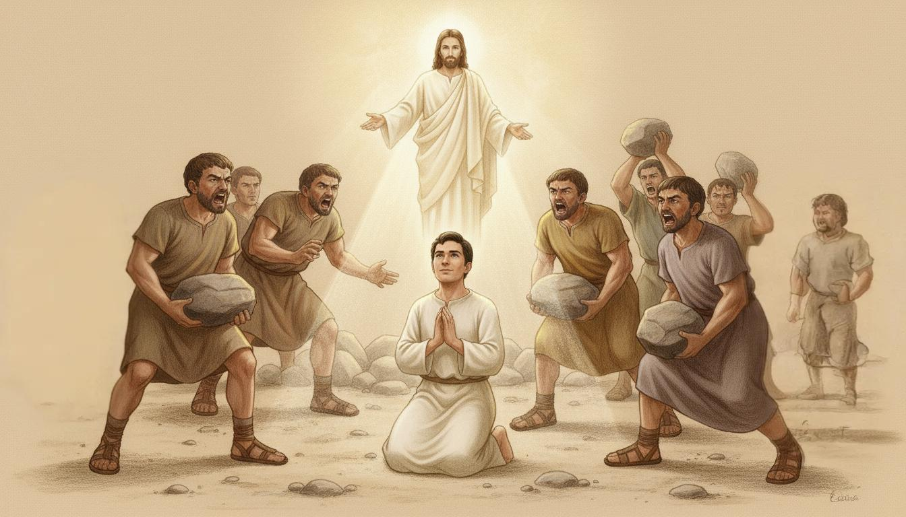
Notes:
“The Spirit was unleashed in me,” Stephen continues.
“He gave me courage to speak the truth.”
“Through His power, miracles happened, and many believed in Jesus.”
“When persecution came, I wasn’t afraid.”
“I saw Jesus waiting for me in heaven. I closed my eyes on Earth and opened them here in glory.”
Luca says softly, “The Spirit really gives strength to those who suffer.”

Slide 6
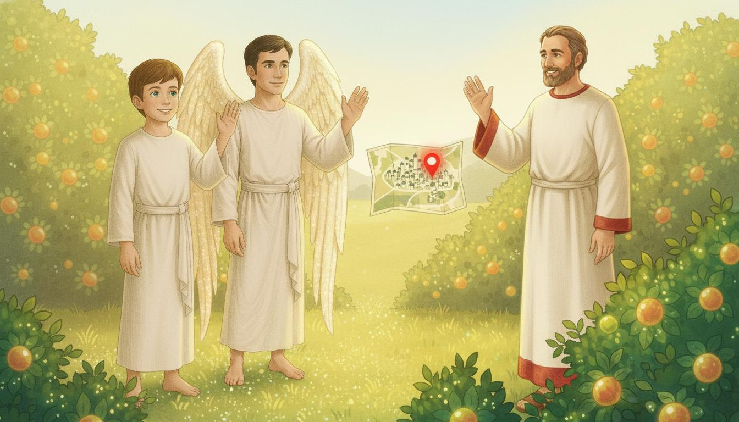
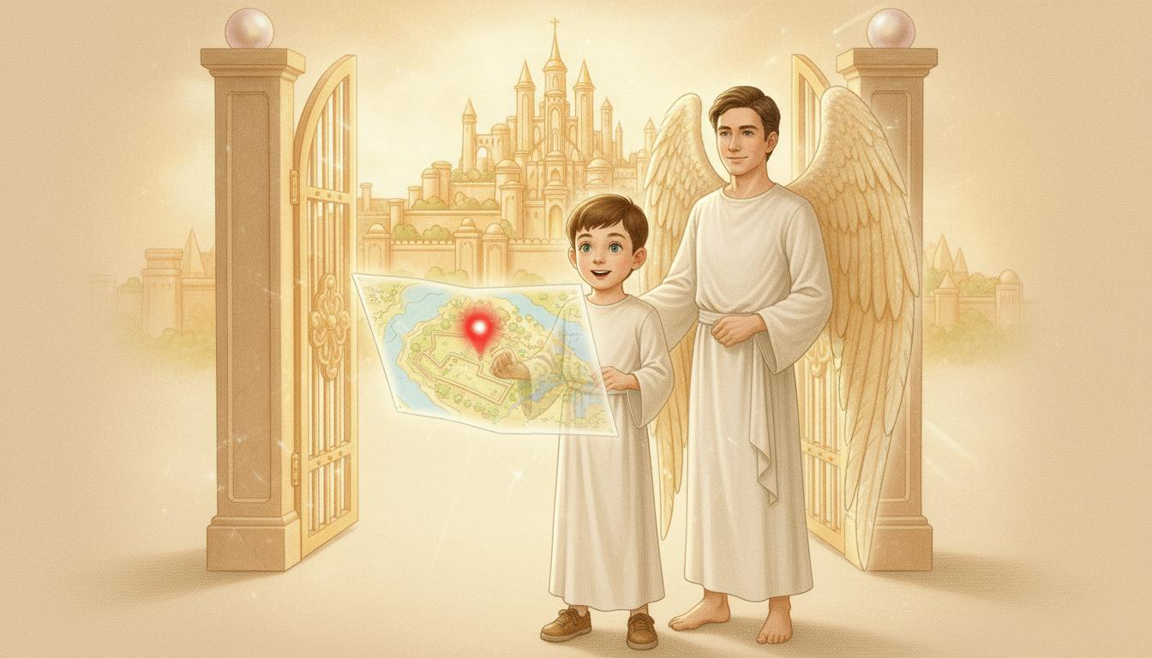
Notes:
The glowing map appears in Orel’s hands, showing a red dot.
“Another destination?” asks Luca eagerly.
Stephen smiles. “Go, my friends. Continue discovering the power of the Spirit.”
“Thank you, Stephen!” says Luca. “Your story gave me courage.”
“The Spirit who was with me,” Stephen says, “will be with you, too.”
The light grows brighter as Luca and Orel wave goodbye.

Slide 7

Notes:
The Spirit gives courage and peace, even in suffering.
Let’s Get to Work!
Make a card to encourage someone who’s having a hard time.
Write: “Jesus loves you and is with you.”
Let’s Pray!
Ask the Spirit to help you be strong and faithful like Stephen.
Thank Him for being your comfort and strength.

