Slide 1

Day 8
The
UNLEASHED SPIRIT
Drives Us to Mission
DAYS OF
PRAYER
January 7-17, 2026
Notes:
Welcome to Day 8!
Today we’ll learn how the Spirit drives us to share Jesus with others.
Luca and Orel are about to meet one of the Bible’s greatest evangelists.

Slide 2
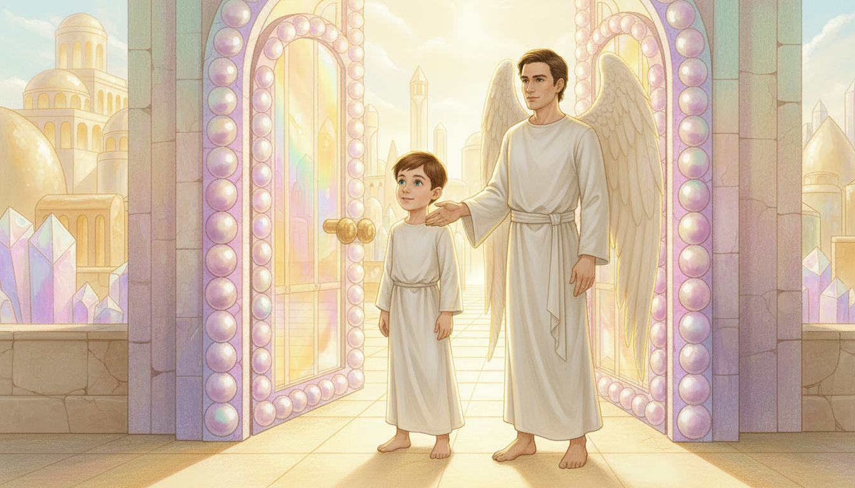
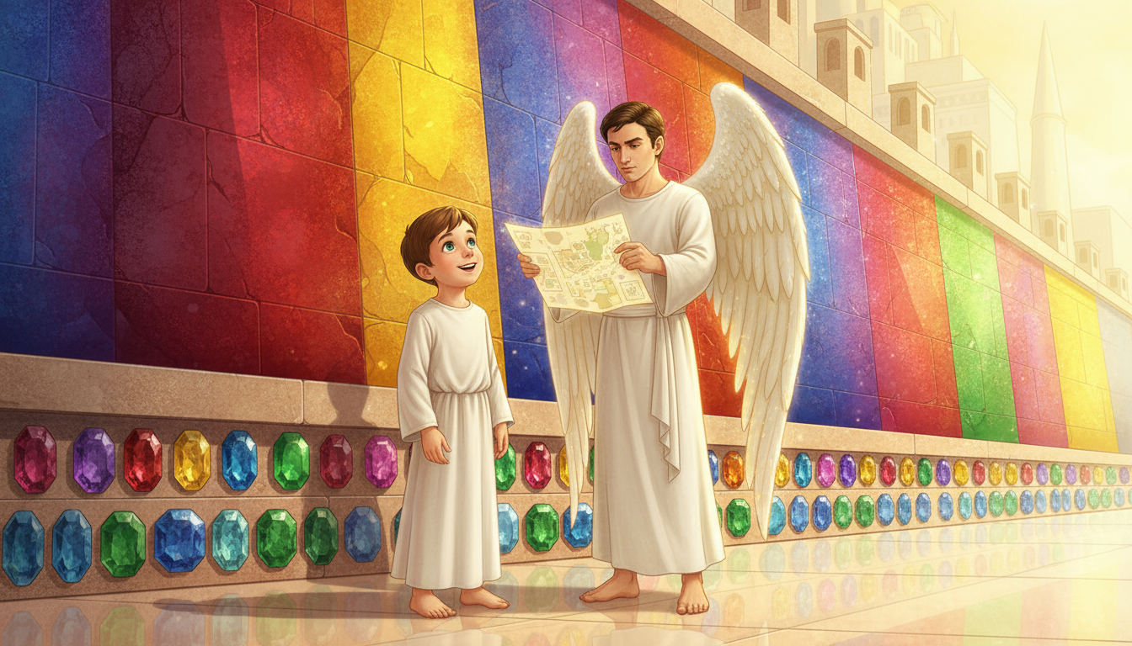
Notes:
The floating map shows their arrival.
“It’s right here,” says Orel, pointing to the South Wall.
Luca stares at the tall jasper wall, glowing with red, yellow, and blue colors.
“Look at the wall—it’s amazing!”
“Not just the wall,” says Orel. “Look at the foundations—emeralds, sapphires, jasper. So many precious stones!”

Slide 3
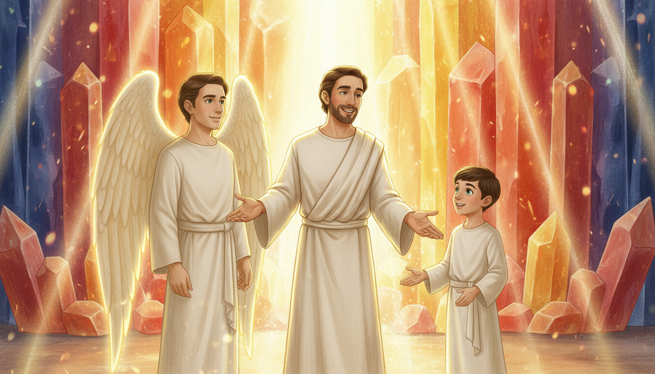
Notes:
Suddenly, a man appears behind Luca.
“You have a good eye for details,” he says kindly.
“Luca,” Orel smiles, “this is Philip the Evangelist!”
“You startled me!” laughs Luca.
“That’s his style,” says Orel. “He always makes dramatic entrances.”
“I saw you arrive,” says Philip. “I wanted to surprise you!”

Slide 4
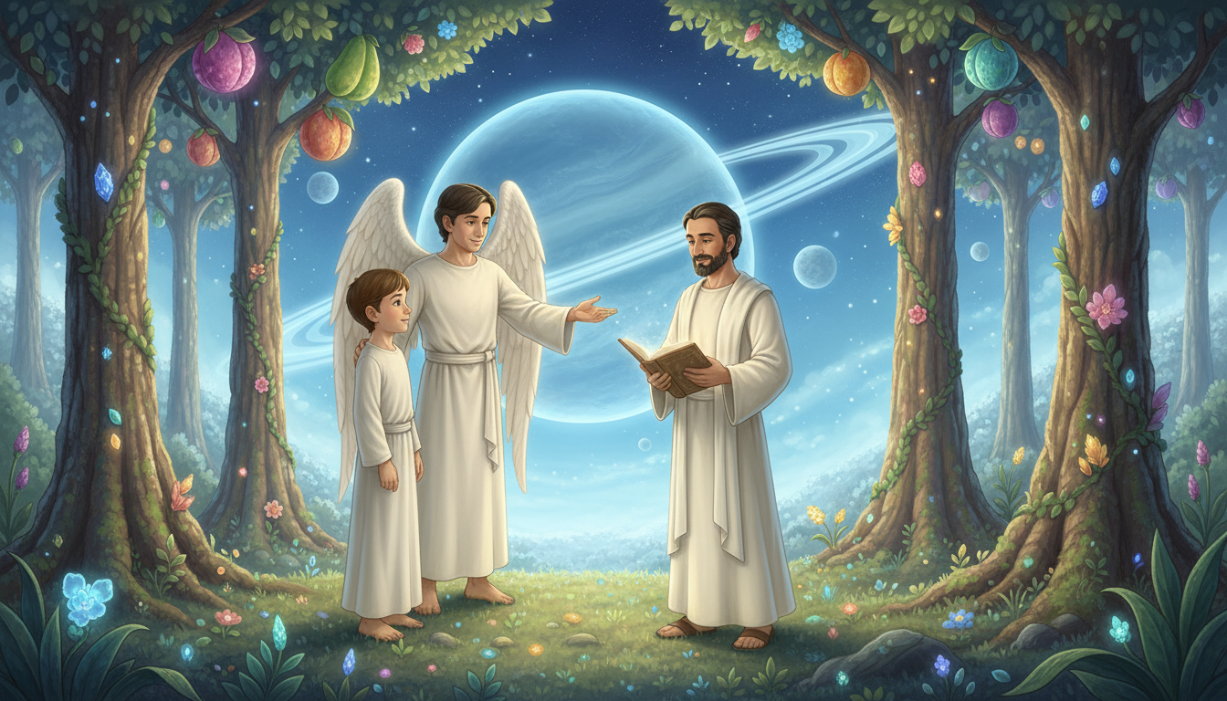
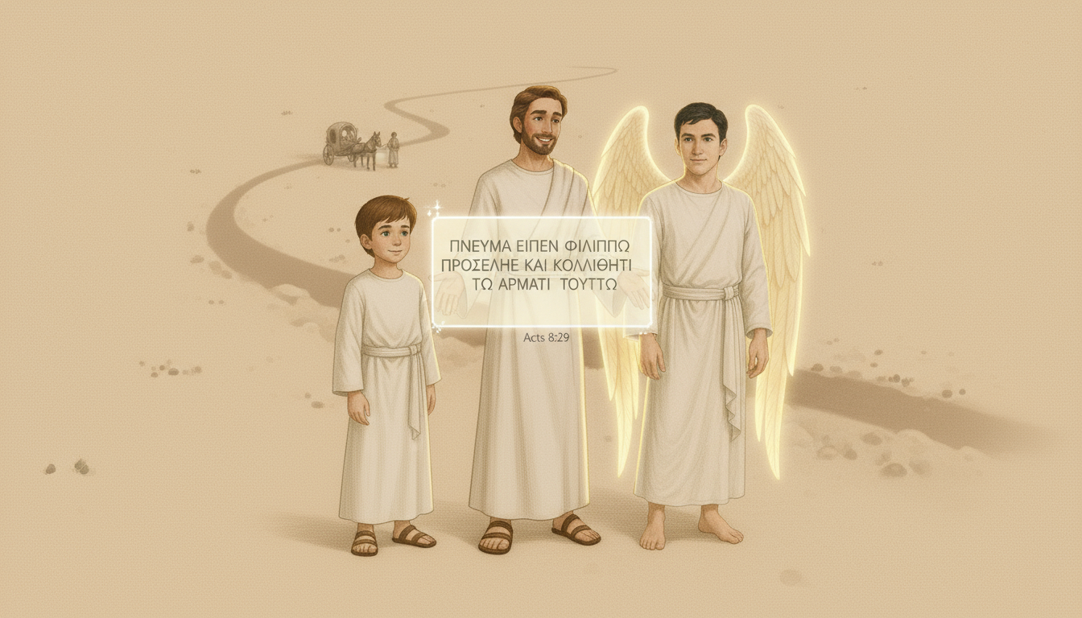
Notes:
“I remember reading you were guided by the Holy Spirit,” says Luca.
“Indeed,” Philip replies. “He led me in everything I did.”
“Let’s see what the Bible says,” says Orel, opening the glass.
He reads Acts 8:29 (NIV):
“The Spirit told Philip, ‘Go to that chariot and stay near it.’”
“Yes!” says Philip. “The Spirit led me directly to someone who needed Jesus.”
“Ever since I met Jesus, I wanted to share Him with everyone!”

Slide 5
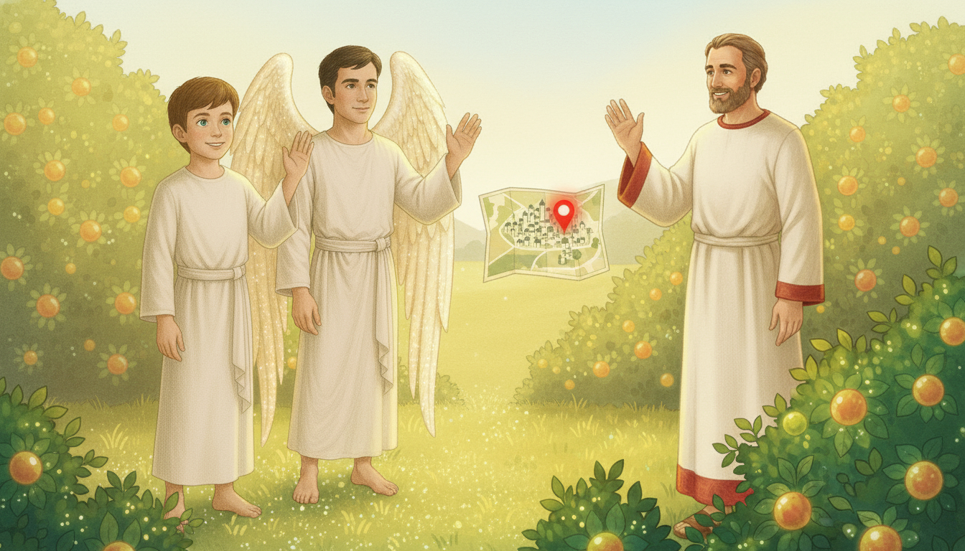
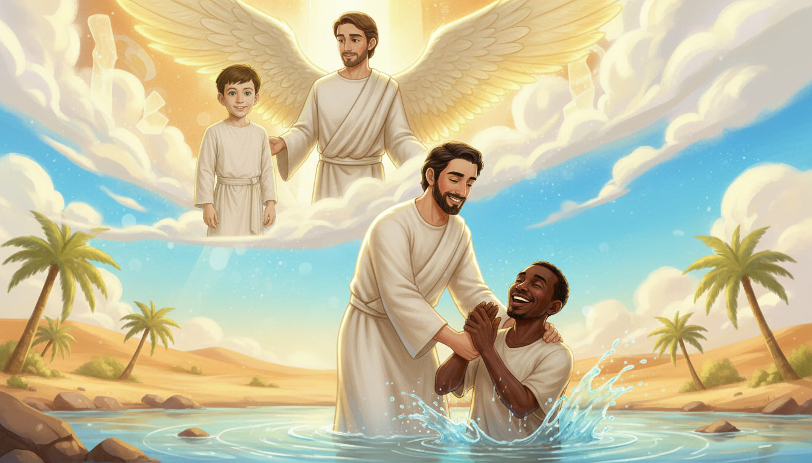
Notes:
“The Spirit was unleashed upon me,” Philip continues.
“He showed me people who were searching for the truth.”
“That day, He sent me to an Ethiopian man who longed to know Jesus.”
“He was confused and returning home—but the Spirit sent me to explain God’s Word.”
“The Spirit changed his life, and he became a missionary in his country!”
Luca smiles. “So, the Spirit really drives us to mission!”

Slide 6
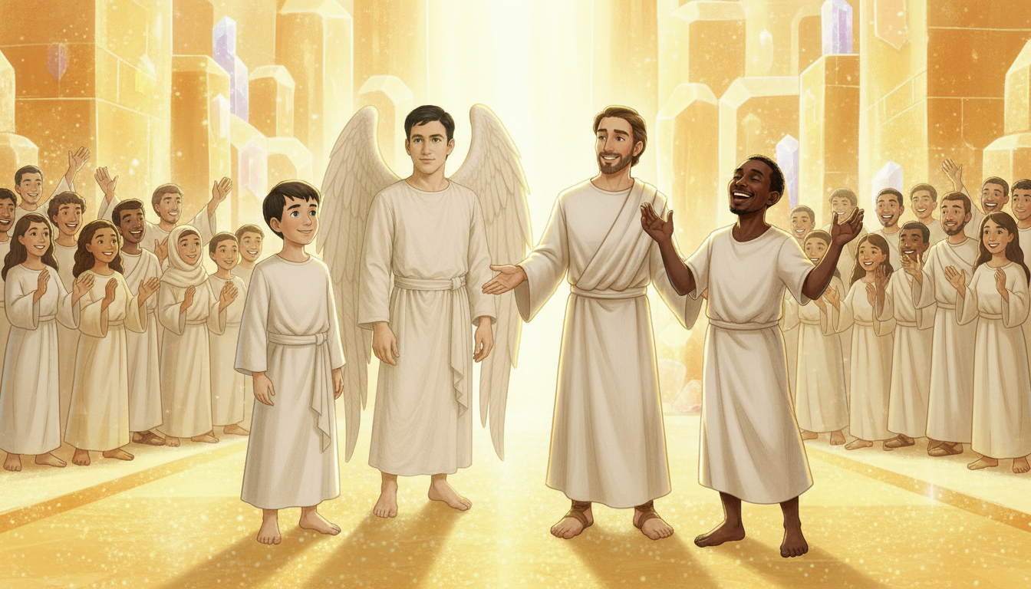
Notes:
“There you are, my friend Philip!” a voice calls.
A man approaches, smiling brightly.
“This is the Ethiopian!” says Philip joyfully.
“I’ve gathered more than 500 people who came to Jesus in Ethiopia,” says the man.
“They’re all here in heaven! We came to thank Philip.”
Luca smiles. “What a reunion!”
“It’s all the Spirit’s work,” says Philip. “He changed hearts then—and He still does.”

Slide 7
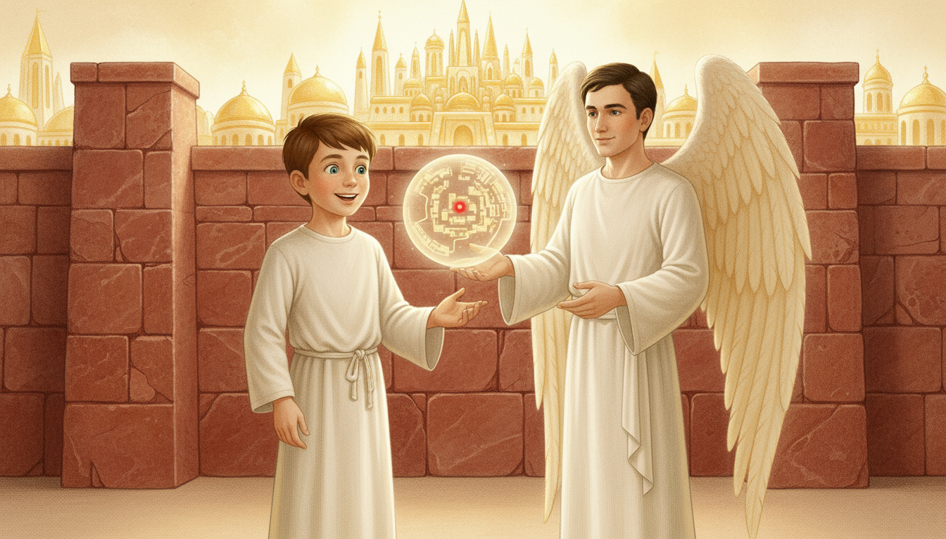
Notes:
Orel’s floating map appears, showing a bright red dot glowing far away.
“Another destination?” asks Luca.
“Yes,” says Orel. “The Spirit has more to show us.”
“Go, my friends,” says Philip. “Keep sharing God’s message.”
“Thank you, Philip!” says Luca. “We’ll see you again!”
The light grows brighter as they wave goodbye.

Slide 8

Notes:
The Spirit drives us to share Jesus with everyone.
Let’s Get to Work!
Memorize Psalm 23 or another psalm, and recite it at church or school.
Or prepare a short devotional to share with your family or friends.
Let’s Pray!
Ask the Holy Spirit to be unleashed in your life.
Pray that He helps you bring others to Jesus.

